Slide 1
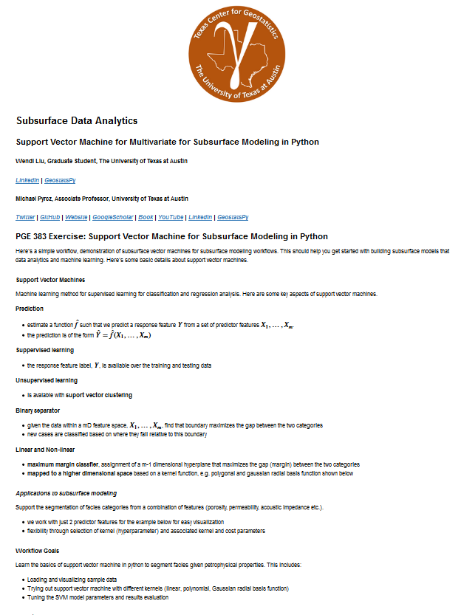
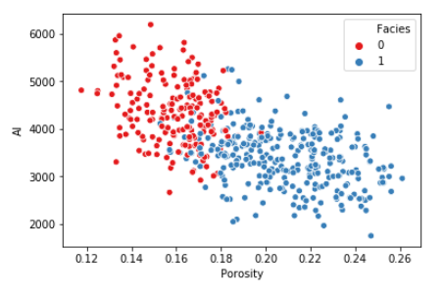
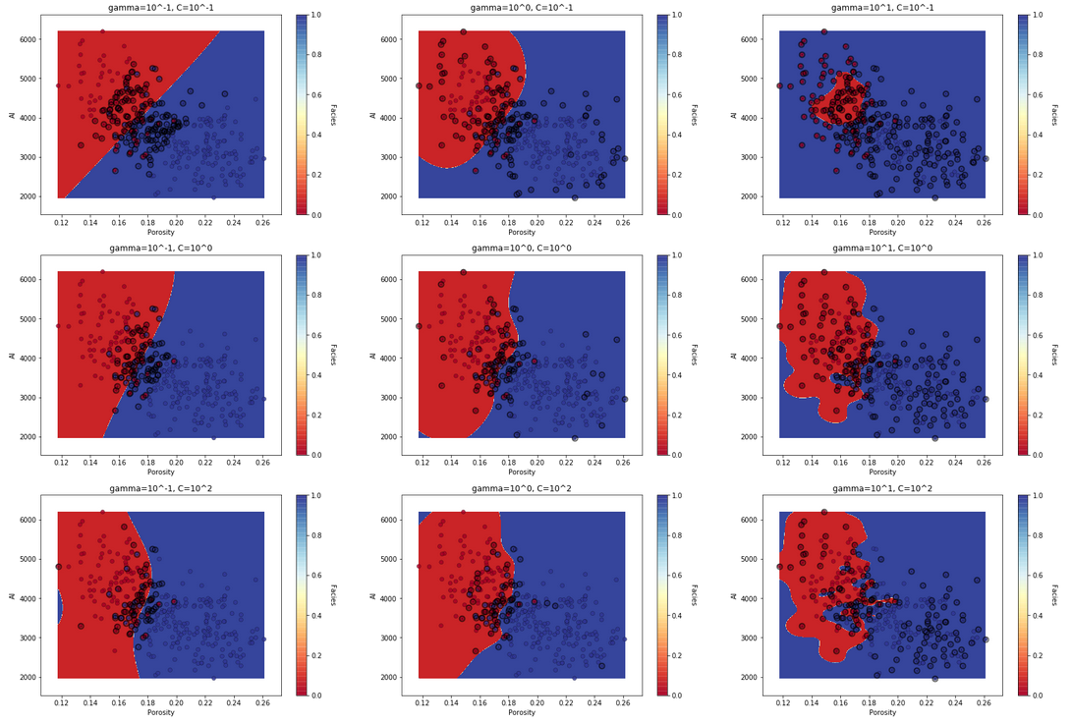
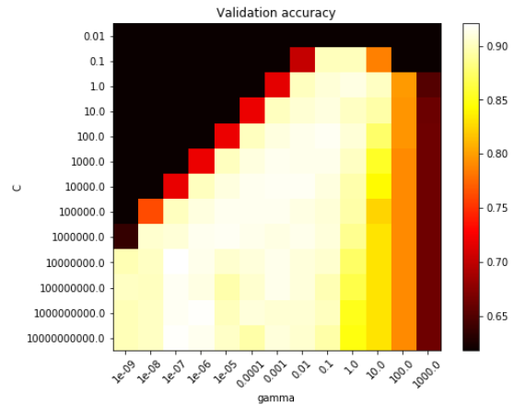
Python Workflow in Jupyter Notebook for Support Vector Machines
Wendi Liu and Michael Pyrcz (@GeostatsGuy), University of Texas at Austin
The University of Texas at Austin
Texas Center for Geostatistics
Heard of the Support Vector Machines? Very powerful machine learning method for multivariate classification, regression and clustering. Here’s a facies classification demonstration workflow for subsurface modeling. This machine learning method has been previously applied to spatial problems in geoscience by Kanevski and others (2002) and temporal problems for electrocardiograms (ECG) by Goovaerts and others (2018). Flexible approach with the ability to select from a variety of kernels for linear, polynomial and radial basis etc. Here’s a well-documented Python Jupyter Notebook workflow posted on GitHub at https://git.io/fj3vX.
Python Workflow in Jupyter Notebook
Multivariate Subsurface Dataset
Facies Classification for a Variety of Kernels and Hyperparameters
Cross-validation to Tune Hyperparameters

