Slide 1

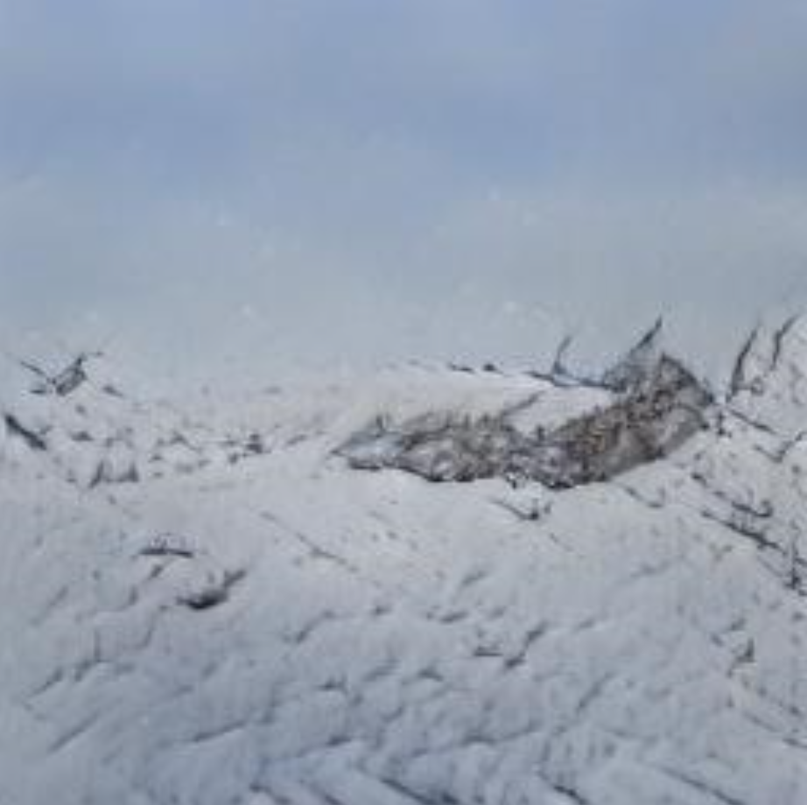
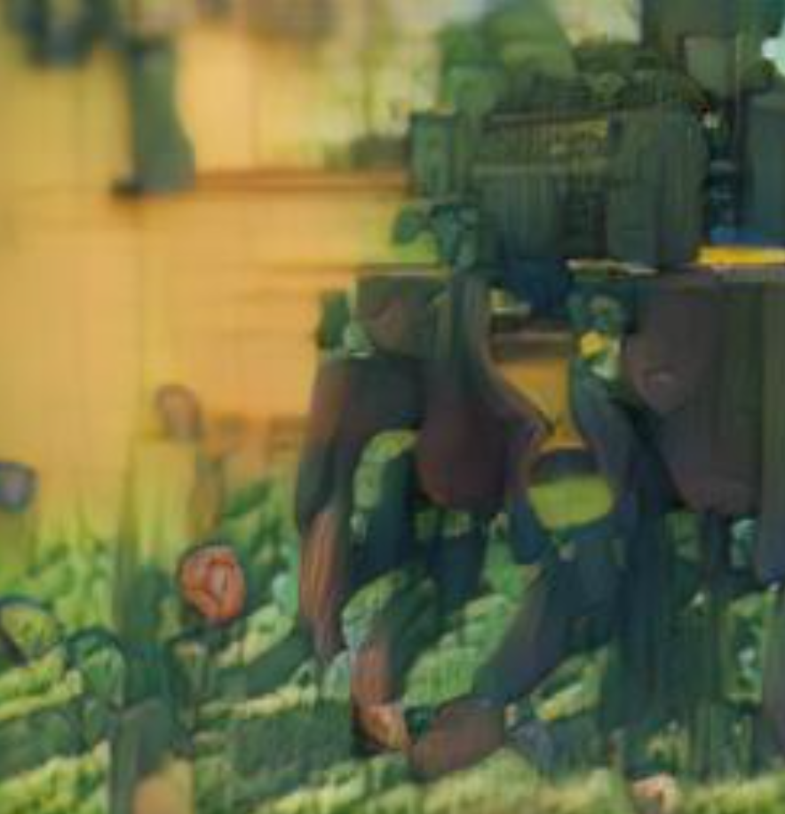
Machine Learning: Text to Image by Cris Valenzuela
Michael Pyrcz, University of Texas at Austin (@GeostatsGuy)
Text to image using AttnGAN
Sun over snowy mountain peaks, clouds, and trees.
Cemetery full of headstones, bright sunny day

