Slide 1
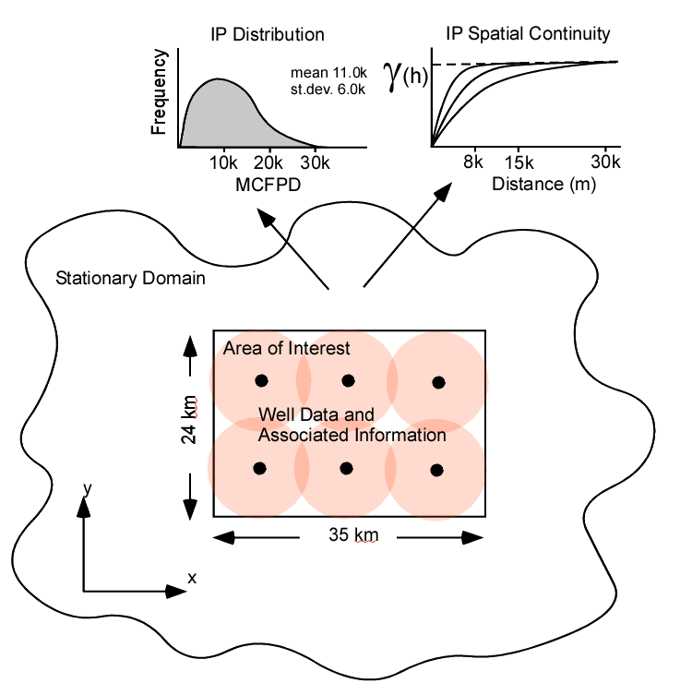
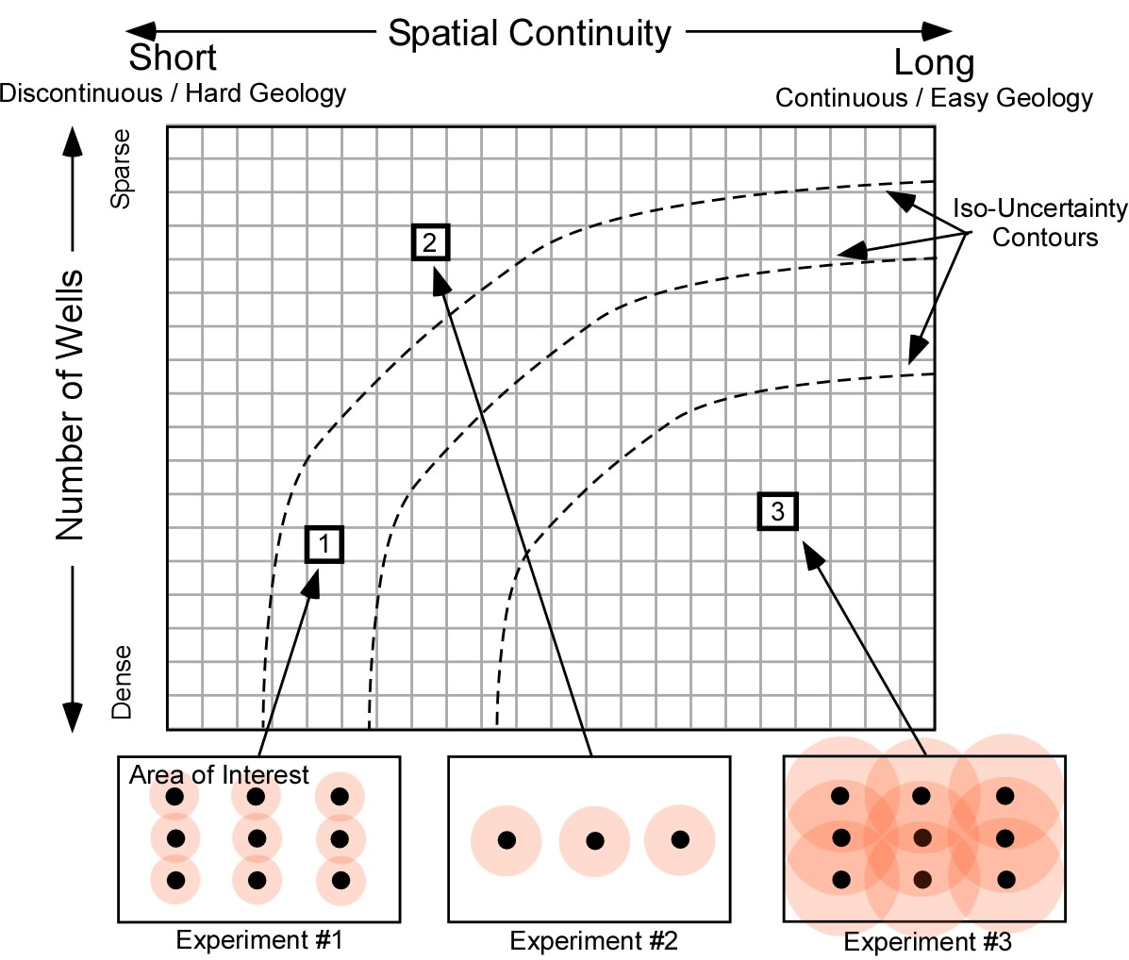
The University of Texas at Austin
Uncertainty as a Function of Spatial Continuity and Number of Data for Geoscientists and Geo-engineers
Michael Pyrcz, University of Texas at Austin (@GeostatsGuy)
Texas Center for Geostatistics
We can quantify the uncertainty response surface for an estimate over a volume of interest, e.g. what is the uncertainty in initial production of a well given a known, stationary, global distribution and spatial continuity (see below)? We can immediately observe: (1) the limitations of bootstrap-based uncertainty that ignores spatial continuity and (2) the trade-off between data density and spatial continuity, the same uncertainty for low data density with high spatial continuity (easy geology) and high data density with low spatial continuity (hard geology).
Experimental Setup
Uncertainty Response Surface
Bootstrap Uncertainty Surface
Global Kriging Uncertainty
40%
20%
10%
5%
2%
1%
Experiment setup and assumptions.
Specification for the uncertainty response surface.
Response surface for bootstrap-based uncertainty.
Response surface for global kriging.

