Slide 1
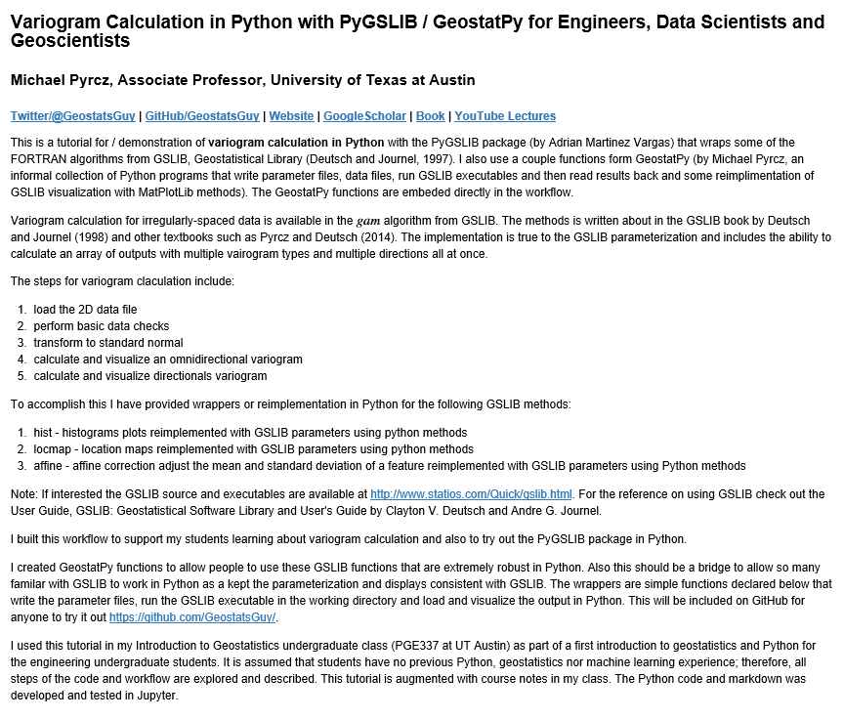
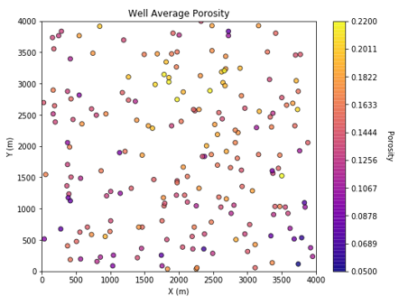
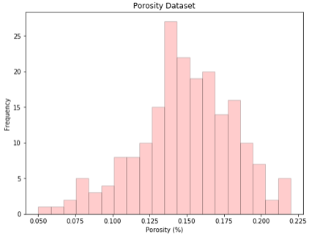
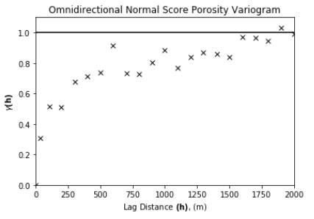
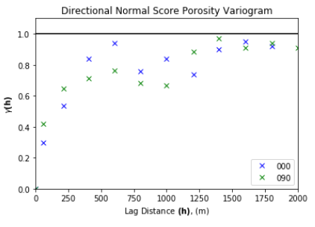
Variogram Calculation with Subsurface Demonstration in Python for Geoscientists, Data Scientists and Engineers
Michael Pyrcz, University of Texas at Austin (@GeostatsGuy)
The University of Texas at Austin
Texas Center for Geostatistics
GSLIB: Geostatistical Software Library by Deutsch and Journel (1998) is commonly applied to build geostatistical workflows. I tried out the PyGSLIB package (by Andrian Martinez Vargas) that wraps GSLIB for Python and built a workflow by including some of my GeostatPy GSLIB reimplementations. Spatial continuity quantification is essential in spatial modeling! Here’s how to do it in Python https://git.io/fxSHl.
Example Spatial Dataset
Omnidirectional and Directional Normal Score Variograms

