Slide 1

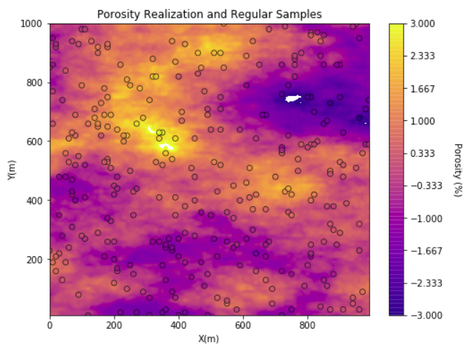
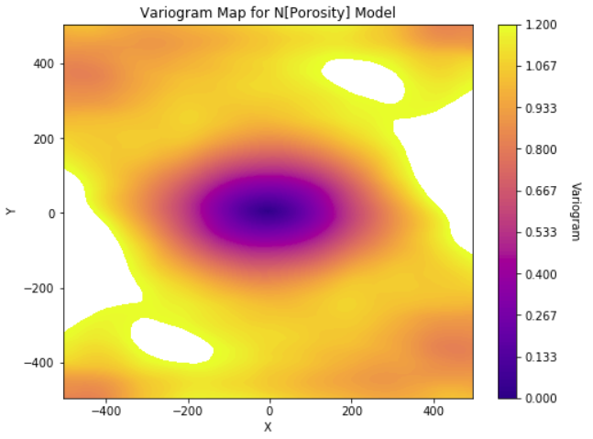
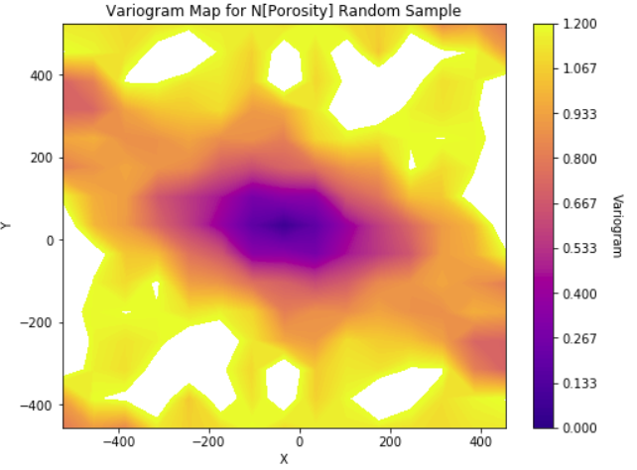
GSLIB: Geostatistical Software Library, Spatial Analysis in Python for Geoscientists and Geo-engineers
Michael Pyrcz, University of Texas at Austin (@GeostatsGuy)
GSLIB: Geostatistical Software Library by Deutsch and Journel is commonly applied to build geostatistical workflows. We have started to wrap and reimplement GSLIB in Python using the strength of improved data management and visualization from numpy, pandas and matplotlib while retaining the conventions from GSLIB that are so familiar to the community. This is the last phase. Just added variogram maps for both regularly and irregularly sampled data. This includes wrapping of varmap with a function the produces a custom variogram map display. All the methods are now available for variogram-based spatial analysis.
N[Porosity] Realization and 30 Random Samples
Regularly Sampled Data Variogram Map
Irregularly Sampled Data Variogram Map

