Slide 1
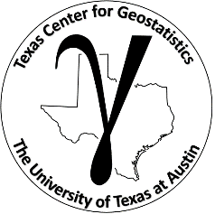
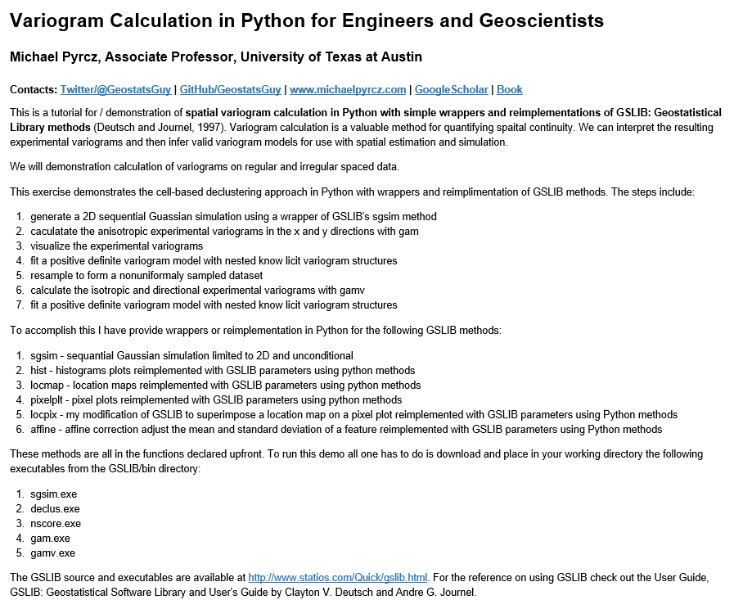
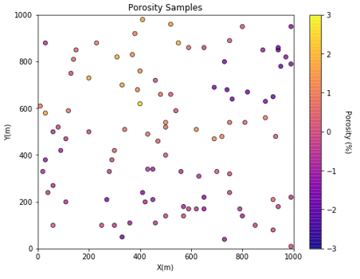
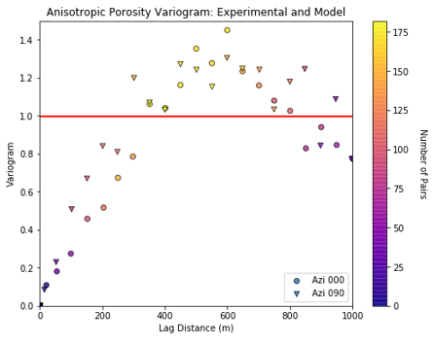
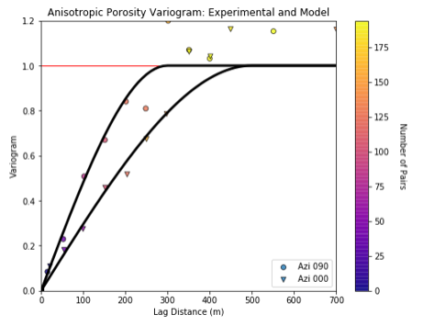
GSLIB: Geostatistical Software Library, Spatial Analysis in Python for Geoscientists and Geo-engineers
Michael Pyrcz, University of Texas at Austin (@GeostatsGuy)
GSLIB: Geostatistical Software Library by Deutsch and Journel is commonly applied to build geostatistical workflows. We have started to wrap and reimplement GSLIB in Python using the strength of improved data management and visualization from numpy, pandas and matplotlib while retaining the conventions from GSLIB that are so familiar to the community. In this next phase we have demonstrated variogram calculation and modeling in 2D for irregularly spaced data. This includes wrapping of gamv, vmodel and nscore for variogram calculation and modeling, and reimplementation of vargplt for visualization.
Variogram Calculation (wrapped 2D gamv)
Variogram Modeling (wrapped 2D vmodel) and Visualization (reimplemented vargplt)

