Slide 1
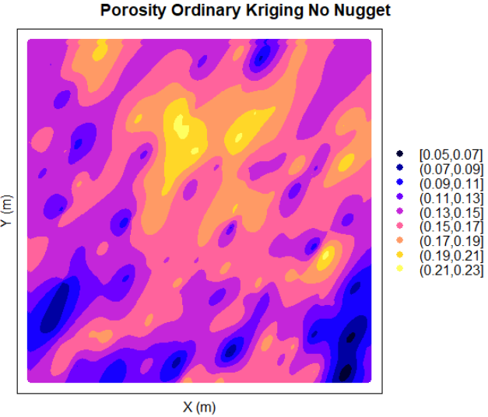
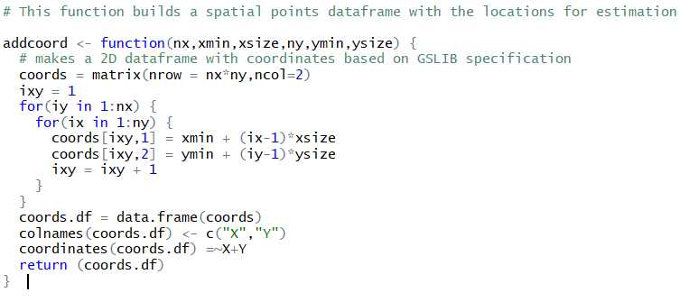
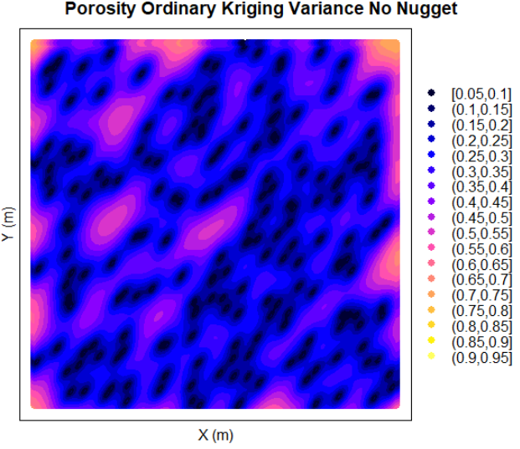
Function to Specify a Regular Estimation / Simulation Grid in R
Michael Pyrcz, the University of Texas at Austin, @GeostatsGuy
This function takes the GSLIB, Geo-DAS regular grid specification and builds a location spatial points dataframe that may be used directly with gstat inverse distance, kriging and simulation methods to specify the model grid.

