Slide 1

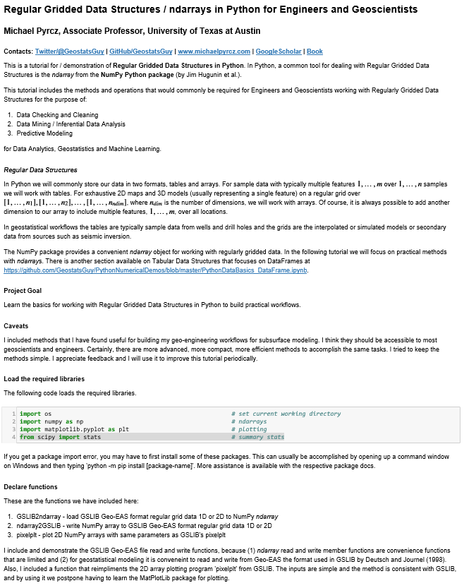
Four Horsemen of Subsurface Machine Learning for Geoscientists, Data Scientists and Engineers
Michael Pyrcz, University of Texas at Austin (@GeostatsGuy)
Firstly let me admit that I’m going for dramatic effect. These are the fundamental challenges to be faced with wide adoption of machine learning in subsurface projects.
Pale Horse – Sparse Data
Data Visualization
Making Arrays
Searching / Manipulating
Summary Statistics / Data Checking
Operations

