Slide 1
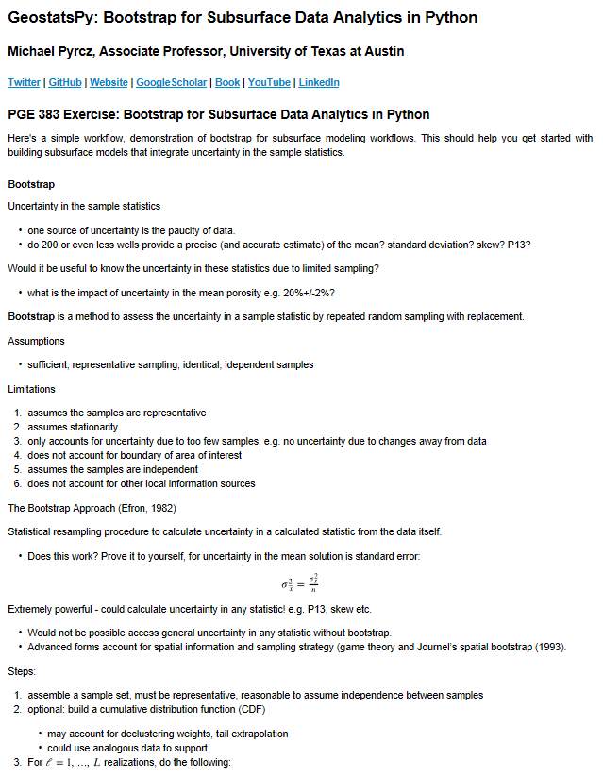
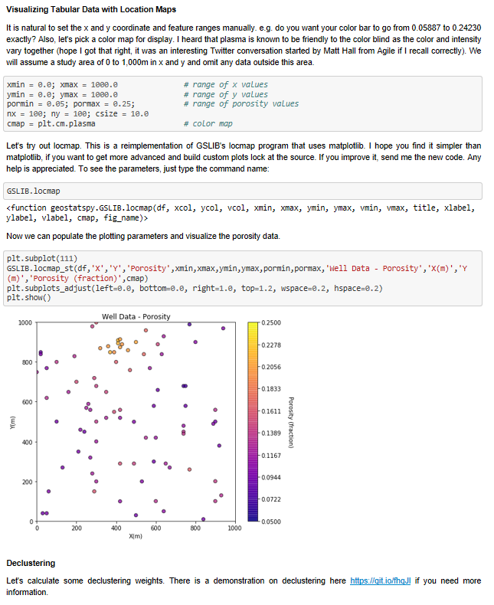
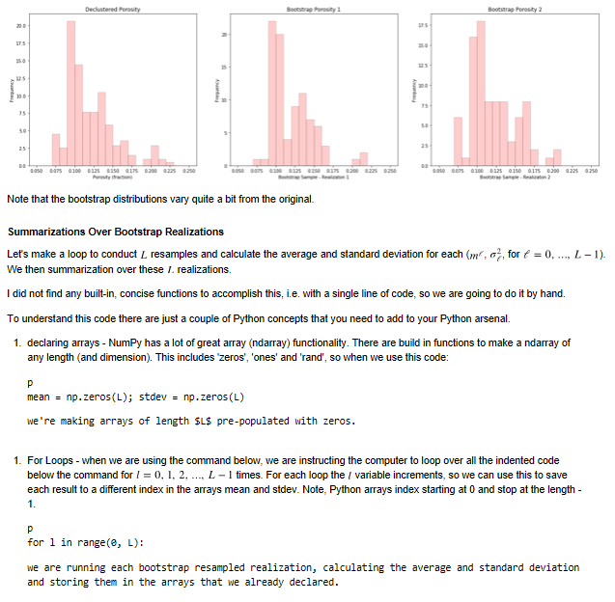
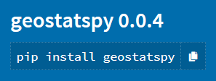
Bootstrap for Subsurface Uncertainty with the GeostatsPy Python Package
Michael Pyrcz, the University of Texas at Austin, @GeostatsGuy, GeostatsGuy Lectures
The University of Texas at Austin
Texas Center for Geostatistics
Here’s a subsurface bootstrap uncertainty workflow tutorial in Python, Jupyter Notebook using the GeostatsPy package for subsurface data analytics and geostatistics. The tutorial includes explanations to get you started and a complete subsurface modeling workflow with an example spatial dataset, univariate statistics, visualization and analysis of results. The workflow is here on GitHub at: https://git.io/fhgUW, and the associated YouTube lecture is here: https://youtu.be/wCgdoImlLY0.
1. Explanation of the Bootstrap approach, supporting recorded lectures.
2. Complete workflow with example spatial dataset, debiasing and visualization.
3. Summarization of resulting uncertainty model with analysis and visualization
Try out GeostatsPy install it with →

