Slide 1
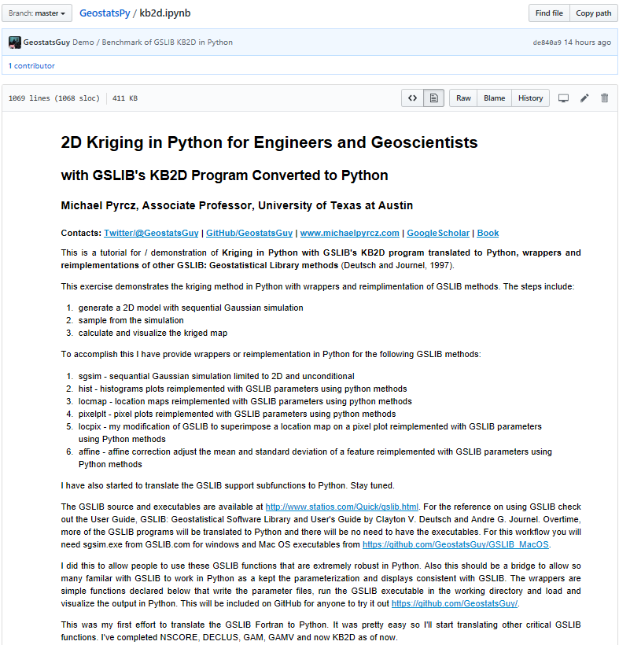
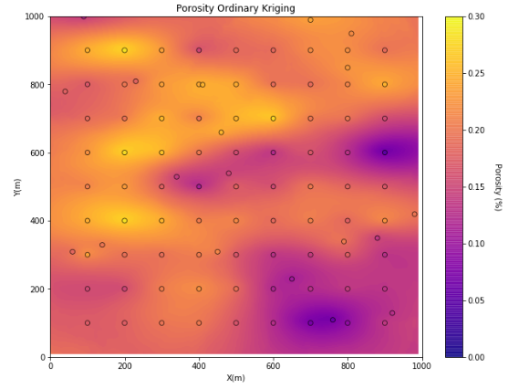
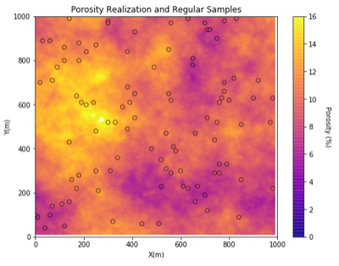
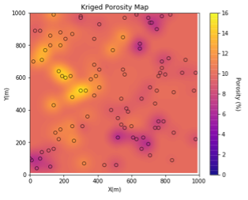
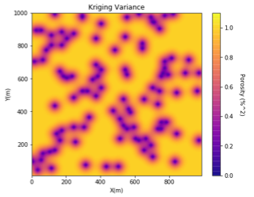
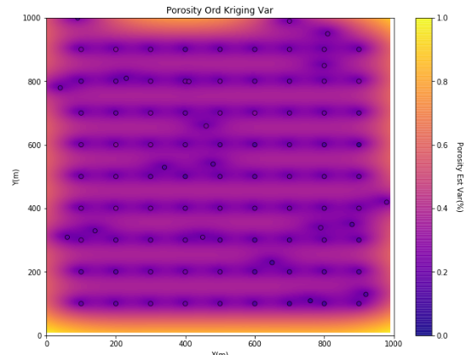
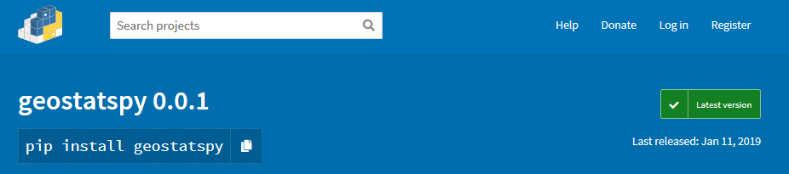
GSLIB’s KB2D Kriging Converted to Python for Furture GeostatsPy Python Package
Michael Pyrcz, the University of Texas at Austin, @GeostatsGuy, GeostatsGuy Lectures
The University of Texas at Austin
Texas Center for Geostatistics
I’m translating and reimplimenting GSLIB Geostatistical Library in Python to support teaching geostatistics. We benefit from a set of functions: (1) to support the construction of geostatistical spatial modeling workflows in Python, (2) that retain the parameter conventions and open, building block approach for flexible modeling workflow design and construction established in GSLIB: Geostatistical Library (Deutsch and Journel, 1998) and (3) are dependent on common Python packages, NumPy, Numba, pandas and matplotlib for maximum availability.
GeostatsPy
1. Demonstration / benchmark available on GitHub. https://git.io/fhnjO
2. Code rewritten to utilize numerical methods available in NumPy / SciPy
3. Parametric inputs and visualization methods the same as GSLIB
Note: download code from GitHub now or wait for geostatspy package.
Simulation is almost ready also…
Source, Docs are available at:
https://github.com/GeostatsGuy/GeostatsPy

