Slide 1
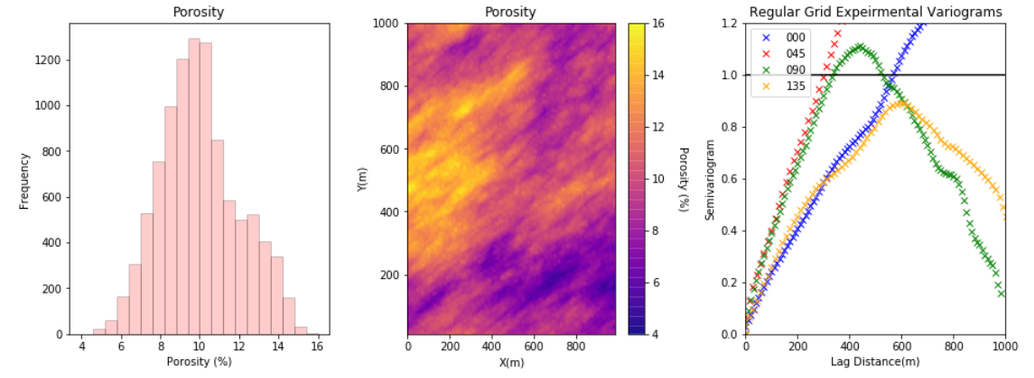
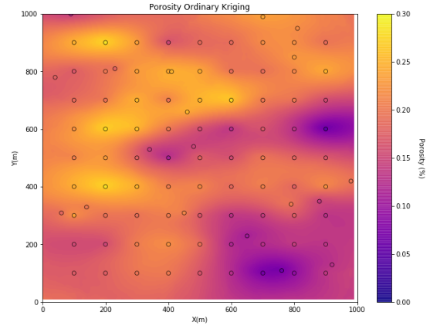
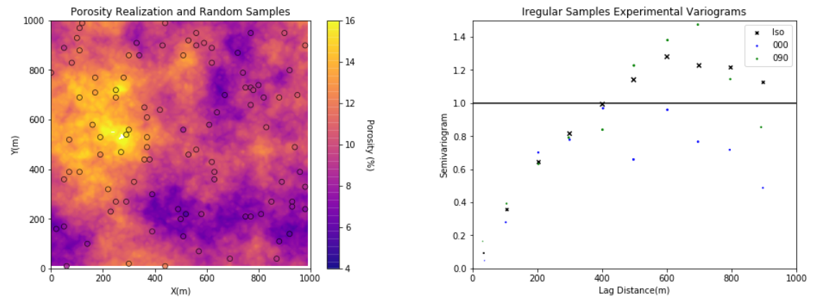
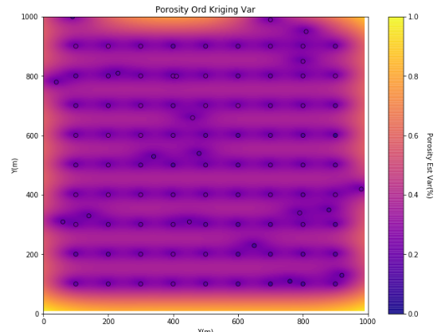
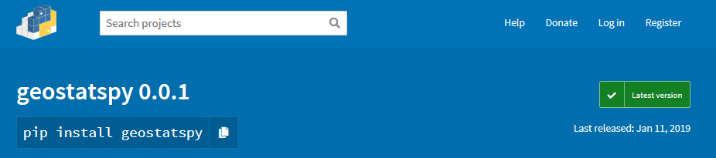
GeostatsPy Python Package Now Available on the Python Package Index
Michael Pyrcz, the University of Texas at Austin, @GeostatsGuy, GeostatsGuy Lectures
The University of Texas at Austin
Texas Center for Geostatistics
A set of functions to support the construction of geostatistical spatial modeling workflows in Python.
Retaining the parameter conventions established in GSLIB: Geostatistical Library (Deutsch and Journel, 1998).
Common, open, building block approach for flexible modeling workflow design and construction.
Methods dependent on common Python packages, NumPy, Numba, pandas and matplotlib for maximum availability.
Utilities to support modeling workflows
Converting data and models from GSLIB Geo-EAS to DataFrames and ndarrays
2. Phase 1: Linkages to GSLIB methods
Python functions that run robust GSLIB executables and load results back to Python DataFrames and ndarrays
3. Phase 2: Reimplementation of GSLIB in Python
Visualization: locmap, pixelplt, locpix, hist
Spatial continuity calculation: gam, gamv, vargplt
Spatial debiasing: declus
Spatial estimation and simulation: kb2d, sgsim (to be added soon)
Variogram parameter dictionary
Example workflows for spatial characterization and modeling in Python
Note: package is immature, any contribution / collaboration is welcome!
PyGSLIB examples are included, but not essential, ignore warning if not installed.
Find it on https://pypi.org/
Source, Docs are available at:
https://github.com/GeostatsGuy/GeostatsPy

