Slide 1
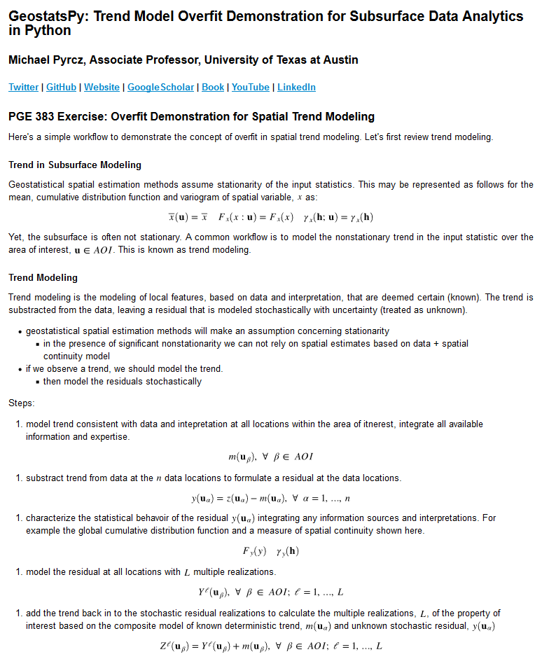
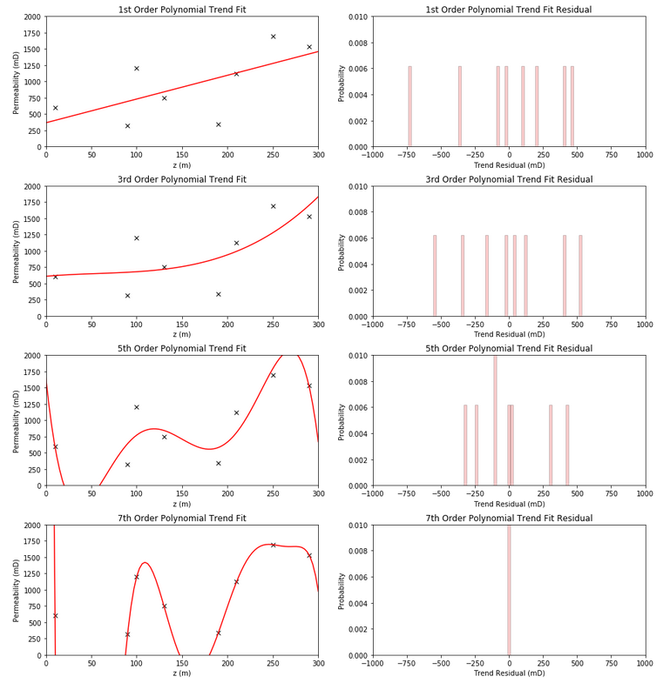
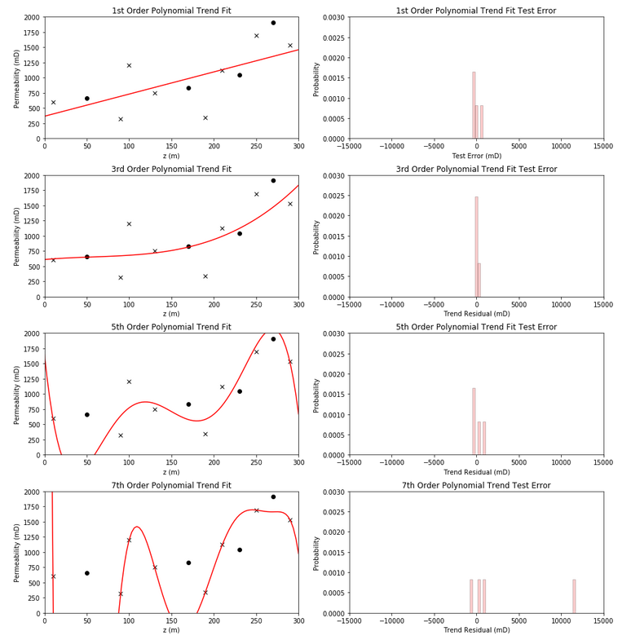
Trend Overfit for Subsurface Uncertainty with the NumPy Python Package
Michael Pyrcz, the University of Texas at Austin, @GeostatsGuy, GeostatsGuy Lectures
The University of Texas at Austin
Texas Center for Geostatistics
Here’s a subsurface / spatial trend modeling overfit demonstration, tutorial in Python, Jupyter Notebook using the NumPy package for subsurface data analytics and geostatistics. The tutorial includes details on deterministic trend modeling for spatial data, partitioning of variance and demonstration of trend fitting with diagnostics. The demonstration is here on GitHub at: https://git.io/fhSZg, and the associated YouTube lecture is here: https://youtu.be/BCnivpSKF18.
1. Explanation of the deterministic trend modeling approach
2. Complete workflow with example spatial dataset, trend training and visualization.
3. Demonstration of overfit with reduced testing accuracy.

