Slide 1

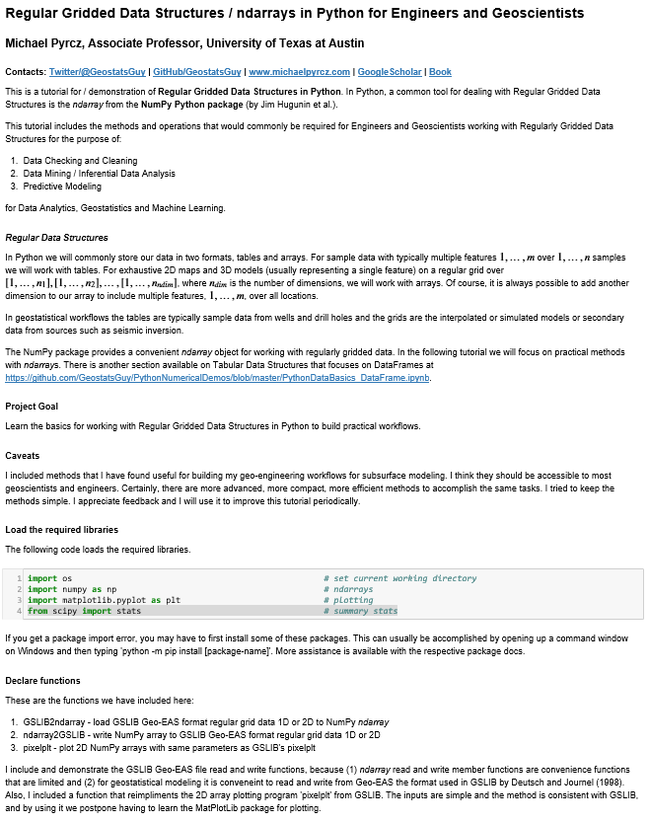
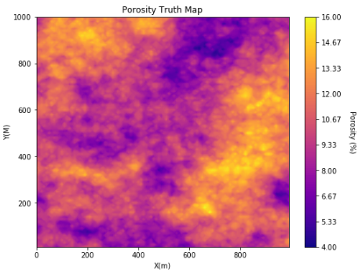
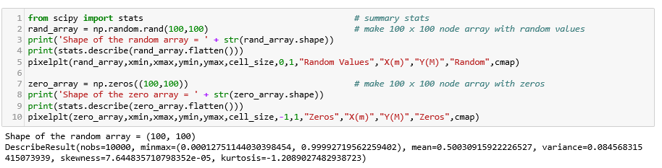
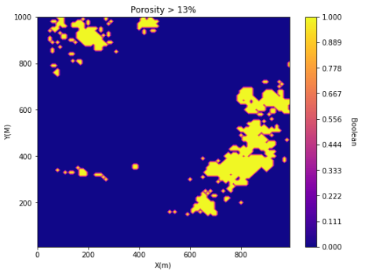
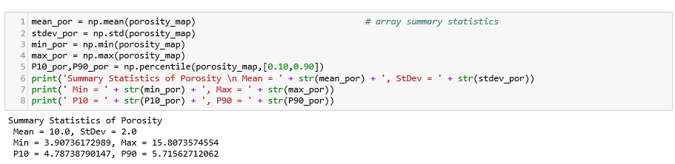
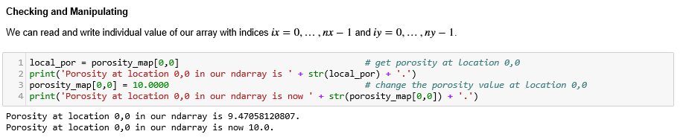
Gridded Data with ndarrays in Python for Geoscientists, Data Scientists and Engineers
Michael Pyrcz, University of Texas at Austin (@GeostatsGuy)
Many geoscientists and engineers struggle with getting started with data analytics, machine learning and geostatistics in Python, because they do not know how to handle their data. ndarrays from the NumPy package, by Jim Hugunin et al., is designed for high performance, easy to use gridded data structures. Here’s a tutorial in Jupyter with Markdown with all the gridded data operations needed to build most subsurface modeling workflows. Find it here: https://git.io/fNgRu
Jupyter Notebook Tutorial with Markdown
Data Visualization
Making Arrays
Searching / Manipulating
Summary Statistics / Data Checking
Operations

