Slide 1
Daytum +2 Course Uncertainty
Lecture outline . . .
Sources of Uncertainty
Representing Uncertainty
Calculating Uncertainty
Sampling Uncertainty
Summarizing Over Realizations
Uncertainty Summary
Michael Pyrcz, The University of Texas at Austin

Slide 2
Daytum +2 Course Uncertainty
Lecture outline . . .
Sources of Uncertainty
Michael Pyrcz, The University of Texas at Austin

Slide 3


Uncertainty What is uncertainty?
u₃
?
u₇
u₆
?
u₀
u₁
u₅
Property of Interest
PDF
u₂
u₄
Stationary domain, samples at locations, u₁₋₇
Uncertainty is not an intrinsic property of the subsurface.
At every location (u_{α}) within the volume of interest the true properties could be measured if we had access (facies, porosity etc.).
Uncertainty is a function of our ignorance, our inability to observed and measure the subsurface with the coverage and scale required to support our scientific questions and decision making.
sparsity of sample data + heterogeneity = uncertainty
If the subsurface was homogeneous, with a few measurements uncertainty would be reduced and estimates resolved to a sufficient degree of exactitude.

Slide 4
Types of Uncertainty
Gamma Ray
Measurement / Interpretation Error.
Formation evaluation – tool tolerance, calibration error, approximations / assumptions
Interpreter experience and prior model / assumptions
How to integrate it?
Indicator method code as soft inputs
Multiple data realizations in design of experiments
100
0
200
90
80
70
Depth (m)
60
50
40
30
20
10
0
Example well log.

Slide 5
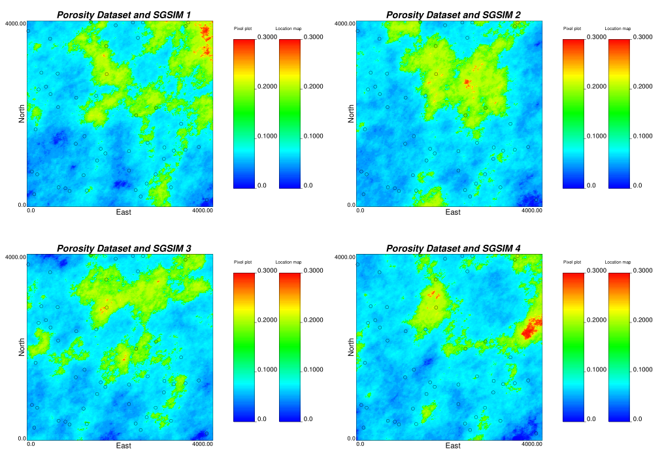
Types of Uncertainty
Spatial Uncertainty
Uncertainty due to spatial offset from sampled locations
Integrate through multiple local realizations and scenarios

Slide 6
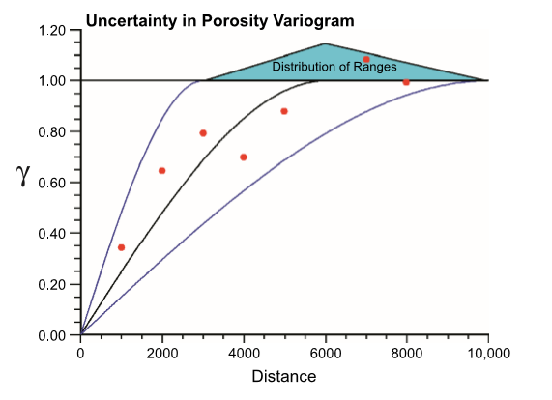
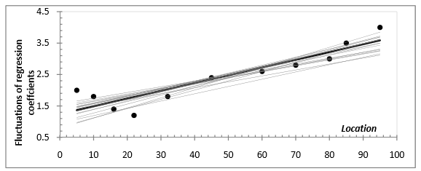
Types of Uncertainty
Parameter Uncertainty
Uncertainty in the input statistics to constrain the model area
E.g. global reference porosity distribution for simulation
Formulate distribution scenarios and bootstrap realizations
Trend Uncertainty (Villalba and Deutsch., 2010)
Distribution of Variogram Ranges
(Pyrcz et al., 2006)

Slide 7
Daytum +2 Course Uncertainty
Lecture outline . . .
Representing Uncertainty
Michael Pyrcz, The University of Texas at Austin

Slide 8
How Do We Represent Uncertainty?
Random Variables and Functions: A random variable is a property at a location (u_{α}) that can take on multiple possible outcomes. This is represented by a probability density function (PDF).
z¹(u₀)
Random
Variable
Multiple
Outcomes
?
Property of Interest
PDF Z(u₀)
z^{n}(u₀)
If we take a set of random variables at all locations of interest and we impart the correct spatial continuity between them then we have a random function. Each outcome from the random function is a potential model of the subsurface.
Z(u₃)
Z(u₄)
Z(u₁)
Z(u₂)
Multiple Joint Outcomes Multiple Models

Slide 9
How Do We Represent Uncertainty?
Using Multiple Models: We represent uncertainty with multiple models.
Scenarios: when the input decisions and parameters are changed
Captures interpretation and data uncertainty.
Realizations: when the input decisions and parameters are held constant and only the random number seed is changed
Captures spatial uncertainty.
Working With Multiple Models: It is generally not appropriate to analyze a single or few scenarios and realizations.
Use all the models all the time applied to the transfer function
(e.g. volumetric calculation, contaminant transport, ore grade scale up, flow simulation etc.).

Slide 10
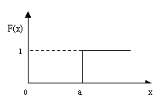
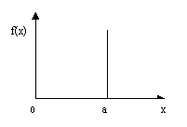
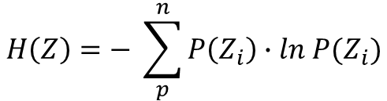


How Do We Represent Uncertainty?
We have a PDF / CDF of a measure over a volume: therefore our measures of spread / dispersion are our measures of uncertainty.
Variance
Var$\left(Z\right)= {\int_{−∞}^{∞}{\left(z−m\right)}}^{2}f\left(z\right)dz$
Expected squared difference from mean.
Dispersion Variance
$$D^{2}\left(v,V\right)={\overline{γ}}_{V,V} −{\overline{γ}}_{v,v}$$
Generalized variance accounting scale
and heterogeneity.
$$H\left(Z\right)=− \sum_{p}^{n}{P\left(Z_{i}\right)∙ln P(Z_{i})}$$
Measure of uncertainty for categorical
Variables.
Entropy
Discrete distribution
Discrete distribution
1
2
3
maximum
entropy
1
2
3
minimum
entropy
1
2
3
1
2
3

Slide 11
How Do We Represent Uncertainty?
Variance is partitioned between trend, deterministic, known and residual, stochastic, unknown.
0
Variance
Components
σ² = σ_{t}² + σ_{r}² + 2 C_{t,r} (0)
Total variance = Deterministic / Known + Stochastic / Unknown
Variance
Variance
Variance Partitions
σ²_{residual}
σ²_{trend}
σ²_{residual}
σ²_{trend}

Slide 12

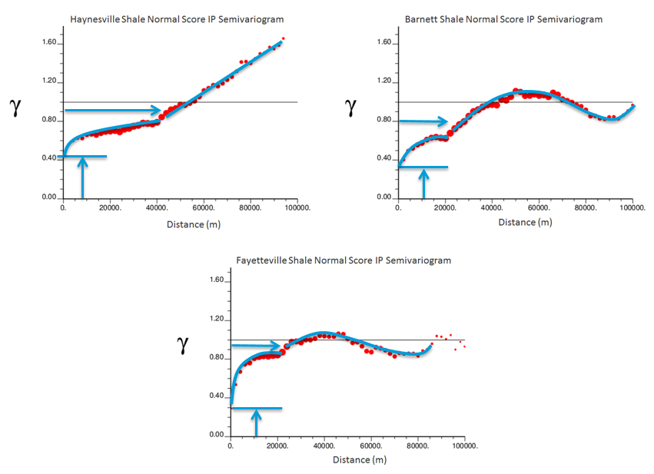






How Do We Represent Uncertainty?
Variance is partitioned spatially with variogram features.
Simple Kriging Est. Var.
For one neighboring data:
${σ_{k}^{2}=σ}^{2}−\frac{C(h)}{σ^{2}}$ $=1 −C(h)$ $=γ(h)$ (if $σ^{2}$ = 1)
$γ(h)$
1
?
$$σ^{2}$$
trend
$$γ\left(h\right)$$
${ σ}_{k}^{2}$
trend
spherical
spherical
0
nugget
nugget
$h$
Nested structures each describe
spatial uncertainty components.
$γ\left(h\right)=γ\left(h\right)$_{nugget} + $γ\left(h\right)$_{spherical} + $γ\left(h\right)$_{trend}
trend
spherical
σ_{k}² = σ²_{nugget} + σ²_{spherical} + σ²_{trend}
nugget

Slide 13
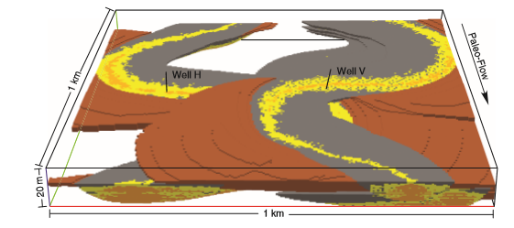
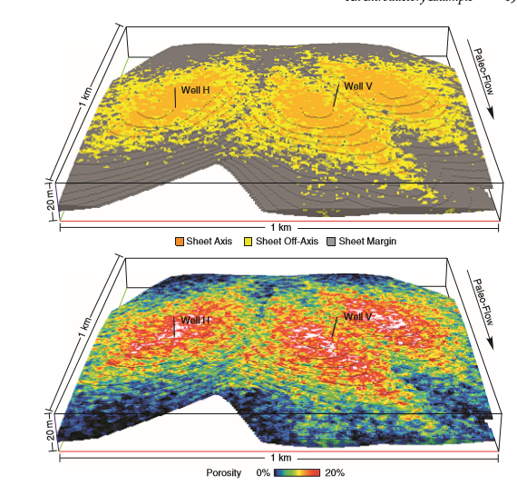
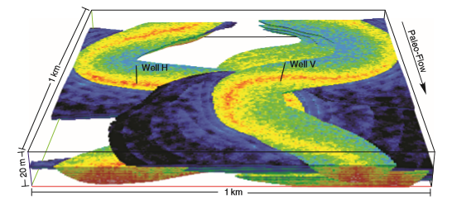
How Do We Represent Uncertainty?
Discrete Cases
At times it is NOT possible to represent uncertainty as a continuous distribution.
Discrete scenarios are required
Porosity compaction trend - yes or no.
Channelized or lobe uncertainty

Slide 14
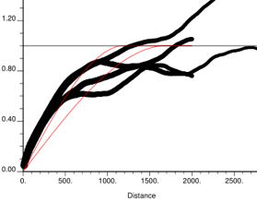
How Do We Represent Uncertainty?
Ergodic fluctuations – Can’t leave uncertainty to the algorithm!
In the “old days” ergodic fluctuations were treated as a comprehensive uncertainty model in input statistics.
Function of variogram range, data conditioning and size of model area.
Can be predicted:
Fluctuations in
Variogram
Generalize Variance
Definition
v
Does not completely account for uncertainty in inferring input statistics.
We must take ownership of our inputs and associated uncertainty models.
V

Slide 15
Daytum +2 Course Uncertainty
Lecture outline . . .
Calculating Uncertainty
Michael Pyrcz, The University of Texas at Austin

Slide 16
How is Uncertainty Calculated?
Simple example:
Uncertainty in porosity estimate at location u₁.
Global Uncertainty from Scenario: Depositional Setting Deepwater Lobe
Local Uncertainty given Trend Model
Porosity(u₁)
trend
m_{global},σ²_{global} (Case_{Lobe})
σ²_{residual} (u₁) = σ²_{global} (u₁) ⁻ σ²_{trend} (u₁)
m_{trend}(u₁), σ²_{residual}(u₁)

Slide 17
How is Uncertainty Calculated?
Simple example:
Uncertainty in porosity estimate at location u₁.
Local Uncertainty given Trend Model and Conditioning Data
Uncertainty at u₁ for porosity given Case_{Lobe}, trend model and conditioning data.
Porosity(u₁)
trend
1
σ²_{residual | data} (u₁) ~ σ²_{residual} (u₁) – C(h)
σ²_{residual | data} (u₁) = σ_{k}²
m_{trend | data}(u₁) = Z*
m_{trend | data}(u₁), σ²_{residual | data}(u₁)

Slide 18
How is Uncertainty Calculated?
Sample uncertainty through modeling scenarios and realizations:
We can ask any question of the model by considering all scenarios and realizations jointly.
Scenario 1
Scenario 2
3
7
3
7
1
2
1
5
6
2
4
4
5
6
1,…,L realizations (all inputs the same)
1,…,L realizations (all inputs the same)
Scenario 3
3
7
1
2
4
5
6
1,…,L realizations (all inputs the same)

Slide 19
How is Uncertainty Calculated?
Modeling Subsurface Uncertainty Without Scenarios
Implicitly assume perfect knowledge of:
Scenario 1
Primary and
Secondary Data
conditioning data - results in reduced local uncertainty
Porosity
3
7
Univariate
Distributions
1
2
mean porosity - results in reduced volumetric uncertainty
5
6
4
Porosity
1,…,L realizations (all the same inputs)
γ
Spatial
Continuity
spatial heterogeneity - results in reduced recovery uncertainty
Lag Distance (h)
Relying on ergodic fluctuations to characterize uncertainty in the input statistics.
Bivariate
Distributions
bivariate relationships - results in reduced local uncertainty and recovery uncertainty
Permeability
Porosity

Slide 20
How is Uncertainty Calculated?
Working without realizations?:
Implicitly assume perfect knowledge:
Scenario 1
H
3
7
Spatial Uncertainty
3
7
Spatially, away from data.
Freeze stochastic islands
away from data!
1
2
1
2
5
6
5
L
6
4
4
Porosity Realization
Scenario 2
3
7
Input Statistic
Fluctuations
Ergodic fluctuations from target statistics.
1
2
4
5
6
Porosity Output Distribution
Scenario 3
3
7
Ergodic fluctuations transfer to response surface creating
additional undulations.
1
2
Response
Surface
5
6
Var2
4
Var1
Response Surface

Slide 21
How is Uncertainty Calculated?
Uncertainty Space is Vast!
Consider typical design
Consider there are typically are around 10 or more uncertain variables.
3¹⁰ = 59,049 scenarios x 10 realizations of each scenario = 590,490 models
Variable screening is important!
3 level may still poor sampling
σ²_{permeability}
3 level design, 2 variables
level^{var} = 9 scenarios
m_{porosity}
Univariate
Response
Recovery
Factor
Fit
Model
σ²_{permeability}

Slide 22
How is Uncertainty Calculated?
We have represented the “uncertainty model” through scenarios and realizations:
We can ask any question of the model by considering all scenarios and realizations jointly.
What is the uncertainty in porosity at location u₁?
3
7
Porosity(u₁) = F(Φ; u₁)
1
2
5
6
4
3
7
1
2
5
6
4
3
7
1
2
4
5
6

Slide 23
How is Uncertainty Calculated?
We have represented the “uncertainty model” through scenarios and realizations:
We can ask any question of the model by considering all scenarios and realizations jointly.
What is the uncertainty in average porosity over volume, v?
3
7
m_{porosity}(v) = F(Φ; v)
1
2
5
6
4
3
7
1
2
5
6
4
3
7
1
2
4
5
6

Slide 24
How is Uncertainty Calculated?
We have represented the “uncertainty model” through scenarios and realizations:
We can ask any question of the model by considering all scenarios and realizations jointly.
What is the uncertainty in the recovery factor between Inj₁ and Prod₃?
3
7
1
2
RF(1-3) = F(RF; 1-3)
5
6
4
3
7
1
2
5
6
4
3
7
1
2
4
5
6

Slide 25
How is Uncertainty Calculated?
We have represented the “uncertainty model” through scenarios and realizations:
Models could be ranked as Pxx for a specific question.
But for every new question, the calculation of rank must be RERUN!
Why would a single model be the P90 for all of these questions?
3
7
Porosity(u₁) = F(Φ; u₁)
1
2
m_{porosity}(v) = F(Φ; v)
5
6
4
3
7
RF(1-3) = F(RF; 1-3)
1
2
5
6
4
3
7
1
2
4
5
6

Slide 26
Daytum +2 Course Uncertainty
Lecture outline . . .
Sampling Uncertainty

Slide 27
Sampling the Uncertainty Space
Sampling the Uncertainty Space
Generally models are treated as equiprobably
Equal-likely to be drawn realizations of the subsurface
We are attempting to sample model the decision criteria CDF
Model 1
Model 2
Model 3
Decision
Criteria
CDF
Model M
Decision Criteria

Slide 28

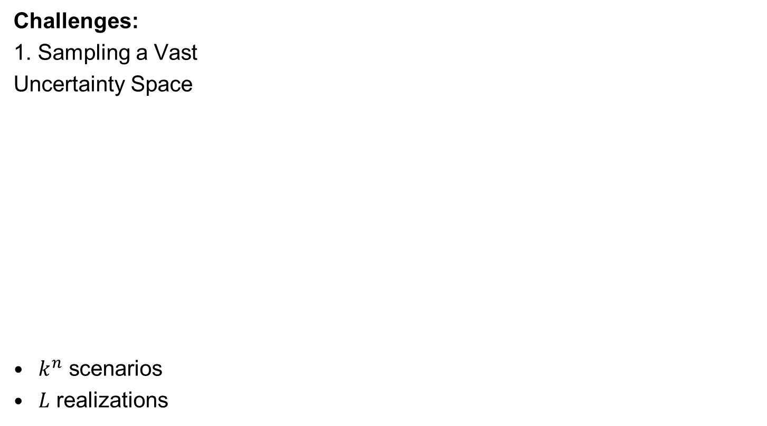

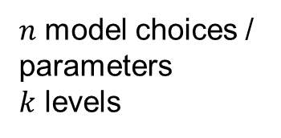


Sampling the Uncertainty Space
Challenges:
1. Sampling a Vast
Uncertainty Space
$k^{n}$ scenarios
$L$ realizations
$n$ model choices /
parameters
$k$ levels
$$S=k^{n}$$
Scenario 1
Scenario 2
Scenario S
Realizations
$$1,…,L$$
Scenarios $1,…,S$
Transfer Function
2. Expensive Transfer Function
$$Models, M=k^{n}∙L$$
Decision Criteria

Slide 29
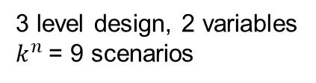
Response Surfaces
Even with full combinatorial sampling we have only sampled quite a limited combination of possible parameters:
Consider this 2 parameters, 3 level model with exhaustive sampling
We have only sampled this configuration of the joint distribution!
Recall curse of dimensionality – this is poor coverage as the dimension increases
σ²_{permeability}
3 level design, 2 variables
$k^{n}$ = 9 scenarios
Recover Factor
m_{porosity}

Slide 30
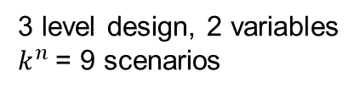
Response Surfaces
A response surface is modeled to fill in, improve coverage
Fit a hyperdimensional model to the samples of the decision criteria
Assume smooth response behavior and limited extrapolation
The Monte Carlo sample from the response surface over a complete range of the predictor variables
σ²_{permeability}
3 level design, 2 variables
$k^{n}$ = 9 scenarios
m_{porosity}

Slide 31
Response Surfaces
A response surface is modeled to fill in, improve coverage
The Monte Carlo sample from the response surface over a complete distribution of the predictor range.
σ²_{permeability}
Recover Factor Realization
σ²_{permeability} Realization
m_{porosity} Realization

Slide 32
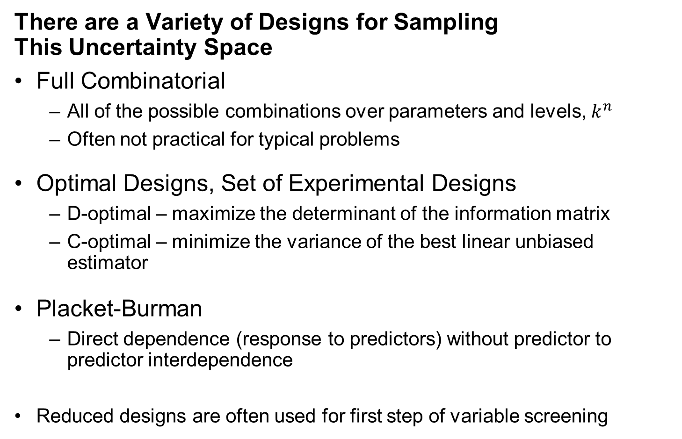
Sampling Designs
There are a Variety of Designs for Sampling This Uncertainty Space
Full Combinatorial
All of the possible combinations over parameters and levels, $k^{n}$
Often not practical for typical problems
Optimal Designs, Set of Experimental Designs
D-optimal – maximize the determinant of the information matrix
C-optimal – minimize the variance of the best linear unbiased estimator
Placket-Burman
Direct dependence (response to predictors) without predictor to predictor interdependence
Reduced designs are often used for first step of variable screening

Slide 33
Ranking Models
A Short Cut, Model Ranking
Use a fast proxy for the transfer function to assign a rank estimate to each model
Sorting models from P00 to P100
Model 1
Rank Error
Model 2
Model 3
Decision
Criteria
CDF
Model M
Decision Criteria

Slide 34
Ranking Models
Model Ranking
Identify critical percentiles, P10, P50 and P90 are common
Apply expensive transfer function only to these models
P90
Model 13
P50
Decision
Criteria
CDF
Model 453
P10
Model 729
Decision Criteria

Slide 35
Ranking Models
Model Ranking - Limitations
Ranking inaccuracy
the fast ranking proxy has ranking error (not a perfect proxy)
Rank P10 may actually be P13, P15 or even P53 with a poor proxy
Quite Limited Sampling of the Decision Criteria Distribution
Simplifying assumption of distribution shape
Extreme tail extrapolation required
May miss our low and high cases (essential for low-side mitigation and high-side opportunity)
Rank model labels are ‘sticky’
Once a model is labelled as P10, must retain criteria with rank!
Common for rank label to be incorrectly retained for other criteria

Slide 36
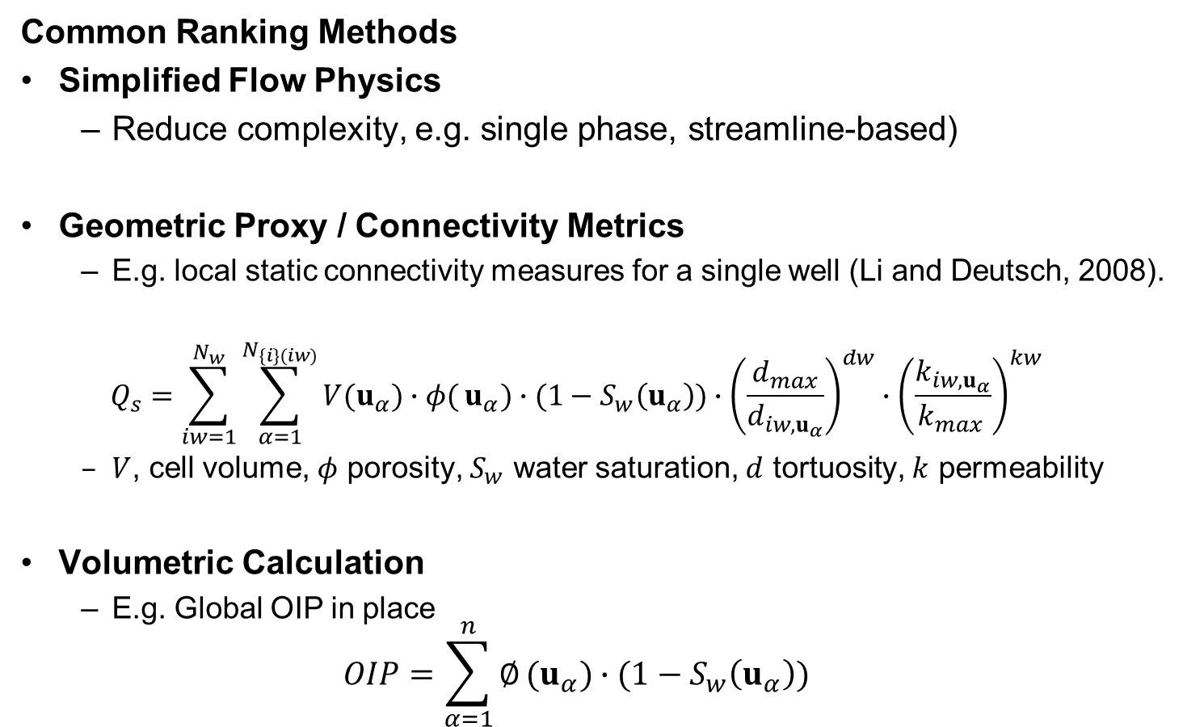
Ranking Models
Common Ranking Methods
Simplified Flow Physics
Reduce complexity, e.g. single phase, streamline-based)
Geometric Proxy / Connectivity Metrics
E.g. local static connectivity measures for a single well (Li and Deutsch, 2008).
$$Q_{s}=\sum_{iw=1}^{N_{w}}{\sum_{α=1}^{N_{\{i\}(iw)}}{V(u_{α})∙φ(}}u_{α})∙(1−S_{w}\left(u_{α}\right))∙{\left(\frac{d_{max}}{d_{iw,u_{α}}}\right)}^{dw}∙{\left(\frac{k_{iw,u_{α}}}{k_{max }}\right)}^{kw}$$
$V$, cell volume, $φ$ porosity, $S_{w}$ water saturation, $d$ tortuosity, $k$ permeability
Volumetric Calculation
E.g. Global OIP in place
$$OIP=\sum_{α=1}^{n}{∅}(u_{α})∙(1−S_{w}\left(u_{α}\right))$$

Slide 37
Ranking Models
Expert Advice is to Avoid Ranking
Apply transfer function to all the models if possible
If ranking is needed, procrastinate to the latest possible in the workflow
Ranking could be integrated at any workflow step to reduce the number of models considered to a few representative ones
Don’t rank on static measures and then pass only a few static models for exploring dynamic model parameters
Many modeling failures can be traced to misuse of ranking

Slide 38
Daytum +2 Course Uncertainty
Lecture outline . . .
Summarizing Over Realizations
Michael Pyrcz, The University of Texas at Austin

Slide 39
Summarizing Uncertainty Over Multiple Realizations
Multiple Realizations
Visualizing / Communicating Uncertainty
We need practical workflows to summarize over multiple realizations
Local uncertainty maps provide measures of local uncertainty suitable to support decision making (more on this later)

Slide 40







Summarizing Uncertainty Over Multiple Realizations
Method:
Scan over all the realizations and scenarios
Calculate the local distributions of uncertainty at each location
Calculate statistical summary over each location and place in a map / model
$$p$$
What is a specific percentile outcome at this location?
$$z_{p}\left(u_{α}\right)$$
$z_{p}\left(u_{α}\right)=F_{z}^{−1}(p;u_{α})$
What is the local probability of exceeding a threshold at this location?
3
7
1
$P\left({z(u}_{α})>z_{k}\right)=1−F_{z} ({z_{k};u}_{α})$
2
4
5
6
$$P\left({z(u}_{α})<z_{k}\right)$$
$F_{z} ({z;u}_{α})$
$$z_{k}$$

Slide 41
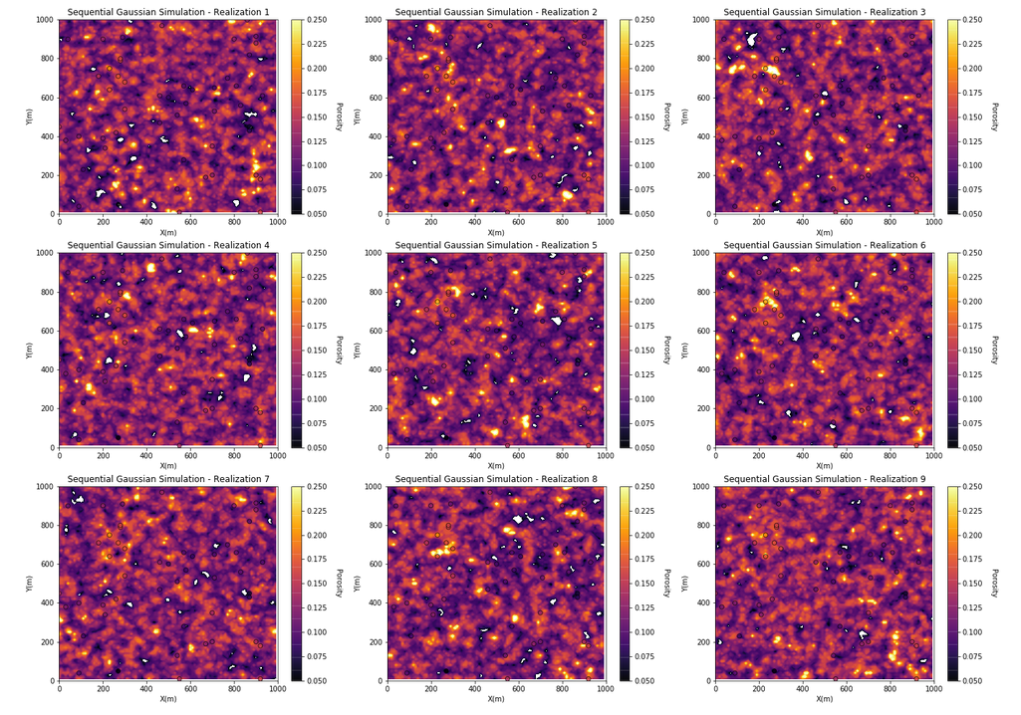
Local Uncertainty Example
9 Realizations of porosity

Slide 42
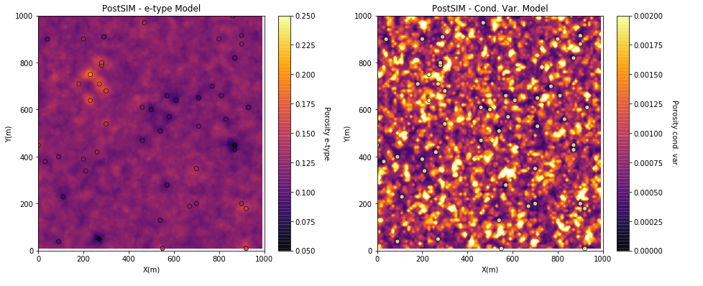
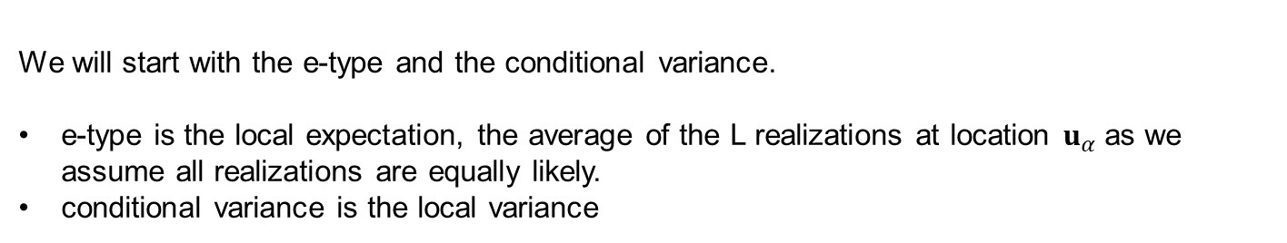
Local Uncertainty Example
We will start with the e-type and the conditional variance.
e-type is the local expectation, the average of the L realizations at location $u_{α}$as we assume all realizations are equally likely.
conditional variance is the local variance

Slide 43
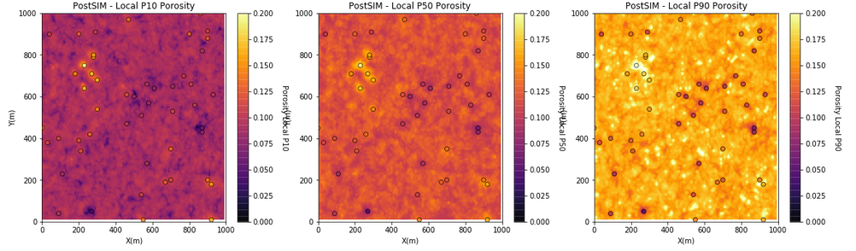
Local Uncertainty Example
Local percentile maps are the maps with the local percentile values sampled from the local realizations
We can interpret these as follows, at a location if we have a local P10 of 14% porosity, then we have a 90% probability of an even higher porosity, the porosity at that location is surely high.
Local percentiles are very convenient to understand local uncertainty. We must NOT confuse them with a percentile model (the model that is globally ranked as a specific percentile outcome).

Slide 44
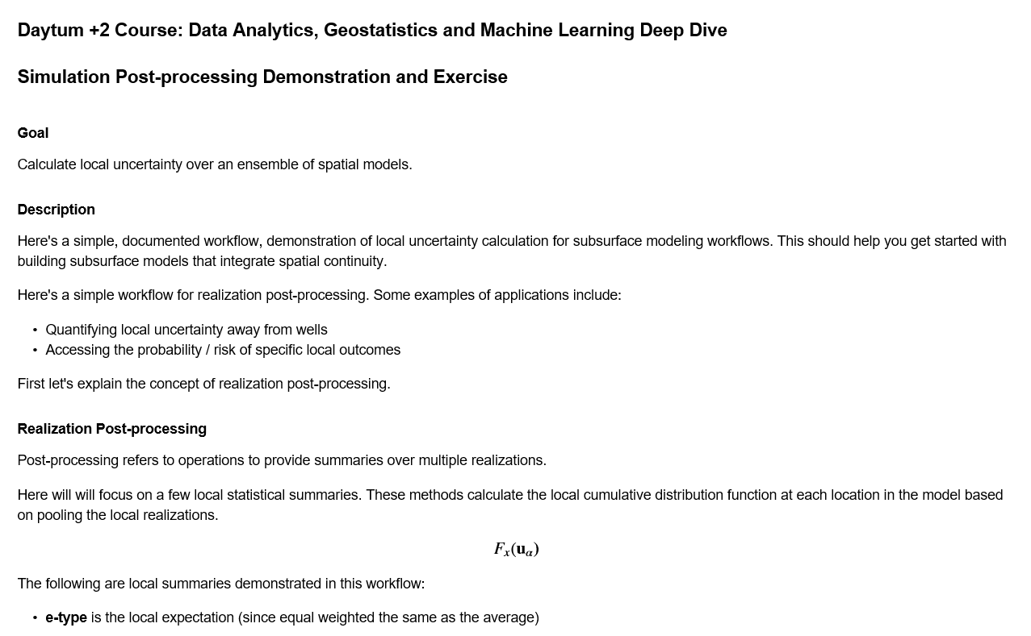
Local Uncertainty Hands-on
Realization Post-processing
Things to try:
Observed the results at and away from the data.
Adjust the percentiles.
Adjust the thresholds.
The file is Daytum_Simulation_Postsim.ipynb

Slide 45
Daytum +2 Course Uncertainty
Lecture outline . . .
Uncertainty Summary
Michael Pyrcz, The University of Texas at Austin

Slide 46
Uncertainty Comments
Calculating Uncertainty in a Modeling Parameter: Use Bayesian methods, spatial bootstrap etc. You must account for the volume of interest, sample data quantity and locations, and spatial continuity.
If You Know It, Put It In. Use expert geologic knowledge and data to model trends. Any variability captured in a trend model is known and is removed from the unknown, uncertain component of the model. Overfit trend will result in unrealistic certainty.
Types of Uncertainty: (1) data measurement, calibration uncertainty, (2) decisions and parameters uncertainty, and (3) spatial uncertainty in estimating away from data. Your job is to hunt for and include all significant sources of uncertainty.
Be an uncertainty detective! Discover and evaluate various sources.

Slide 47
Uncertainty Comments
What about Uncertainty in the Uncertainty? Don’t go there! Use defendable choices in your uncertainty model, be conservative about what you known, document and move on.
Uncertainty Depends on Scale. It is much harder to predict a property of tea spoon vs. a house-sized volume at a location (u_{α}) in the subsurface. Ensure that scale and heterogeneity are integrated.
You Cannot Hide From It. Ignoring uncertainty assumes certainty and is often a very extreme and dangerous assumption.
Decision Making with Uncertainty. Apply all the models to the transfer function to calculate uncertainty in subsurface outcome to support decision making in the presence of uncertainty.
Ignoring uncertainty is assuming certainty.

Slide 48
Daytum +2 Course Uncertainty
Lecture outline . . .
Sources of Uncertainty
Representing Uncertainty
Calculating Uncertainty
Sampling Uncertainty
Summarizing Over Realizations
Uncertainty Summary
Michael Pyrcz, The University of Texas at Austin

Slide 49
Uncertainty New Tools
Topic | Application to Subsurface Modeling
Sources of Uncertainty | Seek out and integrate all significant sources of uncertainty. Uncertainty in the data measures based on data realizations combined with spatial uncertainty with multiple spatial realizations.
Scenarios | Capture uncertainty in model parameters and decisions through multiple scenarios. Construction of 3 set of realizations for low, mid and high case spatial continuity models.
Calculating Uncertainty | Use bootstrap, model resampling, expert assessments, Bayesian updating etc. Use a combination of expert judgement, analogs and robust statistical methods.
Michael Pyrcz, The University of Texas at Austin

