Slide 1
Daytum +2 Course Machine Learning
Lecture outline . . .
Machine Learning Overview
A Simple Machine
Examples of Machine Learning
Michael Pyrcz, The University of Texas at Austin

Slide 2
Daytum +2 Course Machine Learning
Lecture outline . . .
Machine Learning Overview
Michael Pyrcz, The University of Texas at Austin

Slide 3
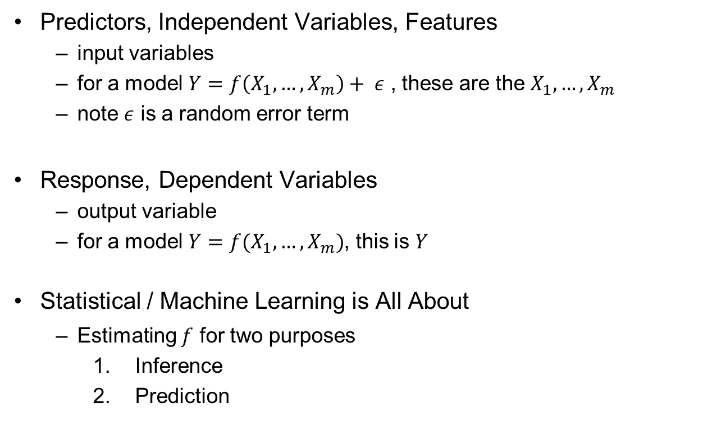
The Model
Predictors, Independent Variables, Features
input variables
for a model $Y=f\left(X_{1},…,X_{m}\right)+ ε$ , these are the $X_{1},…,X_{m}$
note $ε$ is a random error term
Response, Dependent Variables
output variable
for a model $Y=f(X_{1},…,X_{m})$, this is $Y$
Statistical / Machine Learning is All About
Estimating $f$ for two purposes
Inference
Prediction

Slide 4
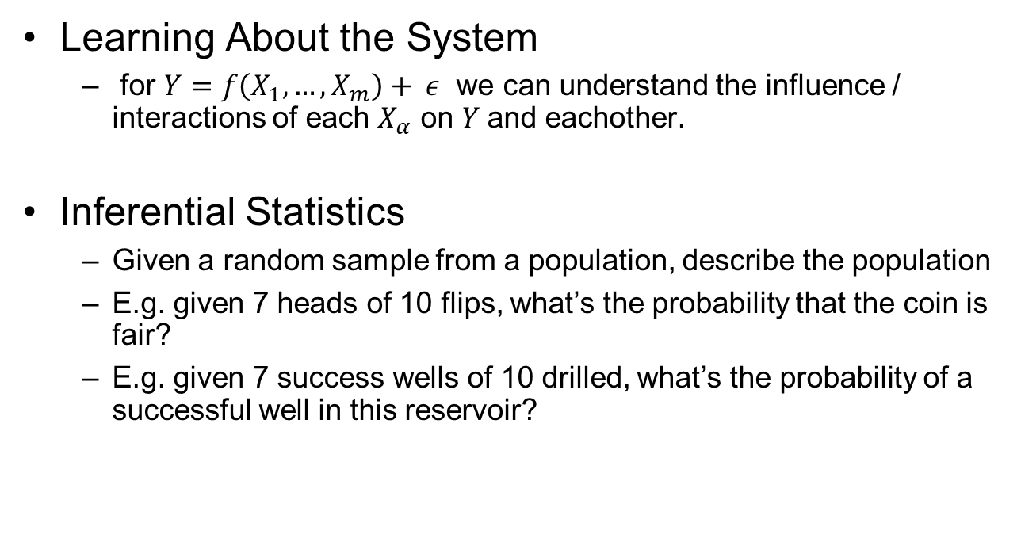
Inference
Learning About the System
for $Y=f\left(X_{1},…,X_{m}\right)+ ε$ we can understand the influence / interactions of each $X_{α}$ on $Y$and eachother.
Inferential Statistics
Given a random sample from a population, describe the population
E.g. given 7 heads of 10 flips, what’s the probability that the coin is fair?
E.g. given 7 success wells of 10 drilled, what’s the probability of a successful well in this reservoir?

Slide 5
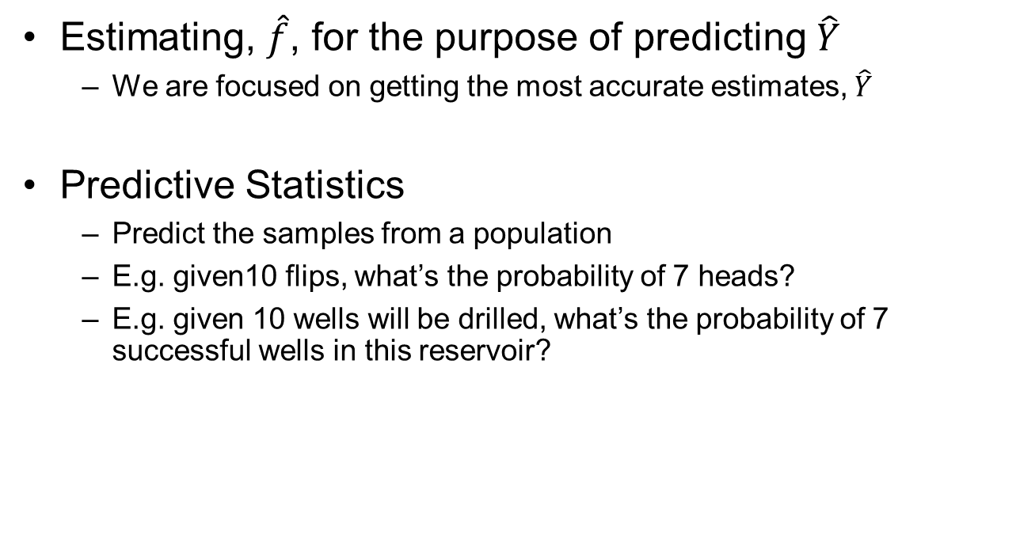
Prediction
Estimating, $\hat{f}$, for the purpose of predicting $\hat{Y}$
We are focused on getting the most accurate estimates, $\hat{Y}$
Predictive Statistics
Predict the samples from a population
E.g. given10 flips, what’s the probability of 7 heads?
E.g. given 10 wells will be drilled, what’s the probability of 7 successful wells in this reservoir?

Slide 6
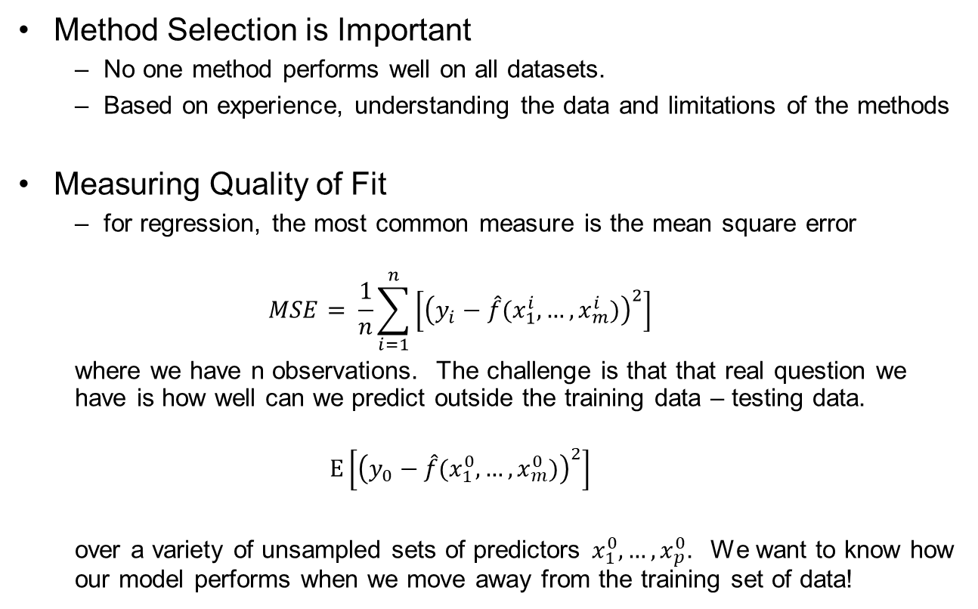

Assessing Model Accuracy
Method Selection is Important
No one method performs well on all datasets.
Based on experience, understanding the data and limitations of the methods
Measuring Quality of Fit
for regression, the most common measure is the mean square error
$$MSE= \frac{1}{n}\sum_{i=1}^{n}{\left[{\left(y_{i}−\hat{f}(x_{1}^{i},…,x_{m}^{i})\right)}^{2}\right]}$$
where we have n observations. The challenge is that that real question we have is how well can we predict outside the training data – testing data.
$$E\left[{\left(y_{0}−\hat{f}(x_{1}^{0},…,x_{m}^{0})\right)}^{2}\right]$$
over a variety of unsampled sets of predictors${ x}_{1}^{0},…,x_{p}^{0}$. We want to know how our model performs when we move away from the training set of data!
for $i=1,…,n$ training data and
for $1,…,m$ features.
over testing data

Slide 7

Model Bias and VarianceTrade-off
The Expected Test Mean Square Error may be calculated as:
$$E\left[{\left(y_{0}−\hat{f}(x_{1}^{0},…,x_{m}^{0})\right)}^{2}\right]=Var\left(\hat{f}(x_{1}^{0},…,x_{m}^{0})\right)+{\left[Bias\left(\hat{f}(x_{1}^{0},…,x_{m}^{0})\right)\right]}^{2}+Var(ε)$$
Model Variance
Model Bias
Irreducible
Model Variance is the variance if we had estimated the model with a different training set / sensitivity to data /
Model Bias is error due to using an approximate model / model is too simple
Irreducible error is due to missing variables and limited samples can’t be fixed with modeling / entire feature space is not sampled
Optimum
Complexity
Total Test
Error
Test Error
Irreducible
Error
Model Variance
Model Bias
Model Complexity

Slide 8
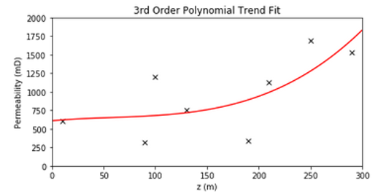
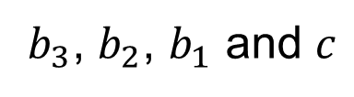

Model Parameters Definition
Model Parameters
Derived during training phase to fit the model to the training data
Parameters
$$k=b_{3}z^{3}+b_{2}z^{2}+b_{1}z+c$$
$b_{3}$, $b_{2}$, $b_{1}$ and $c$

Slide 9
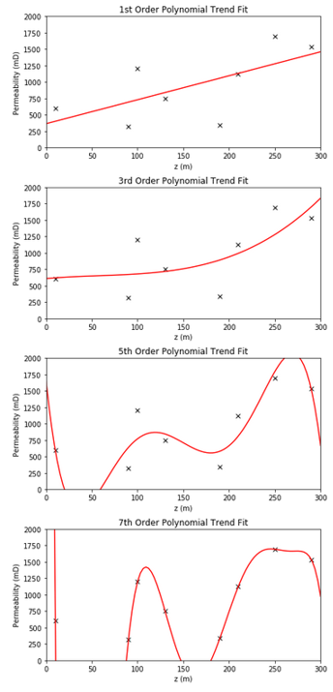



Model Hyperparameters Definition
Model Hyperparameters
Set prior to learning from the data. Impact the form of the model and often the complexity.
3rd Order:
$$k=b_{3}z^{3}+b_{2}z^{2}+b_{1}z+c$$
2nd Order:
$$k=b_{2}z^{2}+b_{1}z+c$$
1st Order:
$$k=b_{1}z+c$$

Slide 10
Training and Testing
The Training and Testing Workflow
establish a subset of the data for fair testing of the model
Train the Model Parameters
Maximize Accuracy with Training Data
Separate The Data
Training
Testing
Tune the Model
Test the Model Tune the Hyperparameters
to Optimize the Complexity
We avoid the overfit problem.

Slide 11
Model Complexity / Flexibility Definition
Model Complexity / Flexibility
A variety of concepts may be used to describe model complexity:
The number of features:
predictor variables are in the model, dimensionality of the model
The number of terms / parameters
the order applied for each term, e.g. linear, quadrative, thresholds
Expression of the model:
Can the model be expressed as:
a compact equation – polynomial regression
nested conditional statements – decision tree
For example, more complexity with a high order polynomial, larger decision trees etc.

Slide 12
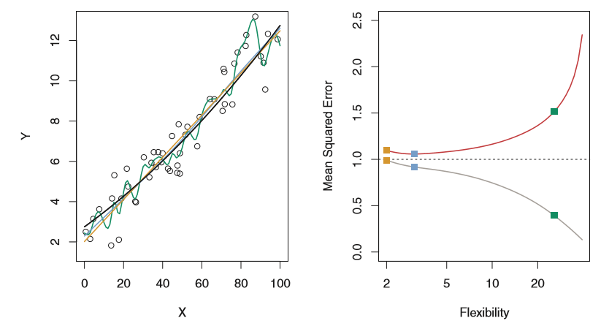
Overfitting
Flexibility vs. Accuracy
Increased flexibility will generally decrease MSE on the training dataset
May result in increase MSE with testing data! Worse prediction!
Not generally a good idea to select method only to minimize training MSE
High flexibility + minimize MSE = likely overfit.
Testing
Training
Data and model fits (left) and MSE for training and testing (right) from James et al. (2013).

Slide 13
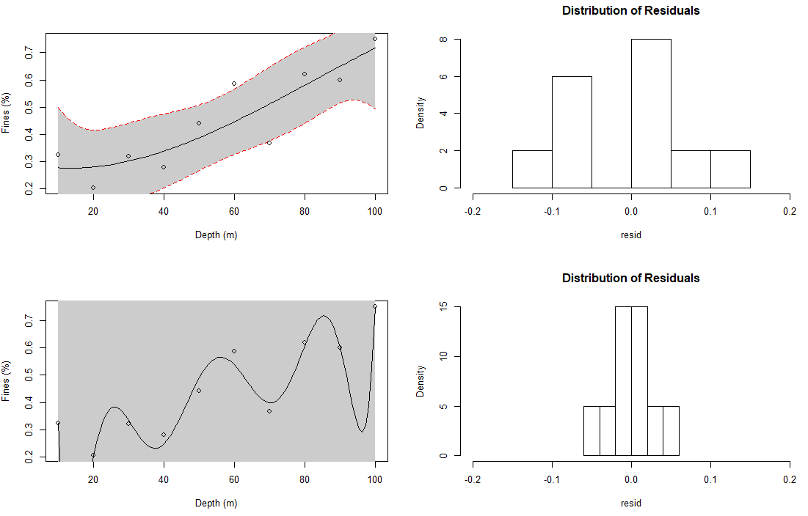
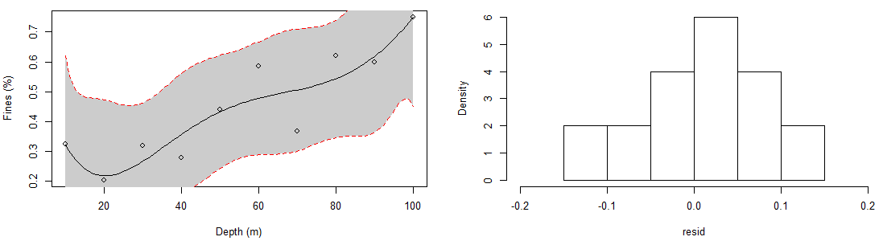
Overfitting
Example of trend fits:
3rd Ordered Polynomial
5th Order Polynomial
model confidence intervals
model confidence intervals
model confidence intervals
model confidence intervals
Overfit demonstration in R, code is here: https://github.com/GeostatsGuy/geostatsr/blob/master/overfit.R
R code at Code/Overfit.R

Slide 14
Overfitting
Example of trend fits:
3rd Ordered Polynomial
8th Order Polynomial
model confidence intervals
model confidence intervals
Overfit demonstration in R, code is here: https://github.com/GeostatsGuy/geostatsr/blob/master/overfit.R
R code at Code/Overfit.R

Slide 15
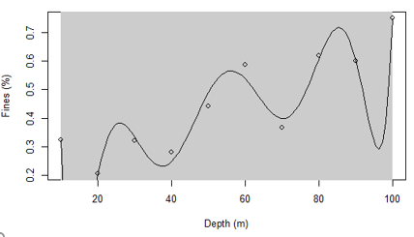
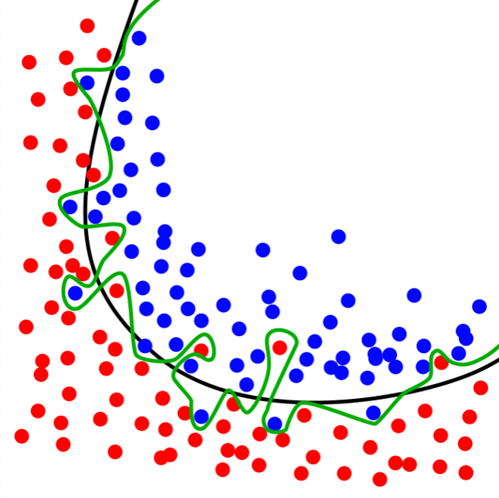
Definition of Overfitting
Overly complicated model to explain “idiosyncrasies” of the data, capturing data noise in the model
More parameters than can be justified with the data
Results in likely very high error away from the data / new data
But, results in low residual variance!
High R²
Very accurate at the data! - Claim you know more than you actually do!
Overfit demonstration in R, code is here: https://github.com/GeostatsGuy/geostatsr/blob/master/overfit.R
Overfit classification model example from: https://en.wikipedia.org/wiki/Overfitting#/media/File:Overfitting.svg

Slide 16
Now We Begin Machine Learning
With these concepts established, let’s start to get into machine learning / statistical learning methods
These methods will allow you to perform inference and prediction
Work with complicated data sets / big data analytics
Detect patterns in data
Remember in our business to win:
Have the best data
Use the data best
We are at the beginning of the 4th paradigm for scientific discovery
Data-driven discovery
Smart fields, 4D seismic surveys, computational resources
Expanding opportunities for machine learning
We’ll start unsupervised, dimensional reduction:
Principal Component Analysis

Slide 17
Daytum +2 Course Machine Learning
Lecture outline . . .
A Simple Machine
Michael Pyrcz, The University of Texas at Austin

Slide 18
Statistical / Machine Learning for Prediction
What is Machine Learning?
A mathematical / statistical model that learns from data, supported with expert knowledge
Not explicitly told how to predict
General method that may be applied to a range of problems

Slide 19
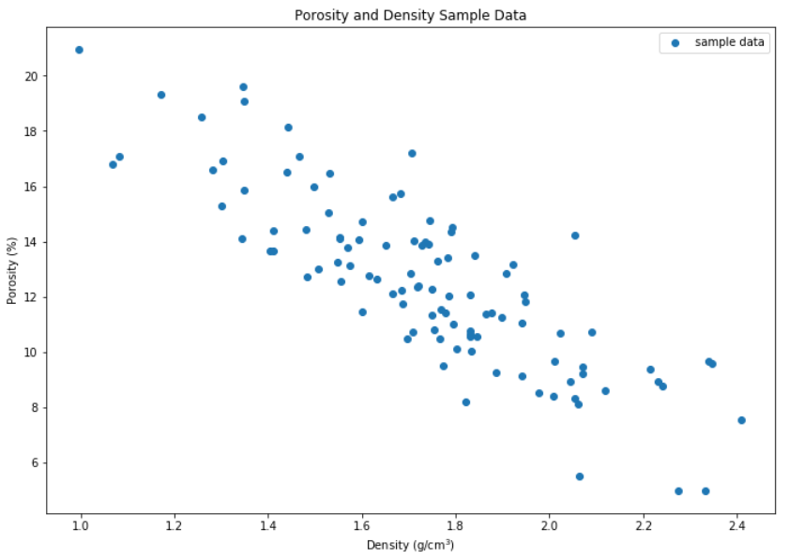
Our First Machine
Loaded up a simple porosity vs. density dataset in Python.

Slide 20
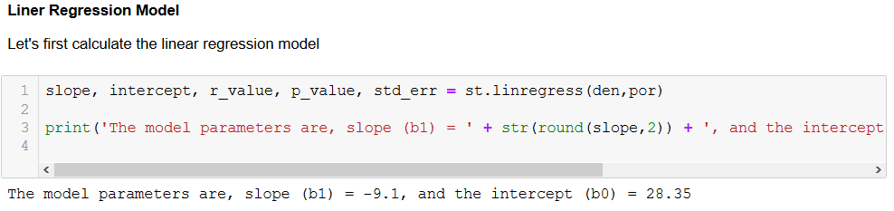
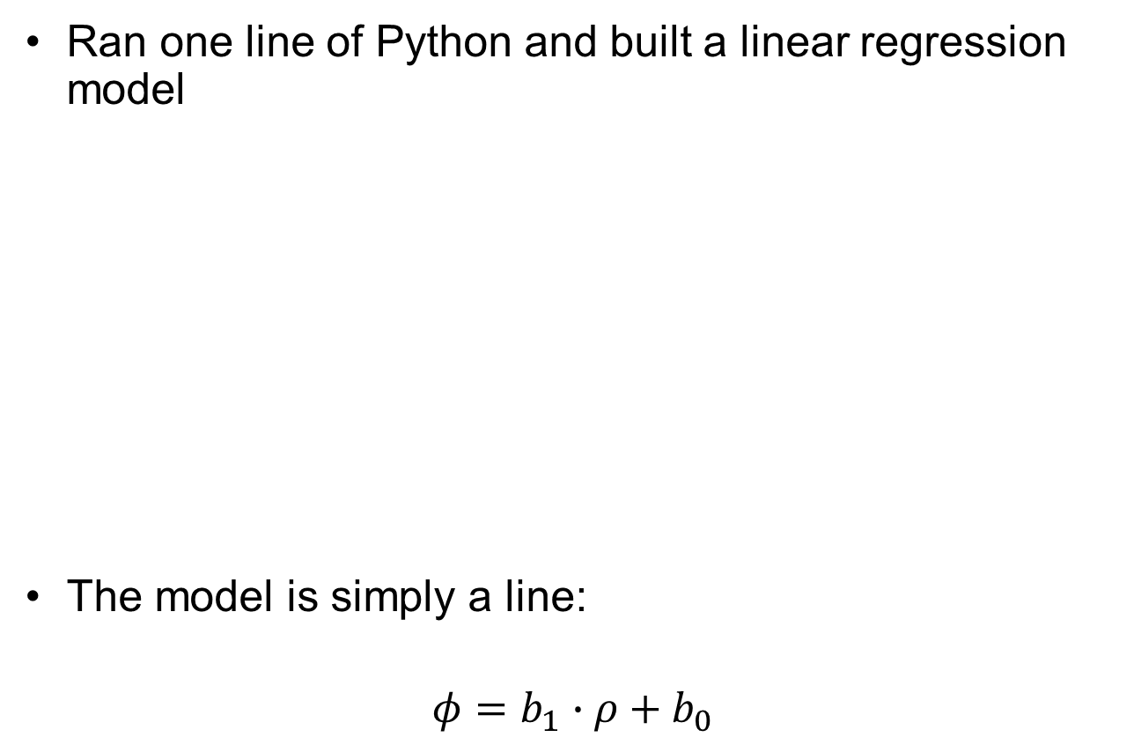
Our First Machine
Ran one line of Python and built a linear regression model
The model is simply a line:
$$φ=b_{1}∙ρ+b_{0}$$
Linear
Response
Feature
Predictor
Feature

Slide 21
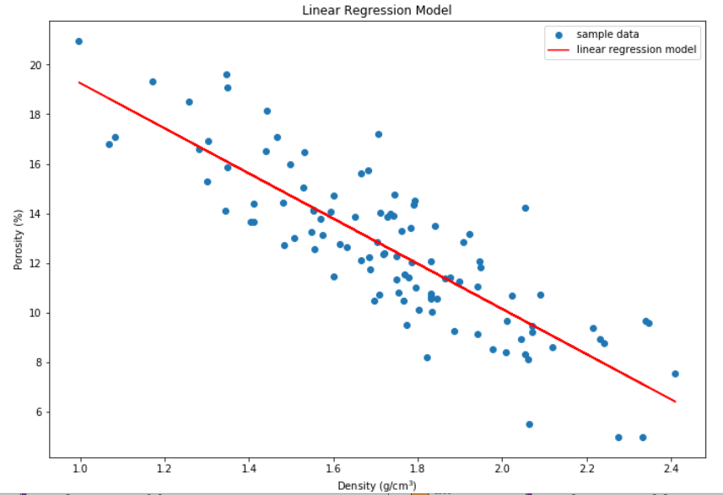
Our First Machine
Let’s look at the model.
If we change the data, the model would update. It learns!
Nothing intimidating about linear regression!

Slide 22

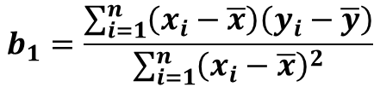



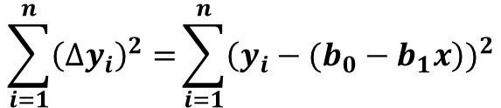

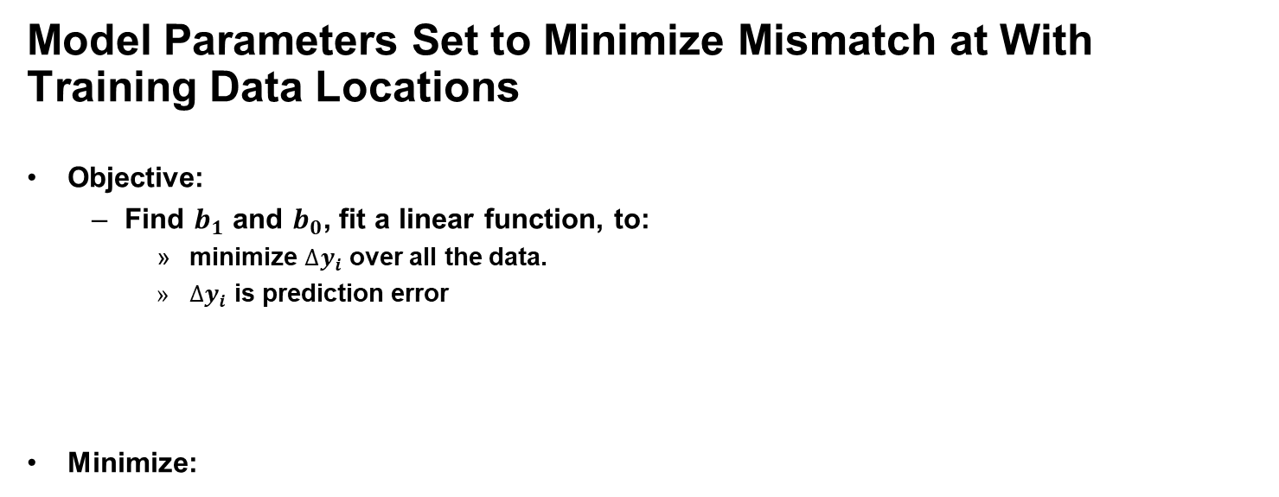









Our First Machine
Model Parameters Set to Minimize Mismatch at With Training Data Locations
Objective:
Find $b_{1}$ and $b_{0}$, fit a linear function, to:
minimize ${∆y}_{i}$ over all the data.
${∆y}_{i}$ is prediction error
Minimize:
$$por=b_{0}+b_{1} × density$$
$${∆y}_{i}=y_{i}−y_{est}$$
$${∆y}_{5}$$
$${∆y}_{4}$$
data
model
$$\frac{∆y}{∆x }=b_{1}$$
$$y$$
$$∆y$$
Sum of Square Error
$${∆y}_{3}$$
$$∆x$$
$$\sum_{i=1}^{n}{{\left({∆y}_{i}\right)}^{2}=}\sum_{i=1}^{n}{{\left(y_{i}−(b_{0}−b_{1}x\right))}^{2}}$$
$${∆y}_{1}$$
$${∆y}_{2}$$
Skipped derivation.
$$b_{1}=\frac{\sum_{i=1}^{n}{\left(x_{i}−\overline{x}\right)\left(y_{i}−\overline{y}\right)}}{\sum_{i=1}^{n}{{\left(x_{i}−\overline{x}\right)}^{2}}}$$
,
$$b_{0}=\overline{y}−b_{1}\overline{x}$$
$$b_{0}$$
0
$$x$$

Slide 23
Our First Machine
The Model Includes Important Assumptions About The Data and the Model
Error-free: predictor variables are error free, not random variables
Linearity: response is linear combination of feature(s)
Constant Variance: error in response is constant over predictor(s) value
Independence of Error: error in response are uncorrelated with each other
No multicollinearity: none of the features are redundant with other features

Slide 24

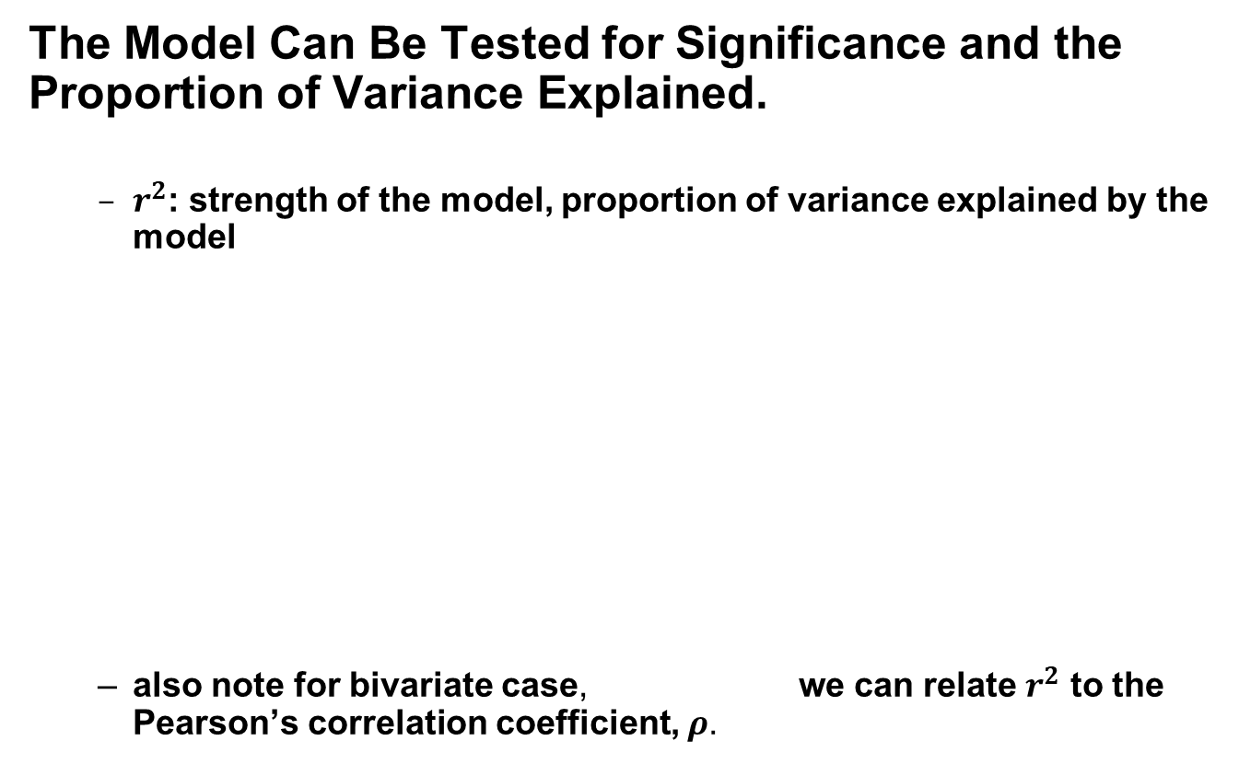
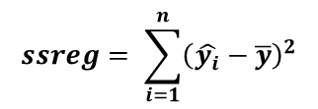
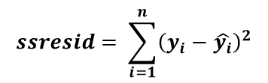

Our First Machine
The Model Can Be Tested for Significance and the Proportion of Variance Explained.
$r^{2}$: strength of the model, proportion of variance explained by the model
also note for bivariate case, we can relate $r^{2}$ to the Pearson’s correlation coefficient, $ρ$.
Variance explained by the model
Variance NOT explained by the model
$$ssreg= \sum_{i=1}^{n}{{\left(\hat{y_{i}}−\overline{y}\right)}^{2}}$$
$$ssresid= \sum_{i=1}^{n}{{\left(y_{i}−\hat{y_{i}}\right)}^{2}}$$
$$r^{2}=\frac{ssreg}{ssreg+ssresid}=\frac{explained variation}{total variation}$$
$r^{2}={\left(ρ\right)}^{2}$,

Slide 25






Our First Machine
We Can Calculate the Uncertainty in the Model
Confidence interval for model parameters given the available training data
$$\hat{b_{1}}$$
$$\hat{b_{1}}±t_{(α/2,n −2)}× {SE}_{b_{1}}$$
se1 in Excel
$$\hat{b_{0}}±t_{(α/2,n −2)}× {SE}_{b_{0}}$$
$$\hat{b_{0}}$$
seb in Excel

Slide 26

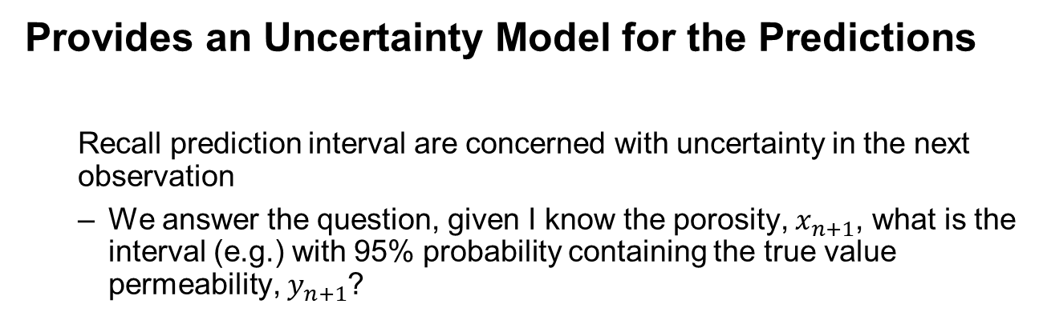
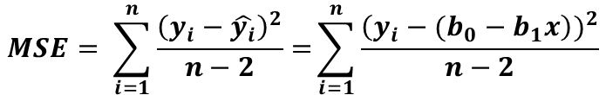
Our First Machine
Provides an Uncertainty Model for the Predictions
Recall prediction interval are concerned with uncertainty in the next observation
We answer the question, given I know the porosity, $x_{n+1}$, what is the interval (e.g.) with 95% probability containing the true value permeability, $y_{n+1}$?
next sample
$$MSE= \sum_{i=1}^{n}{\frac{{\left(y_{i}−\hat{y_{i}}\right)}^{2}}{n−2}=}\sum_{i=1}^{n}{\frac{{\left(y_{i}−(b_{0}−b_{1}x\right))}^{2}}{n−2}}$$
model estimate
t-statistic
standard error of our model estimate

Slide 27
Our First Machine
Would this be a fair model?
Does the data support this model? We are overfitting the data!
Is it safe to extrapolate with this model away from the data?

Slide 28
Our First Machine
What did we learn from our simple machine?
Flexible to fit the data, learns from the data
Minimize error with the training data
Important assumptions about the data and model
Model can be tested for significance and the proportion of variance explained
Includes uncertainty in the model
Predict based on new data with uncertainty
Issues with overfit and extrapolation
Think of machine learning as advanced linear regression / line fitting to data!

Slide 29
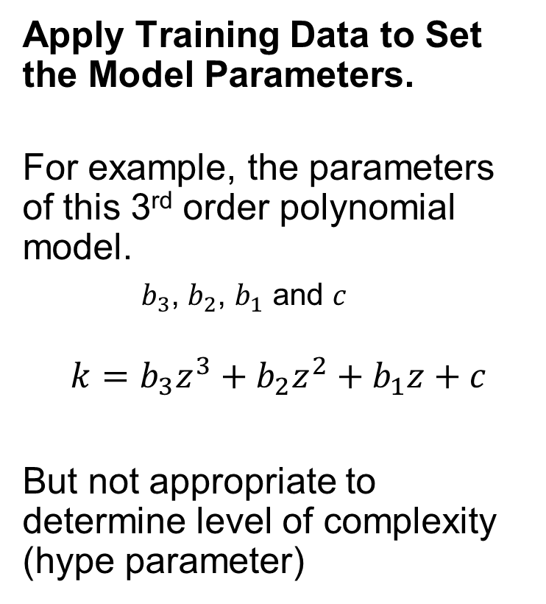
Training Our Machine
Apply Training Data to Set the Model Parameters.
For example, the parameters of this 3rd order polynomial model.
$b_{3}$, $b_{2}$, $b_{1}$ and $c$
$$k=b_{3}z^{3}+b_{2}z^{2}+b_{1}z+c$$
But not appropriate to determine level of complexity (hype parameter)
Hyperparameter of our model:
1st, 2nd, 3rd 4th … order polynomial?

Slide 30
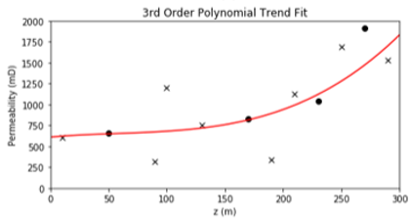
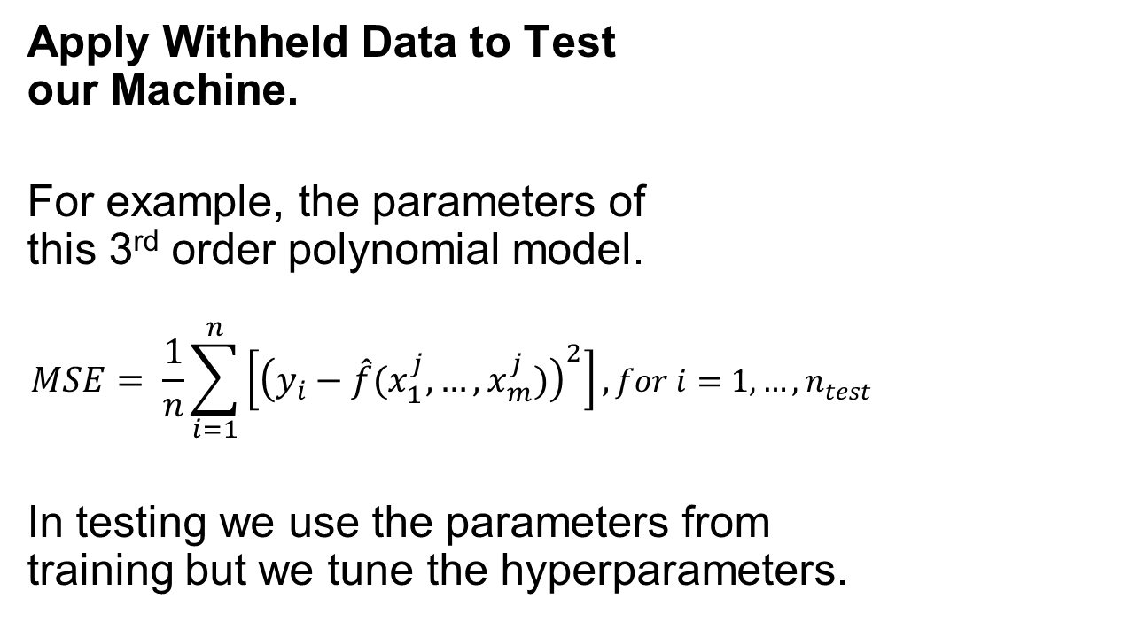
Testing Our Machine
Apply Withheld Data to Test our Machine.
For example, the parameters of this 3rd order polynomial model.
$$MSE= \frac{1}{n}\sum_{i=1}^{n}{\left[{\left(y_{i}−\hat{f}(x_{1}^{j},…,x_{m}^{j})\right)}^{2}\right]},for i=1,…,n_{test}$$
In testing we use the parameters from training but we tune the hyperparameters.
Hyperparameter of our model:
1st, 2nd, 3rd 4th … order polynomial?

Slide 31
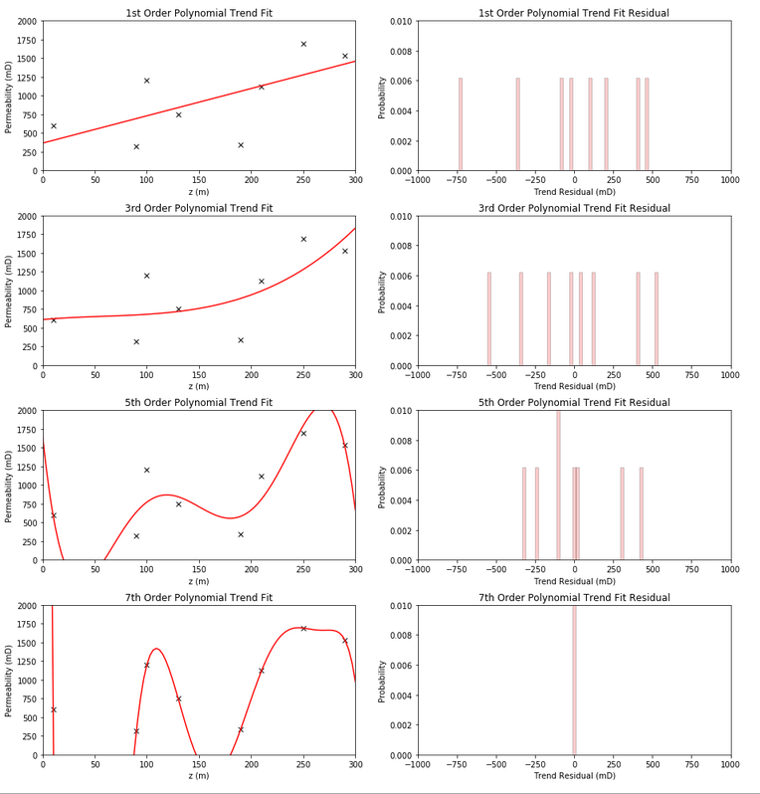
Making Our Machine
What would happened if we just maximized fit to the data?
Very complicated model would be best.
Perfectly fit the data.

Slide 32
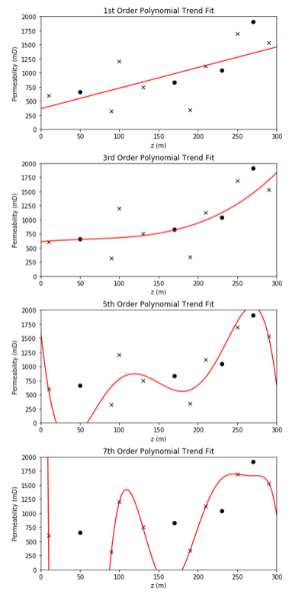
Making Our Machine
The More Complicated Model Would be Overfit
Have high accuracy at training data
Poor testing accuracy with new observations!
Very dangerous with extrapolation.
Low model bias, but high model variance.
Testing data

Slide 33
Daytum +2 Course Machine Learning
Lecture outline . . .
Examples of Machine Learning
Michael Pyrcz, The University of Texas at Austin

Slide 34
Examples of Machine Learning
Provides a set of examples with machine learning to address subsurface challenges.
In the next couple of lectures we will cover:
Dimensionality Reduction
Tree-based Methods
Support Vector Machines

Slide 35
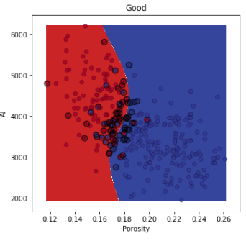
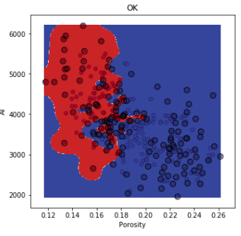
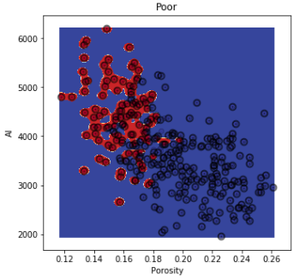
Support Vector Machines
Support vector machines for interpolating, extrapolating facies from data.
A range of spatial models with radial basis function Kernels with a variety of penalties and Kernel parameters
Workflow developed by Wendi Liu, PhD student at The University of Texas at Austin.

Slide 36
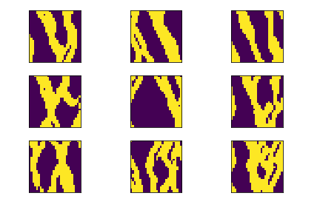
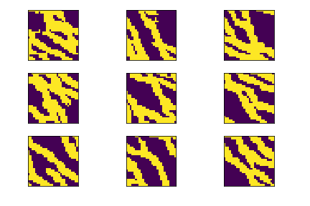
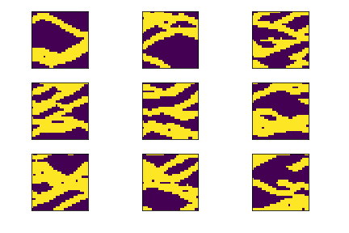
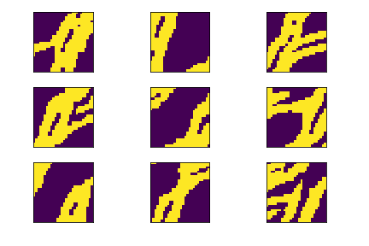
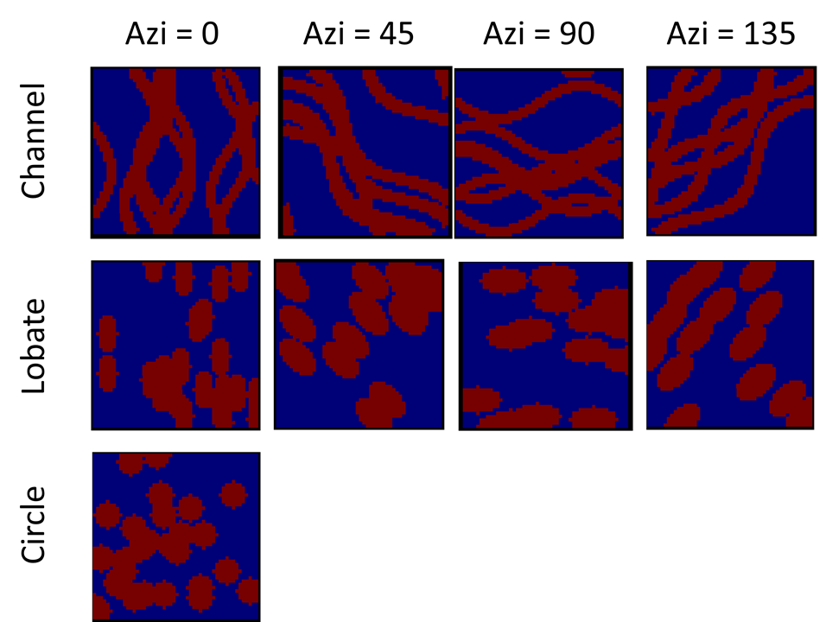
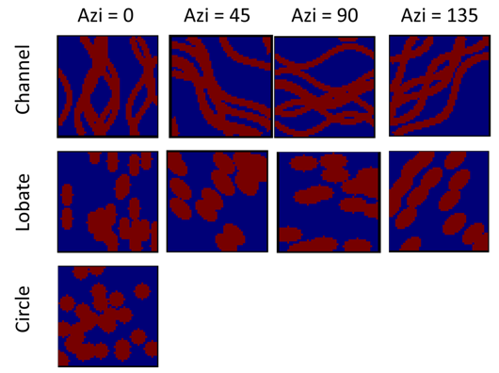
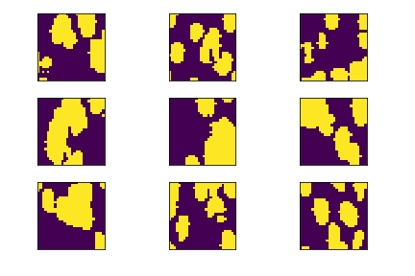
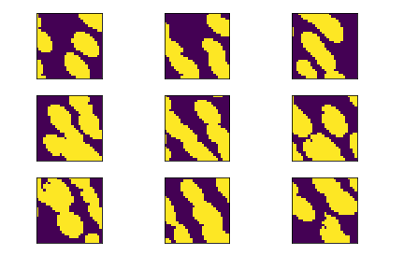
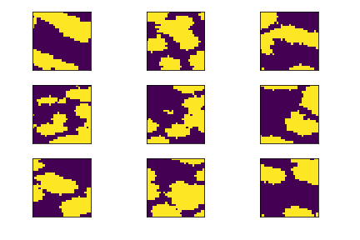
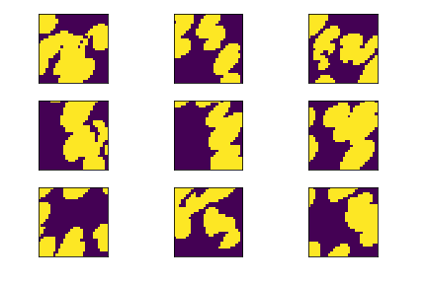
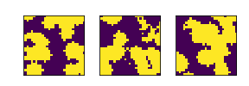
Neural Nets
Realizations
Simple geometric training images for channels, ellipses and circles and realizations.
Training Images
Workflow developed by Honggeun Jo and Javier Santos, PhD student at The University of Texas at Austin.

Slide 37
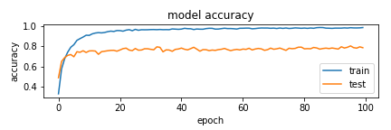
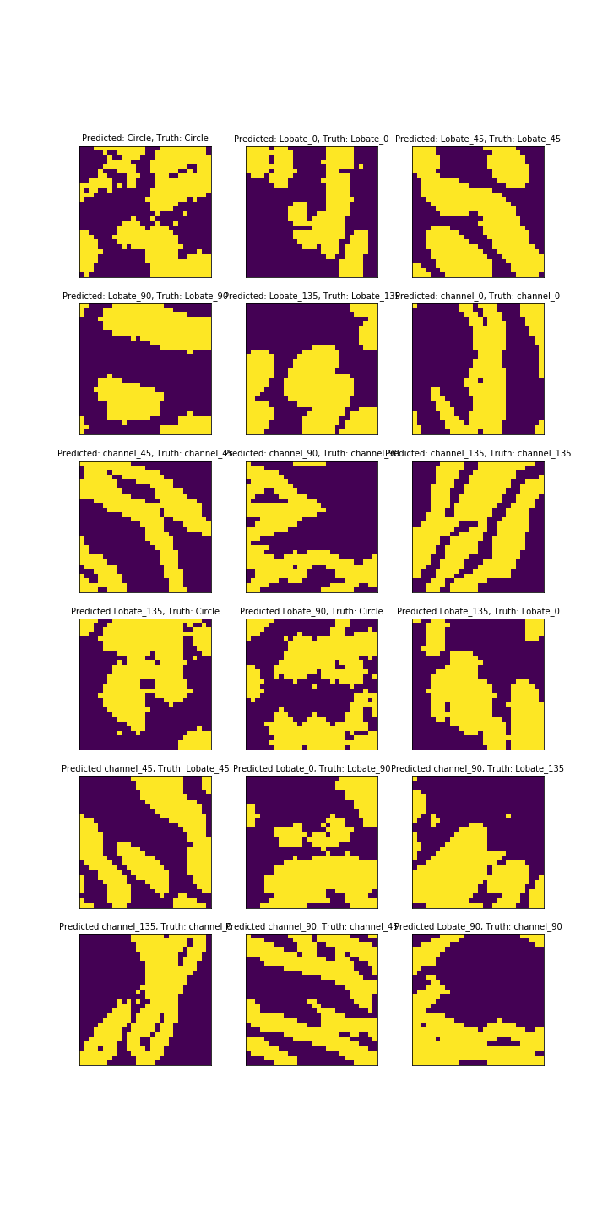
Neural Nets
The training and testing accuracy vs. number of training cycles, Epoch
Levels off at about 78% accuracy
Correct Identification
Incorrect Identification
Workflow developed by Honggeun Jo and Javier Santos, PhD student at The University of Texas at Austin.

Slide 38
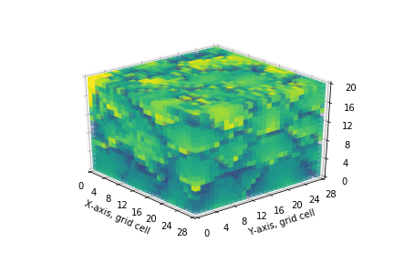
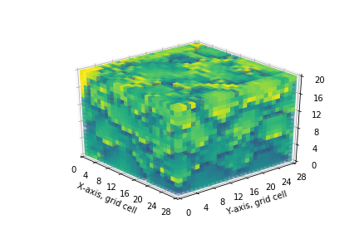
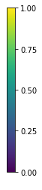
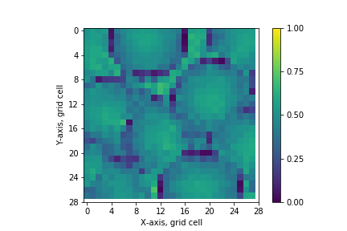











Convolutional Neural Nets
Can explore the space of uncertainty along a continuous manifold.
A latent reservoir manifold based on a single paramter
Realization 1
Vsh
Realization ‘L’
3D view
Cross-sectional view
(Horizontal)
Cross Section view
Cross-sectional view
(Vertical)
Plan Section view
Workflow developed by Honggeun Jo and Javier Santos, PhD student at The University of Texas at Austin.

Slide 39


Convolutional Neural Nets
Filling In Missing Spatial Information
Semantic inpainting algorithm (Yeh et al., 2015).
Using conceptual and perceptual information
Examples of semantic image inpainting with DCGAN (Yeh et al., 2016)
Workflow developed by Honggeun Jo and Javier Santos, PhD student at The University of Texas at Austin.

Slide 40


Convolutional Neural Nets
Conditioning to Well Data?
Remove model around data
Use conceptual (model around mask) and perceptual (model elsewhere to fill in missing model consistent with data
Original Model
Final Model
Inpainting Around Data
Workflow developed by Honggeun Jo, PhD student at The University of Texas at Austin.

Slide 41

Long Short-Term Memory Networks
Prediction of producer flow rates based on complicated interactions of injectors.
Train with 2500 days and predict future 100 days.
Workflow developed by Azor Nwachukwu, PhD student at The University of Texas at Austin.

Slide 42
Daytum +2 Course Machine Learning
Lecture outline . . .
Machine Learning Overview
A Simple Machine
Examples of Machine Learning
Michael Pyrcz, The University of Texas at Austin

