Slide 1
Daytum +2 Course Dimensionality Reduction
Curse of Dimensionality
Dimensionality Reduction
Principal Component Analysis
Michael Pyrcz, The University of Texas at Austin

Slide 2
Daytum +2 Course Dimensionality Reduction
Curse of Dimensionality
Michael Pyrcz, The University of Texas at Austin

Slide 3
Multivariate
One of the definitions of Big Data is variety
This suggests massively multivariate datasets
Traditional reservoir modeling workflows were bivariate
Facies, then porosity in facies and permeability constrained to porosity
The most complicated simulation is permeability accounting for the joint porosity simulated realization
Unconventionals, and Whole Earth Models
Require inclusion many more variables
We need to model facies, porosity, geomechanical properties, geophysical properties, total organic carbon, maturity etc.
When working with Multivariate it is very challenging:
Visualize
Detect relationships and patterns

Slide 4
Curse of Dimensionality
Working with more features / variables is harder!
More difficult to visualize
More data are required to infer the joint probabilities
Less coverage
More difficult to interrogate / check the model
More likely redundant
More complicated, more likely overfit

Slide 5
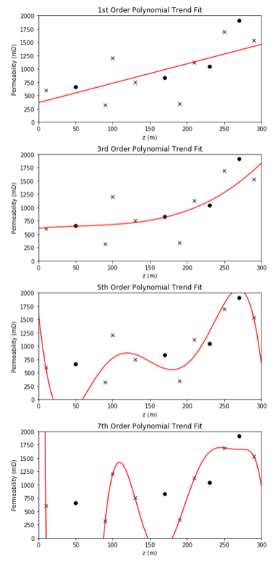
Visualization
Consider this simple model:
1 predictor feature
1 response feature
How’s our model performing?
Accuracy in training and testing
Range of Applicability?
Are we extrapolating?
Overfit
Is the model defendable given the data?

Slide 6
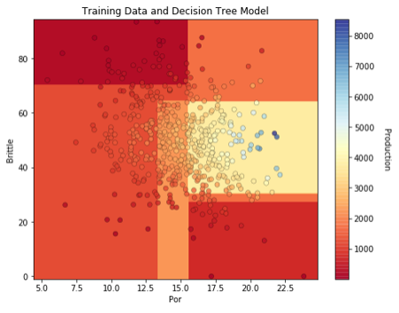
Visualization
Consider this simple model:
2 predictor features
1 response feature
How’s our model performing?
Accuracy in training and testing
Range of Applicability?
Are we extrapolating?
Overfit
Is the model defendable given the data?

Slide 7
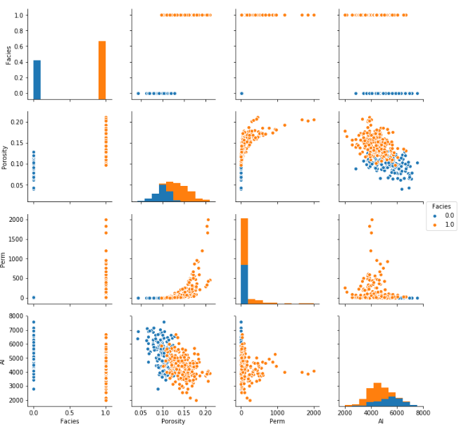
Visualization
Consider this:
4 predictor features
1 response feature (not shown)
What are the relationships between features?
Are there constraints?

Slide 8
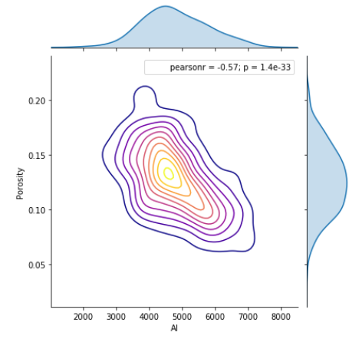

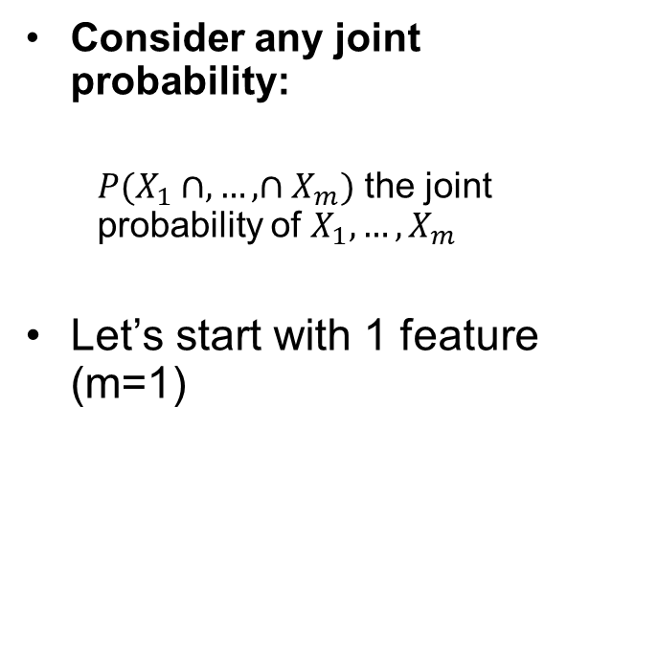
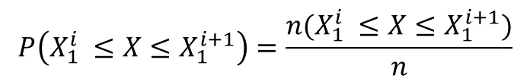
Curse of Dimensionality
Consider any joint probability:
$P(X_{1}∩,…,∩X_{m})$ the joint probability of $X_{1},…,X_{m}$
Let’s start with 1 feature (m=1)
$$P\left(X_{1}^{i} ≤X≤X_{1}^{i+1}\right)=\frac{n(X_{1}^{i} ≤X≤X_{1}^{i+1})}{n}$$
In each bin we are estimating a probability!
10 data in each bin = 80 data?

Slide 9
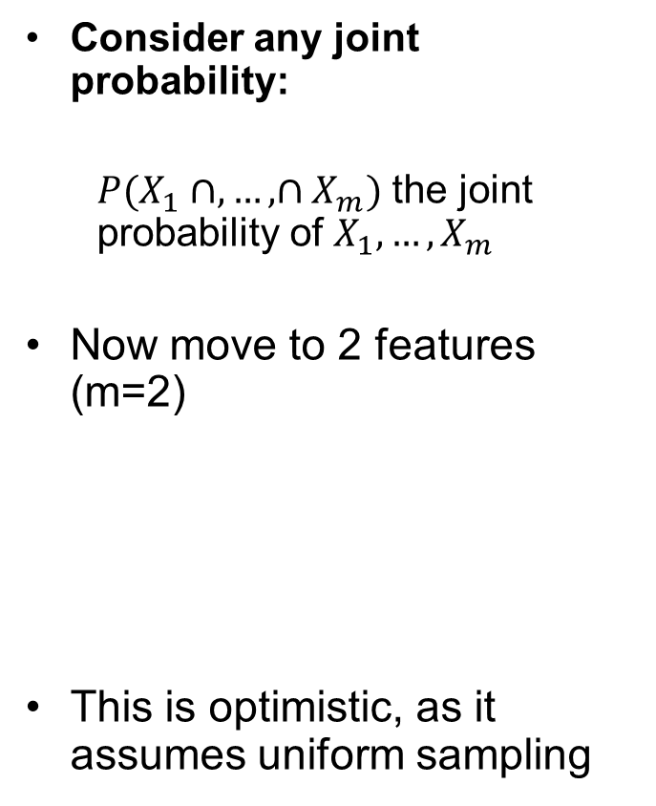

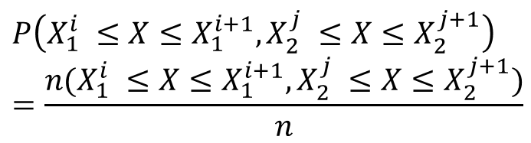
Curse of Dimensionality
Consider any joint probability:
$P(X_{1}∩,…,∩X_{m})$ the joint probability of $X_{1},…,X_{m}$
Now move to 2 features (m=2)
This is optimistic, as it assumes uniform sampling
$$P\left(X_{1}^{i} ≤X≤X_{1}^{i+1},X_{2}^{j} ≤X≤X_{2}^{j+1}\right)=\frac{n(X_{1}^{i} ≤X≤X_{1}^{i+1},X_{2}^{j} ≤X≤X_{2}^{j+1})}{n}$$
$$n=Data/Bin∙{Bins}^{m}$$
In each bin we are estimating a probability!
10 data in each bin = 640 data?

Slide 10
Curse of Dimensionality
Consider coverage:
The range of the sample values
The fraction of the possible solution space that is sampled.
Let’s return to 1 feature, and assume 80% coverage!
That’s pretty good right?

Slide 11
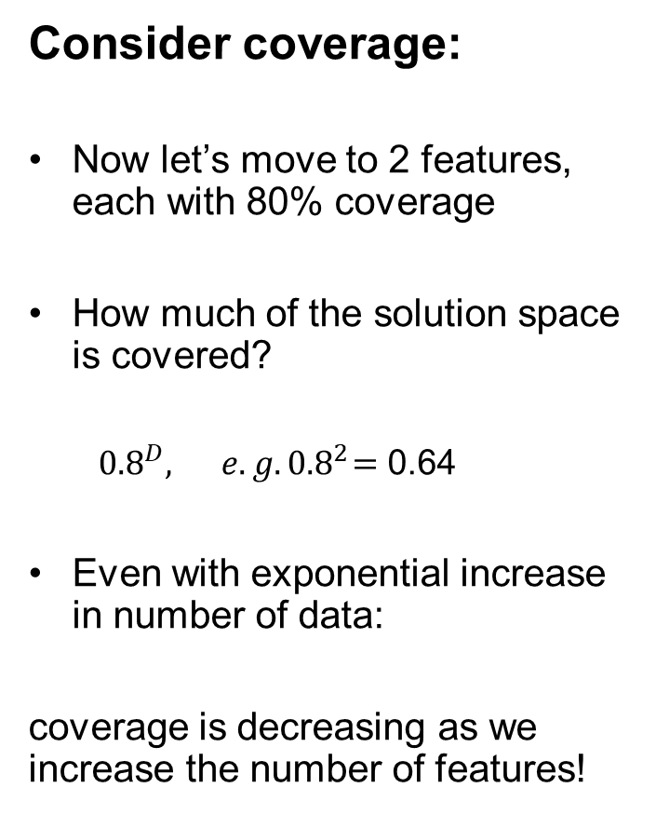

Curse of Dimensionality
Consider coverage:
Now let’s move to 2 features, each with 80% coverage
How much of the solution space is covered?
${0.8}^{D},{ e.g. 0.8}^{2}=$ 0.64
Even with exponential increase in number of data:
coverage is decreasing as we increase the number of features!
$$n=Data/Bin∙{Bins}^{m}$$

Slide 12
Multicollinearity Feature Redundancy
“the existence of such a high degree of correlation between supposedly independent variables being used to estimate a dependent variable that the contribution of each independent variable to variation in the dependent variable cannot be determined”
- Merriam-Webster Online Dictionary
“In statistics, multicollinearity (also collinearity) is a phenomenon in which one predictor variable in a multiple regression model can be linearly predicted from the others with a substantial degree of accuracy.”
- Wikipedia
It is like fitting a plane to a line!

Slide 13
Motivation for Dimensionality Reduction
We get a better model with fewer, informative features than
‘Throwing everything and the kitchen sink into the model!’
Fewer features for models are simpler, faster, easier to visualize and less likely overfit.

Slide 14
Daytum +2 Course Dimensionality Reduction
Dimensionality Reduction
Michael Pyrcz, The University of Texas at Austin

Slide 15
Dimensionality Reduction
Motivated by the curse of dimensionality and multicollinearity
Known as dimension reduction or dimensionality reduction
Applied in statistics, machine learning and information theory
Multiple strategies:
Features Selection – find the subset of original features that are most important for the problem (big hitters).
Feature Projection – transform the data from a higher to lower dimensional space

Slide 16
Feature Selection Recall
Consider a wide-array approach to assess variable importance.
Here's the general types of metrics that we will consider for feature ranking:
Visual Inspection of Data Distributions and Scatter Plots
Statistical Summaries
Model-based
Recursive Feature Elimination

Slide 17
Feature Selection Metrics Recall
Expert Knowledge:
Also, we should not neglect expert knowledge.
If additional information is known about physical processes, causation, reliability and availability of features this should be integrated into assigning feature ranks.
We should be learning as we perform our analysis, testing new hypotheses.

Slide 18
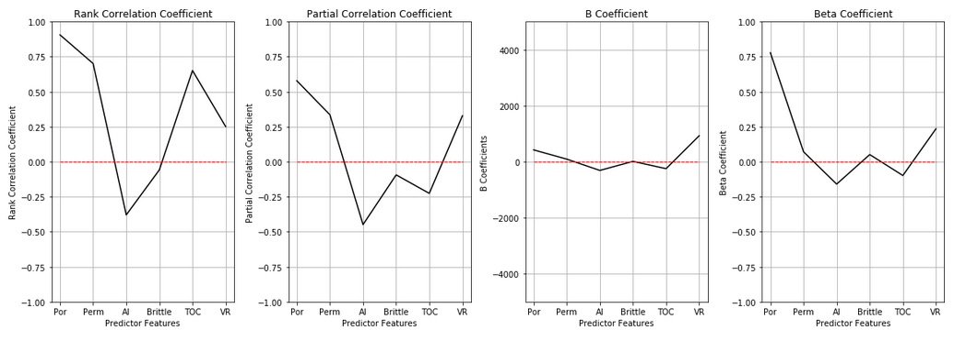
Feature Selection Metrics Recall
Example of Ranking Metrics Applied to Unconventionals
Provides evidence to support feature selection
Beta demotes permeability!
Porosity, acoustic impedance and vitrinite reflectance retain high metrics

Slide 19

Feature Ranking Live Demo Recall
Experiment with
Multivariate Feature Ranking
in Python Jupyter Notebooks.
We will not cover this again, for reference.
The file is SubsurfaceDataAnalytics_Feature_Ranking.ipynb at location https://git.io/fjm4p.

Slide 20
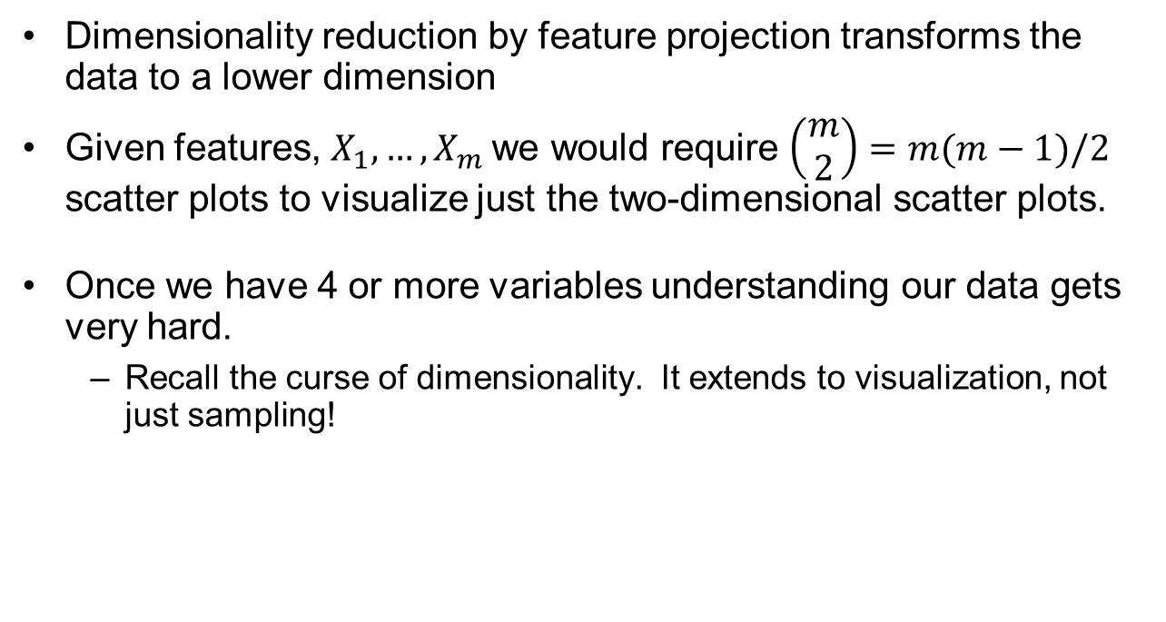
Feature Projection
Dimensionality reduction by feature projection transforms the data to a lower dimension
Given features, $X_{1},…,X_{m}$we would require $\left(\begin{matrix}m \\ 2\end{matrix}\right)=m(m−1)/2$ scatter plots to visualize just the two-dimensional scatter plots.
Once we have 4 or more variables understanding our data gets very hard.
Recall the curse of dimensionality. It extends to visualization, not just sampling!

Slide 21
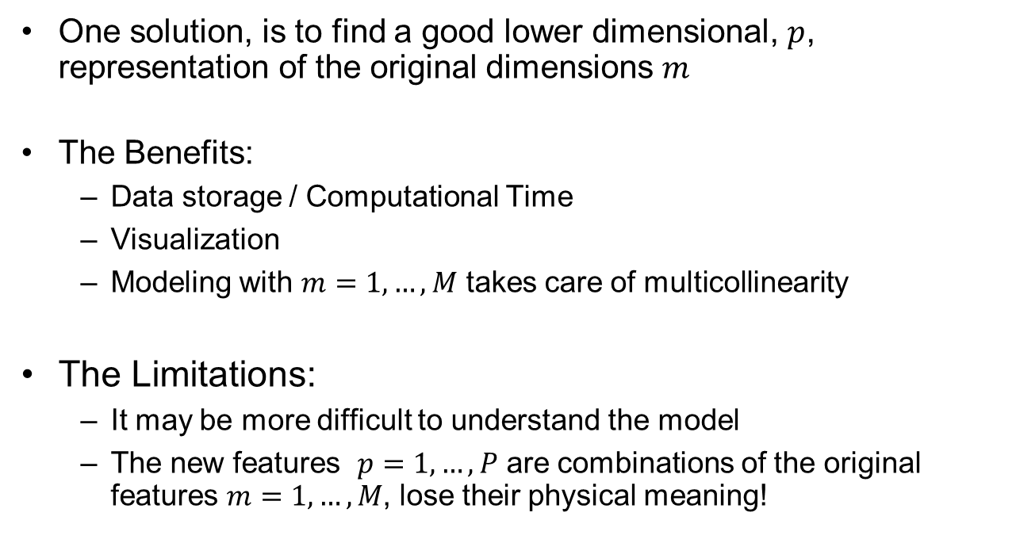
Feature Projection
One solution, is to find a good lower dimensional, $p$, representation of the original dimensions $m$
The Benefits:
Data storage / Computational Time
Visualization
Modeling with $m=1,…,M$ takes care of multicollinearity
The Limitations:
It may be more difficult to understand the model
The new features $p=1,…,P$ are combinations of the original features $m=1,…,M$, lose their physical meaning!

Slide 22
Feature Projection
Wide variety of methods:
Principal component analysis
Linear mapping of the data to lower dimensional space
Maximizes the variance explained by the reduced subset of features
Kernel Principal component analysis
Nonlinear mapping of the data to lower dimensional space with the kernel trick
Kernel Trick – use of a kernel function to operate in higher dimensional feature space with only the ‘similarity’ between the data points

Slide 23
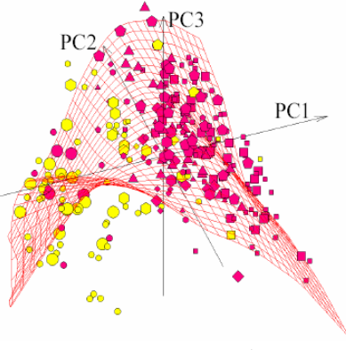
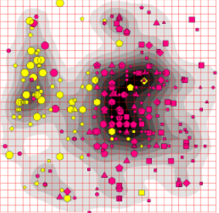
Feature Projection
Wide variety of methods:
Factor Analysis
Like PCA, linear combinations of the features
Focus on inter-correlations
Non-linear PCA
Form an embedded manifold for data approximation
Project the data onto the manifold
Natural geometric interpretation principal curves and manifolds
Figure from Handbook of Research on Machine Learning Applications and Trends: Algorithms, Methods and Techniques, Olivas E.S. et al Eds. Information Science Reference, IGI Global: Hershey, PA, USA, 2009. 28–59.
Nonlinear PCA 3D to 2D

Slide 24
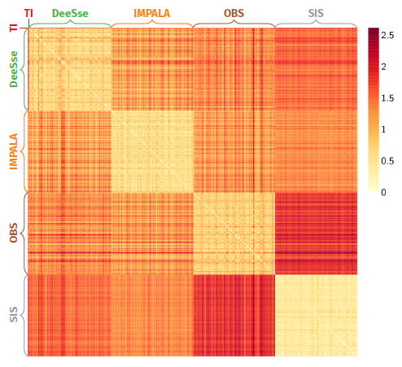
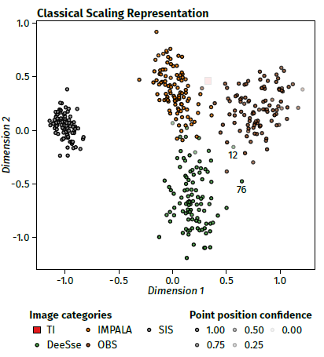
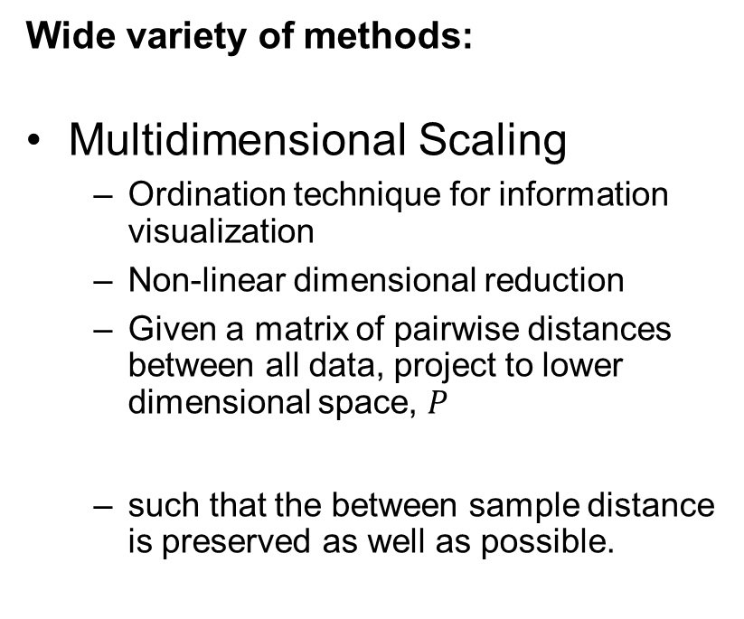
Feature Projection
Dissimilarity based on combination of metrics: proportions, transitions, connectivity, shape, networks
Wide variety of methods:
Multidimensional Scaling
Ordination technique for information visualization
Non-linear dimensional reduction
Given a matrix of pairwise distances between all data, project to lower dimensional space, $P$
such that the between sample distance is preserved as well as possible.
MDS to Visualize Model Uncertainty Space Sampled with Scenarios and Realizations
Figure from Rongier, G. Ph.D. thesis.

Slide 25
Daytum +2 Course Dimensionality Reduction
Principal Component Analysis
Michael Pyrcz, The University of Texas at Austin

Slide 26
PGE 383 Lecture 26 Machine Learning - PCA
Introduction
Principal Component Analysis
Prerequisites
Data Preparation
Univariate Analysis
Multivariate Analysis
Spatial Characterization
Spatial Estimation
Spatial Simulation
Michael Pyrcz, The University of Texas at Austin
Uncertainty Analysis
Model Checking
Machine Learning
Decision Making

Slide 27
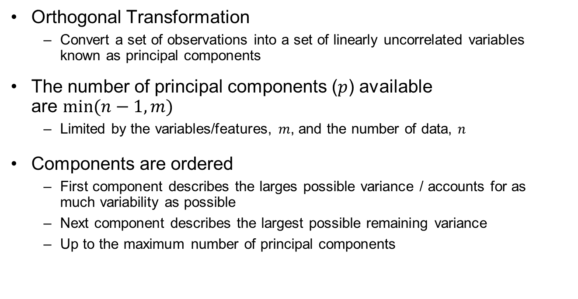
Principal Components Analysis
Orthogonal Transformation
Convert a set of observations into a set of linearly uncorrelated variables known as principal components
The number of principal components ($p$) available are $min⁡(n−1,m)$
Limited by the variables/features, $m$, and the number of data, $n$
Components are ordered
First component describes the larges possible variance / accounts for as much variability as possible
Next component describes the largest possible remaining variance
Up to the maximum number of principal components

Slide 28
Principal Components Analysis
Eigen Values / Eigen Vectors
The Eigen values are the variance explained for each component.
The Eigen vectors of the data covariance matrix are the principal components and the Eigen
Out of scope – just making the linkage

Slide 29
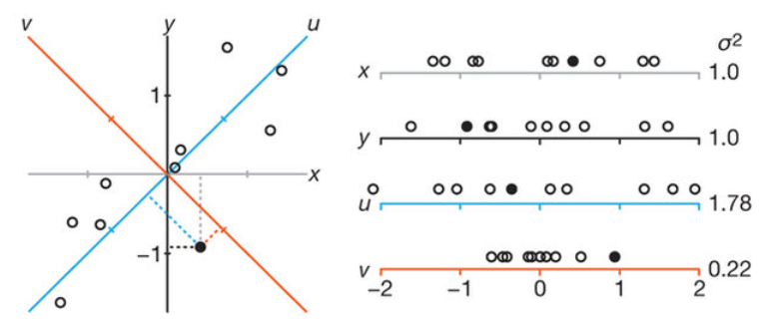
Principal Components Analysis
Finding the orthogonal projections in order of greatest variance described
Start with regular 2D, data with x and y coordinates below.
See the projections on to x and y axes. Note the data has equal variance in x and y. If you omitted x or y from the dataset you would lose a lot of information!
Find the rotation that would maximize the variance on the projection, u.
The 2nd axis is given as perpendicular to the first (determined since problem is 2D.
Lost image citation.

Slide 30
Principal Components Analysis
It is fitting a m-dimensional ellipsoid to the data
The length of each axis indicates the amount of variance described by each component
Omitting that axis and the associated principal component from our representation of the dataset, we would lose information proportional to the length of the axis
our data represented by 1 PC only
Lost image citation.

Slide 31

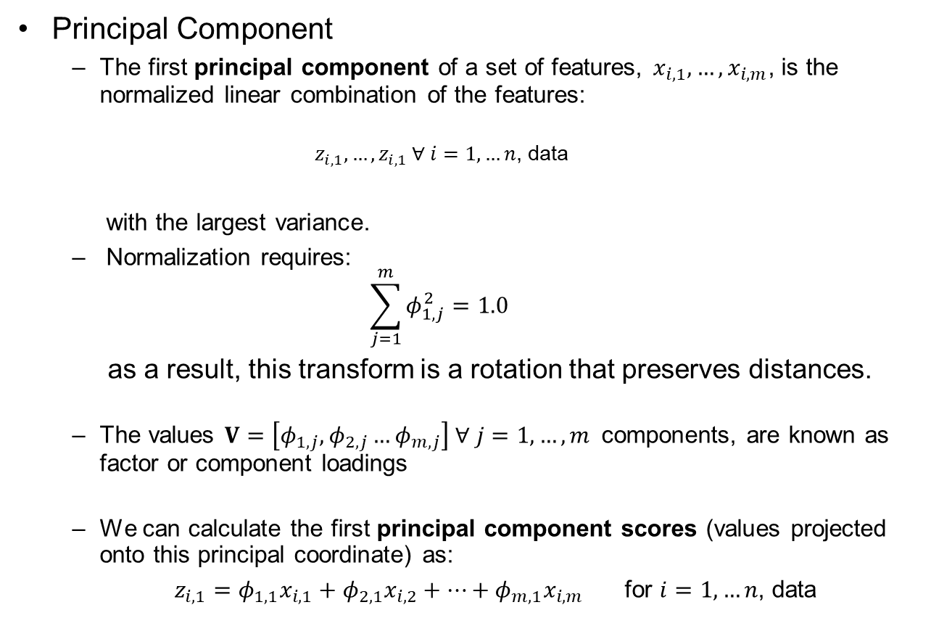

Principal Components Analysis
Principal Component
The first principal component of a set of features, $x_{i,1},…,x_{i,m}$, is the normalized linear combination of the features:
$$z_{i,1},…,z_{i,1} ∀ i=1,…n\text{, }\text{data}$$
with the largest variance.
Normalization requires:
$$\sum_{j=1}^{m}{φ_{1,j}^{2}=1.0}$$
as a result, this transform is a rotation that preserves distances.
The values $V=\left[φ_{1,j},φ_{2,j}…φ_{m,j}\right] ∀ j=1,…, m$components, are known as factor or component loadings
We can calculate the first principal component scores (values projected onto this principal coordinate) as:
$z_{i,1}=φ_{1,1}x_{i,1}+φ_{2,1}x_{i,2}+…+φ_{m,1}x_{i,m}$ for $i=1,…n$, data
In matrix
notation:
Factor
Loadings
first principal component ($PC$#1)
$$PC=V X$$
Principal
Component Scores
Centered
Data Matrix

Slide 32
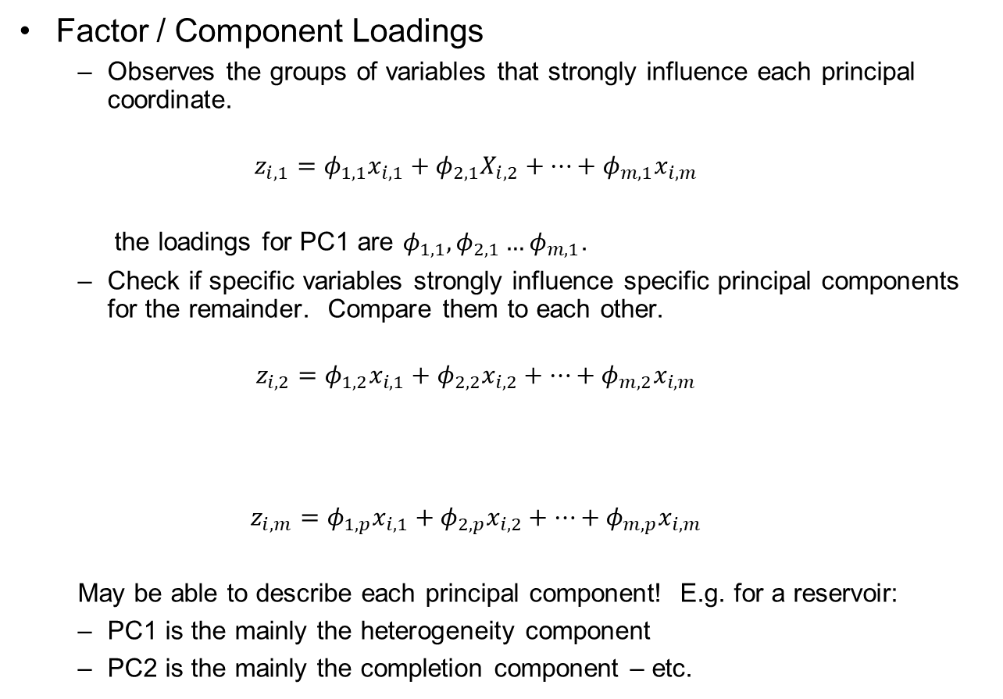
Principal Components Analysis
Factor / Component Loadings
Observes the groups of variables that strongly influence each principal coordinate.
$$z_{i,1}=φ_{1,1}x_{i,1}+φ_{2,1}X_{i,2}+…+φ_{m,1}x_{i,m}$$
the loadings for PC1 are $φ_{1,1}, φ_{2,1}…φ_{m,1}$.
Check if specific variables strongly influence specific principal components for the remainder. Compare them to each other.
$$z_{i,2}=φ_{1,2}x_{i,1}+φ_{2,2}x_{i,2}+…+φ_{m,2}x_{i,m}$$
$$z_{i,m}=φ_{1,p}x_{i,1}+φ_{2,p}x_{i,2}+…+φ_{m,p}x_{i,m}$$
May be able to describe each principal component! E.g. for a reservoir:
PC1 is the mainly the heterogeneity component
PC2 is the mainly the completion component – etc.
1st Principal
Component
2nd Principal
Component
m^{th} Principal
Component

Slide 33

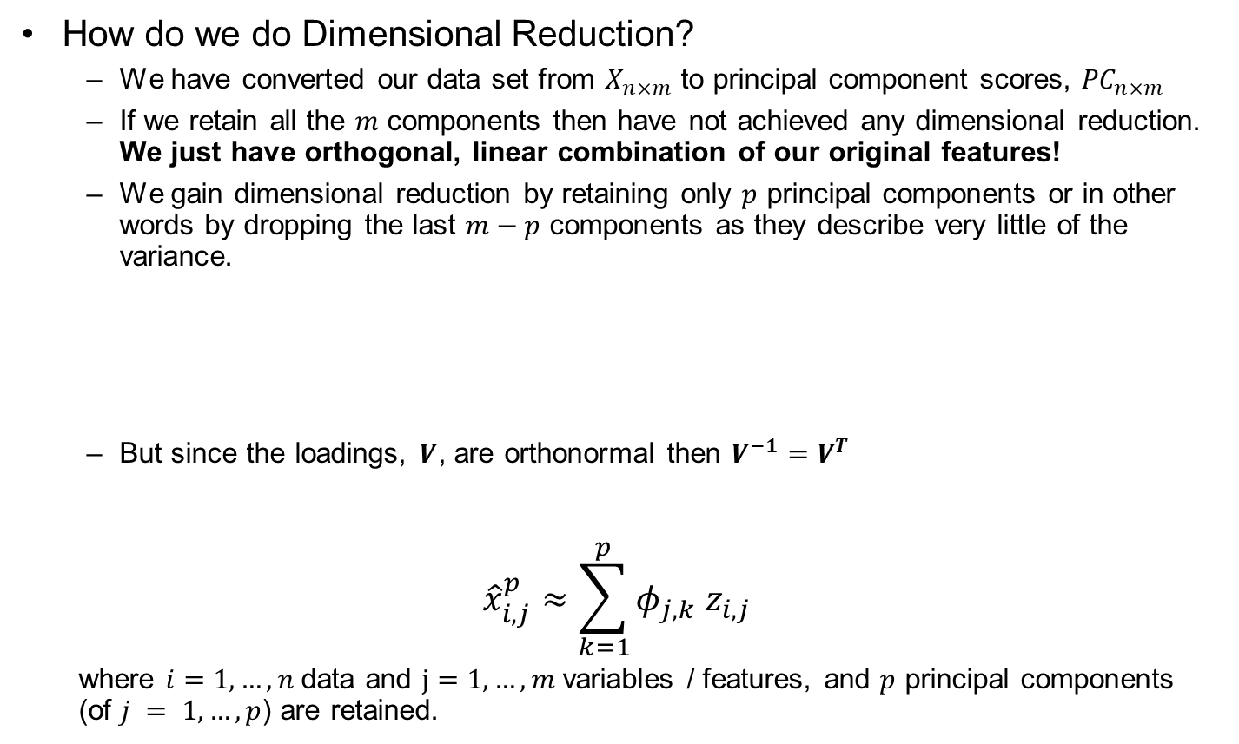


Principal Components Analysis
How do we do Dimensional Reduction?
We have converted our data set from $X_{n×m}$ to principal component scores, ${PC}_{n×m}$
If we retain all the $m$ components then have not achieved any dimensional reduction. We just have orthogonal, linear combination of our original features!
We gain dimensional reduction by retaining only $p$ principal components or in other words by dropping the last $m−p$ components as they describe very little of the variance.
But since the loadings, $V$, are orthonormal then $V^{−1}=V^{T}$
$${\hat{x}}_{i,j}^{p}≈\sum_{k=1}^{p}{{φ_{j,k} z}_{i,j}}$$
where $i=1,…,n$data and $j=1,…,m$variables / features, and $p$ principal components (of $j = 1,…,p$) are retained.
$$PC=V X$$
Back transforming from principal components to original values.
$$\hat{X}=V^{−1} ∙PC$$
$$\hat{X}=V^{T} ∙PC$$
principal component scores
factor loadings

Slide 34
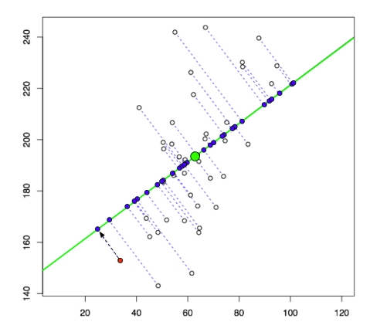
Principal Components Analysis
Graphical Representation
Line is the 1st principal component
Projection of points on line (purple points) are the 1st principal component scores
Given the problem is 2D the 2nd principal component is determined from the first (must be orthogonal)
If we approximated this dataset with just the 1st principal component for dimensional reduction, our approximation would be the purple points.
The first principal component maximizes the variance of the projected purple points.
1st principal component, projects on the line are the 1st principal component scores (from https://liorpachter.wordpress.com/2014/05/26/what-is-principal-component-analysis/).

Slide 35




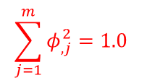








Principal Components Analysis Summary
Forward Transform
Normalized
Data
Component
Loadings
Principal Component
Scores
Data Features
$$m$$
$$p$$
$$m$$
Components
Components
$$p$$
$$m$$
Data Samples
X
$$×$$
V
$$=$$
PC
Data Features
Data Samples
$$n$$
$$m$$
$$n$$
Normalized by-Feature
Orthogonal / Rotation
Data Projection / Coordinate
in Orientation that Explains the Most Variance
$${\overline{x}}_{X_{j}}=0.0, σ_{X_{j}}^{2}=1.0$$
$$\sum_{j=1}^{m}{φ_{,j}^{2}=1.0}$$
Scree Plot
$$σ_{explained}^{2}$$
Components
$m$

Slide 36


Principal Components Analysis Summary
Reverse Transform
Principal Component
Scores
Component
Loadings
Normalized
Data Projection
Components
$$p$$
$$m$$
Data Features
$$m$$
Data Features
$$m$$
Components
T
X
PC
$$×$$
V
$$=$$
X*
Data Samples
Data Samples
$$p$$
$$n$$
$$m$$
$$n$$
Date Projection / Coordinate
In Orientation that Explains the Most Variance
Remove / Zero Unused
Components $m−p$
De-normalize to Restore
Original Features
Restore Correct Variance and Mean
Affine Correction

Slide 37

Principal Components Analysis Summary
Visualize / Analyze / Model
with Component Scores
Lower dimensional space, lower risk of overfit and easier to model.
Typical Workflow
Component
Loading
Principle Component
Scores
Statistical Modeling
and Inference
Model in Original
Features
Original Data
$$p$$
Features
Visualize / Analyze
Component Loadings
The rotation that defines each independent component that describe components of the variance
Variable groupings
Important features (images)
that describe the observed variability between training
Visualize / Analyze
Component Scores
Set of independent Features
that describe components
of the variance
$$m$$
$$m$$

Slide 38
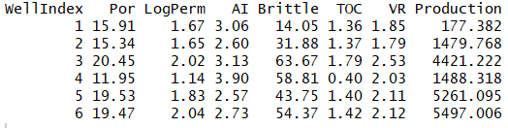
Principal Components Analysis
Principal Components Analysis Example
Multiple variate dataset with:
1,000 wells
Porosity (%)
Log transform of permeability to linearize relationship with porosity
Acoustic impedance, product of density and velocity
Brittleness index, percentage based on rock mechanics
Total organic carbon
Vitrinite reflectance, reflected light
Production, initial production average monthly production over first 3 months
File name is “unconv_MV.csv”
Here’s the first 7 lines of the file:

Slide 39
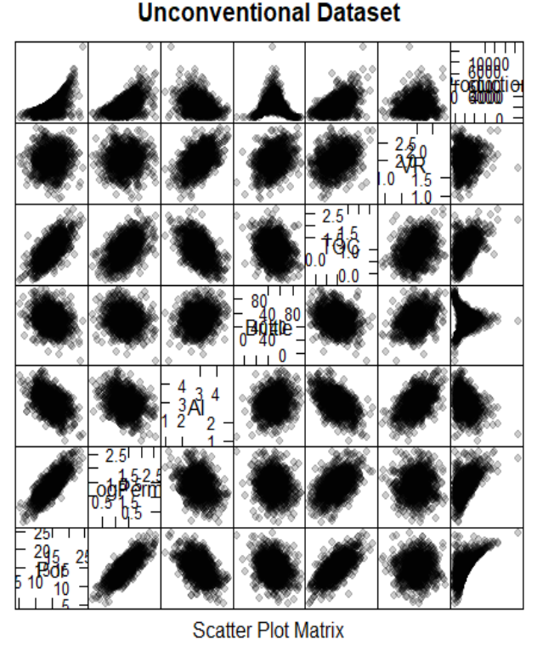
Principal Components Analysis
Multiple variate dataset with:
Porosity, Por
Log transform of perm, LogPerm
Acoustic impedance, AI
Brittleness index, Brittle
Total organic carbon, TOC
Vitrinite reflectance, VR
Initial Production
Matrix Scatter Plot of all Data
Most relationships are Gaussian
Production is more complicated

Slide 40
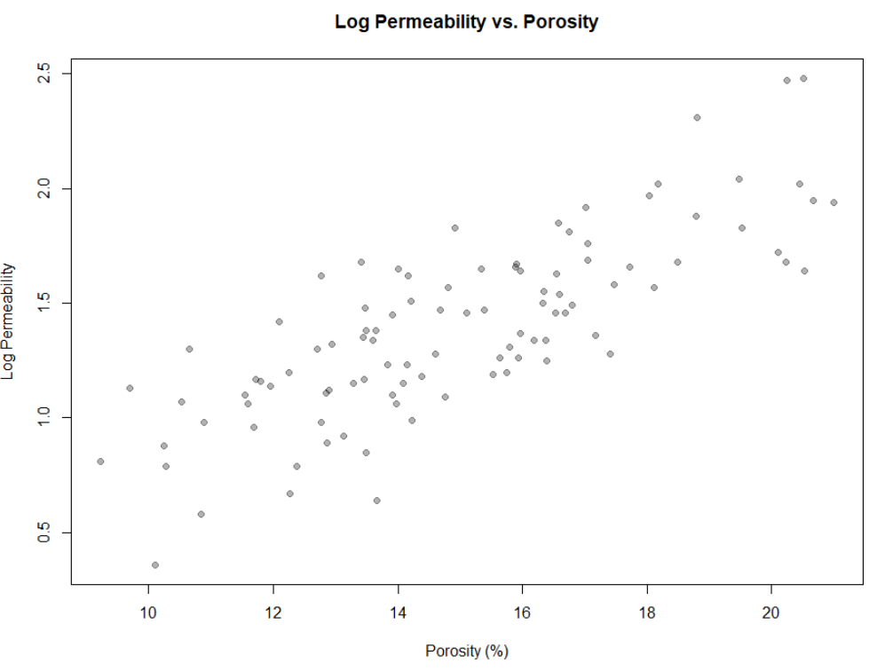
Principal Components Analysis
Let’s start simple:
Take first 100 wells
Only consider porosity and log perm.
We reduce our problem to bivariate since it is very easy to visualize.

Slide 41



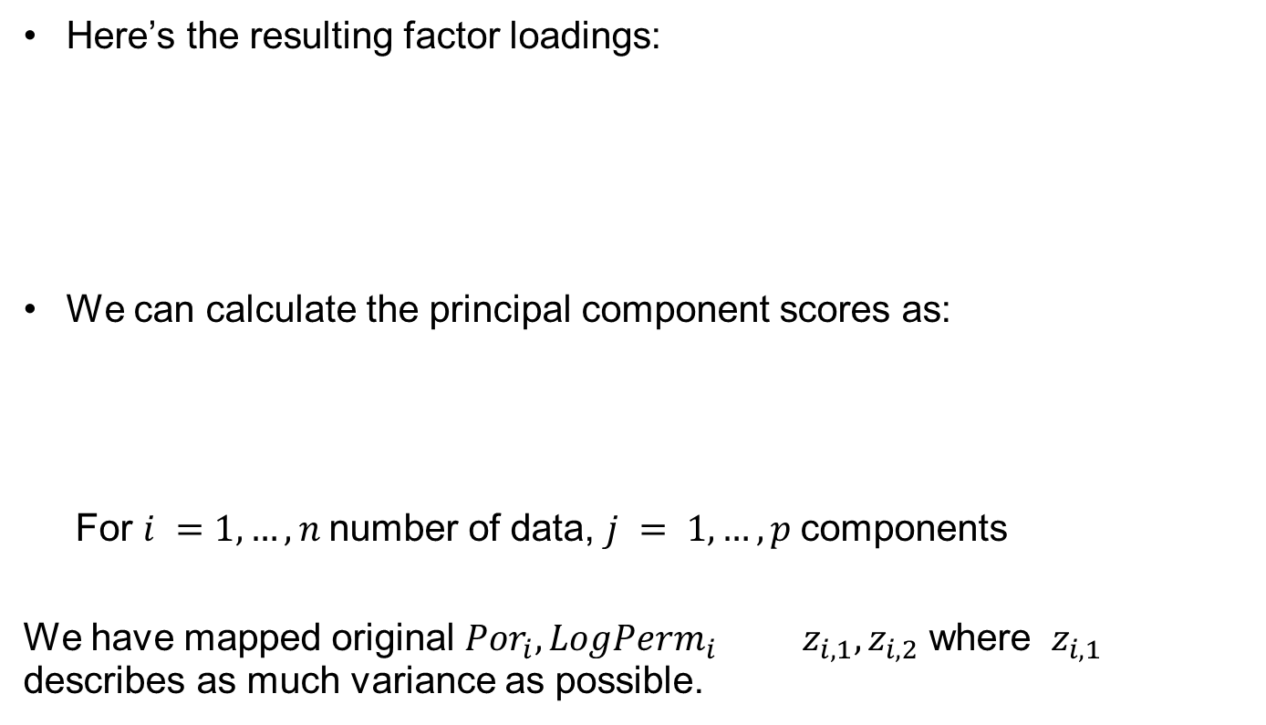


Principal Components Analysis
$$φ_{Por,1}$$
$$φ_{Por,2}$$
Here’s the resulting factor loadings:
We can calculate the principal component scores as:
For $i =1,…, n$number of data, $j = 1,…,p$components
We have mapped original ${Por}_{i},{LogPerm}_{i}$ ${ z}_{i,1},z_{i,2}$ where ${ z}_{i,1}$ describes as much variance as possible.
m variables
$$φ_{LogPerm,1}$$
$$φ_{LogPerm,2}$$
p components
$$Z_{i,1}=φ_{Por,1}∙\left({Por}_{i}−\overline{Por}\right)+φ_{LogPerm,1}∙\left({LogPerm}_{i}−\overline{LogPerm}\right)$$
$$Z_{i,2}=φ_{Por,2}∙\left({Por}_{i}−\overline{Por}\right)+φ_{LogPerm,2}∙\left({LogPerm}_{i}−\overline{LogPerm}\right)$$
Data
Principle Components

Slide 42
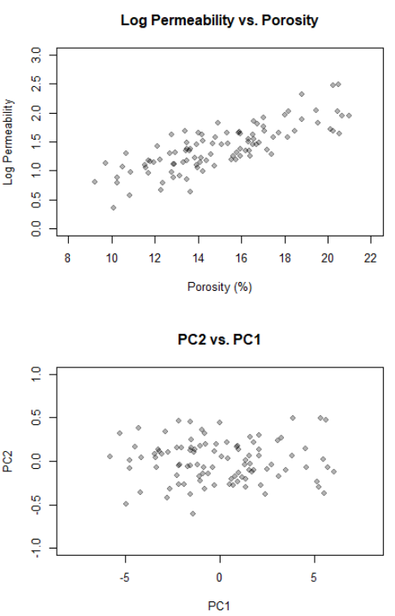
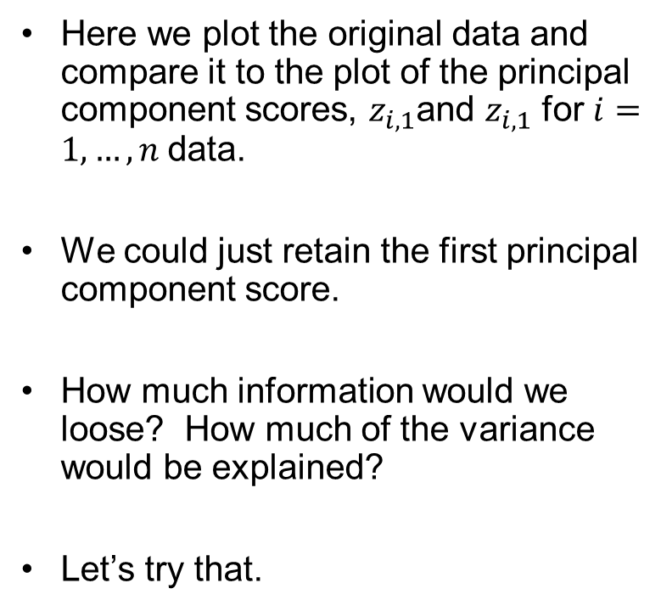
Principal Components Analysis
Here we plot the original data and compare it to the plot of the principal component scores, $z_{i,1}$and $z_{i,1}$ for $i=1,…, n$data.
We could just retain the first principal component score.
How much information would we loose? How much of the variance would be explained?
Let’s try that.

Slide 43
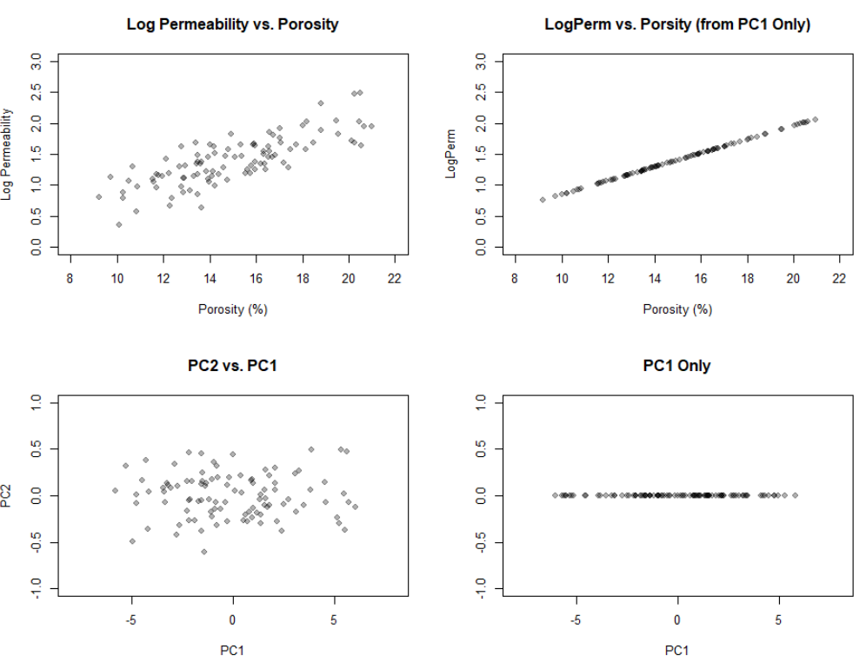
Principal Components Analysis
2nd
1st
PCA
Calculate principal
component scores
Inverse PCA
Calculate estimates
of data values.
Remove or zero the 2nd score
Use only the 1st principal coordinate.

Slide 44
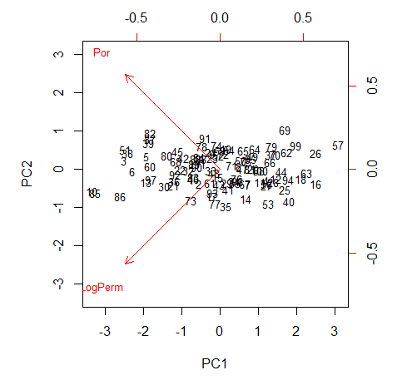
Principal Components Analysis
Biplots
An enhanced scatter plot with the points for the principal component scores and the principal components plotted as vectors.
The data plotted by principal component scores
Left and lower axes
Data labels are shown
See, most variance is described with PC1
The principal components as vectors
Right and upper axis
Indicates alignment / correlation between specific features and principal coordinates
See PC1 and PC2 are shared by Por and LogPerm.

Slide 45
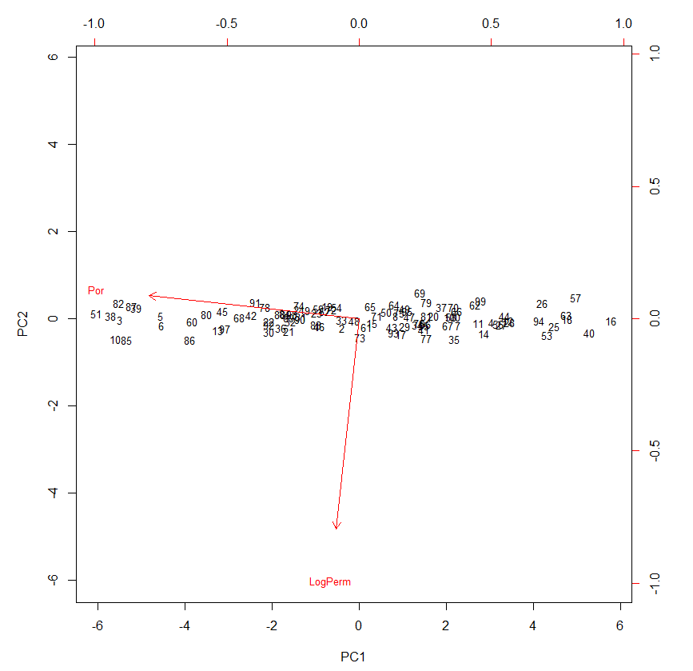
Principal Components Analysis
Scaling
When working with a variety of variables with different scales, units you should scale the input before PCA calculation
Scaling takes each variable and standardizes to a standard deviation of 1.0
This is in addition to setting the mean to 0.0 (centering)
Why is the done?
See our example without scaling.
The larger range of the porosity values causes porosity to dominate the 1st principal component! Instead of sharing each.

Slide 46
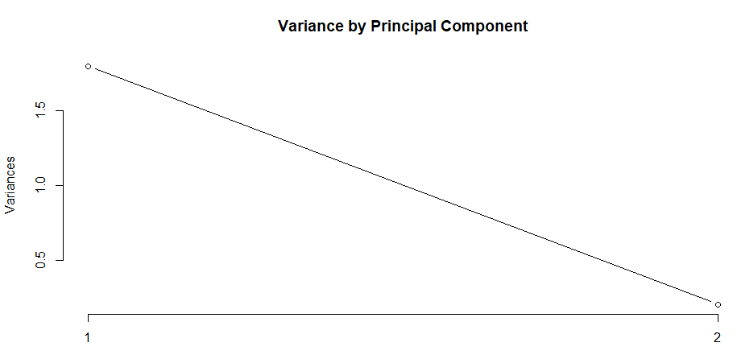
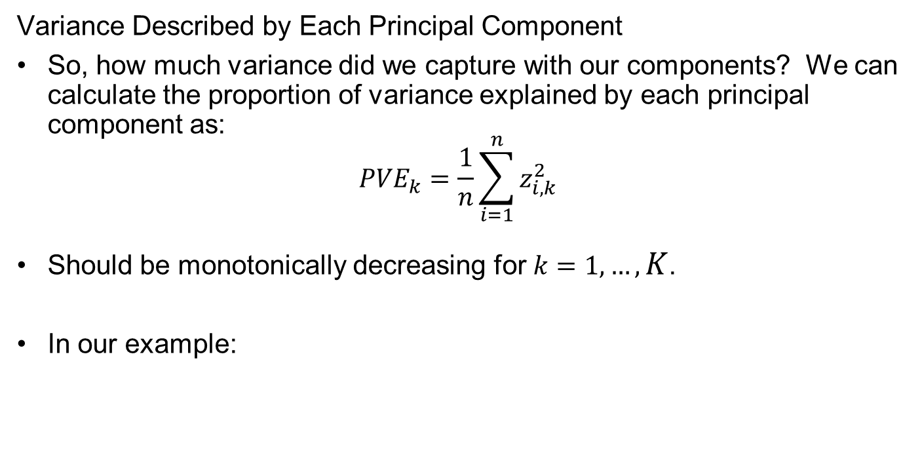
Principal Components Analysis
Variance Described by Each Principal Component
So, how much variance did we capture with our components? We can calculate the proportion of variance explained by each principal component as:
$${PVE}_{k}=\frac{1}{n}\sum_{i=1}^{n}{z_{i,k}^{2}}$$
Should be monotonically decreasing for $k=1,…,K$.
In our example:
89.6%
10.4%
PC1
PC2

Slide 47
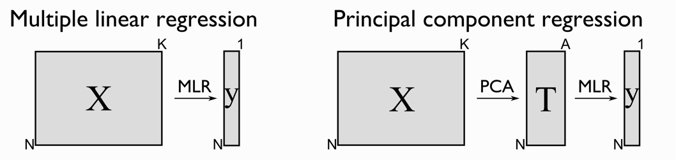
Principal Components Analysis
What can you do with PCA?
Prediction:
Reduce dimensions, build a model with the principal component scores and then restore to estimates the data values.
PCA regression, regression on the most important principal components
Inference:
Understand our variables and how variance is partitioned
Check for and mitigate multi-collinearity
Exclude principal components that have low variance
m
m
p
Image from: https://learnche.org/pid/latent-variable-modelling/principal-components-regression

Slide 48
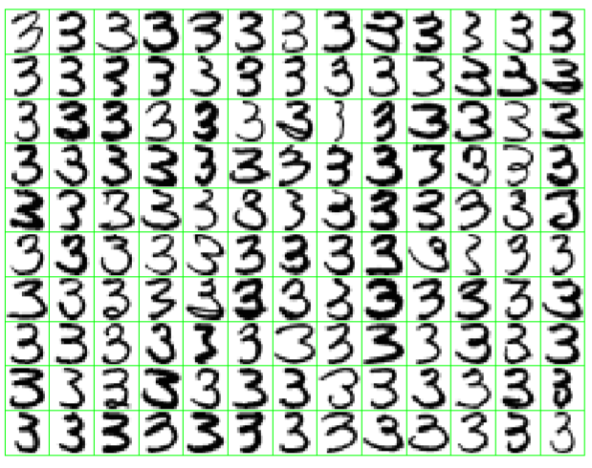
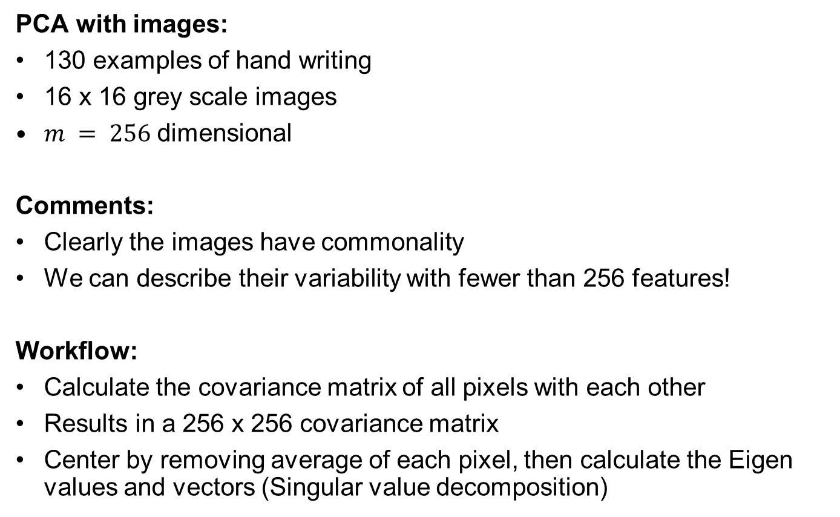
Principal Components Analysis Image Example
PCA with images:
130 examples of hand writing
16 x 16 grey scale images
$m = 256$dimensional
Comments:
Clearly the images have commonality
We can describe their variability with fewer than 256 features!
Workflow:
Calculate the covariance matrix of all pixels with each other
Results in a 256 x 256 covariance matrix
Center by removing average of each pixel, then calculate the Eigen values and vectors (Singular value decomposition)
Figure and example from Hastie et al., 2009.

Slide 49
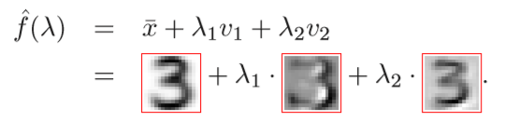
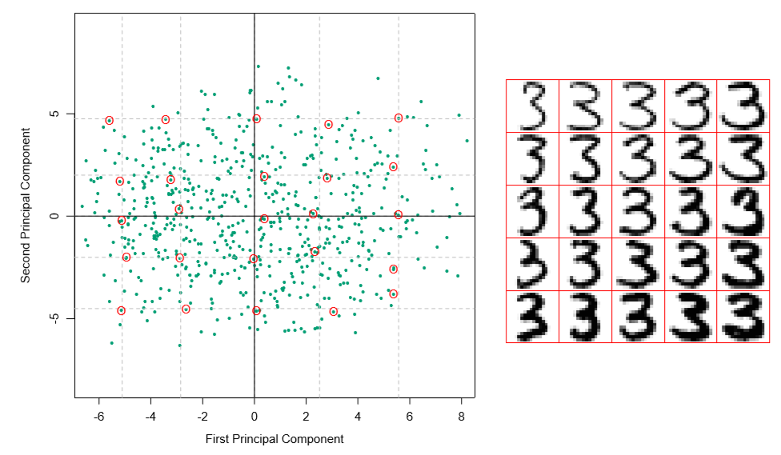
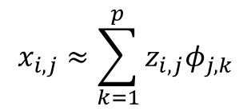

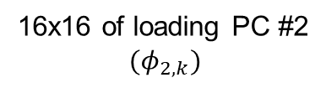
Principal Components Analysis Image Example
principal component score ($z_{i,2}$)
16x16 of loading PC #2
$$(φ_{2,k})$$
Retain the first 2 principal components:
Comments:
We can now explore the variability of these handwritten 3’s with the first two 2 principle components.
256x256 loadings
2 dials, instead of 256 to explore the space.
Line thickness
Length of lower tail
$$x_{i,j}≈\sum_{k=1}^{p}{z_{i,j}φ_{j,k}}$$
Figures and example from Hastie et al., 2009.

Slide 50
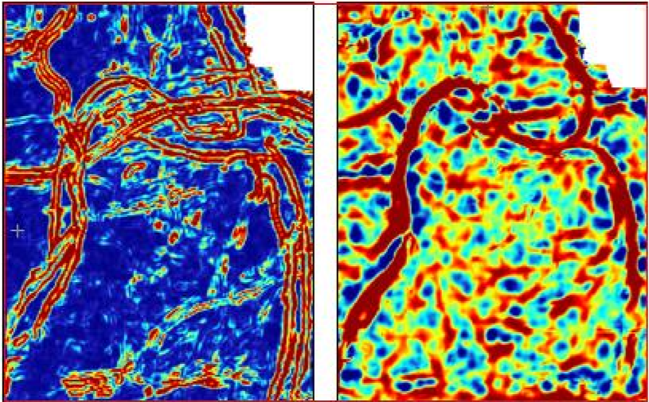
Principal Components Analysis Image Example
6 Seismic attributes and first 3 capture 97% of variability! Here’s 2.
Loadings of PC#1
Loadings of PC#2
Each principal component describes different aspects of the multivariate seismic.
Fit models with less probability of overfit.
Figure and example from Chopra and Marfurt, 2014.

Slide 51
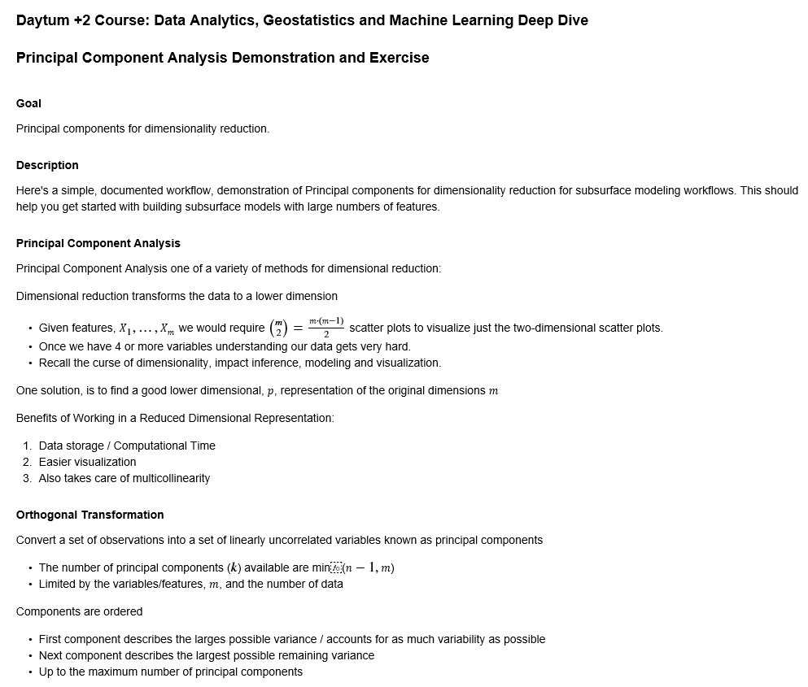
Principal Components Analysis Example
Workflow file is Daytum_PCA.ipynb

Slide 52
Principal Components in Reservoir Modeling
Examples of PCA in Subsurface Modeling:
Modeling multivariate relationship while avoiding over fitting, porosity from a set of seismic attributes.
Image analysis on seismic information, separating multiple attributes into information and noise.
Analysis of feature grouping, redundancy
Reducing dimensionality to support simpler workflows, e.g. bivariate, cosimulation methods

Slide 53
Daytum +2 Course Dimensionality Reduction
Curse of Dimensionality
Dimensionality Reduction
Principal Component Analysis
Michael Pyrcz, The University of Texas at Austin

