Slide 1
Daytum +2 Course Course Overview
Lecture outline . . .
Motivation / Goals
Class Description / Objectives
Summary
Open Source
Instructor: Michael Pyrcz, the University of Texas at Austin

Slide 2
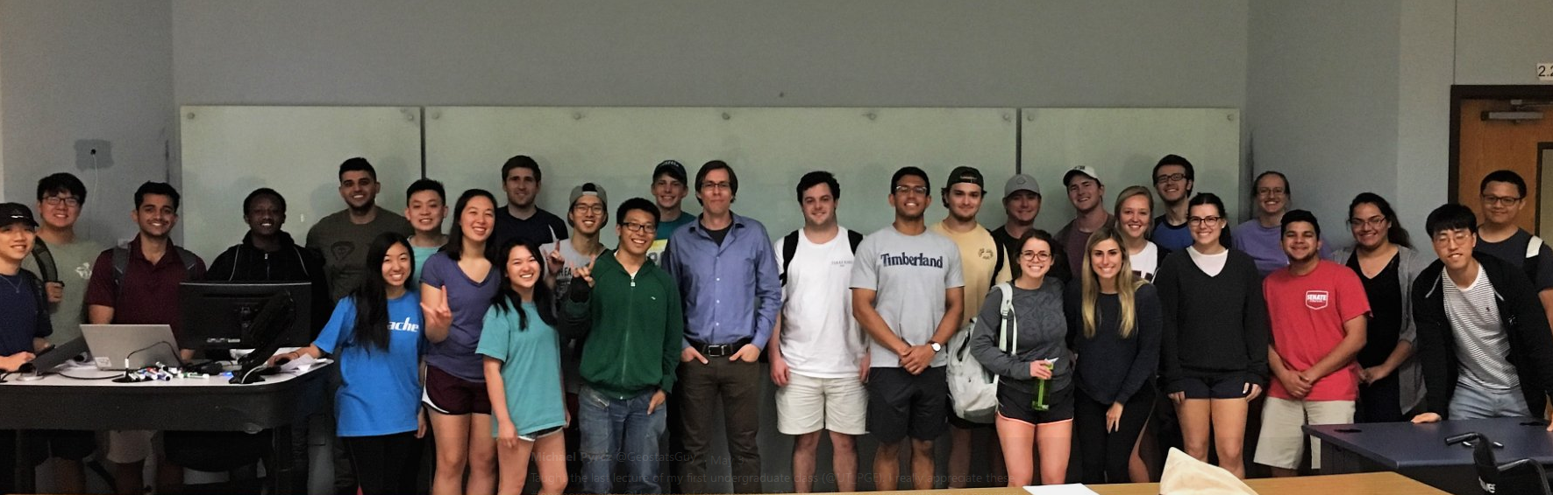
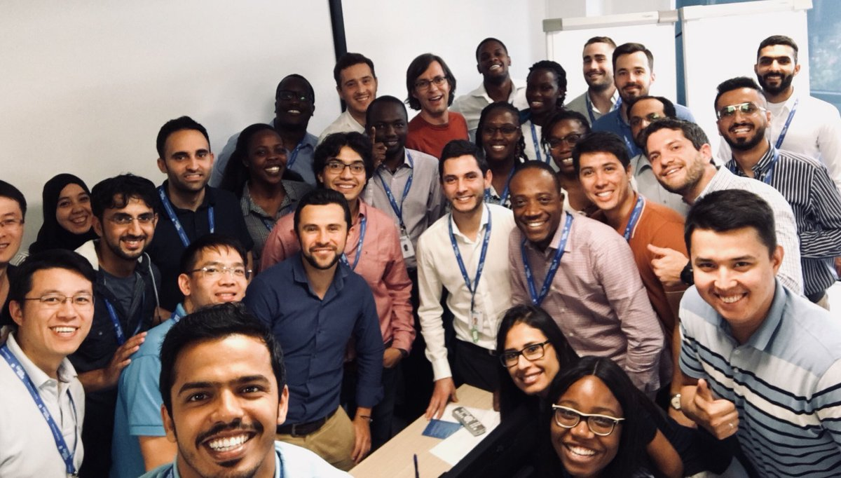
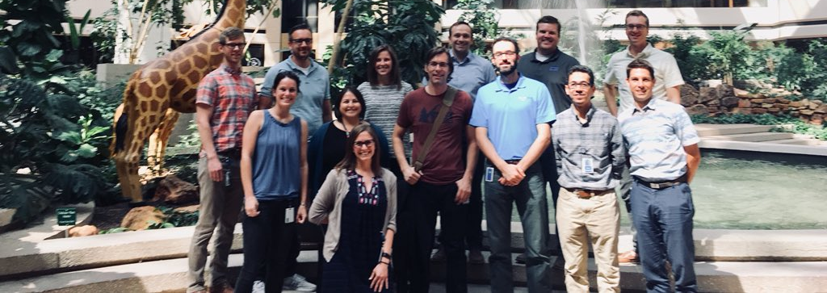
Introductions: The Instructors Michael Pyrcz
Spring 2018 Class of Introduction to Geostatistics
Oil and Gas University, Florence, Italy
Michael Pyrcz
Pyrcz: is pronounced “perch”
I’m New: new to UT PGE, started August, 2017. Everything is new!
I have practical experience: over 17 years of experience in consulting, teaching and industrial R&D in statistical modeling, reservoir modeling and uncertainty characterization.
Anadarko, Midland, TX

Slide 3
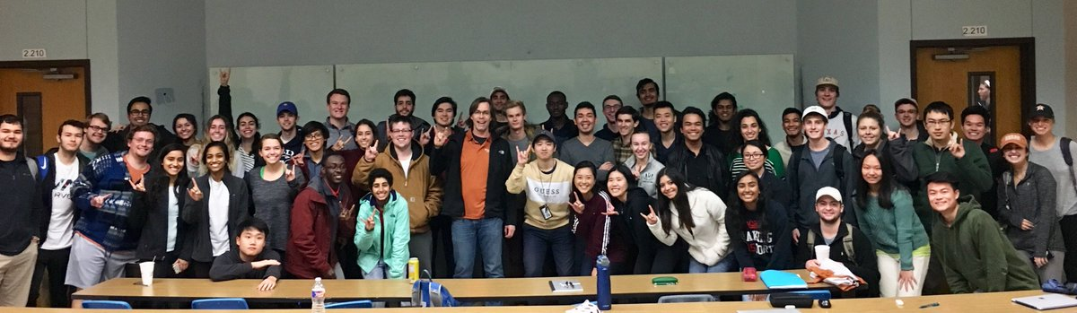
Introductions: The Instructors Michael Pyrcz
Fall 2018 Class of Introduction to Geostatistics
Michael Pyrcz
4. Flexible: got ideas, feedback to improve the learning opportunities. Let’s work together to reach our learning objective.
Available: I have an open door policy. Drop by my office. Drop a line anytime.
An Engineer, but: My B.Sc. was Mining Engineering, my M.Sc. started as Geotechnical Engineering (then skipped to Ph.D.) and my Ph.D. was in Quantitative Geology. I spent 13 years in Earth Science R&D working with geological and geophysical reservoir modeling. I speak geo.

Slide 4
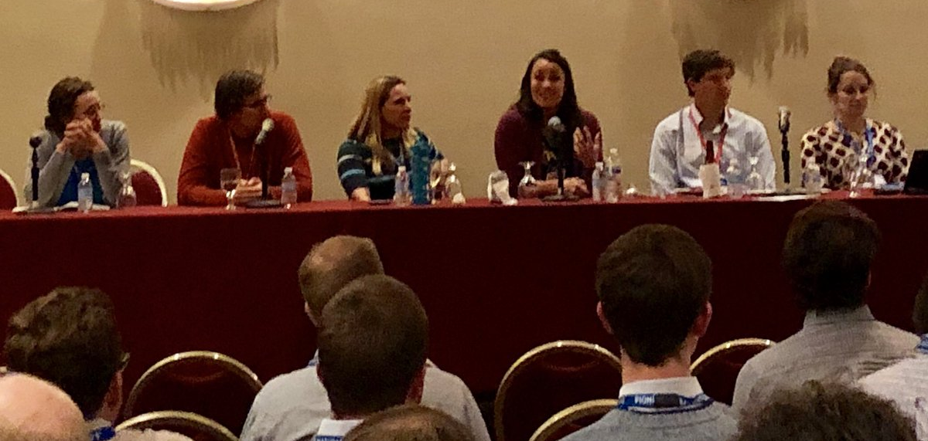
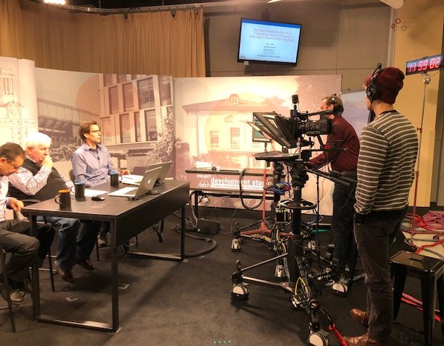
Introductions: The Instructors Michael Pyrcz
AAPG SEPM Panel Discussion on Modeling
CPGE Webinar on Big Data
Michael Pyrcz
Active in Outreach, Social Media and Professional Organizations
associate editor with Computers and Geosciences, editorial board of Mathematical Geosciences for the International Association of Mathematical Geosciences
program chair for SPE Data Analytics Technical Section
associate editor with Computers and Geosciences
author of the textbook “Geostatistical Reservoir Modeling”
board member for Mathematical Geosciences
GeostatsGuy on Twitter, GitHub, GeostatsGuy Lectures on YouTube
I’m committed to supporting / partnering for development opportunities of working professionals

Slide 5
Introductions: The Instructors

Slide 6
Introductions
Short Introductions:
Name
Role
Expectations from this Class

Slide 7
What Will You Learn?
The Goal – Deep Dive into Data Analytics, Geostatistics and Machine Learning
Day 1
Prerequisites and Perspectives
Data Preparation
Feature Engineering
Spatial Models and Spatial Estimation
Building Workflows
Day 2
Machine Learning Intro
Dimensionality Reduction
Clustering
Tree-based Regression
Building Workflows

Slide 8
What Will You Learn?
This time is an investment in learning
Build operational capability
Provide incremental value.
Data Analytics, Geostatistics and Machine Learing Methods
New Theory and Methods
with Various Solutions
Value Added
New Theory and Methods
Previous Methods
Technical Solutions to Existing Problems

Slide 9
What Will You Learn?
Reaching our Goal
Today we will:
Build up from zero
Provide an overview of the methods
Hands-on experiential learning
Demonstrate well-documented, practical workflows
Of course, full workflow development would require time to investigate the problem and available data.
I have a lot of content for more advanced topics.
“If I haved erred it is on the side of simplicity.”

Slide 10
What Will You Learn?
There is Much More! – the building blocks can be reimplemented and expanded to address various other problems, opportunities.
There is much more that we could cover.
Additional Theory
More Hands-on / Experiential
Workflow Development
Basics of Python / R
Model QC
Methods to Integrate More Geoscience and Engineering

Slide 11
How Will You Learn All of That?
Here’s the Plan:
Interactive lectures / discussion to cover the basic concepts
Demonstrations of methods and workflows in Python
Hands-on experiential learning with well-documented workflows for accessibility

Slide 12
What Will You Learn?
This is an ambitious schedule.
We will adjust for success:
Let me know if you are lost, stuck, something is not working or you aren’t learning!
We may adjust
Feedback welcome as we proceed.

Slide 13
Why Excel and Python?
Python:
Is very powerful, the most resources and assistance
Packages allow us to put together workflows with limited old-fashioned ‘coding’
Leverage the world’s brilliance
‘Certainly there’s a phenomenon around open source. You know free software will be a vibrant area. ‘There will be a lot of nest things that get done there.’
- Bill Gates
‘20 years with C++ and FORTRAN, but with Python I code less, but get more done.’
- Michael Pyrcz

Slide 14
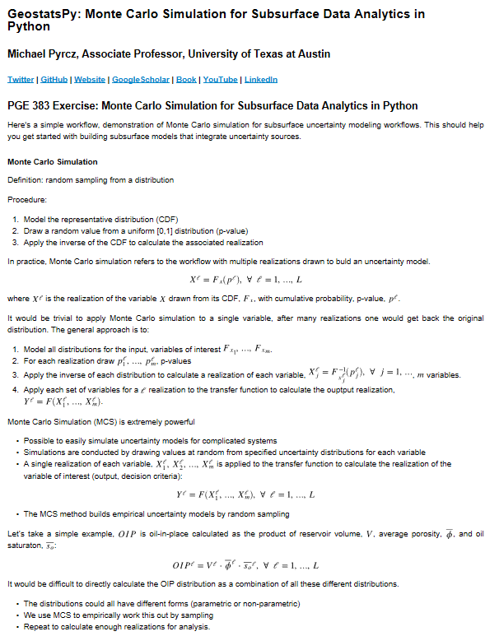
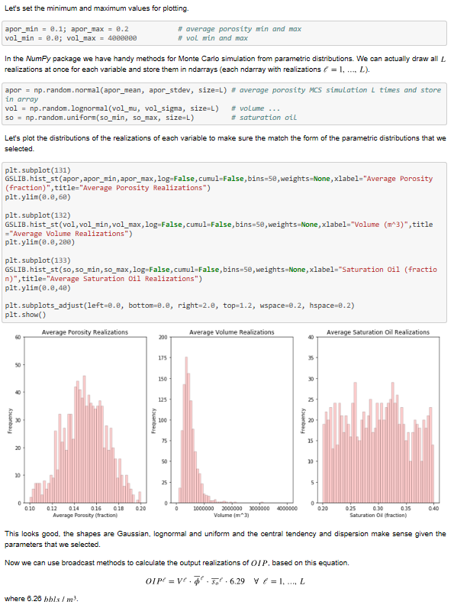
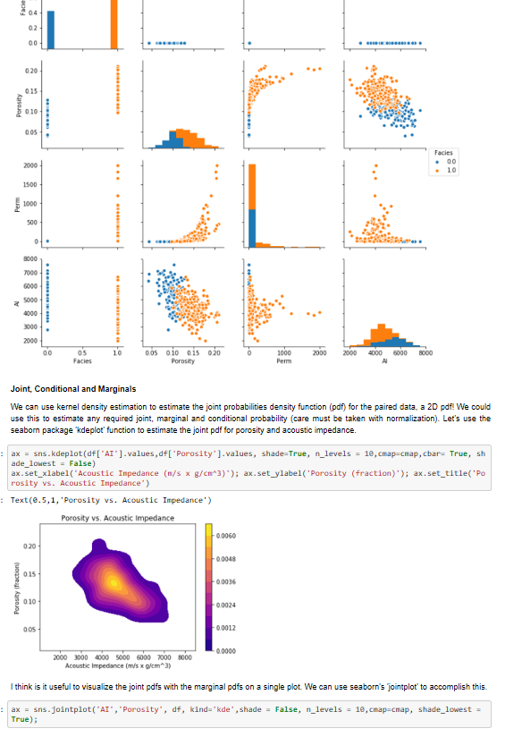
Jupyter Notebooks?
Python with Jupyter Notebooks
Workflows that integrate blocks of code, documentation, results
Work with a variety of kernels (Python, R, C, JavaScript, etc.)
Make and deploy professional workflows with Markdown docs
Use containers and run online (e.g. Docker)

Slide 15
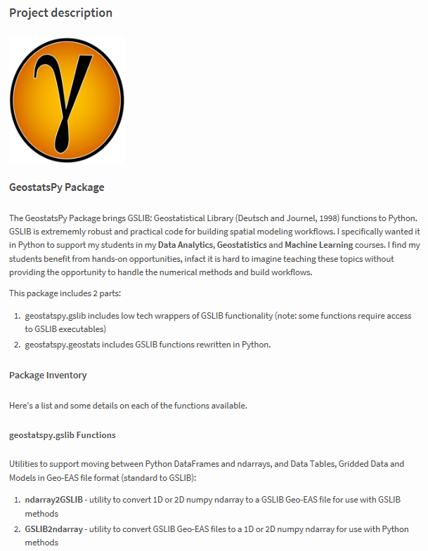
GeostatsPy?
GeostatsPy
Set of Functions in Python
GeostatsPy is a set of Python functions for most of the required workflow steps
Much is reimplemented in Python.
Package written by myself, we will tailor, augment to support training.
I welcome feedback.
Open Source anyone can use it
Free for any to use
Download it from PyPi with:
‘pip install geostatspy’

Slide 16
More on Coding
More on Software / Coding:
Coding:
Workflow Focus: We introduce a lot of well-documented Python workflows in Data Analytics, Geostatistics and Machine Learning
Practical Approach: We focus on coding as a means to an ends, to get the job done.
Expectations:
Awareness: Appreciation for what can be done and the level of complexity
Basic Workflow Design: Basic coding, workflow design
Experience with Tools: Use of methods available in common packages (from the previous 3 days)

Slide 17
Reasons to Learn Some Coding
Transparency – no compiler accepts hand waiving! Coding forces your logic to be uncovered for any other scientist or engineer to review.
Reproducibility – run it, get an answer, hand it over, run it, get the same answer. This is a main principle of the scientific method.
Quantification – programs need numbers. Feed the program and discover new ways to look at the world.
Open-source – leverage a world of brilliance. Check out packages, snippets and be amazed with what great minds have freely shared.
Break Down Barriers – don’t throw it over the fence. Sit at the table with the developers and share more of your subject matter expertise for a better product.
Deployment – share it with others and multiply the impact. Performance metrics or altruism, your good work benefits many others.
Efficiency – minimize the boring parts of the job. Build a suite of scripts for automation of common tasks and spend more time doing science and engineering!
Always Time to Do it Again! – how many times did you only do it once? It probably takes 2-4 times as long to script and automate a workflow. Usually worth it.
Be Like Us – it will change you. Users feel limited, programmers truly harness the power of their applications and hardware.

Slide 18
Reasons to Learn Coding
Caveats for the previous reasons for coding:
Any type of coding, scripting, workflow automation matched to your working environment is great. We don’t all need to be C++ experts.
We respect the experience component of geoscience and engineering expertise. This is beyond coding and is essential to workflow logic development, best use of data etc.
Some expert judgement will remain subjective and not completely reproducible. I’m not advocating for the geoscientist or engineer being replaced by a computer.

Slide 19
Let’s Get Started
We will first start with prerequisites:
Day 1
Prerequisites and Perspectives
Data Preparation
Feature Engineering
Spatial Models and Spatial Estimation
Building Workflows
Day 2
Machine Learning Intro
Dimensionality Reduction
Clustering
Tree-based Regression
Building Workflows

