Slide 1
Geostatistics and Machine Learning Introduction
Introduction
Lecture outline . . .
General Comments
Data Analytics
Machine / Statistical Learning
Prediction and Inference
Data Analytics
Inferential Methods
Predictive Methods
Advanced Methods
Conclusions
Instructor: Michael Pyrcz, the University of Texas at Austin

Slide 2
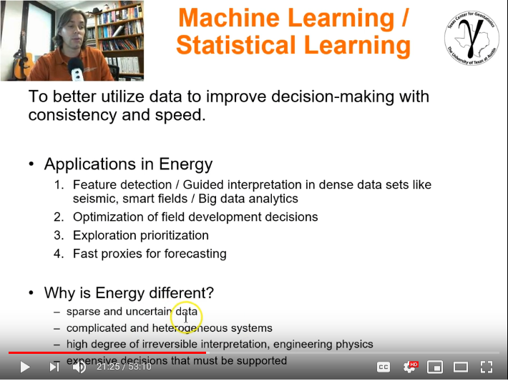
Geostatistics and Machine Learning Introduction
Other Resources:
Recorded Lecture Statistical / Machine Learning
Instructor: Michael Pyrcz, the University of Texas at Austin

Slide 3
Goals of This Lecture
Motivation
My biases
Definition of terms and introduce concepts
Then we will dive into data analytics, followed by machine learning.

Slide 4
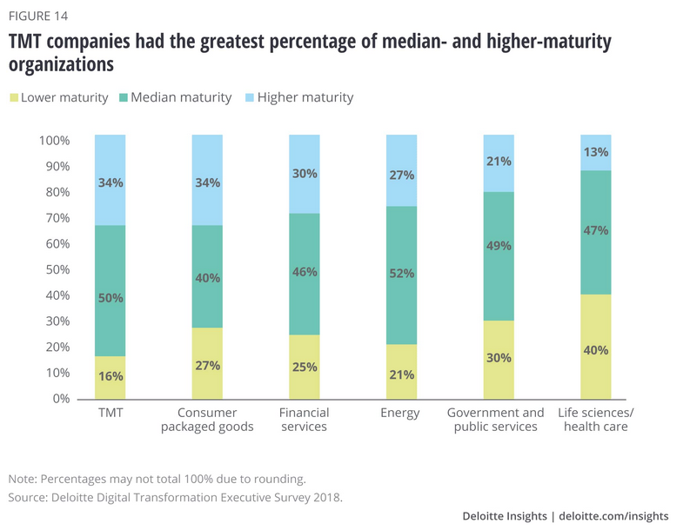
Digital Transformations
We are not alone, digital transformations are underway in all sectors of our economy.
Every energy company that I visit is working on this right now.
Digital transformation study by Deloitte, 2019.
https://www2.deloitte.com/insights/us/en/focus/digital-maturity/digital-maturity-pivot-model.html

Slide 5

Digital Transformations
My Biases:
There are opportunities to do more with our data
There are opportunities to teach data analytics and statistical / machine learning methods to engineers and geoscientists to improve capability
Geoscience and engineering knowledge and expertise remains core to our business
Digital transformation PricewaterhouseCoopers (PwC) panel April, 9th, 2019.

Slide 6
Geostatistics and Machine Learning Introduction
Introduction
Lecture outline . . .
Data Analytics
Data Analytics
Inferential Methods
Predictive Methods
Advanced Methods
Conclusions
Instructor: Michael Pyrcz, the University of Texas at Austin

Slide 7
Big Data
Big Data: you have big data if your data has a combination of these:
Volume: large number of data samples, large memory requirements and difficult to visualize
Velocity: data is gathered at a high rate, continuously relative to decision making cycles
Variety: data form various sources, with various types and scales
Variability: data acquisition changes during the project
Veracity: data has various levels of accuracy
“Energy has been big data before tech learned about big data.” – Michael Pyrcz
Big Data Analytics – methods to explore and detect patterns, trends and other useful information from big data to improve decision making.
m features
Data Table
n samples

Slide 8

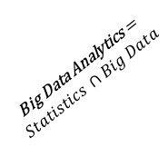
Big Data Analytics
Statistics is collecting, organizing, and interpreting data, as well as drawing conclusions and making decisions.
Geostatistics is a branch of applied statistics: (1) the spatial (geological) context, (2) the spatial relationships, (3) volumetric support, and (4) uncertainty.
Big Data Analytics is the process of examining large and varied data sets (big data) to discover patterns and make decisions.
Big data analytics is expert use of (geo)statistics on big data.
$$Statistics$$
$$Geostatistics$$
Spatial Big
Data Analytics
Big Data Analytics =
$$Statistics ∩Big Data$$
$$Big Data$$
Spatial Big Data Analytics = $Geostatistics ∩Big Data$
Proposed Venn diagram for spatial big data analytics.

Slide 9
Geostatistics and Machine Learning Introduction
Introduction
Lecture outline . . .
Machine / Statistical Learning
Data Analytics
Inferential Methods
Predictive Methods
Advanced Methods
Conclusions
Instructor: Michael Pyrcz, the University of Texas at Austin

Slide 10
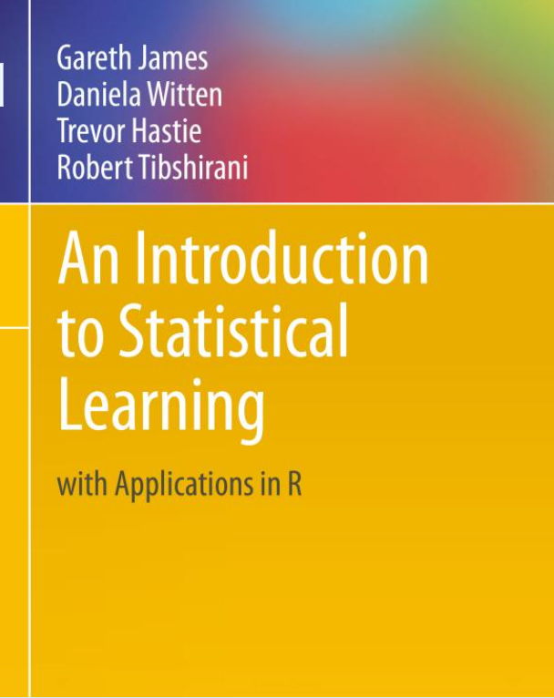
Machine Learning / Statistical Learning
Excellent Reading on this Topic: An Introduction to Statistical Learning with Applications in R, 2013, James et al., Springer. (http://www-bcf.usc.edu/~gareth/ISL/ISLR%20First%20Printing.pdf)
Statistical Learning
vast set of tools for learning from data
based on initial assumptions and hypothesis
Machine Learning vs. Statistical Learning
vast set of tools for learning patterns
very little if any prior assumptions
Supervised Learning
building a predictive model for estimating an output given one or more inputs
Unsupervised Learning
all inputs, no output
learn from the structures of the data alone
Note: Some consider statistical learning and machine learning to be the same
I’ll use them interchangeably

Slide 11
Machine Learning / Statistical Learning
Artificial
Intelligence
Machine
Learning
Deep
Learning
Artificial Intelligence: the theory and development of computer systems able to perform tasks that normally require human intelligence, such as visual perception, speech recognition, decision-making, and translation between languages (Google Dictionary)
Machine Learning: is an application of artificial intelligence (AI) that provides systems the ability to automatically learn and improve from experience without being explicitly programmed (Google Dictionary). Access data and learn for themselves.
Deep Learning: subset of machine learning with complicated neural nets

Slide 12
Machine Learning / Statistical Learning
Machine Learning:
“is the study of algorithms and mathematical models that computer systems use to progressively improve their performance on a specific task. Machine learning algorithms build a mathematical model of sample data, known as "training data", in order to make predictions or decisions without being explicitly programmed to perform the task.”
“where it is infeasible to develop an algorithm of specific instructions for performing the task.”
training with data
toolkit
learning
general
not a panacea
Machine Learning - Wikipedia

Slide 13
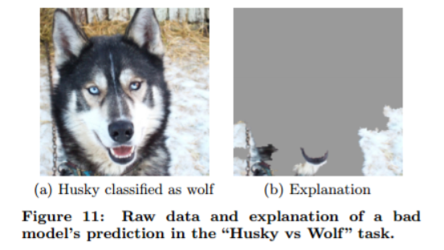
Machine Learning / Statistical Learning
Concerns:
Biased training data
Rideiro et al. (2016) trained a logistic regression classifier with 20 wolves and dogs images to detect the difference between wolves and dogs.
The problem is:
interpretability may be low
application may become routine and trusted
the machine is trusted, becomes an authority
Image and example from Ribeiro et al., (2016) https://arxiv.org/pdf/1602.04938.pdf

Slide 14
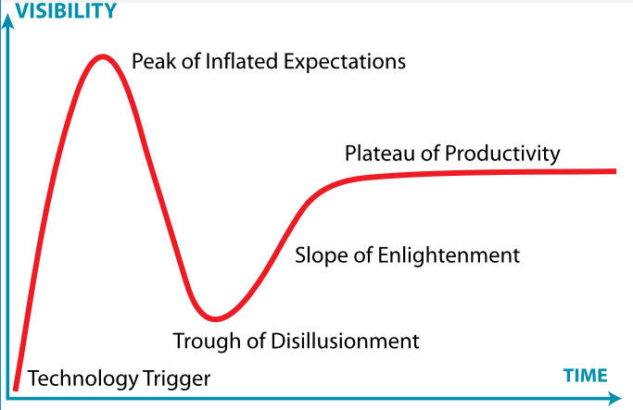
Machine Learning / Statistical Learning
Hype Cycle – from information technology firm, Gartner.
Where are we currently for data analytics and machine learning?
Image from https://en.wikipedia.org/wiki/Hype_cycle.

Slide 15
Machine Learning / Statistical Learning
Applications Around You / Societal Impacts
Driving directions that crowd source and update improve traffic flow
Air traffic routing
Spam filters
Plagiarism checkers
Translation / computer reading
Credit card fraud detection
Face recognition (Facebook, Snapchat etc.)
Recommendations (Amazon, Netflix, YouTube)
Smart personal assistants

Slide 16

Machine Learning / Statistical Learning
But Energy is Very Different
sparse and uncertain data
complicated and heterogeneous, open earth systems
high degree of necessary geoscience and engineering interpretation and physics
Expensive, high value decisions that must be supported
Spotify recommendation engine, recommender system

Slide 17
Machine Learning / Statistical Learning
My recommendations for Machine Learning in Energy:
Support Subsurface Development when:
volume of data is too large to queried by hand
the system is high dimensional and cannot be explained with geoscience and engineering
the task is routine, highly repetitive and low value
With systems that:
Streamline and automate
Support expert and system interaction
Interrogatable with excellent visualization and diagnostics

Slide 18
Machine Learning / Statistical Learning
Example Machine Learning Applications in Energy
Feature detection / guided interpretation in dense data sets like seismic and smart fields
Expert systems to detect anomalous operating conditions for safe drilling
Optimization of field development decisions with the integration of all relevant geoscience and engineering interpretations and physics
Model feedback with fast proxies for geologic and engineering processes to provide guidance for subsurface interpretation and modeling.
“Significance, consistency, efficiency for more impact.”

Slide 19
Machine Learning / Statistical Learning
Data, Metadata and Databases
80% of any subsurface study is data preparation and interpretation
We continue to face a challenge with data:
Data curation
Large volume
Large volumes of metadata
Variety of data, scale, collection, interpretation
Transmission, controls and security
Databases are prerequisite to all data analytics and machine learning.

Slide 20
MetaData Definition
‘a set of data that describes and gives information about other data’ - Google dictionary
‘computing information that is held as a description of stored data’ – dictionary.com
data collection, calibration, uncertainty, transformations, standardization, interpretation, correction, debiasing
we have a massive amount of metadata

Slide 21
Skilled Use
Just like spatial statistics / geostatistics, statistical learning is a set of tools to add to your tool box as geoscientist or engineer
Each is very dangerous to use as a black box. You will need to understand what’s under the hood
methods, workflows, assumptions and limitations.
scope and trade offs between alternative methods

Slide 22
Skilled Use
Imagine you are a carpenter (from Pyrcz and Deutsch, 2014).
You would have a tool box
You would know each tool perfectly well
Understand performance over a variety of applications
You would understand the range of applications, weaknesses, strengths, limits.
Choice between tools would be based on expert judgement of circumstances and goals of a project
You would choose specific tools to have ready for use and other for more rare circumstances
Too few tools and a box overwhelmed with obscure tools are both issues.

Slide 23

Skilled Use
Hadley Wickham, Chief Scientist at RStudio, known for development of open-source statistical packages for R to make statistics accessible and fun (http://hadley.nz/).
Read Hadley Wickham’s, Teaching Safe-Stats, Not Statistical Abstinence (https://nhorton.people.amherst.edu/mererenovation/17_Wickham.PDF)
Teaching: We need to rethink statistics curriculum – we risk becoming irrelevant!
Practice: Stats tends to be taught as avoid, unless you are an “statistician” or with one
Otherwise you will cause great harm
But there are not enough professional statisticians
Rather than stigmatize amateur, new tools should be safer to use
Tools: New tools should be easy and fun to use to encourage use
Flexible grammars, minimal set of independent components to build workflows
Hadley Wickham photograph from https://en.wikipedia.org/wiki/Hadley_Wickham

Slide 24
Geostatistics and Machine Learning Introduction
Introduction
Lecture outline . . .
Prediction and Inference
Data Analytics
Inferential Methods
Predictive Methods
Advanced Methods
Conclusions
Instructor: Michael Pyrcz, the University of Texas at Austin

Slide 25
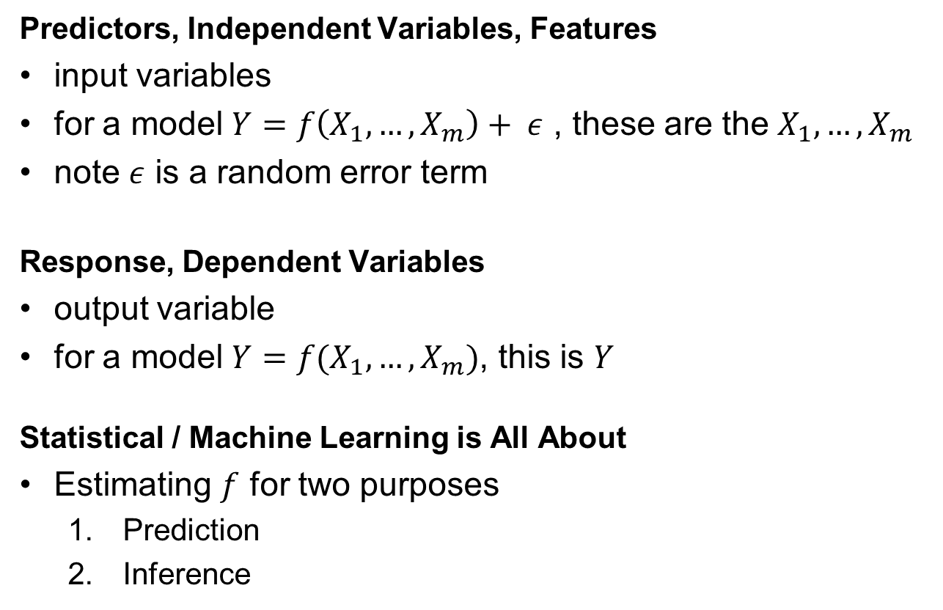
The Model
Predictors, Independent Variables, Features
input variables
for a model $Y=f\left(X_{1},…,X_{m}\right)+ ε$ , these are the $X_{1},…,X_{m}$
note $ε$ is a random error term
Response, Dependent Variables
output variable
for a model $Y=f(X_{1},…,X_{m})$, this is $Y$
Statistical / Machine Learning is All About
Estimating $f$ for two purposes
Prediction
Inference

Slide 26
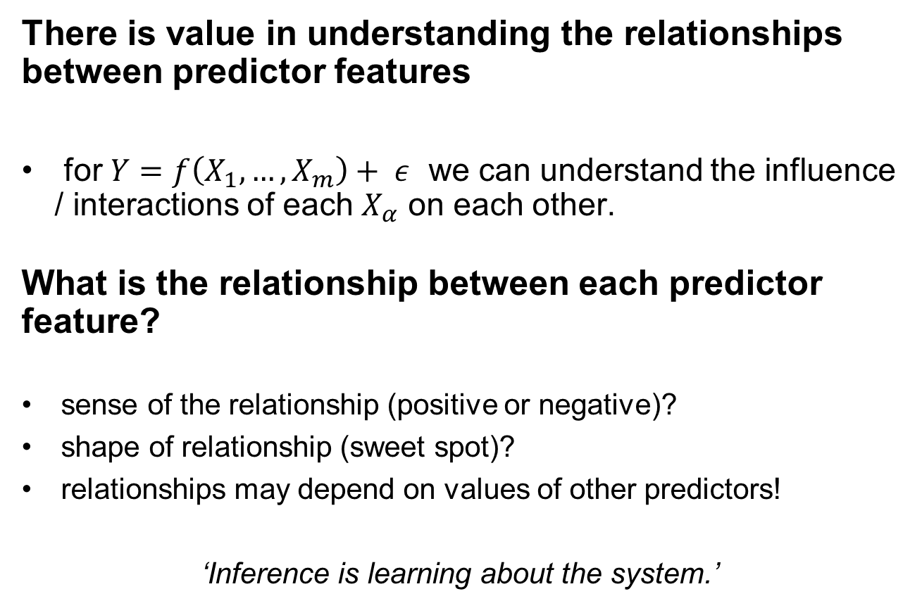
Inference
There is value in understanding the relationships between predictor features
for $Y=f\left(X_{1},…,X_{m}\right)+ ε$ we can understand the influence / interactions of each $X_{α}$ on each other.
What is the relationship between each predictor feature?
sense of the relationship (positive or negative)?
shape of relationship (sweet spot)?
relationships may depend on values of other predictors!
‘Inference is learning about the system.’

Slide 27
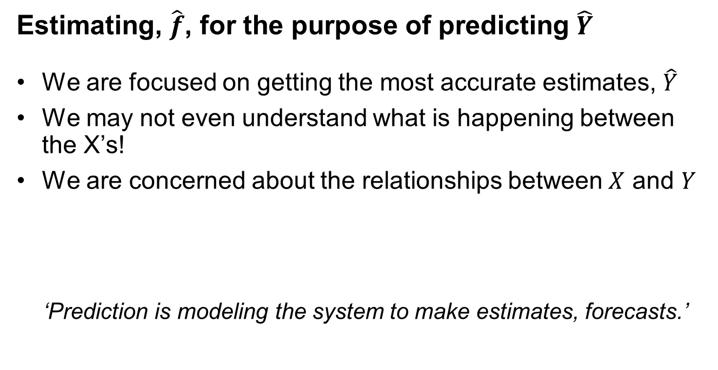
Prediction
Estimating, $\hat{f}$, for the purpose of predicting $\hat{Y}$
We are focused on getting the most accurate estimates, $\hat{Y}$
We may not even understand what is happening between the X’s!
We are concerned about the relationships between $X$ and $Y$
‘Prediction is modeling the system to make estimates, forecasts.’

Slide 28

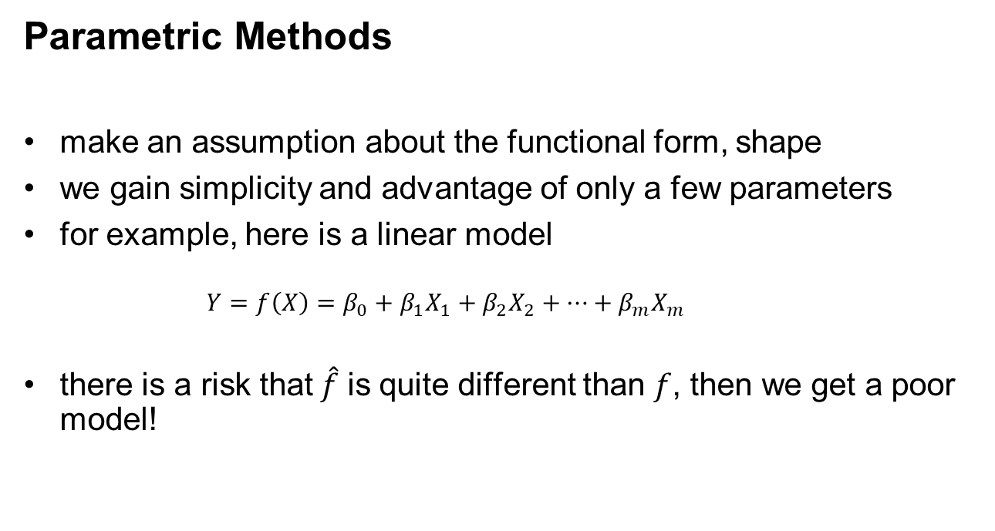
Estimating $f$
Parametric Methods
make an assumption about the functional form, shape
we gain simplicity and advantage of only a few parameters
for example, here is a linear model
$$Y=f\left(X\right)=β_{0}+β_{1}X_{1}+β_{2}X_{2}+…+β_{m}X_{m}$$
there is a risk that$\hat{f}$ is quite different than $f$, then we get a poor model!

Slide 29
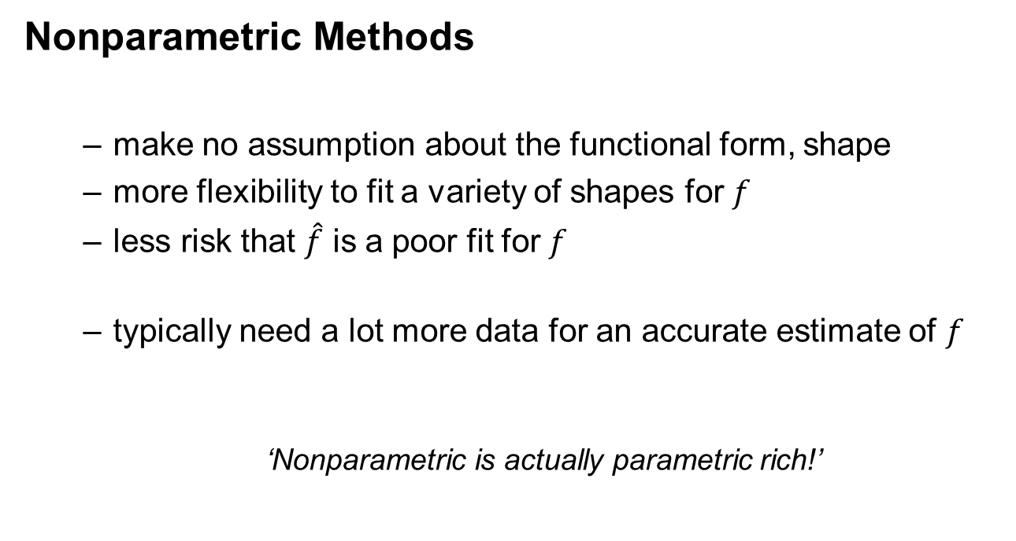
Estimating $f$
Nonparametric Methods
make no assumption about the functional form, shape
more flexibility to fit a variety of shapes for $f$
less risk that $\hat{f}$ is a poor fit for $f$
typically need a lot more data for an accurate estimate of $f$
‘Nonparametric is actually parametric rich!’

Slide 30
Training and Testing
The Training and Testing Workflow
Train the Model
Train the Model Parameters
Maximize Accuracy with Training Data
Separate The Data
Training
Testing
Tune the Model
Test the Model Tune the Hyperparameters
to Optimize the Complexity
We avoid the overfit problem.

Slide 31
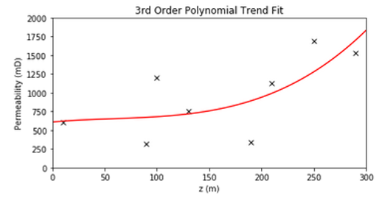
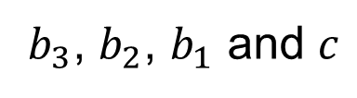

Model Parameters Definition
Model Parameters
Derived during training phase to fit the model to the training data
Parameters
$$k=b_{3}z^{3}+b_{2}z^{2}+b_{1}z+c$$
$b_{3}$, $b_{2}$, $b_{1}$ and $c$

Slide 32
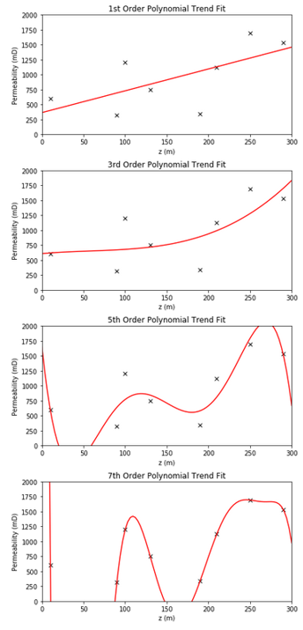



Model Hyperparameters Definition
Model Hyperparameters
Set prior to learning from the data. Impact the form of the model and often the complexity.
3rd Order:
$$k=b_{3}z^{3}+b_{2}z^{2}+b_{1}z+c$$
2nd Order:
$$k=b_{2}z^{2}+b_{1}z+c$$
1st Order:
$$k=b_{1}z+c$$

Slide 33
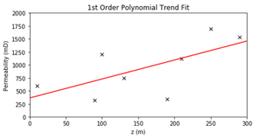
Prediction Accuracy vs. Model Interpretability / Explainability
Interpretability / Explain-ability
is the ability to understand the model
how each predictor is associated with the response
for example, with a linear model is very easy to observe the influence of each predictor on the response
but for an artificial neural net it is very difficult

Slide 34
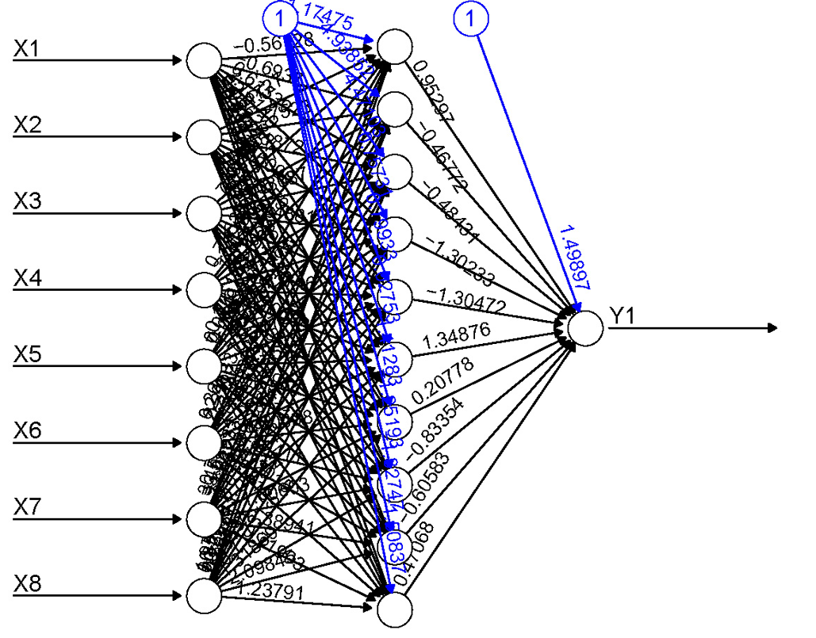
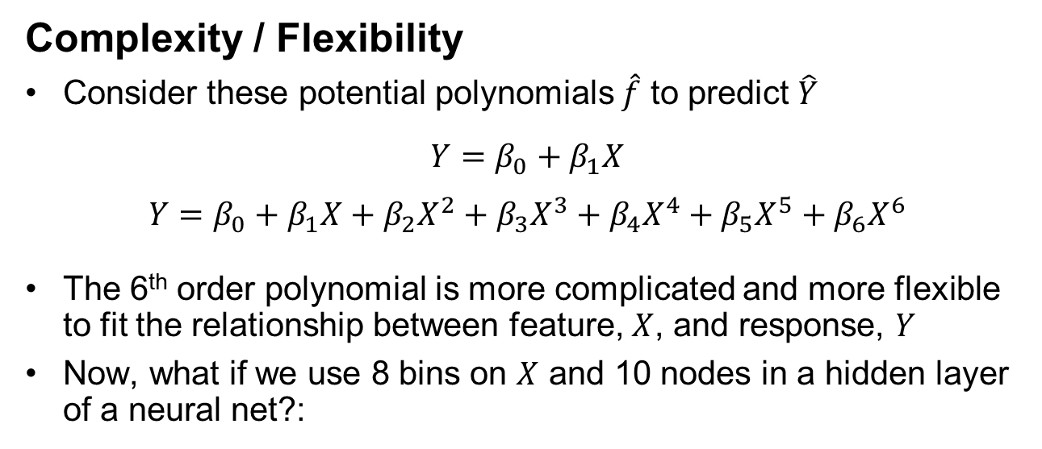

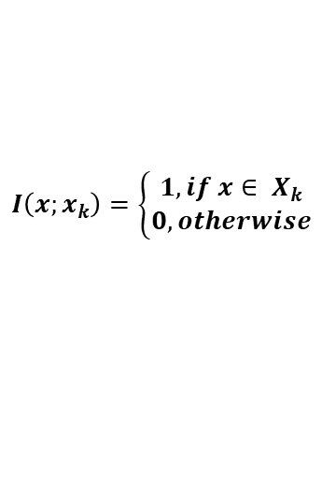
Complexity / Flexibility
Complexity / Flexibility
Consider these potential polynomials $\hat{f}$ to predict $\hat{Y}$
$$Y=β_{0}+β_{1}X$$
$$Y=β_{0}+β_{1}X+β_{2}X^{2}+β_{3}X^{3}+β_{4}X^{4}+β_{5}X^{5}+β_{6}X^{6}$$
The 6th order polynomial is more complicated and more flexible to fit the relationship between feature, $X$, and response, $Y$
Now, what if we use 8 bins on $X$ and 10 nodes in a hidden layer of a neural net?:
Indicator Code X into Bins
We will discuss neural nets later.
$$I\left(x;x_{k}\right)=\left\{\begin{matrix}1, if x∈ X_{k} \\ 0, otherwise\end{matrix}\right.$$
$$Y$$
Neural network in R image from: https://beckmw.files.wordpress.com/2013/11/neuralnet_plot.jpg

Slide 35
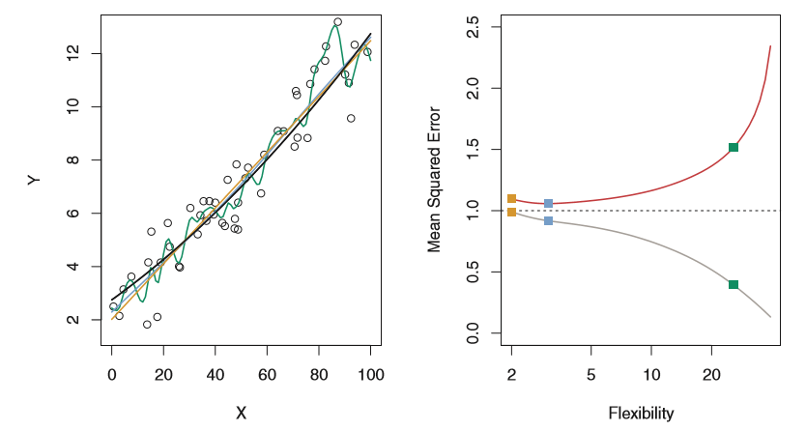
Assessing Model Accuracy
Flexibility / Complexity vs. Accuracy
Increased flexibility will generally decrease MSE on the training dataset
May result in increase MSE with testing data
Not generally a good idea to select method only to minimize training MSE
Testing
Training
Data and model fits (left) and MSE for training and testing (right) from James et al. (2013).

Slide 36
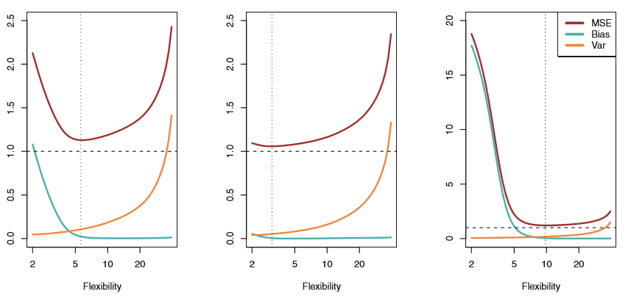
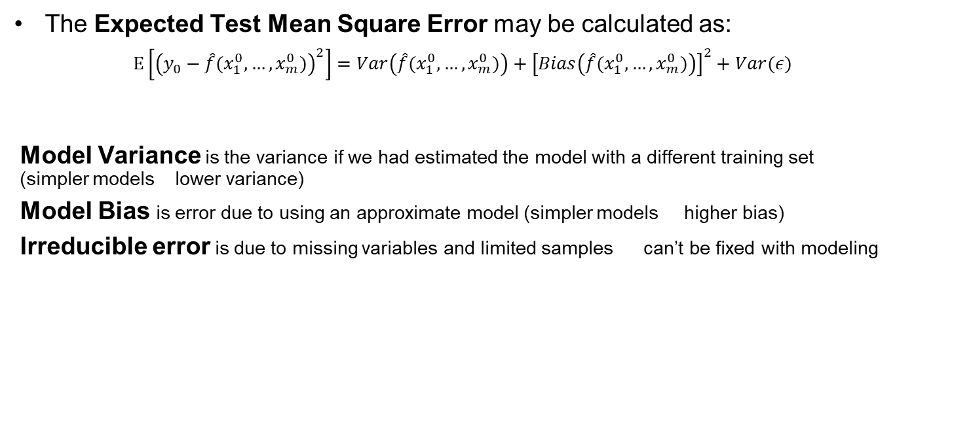
Bias and Variance Trade-off
The Expected Test Mean Square Error may be calculated as:
$$E\left[{\left(y_{0}−\hat{f}(x_{1}^{0},…,x_{m}^{0})\right)}^{2}\right]=Var\left(\hat{f}(x_{1}^{0},…,x_{m}^{0})\right)+{\left[Bias\left(\hat{f}(x_{1}^{0},…,x_{m}^{0})\right)\right]}^{2}+Var(ε)$$
Model Variance is the variance if we had estimated the model with a different training set (simpler models lower variance)
Model Bias is error due to using an approximate model (simpler models higher bias)
Irreducible error is due to missing variables and limited samples can’t be fixed with modeling
Model Variance
Model Bias
Irreducible
optimum flexibility
optimum flexibility
optimum flexibility
irreducible
error
irreducible
error
irreducible
error
Flexibility / Complexity
Flexibility / Complexity
Flexibility / Complexity
Model variance, model bias and test MSE for 3 datasets with variable flexibility (Fig 2.12, James et al., 2013), labels added for clarification.

Slide 37
Statistical Learning New Tools
Topic | Application to Subsurface Modeling
Data Analytics is the use of statistics, geoscience and engineering with data. | Learn applied statistics and workflows to support your work with data. Growing new competencies to augment geoscience and engineering expertise is a great solution, consider open source packages in Python.
Parametric and Nonparametric | Parametric models need less data to train but may have model bias, nonparametric models often are parametric rich and may be overfit. Be aware of the performance of your selected modeling methods.
Model bias, Model variance and Irreducible Error | There is an error trade-off for accuracy with testing data. Low complexity models may outperform high complexity models.

Slide 38
Geostatistics and Machine Learning Introduction
Introduction
Lecture outline . . .
General Comments
Data Analytics
Machine / Statistical Learning
Prediction and Inference
Data Analytics
Inferential Methods
Predictive Methods
Advanced Methods
Conclusions
Instructor: Michael Pyrcz, the University of Texas at Austin

