Slide 1
Daytum +2 Course Data Preparation
Lecture outline . . .
Sampling Limitations
Declustering
Quantifying Uncertainty
Instructor: Michael Pyrcz, the University of Texas at Austin

Slide 2
Daytum +2 Course Data Preparation
Lecture outline . . .
Sampling Limitations
Instructor: Michael Pyrcz, the University of Texas at Austin

Slide 3
One Source of Bias Data Collection
Data is collected to answer questions:
how far does the contaminant plume extend? – sample peripheries
where is the fault? – drill based on seismic interpretation
what is the highest mineral grade? – sample the best part
who far does the reservoir extend? – offset drilling
and to maximize NPV directly:
maximize production rates

Slide 4
Representativity
The concern is when we attempt to make an estimate:
e.g. the average porosity to calculate OIP
1
6
7
4
5
y
2
3
x

Slide 5
Representativity
The concern is when we attempt to make an estimate:
What if we knew from seismic that the reservoir quality is better in the top left area?
1
High
6
7
4
5
y
2
Low
3
x

Slide 6
Representativity
The concern is when we attempt to make an estimate:
What if we knew from seismic that the reservoir quality is better in the top left area?
8
6
1
12
9
10
7
4
5
y
11
2
3
x

Slide 7
Representativity
The concern is when we attempt to make an estimate:
We need to mitigate this bias.
Drilling representatively? Why do we drill in a biased manner?
Well Average
Porosity
Sampling Bias
Number of Wells Drilled

Slide 8
(Geo)statistics Sampling Representatively
How Would We Sample for Representativity?
Random Sampling: when every item in the population has a equal chance of being chosen. Selection of every item is independent of every other selection.
Is random sampling sufficient for subsurface? Is it available?
Regular Sampling: when samples are taken at regular intervals (equally spaced).
Less reliable than random sampling.
Warning: May resonate with some unsuspected environmental variable.

Slide 9
Data Collection
If we were sampling for representativity of the sample set and resulting sample statistics, by theory we have 2 options:
random sampling
regular sampling (as long as we don’t align with natural periodicity)
What would happen if you proposed random sampling in the Gulf of Mexico at $150M per well?
We should not change current sampling methods as they result in best economics, we should address sampling bias in the data.
Never use raw spatial data without access sampling bias / correcting.

Slide 10
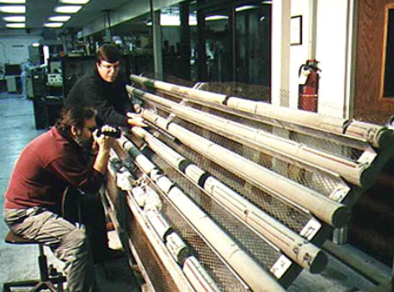
(Geo)statistics Sampling Bias
Example of Sampling Bias:
Well’s drilled in part of reservoir identified to have the greatest thickness in seismic.
Core extracted from the well bore in the location estimated to have the best reservoir.
Core plugs extracted from whole cores for porosity / permeability analysis avoiding shales.
Routine core analysis from https://www.rigzone.com/training/insight.asp?insight_id=325.
Prof. Michael Pyrcz, Ph.D., P.Eng., the University of Texas at Austin, PGE 337 - Introduction to Geostatistics, @GeostatsGuy

Slide 11
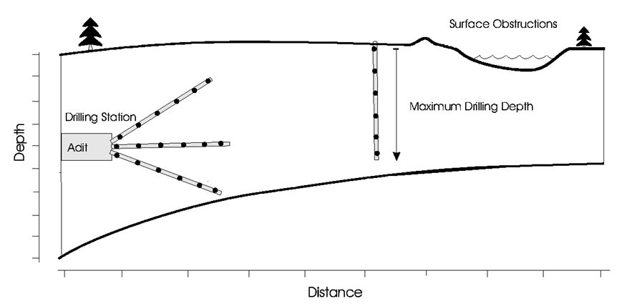
(Geo)statistics Sampling Bias
There are also limits to our data collection:
accessibility to the sample – obstruction, reliable drilling, subsalt imaging
inability to process the sample – may not be able to recover shale core samples
can’t run permeability evaluation on low permeability rock
Image from Pyrcz and Deutsch (2003) http://gaa.org.au/pdf/DeclusterDebias-CCG.pdf

Slide 12
Spatially Clustered Data
Data are rarely collected for their statistical representativity:
Wells are drilled in areas with the greatest probability of high production
Horizontal wells target stratigraphic zones of interest (high pay)
Core are taken preferentially from good quality reservoir rock
These data collection practices should not be changed:
best economics
most data in the most important locations

Slide 13
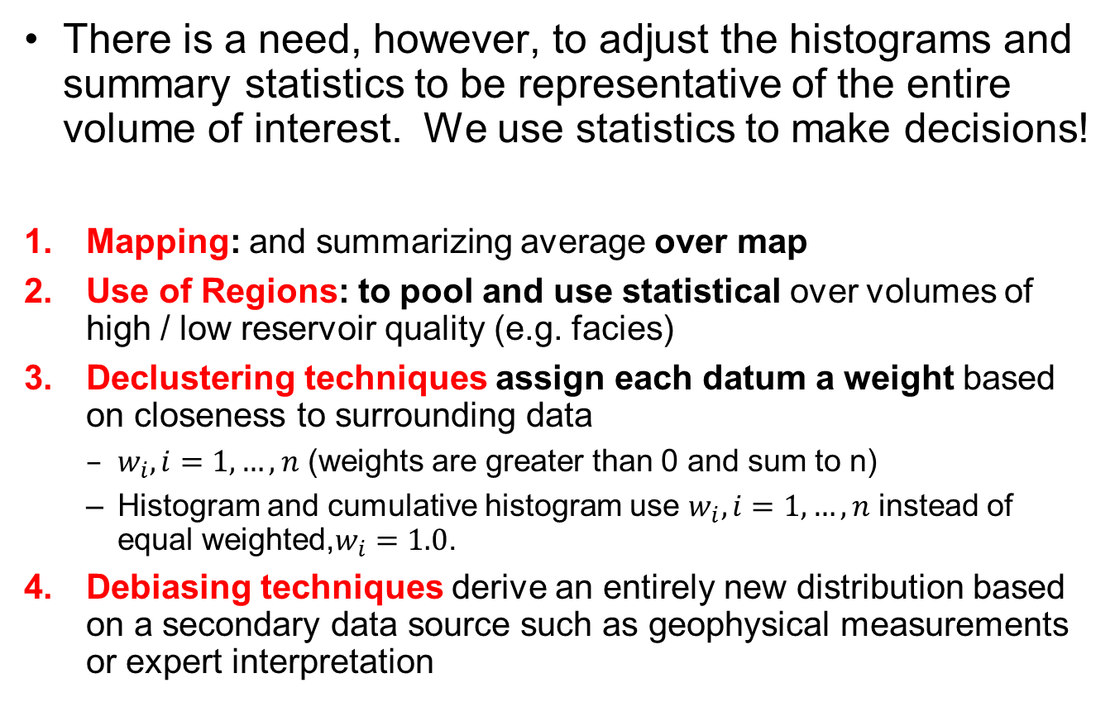
Solutions to Biased Sampling
There is a need, however, to adjust the histograms and summary statistics to be representative of the entire volume of interest. We use statistics to make decisions!
Mapping: and summarizing average over map
Use of Regions: to pool and use statistical over volumes of high / low reservoir quality (e.g. facies)
Declustering techniques assign each datum a weight based on closeness to surrounding data
$w_{i},i=1,…,n$ (weights are greater than 0 and sum to n)
Histogram and cumulative histogram use $w_{i},i=1,…,n$ instead of equal weighted,$w_{i}=1.0$.
Debiasing techniques derive an entirely new distribution based on a secondary data source such as geophysical measurements or expert interpretation

Slide 14
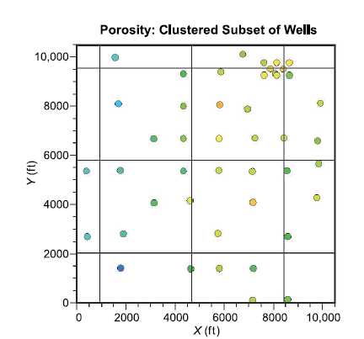
(Geo)statistics Goal of Sampling and Statistics Example
Addressing Bias:
Would it be fair to calculate the average of these wells and to apply that as an average for this area of interest?
What is the average porosity over this reservoir?
Porosity sample data for an example reservoir (Pyrcz and Deutsch, 2014).

Slide 15
(Geo)statistics Sampling Bias
Addressing Bias with Regions:
Would it be fair to calculate the average of these wells and to apply that as an average for this area of interest?
Break model up into subsets.
Avoid densely sampled high quality reservoir inflating average over the entire reservoir
Low
Quality
High Quality
Medium Quality
Porosity sample data for an example reservoir (Pyrcz and Deutsch, 2014).

Slide 16
(Geo)statistics Sampling Bias
Addressing Bias:
Would it be fair to calculate the average of these wells and to apply that as an average for this area of interest?
Build a map of the property of interest.
Calculate the average of the map
Avoid densely sampled high
Porosity sample data for an example reservoir (Pyrcz and Deutsch, 2014).

Slide 17
Daytum +2 Course Data Preparation
Lecture outline . . .
Declustering
Instructor: Michael Pyrcz, the University of Texas at Austin

Slide 18
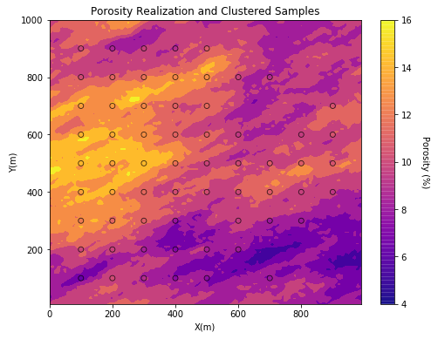
Spatially Clustered Data Example
What is wrong with this sample set?

Slide 19
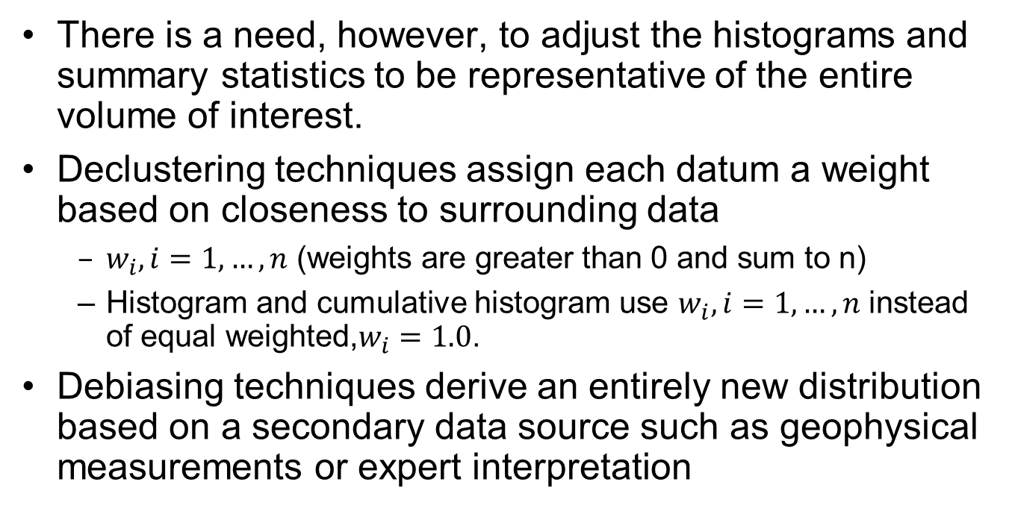
Spatially Clustered Data
There is a need, however, to adjust the histograms and summary statistics to be representative of the entire volume of interest.
Declustering techniques assign each datum a weight based on closeness to surrounding data
$w_{i},i=1,…,n$ (weights are greater than 0 and sum to n)
Histogram and cumulative histogram use $w_{i},i=1,…,n$ instead of equal weighted,$w_{i}=1.0$.
Debiasing techniques derive an entirely new distribution based on a secondary data source such as geophysical measurements or expert interpretation

Slide 20
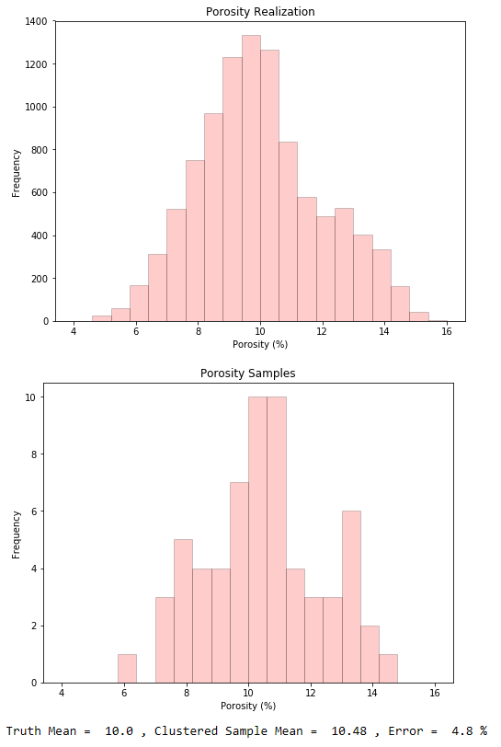
Spatially Clustered Data
Location map of 64 wells. with truth model.
See the error between the samples and the underlying truth model.

Slide 21
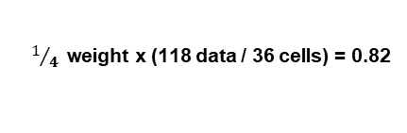
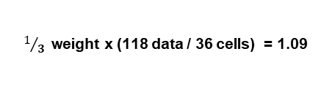

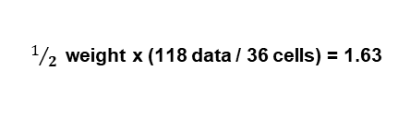
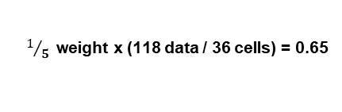
Cell Declustering
Cell Declustering, is robust in 3-D and when the limits are poorly defined:
divide the volume of interest into a grid of cells l=1,…,L
count the occupied cells L_{o} and the number in each cell n_{l}, l=1,…, L_{o}
weight inversely by number in cell (standardize by L_{o})
The issue, of course, is how to choose the cell size…
$1$weight x (118 data / 36 cells) = 3.27
$1/3$weight x (118 data / 36 cells) = 1.09
$1/4$weight x (118 data / 36 cells) = 0.82
$1/5$weight x (118 data / 36 cells) = 0.65
$1/2$weight x (118 data / 36 cells) = 1.63
Sum of all weights = n
Nonclustered weight = 1.0

Slide 22
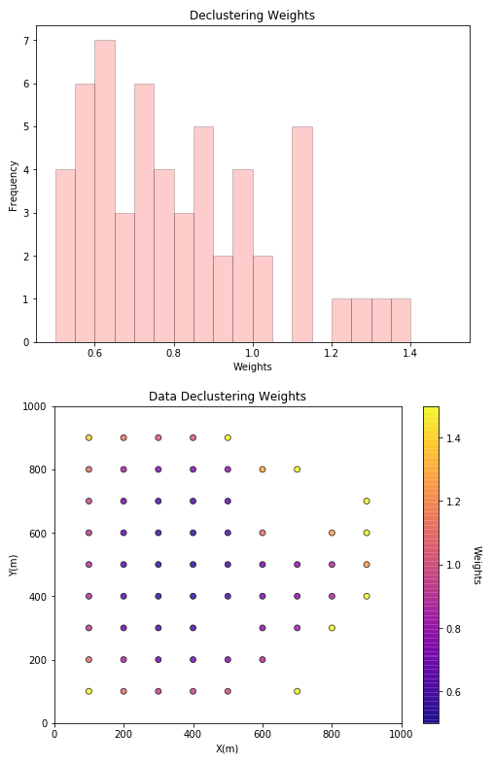
Declustering Weights
Declustering weights
1.0 nominal weight
< 1.0 reduced weight
> 1.0 increased weight

Slide 23
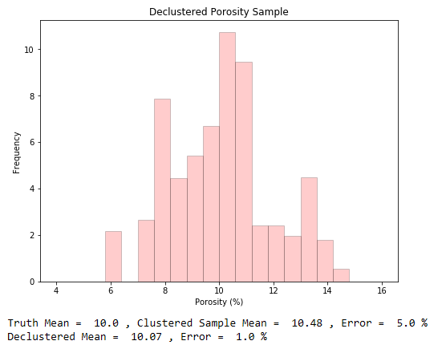
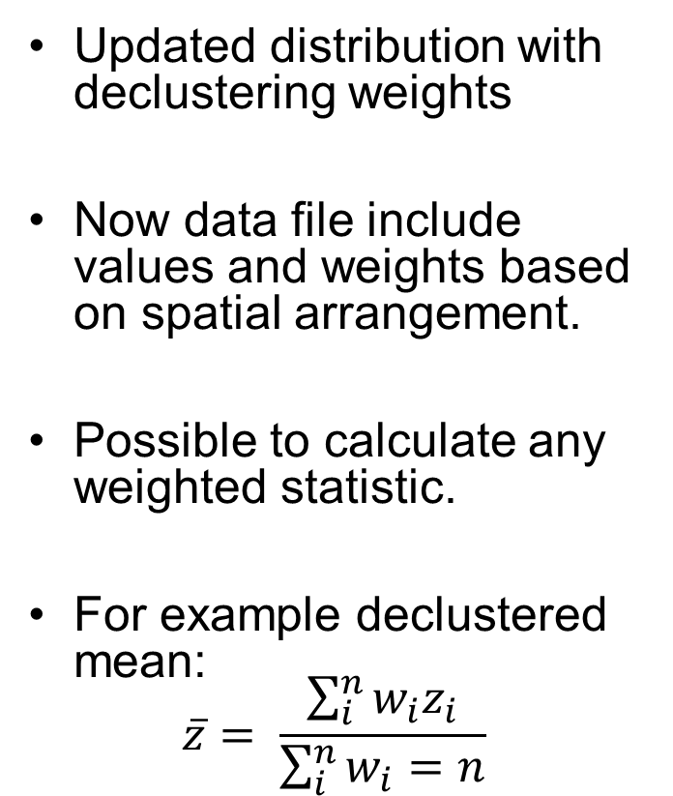
Declustered Distribution
Updated distribution with declustering weights
Now data file include values and weights based on spatial arrangement.
Possible to calculate any weighted statistic.
For example declustered mean:
$$\overline{z}= \frac{\sum_{i}^{n}{w_{i}z_{i}}}{\sum_{i}^{n}{w_{i}=n}}$$

Slide 24
The Cell Size
Plot declustered mean versus the cell size for a range of cell sizes:
There is no theory that says we are looking for a minimum when the values are clustered in high values or a maximum when clustered in low values – it just seems to make sense
The result can be very sensitive to large scale trends – it is often better to choose the cell size be visual inspection and some sensitivity studies
23.0
22.0
21.0
20.0
19.0
Number of Data 122
mean 20.02
std. dev. 6.63.
coef. of var. 0.33
maximum 29.31
upper quartile 25.32
median 22.02
lower quartile 16.22
minimum 6.06
cell declustering
Declustered Mean, Porosity, %
0.10
0.08
0.06
0.04
0.02
0.00
Frequency
Minimum declustered mean
0 200 400 600 800 1000
0.0 10.0 20.0 30.0 40.0
Cell Size
Porosity, %

Slide 25
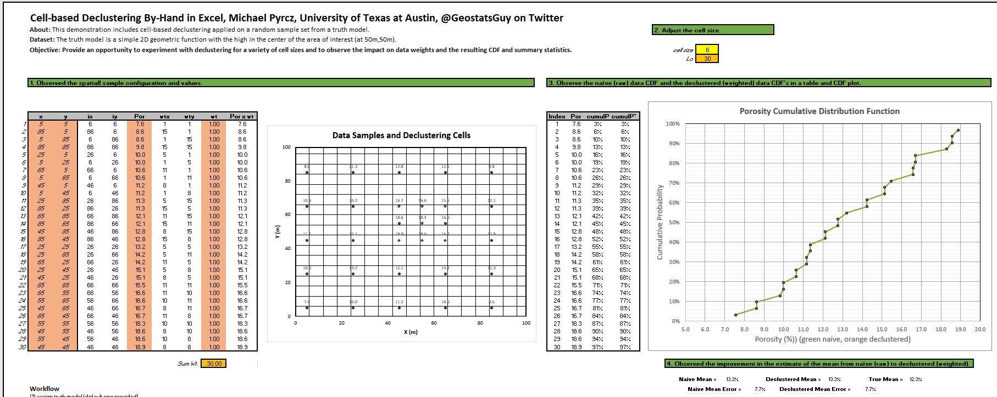
Declustering Hands-on
Here’s an opportunity for experiential learning with Cell-based Declustering.
Things to try:
Set the cell size very small (1). What’s the data weights and CDF / mean? Very large?
What do you think is the best cell size for this data configuration?
File Name: Declustering_Debiasing_Demo.xlsx File is at: https://git.io/fxA3O

Slide 26

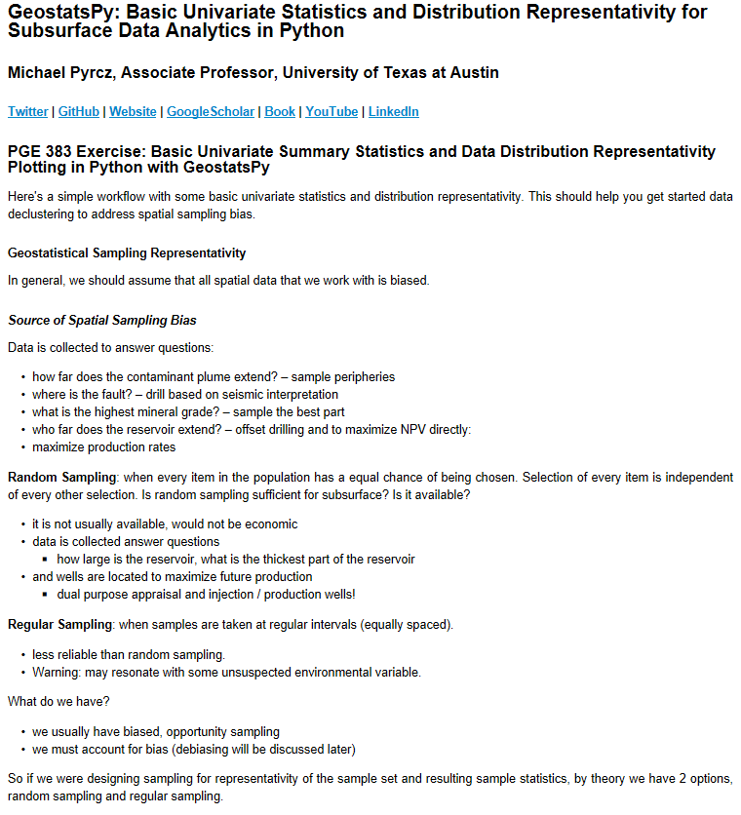
Python / GSLIB Declustering Demo
Here’s a workflow that used GeostatsPy.
Things to demonstrate:
Load data, visualize
Cell-base declustering
Visualize the weights
Calculated weighted statistics
Check multiple cell sizes
Data File is at: https://git.io/fh0CW and Jupyter Notebook Workflow is at: https://git.io/fhgJl

Slide 27
Probability and Statistics New Tools
Topic | Application to Subsurface Modeling
Awareness | Every subsurface dataset is sampled to answer questions and add value, not for statistical representativity. Assume all data sets are biased, test for bias.
Cell Declustering | Given the spatial location of the sample data, calculate declustering weights. Build representative sample statistics that correct for sampling bias.

Slide 28
Daytum +2 Course Data Preparation
Introduction
Lecture outline . . .
Quantifying Uncertainty
Fundamental Concepts
Probability
Data Prep / Analytics
Spatial Continuity / Prediction
Multivariate Modeling
Uncertainty Modeling
Machine Learning
Instructor: Michael Pyrcz, the University of Texas at Austin

Slide 29
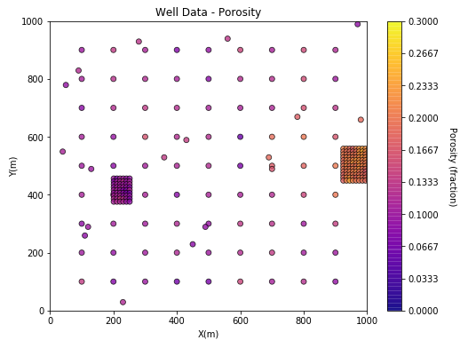
Bootstrap Motivation
Uncertainty in the Sample Statistics
One source of uncertainty is the paucity of data.
Do these 200 or so wells provide a precise (and accurate estimate) of the mean? standard deviation? skew? P13?

Slide 30
Bootstrap Motivation
Would it be Useful to Know the Uncertainty in these Statistics Due to Limited Sampling?
What is the impact of uncertainty in the mean porosity e.g. 20%+/-2%?

Slide 31
Bootstrap Definition
Bootstrap
method to assess the uncertainty in a sample statistic by repeated random sampling with replacement
Assumptions
sufficient, representative sampling
Limitations
assumes the samples are representative
assumes stationarity
only accounts for uncertainty due to too few samples, e.g. no uncertainty due to changes away from data
does not account for area of interest
assumes the samples are independent
does not account for other local information sources
No spatial
Context

Slide 32
Univariate Statistics Bootstrap
Bootstrap for Uncertainty in the Mean
Freq.
n = 10
EUR Distribution
CDF
10 Monte
Carlo Simulations
EUR Distribution
Well Aggregate
Average
Realization #1
Freq.
Freq.
Uncertainty in the Mean
Well Aggregate Realization #1

Slide 33
Univariate Statistics Bootstrap
Bootstrap for Uncertainty in the Mean
Freq.
n = 10
EUR Distribution
CDF
EUR Distribution
Well Aggregate
Average
Realization #1
Freq.
Freq.
Uncertainty in the Mean
Well Aggregate
Average
Realization #2
Well Aggregate Realization #1
Freq.
Well Aggregate Realization #2

Slide 34
Univariate Statistics Bootstrap
Bootstrap for Uncertainty in the Mean
Freq.
n = 10
EUR Distribution
CDF
EUR Distribution
Well Aggregate
Average
Realization #1
Freq.
Freq.
Well Aggregate
Average
Realization #3
Uncertainty in the Mean
Freq.
Well Aggregate
Average
Realization #2
Well Aggregate Realization #1
Freq.
Well Aggregate Realization #3
Well Aggregate Realization #2

Slide 35
Univariate Statistics Bootstrap
Bootstrap for Uncertainty in the Mean
Monte Carlo Simulations
Sample Data (n = 10)
CDF
Frequency
Subsurface Variable
Subsurface Variable
10 Monte Carlo Sim.
Well Aggregate
Average
Realization #1
Realizations
ℓ = 1,…, L
PDF
10 Monte Carlo Sim.
Well Aggregate
Average
Realization #3
Frequency
Uncertainty in
the Average
Well Aggregate
Average
Realization #2
Well Aggregate Realization #1
Frequency
10 Monte Carlo Sim.
Frequency
Well Aggregate Realization #3
Well Aggregate Realization #2

Slide 36

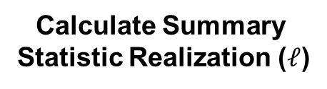

Univariate Statistics Bootstrap
Bootstrap Approach (Efron, 1982)
Statistical resampling procedure to calculate uncertainty in a calculated statistic from the data itself.
For uncertainty in the mean solution is standard error:
Extremely powerful. Could get uncertainty in any statistic! e.g. P13, skew etc.
Would not be possible without bootstrap.
Advanced forms account for spatial information and strategy (game theory).
Gather Sample Set (n)
n Random Samples
with Replacement
$$σ_{\overline{x}}^{2}=\frac{σ_{s}^{2}}{n}$$
Calculate Summary
Statistic Realization ($ℓ$)
Pool $ℒ$ realizations
Summarize Uncertainty

Slide 37
Univariate Statistics Bootstrap
You now know about one of the most powerful tools ever!
Caveats:
assumes the sample set is representative
unbiased and covers the full range
assumes all samples are independent if not consider Journel’s spatial bootstrap (1993).
You can do bootstrap in Excel.
Gather Sample Set (n)
n Random Samples
with Replacement
Calculate Summary
Statistic Realization ($ℓ$)
Pool $ℒ$ realizations
Summarize Uncertainty

Slide 38
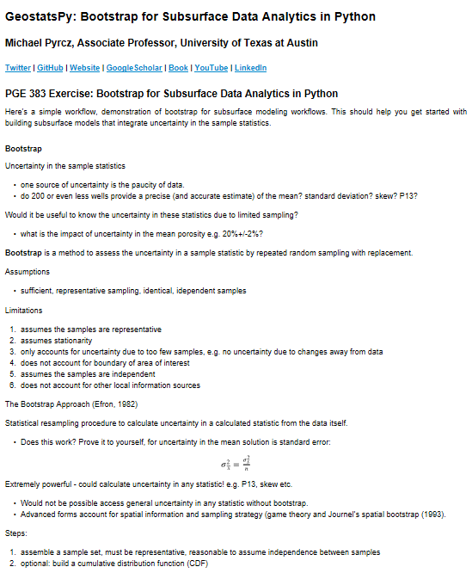
Univariate Statistics Bootstrap Demo
Things to demonstrate:
Load data, visualize
Summary statistics
Bootstrap Realizations
Summarization over Bootstrap Realizations
Uncertainty in Average and Standard Deviation

Slide 39
Univariate Statistics New Tools
Topic | Application to Subsurface Modeling
Awareness of Uncertainty Due to Sparse Sampling | Sample statistics are uncertain due to limited sampling Quantify and apply this uncertainty model in subsurface modeling workflows.
Bootstrap | Resamling with replacement to calculate realizations of statistics While aware of the limitations, use them method to calculate uncertainty in e.g. mean porosity and carry through workflow as scenarios

Slide 40
Daytum +2 Course Data Preparation
Lecture outline . . .
Sampling Limitations
Declustering
Quantifying Uncertainty
Instructor: Michael Pyrcz, the University of Texas at Austin

