Slide 1
Daytum +2 Course Spatial Data Analytics
Lecture outline . . .
Stationarity
Spatial Continuity
Variogram Calculation
Spatial Estimation
Introduction
Fundamental Concepts
Probability
Data Prep / Analytics
Spatial Continuity / Prediction
Multivariate Modeling
Uncertainty Modeling
Machine Learning
Instructor: Michael Pyrcz, the University of Texas at Austin

Slide 2
Daytum +2 Course Spatial Data Analytics
Lecture outline . . .
Stationarity
Instructor: Michael Pyrcz, the University of Texas at Austin

Slide 3
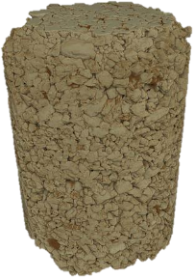
Stationarity Substituting Time for Space
Any statistic requires replicates, repeated sampling (e.g. air or water samples from a monitoring station). In our geospatial problems repeated samples are not available at a location in the subsurface.
Instead of time, we must pool samples over space to calculate our statistics. This decision to pool is the decision of stationarity. It is the decision that the subset of the subsurface is all the “same stuff”.
After Sample
Extraction
Extracted Sample at Location, u₁
Hole Remains at Location, u₁

Slide 4

Stationarity Substituting Time for Space
The decision of the stationary domain for sampling is an expert choice. Without it we are stuck in the “hole” and cannot calculate any statistics nor say anything about the behavior of the subsurface between the sample data.
Import License: choice to pool specific samples to evaluate a statistic.
Export License: choice of where in the subsurface this statistic is applicable.
u₃
u₇
u₆
u₁
u₄
u₅
Property of Interest
Histogram
u₂
Stationary domain, samples at locations, u₁₋₇

Slide 5
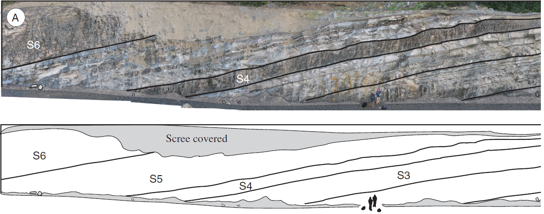
Stationarity Definition 1: Geologic
Geological Definition: e.g. ‘The rock over the stationary domain is sourced, deposited, preserved, and postdepositionally altered in a similar manner, the domain is map-able and may be used for local prediction or as information for analogous locations within the subsurface; therefore, it is useful to pool information over this expert mapped volume of the subsurface.’
Photomosaic, line drawing Punta Barrosa Formation sheet complex (Fildani et al. (2009).

Slide 6
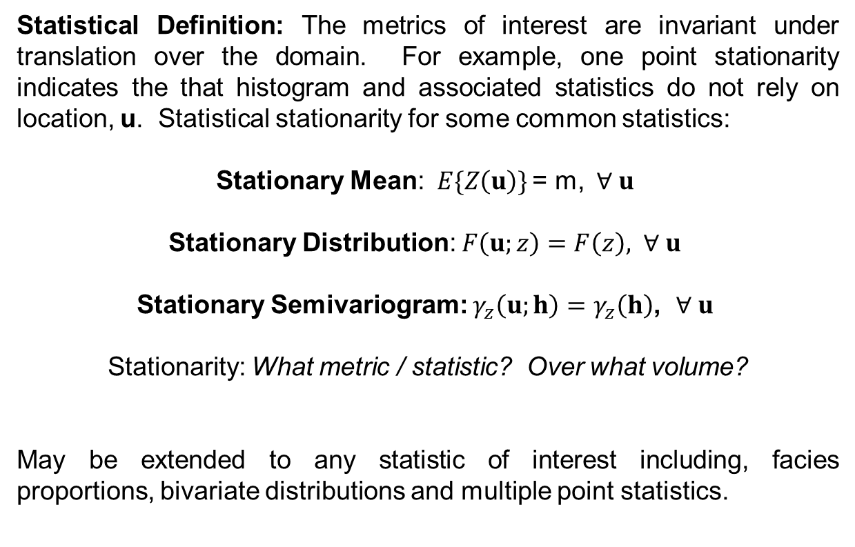
Stationarity Definition 2: Statistical
Statistical Definition: The metrics of interest are invariant under translation over the domain. For example, one point stationarity indicates the that histogram and associated statistics do not rely on location, u. Statistical stationarity for some common statistics:
Stationary Mean:$E\{Z\left(u\right)\}$ = m, $∀ u$
Stationary Distribution: $F\left(u;z\right)=F\left(z\right), ∀ u$
Stationary Semivariogram: $γ_{z}\left(u;h\right)=γ_{z}\left(h\right)$, $∀ u$
Stationarity: What metric / statistic? Over what volume?
May be extended to any statistic of interest including, facies proportions, bivariate distributions and multiple point statistics.

Slide 7
Daytum +2 Course Spatial Data Analytics
Lecture outline . . .
Spatial Continuity
Instructor: Michael Pyrcz, the University of Texas at Austin

Slide 8
Motivation for Measuring Spatial Continuity
Simple Example
Area of interest
1 Injector and 4 producers
Porosity and permeability distributions (held constant for all cases)
Producer#4
Producer#1
Injector#1
1,000m
Producer#3
Producer#2
1,000m
Frequency
Frequency
5
Porosity (%)
20
1
Permeability (mD)
200

Slide 9
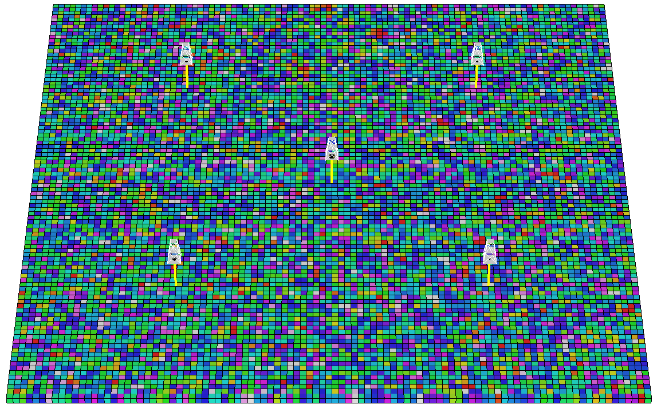
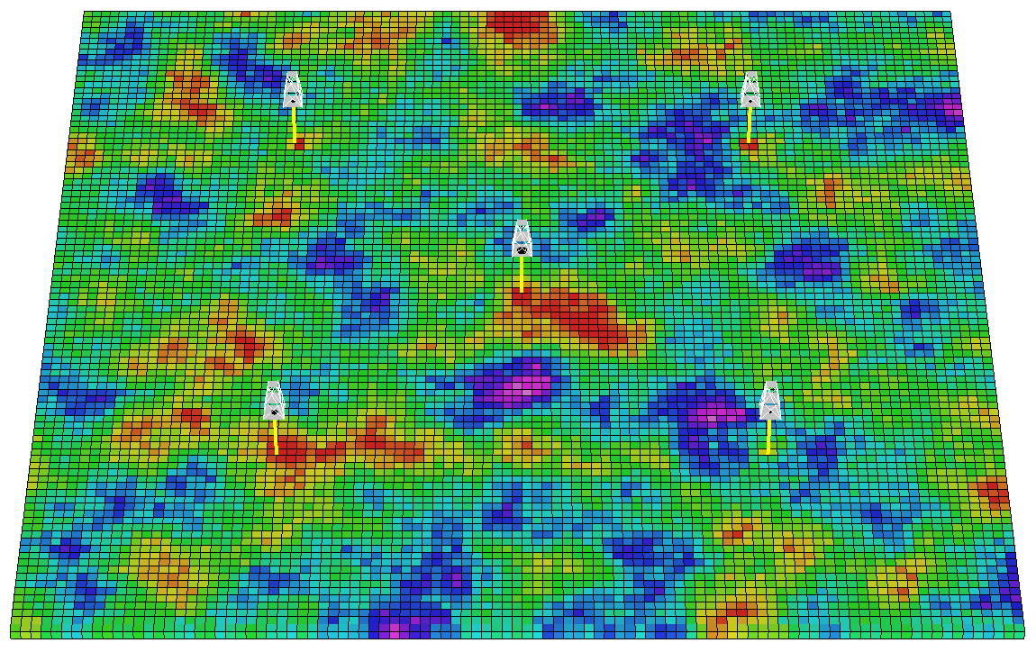
Motivation for Measuring Spatial Continuity
Does spatial continuity of reservoir properties matter?
Consider these models of permeability
Recall – all models have the same porosity and permeability distributions
Mean, variance, P10, P90 …
Same static oil in place!
Permeability (mD)
100
10
1

Slide 10
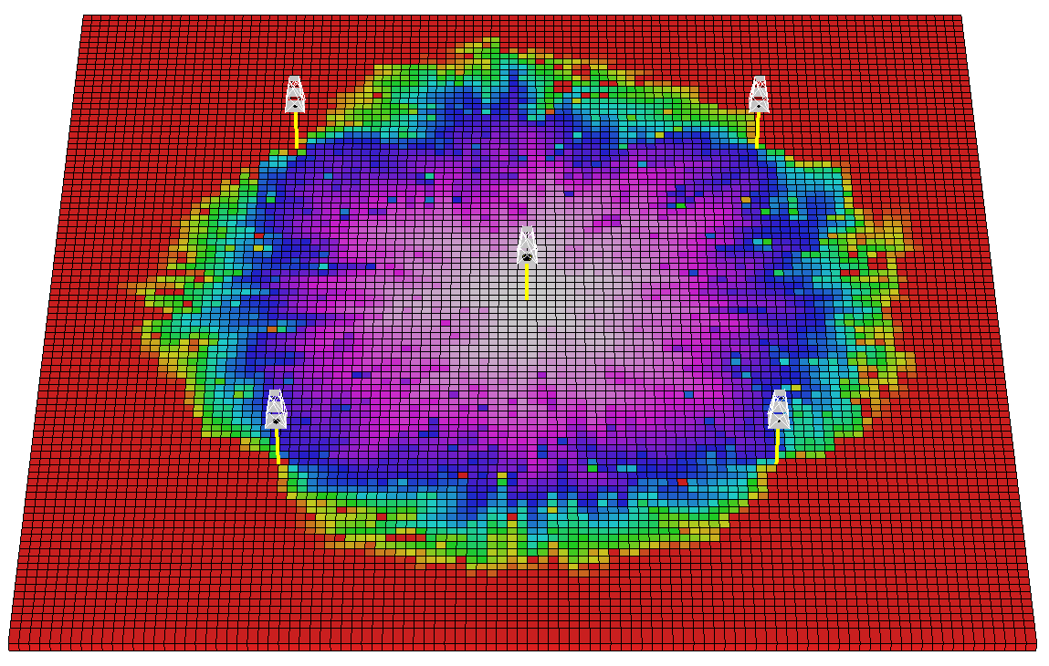
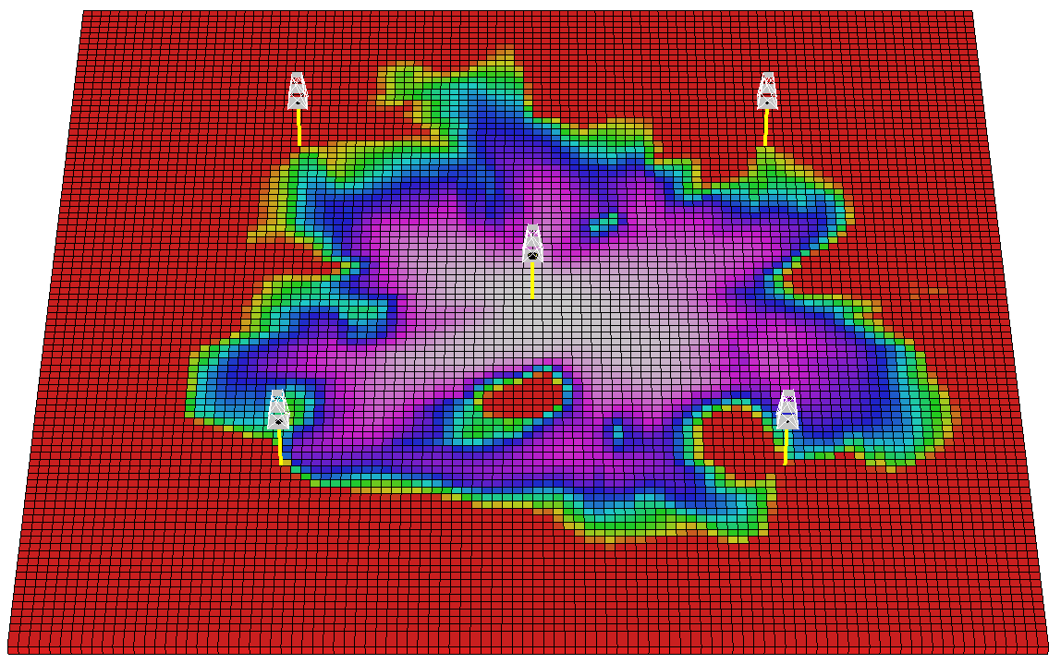
Motivation for Measuring Spatial Continuity
How does heterogeneity impact recovery factor?
Permeability (mD)
100
10
1
Time of Flight (PV)
1
0.5
0

Slide 11
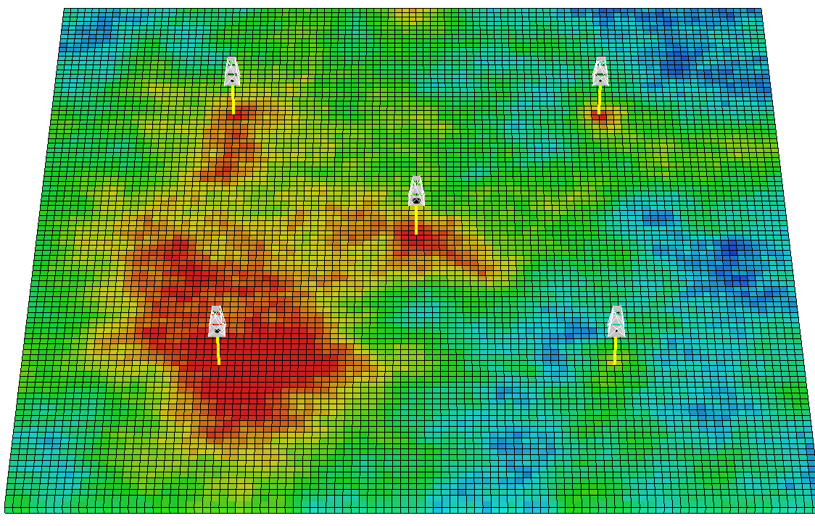
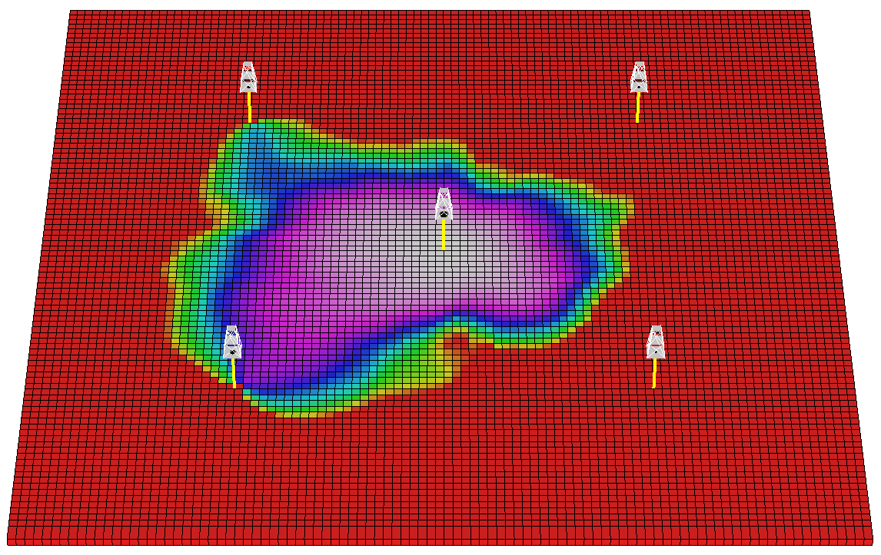
Motivation for Measuring Spatial Continuity
How does heterogeneity impact recovery factor?
Permeability (mD)
100
10
1
Time of Flight (PV)
1
0.5
0

Slide 12
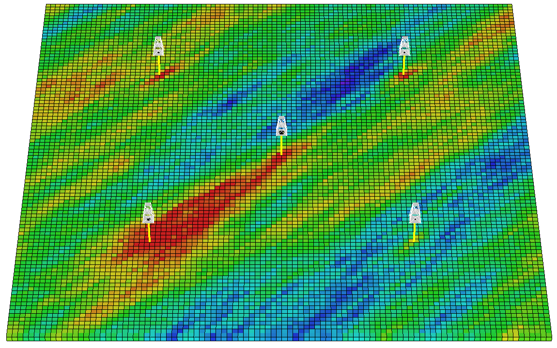
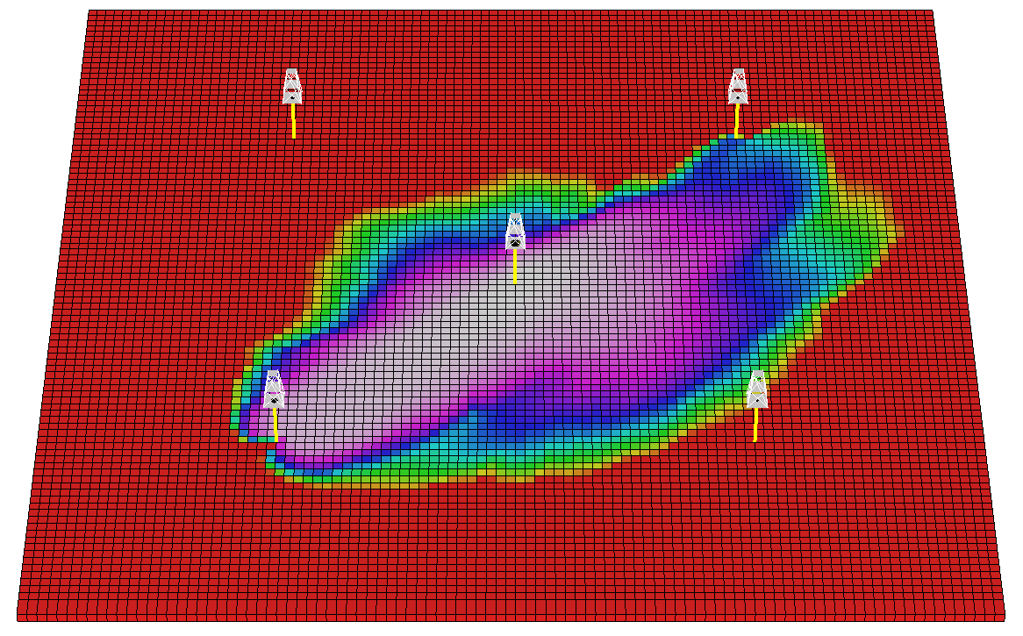
Motivation for Measuring Spatial Continuity
How does heterogeneity impact recovery factor?
Permeability (mD)
100
10
1
Time of Flight (PV)
1
0.5
0

Slide 13
Motivation for Measuring Spatial Continuity
For the same reservoir property distributions a wide range of spatial continuities are possible.
Spatial continuity often impacts reservoir forecasts.
Need to be able to:
Spatial Continuity
“Very Short”
“Medium”
Characterize / Quantify
“Long”
Spatial Continuity
Measures
Impose in Reservoir Models
“Anisotropic “

Slide 14
Spatial Continuity Definition
Spatial Continuity – correlation between values over distance.
No spatial continuity – no correlation between values over distance, random values at each location in space regardless of separation distance.
Homogenous phenomenon have perfect spatial continuity, since all values as the same (or very similar) they are correlated.

Slide 15
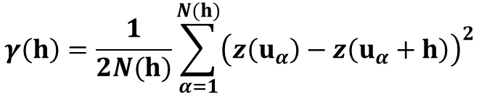
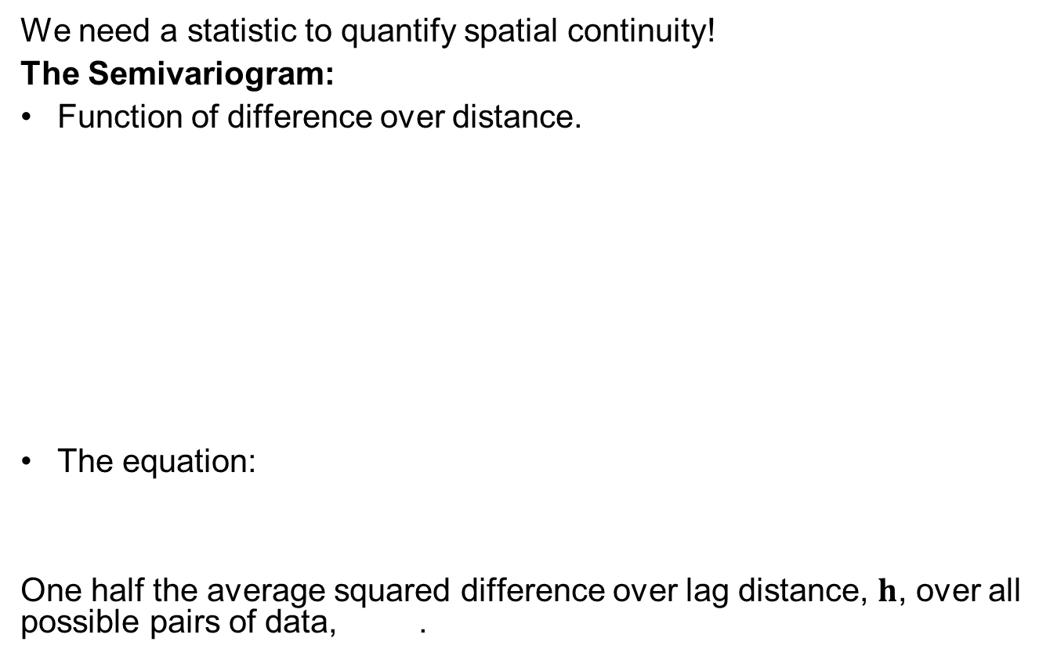


Measuring Spatial Continuity
We need a statistic to quantify spatial continuity!
The Semivariogram:
Function of difference over distance.
The equation:
One half the average squared difference over lag distance, $h$, over all possible pairs of data, .
$$γ$$
head
$$(h)$$
Variogram
h
u + h
Lag Vector
Location Vector
200
400
600
800
1000
y
tail
u
Lag Distance (h), meters in X direction
Location Vector
tail
head
$$γ\left(h\right)=\frac{1}{2N(h)}\sum_{α=1}^{N(h)}{{\left(z\left(u_{α}\right)−z\left(u_{α}+h\right)\right)}^{2}}$$
x
Modified from Deutsch, MinE310

Slide 16
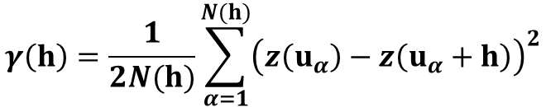
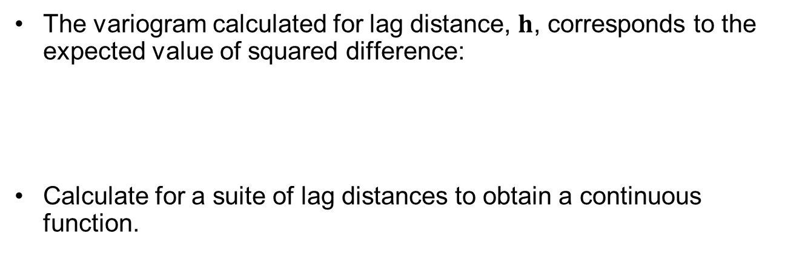



“h” Scatterplot
$$z\left(u_{α}\right)=z\left(u_{α}+h\right)$$
$$z\left(u_{α}+h\right)$$
$$z\left(u_{α}\right)$$
The variogram calculated for lag distance, $h$, corresponds to the expected value of squared difference:
Calculate for a suite of lag distances to obtain a continuous function.
$$γ\left(h\right)=\frac{1}{2N(h)}\sum_{α=1}^{N(h)}{{\left(z\left(u_{α}\right)−z\left(u_{α}+h\right)\right)}^{2}}$$

Slide 17

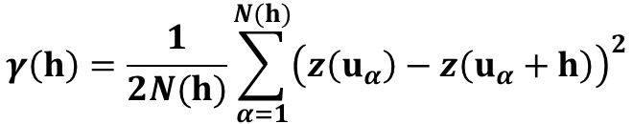

Variogram Definition
Variogram – a measure of dissimilarity vs. distance. Calculated as ½ the average squared difference of values separated by a lag vector.
The precise term is semivariogram (variogram if you remove the 1/2 ), but in practice the term variogram is used.
The ½ is used so that the covariance function and variogram may be related directly:
Note the correlogram is related to the covariance function as:
$$γ\left(h\right)=\frac{1}{2N(h)}\sum_{α=1}^{N(h)}{{\left(z\left(u_{α}\right)−z\left(u_{α}+h\right)\right)}^{2}}$$
$$C_{x}\left(h\right)= σ_{x}^{2}−γ_{x}\left(h\right)$$
$$ρ_{x}\left(h\right)=\frac{C_{x}\left(h\right)}{σ_{x}^{2}}$$
, h-scatter plot correlation vs. lag distance

Slide 18
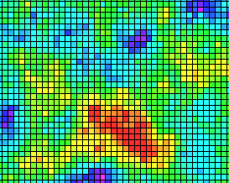



Variogram Observations
Observation #1
As distance increases, variability increase (in general).
$$γ$$
$$(h)$$
Semivariogram
Increasing
Variability
200
400
600
800
1000
Lag Distance ($h$), m in x direction
y
Increase in variability with increase in lag distance (zoomed in)
x

Slide 19
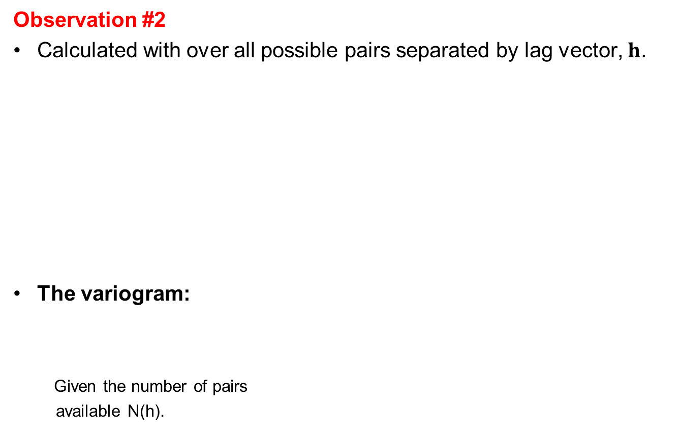

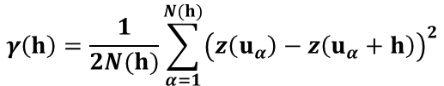



Variogram Observations
Observation #2
Calculated with over all possible pairs separated by lag vector, $h$.
The variogram:
Given the number of pairs
available N(h).
$$γ$$
$$(h)$$
h = 100 in x direction
Semivariogram
h = 100
200
400
600
800
1000
Lag Distance ($h$), m in x direction
$$γ\left(h\right)=\frac{1}{2N(h)}\sum_{α=1}^{N(h)}{{\left(z\left(u_{α}\right)−z\left(u_{α}+h\right)\right)}^{2}}$$
y
x
Scan of all possible sets of pairs (zoomed in)

Slide 20









Variogram Observations
Observation #3
Need to plot the sill to know the degree of correlation.
Sill is the Variance, σ²
Given stationarity of the variance and $γ_{x}\left(h\right)$:
Covariance Function:
Given a standardized distribution $σ_{x}^{2}=1.0$:
Correlogram:
h – lag scatter plots
$$C_{x}\left(h\right)= σ_{x}^{2}−γ_{x}\left(h\right)$$
head
$$ρ_{x}\left(h\right)= σ_{x}^{2}−γ_{x}\left(h\right)$$
Correlation($h$) = 0
$$γ$$
tail
Sill = No Correlation = σ²
$$(h)$$
Semivariogram
Correlation(h) = $ρ_{x}\left(h\right)$, if $σ_{x}^{2}$=1.0
head
Correlation($h$) = 0.5
200
400
600
800
1000
tail
Lag Distance ($h$), m in x direction

Slide 21
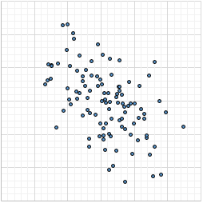
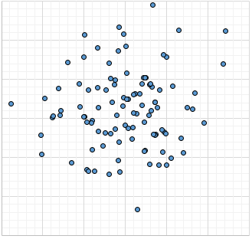
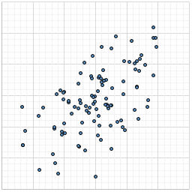


3
p = -0.47
Variogram Interpretation
2
Tail Value
1
0
-1
-2
Observation #3
Need to plot the sill to know the degree of correlation.
Another illustration of h-scatter plot correlation vs. lag distance.
-3
-3
-2
-1
0
1
2
3
Head Value
3
p = 0.02
1.6
$$P_{x}(h)$$
2
1.2
Tail Value
1
γ
0
0.8
-1
0.4
$$P_{x}(h)$$
-2
0.0
-3
0
10.0
20.0
30.0
-3
-2
-1
0
1
2
3
Distance
Head Value
3
p = 0.60
2
Tail Value
1
0
-1
-2
-3
-3
-2
-1
0
1
2
3
Head Value

Slide 22

Variogram Observations
Observation #4
The lag distance at which the variogram reaches the sill is know as the range.
At the range, knowing the data value at the tail provides no information about a value at the head.
head
$$γ$$
Sill = No Correlation
Correlation($h$) = 0
$$(h)$$
Semivariogram
tail
Range
y
Range
No Information
200
400
600
800
1000
Well
Lag Distance ($h$), m in x direction
x

Slide 23



Variogram Observations
Observation #5
Sometimes there is a discontinuity in the variogram at distances less than the minimum data spacing. This is known as nugget effect.
As a ratio of nugget / sill, is known as relative nugget effect (%)
Modeled as a no correlation structure that at lags, $h>ε$, an infinitesimal distance
Measurement error, mixing populations cause apparent nugget effect
$$γ$$
$$(h)$$
Semivariogram
Nugget Effect
200
400
600
800
1000
Lag Distance (h), m in x direction

Slide 24
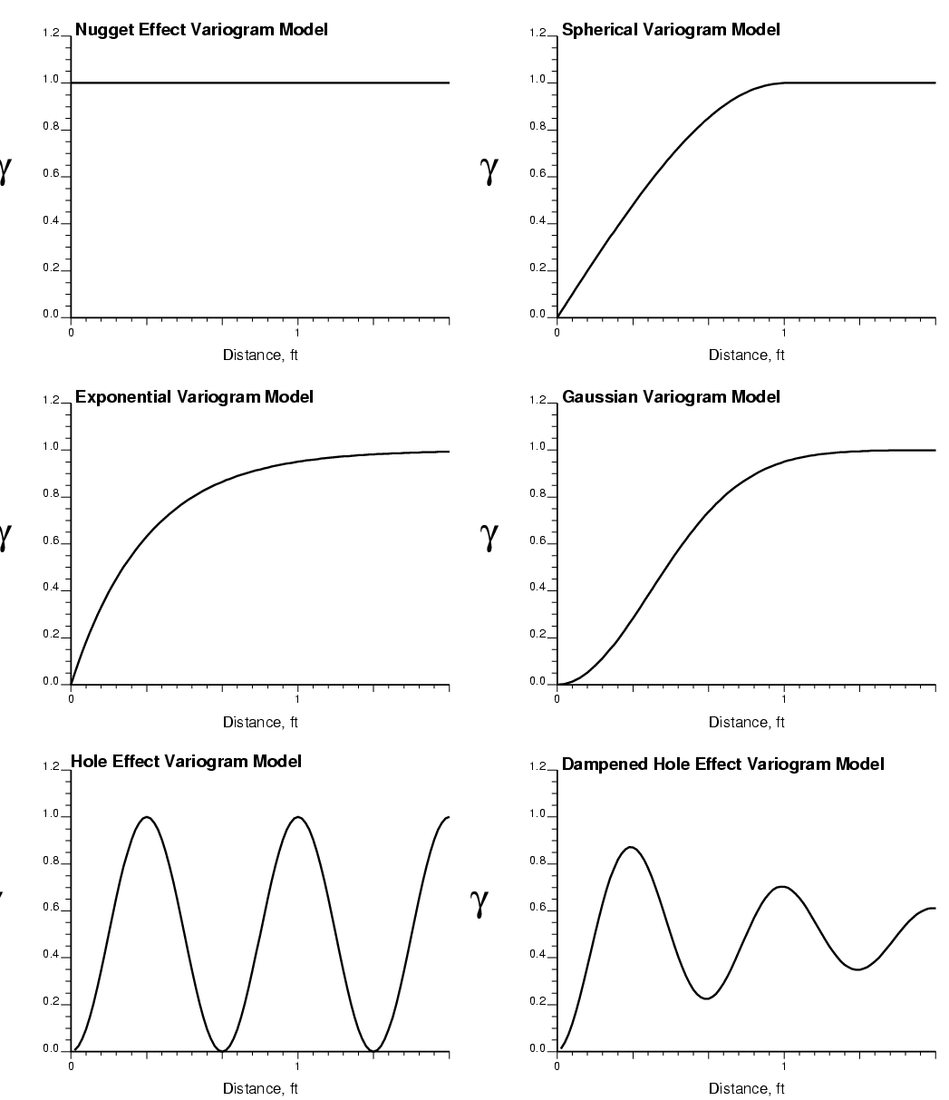
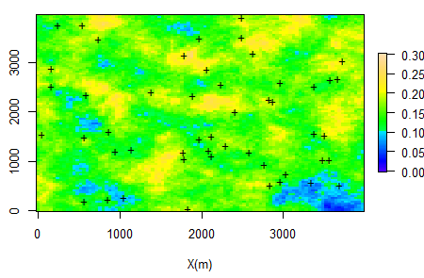
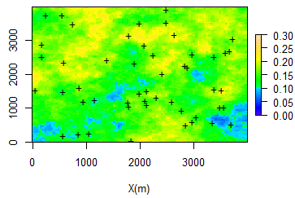
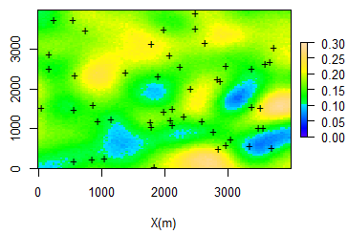
Spatial Variability
The three maps are remarkably similar: all three have the same 50 data, same histograms and same range of correlation, and yet their spatial variability/continuity is quite different
The spatial variability/continuity depends on the detailed distribution of the petrophysical attribute (φ,Κ)
The charts on the left are “variograms”
Our map-making efforts should consider the spatial variability/continuity of the variable we are mapping:
Variability
Uncertainty
Distance (m)
Y (m)
Distance (m)
Distance (m)
X (m)
Porosity Realizations with 3 isotropic variograms.

Slide 25
Daytum +2 Course Spatial Data Analytics
Lecture outline . . .
Variogram Calculation
Instructor: Michael Pyrcz, the University of Texas at Austin

Slide 26
Variogram Definition
Variogram – a measure of dissimilarity vs. distance. Calculated as ½ the average squared difference of values separated by a lag vector.
The precise term is semivariogram (variogram if you remove the 1/2 ), but in practice the term variogram is used.
The ½ is used so that the covariance function and variogram may be related directly:
Note the correlogram is related to the covariance function as:
$$γ\left(h\right)=\frac{1}{2N(h)}\sum_{α=1}^{N(h)}{{\left(z\left(u_{α}\right)−z\left(u_{α}+h\right)\right)}^{2}}$$
$$C_{x}\left(h\right)= σ_{x}^{2}−γ_{x}\left(h\right)$$
$$ρ_{x}\left(h\right)=\frac{C_{x}\left(h\right)}{σ_{x}^{2}}$$
, h-scatter plot correlation vs. lag distance

Slide 27
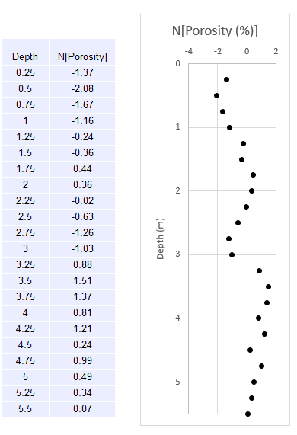
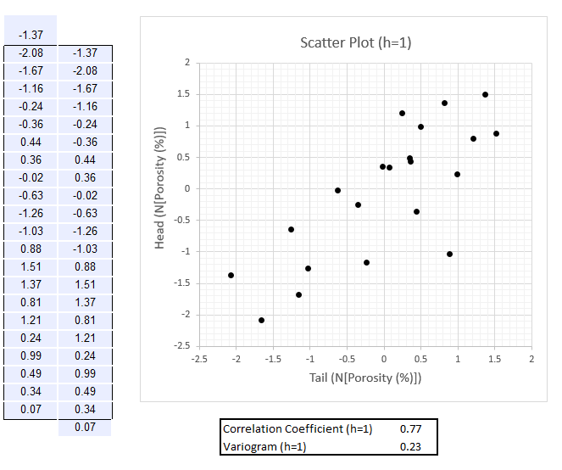
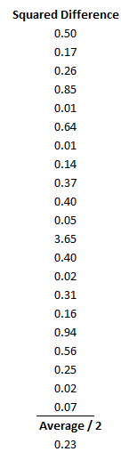
Variogram Calculation
Consider data values separated by lag vectors (the h values)
Here are two examples of a lag vector equal to the data spacing and then twice the data spacing:

Slide 28
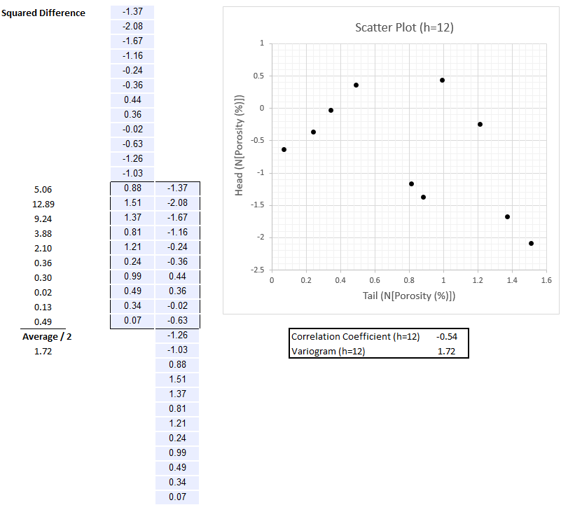
Variogram Calculation
Consider data values separated by lag vectors (the h values)
Here are two examples of a lag vector equal to the data spacing and then twice the data spacing:

Slide 29
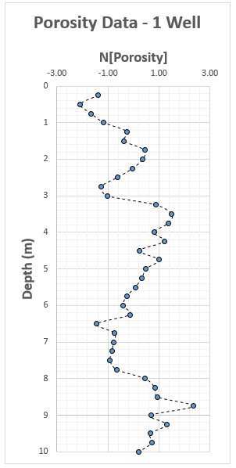
Variogram Calculation
Depth | N[Porosity]
0.25 | -1.37
0.5 | -2.08
0.75 | -1.67
1 | -1.16
1.25 | -0.24
1.5 | -0.36
1.75 | 0.44
2 | 0.36
2.25 | -0.02
2.5 | -0.63
2.75 | -1.26
3 | -1.03
3.25 | 0.88
3.5 | 1.51
3.75 | 1.37
4 | 0.81
4.25 | 1.21
4.5 | 0.24
4.75 | 0.99
5 | 0.49
5.25 | 0.34
5.5 | 0.07
5.75 | -0.26
6 | -0.41
6.25 | -0.14
6.5 | -1.44
6.75 | -0.75
7 | -0.78
7.25 | -0.85
7.5 | -0.92
7.75 | -0.66
8 | 0.47
8.25 | 0.85
8.5 | 0.95
8.75 | 2.35
9 | 0.69
9.25 | 1.31
9.5 | 0.66
9.75 | 0.72
10 | 0.21
Pick a lag distance and calculate the variogram for that one lag distance.
The file is Variogram_Simple_Calculation.xlsx

Slide 30
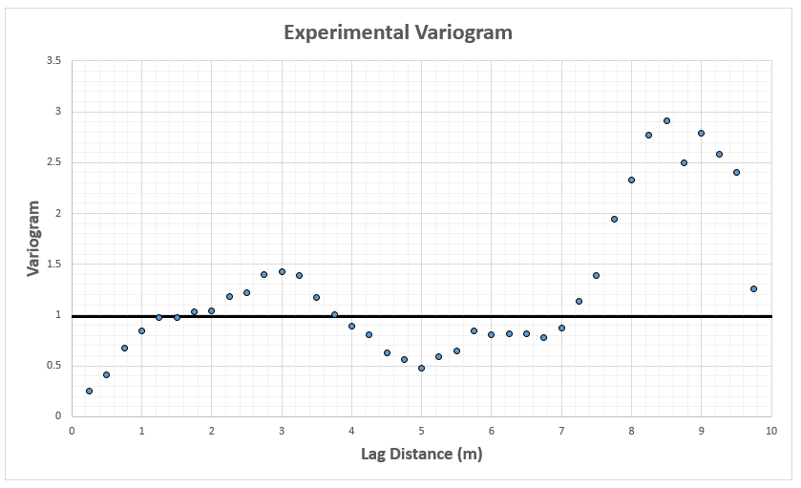
Variogram Calculation Example
Depth | N[Porosity]
0.25 | -1.37
0.5 | -2.08
0.75 | -1.67
1 | -1.16
1.25 | -0.24
1.5 | -0.36
1.75 | 0.44
2 | 0.36
2.25 | -0.02
2.5 | -0.63
2.75 | -1.26
3 | -1.03
3.25 | 0.88
3.5 | 1.51
3.75 | 1.37
4 | 0.81
4.25 | 1.21
4.5 | 0.24
4.75 | 0.99
5 | 0.49
5.25 | 0.34
5.5 | 0.07
5.75 | -0.26
6 | -0.41
6.25 | -0.14
6.5 | -1.44
6.75 | -0.75
7 | -0.78
7.25 | -0.85
7.5 | -0.92
7.75 | -0.66
8 | 0.47
8.25 | 0.85
8.5 | 0.95
8.75 | 2.35
9 | 0.69
9.25 | 1.31
9.5 | 0.66
9.75 | 0.72
10 | 0.21
Pick a lag distance and calculate the variogram for that one lag distance.
Here’s all of them:

Slide 31
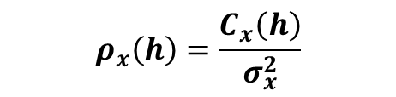


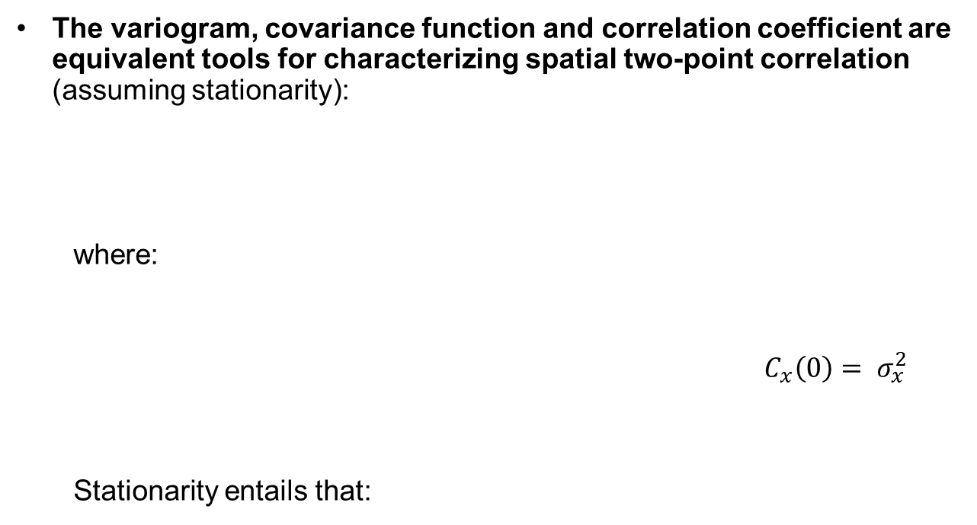

The Variogram and Covariance Function
The variogram, covariance function and correlation coefficient are equivalent tools for characterizing spatial two-point correlation (assuming stationarity):
where:
$$C_{x}\left(0\right)= σ_{x}^{2}$$
Stationarity entails that:
$$γ_{x}\left(h\right)=σ_{x}^{2}−C_{x}\left(h\right)$$
$$ρ_{x}\left(h\right)=\frac{C_{x}\left(h\right)}{σ_{x}^{2}}$$
$${ =σ}_{x}^{2}(1−ρ_{x}\left(h\right))$$
$C_{x}\left(h\right)=E\left\{X\left(u\right)∙X\left(u+h\right)\right\}−\left[E\left\{X\left(u\right)\right\}∙E\left\{X\left(u+h\right)\right\}\right],∀ u$, $u+h∈A$
$C_{x}\left(h\right)=\frac{\sum_{α=1}^{n}{x(u_{α})∙x\left(u_{α}+h\right)}}{n}−{(\overline{x})}^{2}$, if stationary mean

Slide 32
The Variogram and Covariance Function
Must plot variance to interpret variogram:
Positive correlation when semivariogram less than variance
No correlation when the semivariogram is equal to the variance
Negative correlation when the semivariogram points above variance
ρ < 0
γ(h)
C(0) = σ²
ρ = 0
ρ > 0
0
h
“lag” Distance
C(h)

Slide 33

Covariance Function Definition
Covariance Function – a measure of similarity vs. distance. Calculated as the average product of values separated by a lag vector centered by the square of the mean.
The covariance function is the variogram upside down.
We model variograms, but inside the kriging and simulation methods they are converted to covariance values for numerical convenience.
$C_{x}\left(h\right)=\frac{\sum_{α=1}^{n}{x(u_{α})∙x\left(u_{α}+h\right)}}{n}−{(\overline{x})}^{2}$, if stationary mean
$$γ_{x}\left(h\right)=σ_{x}^{2}−C_{x}\left(h\right)$$

Slide 34
Variogram Components Definition
Nugget Effect – discontinuity in the variogram at distances less than the minimum data spacing
As a ratio of nugget / sill, is known as relative nugget effect (%)
Measurement error, mixing populations cause apparent nugget effect
Sill – the sample variance
Interpret spatial correlation relative to the sill, level of no correlation
Range – lag distance to reach
the sill
Up to that distance you have
information
parameterization of variogram models
γ
Sill
Nugget
Effect
h
Range

Slide 35
Spoiler Alert
We need to practically calculate and model spatial continuity. From the available and often sparse subsurface data.
Calculate variogram with irregularly spaced data
Search templates with parameters
Valid spatial model
Fit with a couple different, nest (additive) spatial continuity models e.g. nugget, spherical, exponential and Gaussian
Full 3D spatial continuity model
Model primary directions, i.e. major horizontal, minor horizontal and vertical and combine together with assumption of geometric anisotropy
We will not cover variogram modeling.

Slide 36
Calculating Experimental Variograms
How do we get pairs separated by lag vector?
Regular spaced data:
Specify as offsets of grid units
Fast calculation
Diagonal directions are awkward
Irregular spaced data:
Nominal distance for each lag
Distance tolerance
Azimuth direction
Azimuth tolerance
Dip direction
Dip tolerance
Bandwidth (maximum deviation) in originally horizontal plane
Bandwidth in originally vertical plane
Y axis (North)
Lag Tolerance
Azimuth
Lag 4
Bandwidth
Lag 3
Lag Distance
Lag 2
Azimuth
tolerance
Lag 1
X axis (East)
Image from Pyrcz and Deutsch, 2014

Slide 37
Calculating Experimental Variograms
Example: Starting With One Lag (i.e. #4)
Start at a node, and compare value to all nodes which fall in the lag and angle tolerance.
...

Slide 38
Calculating Experimental Variograms
Move to next node.
...

Slide 39
Calculating Experimental Variograms
Now Repeat for All Nodes
And Repeat for All Lags
No correlation
Variogram, γ(h)
Increasing
Variability
...
Lag Distance (h)

Slide 40
Some Options
Data transformation:
Transform a continuous variable to a Gaussian or normal distribution, for use with / consistency with Gaussian simulation methods
Transform a categorical variable to a series of indicator variables for indicator methods and categorical to continuous for truncated Gaussian methods
Coordinate transformation:
Variograms are calculated aligned with the stratigraphic framework
Otherwise the spatial continuity will be underestimated
Should calculate the variogram on the variable being modeled with transforms (data and coordinates)
Calculate the variogram, as this is what we model and apply in estimation and simulation (more later).

Slide 41
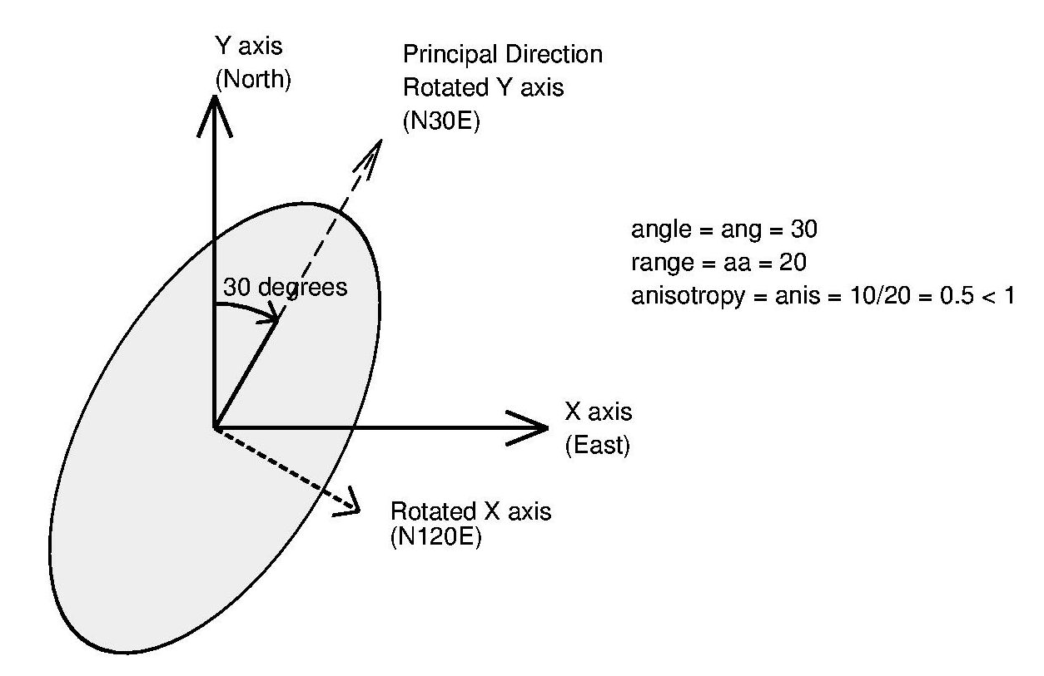
Choosing the Directions
Inspect the data and interpretations, sections, plan views, …
Azimuth angles in degrees clockwise from north
Review multiple directions before choosing a set of 3 perpendicular directions
Omnidirectional: all directions taken together → often yields the most well-behaved variograms.
Major horizontal direction & two perpendicular to major direction
All anisotropy in geostatistics is geometric – three mutually orthogonal directions with ellipsoidal change in the other directions:
Image from Pyrcz and Deutsch, 2014

Slide 42
Choosing the Lag Distances and Tolerances
Guidance for Variogram Calculation Parameters:
Lag separation distance should coincide with data spacing
Lag tolerance typically chosen to be ½ lag separation distance
in cases of erratic variograms, may choose to overlap calculations so lag tolerance > ½ lag separation, results in more pairs.
The variogram is only valid for a distance one half of the field size: start leaving data out of calculations with larger distances
Y axis (North)
Lag Tolerance
Azimuth
Lag 4
Bandwidth
Lag 3
Lag Distance
Lag 2
Azimuth
tolerance
Image from Pyrcz and Deutsch, 2014
Lag 1
X axis (East)

Slide 43
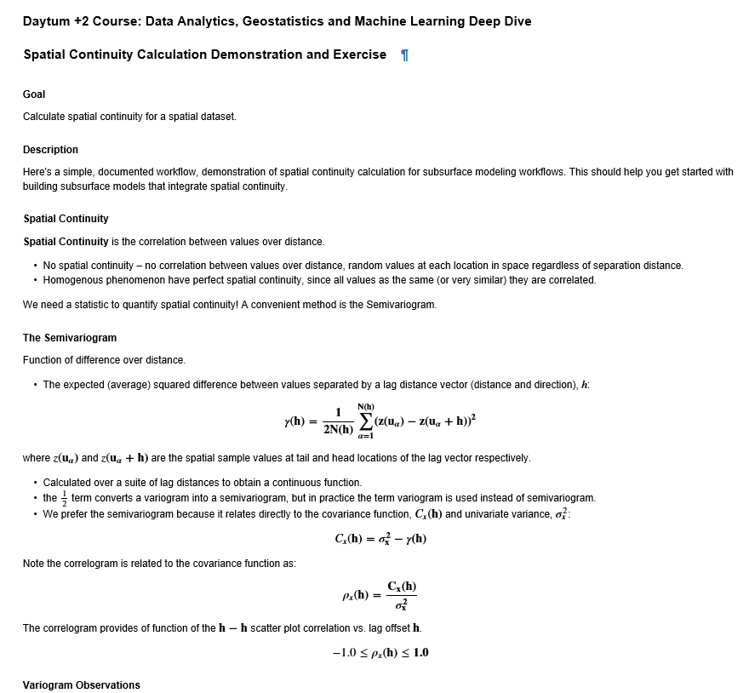
Spatial Calculation in Demo in Python
Experiment with Variogram Calculation:
Things to Try:
Variogram maps
Relate to the data location maps
Directional variograms
Change lag tolerance
Change lag distance
Python notebook file: GeostatsPy_spatial_continuity_directions.ipynb

Slide 44
Spatial Continuity New Tools
Topic | Application to Subsurface Modeling
Stationarity | In the presence of multivariate relationships, must jointly model variables. Summarize with bivariate statistics, and visualize and use conditional statistics to go beyond linear measures.
Random Variables and Functions | Random variables and random functions are used to represent spatial uncertainty. Porosity at a pre-drill location has the uncertainty model based on a random variable with Gaussian mean of 15% and standard deviation of 3%.
Variogram Calculation | Calculate spatial continuity from spatial data to use for spatial prediction. From the available wells the porosity spatial continuity range is 300 m in the 030 azimuth, we have no information beyond this spacing from existing wells.

Slide 45
Daytum +2 Course Spatial Data Analytics
Lecture outline . . .
Spatial Estimation
Instructor: Michael Pyrcz, the University of Texas at Austin

Slide 46
Trend Modeling
We Must Start with Trend Modeling
Geostatistical spatial estimation methods make an assumption concerning stationarity
In the presence of significant nonstationarity we would not rely 100% for spatial estimation on data + spatial continuity model
20
What is Vsh
at location u₀?
15
Vsh(%)
10
5
Data
v(u₁)
v(u₂)
v(u₃)
u₀
v(u₄)
v(u₅)
X(m)

Slide 47
Trend Modeling
Geostatistical spatial estimation methods will make an assumption concerning stationarity
If we observe a trend, we should model the trend.
20
15
Vsh(%)
10
5
v(u₁)
v(u₂)
v(u₃)
u₀
v(u₄)
v(u₅)
X(m)

Slide 48
Trend Modeling
Geostatistical spatial estimation methods will make an assumption concerning stationarity
Then model the residuals.
5.0
2.5
Residual Vsh(%)
0
Model
-0.5
-1.0
v(u₁)
v(u₂)
v(u₃)
u₀
v(u₄)
v(u₅)
X(m)

Slide 49
Trend Modeling
Geostatistical spatial estimation methods will make an assumption concerning stationarity
After modeling, add the trend back to the modelled residuals
20
15
Vsh(%)
10
5
v(u₁)
v(u₂)
v(u₃)
u₀
v(u₄)
v(u₅)
X(m)

Slide 50
Trend Modeling
How bad could it be if we did not model a trend?
Geostatistical estimation would assume stationarity and away from data we would estimate with the global mean (simple kriging)!
20
15
Vsh(%)
Model with
stationary
mean + data.
10
5
v(u₁)
v(u₂)
v(u₃)
u₀
v(u₄)
v(u₅)
X(m)
20
15
Vsh(%)
10
Model with
mean trend model
and residual + data.
5
v(u₁)
v(u₂)
v(u₃)
u₀
v(u₄)
v(u₅)
X(m)

Slide 51
Trend Modeling
Trend Modeling
We must identify and model
trends / nonstationarities
Variable
of Interest
Z variable value
Large Scale
Trend
Small Scale
Trend
x Coordinate (m)
Variable
of Interest

Slide 52

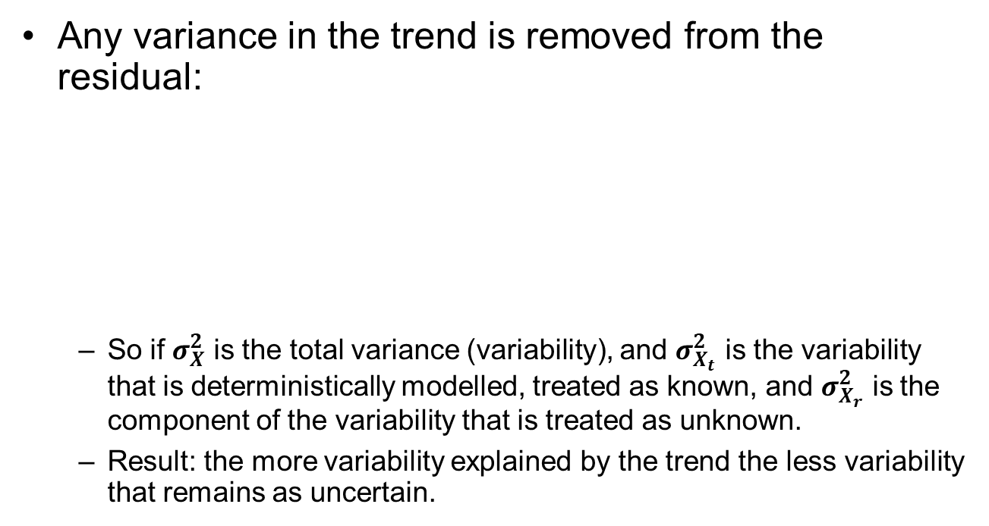


Trend Modeling
Any variance in the trend is removed from the residual:
So if $σ_{X}^{2}$ is the total variance (variability), and $σ_{X_{t}}^{2}$ is the variability that is deterministically modelled, treated as known, and $σ_{X_{r}}^{2}$ is the component of the variability that is treated as unknown.
Result: the more variability explained by the trend the less variability that remains as uncertain.
$$σ_{X}^{2}=σ_{X_{t}}^{2}+σ_{X_{r}}^{2}+2C_{X_{t},X_{r}}$$
Known
Trend
if the $X_{t}{ X}_{r},C_{X_{t},X_{r}}$= 0
Unknown
Residual
$$σ_{X_{r}}^{2}=σ_{X}^{2}−σ_{X_{t}}^{2}$$

Slide 53
Definition Deterministic Model
Model that assumes perfect knowledge, without uncertainty
Based on knowledge of the phenomenon or trend fitting to data
Most subsurface models have a deterministic component (trend) to capture expert knowledge and to provide a stationary residual for geostatistical modeling.

Slide 54
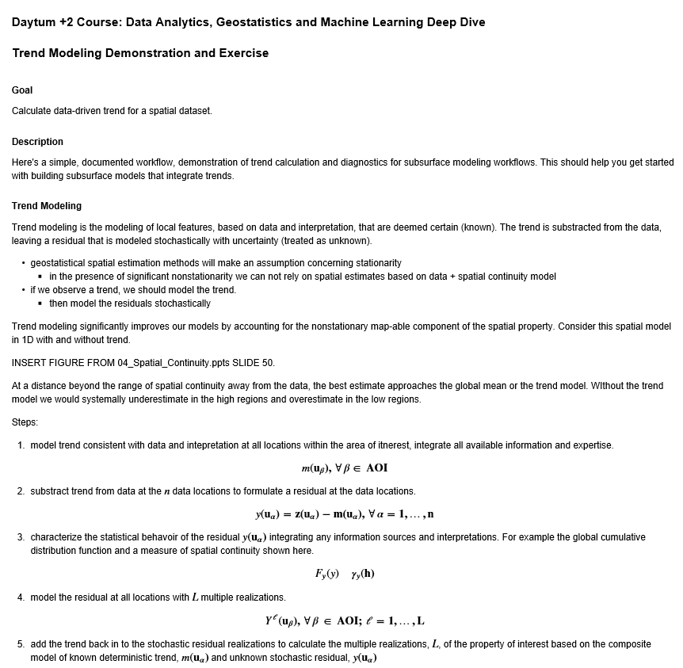
Trend Modeling Hands-on
Here’s an opportunity for experiential learning with Trend Modeling.
Things to try:
Set the radius very large (50). How’s the trend model performing? Try radius very small (1).
What do you think is the best radius to fit a trend to this spatial data?
File Name: Daytum_Trends_v2.ipynb

Slide 55
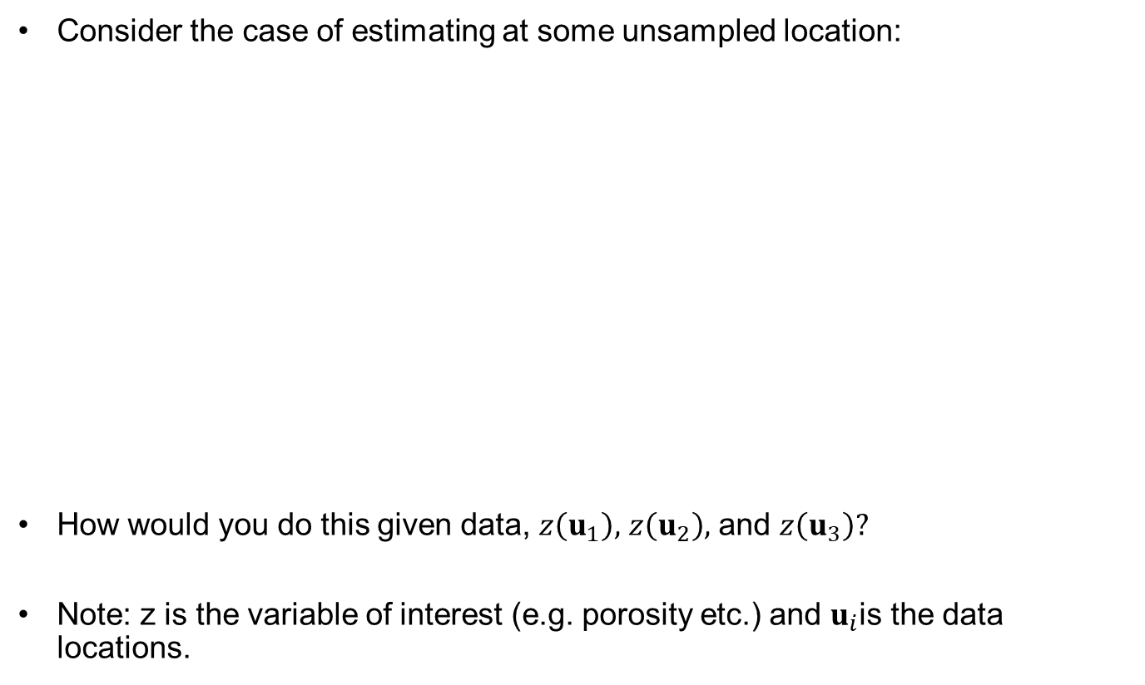
Spatial Estimation
Consider the case of estimating at some unsampled location:
How would you do this given data, $z\left(u_{1}\right),$ $z\left(u_{2}\right),$ and $z\left(u_{3}\right)?$
Note: z is the variable of interest (e.g. porosity etc.) and $u_{i}$is the data locations.
2
1
y
?
3
x

Slide 56
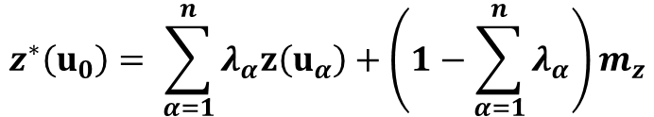





Spatial Estimation
Consider the case of estimating at some unsampled location:
How would you do this given data, $z\left(u_{1}\right),$ $z\left(u_{2}\right),$ and $z\left(u_{3}\right)?$
2
1
$z\left(u_{α}\right)$ is the data values
y
?
$z^{∗}\left(u_{0}\right)$ is an estimate
3
$λ_{α}$ is the data weights
$m_{z}$ is the global mean
x
$$z^{∗}\left(u_{0}\right)= \sum_{α=1}^{n}{λ_{α}z\left(u_{α}\right)}+\left(1−\sum_{α=1}^{n}{λ_{α}}\right)m_{z}$$
Unbiasedness
Constraint
Weights sum to 1.0.

Slide 57
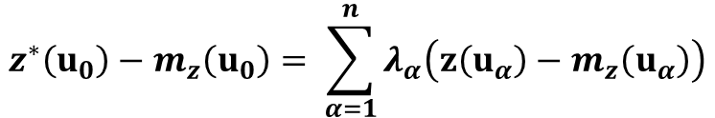
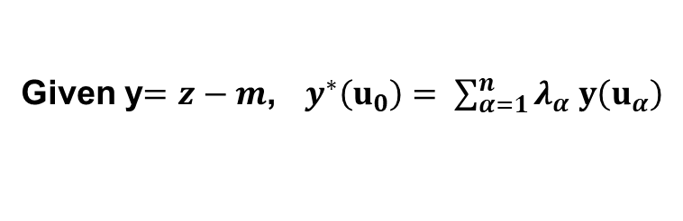
Spatial Estimation
Consider the case of estimating at some unsampled location:
How would you do this given data, $z\left(u_{1}\right),$ $z\left(u_{2}\right),$ and $z\left(u_{3}\right)?$
2
1
y
?
3
x
$$z^{∗}\left(u_{0}\right)−m_{z}\left(u_{0}\right)= \sum_{α=1}^{n}{λ_{α}\left(z\left(u_{α}\right)−m_{z}\left(u_{α}\right)\right)}$$
In the case where
the mean is non-stationary.
Given y$=z−m$, $y^{∗}\left(u_{0}\right)= \sum_{α=1}^{n}{λ_{α} y\left(u_{α}\right)}$
Simplified with residual, y.

Slide 58


Spatial Estimation
Consider the case of estimating at some unsampled location:
Linear weighted, sound good. How do we get the weights?$λ_{α},α=1,…,n$
2
1
y
?
3
x
$$y^{∗}\left(u_{0}\right)= \sum_{α=1}^{n}{λ_{α} y\left(u_{α}\right)}$$
Simplified with residual, y.

Slide 59
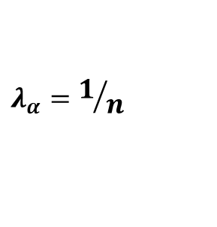
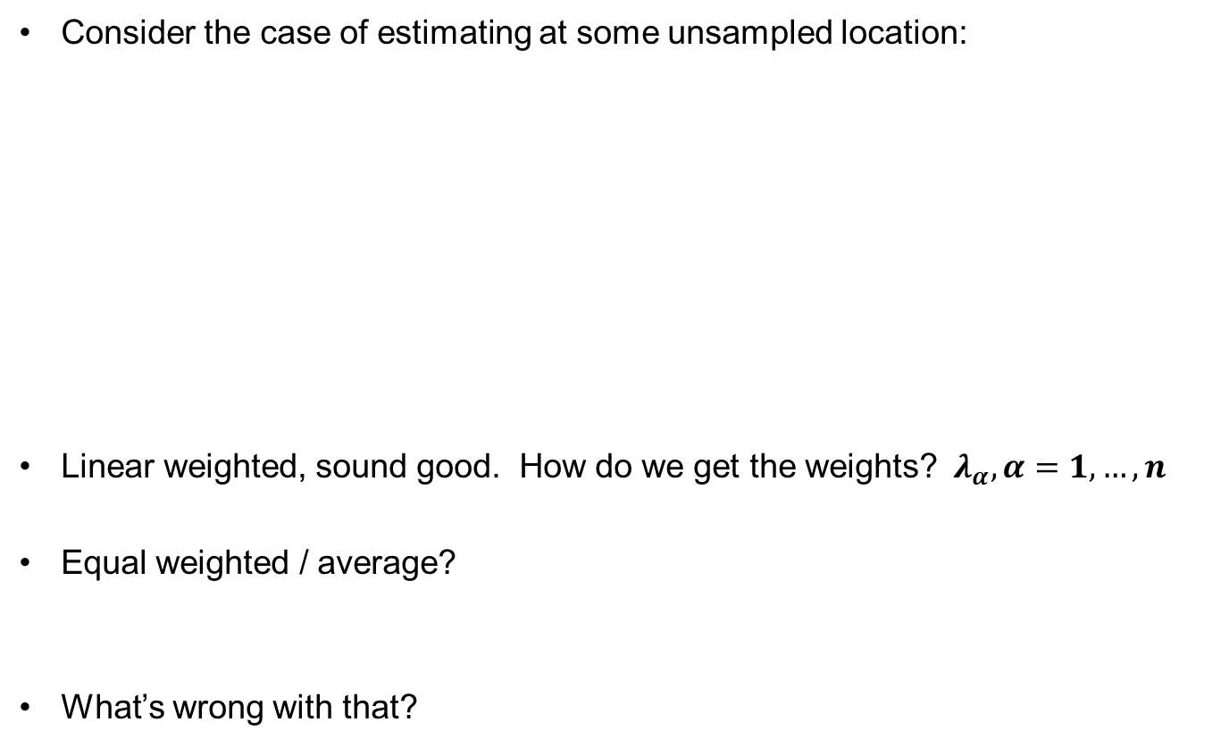
Spatial Estimation
Consider the case of estimating at some unsampled location:
Linear weighted, sound good. How do we get the weights?$λ_{α},α=1,…,n$
Equal weighted / average?
What’s wrong with that?
2
1
y
?
3
x
Equal weight
average of data
$$λ_{α}=1/n$$

Slide 60
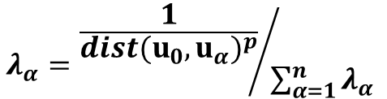

Spatial Estimation
Consider the case of estimating at some unsampled location:
How do we get the weights?$λ_{α},α=1,…,n$
Inverse distance?
What’s wrong with that?
2
1
y
?
3
x
Inverse distance to power
standardized so weights
sum to 1.0.
$$λ_{α}={\frac{1}{{dist(u_{0},u_{α})}^{p}}}/{\sum_{α=1}^{n}{λ_{α} }}$$

Slide 61

Spatial Estimation
Consider the case of estimating at some unsampled location:
How do we get the weights?$λ_{α},α=1,…,n$
It would be great to use weight that account for closeness (spatial correlation > distance alone), redundancy (once again with spatial correlation).
How can we do that?
2
1
y
?
3
x

Slide 62
Spatial Estimation
Kriging Derivations Removed
The results is a very useful and interpretable linear system of equations.

Slide 63

Simple Kriging: Some Details
There are three equations to determine the three weights:
In matrix notation: Recall that
$λ_{1}∙C\left(u_{1},u_{1}\right)+λ_{2}∙C\left(u_{1},u_{2}\right)+λ_{3}∙C\left(u_{1},u_{3}\right)$ = $C\left(u_{0},u_{1}\right)$
$λ_{1}∙C\left(u_{2},u_{1}\right)+λ_{2}∙C\left(u_{2},u_{2}\right)+λ_{3}∙C\left(u_{2},u_{3}\right)$ = $C\left(u_{0},u_{2}\right)$
$λ_{1}∙C\left(u_{3},u_{1}\right)+λ_{2}∙C\left(u_{1},u_{2}\right)+λ_{3}∙C\left(u_{1},u_{3}\right)$ = $C\left(u_{0},u_{1}\right)$
2
1
y
?
$$\left[\begin{matrix}C\left(u_{1},u_{1}\right) & C\left(u_{1},u_{2}\right) & C\left(u_{1},u_{3}\right) \\ C\left(u_{2},u_{1}\right) & C\left(u_{2},u_{2}\right) & C\left(u_{2},u_{3}\right) \\ C\left(u_{3},u_{1}\right) & C\left(u_{3},u_{2}\right) & C\left(u_{3},u_{3}\right)\end{matrix}\right]\left[\begin{matrix}λ_{1} \\ λ_{2} \\ λ_{3}\end{matrix}\right]=\left[\begin{matrix}C\left(u_{o},u_{1}\right) \\ C\left(u_{o},u_{2}\right) \\ C\left(u_{o},u_{3}\right)\end{matrix}\right]$$
3
x
redundancy
closeness
weights

Slide 64


Properties of Simple Kriging
What Does Kriging Provide?:
Best Estimate: Minimum error estimator (just try to pick weights, you won’t bet it)
Estimation Variance: Provides a measure of the estimation (or kriging) variance (uncertainty in the estimate):
$$σ_{E}^{2} →[0,σ_{x}^{2}]$$
Estimation
Variance
Covariance Between
Data and Estimate Location
Variance
Kriging Weights

Slide 65


More Properties
Exact interpolator: at data location
Kriging variance can be calculated before getting the sample information, homoscedastic!
Kriging takes into account:
distance of the information:
configuration of the data:
structural continuity of the variable being considered:
The smoothing effect of kriging can be forecast – we will return to this with simulation.
Kriging theory is part of the probabilistic theory of projectors: orthogonal projection onto space of linear combinations of the n data (Hilbert space)

Slide 66

Simple Kriging Hands-on
Here’s an opportunity for experiential learning with Simple Kriging.
Things to try:
Change the indicator kriging to simple kriging from originary kriging.
Decrease the variogram range.
Increase the geometric anisotropy.
File Name: Daytum_Kriging.ipynb

Slide 67
Spatial Estimation New Tools
Topic | Application to Subsurface Modeling
Trend Modeling | Decompose variance into deterministic trend and stochastic residual. 30% of porosity variance is described by a linear depth trend and 70% is described by a 3D variogram model.
Kriging Estimates and Kriging Variances | Kriging provides the best estimate and a measure of estimation variance. Given a kriging estimate of 13% and kriging variance of 9% and the assumption of a Gaussian distribution we have a complete local distribution of uncertainty for pre-drill porosity.

Slide 68
Data Analytics, Geostatistics and Machine Learning Spatial Continuity / Prediction
Lecture outline . . .
Spatial Estimation
Introduction
Fundamental Concepts
Probability
Data Prep / Analytics
Spatial Continuity / Prediction
Multivariate Modeling
Uncertainty Modeling
Machine Learning
Instructor: Michael Pyrcz, the University of Texas at Austin

