Slide 1
Daytum +2 Course Clustering
Prototype Methods
K-means Clustering
Instructor: Michael Pyrcz, the University of Texas at Austin

Slide 2
Daytum +2 Course Clustering
Prototype Methods
Instructor: Michael Pyrcz, the University of Texas at Austin

Slide 3
Prototype Methods
Represent the training data with set of points in the feature space.
Prototypes are typically not actual samples
Training data often assigned to the nearest (Euclidean) distance prototype
Feature Space
Permeability (mD)
prototypes
Porosity (%)

Slide 4
Daytum +2 Course Clustering
K-means Clustering
Instructor: Michael Pyrcz, the University of Texas at Austin

Slide 5
K-means Clusters
General Comments on K-means Clustering
Clustering - of training data in feature space to identify similar cases / distinct subsets in the multivariate data space.
Unsupervised Learning - the training data are not labeled and are assigned
Prototype Method - represents the training data with number of synthetic cases in the features space. For K-means clustering we assign prototypes.
Iterative Solution - the initial prototypes are assigned randomly in the feature space, the labels for each training sample are updated to the nearest prototype, then the prototypes are adjusted to the centroid of their assigned training data, repeat until convergence.

Slide 6
K-means Clusters
General Comments on K-means Clustering
Feature Weighting - the procedure depends on the 'distance' between training samples and prototypes in feature space. If the features have significantly different magnitudes, the feature(s) with the largest magnitudes and ranges will dominate the process. One approach is to sandardize the variables. Also, by-feature weighting may be applied.
Supervised Learning Classification Variant - applies multiple prototypes in each category to then inform a decision boundary for classification.

Slide 7
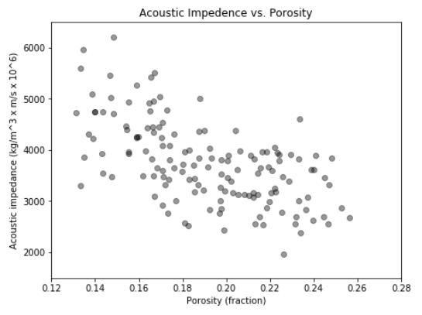
K-means Clustering
For example, given this training data with porosity and acoustic impedance, find ‘K’ facies that:
segment the porosity and acoustic impedance feature space.

Slide 8
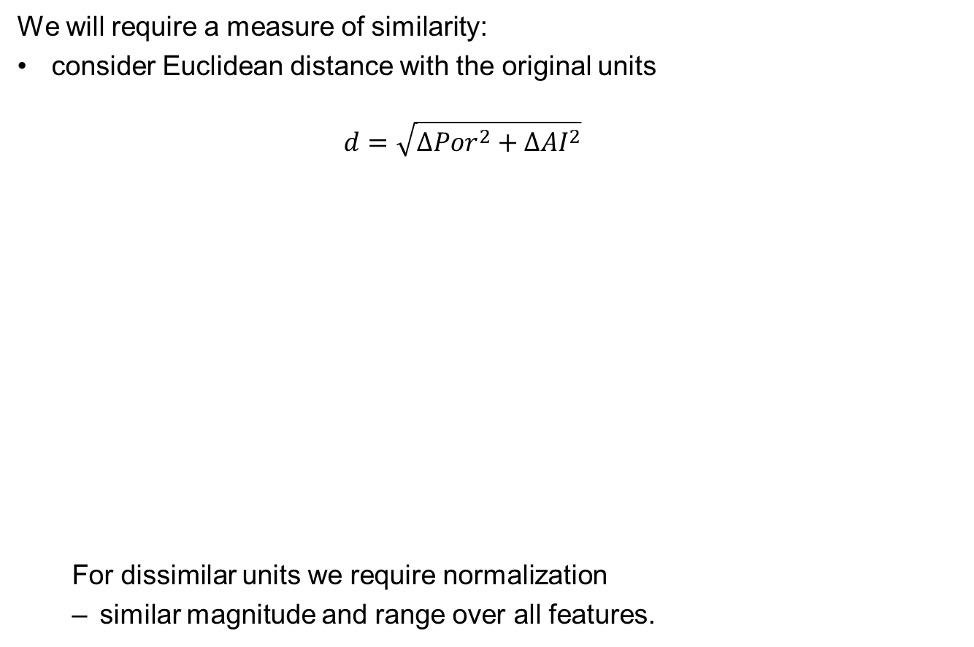
K-means Clustering
Feature Normalization
We will require a measure of similarity:
consider Euclidean distance with the original units
$$d=\sqrt{{∆Por}^{2}+{∆AI}^{2}}$$
For dissimilar units we require normalization
similar magnitude and range over all features.
Very Far
Very Close

Slide 9
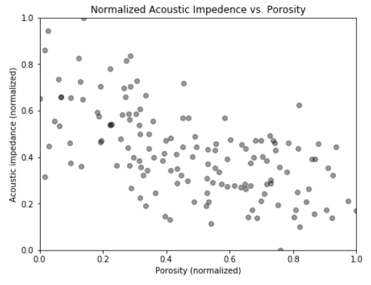
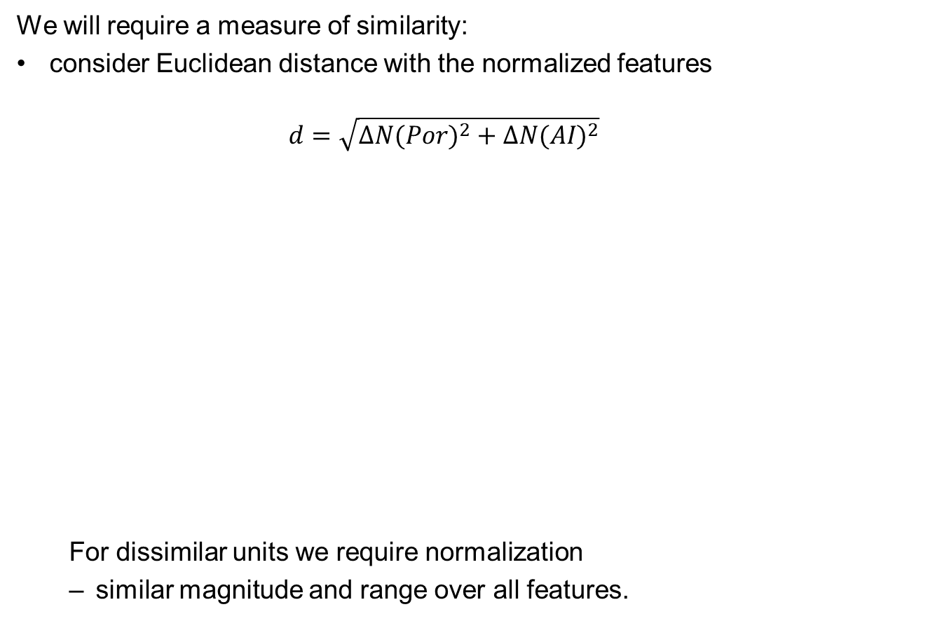
K-means Clustering
Feature Normalization
We will require a measure of similarity:
consider Euclidean distance with the normalized features
$$d=\sqrt{{∆N(Por)}^{2}+{∆N(AI)}^{2}}$$
For dissimilar units we require normalization
similar magnitude and range over all features.
Same Distance

Slide 10
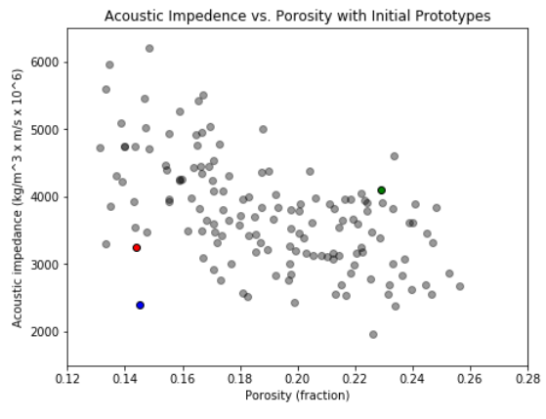
K-means Clustering
Workflow
Assign K prototypes in the feature space:
random assignment (random value between min and max)
Note: the initial prototypes could be poor choices
clustered, outside the training data etc.
initial
prototypes

Slide 11
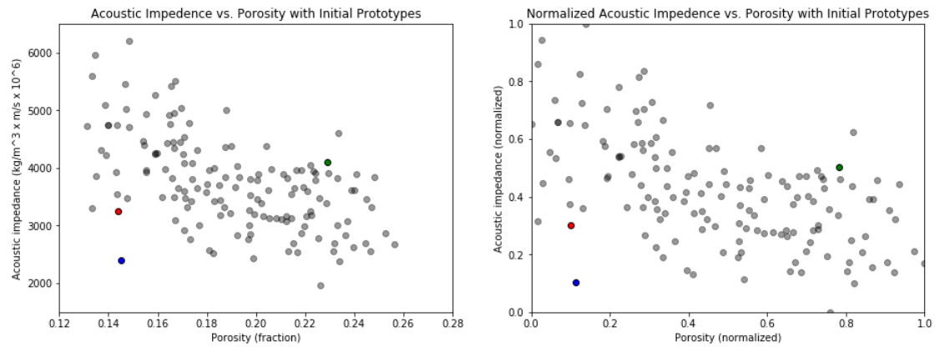
K-means Clustering
Workflow
Assign K prototypes in the feature space:
as a reminder this is happening in the normalized features space

Slide 12
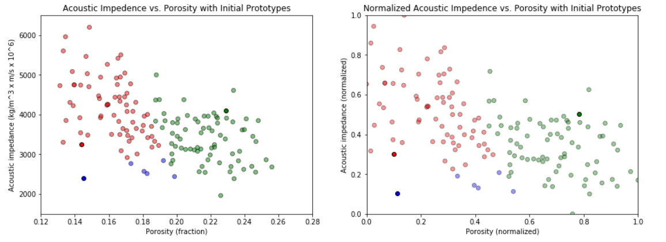
K-means Clustering
Workflow
Assign training data to the nearest prototype:
we apply nearest Euclidian distance with the normalized features
Note, these initial clusters are not very good

Slide 13
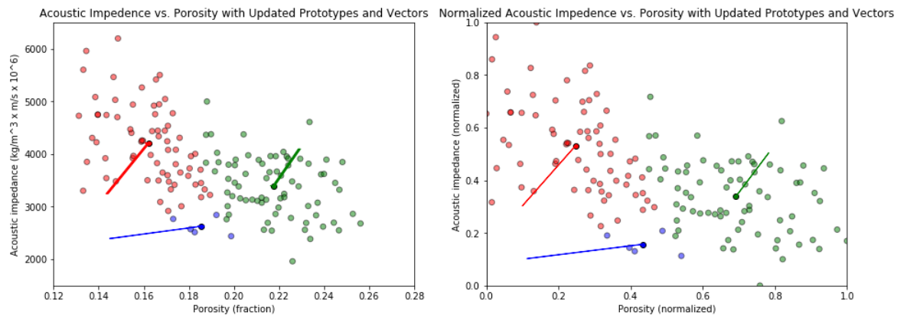
K-means Clustering
Workflow
Update the prototypes to the centroids of the assigned training data:
vectors are included to show the update of the prototypes
The prototypes have improved.

Slide 14
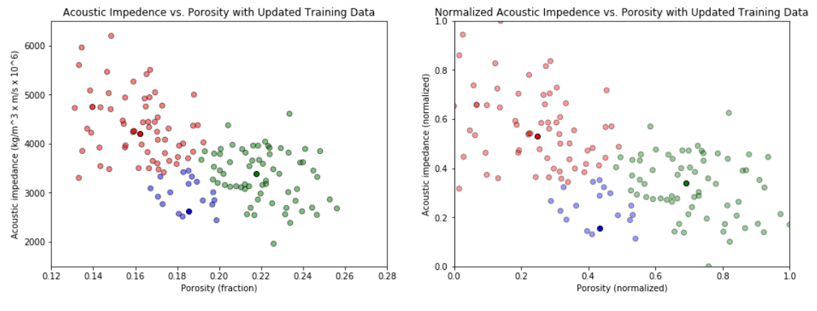
K-means Clustering
Workflow
Update the training data assignment to the nearest updated prototypes:
once again we apply nearest Euclidian distance with the normalized features
The prototypes have improved.

Slide 15
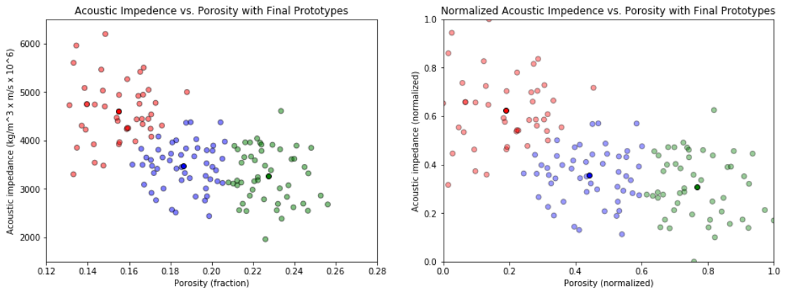
K-means Clustering
Workflow
Iterate until the centroid stop moving and the assignments stabilize:
we now have 3 clusters that minimize the within group variation

Slide 16
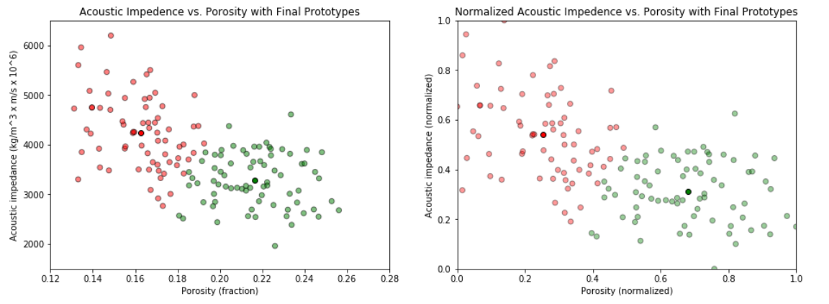
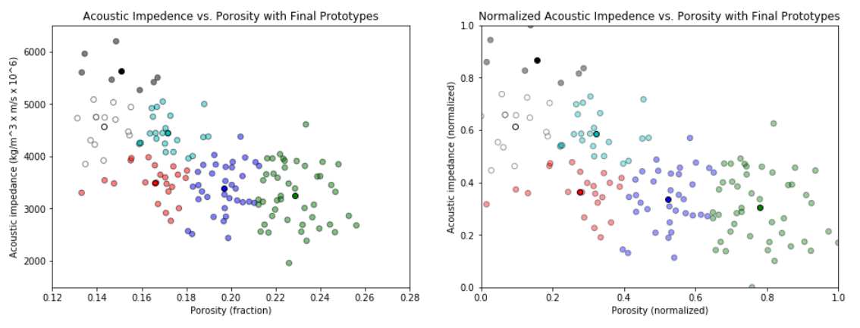
K-means Clustering
Workflow
The number of K clusters is an important decision:
examples with K = 2 and 7

Slide 17
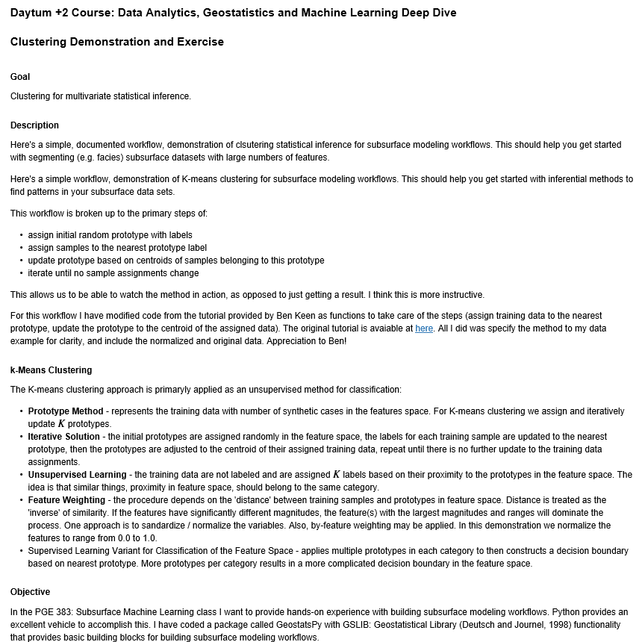
K-means Clustering Demonstration
Demonstration workflow with K-means clustering for unsupervised clustering / segmentation of training data.
The workflow is Daytum_Clustering.ipynb.

Slide 18
K-means for Classification
Given a set of labelled data (e.g. facies labels included with continuous features)
Apply K-means clustering in each category
Training data often assigned to the nearest (Euclidean) distance prototype
Feature Space
Permeability (mD)
prototypes
Porosity (%)

Slide 19
Daytum +2 Course Clustering
Prototype Methods
K-means Clustering
Instructor: Michael Pyrcz, the University of Texas at Austin

