Slide 1
Daytum +2 Course Decision Tree
Decision Tree
Ensemble Methods
Instructor: Michael Pyrcz, the University of Texas at Austin

Slide 2
Daytum +2 Course Decision Tree
Decision Tree
Instructor: Michael Pyrcz, the University of Texas at Austin

Slide 3
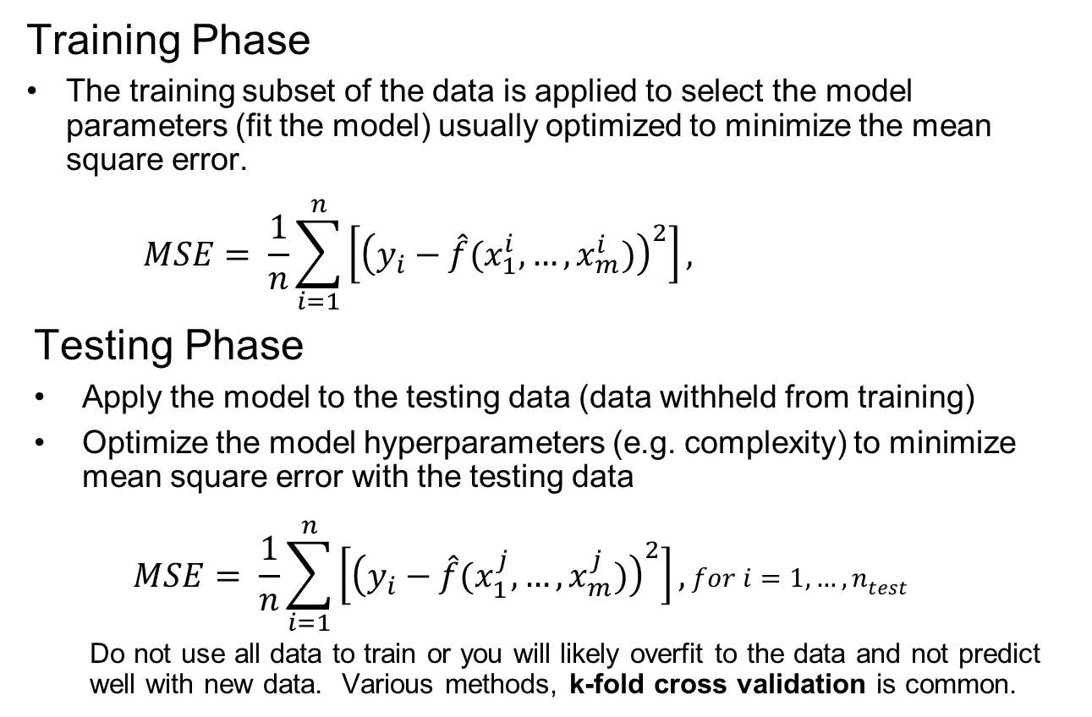

Training and Testing
Training Phase
The training subset of the data is applied to select the model parameters (fit the model) usually optimized to minimize the mean square error.
$$MSE= \frac{1}{n}\sum_{i=1}^{n}{\left[{\left(y_{i}−\hat{f}(x_{1}^{i},…,x_{m}^{i})\right)}^{2}\right]},$$
Testing Phase
Apply the model to the testing data (data withheld from training)
Optimize the model hyperparameters (e.g. complexity) to minimize mean square error with the testing data
$$MSE= \frac{1}{n}\sum_{i=1}^{n}{\left[{\left(y_{i}−\hat{f}(x_{1}^{j},…,x_{m}^{j})\right)}^{2}\right]},for i=1,…,n_{test}$$
Do not use all data to train or you will likely overfit to the data and not predict well with new data. Various methods, k-fold cross validation is common.
$$for i=1,…,n_{train}$$

Slide 4
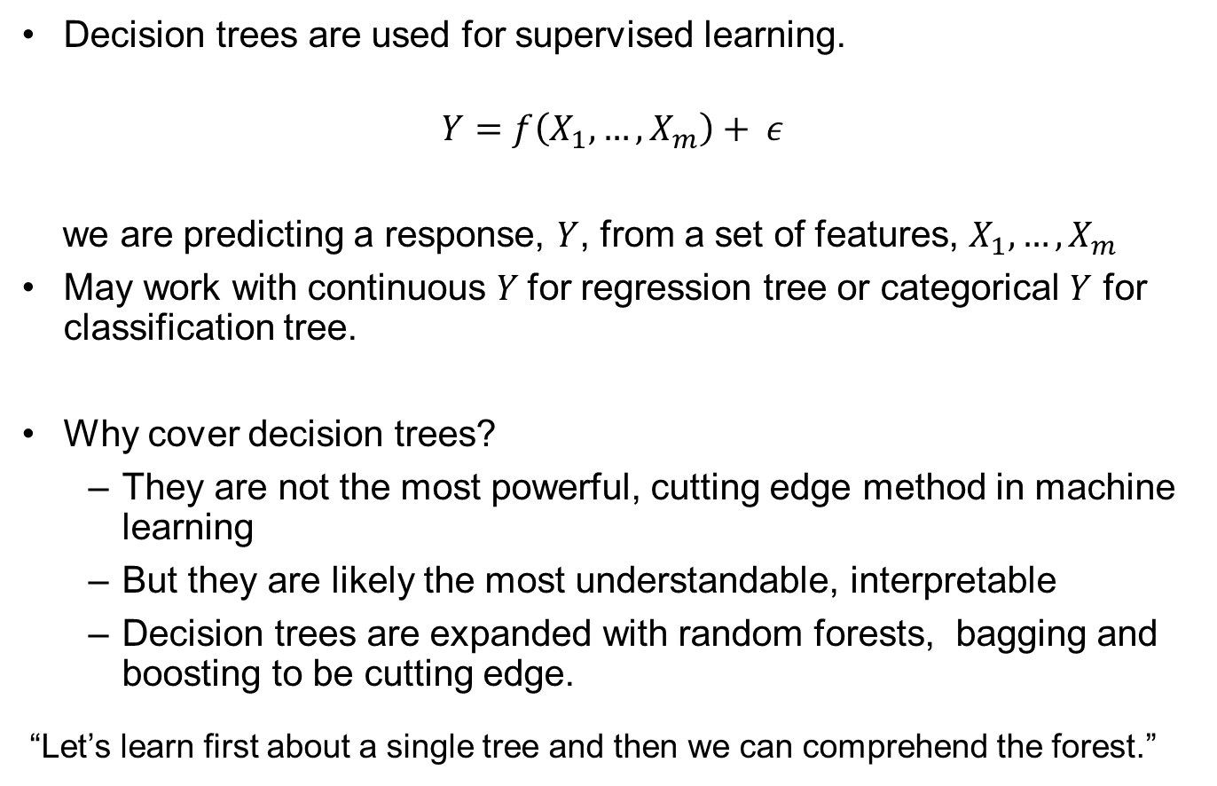
Decision Trees
Decision trees are used for supervised learning.
$$Y=f\left(X_{1},…,X_{m}\right)+ ε$$
we are predicting a response, $Y$, from a set of features, $X_{1},…,X_{m}$
May work with continuous $Y$for regression tree or categorical $Y$ for classification tree.
Why cover decision trees?
They are not the most powerful, cutting edge method in machine learning
But they are likely the most understandable, interpretable
Decision trees are expanded with random forests, bagging and boosting to be cutting edge.
“Let’s learn first about a single tree and then we can comprehend the forest.”

Slide 5
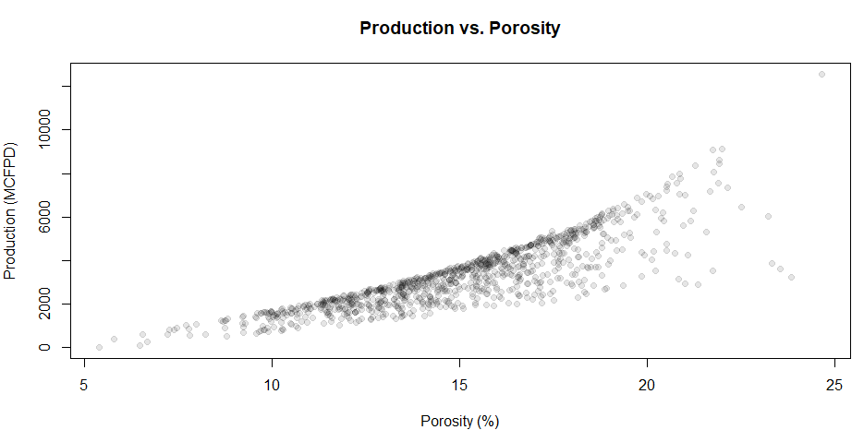


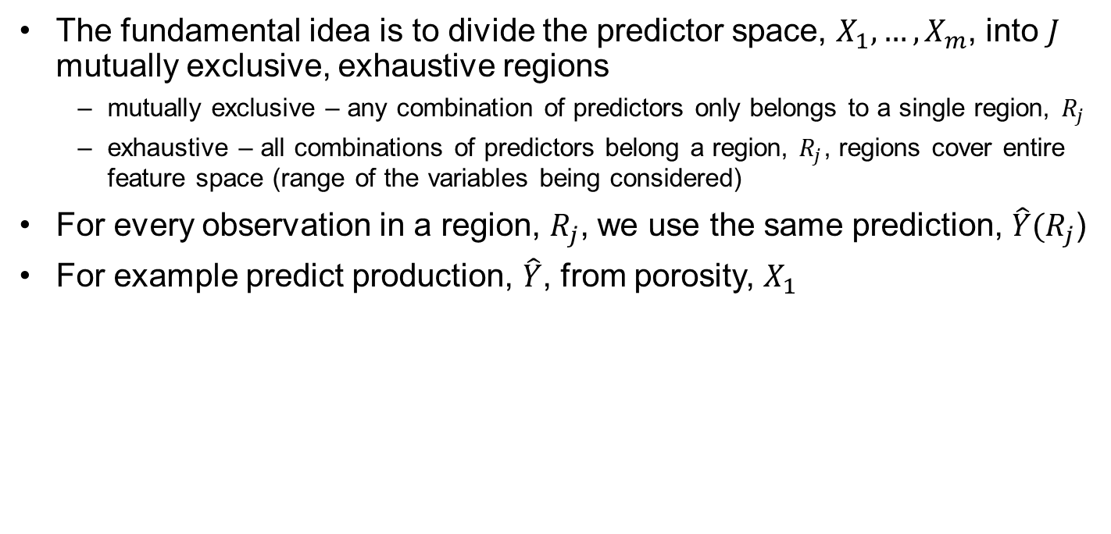






Decision Trees
The fundamental idea is to divide the predictor space, $X_{1},…,X_{m}$, into $J$ mutually exclusive, exhaustive regions
mutually exclusive – any combination of predictors only belongs to a single region, $R_{j}$
exhaustive – all combinations of predictors belong a region, $R_{j}$, regions cover entire feature space (range of the variables being considered)
For every observation in a region, $R_{j}$, we use the same prediction, $\hat{Y}(R_{j}$)
For example predict production, $\hat{Y}$, from porosity, $X_{1}$
$$R_{1}$$
$$R_{2}$$
$$R_{3}$$
$$R_{4}$$
$\hat{Y}(R_{4}$)
$\hat{Y}(R_{3}$)
$\hat{Y}(R_{2}$)
$\hat{Y}(R_{1}$)

Slide 6
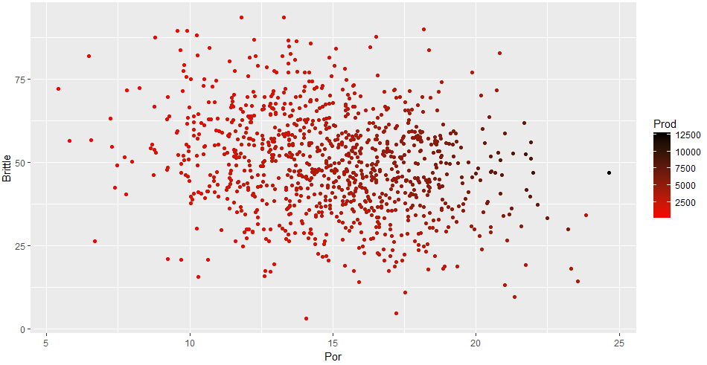







Decision Trees The Regions
How do we construct the Regions, $R_{1, }R_{2 },…,R_{J}$?
They could be any shape!
Consider the 3 variable problem below.
Prediction of unconventional well production (MCFPD) from porosity (%) and brittleness (%)
$$R_{1}$$
$$R_{2}$$
$$R_{3}$$
$\hat{Y}(R_{2}$)
$\hat{Y}(R_{3}$)
$\hat{Y}(R_{1}$)

Slide 7



















Decision Trees The Regions
How do we construct the Regions, $R_{1, }R_{2 },…,R_{J}$?
They could be any shape!
Consider the trivariate (3 variable) problem below.
We decide to use high-dimensional rectangles or boxes simple interpretation / rules
Hierarchical segmentation over the features – very flexible, compact model!
$$R_{2}$$
$$R_{5}$$
$\hat{Y}(R_{5}$)
$\hat{Y}(R_{2}$)
$$R_{6}$$
$\hat{Y}(R_{6}$)
$$R_{1}$$
$$R_{3}$$
$\hat{Y}(R_{7}$)
$$R_{7}$$
$\hat{Y}(R_{1}$)
$\hat{Y}(R_{3}$)
$$R_{8}$$
$\hat{Y}(R_{8}$)
$$R_{4}$$
$\hat{Y}(R_{4}$)
$\hat{Y}(R_{9}$)
$$R_{9}$$
Prediction of unconventional well production (MCFPD) from porosity (%) and brittleness (%)

Slide 8
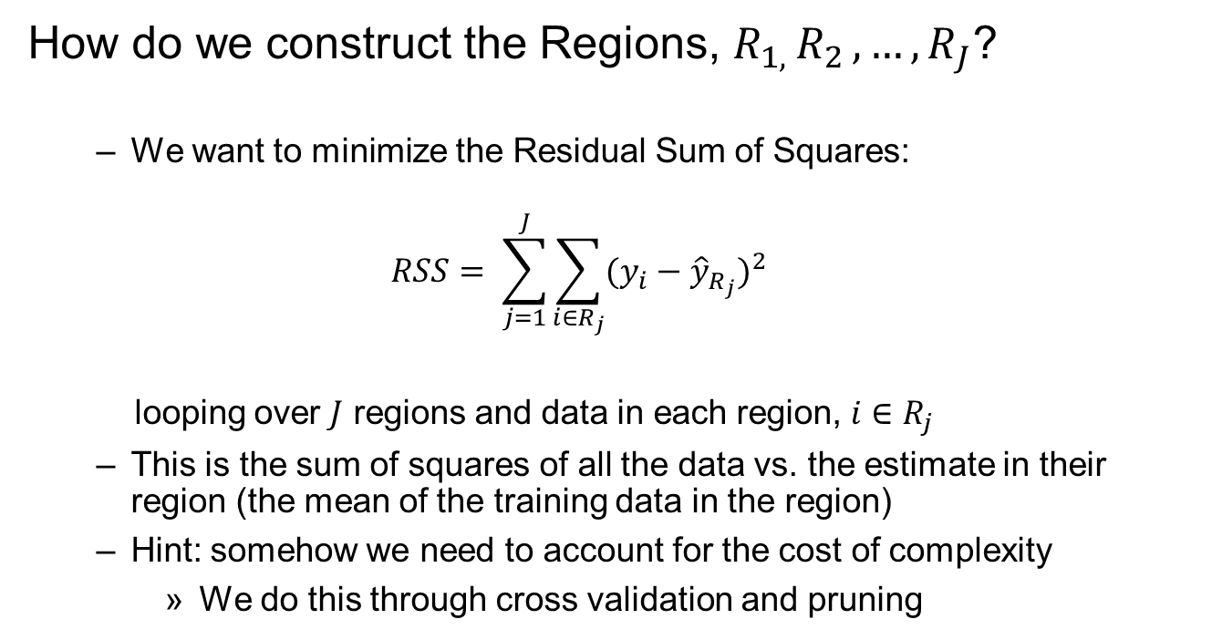
Decision Trees The Regions
How do we construct the Regions, $R_{1, }R_{2 },…,R_{J}$?
We want to minimize the Residual Sum of Squares:
$$RSS= \sum_{j=1}^{J}{\sum_{i∈R_{j}}{{(y_{i}−{\hat{y}}_{R_{j}})}^{2}}}$$
looping over $J$ regions and data in each region, $i∈R_{j}$
This is the sum of squares of all the data vs. the estimate in their region (the mean of the training data in the region)
Hint: somehow we need to account for the cost of complexity
We do this through cross validation and pruning

Slide 9





Decision Trees The Regions
How do we construct the Regions, $R_{1, }R_{2 },…,R_{J}$?
Recursive, binary splitting
Greedy - at each step the method selects the choice that minimizes RSS. There is no attempt to look ahead, jointly optimize over multiple choices
Top-down - at the beginning all data belong to a single region, top of the tree, greedy selection of the single best split over any feature that best reduces the RSS
$$R_{1}$$
$$R_{2}$$
$\hat{Y}(R_{1}$)
$\hat{Y}(R_{2}$)
Prediction of unconventional well production (MCFPD) from porosity (%) and brittleness (%)

Slide 10
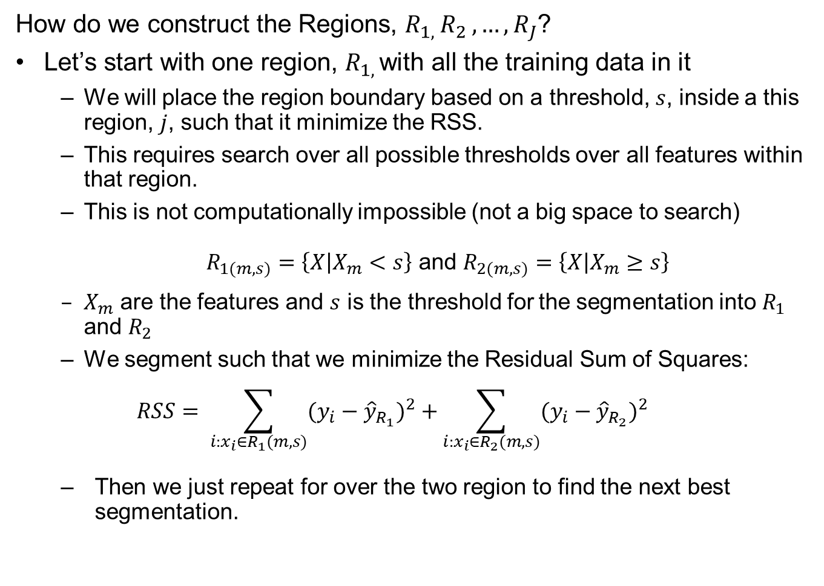
Decision Trees The Regions
How do we construct the Regions, $R_{1, }R_{2 },…,R_{J}$?
Let’s start with one region, $R_{1, }$with all the training data in it
We will place the region boundary based on a threshold, $s$, inside a this region, $j$, such that it minimize the RSS.
This requires search over all possible thresholds over all features within that region.
This is not computationally impossible (not a big space to search)
$R_{1(m,s)}=\left\{X | X_{m}<s\right\}$ and $R_{2(m,s)}=\left\{X | X_{m}≥s\right\}$
$X_{m}$ are the features and $s$ is the threshold for the segmentation into $R_{1}$ and $R_{2}$
We segment such that we minimize the Residual Sum of Squares:
$$RSS= \sum_{i:x_{i}∈R_{1}(m,s)}{{(y_{i}−{\hat{y}}_{R_{1}})}^{2}}+\sum_{i:x_{i}∈R_{2}(m,s)}{{(y_{i}−{\hat{y}}_{R_{2}})}^{2}}$$
Then we just repeat for over the two region to find the next best segmentation.

Slide 11








Decision Trees The Regions
Let’s pause and go back to our initial univariate problem and make a tree by hand!
Where should we split to minimize the error in a tree-based estimate (minimize the residual sum of square)?
$$R_{1}$$
$$R_{2}$$
$$R_{1}$$
$$R_{2}$$
$\hat{Y}(R_{2}$)
$\hat{Y}(R_{2}$)
$\hat{Y}(R_{1}$)
$\hat{Y}(R_{1}$)
$$R_{1}$$
$$R_{2}$$
$$R_{1}$$
$$R_{2}$$
$\hat{Y}(R_{2}$)
$\hat{Y}(R_{2}$)
$\hat{Y}(R_{1}$)
$\hat{Y}(R_{1}$)

Slide 12









Decision Trees The Regions
Let’s pause and go back to our initial bivariate problem and make a tree by hand!
Found first split, now check for next split the maximizes accuracy
$$R_{1}$$
$$R_{2}$$
Porosity < 14.4%
$\hat{Y}(R_{2}$)
$\hat{Y}(R_{1}$)
Porosity < 10.1%
Search over all regions and variables, to find the next best split:
$$R_{1}$$
$$R_{3}$$
$$R_{2}$$
$$R_{1}$$
$$R_{2}$$
$$R_{3}$$
$\hat{Y}(R_{3}$)
$\hat{Y}(R_{2}$)
$\hat{Y}(R_{2}$)
$\hat{Y}(R_{3}$)
$\hat{Y}(R_{1}$)
$\hat{Y}(R_{1}$)

Slide 13





Decision Trees The Regions
How do we construct the Regions, $R_{1, }R_{2 },…,R_{J}$?
The we continue sequentially segmenting region with threshold.
We will place the region boundaries based on a threshold, $s$, inside a previous
$$RSS= \sum_{i:x_{i}∈R_{1}}{{(y_{i}−{\hat{y}}_{R_{1}})}^{2}}+\sum_{i:x_{i}∈R_{2}}{{(y_{i}−{\hat{y}}_{R_{2}})}^{2}}+…+\sum_{i:x_{i}∈R_{J}}{{(y_{i}−{\hat{y}}_{R_{J}})}^{2}}$$
$$R_{1}$$
$$R_{2 }$$
$${\hat{y}}_{R_{1}}$$
$${\hat{y}}_{R_{2}}$$
Prediction of unconventional well production (MCFPD) from porosity (%) and brittleness (%)

Slide 14








Decision Trees The Regions
How do we construct the Regions, $R_{1, }R_{2 },…,R_{J}$?
$$X_{∅}<13.5$$
$$R_{1}$$
$$R_{2 }$$
$$R_{1}$$
$$R_{2}$$
$${\hat{y}}_{R_{1}}$$
$${\hat{y}}_{R_{2}}$$

Slide 15







Decision Trees The Regions
How do we construct the Regions, $R_{1, }R_{2 },…,R_{J}$?
$$X_{∅}<13.5$$
$$R_{1}$$
$$R_{2 }$$
$$R_{3 }$$
$$R_{1}$$
$$X_{∅}<16.3$$
$${\hat{y}}_{R_{1}}$$
$${\hat{y}}_{R_{2}}$$
$${\hat{y}}_{R_{3}}$$
$$R_{2}$$
$$R_{3}$$

Slide 16






Decision Trees The Regions
How do we construct the Regions, $R_{1, }R_{2 },…,R_{J}$?
$$X_{∅}<13.5$$
$$R_{1}$$
$$R_{2 }$$
$$R_{3 }$$
$${\hat{y}}_{R_{3}}$$
$$X_{∅}<16.3$$
$$R_{1}$$
$${\hat{y}}_{R_{1}}$$
$${\hat{y}}_{R_{2}}$$
$$R_{4 }$$
$$R_{2}$$
$$X_{b}<58$$
$${\hat{y}}_{R_{4}}$$
$$R_{4}$$
$$R_{3}$$

Slide 17
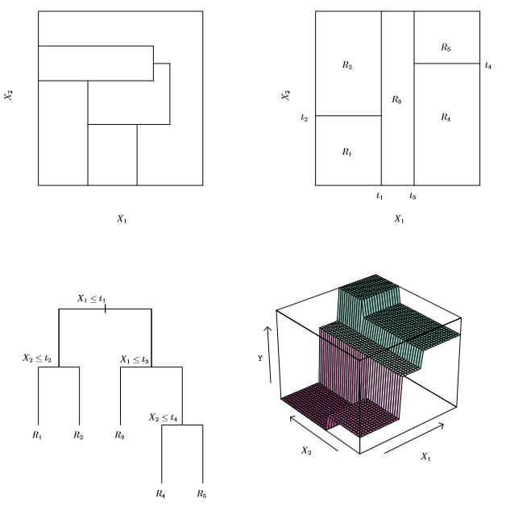
Decision Trees The Regions
Not from recursive binary splitting
Segmented Feature Space
Example from James et al. (2017)
Top-left 2D feature space partitioning that could not result from recursive binary splitting
Top-right feature space partitioning, decision tree and estimation surface for feature space.
Decision Tree
Prediction Surface

Slide 18
Decision Trees Termination
When do we stop recursive binary splitting?
We could continue until every training data value is in it’s own region!
This would be overfit!
The typical approach is to apply a minimum training data in each region criteria
The algorithm stops when all boxes have reached the minimum
We could continue until we cannot not significantly reduce RSS
But the current split could lead to an even better split short sighted

Slide 19
Decision Trees Pruning
Why do we want a less complicated tree?
Decision trees, if allowed to grow very complicated are generally overfit.
It is better to simplify the tree to a smaller tree with fewer splits
lower model variance
better interpretation
with little added model bias
Limiting tree growth with a high decrease in RSS hurdle is short sighted
Best strategy is to build a large, complicated tree and then to prune the tree.
We then select the sub tree to provides the lowest test error rate
We cannot consider all possible sub trees (too vast of a solution space)

Slide 20
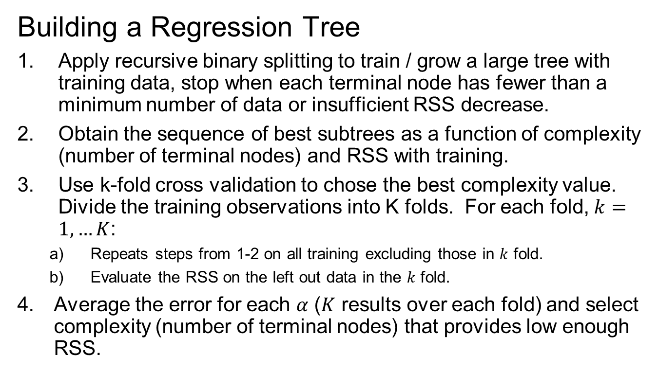
Decision Trees – Steps
Building a Regression Tree
Apply recursive binary splitting to train / grow a large tree with training data, stop when each terminal node has fewer than a minimum number of data or insufficient RSS decrease.
Obtain the sequence of best subtrees as a function of complexity (number of terminal nodes) and RSS with training.
Use k-fold cross validation to chose the best complexity value. Divide the training observations into K folds. For each fold, $k=1,…K$:
Repeats steps from 1-2 on all training excluding those in $k$ fold.
Evaluate the RSS on the left out data in the $k$ fold.
Average the error for each $α$ ($K$ results over each fold) and select complexity (number of terminal nodes) that provides low enough RSS.

Slide 21
K-fold Cross Validation
Cross Validation
Withhold subset of the data during model training
Then testing the trained model with withheld subset dataset
Must make sure cross validation is fair
Training data set (used for training), Testing data set (withheld for testing)
K-fold Approach
Select K, for example
Break data set into K subsets
Loop over K subsets:
use data outside the K part to predict inside the K subset
Average to summarize the result

Slide 22
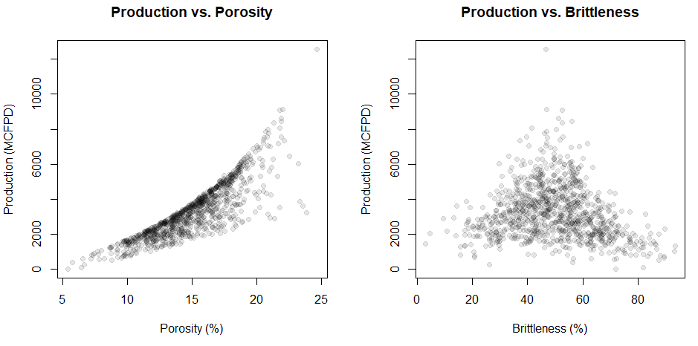
Decision Trees Example
Let’s use our Unconventional Multivariate Data
We added in a production variable for prediction
Both porosity and brittleness have interesting relationships with production
To get a more complete story, check out the labeled scatter plot.

Slide 23
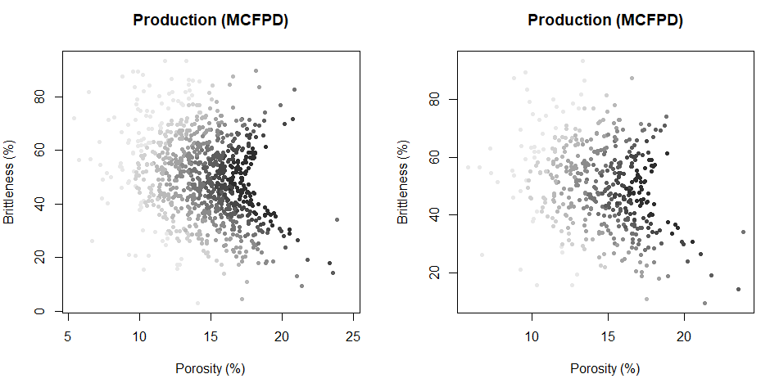
Decision Trees Example
Let’s use our Unconventional Multivariate Data
There is a complicated relationships between porosity, brittleness and production.
Available data set (n=500)
Training data set (n=100)

Slide 24
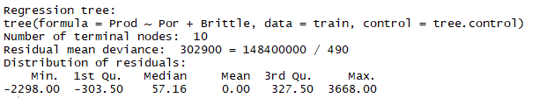
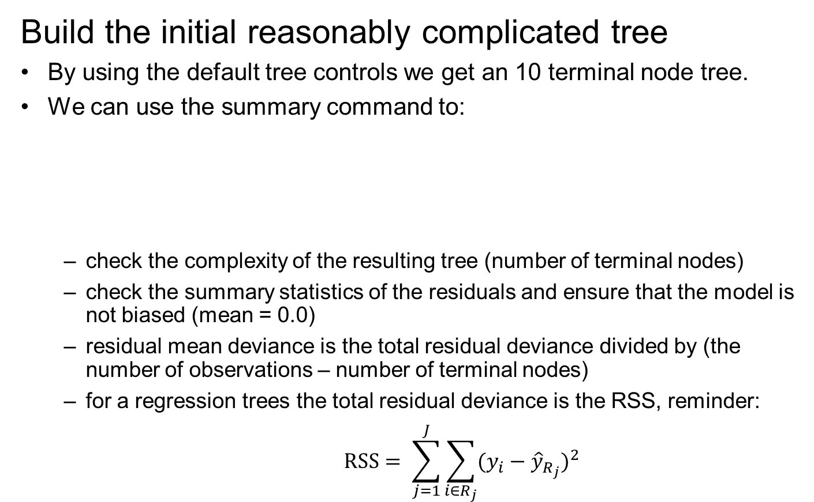
Decision Trees Example
Build the initial reasonably complicated tree
By using the default tree controls we get an 10 terminal node tree.
We can use the summary command to:
check the complexity of the resulting tree (number of terminal nodes)
check the summary statistics of the residuals and ensure that the model is not biased (mean = 0.0)
residual mean deviance is the total residual deviance divided by (the number of observations – number of terminal nodes)
for a regression trees the total residual deviance is the RSS, reminder:
$$RSS= \sum_{j=1}^{J}{\sum_{i∈R_{j}}{{(y_{i}−{\hat{y}}_{R_{j}})}^{2}}}$$

Slide 25
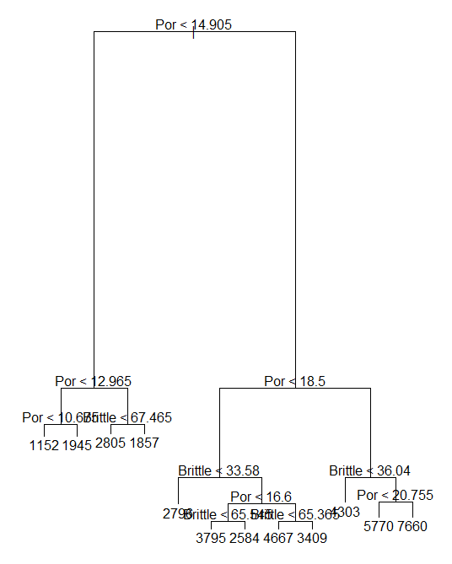
Decision Trees Example
Build the initial reasonably complicated tree
Here’s the tree:
first choice is porosity < or > 14.9%
we get to the 3rd decision before brittleness is considered
length of the branches is proportional to decrease in impurity
decress in RSS of the model for regression tree
a measure of node heterogeneity for classification trees

Slide 26
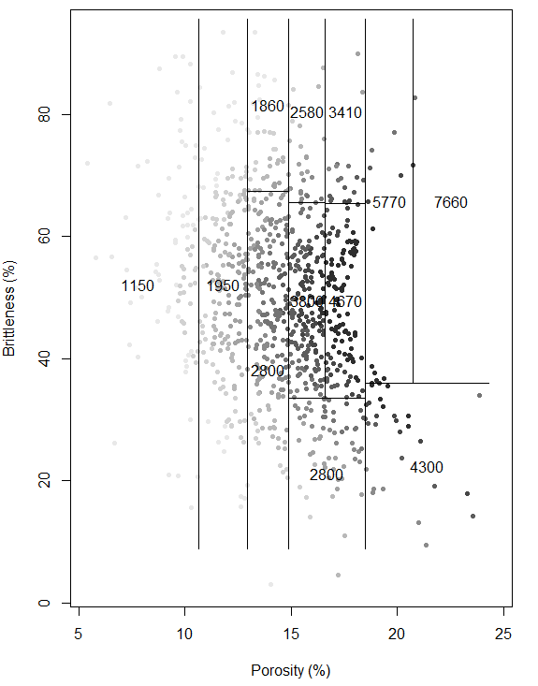
Decision Trees Example
Build the initial reasonably complicated tree
We can plot the original data and the binary recursive boundaries outlining the various regions and the mean values in each region used as the estimate.

Slide 27
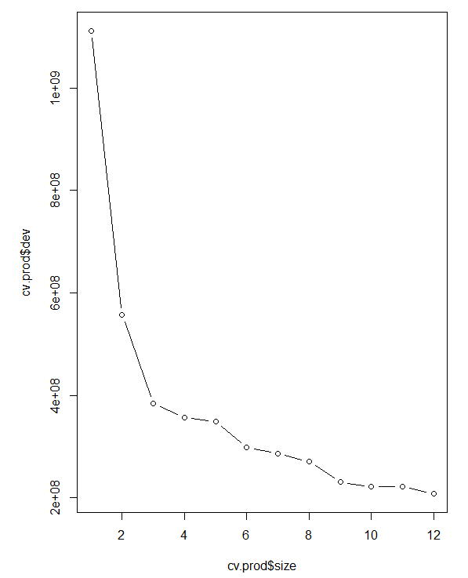
Decision Trees Example
Build the initial reasonably complicated tree
Then we perform k fold cross validation.
Decrease tree complexity from 12 nodes (current model) to 1 node (uniform model)
Calculate the RSS by averaging over k folds of the training data
We can observed that each additional node improves the model
Prune complexity based on:
Diminishing returns
Acceptable level of error
Rate of
Improvement
Acceptable Error

Slide 28
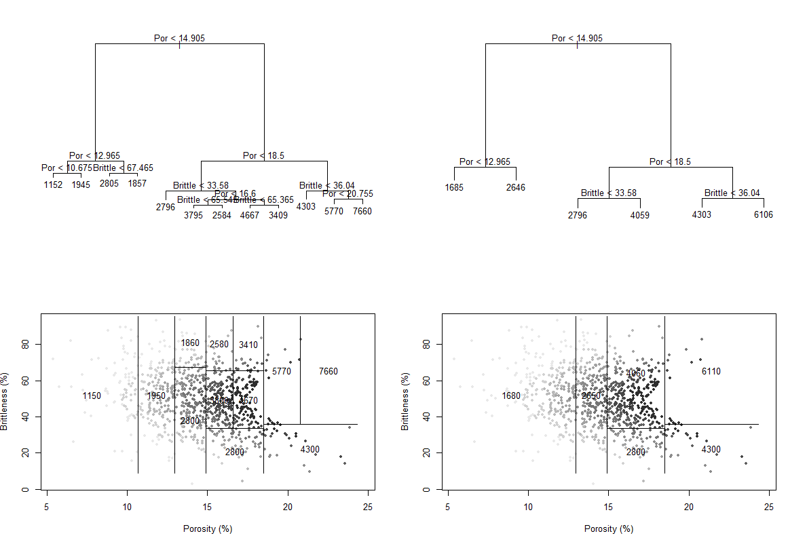
Decision Trees Example
Original and pruned tree:

Slide 29
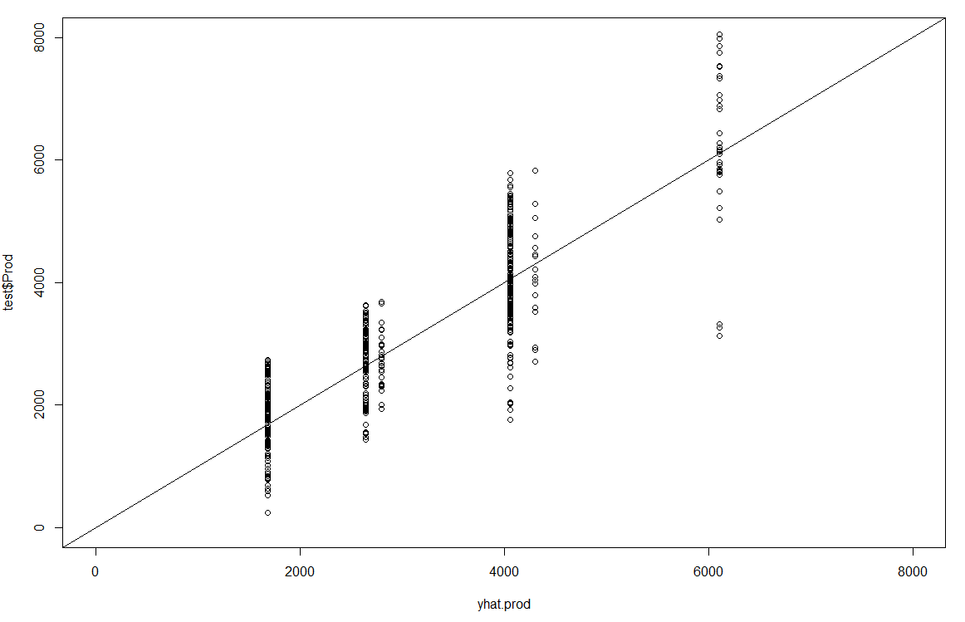
Decision Trees Example
Cross validation with the testing data set
Note: the binning due to estimation with the mean of only 6 regions
We can calculate MSE to assess model accuracy

Slide 30

Decision Trees Demonstration in Python
The workflow is Daytum_DecisionTree.ipynb

Slide 31
Decision Trees Comments
General Comments on Decision Trees
Easy to explain
Analog to human decision making
Graphically displayed
Continuous or categorical variables
Lower predictive accuracy than other machine learning methods
Model bias may be high

Slide 32
Daytum +2 Course Decision Tree
Ensemble Methods
Instructor: Michael Pyrcz, the University of Texas at Austin

Slide 33
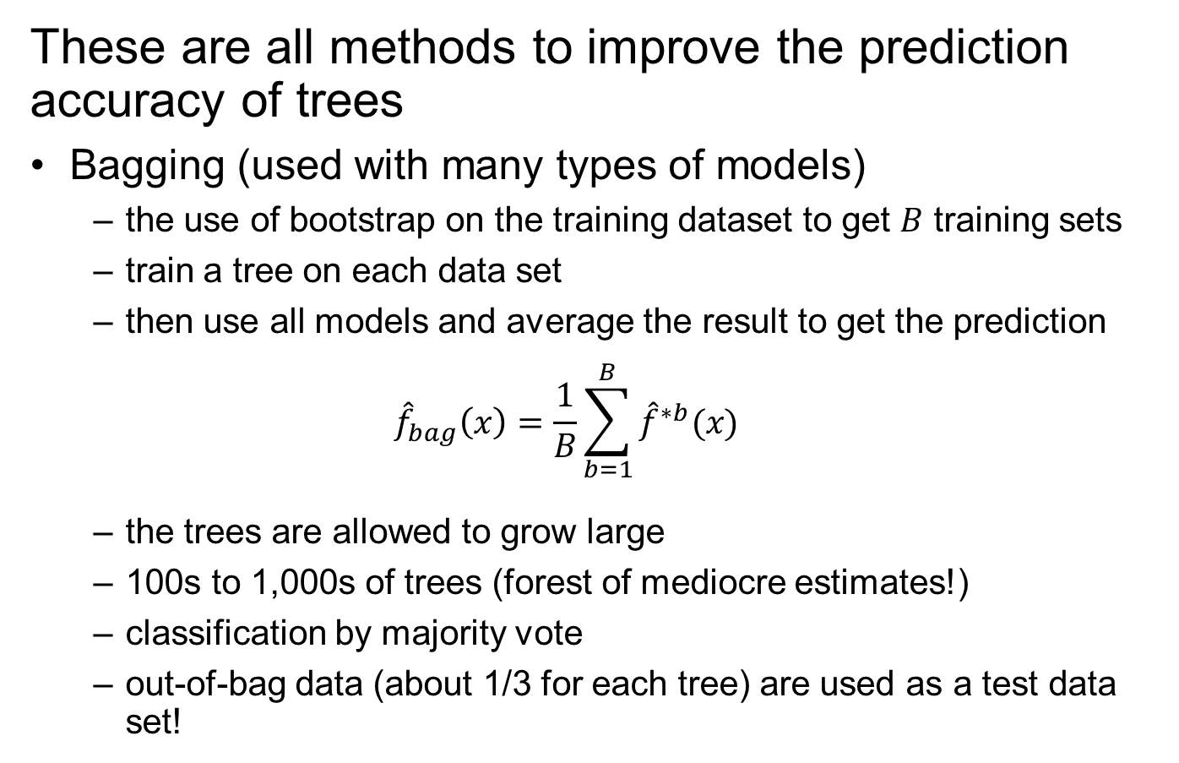
Bagging, Random Forest and Boosting
These are all methods to improve the prediction accuracy of trees
Bagging (used with many types of models)
the use of bootstrap on the training dataset to get $B$ training sets
train a tree on each data set
then use all models and average the result to get the prediction
$${\hat{f}}_{bag}\left(x\right)=\frac{1}{B}\sum_{b=1}^{B}{{\hat{f}}^{∗b}(x)}$$
the trees are allowed to grow large
100s to 1,000s of trees (forest of mediocre estimates!)
classification by majority vote
out-of-bag data (about 1/3 for each tree) are used as a test data set!

Slide 34
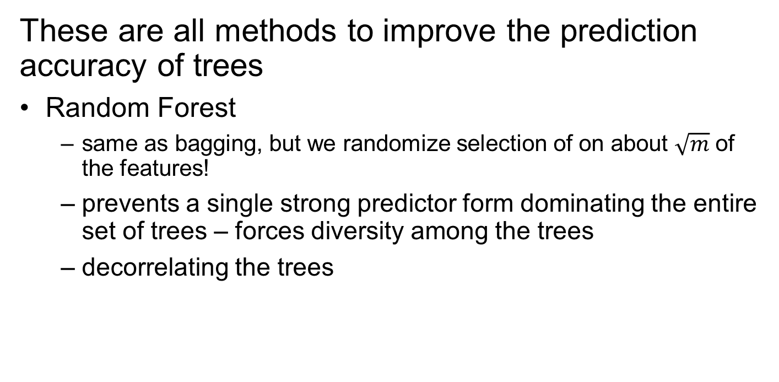
Bagging, Random Forest and Boosting
These are all methods to improve the prediction accuracy of trees
Random Forest
same as bagging, but we randomize selection of on about $\sqrt{m}$ of the features!
prevents a single strong predictor form dominating the entire set of trees – forces diversity among the trees
decorrelating the trees

Slide 35
Bagging, Random Forest and Boosting
These are all methods to improve the prediction accuracy of trees
Boosting (used with many types of models)
sequential modeling of a simple tree
build a tree, calculate residual
build a tree to model residual from 1st tree
build a tree to model the residual from 2nd tree
etc.

Slide 36
Daytum +2 Course Decision Tree
Decision Tree
Ensemble Methods
Instructor: Michael Pyrcz, the University of Texas at Austin

