Slide 1
Daytum +2 Course Support Vector Machines
Support Vector Machines
SVM Demonstration in Python
Instructor: Michael Pyrcz, the University of Texas at Austin

Slide 2
Daytum +2 Course Support Vector Machines
Support Vector Machines
Instructor: Michael Pyrcz, the University of Texas at Austin

Slide 3
Support Vector Machines
A powerful supervised training, machine learning method for segmentation
For example, forming a rule to segment a multivariate dataset into multiple categories with a decision rule.
E.g. Geoscience Kanevski et al., 2000, Bio Goovaerts et al., 2018
Spatial Boundaries
Multivariate Boundaries
Y (m)
Permeability (mD)
X (m)
Porosity (%)

Slide 4
Support Vector Machines
General Comments on Support Vector Machines
Generalization of linear decision boundaries for classification
Applied for classification with optimal separating hyperplanes when the classes overlap.
Nonlinearity is achieved by transforming the feature space (typically to a high dimensional space)
Maximizes the margin, separation between cases in each category
Training data well within the decision boundary have no influence

Slide 5
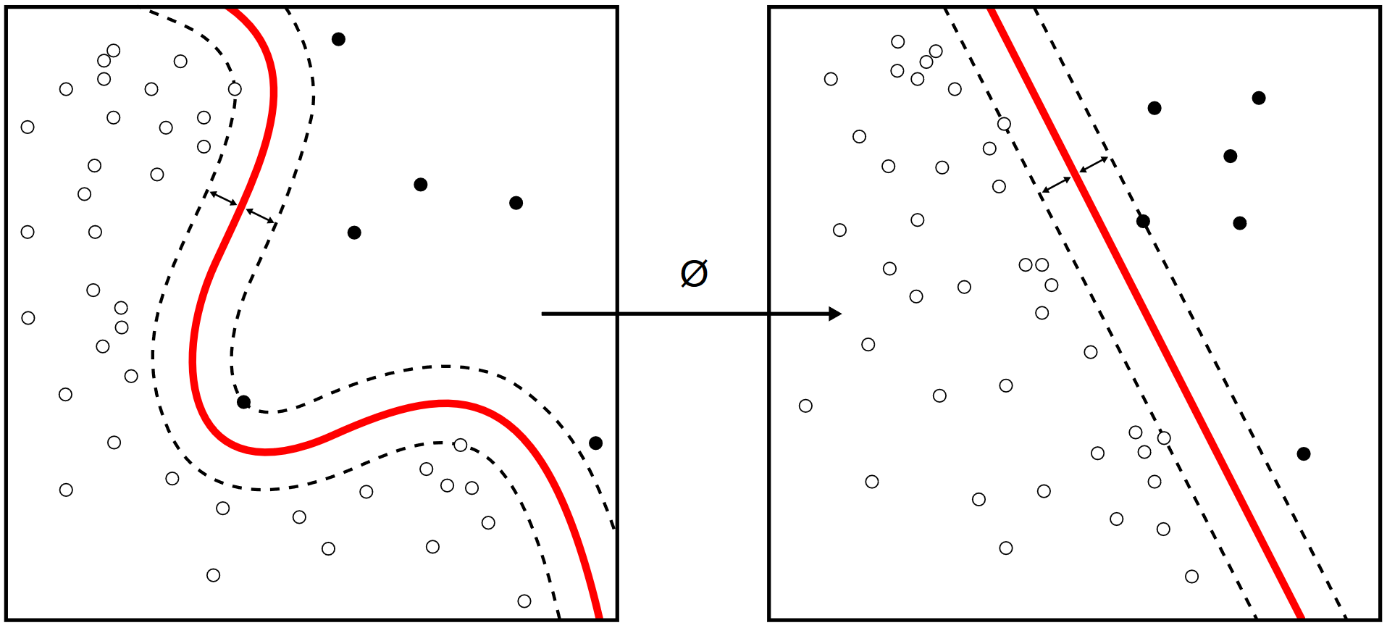
Support Vector Machines
Form a boundary with the largest possible margin between the different cases.
Data within the margin or misclassified update the model, they are called support vectors.
Project into problem into a higher dimensional space to solve linearly, with a variety of kernels.
The C parameter controls to penalty of misclassification, high C will result in a more complicated model (lower model bias, higher model variance).
Original Space
High Dimensional Space
Margin
Support
Vectors
Kernel
Image by Zirguezi, available at https://en.wikipedia.org/wiki/Support-vector_machine#/media/File:Kernel_Machine.svg

Slide 6
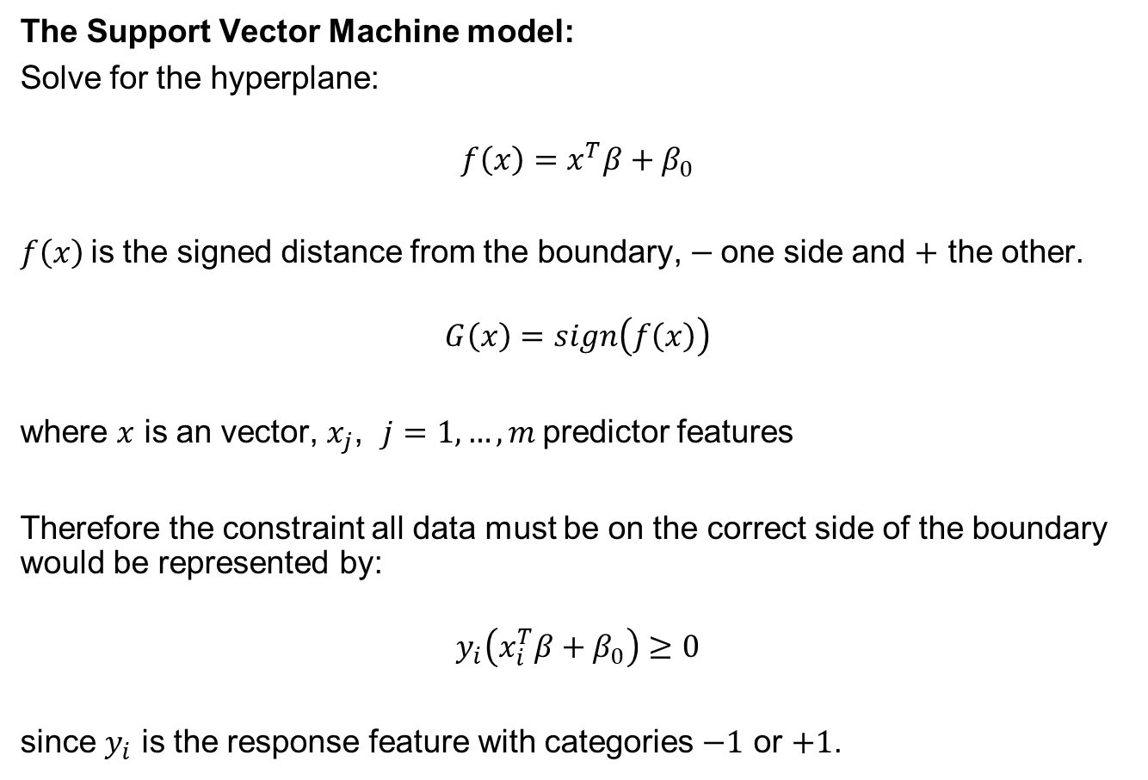
Support Vector Machines
The Support Vector Machine model:
Solve for the hyperplane:
$$f\left(x\right)=x^{T}β+β_{0}$$
$f\left(x\right)$is the signed distance from the boundary, $−$one side and $+$ the other.
$$G\left(x\right)=sign\left(f\left(x\right)\right)$$
where $x$ is an vector, $x_{j}$, $j=1,…, m$predictor features
Therefore the constraint all data must be on the correct side of the boundary would be represented by:
$$y_{i}\left(x_{i}^{T}β+β_{0}\right)≥0$$
since $y_{i}$ is the response feature with categories $−1$ or $+1$.

Slide 7



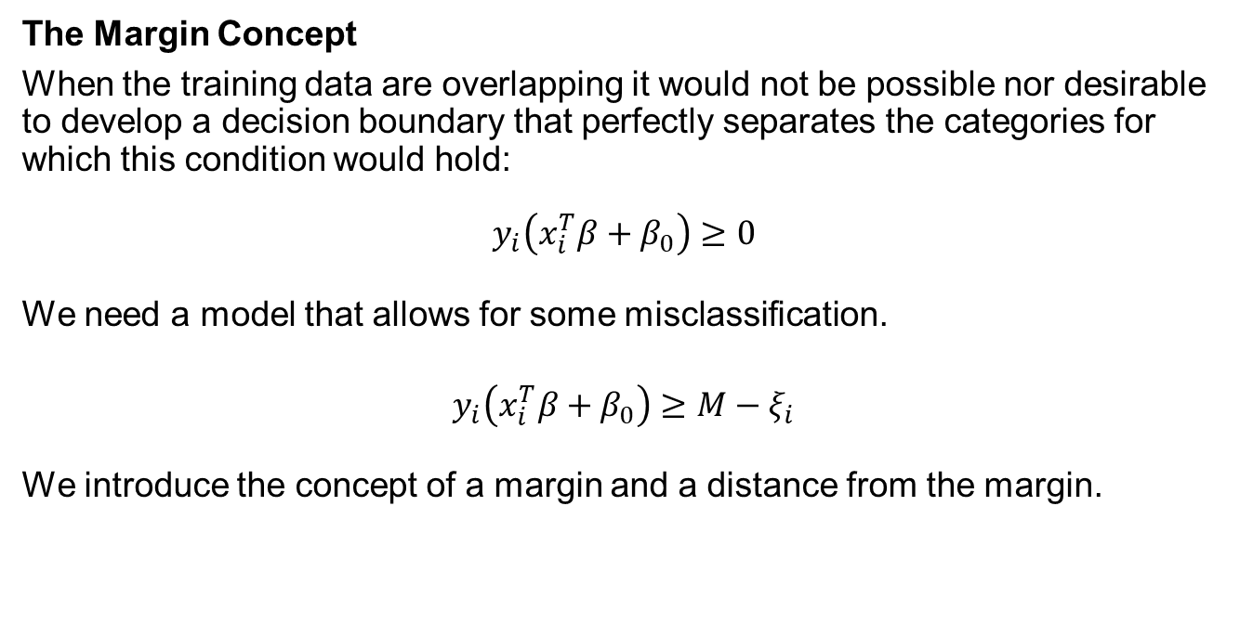






Support Vector Machines
The Margin Concept
When the training data are overlapping it would not be possible nor desirable to develop a decision boundary that perfectly separates the categories for which this condition would hold:
$$y_{i}\left(x_{i}^{T}β+β_{0}\right)≥0$$
We need a model that allows for some misclassification.
$$y_{i}\left(x_{i}^{T}β+β_{0}\right)≥M−ξ_{i}$$
We introduce the concept of a margin and a distance from the margin.
$$ξ_{12}=0$$
$$ξ_{4}$$
$$ξ_{6}$$
$$ξ_{3}$$
$$ξ_{7}$$
$$M$$
$$ξ_{13}$$
$$M$$
$$ξ_{10}=0$$

Slide 8
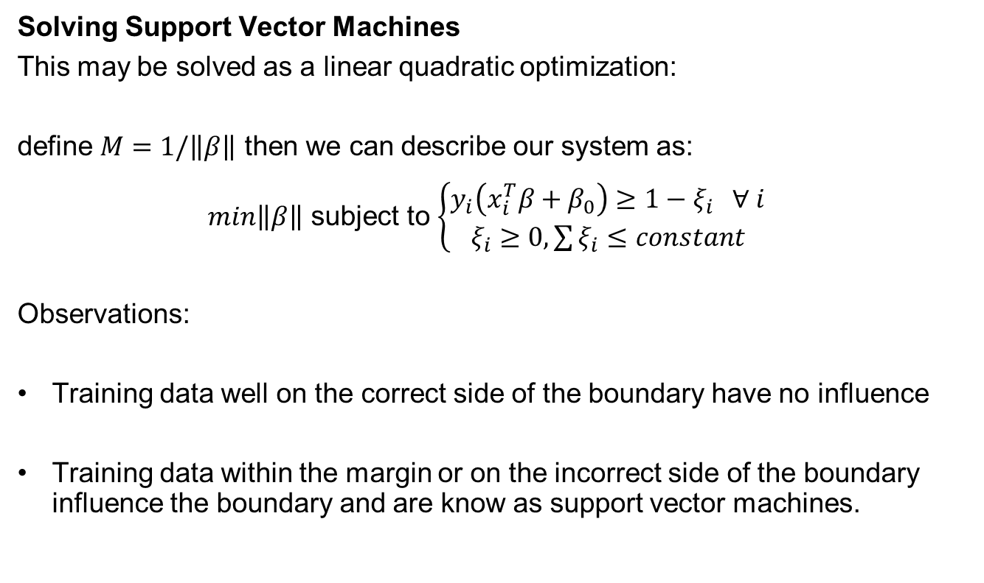
Support Vector Machines
Solving Support Vector Machines
This may be solved as a linear quadratic optimization:
define $M=1/\left\|β\right\|$ then we can describe our system as:
$min\left\|β\right\|$ subject to $\left\{\begin{matrix}y_{i}\left(x_{i}^{T}β+β_{0}\right)≥1−ξ_{i} ∀ i \\ ξ_{i}≥0, \sum{ξ_{i}}≤constant\end{matrix} \right.$
Observations:
Training data well on the correct side of the boundary have no influence
Training data within the margin or on the incorrect side of the boundary influence the boundary and are know as support vector machines.

Slide 9
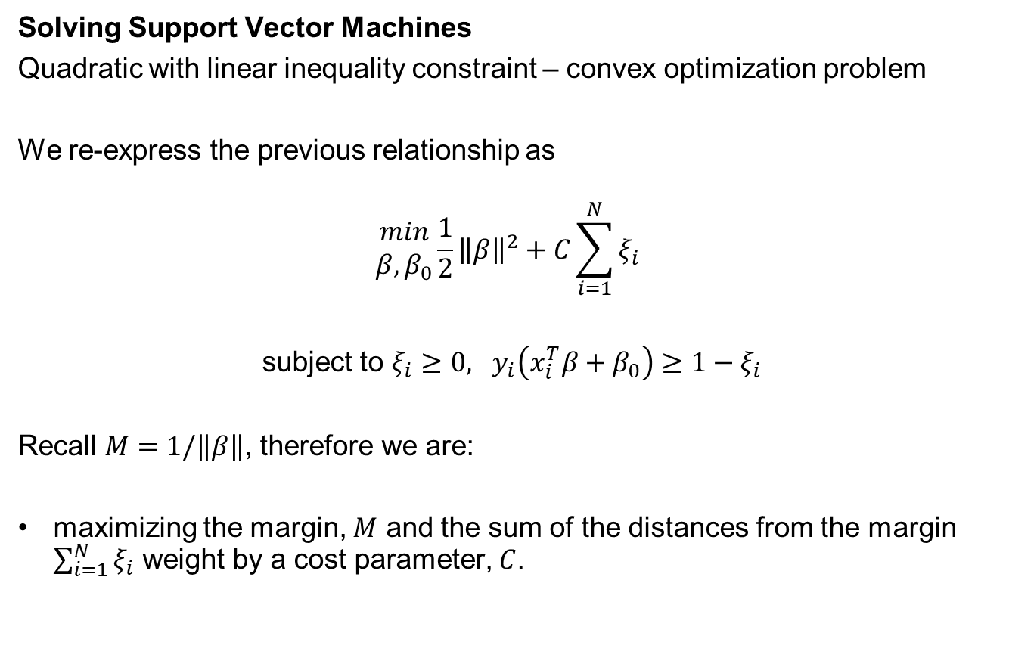
Support Vector Machines
Solving Support Vector Machines
Quadratic with linear inequality constraint – convex optimization problem
We re-express the previous relationship as
$$\begin{matrix}min \\ β,β_{0}\end{matrix}\frac{1}{2}{\left\|β\right\|}^{2}+C\sum_{i=1}^{N}{ξ_{i}}$$
subject to $ξ_{i}≥0, y_{i}\left(x_{i}^{T}β+β_{0}\right)≥1−ξ_{i}$
Recall $M=1/\left\|β\right\|$, therefore we are:
maximizing the margin, $M$ and the sum of the distances from the margin $\sum_{i=1}^{N}{ξ_{i}}$ weight by a cost parameter, $C$.

Slide 10



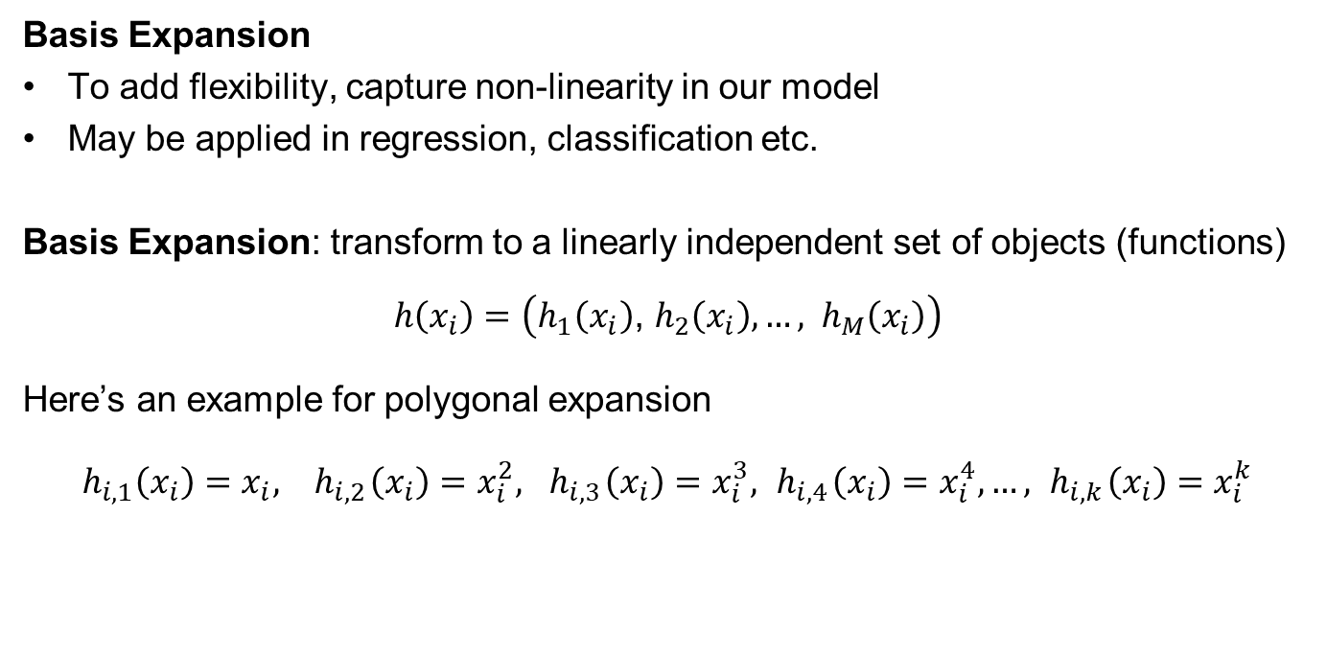





Support Vector Machines
Basis Expansion
To add flexibility, capture non-linearity in our model
May be applied in regression, classification etc.
Basis Expansion: transform to a linearly independent set of objects (functions)
$$h\left(x_{i}\right)=\left(h_{1}\left(x_{i}\right)\text{, }h_{2}\left(x_{i}\right),…, h_{M}\left(x_{i}\right)\right)$$
Here’s an example for polygonal expansion
$$h_{i,1}\left(x_{i}\right)=x_{i},{ h}_{i,2}\left(x_{i}\right)=x_{i}^{2},{ h}_{i,3}\left(x_{i}\right)=x_{i}^{3},{ h}_{i,4}\left(x_{i}\right)=x_{i}^{4}, …,{ h}_{i,k}\left(x_{i}\right)=x_{i}^{k}$$
$$j$$
$$m$$
$$j^{′}$$
$$m× k$$
Basis
Expansion
$$i$$
$$i$$
$$n$$
$$n$$

Slide 11
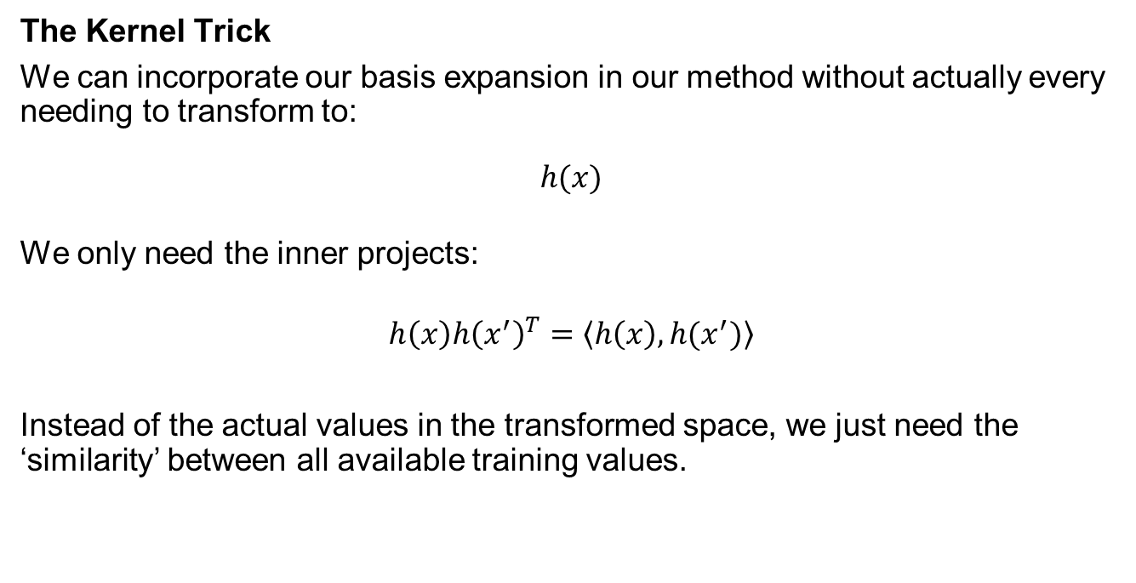
Support Vector Machines
The Kernel Trick
We can incorporate our basis expansion in our method without actually every needing to transform to:
$$h(x)$$
We only need the inner projects:
$$h\left(x\right){h\left(x^{′}\right)}^{T}=\left\langle h\left(x\right),h(x^{′})\right\rangle$$
Instead of the actual values in the transformed space, we just need the ‘similarity’ between all available training values.

Slide 12

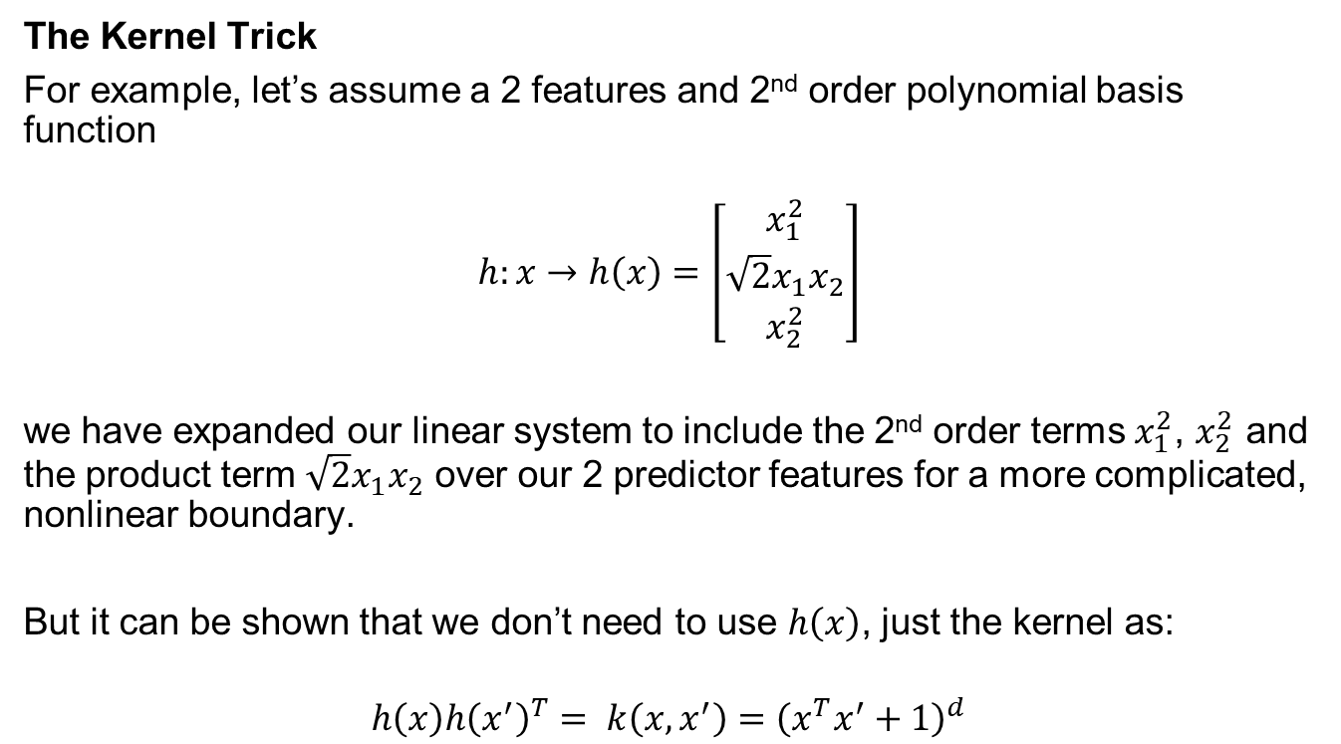
Support Vector Machines
The Kernel Trick
For example, let’s assume a 2 features and 2nd order polynomial basis function
$$h:x→h\left(x\right)=\left[\begin{matrix}x_{1}^{2} \\ \sqrt{2}x_{1}x_{2} \\ x_{2}^{2}\end{matrix}\right]$$
we have expanded our linear system to include the 2nd order terms $x_{1}^{2}$, $x_{2}^{2}$ and the product term $\sqrt{2}x_{1}x_{2}$ over our 2 predictor features for a more complicated, nonlinear boundary.
But it can be shown that we don’t need to use $h\left(x\right)$, just the kernel as:
$$h\left(x\right){h\left(x^{′}\right)}^{T}= k\left(x,x^{′}\right)={\left(x^{T}x^{′}+1\right)}^{d}$$
A function of base features, $x,$ only.

Slide 13
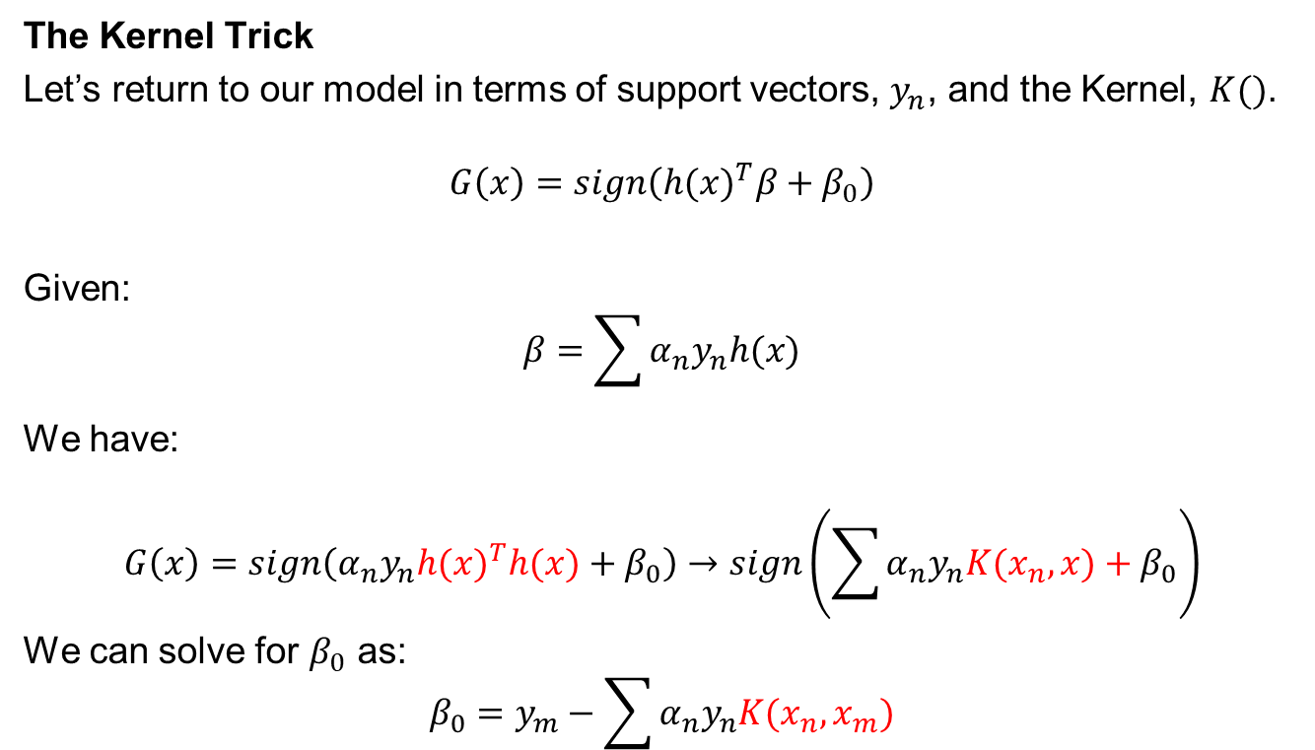
Support Vector Machines
The Kernel Trick
Let’s return to our model in terms of support vectors, $y_{n}$, and the Kernel, $K()$.
$$G\left(x\right)=sign\left({h(x)}^{T}β+β_{0}\right)$$
Given:
$$β=\sum{α_{n}y_{n}h(x)}$$
We have:
$$G\left(x\right)=sign\left(α_{n}y_{n}{h(x)}^{T}h(x)+β_{0}\right)→sign\left(\sum{α_{n}y_{n}K(x_{n},x)+β_{0}}\right)$$
We can solve for $β_{0}$ as:
$$β_{0}=y_{m}−\sum{α_{n}y_{n}K(x_{n},x_{m})}$$

Slide 14
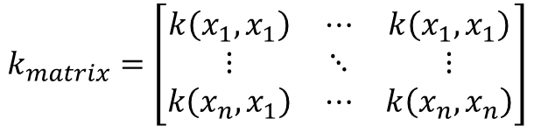
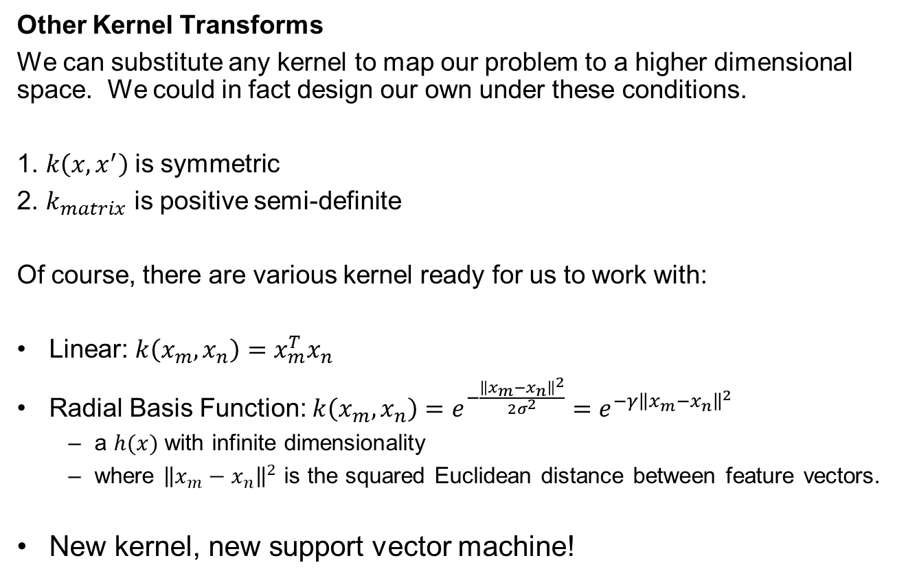
Support Vector Machines
Other Kernel Transforms
We can substitute any kernel to map our problem to a higher dimensional space. We could in fact design our own under these conditions.
1. $k\left(x,x^{′}\right)$is symmetric
2. $k_{matrix}$ is positive semi-definite
Of course, there are various kernel ready for us to work with:
Linear: $k\left(x_{m},x_{n}\right)=x_{m}^{T}x_{n}$
Radial Basis Function: $k\left(x_{m},x_{n}\right)=e^{−\frac{{\left\|x_{m}−x_{n}\right\|}^{2}}{2σ^{2}}}=e^{−{γ\left\|x_{m}−x_{n}\right\|}^{2}}$
a $h(x)$ with infinite dimensionality
where ${\left\|x_{m}−x_{n}\right\|}^{2}$ is the squared Euclidean distance between feature vectors.
New kernel, new support vector machine!
$$k_{matrix}=\left[\begin{matrix}k\left(x_{1},x_{1}\right) & ⋯ & k\left(x_{1},x_{1}\right) \\ ⋮ & ⋱ & ⋮ \\ k\left(x_{n},x_{1}\right) & ⋯ & k\left(x_{n},x_{n}\right)\end{matrix}\right]$$

Slide 15
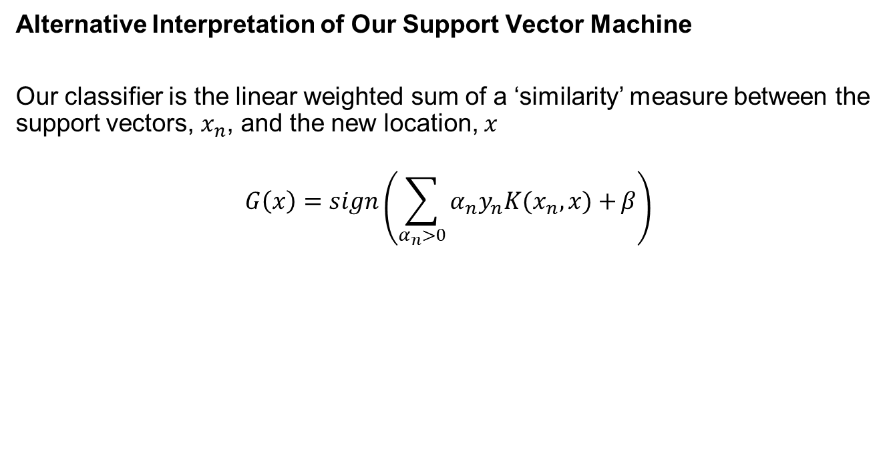
Support Vector Machines
Alternative Interpretation of Our Support Vector Machine
Our classifier is the linear weighted sum of a ‘similarity’ measure between the support vectors, $x_{n}$, and the new location, $x$
$$G\left(x\right)=sign\left(\sum_{α_{n}>0}{α_{n}y_{n}K(x_{n},x)+}β\right)$$

Slide 16
Daytum +2 Course Support Vector Machines
SVM Demonstration in Python
Instructor: Michael Pyrcz, the University of Texas at Austin

Slide 17
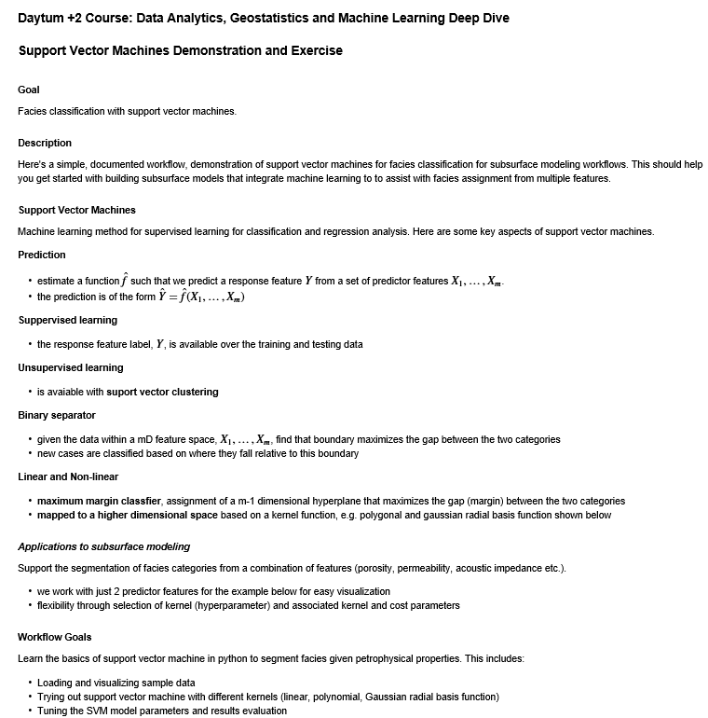
Support Vector Machines Demonstration
Demonstration workflow with support vector machines to form a decision rule for segmentation.
The workflow is Daytum_SupportVectorMachines.ipynb

Slide 18
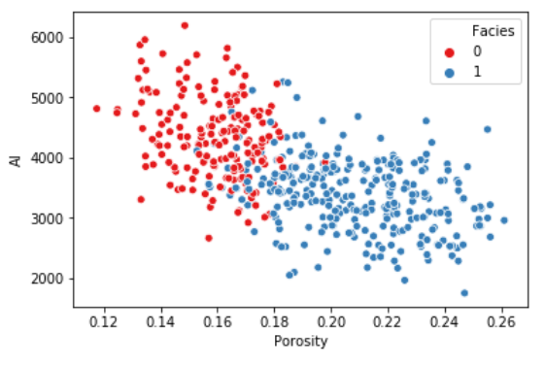
Support Vector Machines Demonstration
Demonstration workflow with support vector machines to form a decision rule for segmentation. Here’s the training data.
Workflow developed by Wendi Liu, PhD student at The University of Texas at Austin.

Slide 19
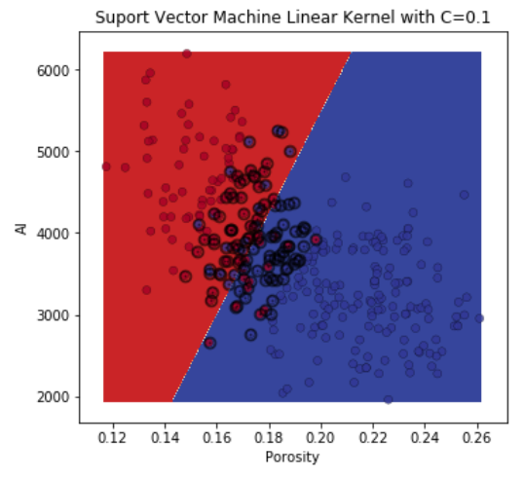
Support Vector Machines Demonstration
Linear kernel – decision boundary and support vectors highlighted.
Workflow developed by Wendi Liu, PhD student at The University of Texas at Austin.

Slide 20
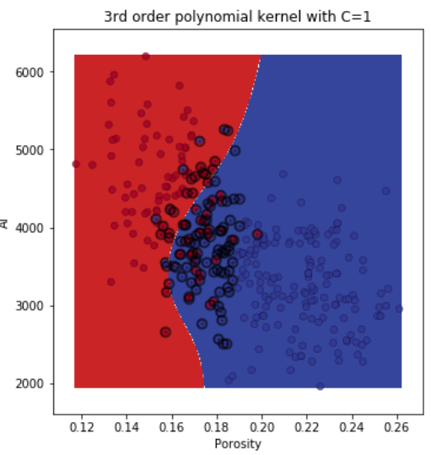
Support Vector Machines Demonstration
3rd Order Polynomial Kernel – decision boundary and support vectors highlighted.
Workflow developed by Wendi Liu, PhD student at The University of Texas at Austin.

Slide 21
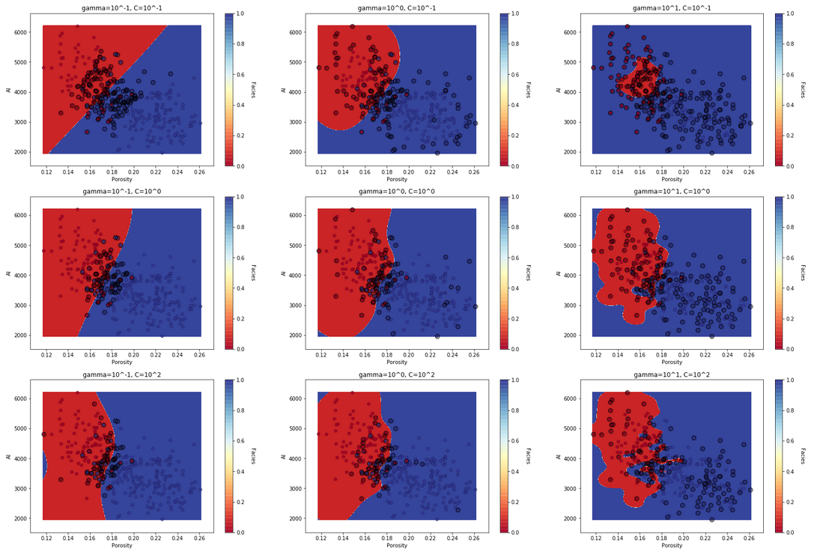

Support Vector Machines Demonstration
Radial Kernel – control of C and curvature parameter, $γ$.
Workflow developed by Wendi Liu, PhD student at The University of Texas at Austin.

Slide 22
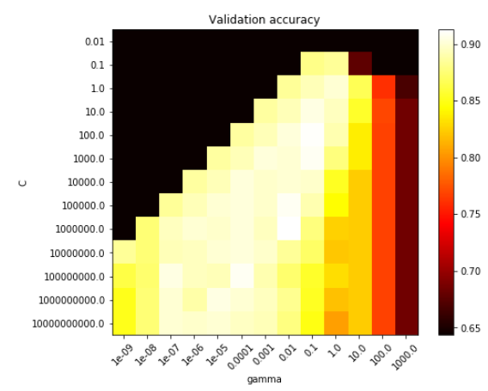
Support Vector Machines Demonstration
Performance with testing for a wide variety of parameters.
Workflow developed by Wendi Liu, PhD student at The University of Texas at Austin.

Slide 23
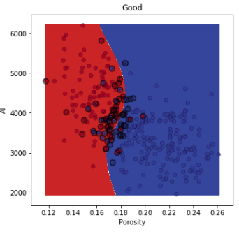
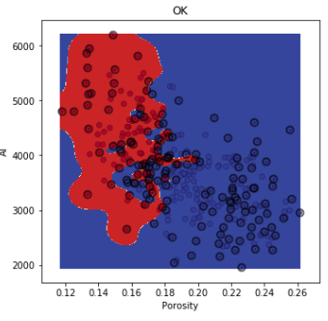
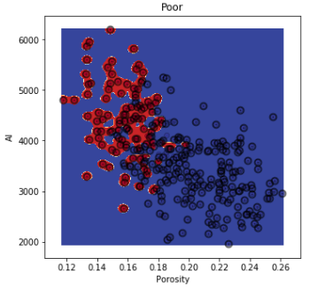
Support Vector Machines Demonstration
Examples of models that perform well, average and poorly in testing.
A clear case of overfit.
Workflow developed by Wendi Liu, PhD student at The University of Texas at Austin.

Slide 24
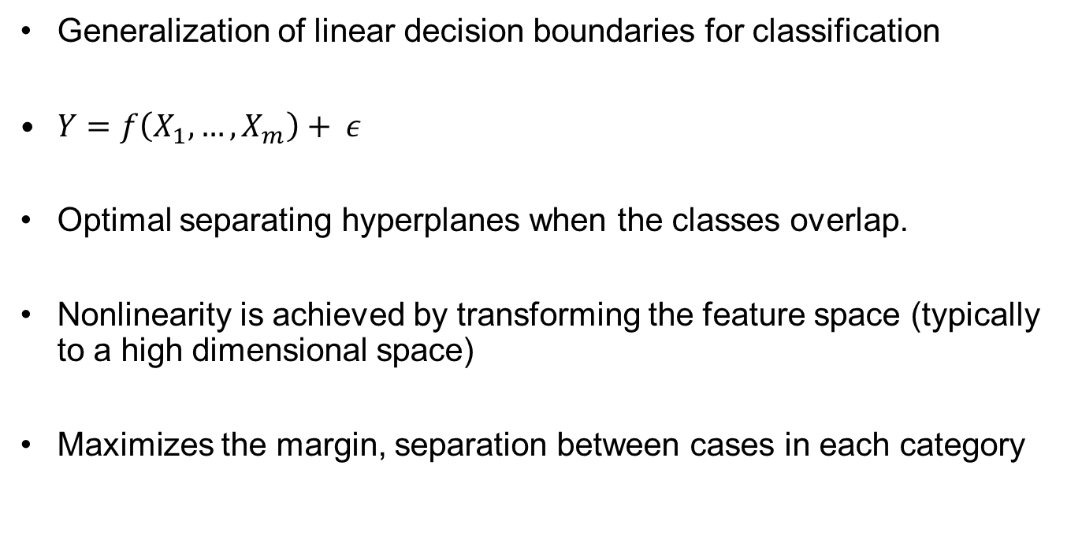
Support Vector Machines
Generalization of linear decision boundaries for classification
$Y=f\left(X_{1},…,X_{m}\right)+ ε$
Optimal separating hyperplanes when the classes overlap.
Nonlinearity is achieved by transforming the feature space (typically to a high dimensional space)
Maximizes the margin, separation between cases in each category

Slide 25
Daytum +2 Course Support Vector Machines
Support Vector Machines
SVM Demonstration in Python
Instructor: Michael Pyrcz, the University of Texas at Austin

