Slide 1
Daytum +2 Course Artificial Neural Networks
Artificial Neural Networks
Artificial Neural Network Example
Instructor: Michael Pyrcz, the University of Texas at Austin

Slide 2
Daytum +2 Course Artificial Neural Networks
Artificial Neural Networks
Instructor: Michael Pyrcz, the University of Texas at Austin

Slide 3
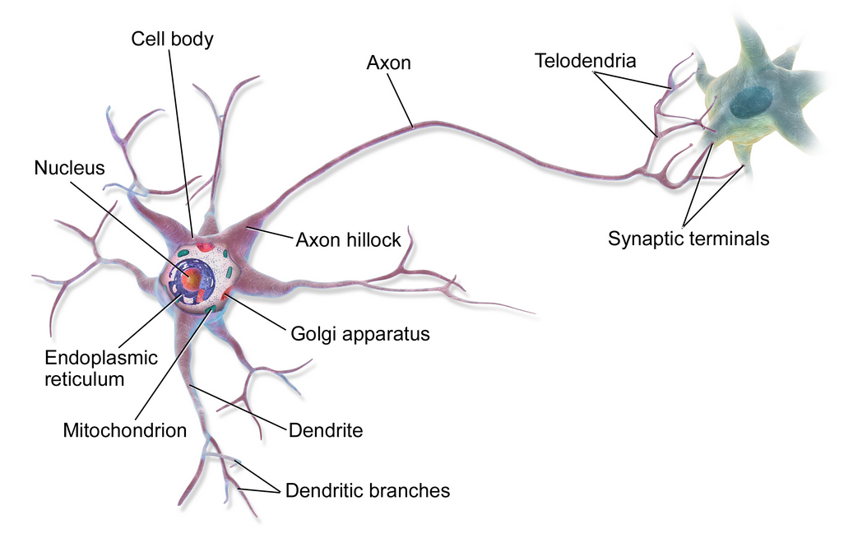
Natural Computing
Looking to nature for inspiration to develop novel problem solving methods.
artificial neural networks are inspired by biological neural networks
the nodes in our model are artificial neurons
the connections are artificial synapses
intelligence emmerges from many connected processors
Image from https://commons.wikimedia.org/wiki/File:Blausen_0657_MultipolarNeuron.png

Slide 4
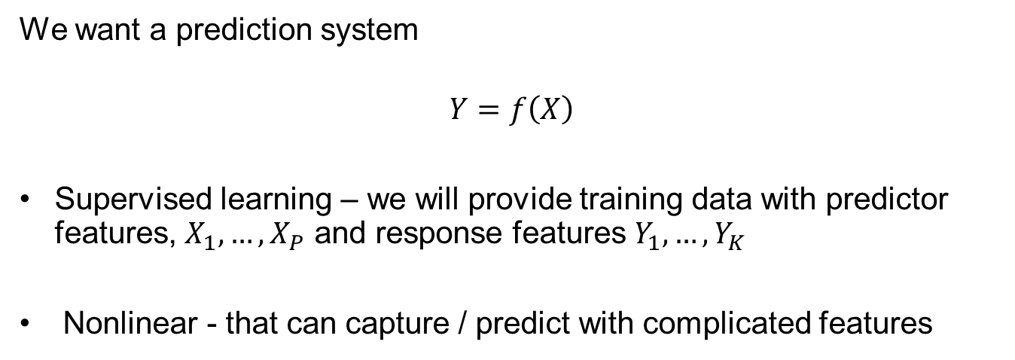
Neural Nets
We want a prediction system
$$Y=f\left(X\right)$$
Supervised learning – we will provide training data with predictor features, $X_{1},…,X_{P}$ and response features $Y_{1},…,Y_{K}$
Nonlinear - that can capture / predict with complicated features

Slide 5















Neural Nets
Let’s build a neural net, single hidden layer, feed-forward neural network to accomplish this.
Feed-forward – all information flows from left to right.
$$X_{1}$$
$$X_{1}^{N}$$
$$Z_{1}$$
$$X_{2}$$
$$X_{2}^{N}$$
$$Y_{1}^{N}$$
$$Z_{2}$$
$$Y_{1}$$
$$X_{3}$$
$$X_{3}^{N}$$
Predictor Features
Response Features
$$Y_{K}^{N}$$
$$Z_{M}$$
$$Y_{K}$$
$$X_{p}$$
$$X_{P}^{N}$$

Slide 6
Neural Nets
Connections: output from a node is passed to nodes in the next layer as inputs.
Connections
$$X_{1}$$
$$X_{1}^{N}$$
$$Z_{1}$$
$$X_{2}$$
$$X_{2}^{N}$$
$$Y_{1}^{N}$$
$$Z_{2}$$
$$Y_{1}$$
$$X_{3}$$
$$X_{3}^{N}$$
Predictor Features
Response Features
$$Y_{K}^{N}$$
$$Z_{M}$$
$$Y_{K}$$
$$X_{p}$$
$$X_{P}^{N}$$

Slide 7
Neural Nets
Nodes: take linearly weighted combinations of inputs and then nonlinearly transform the result.
A very simple processor!
Through a large number of interconnected nodes we get emergent prediction of complicated patterns.
$$X_{1}^{N}$$
$$Z_{1}$$
$$X_{2}^{N}$$
$$Y_{1}^{N}$$
Predictor Features
$$X_{3}^{N}$$
Response Features
$$Y_{K}^{N}$$
$$X_{P}^{N}$$

Slide 8
Neural Nets
Layers: for our feed-forward design we organize the nodes into layers.
Deep Learning is the use of more than one hidden layer
Input
Layer
Hidden
Layer
Output
Layer
$$X_{1}$$
$$X_{1}^{N}$$
$$Z_{1}$$
$$X_{2}$$
$$X_{2}^{N}$$
$$Y_{1}^{N}$$
$$Z_{2}$$
$$Y_{1}$$
$$X_{3}$$
$$X_{3}^{N}$$
Predictor Features
Response Features
$$Y_{K}^{N}$$
$$Z_{M}$$
$$Y_{K}$$
$$X_{p}$$
$$X_{P}^{N}$$

Slide 9
Neural Nets
Normalization: transforming the features to a specific range (commonly -1 ~ 1), centered on 0.0.
remove the influence of scale differences in predictor features
improve activation function sensitivity
predictions are in normalized response features, then backtransform.
Normalization
Reverse
Normalization
$$X_{1}$$
$$X_{1}^{N}$$
$$Z_{1}$$
$$X_{2}$$
$$X_{2}^{N}$$
$$Y_{1}^{N}$$
$$Z_{2}$$
$$Y_{1}$$
$$X_{3}$$
$$X_{3}^{N}$$
Predictor Features
Response Features
$$Y_{K}^{N}$$
$$Z_{M}$$
$$Y_{K}$$
$$X_{p}$$
$$X_{P}^{N}$$

Slide 10



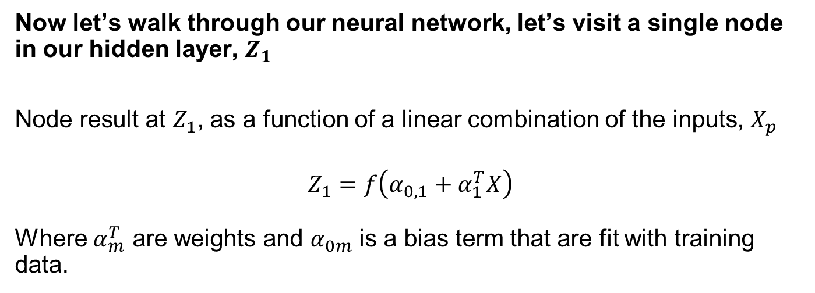


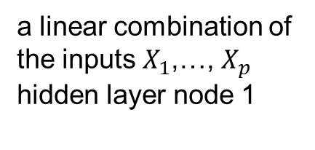

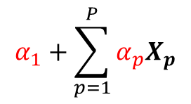
Neural Nets
Now let’s walk through our neural network, let’s visit a single node in our hidden layer, $Z_{1}$
Node result at $Z_{1}$, as a function of a linear combination of the inputs, $X_{p}$
$$Z_{1}=f\left(α_{0,1}+α_{1}^{T}X\right)$$
Where $α_{m}^{T}$ are weights and $α_{0m}$ is a bias term that are fit with training data.
$$X_{1}$$
$$Z_{1}$$
Weights
Bias
$$X_{2}$$
$$α_{1}+\sum_{p=1}^{P}{α_{p}X_{p}}$$
a linear combination of
the inputs $X_{1}$,…, $X_{p}$
hidden layer node 1
$$Z_{2}$$
$$Z_{M}$$
$$X_{P}$$

Slide 11
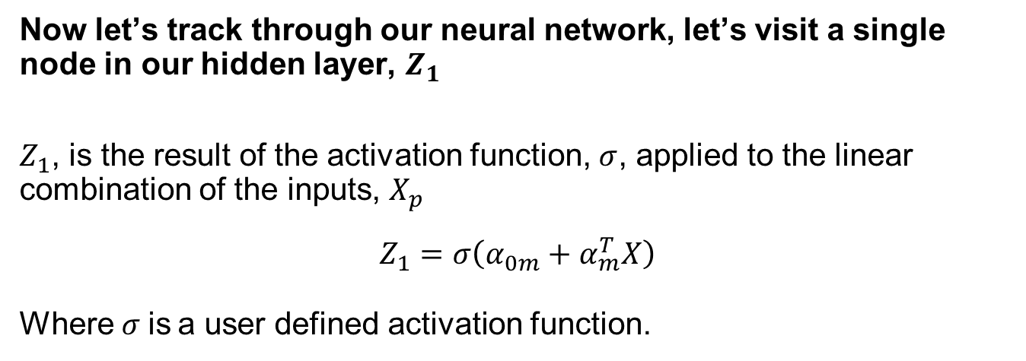
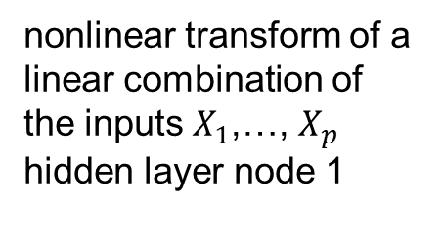
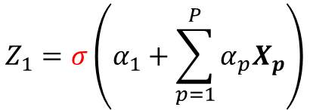
Neural Nets
Now let’s track through our neural network, let’s visit a single node in our hidden layer, $Z_{1}$
$Z_{1}$, is the result of the activation function, $σ$, applied to the linear combination of the inputs, $X_{p}$
$$Z_{1}=σ\left(α_{0m}+α_{m}^{T}X\right)$$
Where$σ$is a user defined activation function.
$$X_{1}$$
$$Z_{1}$$
nonlinear transform of a
linear combination of
the inputs $X_{1}$,…, $X_{p}$
hidden layer node 1
$$X_{2}$$
$$Z_{1}=σ\left(α_{1}+\sum_{p=1}^{P}{α_{p}X_{p}}\right)$$
$$Z_{2}$$
$$Z_{M}$$
$$X_{P}$$

Slide 12



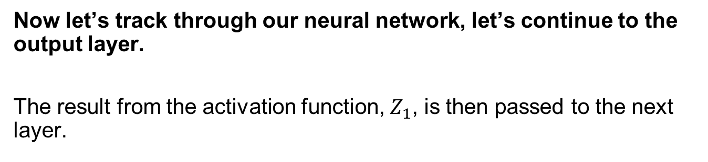




Neural Nets
Now let’s track through our neural network, let’s continue to the output layer.
The result from the activation function, $Z_{1}$, is then passed to the next layer.
$$Z_{1}$$
$$Y_{1}^{N}$$
$$Z_{2}$$
$$Y_{1}$$
$$Y_{K}^{N}$$
Response Features
$$Z_{M}$$
$$Y_{K}$$

Slide 13
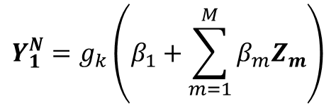


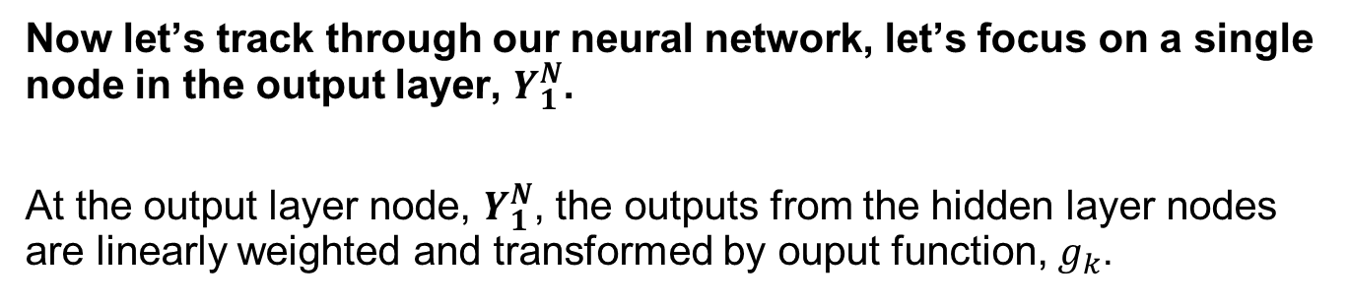


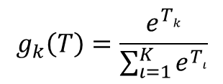


Neural Nets
Now let’s track through our neural network, let’s focus on a single node in the output layer, $Y_{1}^{N}$.
At the output layer node, $Y_{1}^{N}$, the outputs from the hidden layer nodes are linearly weighted and transformed by ouput function, $g_{k}$.
$$Y_{1}^{N}=g_{k}\left(β_{1}+\sum_{m=1}^{M}{β_{m}Z_{m}}\right)$$
For regression:
$$g_{k}\left(T\right)=T$$
$$Z_{1}$$
For classification:
$$Y_{1}^{N}$$
$$Z_{2}$$
$$Y_{1}$$
$$g_{k}\left(T\right)=\frac{e^{Tk}}{\sum_{ι=1}^{K}{e^{Tι}}}$$
Response Features
$$Z_{M}$$
forces positive and sum to one

Slide 14


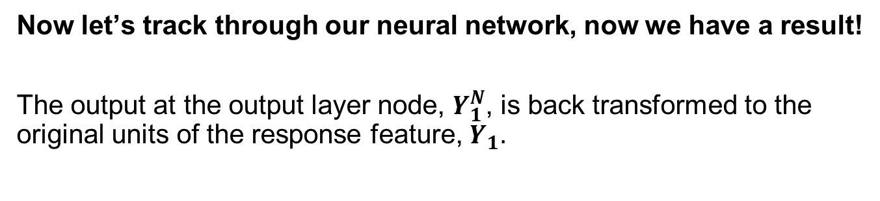



Neural Nets
Now let’s track through our neural network, now we have a result!
The output at the output layer node, $Y_{1}^{N}$, is back transformed to the original units of the response feature, $Y_{1}.$
$$Z_{1}$$
$$Y_{1}^{N}$$
$$Z_{2}$$
$$Y_{1}$$
Response Features
$$Z_{M}$$

Slide 15
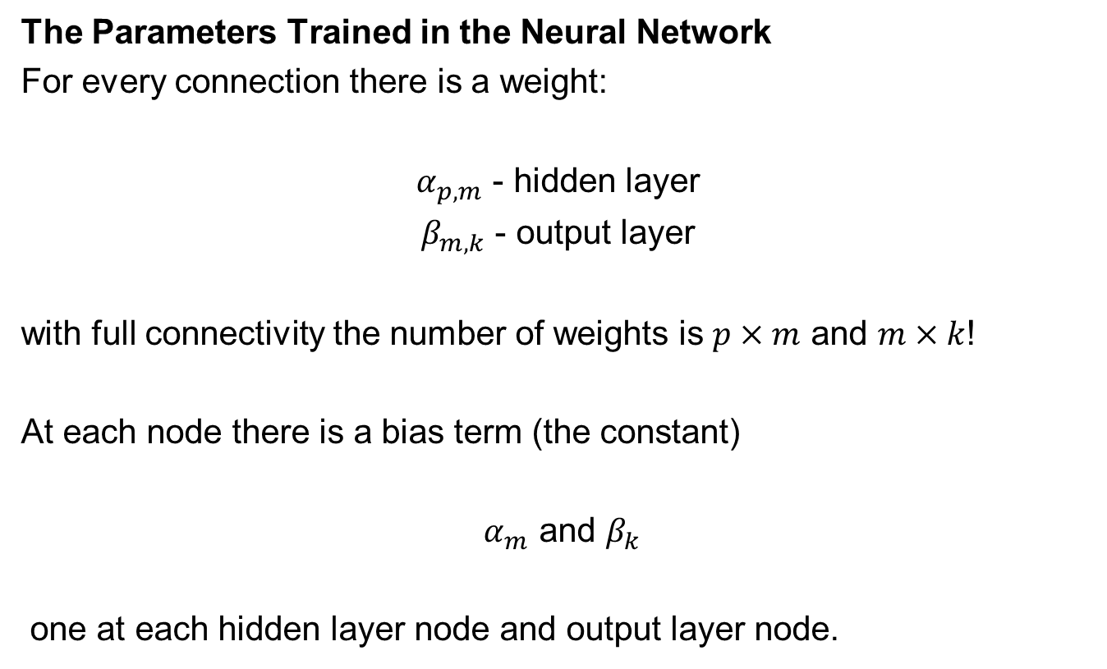
Neural Nets Parameters
The Parameters Trained in the Neural Network
For every connection there is a weight:
$α_{p,m}$ - hidden layer
$β_{m,k}$ - output layer
with full connectivity the number of weights is $p×m$ and $m×k$!
At each node there is a bias term (the constant)
$α_{m}$ and $β_{k}$
one at each hidden layer node and output layer node.

Slide 16
Neural Nets Activitation Functions
The Activation Function is a nonlinear transform of the linear combination of the inputs to a node.
introduce non-linear properties to the network
without the activation function we would have linear regression
increases the power to learn complicate patterns
Universal Function Approximator
ability to learn any possible function.

Slide 17
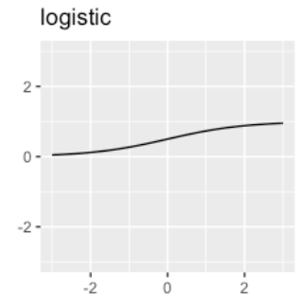
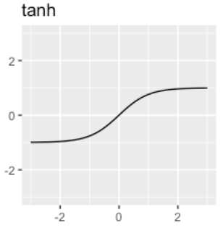
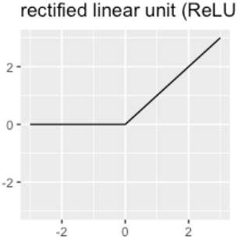
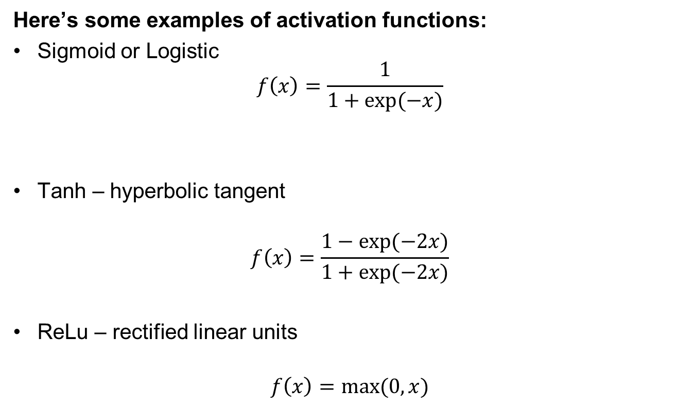
Neural Nets Activitation Functions
Here’s some examples of activation functions:
Sigmoid or Logistic
$$f\left(x\right)=\frac{1}{1+exp⁡(−x)}$$
Tanh – hyperbolic tangent
$$f\left(x\right)=\frac{1−exp⁡(−2x)}{1+exp⁡(−2x)}$$
ReLu – rectified linear units
$$f\left(x\right)=max⁡(0,x)$$
Images from http://uc-r.github.io/ann_fundamentals

Slide 18
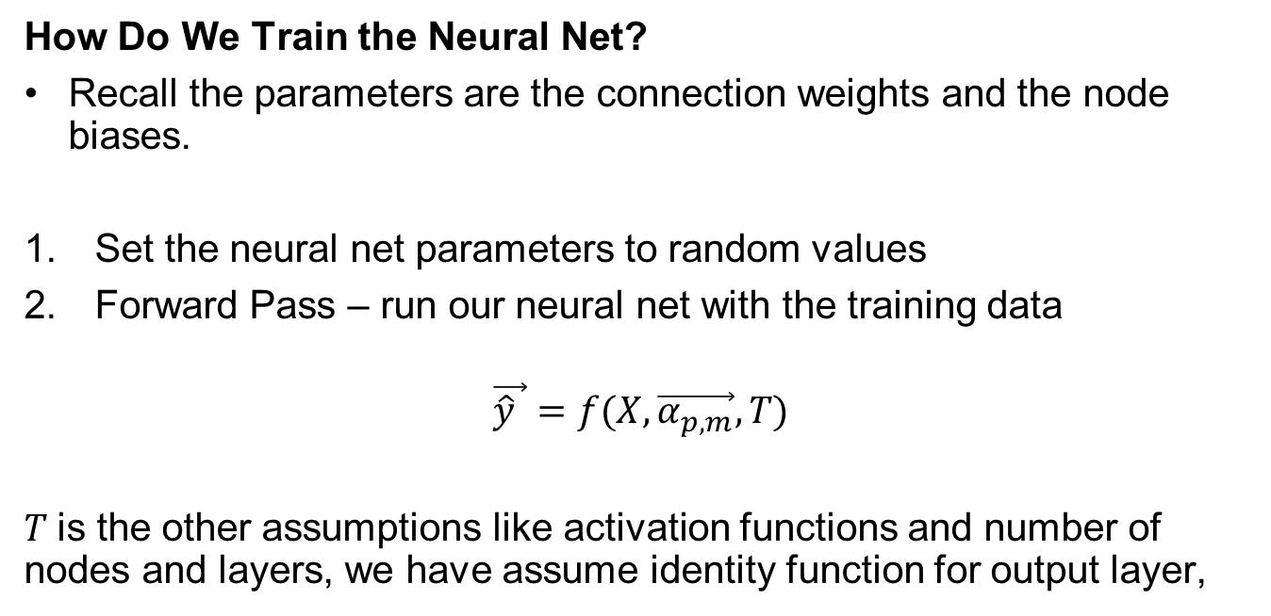
Neural Nets Training
How Do We Train the Neural Net?
Recall the parameters are the connection weights and the node biases.
Set the neural net parameters to random values
Forward Pass – run our neural net with the training data
$$\vec{\hat{y} }=f(X,\vec{α_{p,m}},T)$$
$T$is the other assumptions like activation functions and number of nodes and layers, we have assume identity function for output layer,

Slide 19
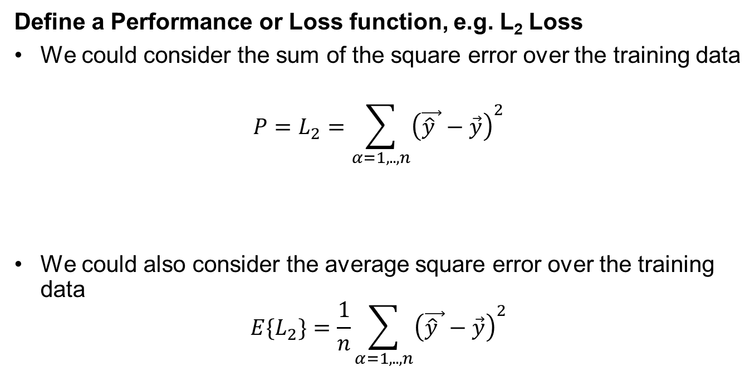
Neural Nets Training
Define a Performance or Loss function, e.g. L₂ Loss
We could consider the sum of the square error over the training data
$${P=L}_{2}=\sum_{α=1,..,n}{{\left(\vec{\hat{y} }−\vec{y}\right)}^{2}}$$
We could also consider the average square error over the training data
$${E\{L}_{2}\}=\frac{1}{n}\sum_{α=1,..,n}{{\left(\vec{\hat{y} }−\vec{y}\right)}^{2}}$$

Slide 20
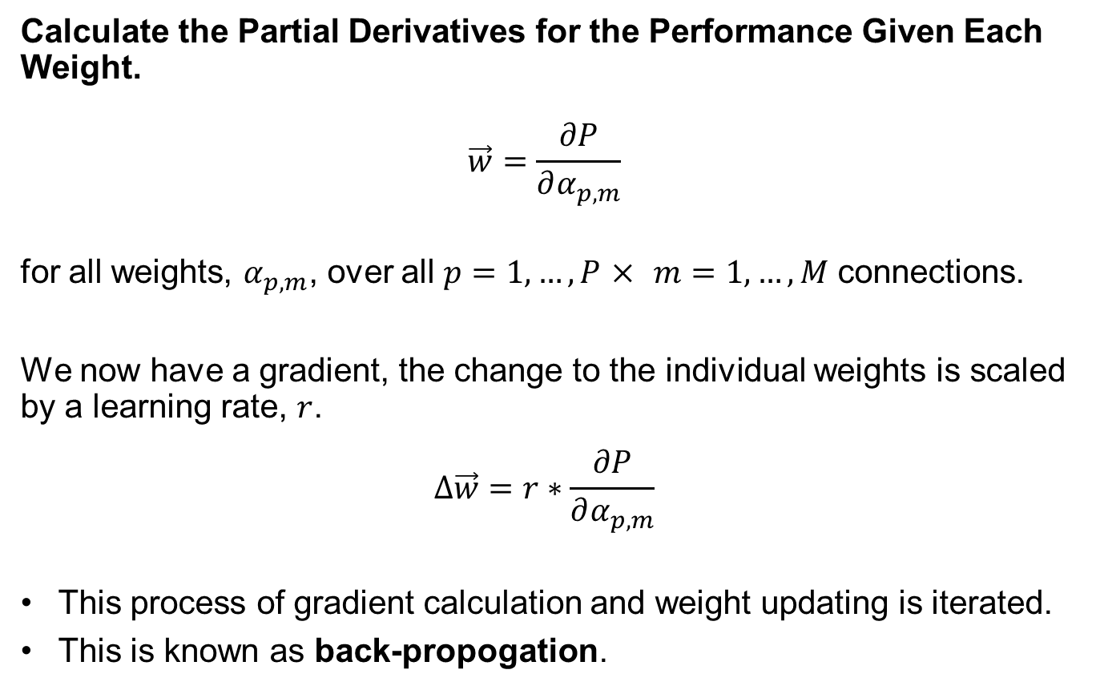
Neural Nets Training
Calculate the Partial Derivatives for the Performance Given Each Weight.
$$\vec{w}=\frac{∂P}{∂α_{p,m}}$$
for all weights, $α_{p,m}$, over all $p=1,…,P$ $×$ $m=1,…,M$ connections.
We now have a gradient, the change to the individual weights is scaled by a learning rate, $r$.
$$∆\vec{w}=r∗\frac{∂P}{∂α_{p,m}}$$
This process of gradient calculation and weight updating is iterated.
This is known as back-propogation.

Slide 21
Neural Nets Training
The Training is Iterative
Epochs: each forward pass – back-propogation, training cycle, is known as an Epoch.
Batch: the number of training data considered in each epoch.
Comments:
Larger batches result in better estimates of the error, but slower epochs (more computational time)
Smaller batches result in noiser estimates of the error, but faster epochs
often results in faster learning and even possibly more robust models

Slide 22
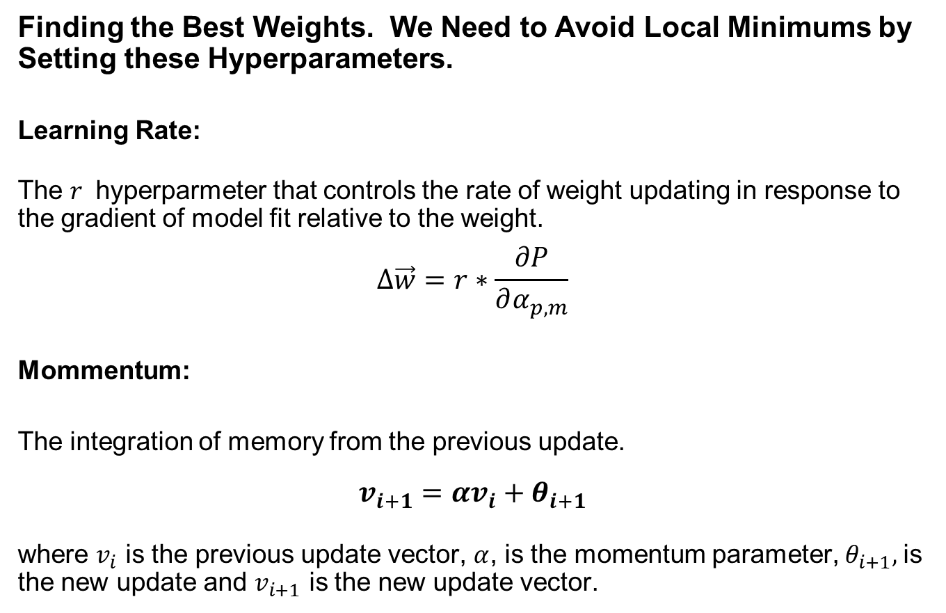
Neural Nets Training
Finding the Best Weights. We Need to Avoid Local Minimums by Setting these Hyperparameters.
Learning Rate:
The $r$ hyperparmeter that controls the rate of weight updating in response to the gradient of model fit relative to the weight.
$$∆\vec{w}=r∗\frac{∂P}{∂α_{p,m}}$$
Mommentum:
The integration of memory from the previous update.
$$v_{i+1}=αv_{i}+θ_{i+1}$$
where $v_{i}$ is the previous update vector, $α$, is the momentum parameter, $θ_{i+1},$is the new update and $v_{i+1}$ is the new update vector.

Slide 23
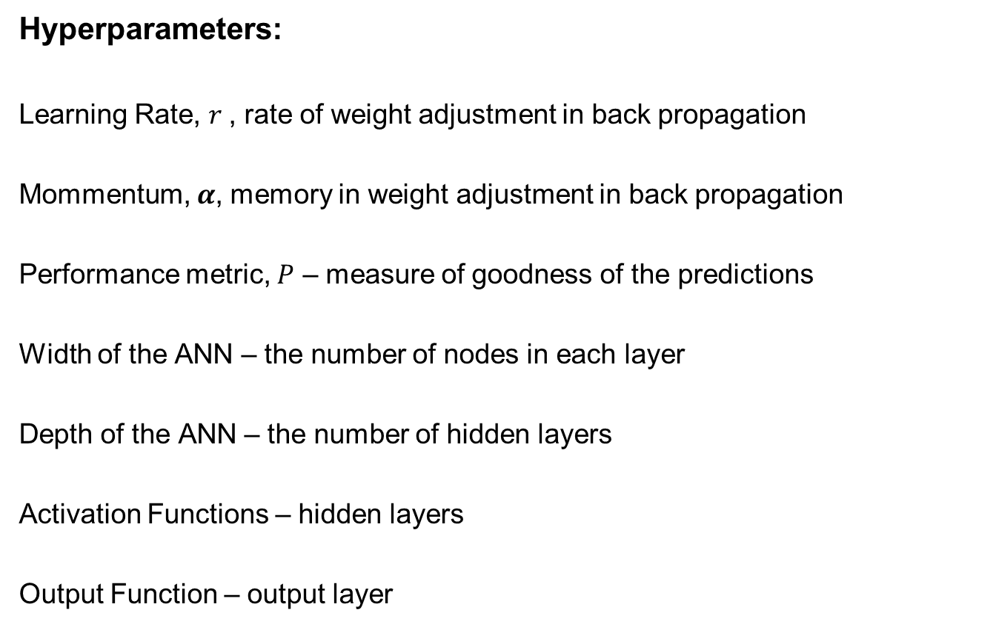
Neural Nets Design
Hyperparameters:
Learning Rate, $r$, rate of weight adjustment in back propagation
Mommentum, $α$, memory in weight adjustment in back propagation
Performance metric, $P$ – measure of goodness of the predictions
Width of the ANN – the number of nodes in each layer
Depth of the ANN – the number of hidden layers
Activation Functions – hidden layers
Output Function – output layer

Slide 24
Neural Nets Design
Limitations of Neural Nets
No Free Lunch Theorem – cannot garauntee the model is always optimum for predicting new, unobserved cases.
Parameter Rich – requires a large number of training data.
Low Interpretability – generally difficult to interrogate the model, not compact.
High Complexity Model – resulting in high model variance and lower model bias.

Slide 25
Neural Nets Variants
There are a variety of designs based on the single hidden layer, feed-forward design that we reviewed.
Deep Learning – use of multiple hidden layers
Recurrent Neural Networks – information can flow backwards
Convolutional Neural Networks – accounts for 2D / 3D information
Auto Encoder – dimensionality reduction

Slide 26
Daytum +2 Course Artificial Neural Networks
Artificial Neural Network Example
Instructor: Michael Pyrcz, the University of Texas at Austin

Slide 27
Neural Nets Example in Python
We will use a well and seismic data to build a neural net-based predictive model.
Train with 80% of well data (144 wells)
Test with 20% of well data.
Application: Apply the model to predict porosity from a acoustic impedance map!
between well estimation of porosity in a single unit

Slide 28
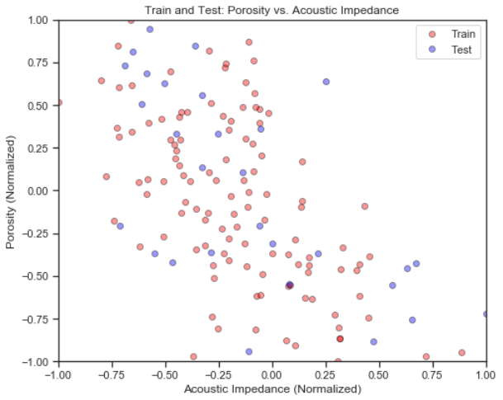
Neural Nets Example in Python
Normalize the variables to range from -1 to 1.
the relationship between acoustic impedance and porosity.

Slide 29







Neural Nets Example in Python
Design a Simple Neural Network
1 hidden layer, 3 nodes in hidden layer
1 node in input and output layer
ReLu activation functions on hidden layer nodes
$$Z_{1}$$
Porosity
$$Y_{1}^{N}$$
Acoustic Impedance
$$Z_{2}$$
$$Y_{1}$$
$$X_{1}$$
$$X_{1}^{N}$$
$$Z_{M}$$

Slide 30
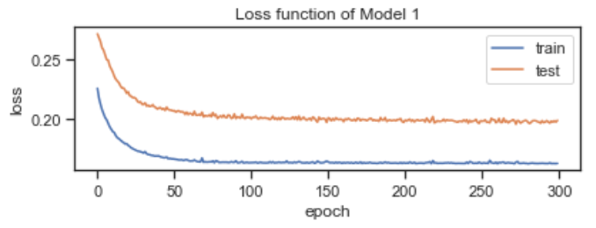
Neural Nets Example in Python
Training a Simple Neural Network
300 epochs with batches of 5
train and test loss

Slide 31
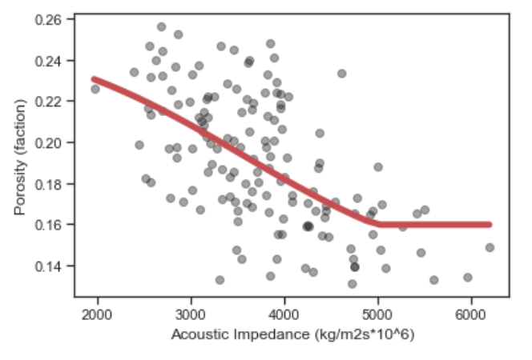
Neural Nets Example in Python
Model Preditions
the model predictions with all training and testing data
demonstrates the ability to fit non-linear data

Slide 32
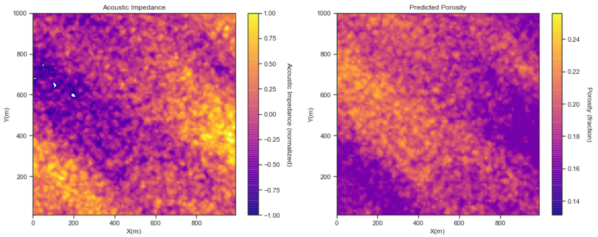
Neural Nets Example in Python
Model Preditions
prediction of porosity from acoustic impedance between well locations.

Slide 33
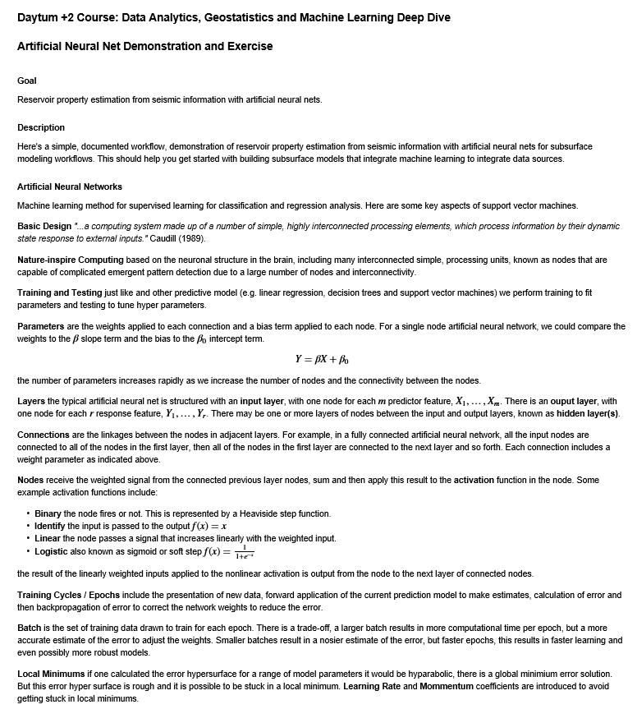
Neural Net Demonstration
Demonstration workflow with artificial neural network for supervised learning from training data.
The workflow is Daytum_NeuralNet.ipynb.

Slide 34
Daytum +2 Course Artificial Neural Networks
Artificial Neural Networks
Artificial Neural Network Example
Instructor: Michael Pyrcz, the University of Texas at Austin

