Slide 1



Pizza Time!
A field study to determine the best location to open a new Pizza Company in Milwaukie,OR. “The Milwaukie Pizza Co.”
Coursera Applied Data Science Capstone
Chris Hanratty

Slide 2
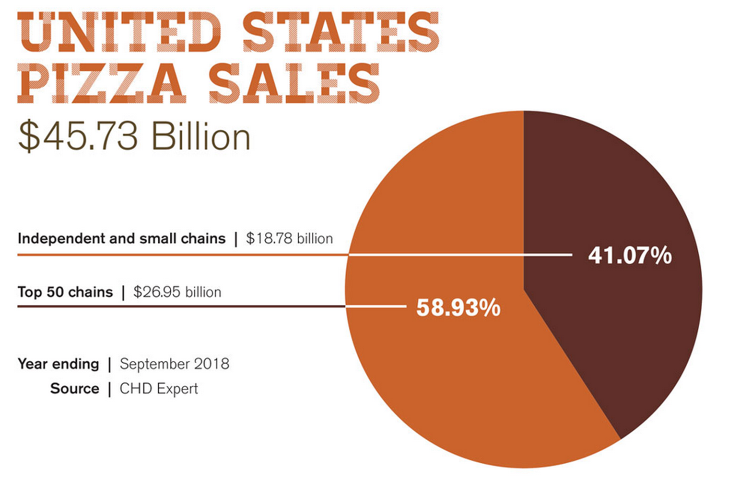
Introduction
In 2017, global revenue for the entire restaurant industry was estimated at $799 billion. At the end of 2018, United States pizza sales totaled 45.73 billion USD.

Slide 3
Introduction, cont’d
That said, Pizza is quite profitable! Pizza places come in all different shapes and sizes, from corporate chains to tiny family establishments. I want to open a pizza place in my home town so that I can contribute to spreading the pizza love and sharing in that profit total.
Milwaukie,OR is my neighborhood and I am a pizza lover!
From my own personal experience, I feel like there is a serious lack of good pizza in town (within 5 miles, that is…). This experiment aims to quantify that feeling by utilizing Foursquare’s location data and more!
The study will identify the best location to place my new pizza business based on information obtained by using the Fourquare API. The study will consider, distance from downtown Milwaukie, existing pizza places (i.e. competition), the rating of existing pizza places, and much more!

Slide 4
Data Acquisition and Cleaning
Foursquare Location Data is the main source of data for this project.
Foursquare Location Data Used:
Search Query: Categorical data used to isolate pizza establishments.
Explore: Venue data used to calculate distance, ID, rating, etc.
Additional Data Used:
Yelp rating data
US Cities LatLong data
Milwaukie.gov zoning data
A dataframe consisting of Foursquare location data and Yelp rating data
was generated to visualize proximity to local competition and its social media score (SMS).

Slide 5
Methods
The two most important factors in determining where to place the Milwaukie Pizza Co. were:
1: How far away is the competition?
2. How do customers rate the competition?
Social Media Score (SMS):
Foursquare Data + Yelp Rating data = Average Pizza Place rating
Used to determine what makes those places successful.
Exploratory Analysis
Statistics of Data Frame
Regression
Data Visualization
Folium Maps with Markers
Marker Clustering

Slide 6
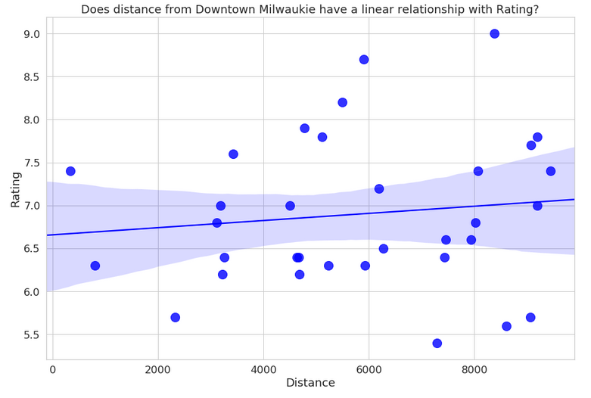
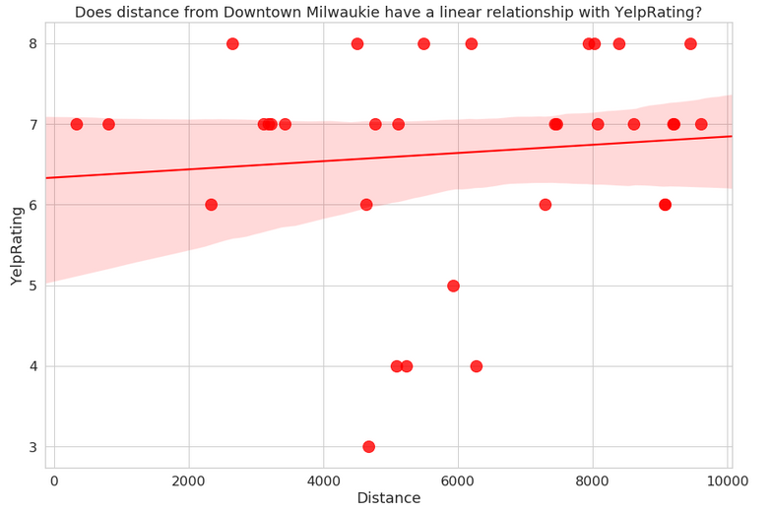
Rating Results: Foursquare vs. Yelp
Foursquare Rating:Mean = 6.9
Yelp Rating:Mean = 6.6
There is no linear correlation between distance from downtown Milwaukie and rating. However, on average, Foursquare users tend to rate higher than Yelp users.

Slide 7
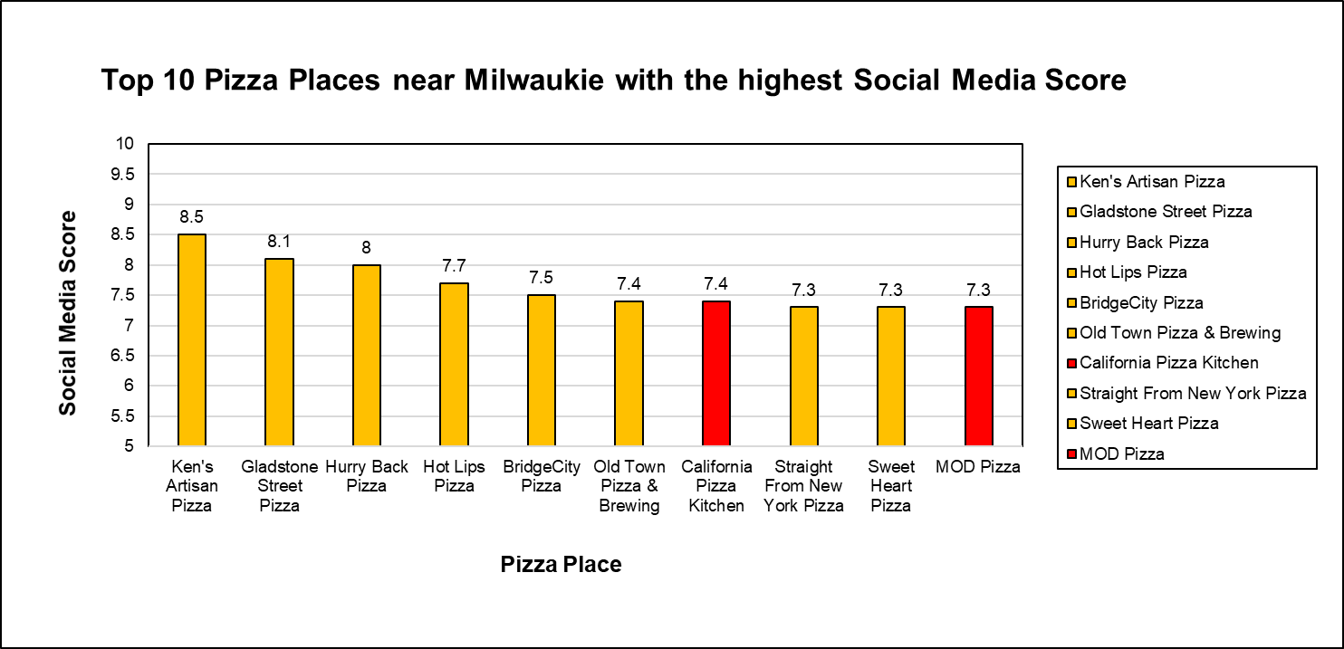
SMS Score Results
Notice that social media users rate non-corporate pizza places higher!
I’ll be opening up an independent restaurant so no problem there!

Slide 8
Takeaway points:
Foursquare location data is incredibly useful!
Foursquare Users rate pizza places higher than Yelp users do.
The highest rated pizza places are >5 km away from downtown.
The highest rated pizza places are non-national chains.
Zoning data indicates that the downtown area is the most ideal for location as residential areas surround that location.
I’ll be opening a non-chain restaurant right in downtown Milwaukie!

Slide 9
Sources:
https://www.rewardsnetwork.com/industry-trends/2018-restaurant-trends-industry/
http://www.pmq.com/December-2018/The-2019-Pizza-Power-Report-A-State-of-the-Industry-Analysis/
https://www.milwaukieoregon.gov/documents

