Slide 1



Pizza Time!
A field study to determine the best location to open a new Pizza Company in Milwaukie,OR. “The Milwaukie Pizza Co.”
Coursera Applied Data Science Capstone
Chris Hanratty

Slide 2
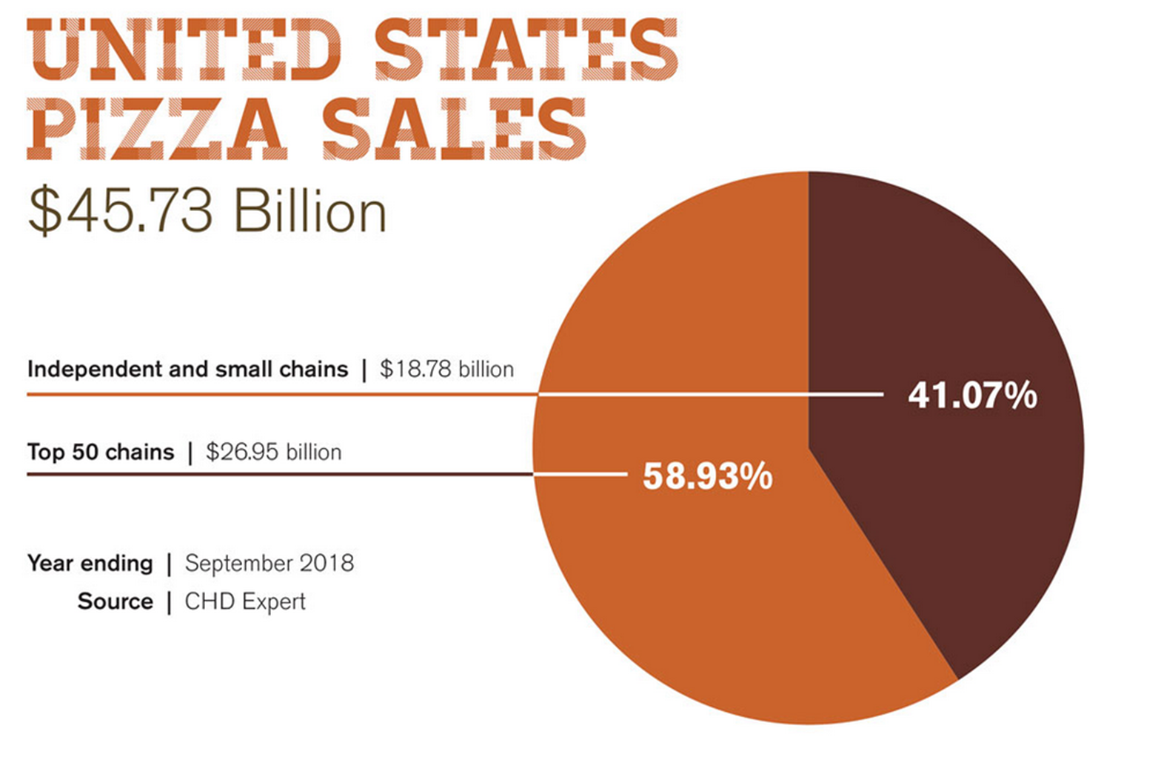
Introduction
In 2017, global revenue for the entire restaurant industry was estimated at $799 billion. At the end of 2018, United States pizza sales totaled 45.73 billion USD.

Slide 3
Introduction, cont’d
That said, Pizza is quite profitable! Pizza places come in all different shapes and sizes, from corporate chains to tiny family establishments. I want to open a pizza place in my home town so that I can contribute to spreading the pizza love and sharing in that profit total.
Milwaukie,OR is my neighborhood and I am a pizza lover!
From my own personal experience, I feel like there is a serious lack of good pizza in town (within 5 miles, that is…). This experiment aims to quantify that feeling by utilizing Foursquare’s location data and more!
The study will identify the best location to place my new pizza business based on information obtained by using the Fourquare API. The study will consider, distance from downtown Milwaukie, existing pizza places (i.e. competition), the rating of existing pizza places, and much more!

Slide 4
Data
Foursquare Location Data is the main source of data for this project.
Foursquare Location Data Used:
Search Query: Categorical data used to isolate pizza establishments.
Explore: Venue data used to distance, ID, rating, etc.
Users: User data used to identify key contributors.
Tips: More user data to understand what makes pizza places the best!
Trending: Relevant data to understand which places are trending up.
Additional Data Used:
US Cities LatLong data
Demographics data
Drive time for customers data
Any existing public dataset to enhance study. (see sources)

Slide 5
Methods

Slide 6
Results

Slide 7
Discussion

Slide 8
Conclusions

Slide 9
Sources:
https://www.rewardsnetwork.com/industry-trends/2018-restaurant-trends-industry/
http://www.pmq.com/December-2018/The-2019-Pizza-Power-Report-A-State-of-the-Industry-Analysis/
More sources will be added along the way, stay tuned!

