Slide 1
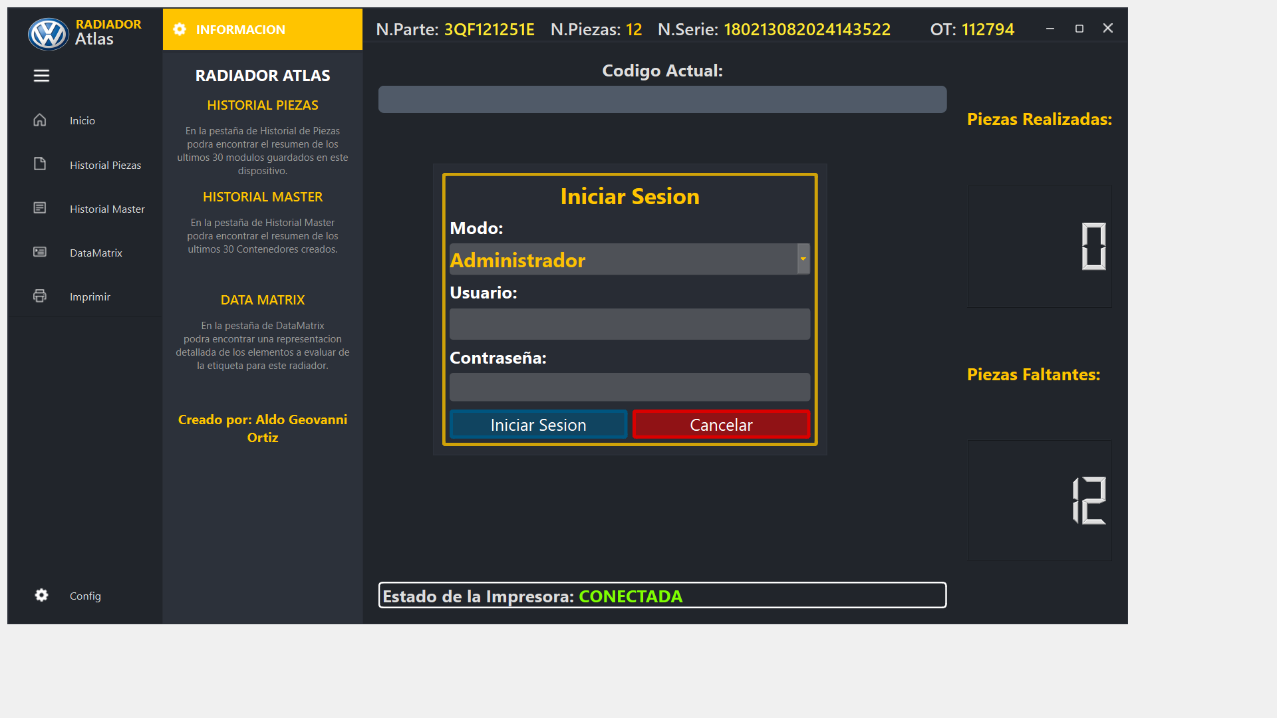
User Loggin
Atlas2024
****

Slide 2
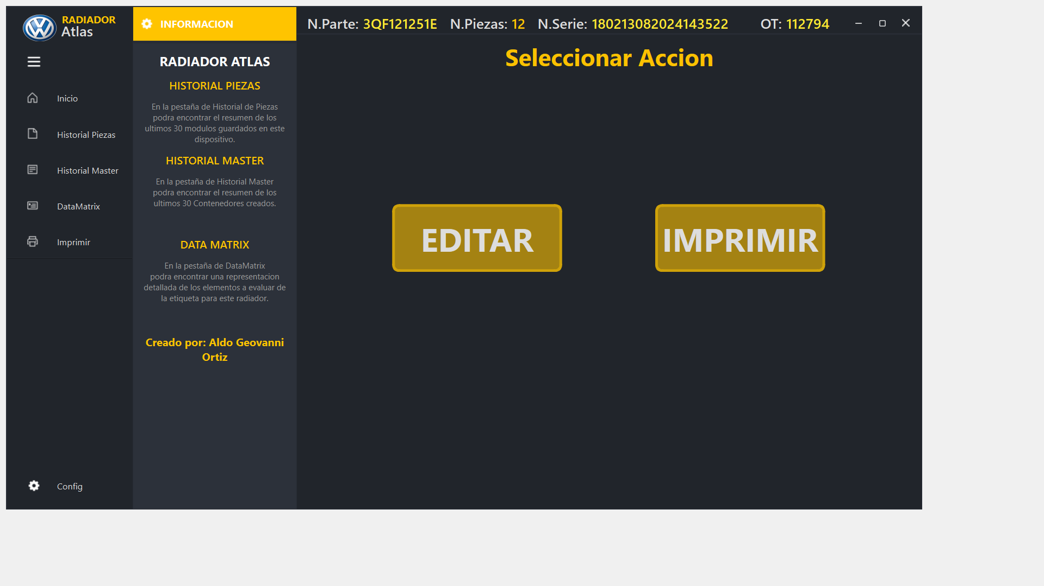
Update Data – Part NUMber

Slide 3
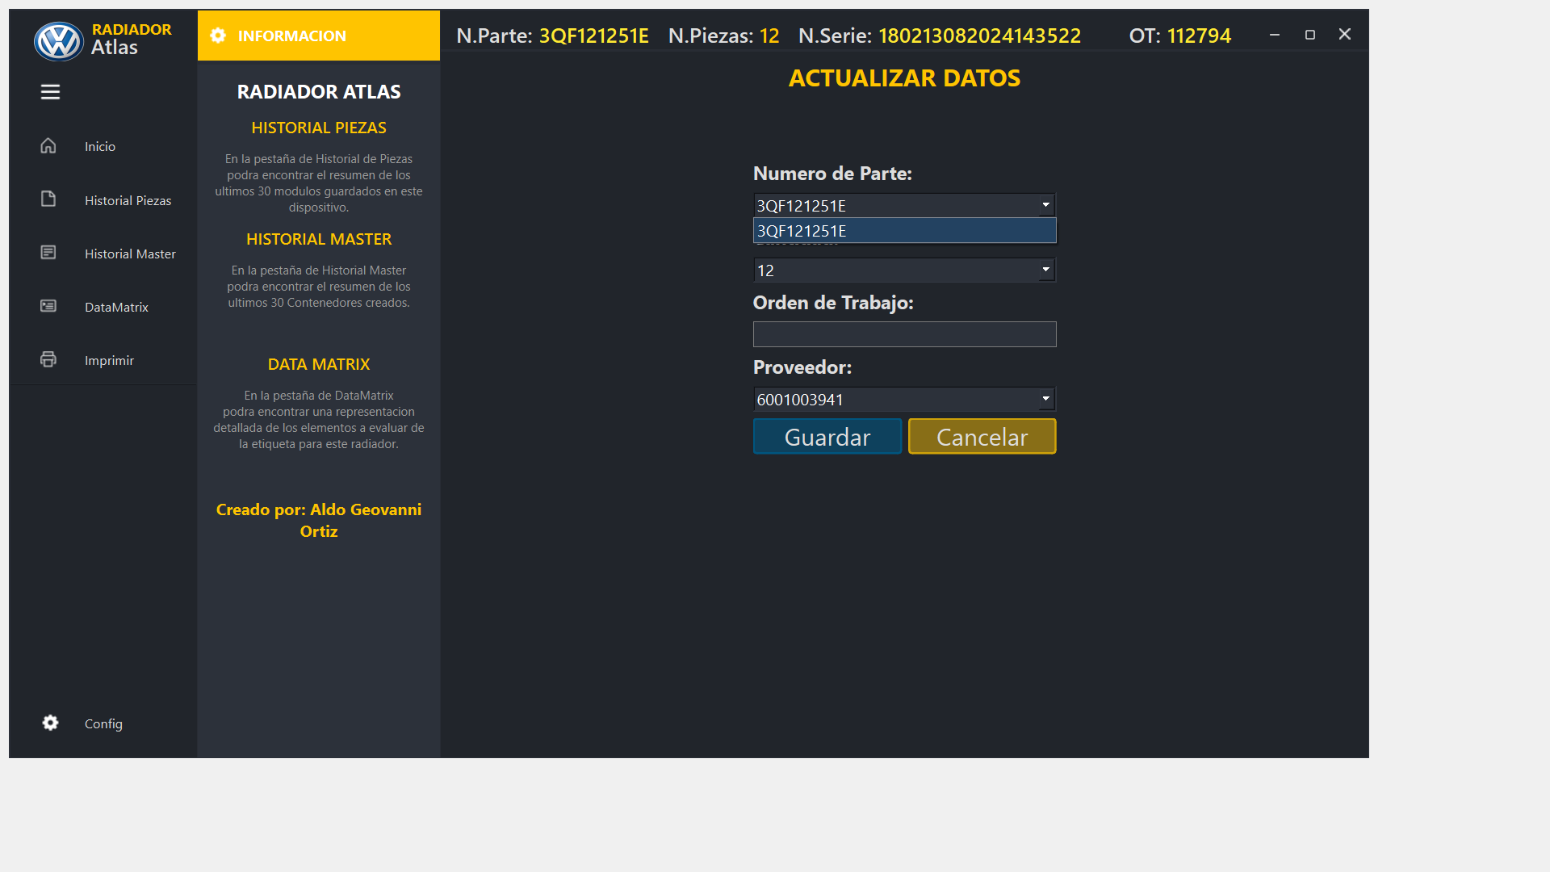
Update Data – Part NUMber
Select part number available

Slide 4

Update Data - QuantiTY
Select current quantity

Slide 5

Update Data – Work order
Insert current work order

Slide 6
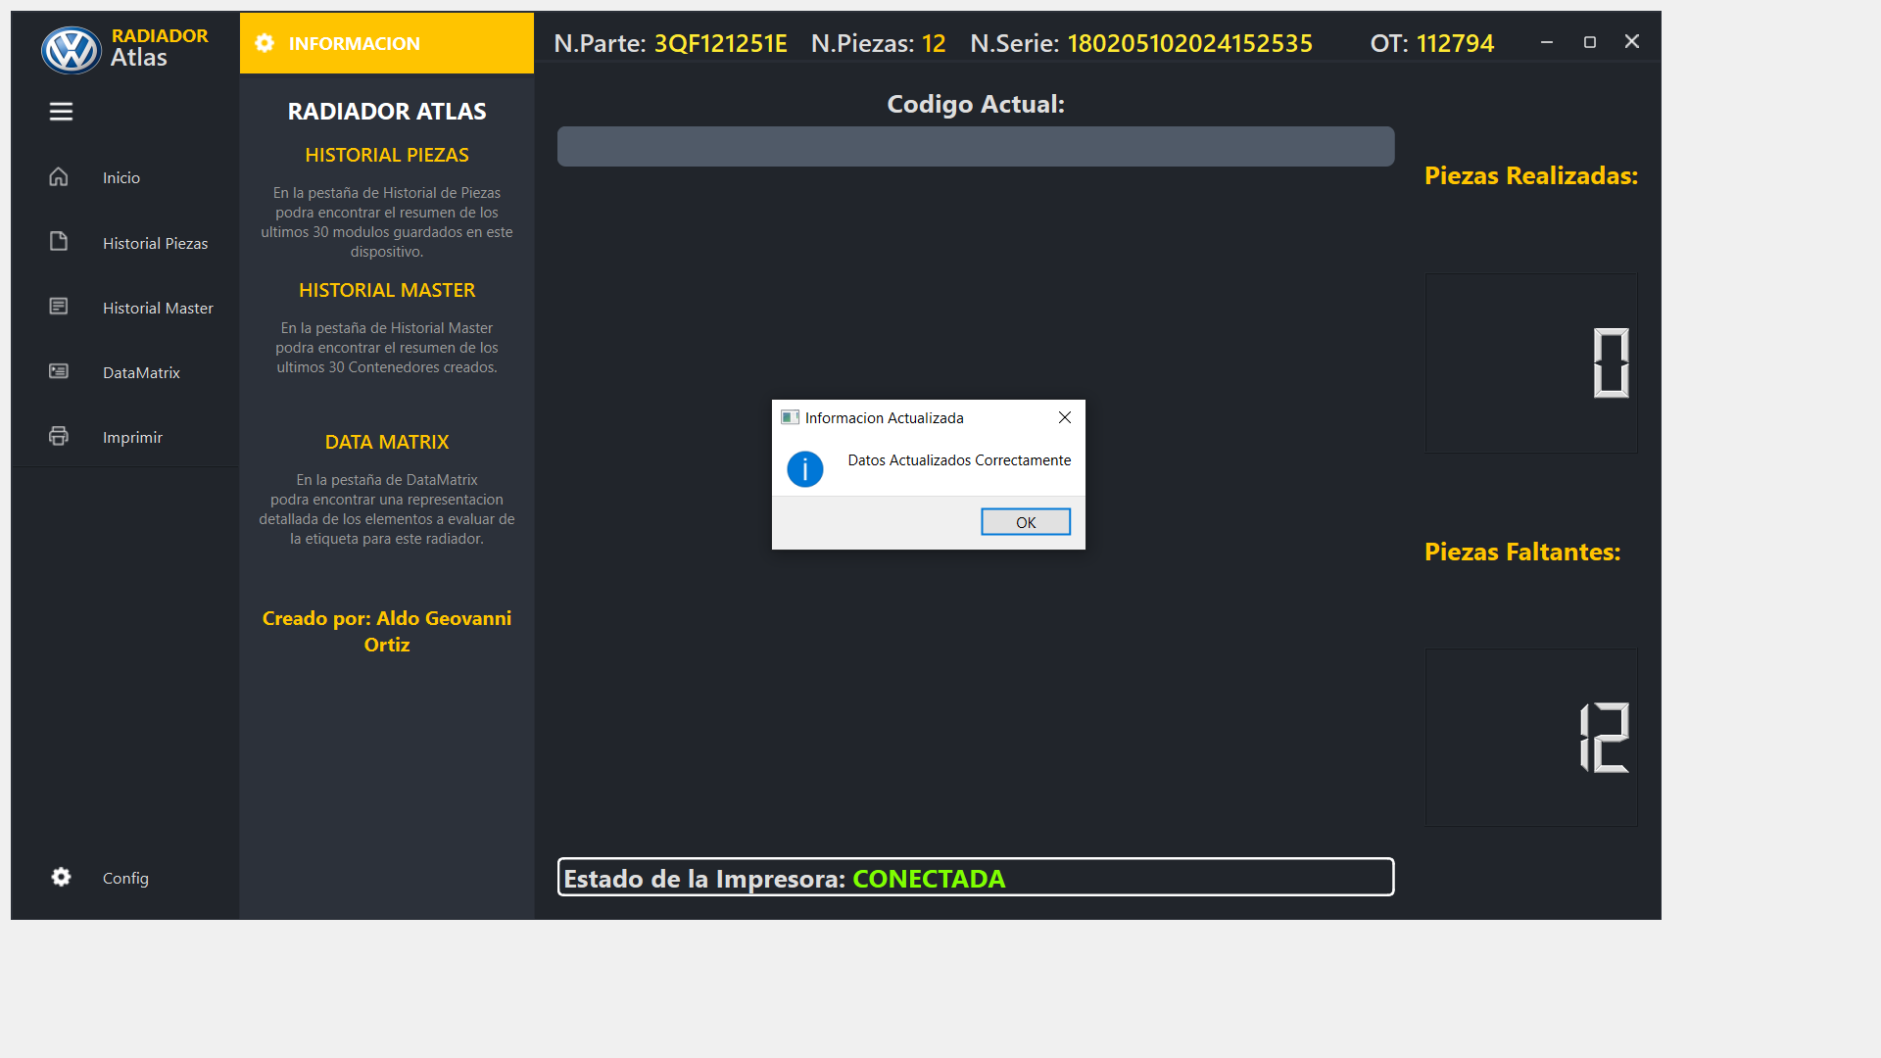
Correct save data
Current ID

Slide 7
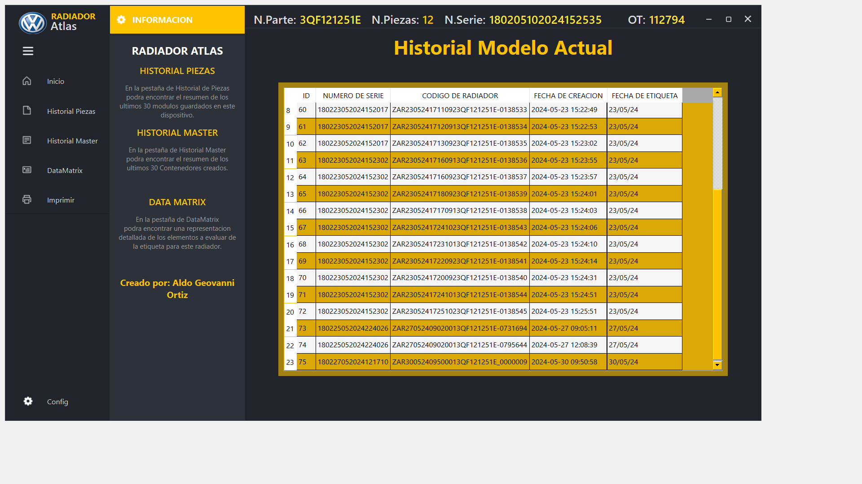
RAD ASSY history

Slide 8
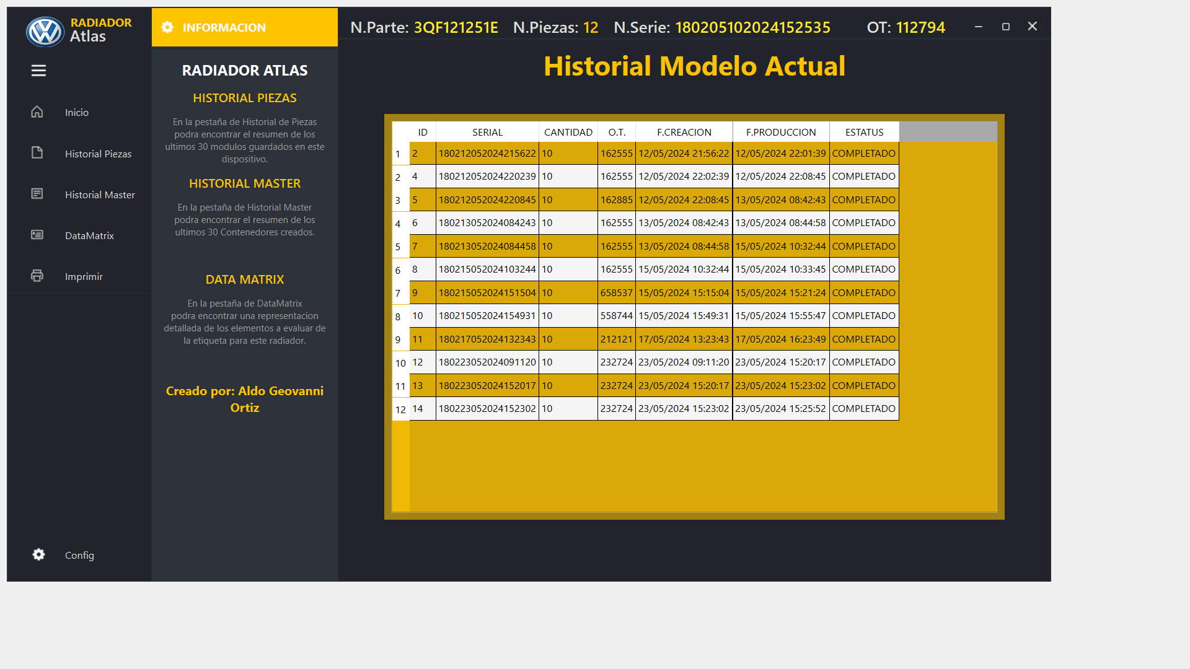
Cac Master history
ID with data Rad from AT

Slide 9
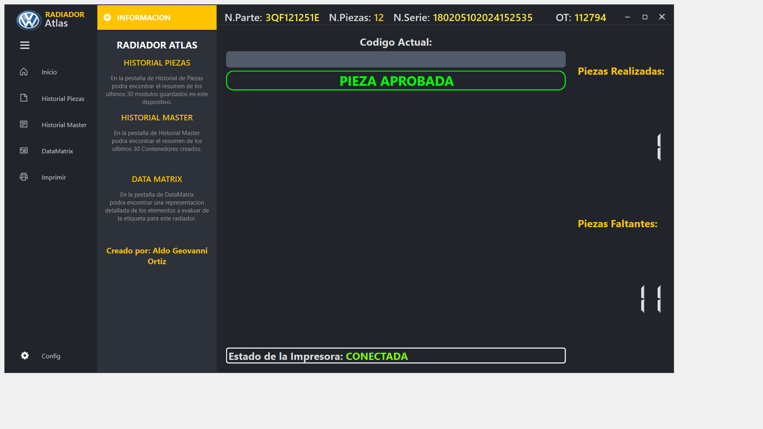
APPROVAL RAD Label

Slide 10
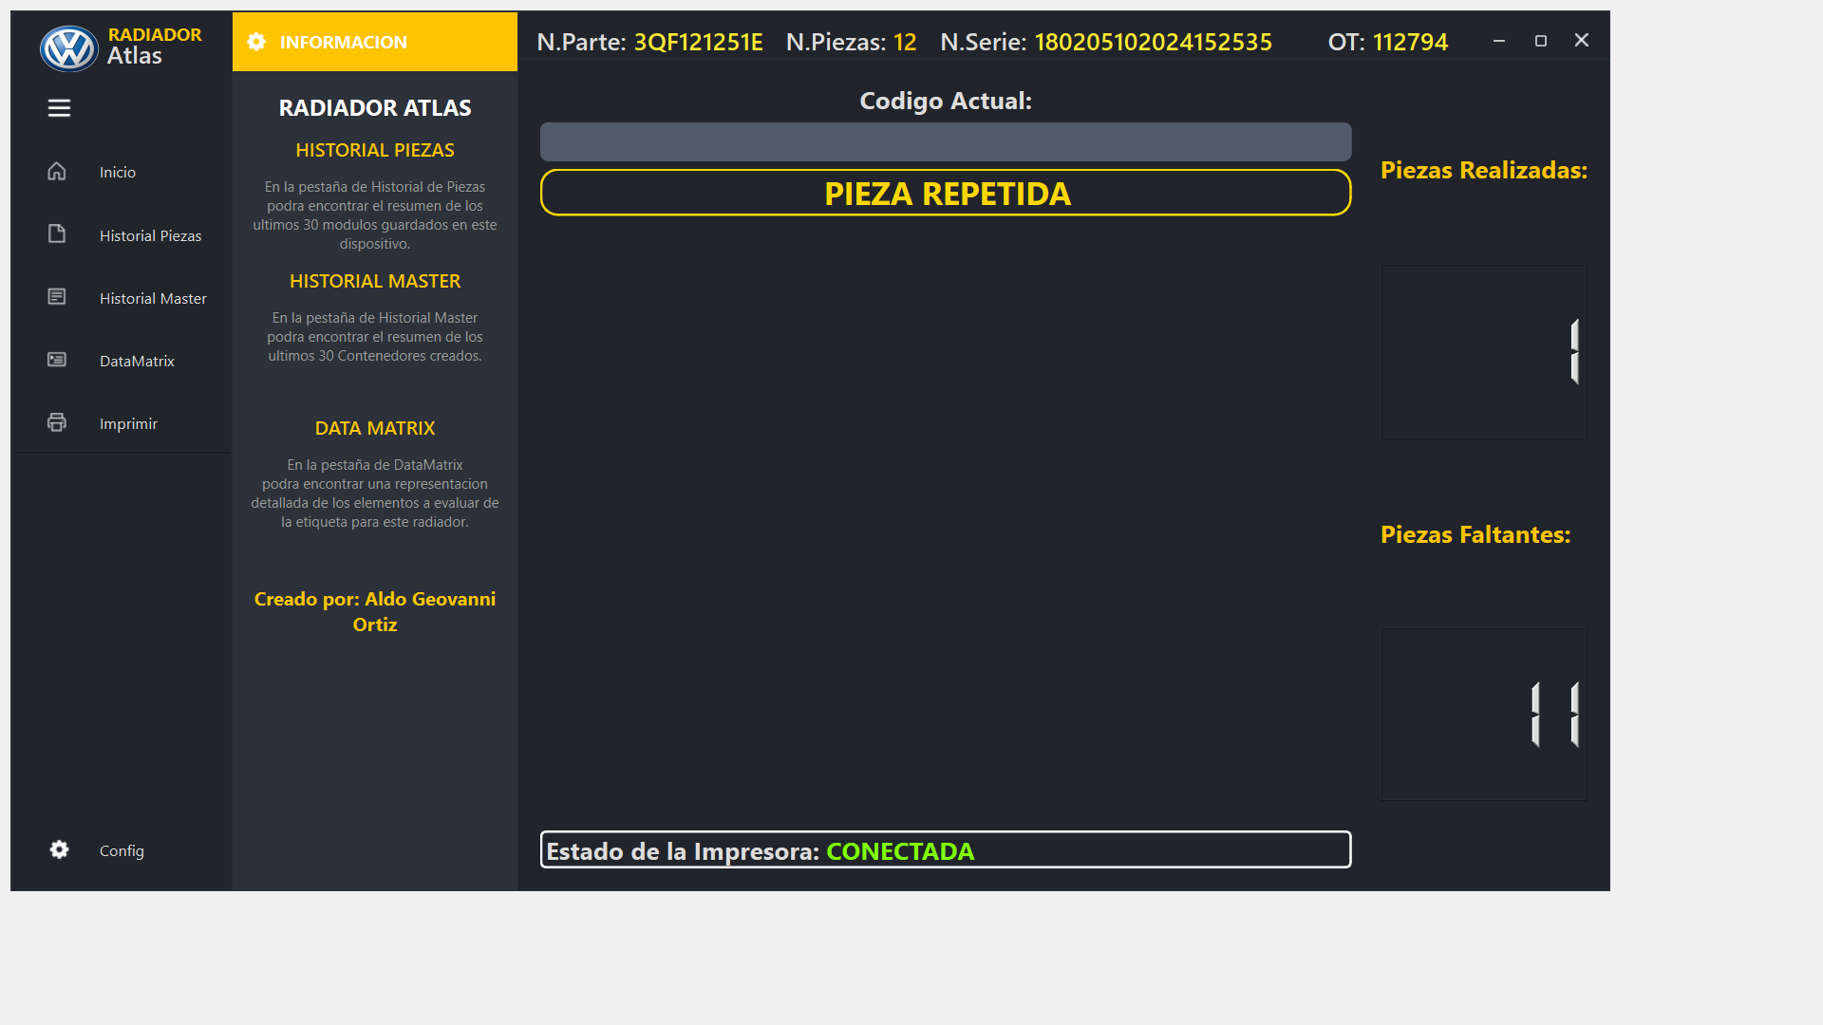
Repeat RAD Label

Slide 11
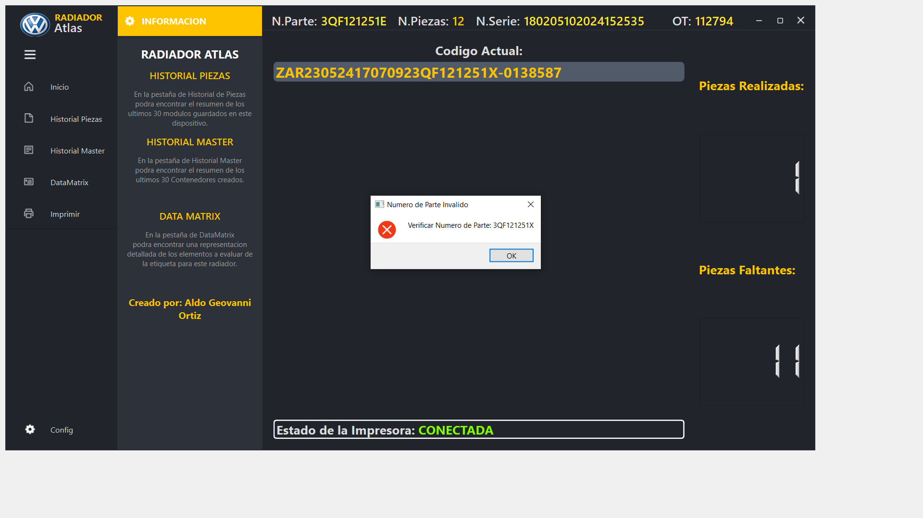
Reject part number

Slide 12
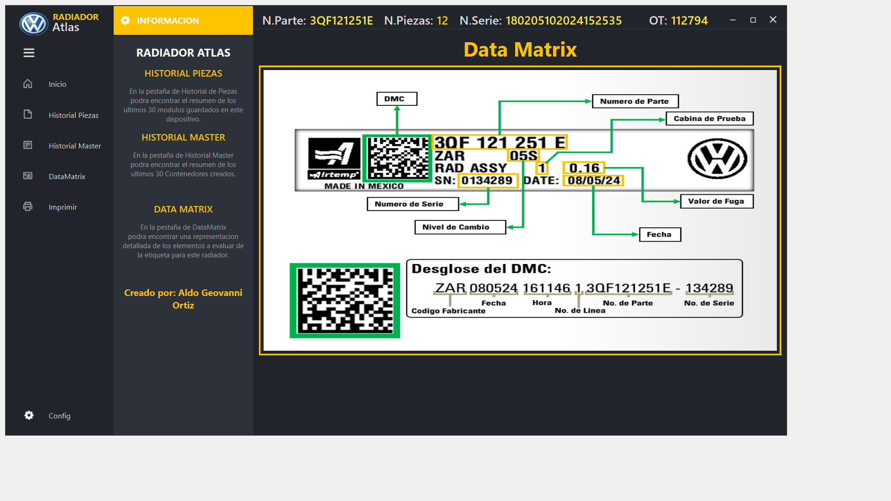
Data matrix– sample

Slide 13
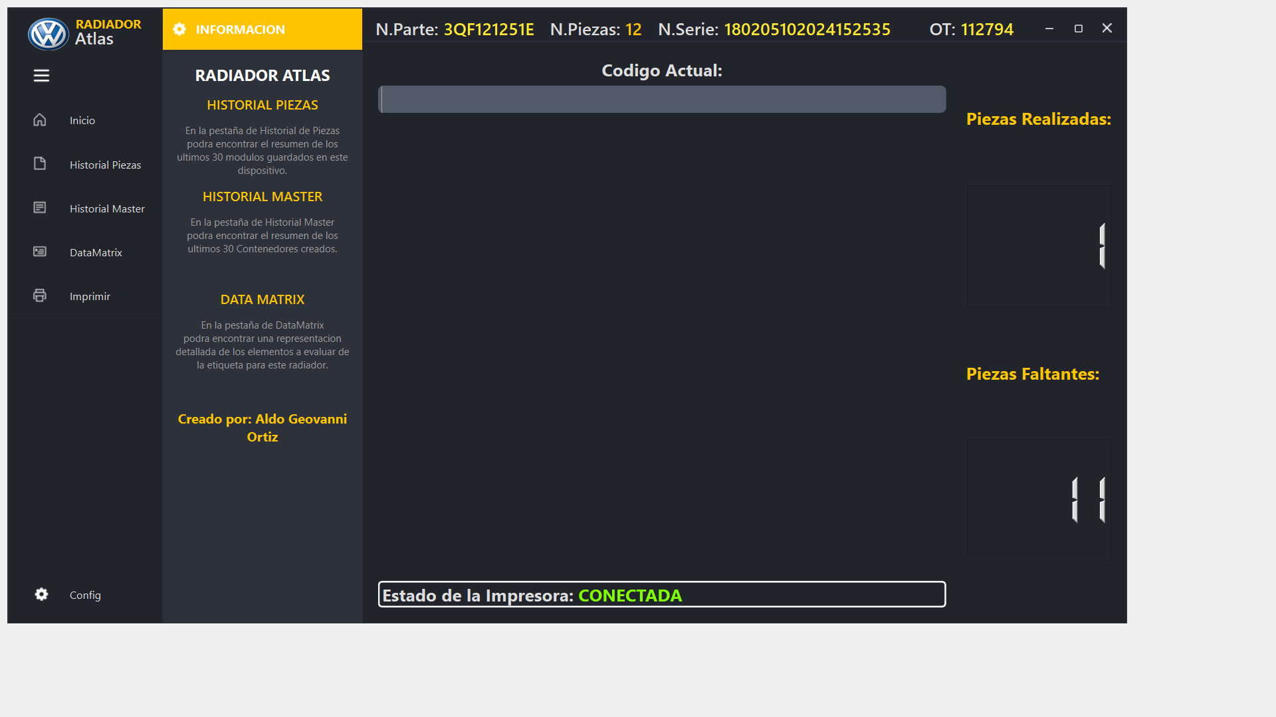
Printer state - connect

Slide 14
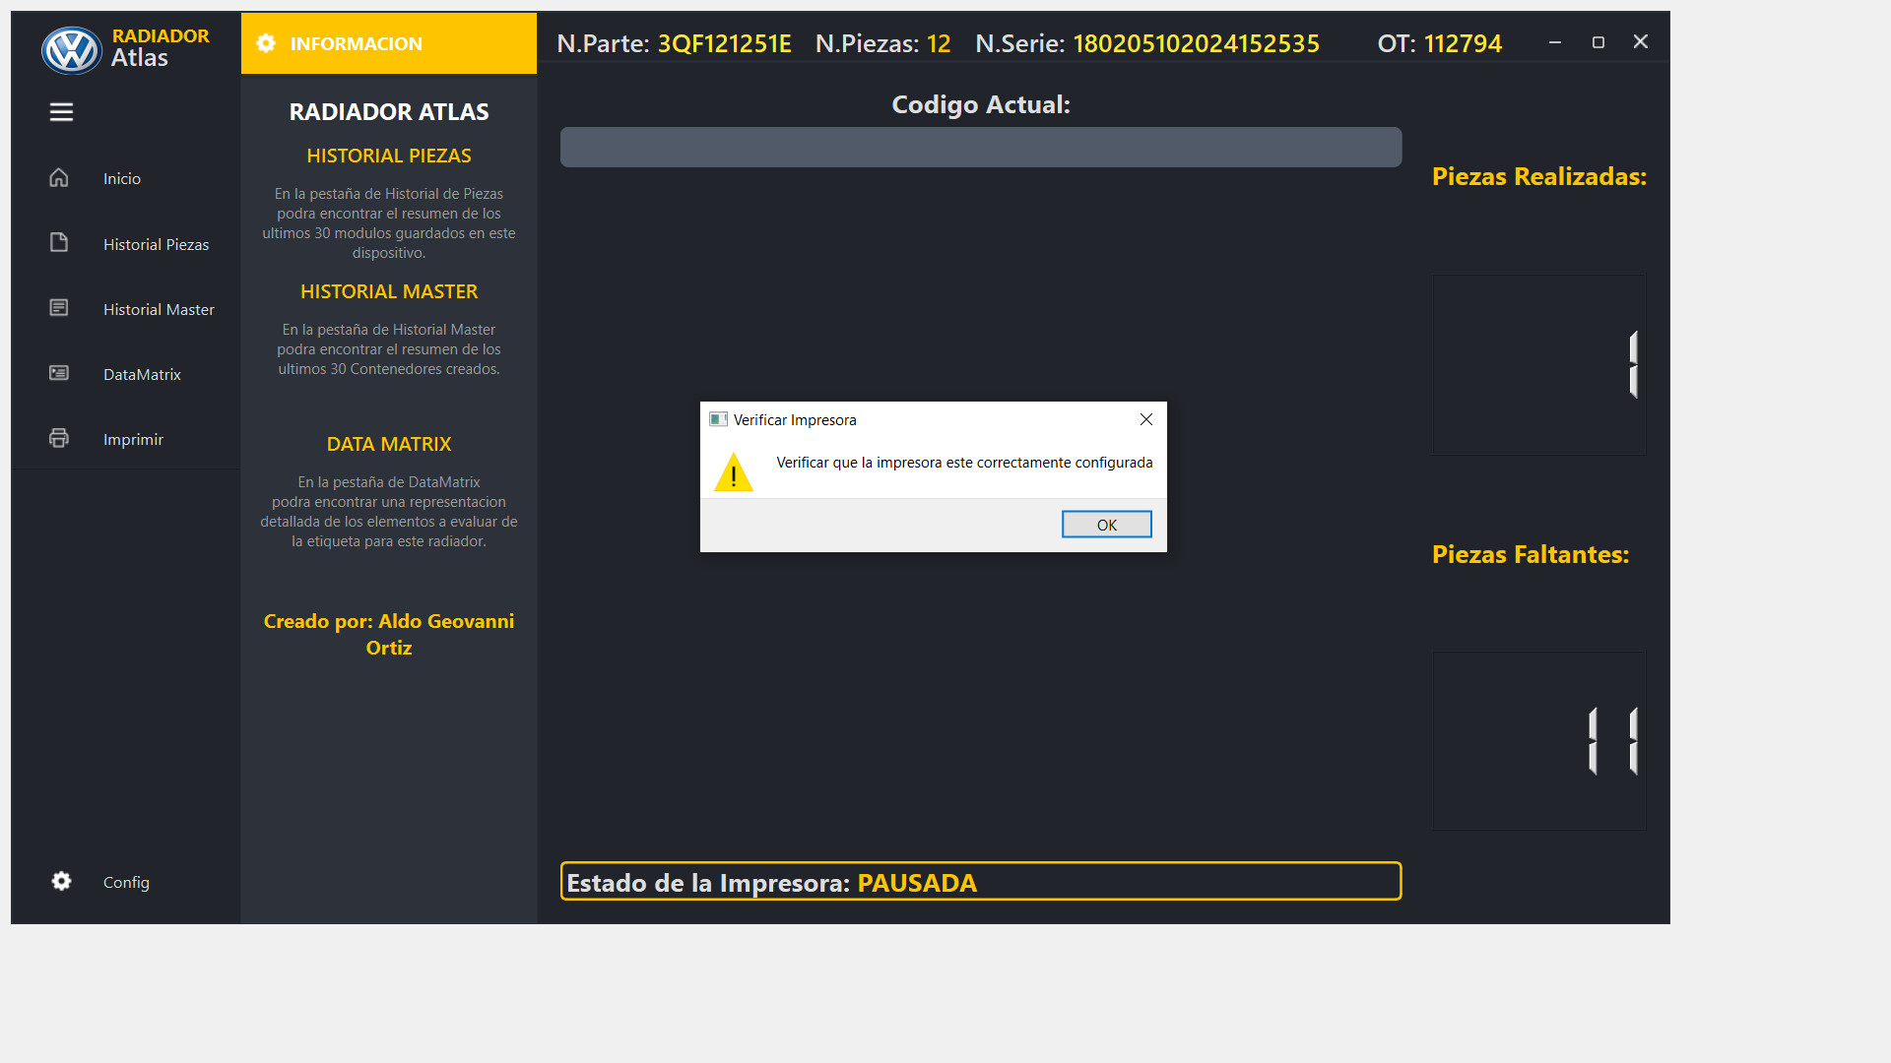
Printer state - PAUSE

Slide 15

Printer state – cover open

Slide 16

Printer state – paper out

Slide 17

Printer state – check ribbon

