Slide 1
Data engineering bootcamp
Geovanni Velázquez medina

Slide 2
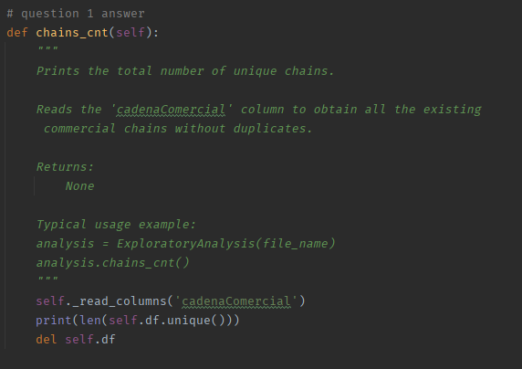

1. How many commercial chains are monitored, and therefore, included in this database?

Slide 3
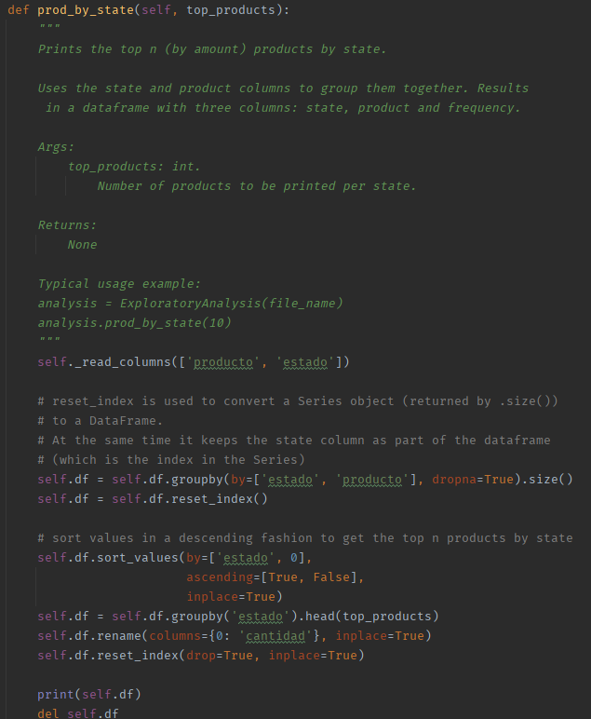
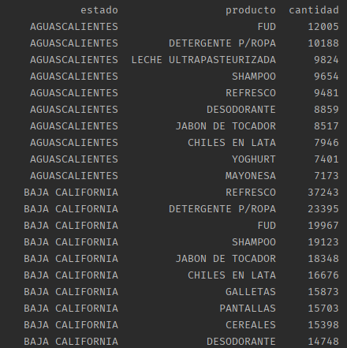
2. What are the top 10 monitored products by State?

Slide 4
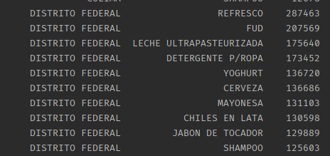
Question 2

Slide 5
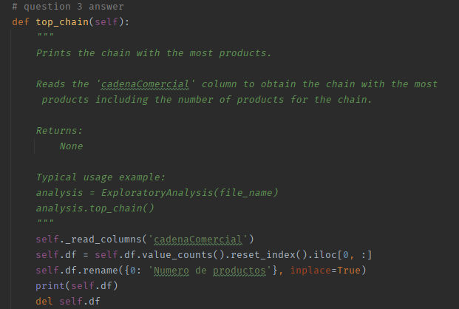

3. Which is the commercial chain with the highest number of monitored products?

Slide 6
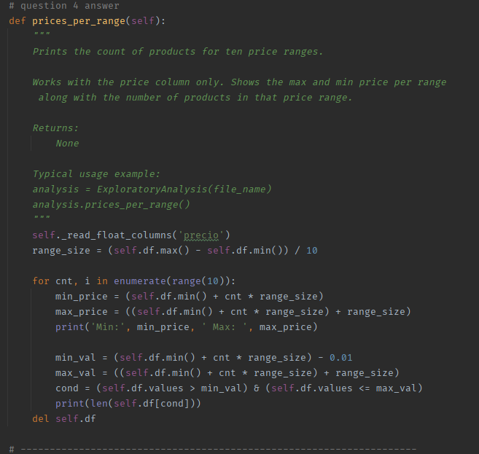
Question 4

Slide 7
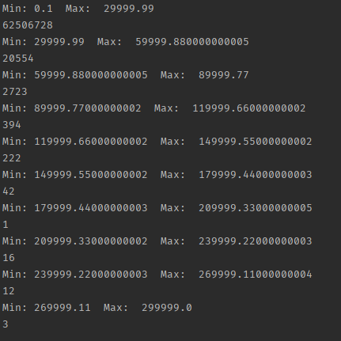
Question 4

Slide 8
Thanks for watching

