Slide 1



Third-party data
(Open) datasets and sources of interest
December 2022

Slide 2
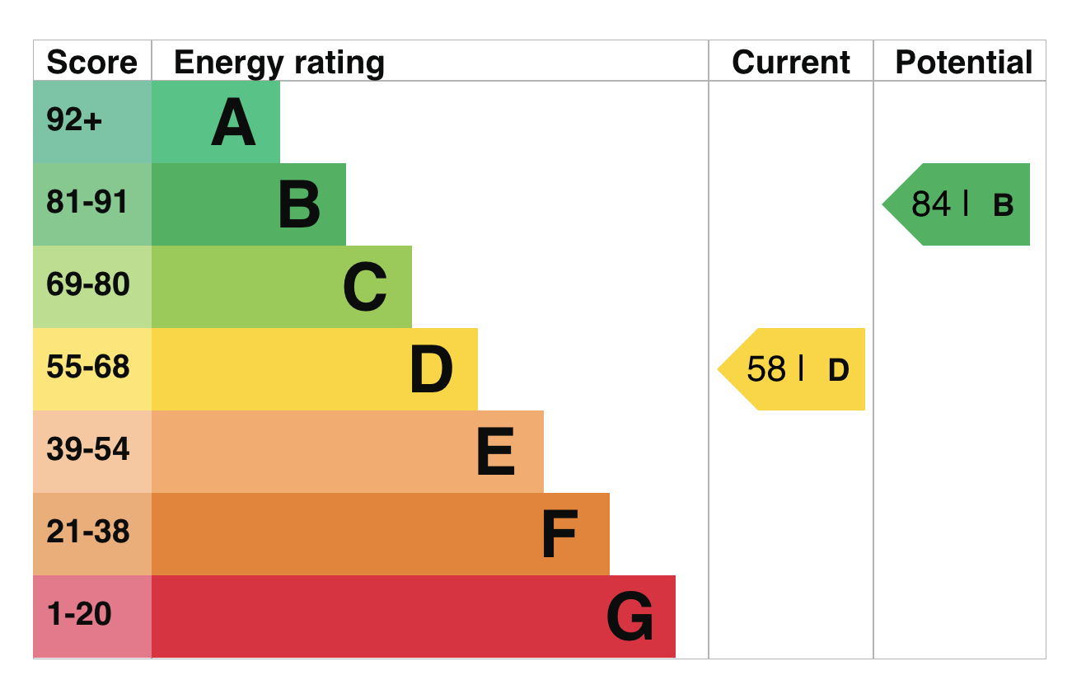
EPC - Building Energy Performance
02
Output
Domestic and Non-domestic lookups of energy performance certificated for buildings
Data to “enable independent research into energy efficiency issues such as fuel poverty and climate change”
Available at https://epc.opendatacommunities.org/
Searchable by:
Address
Postcode
Authority
…and more

Slide 3
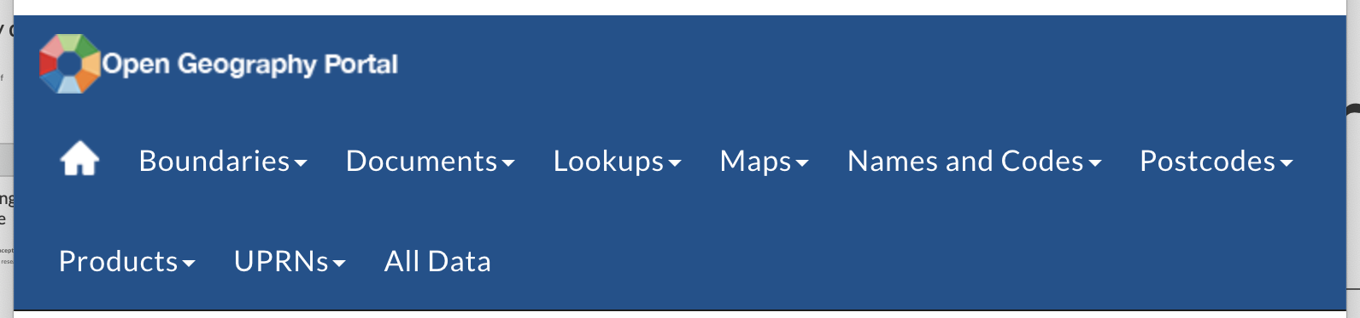
Statistical boundaries and hierarchies
02
Office for National Statistics Geoportal (https://geoportal.statistics.gov.uk)
The ONS Geoportal provides geodata for a huge variety of statistical geographies
Useful for mapping in relation to data about people – population, local authority areas, deprivation
Different kinds of data (with many formats available)
Boundaries
Postcode products
UPRN lookups

Slide 4
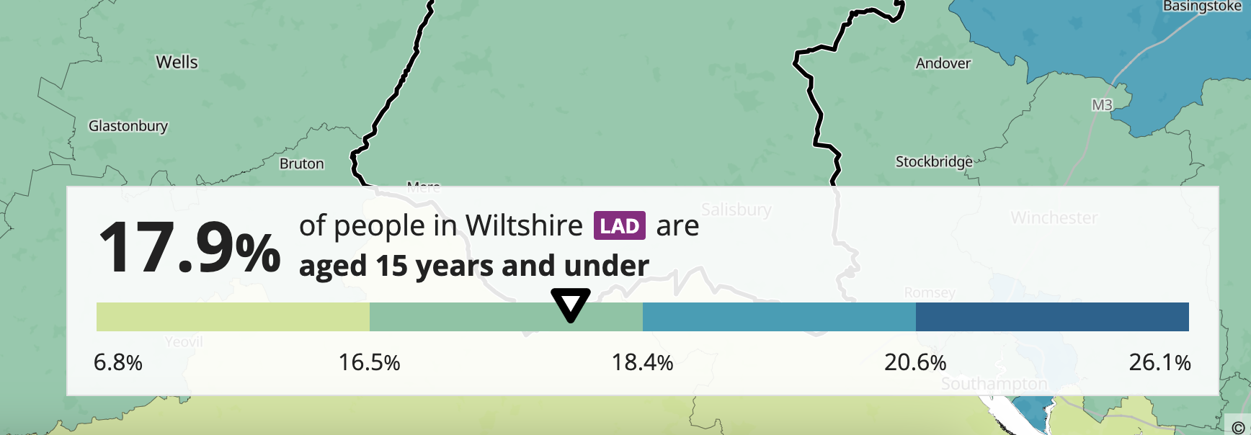
ONS Census Data
02
Data about people
Various datasets relating to results from the 2021 (and previous) Census
See https://census.gov.uk/ for up to date news and data releases
Released against various administrative and statistical geographies
Maps at https://www.ons.gov.uk/census/maps

Slide 5
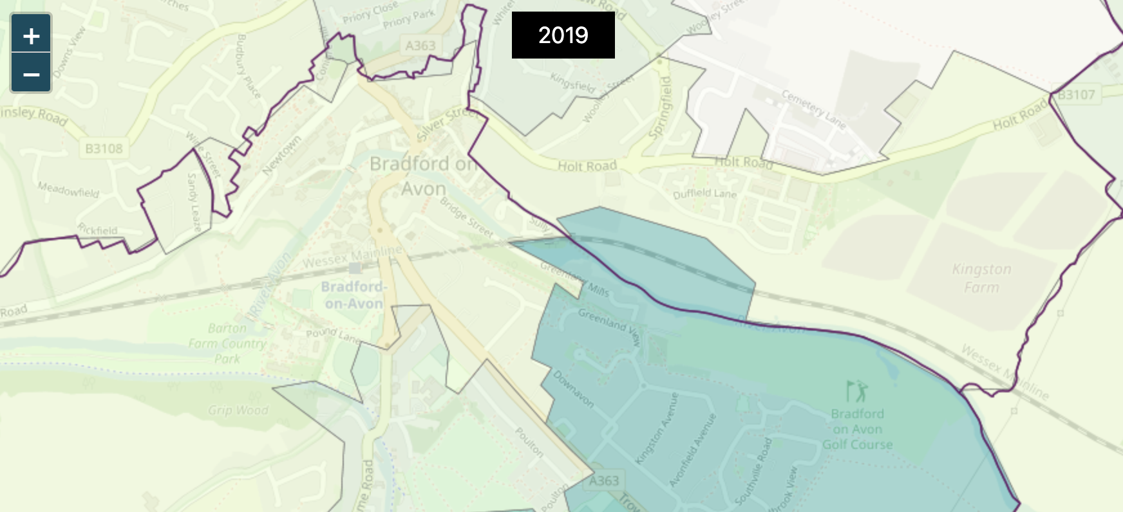
Deprivation indicators
02
Indices of multiple deprivation (latest: 2019)
A set of data to inform about the deprivation of small area geographies https://www.gov.uk/government/statistics/english-indices-of-deprivation-2019
Assesses and ranks small areas in England and Wales across 7 main measures:
Income
Employment
Education
Health
Crime
Barriers to Housing and Services
Living Environment

Slide 6

Thank you!
Contact
Dave Rowe
dave.rowe@os.uk
Become a member at:
www.geovation.uk
Follow us on Twitter: @geovation
Or drop by the Hub in London
Sutton Yard 4th floor
65 Goswell Road London
EC1V 7EN
GEOVATION FROM ORDNANCE SURVEY

