Slide 1



Getting started with the OS Vector Tiles API
December 2022

Slide 2

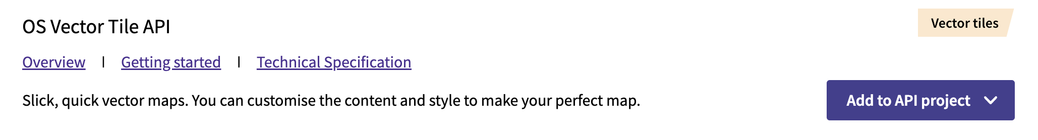
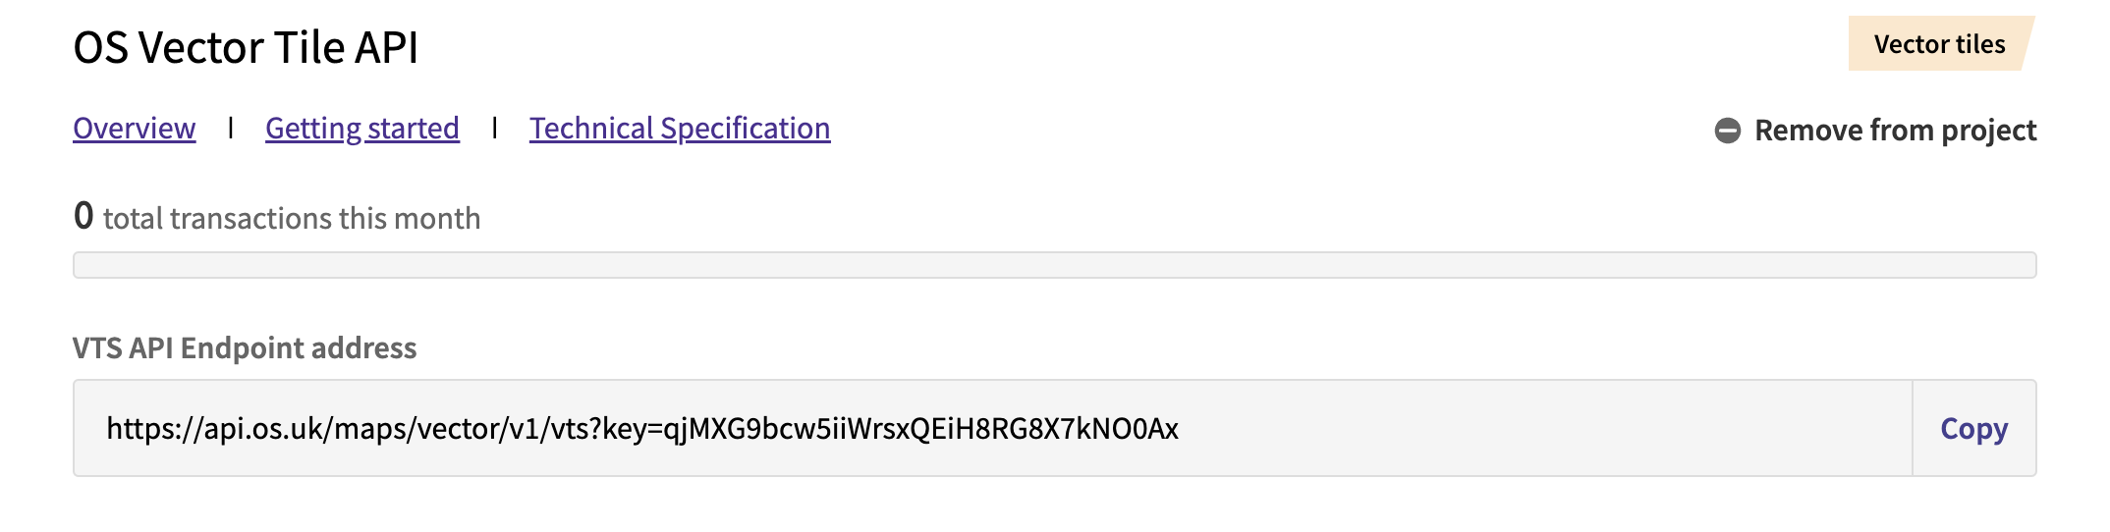
Data Hub Setup
02
Configure Vector Tile Access
Vector tiles are an API service so go to the API Dashboard
In the API pane add the OS Vector Tile API to an existing or new project
Copy the VTS API Endpoint Address (including Key) for use in Desktop or Web mapping projects

Slide 3
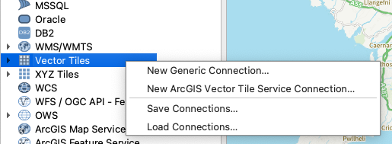
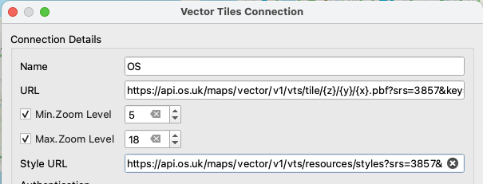
Importing into QGIS
02
Built into QGIS
Can be added to a QGIS project
In the Browser pane select under Vector Tiles to add a New Generic Connection
URL: https://api.os.uk/maps/vector/v1/vts/tile/{z}/{y}/{x}.pbf?srs=3857&key=
Style URL:

Slide 4
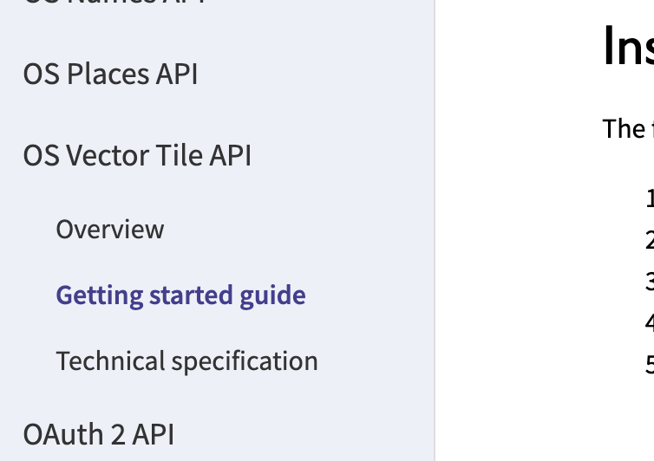
Using in web applications
03
Vector tiles in web map applications
Vector tiles are optimised for usage on the web
Requires a suitable JavaScript mapping library
Leaflet
Mapbox
MapLibre
OpenLayers
See getting started guide in the Docs section of the OS Data Hub https://osdatahub.os.uk/docs/vts/gettingStarted including downloadable demo project.

Slide 5

Thank you!
Contact
Dave Rowe
dave.rowe@os.uk
Become a member at:
www.geovation.uk
Follow us on Twitter: @geovation
Or drop by the Hub in London
Sutton Yard 4th floor
65 Goswell Road London
EC1V 7EN
GEOVATION FROM ORDNANCE SURVEY

