Slide 1

Notes:
Welcome to one of the preliminary videos demoing data access for the upcoming energy map and hack in 2023.

Slide 2



Getting started with the OS Vector Tiles API
Energy Map & Hack 2023
Notes:
Vector tiles are a way of providing a base map for web mapping applications, as well as desktop GIS tools. The benefit of using vector tiled data is that the underlying tiles include data, such as roads, buildings, greenspace, etc. This data can be interacted with in a way that raster image data cannot. The tiles can also be more efficient and allow for any number of resolutions without drastically changing the underlying data.
The OS Vector Tile API is a vector tile service providing detailed Ordnance Survey data as a .customisable base map

Slide 3

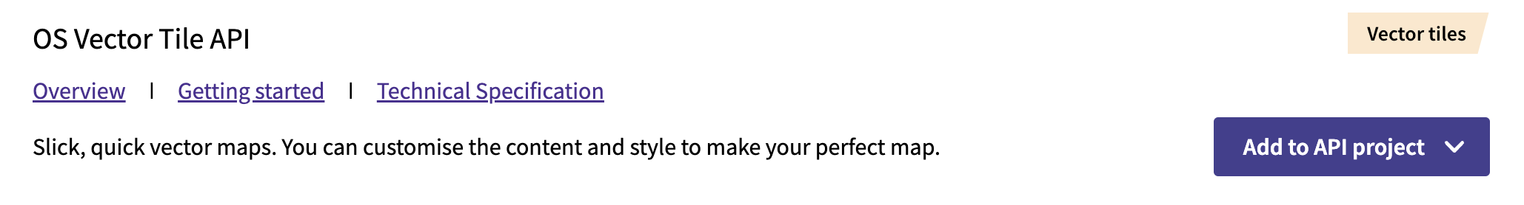
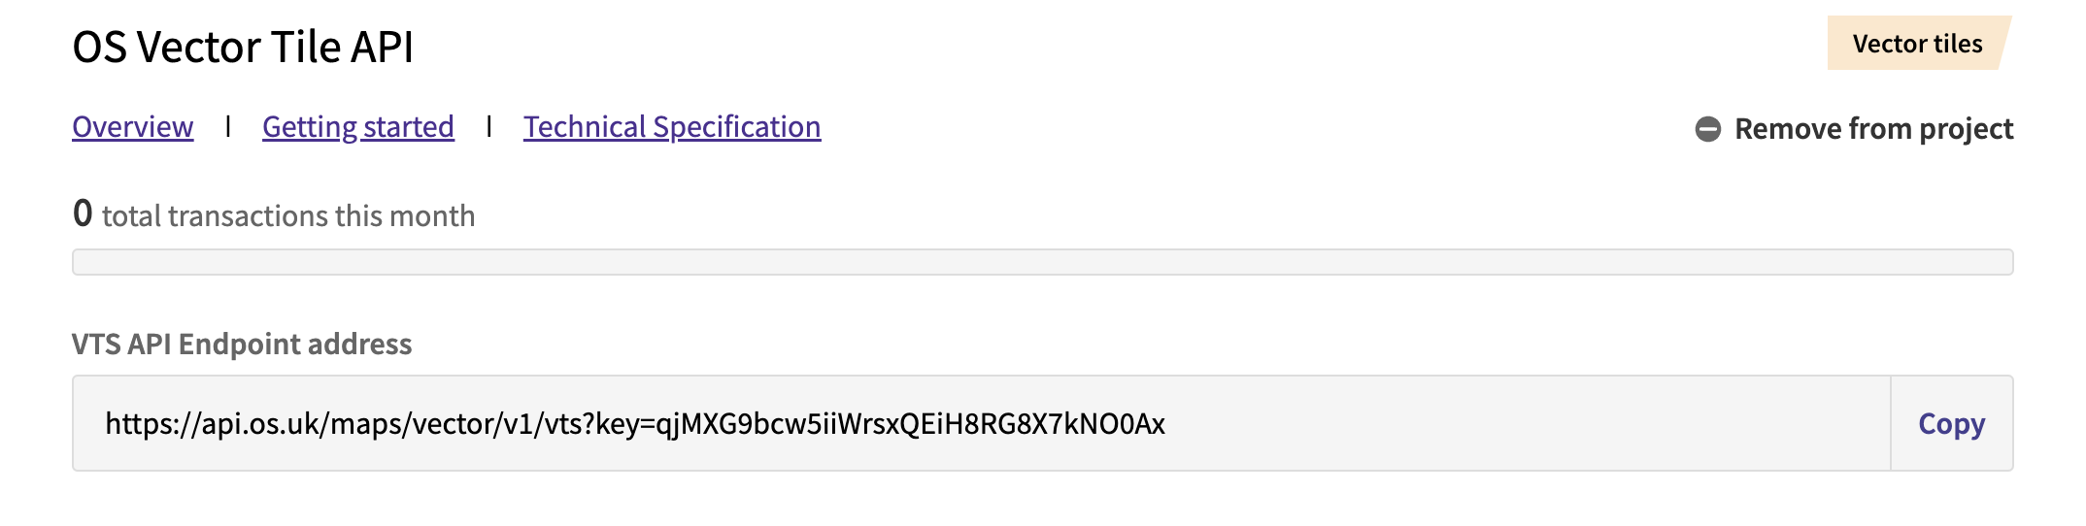
Data Hub Setup
02
Configure Vector Tile Access
Vector tiles are an API service so go to the API Dashboard
In the API pane add the OS Vector Tile API to an existing or new project
Copy the VTS API Endpoint Address (including Key) for use in Desktop or Web mapping projects
Notes:
To get started with the OS vector tile service you can use the OS Data Hub.
Start by navigating to the API Dashboard tab. In the list of available APIs you will find the OS Vector Tile API listed.
Once that is either added to an existing project, or you have created a new project to add it to, the vector tile API dashboard will be displayed.
This dashboard will then display your usage history, as well as the API Endpoint Address with a prepopulated API key. You should keep this key secret (this particular one has been revoked!)

Slide 4
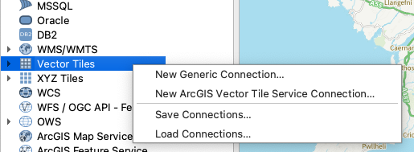
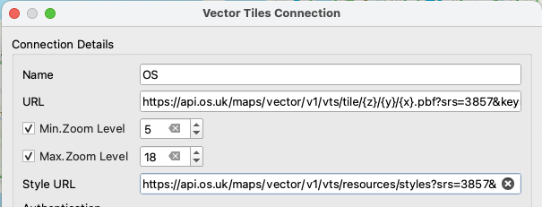
Importing into QGIS
02
Built into QGIS
Can be added to a QGIS desktop project
In the Browser pane select under Vector Tiles to add a New Generic Connection
URL: https://api.os.uk/maps/vector/v1/vts/tile/{z}/{y}/{x}.pbf?srs=3857&key=
Style URL: https://api.os.uk/maps/vector/v1/vts/resources/styles?srs=3857&key=
Notes:
QGIS is an open source and free desktop application for exploring geospatial data.
To do this with a base map you can use the OS vector tiles API. If you open the Browser pane (by default on the left-hand side of the screen) you can click on the Vector Tiles item and select to add a new generic connection.
Two URLs will need to be entered, a tile URL and a style URL. Both of these can be added in with the format as shown on this slide. You will need to include your API key at the end of each URL.

Slide 5
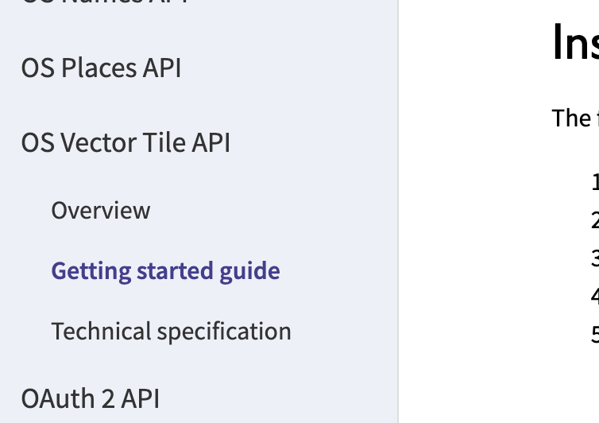
Using in web applications
03
Vector tiles in web map applications
Vector tiles are optimised for usage on the web
Requires a suitable JavaScript mapping library
Leaflet
Mapbox
MapLibre
OpenLayers
See getting started guide in the Docs section of the OS Data Hub https://osdatahub.os.uk/docs/vts/gettingStarted including downloadable demo project.
Notes:
The bulk of usage of vector tile service is in web map applications. These allow you to zoom and scroll and change the pan and tilt of the current map, all of which may highlight different features of the base map.
The OS Vector tile service is compatible with all the major JavaScript libraries that provide a means of embedding maps on a webpage: Leaflet, Mapbox, MapLibre and OpenLayers.
In the Data Hub, navigate the API Dashboard and then the Getting Started Guide for the OS Vector Tile API.
This provides a demo project which can be downloaded and edited from GitHub. It also features code samples for multiple different mapping libraries displaying how the vector tile service can be utlilised.

Slide 6

Thank you!
Contact
Dave Rowe
dave.rowe@os.uk
Become a member at:
www.geovation.uk
Follow us on Twitter: @geovation
Or drop by the Hub in London
Sutton Yard 4th floor
65 Goswell Road London
EC1V 7EN
GEOVATION FROM ORDNANCE SURVEY

