Slide 1
Java Memory Analyse

Slide 2
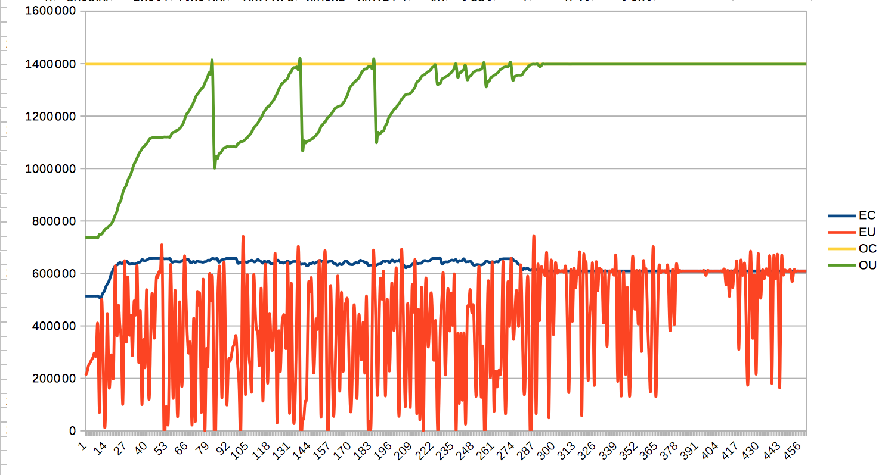
Java Memory
jstat -gc
jstat -gc -t `eap7 pid` 10s | tee tmpmen.csv
In Libre-Office importiert

Slide 3
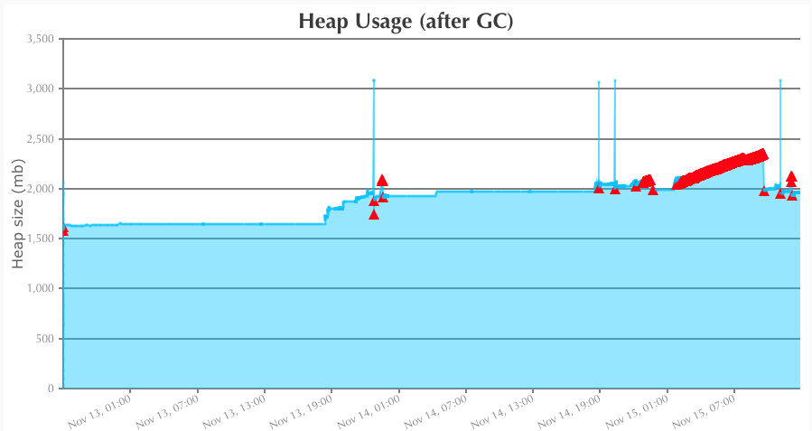
Memory
GC-Log analysieren
  Garbagecat:
  GCeasy: http://www.gceasy.io
java -jar garbagecat-2.0.12-SNAPSHOT.jar gc.log.0.current

Slide 4
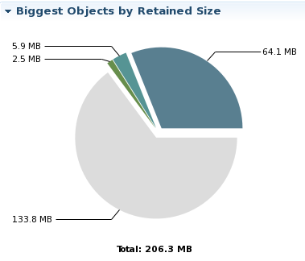
Memory Analyse
Heap-Dumps:
  jvisualvm
  jmap -dump:live,file=dump.bin,format=b <pid>
Analyse
  jvisualvm
  jhat (goßer Speicherbedarf)
  MAT (http://www.eclipse.org/mat/)

Slide 5
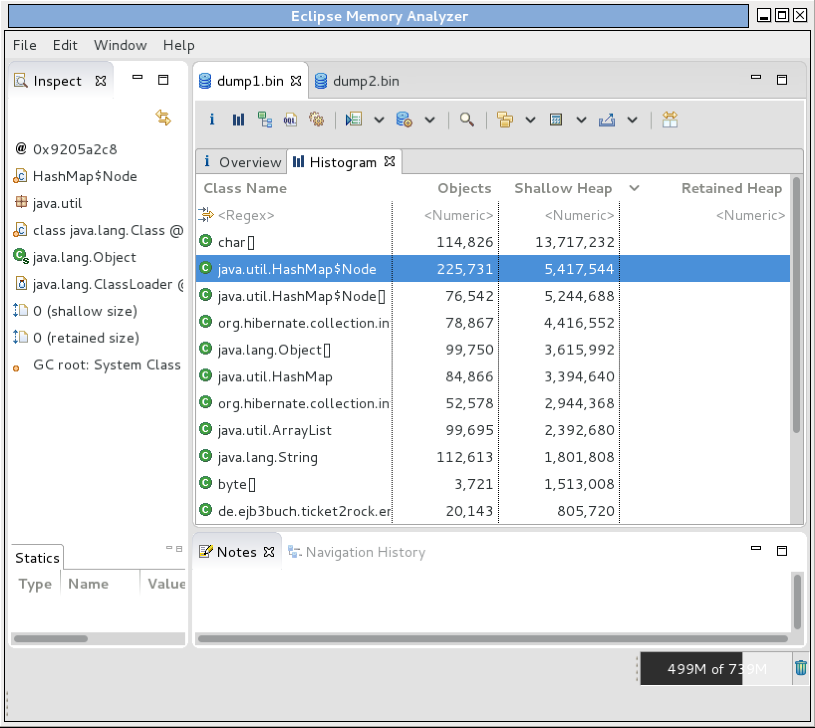
MAT – Memory Analysing Tool
Objects
  Anzahl Objekte der Klasse
Shallow Heap
  Direkt von den Objekten verwendeter Speicher
Retained Heap
  Von den Objekten (indirekt) gehaltener Speicher

Slide 6
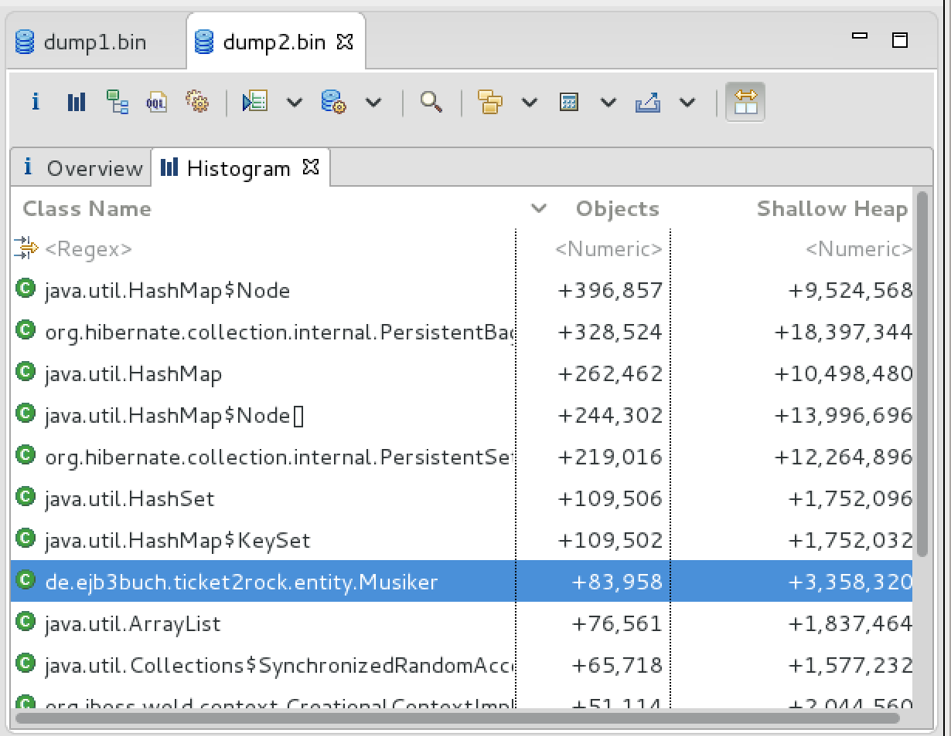
Vergleich von Heaps
erster Heap
zweiter Heap
Vergleich
Differenz

Slide 7
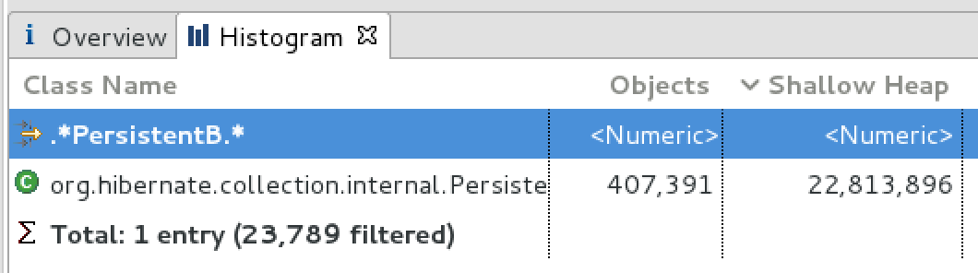
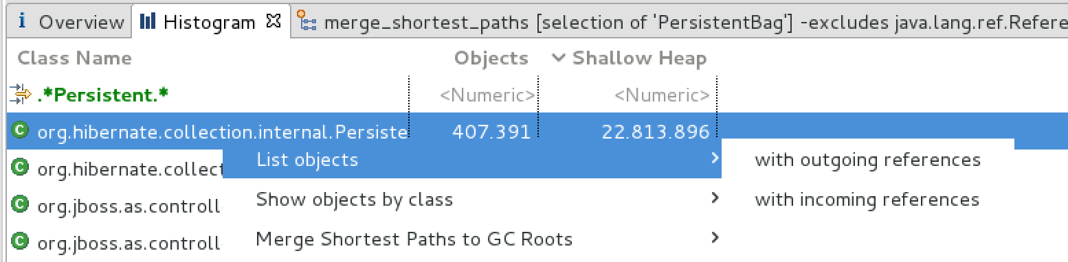
Analysen mit MAT
Filter
Objekte auflisten
Pfad zu Garbage Collection Root

Slide 8
Garbage Collection Roots
  A garbage collection root is an object that is accessible from outside the heap.
Java Local
  Local variable. For example, input parameters or locally created objects of methods that are still in the stack of a thread.
System Class
  Class loaded by bootstrap/system class loader. For example, everything from the rt.jar like java.util.* .
Thread
  A started, but not stopped, thread.

Slide 9
Garbage Collection Roots
Busy Monitor
  Everything that has called wait() or notify() or that is synchronized. For example, by calling synchronized(Object) or by entering a synchronized method. Static method means class, non-static method means object.
JNI
  Local variable in native code, such as user defined JNI code or JVM internal code.
  Global variable in native code, such as user defined JNI code or JVM internal code.
  In or out parameters in native code, such as user defined JNI code or JVM internal code. This is often the case as many methods have native parts and the objects handled as method parameters become GC roots. For example, parameters used for file/network I/O methods or reflection.

Slide 10
Garbage Collection Roots
Thread Block
  Object referred to from a currently active thread block.
Finalizable / Unfinalized
  An object which is in a queue awaiting its finalizer to be run.
  An object which has a finalize method, but has not been finalized and is not yet on the finalizer queue.

Slide 11
Java Memory: Referenz-Typen
Strong Reference
  Normale Referenz in Java
  Bsp: Person p = new Person();
Weak Reference
  Verhindert GC nicht. Wenn nur noch schwache Referenzen, wird trotzdem collected
  Bsp: WeakReference<Person> wp = new WeakReference<Person>(p);
Soft Reference
  Wie Weak Reference, nur wird erst dann collected, wenn Speicher knapp wird.
Phantom Reference
  Keine eigentliche Referenz auf ein Objekt. Kann verwendet werden um festzustellen, wann ein Object aus Memory entfernt wurde.

Slide 12
MAT Object Query
Object Query Language
select * FROM de.ejb3buch.ticket2rock.entity.Band b where toString(b.name) = "Audioslave"

