Slide 1
Java Thread Analyse

Slide 2
Threads
Ein Thread ist ein unabhängiger Ausführungspfad in einem Programm.
In JBoss existieren viele Threads gleichzeitig
Stati:
  NEW: Noch nicht gestartet
  RUNNABLE: Läuft aktiv in der JVM
  BLOCKED: Blockiert und wartet auf einen Monitor-Lock (synchronized)
  WAITING: Wartet unbegrenzt auf eine Aktion eines anderen Threads (Object.wait(), Thread.join() - Object.notify())
  TIMED_WAITING: Wartet eine gewisse Zeit auf eine Aktion eines anderen Threads
  TERMINATED: Thread ist beendet

Slide 3
Thread Dump
"http-/0.0.0.0:8080-Acceptor-0" daemon prio=10 tid=0x00007f62d8b9f000 nid=0x7d36 runnable [0x00007f62d1be3000]
java.lang.Thread.State: RUNNABLE
at java.net.PlainSocketImpl.socketAccept(Native Method)
at java.net.PlainSocketImpl.accept(PlainSocketImpl.java:408)
- locked <0x00000000ba4ad580> (a java.net.SocksSocketImpl)
at java.net.ServerSocket.implAccept(ServerSocket.java:462)
at java.net.ServerSocket.accept(ServerSocket.java:430)
at org.apache.tomcat.util.net.DefaultServerSocketFactory.acceptSocket(DefaultServerSocketFactory.java:61)
at org.apache.tomcat.util.net.JIoEndpoint$Acceptor.run(JIoEndpoint.java:322)
at java.lang.Thread.run(Thread.java:662)
"http-/0.0.0.0:8080-Poller" daemon prio=10 tid=0x00007f62d8601000 nid=0x7d35 in Object.wait() [0x00007f62d1ce4000]
java.lang.Thread.State: TIMED_WAITING (on object monitor)
at java.lang.Object.wait(Native Method)
- waiting on <0x00000000ba4ade78> (a org.apache.tomcat.util.net.JIoEndpoint$Poller)
at org.apache.tomcat.util.net.JIoEndpoint$Poller.run(JIoEndpoint.java:743)
- locked <0x00000000ba4ade78> (a org.apache.tomcat.util.net.JIoEndpoint$Poller)
at java.lang.Thread.run(Thread.java:662)
"EJB default - 7" prio=10 tid=0x00007f62f8347000 nid=0x7dde waiting on condition [0x00007f62f4bf9000]
java.lang.Thread.State: TIMED_WAITING (sleeping)
at java.lang.Thread.sleep(Native Method)
at test.PerfCall.warte(PerfCall.java:33)
at sun.reflect.GeneratedMethodAccessor19.invoke(Unknown Source)
at sun.reflect.DelegatingMethodAccessorImpl.invoke(DelegatingMethodAccessorImpl.java:25)
at java.lang.reflect.Method.invoke(Method.java:597)
at org.jboss.as.ee.component.ManagedReferenceMethodInterceptorFactory$ManagedReferenceMethodInterceptor.
at org.jboss.invocation.InterceptorContext.proceed(InterceptorContext.java:288)
at org.jboss.invocation.InterceptorContext$Invocation.proceed(InterceptorContext.java:374)
at org.jboss.as.weld.ejb.Jsr299BindingsInterceptor.doMethodInterception(Jsr299BindingsInterceptor.java:129)
at org.jboss.as.weld.ejb.Jsr299BindingsInterceptor.processInvocation(Jsr299BindingsInterceptor.java:137)
at org.jboss.as.ee.component.interceptors.UserInterceptorFactory$1.processInvocation
at org.jboss.invocation.InterceptorContext.proceed(InterceptorContext.java:288)
at org.jboss.invocation.WeavedInterceptor.processInvocation(WeavedInterceptor.java:53)
Stack Trace
Source Code Referenz

Slide 4
Stack Trace
at java.lang.Thread.sleep(Native Method)
at test.PerfCall.warte(PerfCall.java:33)
at sun.reflect.GeneratedMethodAccessor19.invoke(Unknown Source)
at sun.reflect.DelegatingMethodAccessorImpl.invoke(DelegatingMethodAccessorImpl.java:25)
at java.lang.reflect.Method.invoke(Method.java:597)
at org.jboss.as.ee.component.ManagedReferenceMethodInterceptorFactory$ManagedReferenceMethodInterceptor.
at org.jboss.invocation.InterceptorContext.proceed(InterceptorContext.java:288)
at org.jboss.invocation.InterceptorContext$Invocation.proceed(InterceptorContext.java:374)
at org.jboss.as.weld.ejb.Jsr299BindingsInterceptor.doMethodInterception(Jsr299BindingsInterceptor.java:129)
at org.jboss.as.weld.ejb.Jsr299BindingsInterceptor.processInvocation(Jsr299BindingsInterceptor.java:137)
at org.jboss.as.ee.component.interceptors.UserInterceptorFactory$1.processInvocation
at org.jboss.invocation.InterceptorContext.proceed(InterceptorContext.java:288)
at org.jboss.invocation.WeavedInterceptor.processInvocation(WeavedInterceptor.java:53)
at java.lang.Thread.sleep(Native Method)
at test.PerfCall.warte(PerfCall.java:33)
at sun.reflect.GeneratedMethodAccessor19.invoke(Unknown Source)
at sun.reflect.DelegatingMethodAccessorImpl.invoke(DelegatingMethodAccessorImpl.java:25)
at java.lang.reflect.Method.invoke(Method.java:597)
at org.jboss.as.ee.component.ManagedReferenceMethodInterceptorFactory$ManagedReferenceMethodInterceptor.
at org.jboss.invocation.InterceptorContext.proceed(InterceptorContext.java:288)
at org.jboss.invocation.InterceptorContext$Invocation.proceed(InterceptorContext.java:374)
at org.jboss.as.weld.ejb.Jsr299BindingsInterceptor.doMethodInterception(Jsr299BindingsInterceptor.java:129)
at org.jboss.as.weld.ejb.Jsr299BindingsInterceptor.processInvocation(Jsr299BindingsInterceptor.java:137)
at org.jboss.as.ee.component.interceptors.UserInterceptorFactory$1.processInvocation
at org.jboss.invocation.InterceptorContext.proceed(InterceptorContext.java:288)
at org.jboss.invocation.WeavedInterceptor.processInvocation(WeavedInterceptor.java:53)
public class PerfCall implements Perf {
...
public String warte(long n){
if ( log.isDebugEnabled() ){
log.debug("Schlafe " + n + " Millisec");
}
try {
Thread.sleep(n);
} catch (InterruptedException e) {
throw new RuntimeException("Interrupt in warte!", e);
}
return "Geschlafen: " + n + " Millisec";
}
Zeile: PerfCall.java:33

Slide 5
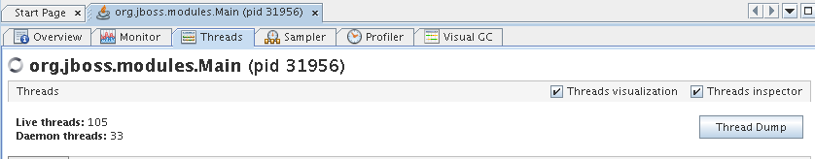
Thread Dumps erzeugen
jstack pid
kill -QUIT pid
jvisualvm
Prozess-ID (pid) mit ps oder jps auslesen

Slide 6
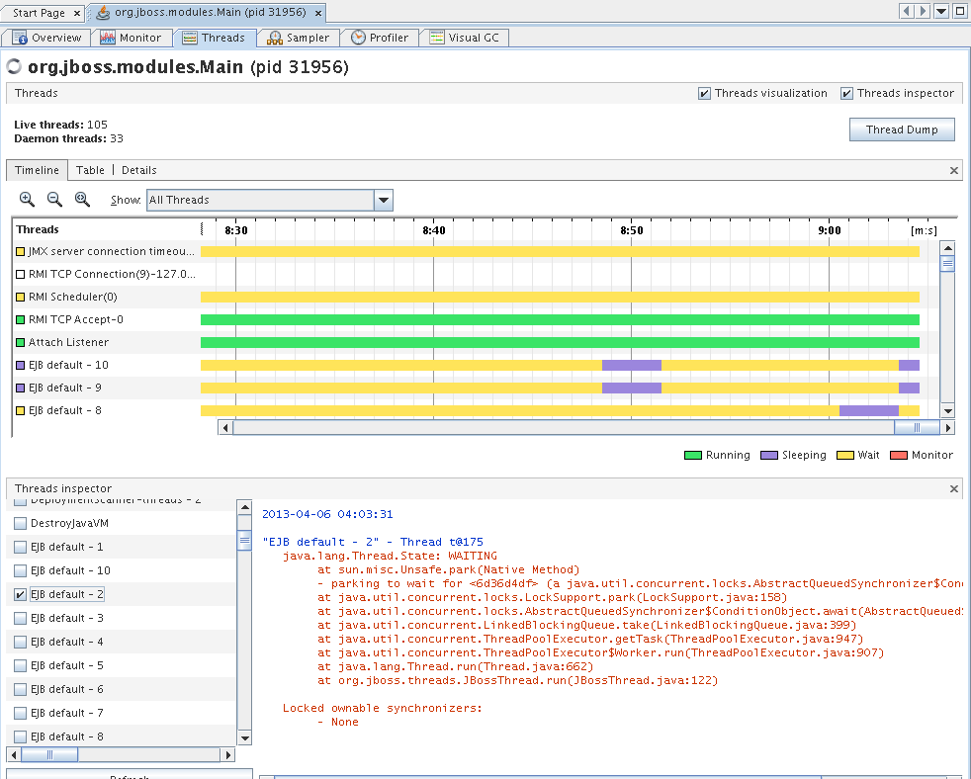
Threads beobachten mit JVisualVM
Threads Inspector
Plugin

Slide 7
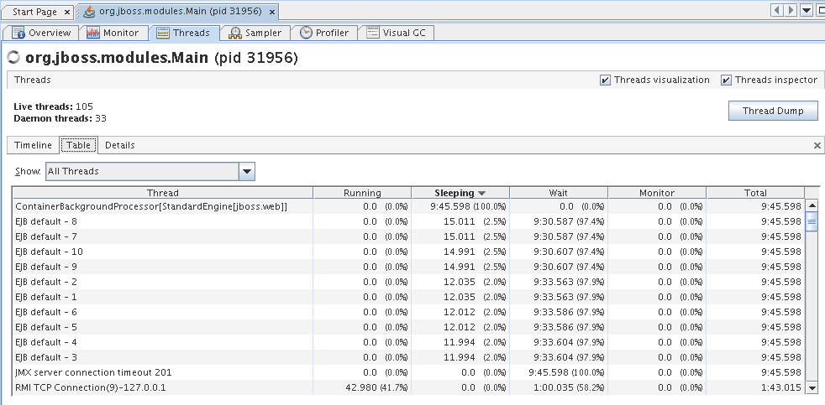
Threads beobachten mit JVisualVM

Slide 8
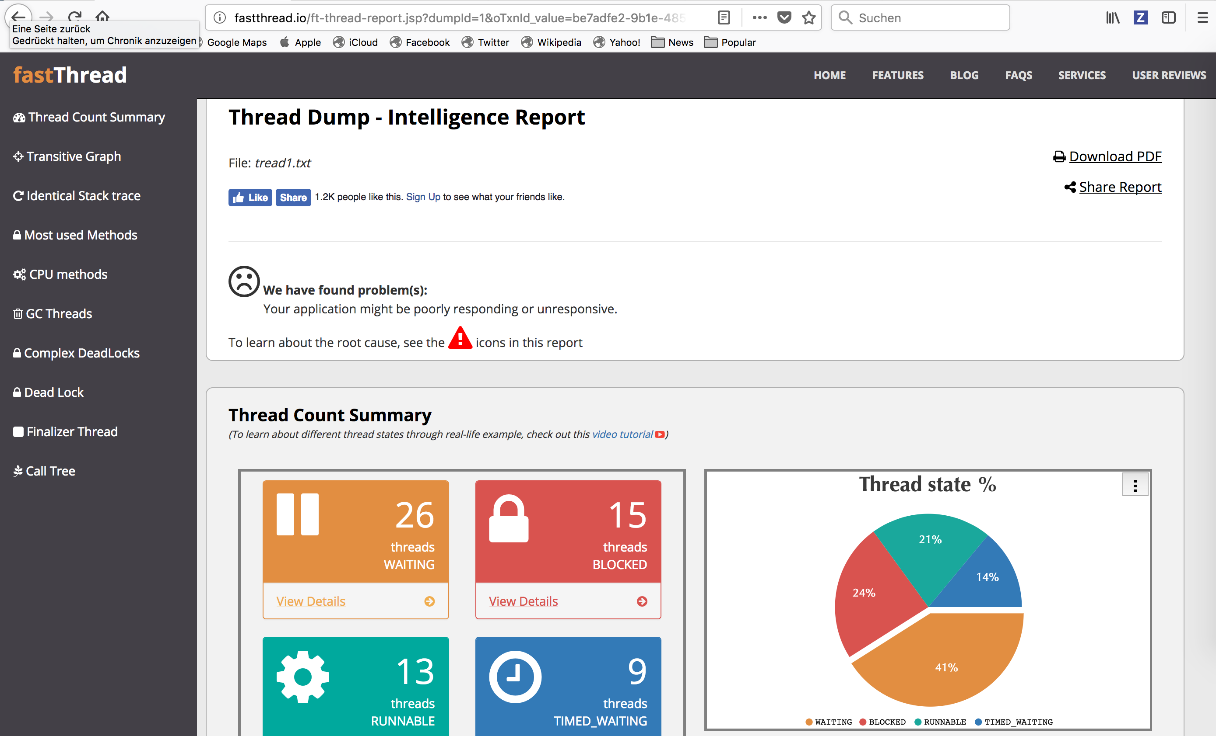
Thread Analysis - fastthread.io

Slide 9
CPU Verbrauch
Prozessspezifisch
  ps -o '%cpu,%mem' -p pid
Treadspezifisch
  top -H und jstack
[esiegl@devjava4 ~]$ ps -eo pid,ppid,cmd,%mem,%cpu --sort=-%mem | head
PID PPID CMD %MEM %CPU
28190 28118 /usr/java/jdk1.8.0_144/bin/ 11.5 56.8
2012 1 /usr/libexec/packagekitd 3.5 0.0
2471 2320 /usr/bin/gnome-shell 3.1 0.0
623 1 /usr/lib/systemd/systemd-jo 1.9 0.0
1778 1755 gnome-shell --mode=gdm --wa 1.4 0.0
Threads mit höchster CPU-Auslastung
jboss:/home/jboss>top -H
jboss:/home/jboss>echo "obase=16; 58577" | bc
E4D1
jboss:/home/jboss>jstack 31201 | grep -i E4D1
"RequestHandlerThread[#3182]" daemon prio=10 tid=0x00007ffd9800b000 nid=0xe4d1 runnable [0x00007ffdfbbf9000]
Thread-ID nach HEX umwandeln
Java-Thread suchen

Slide 10
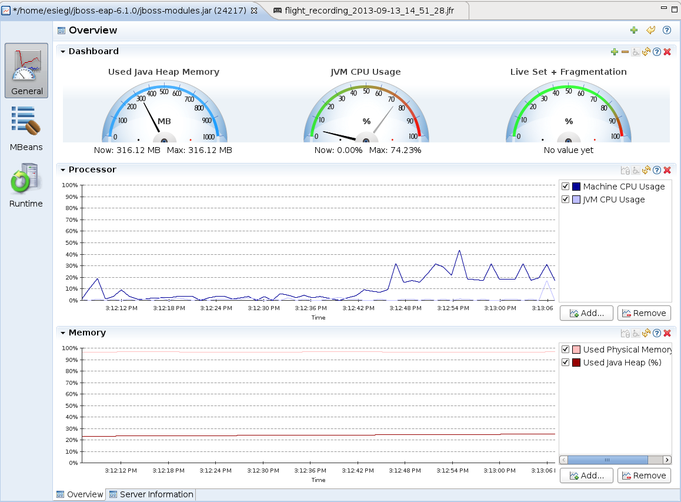
Java Mission Control
(JBoss) JVM starten mit:
  JAVA_OPTS="$JAVA_OPTS -XX:+UnlockCommercialFeatures -XX:+FlightRecorder"

Slide 11
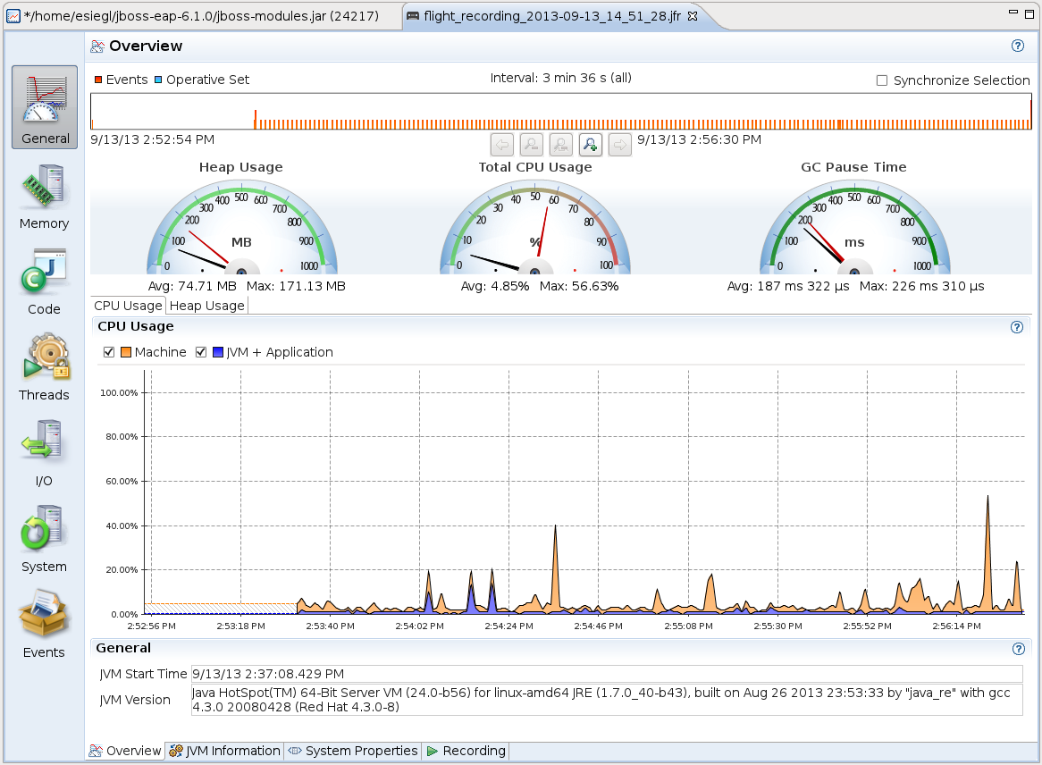
JMC Flight Recorder

Slide 12
Flight Recorder mit Kommandozeile
Export Konfiguration aus jmc
  File → Export → Flight Recording Configuration Template
Starte Recording
  jcmd `jboss pid` VM.unlock_commercial_features
  jcmd `jboss pid` JFR.start duration=60s filename=recording1.jfr settings=/home/jboss/my.jfc
Referenz:
  https://docs.oracle.com/javacomponents/jmc-5-5/jfr-runtime-guide/comline.htm

