Slide 1
Recommender Systems
Team E
Angelopoulos nikos
dallas dimitris
kletsas giorgos

Slide 2
The significance of recommender systems
software tools and techniques providing suggestions
personalized recommendations are offered as ranked lists of items
Predict suitable products or services based on the user's preferences and constraints
given the likes -> better recommendation for a future choice

Slide 3
Our data
Movie-Lens dataset
1st csv -> Users with ids and their ratings on specific movie ids
2nd csv -> Movies with ids, titles and genres

Slide 4
Recommender Algorithms
Popularity Algorithm
Correlation-based Algorithm
Content-based ltering Algorithm
kNN Algorithm

Slide 5
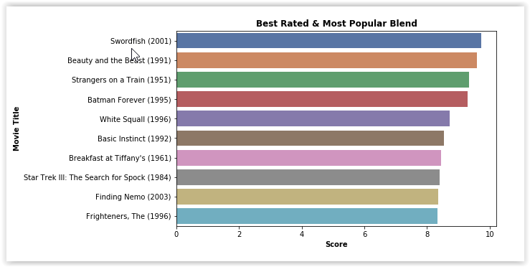
Popularity Algorithm
given the total votes and ratings of the users
we have average popularity of a movie
we recommended the top 20 movies

Slide 6
Correlation-based Algorithm
corrwith method of the Pandas Dataframe
computed the pairwise correlation between a movie entry and the whole dataframe
pick the movies with highest correlation with more than 100 ratings

Slide 7
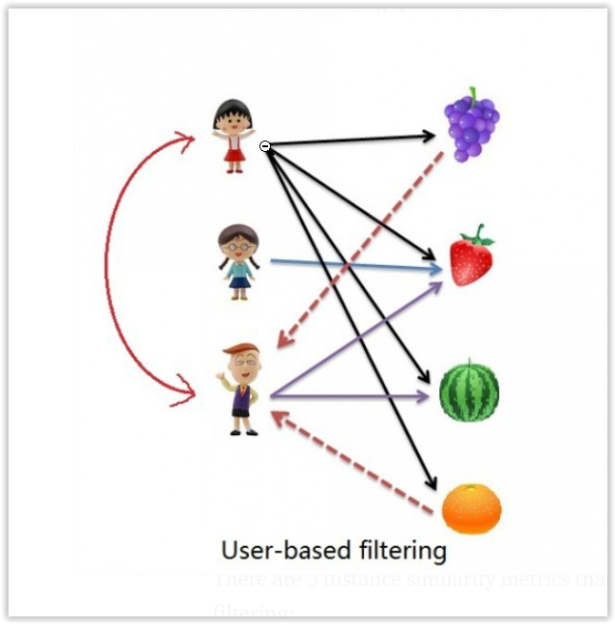
Correlation-Algorithm explanation
3 people have seen Toy Story 1.
All have rated it high.
The 2 have seen Toy Story 2
and rated it high too.
Recommend Toy Story 2 to the
other person.

Slide 8
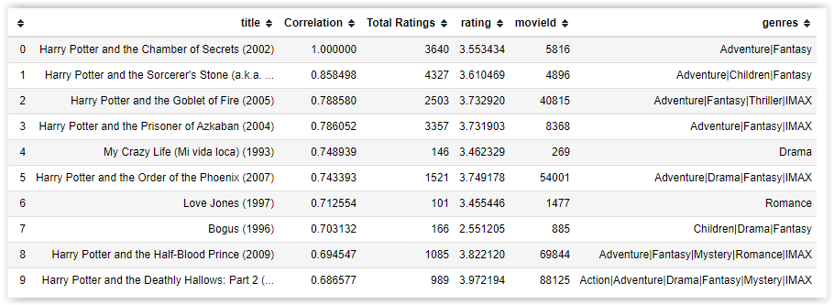
Example of Correlation-Algorithm
Recommendation for Harry Potter and the Chamber of Secrets(2002)
Correlation 100% with itself

Slide 9
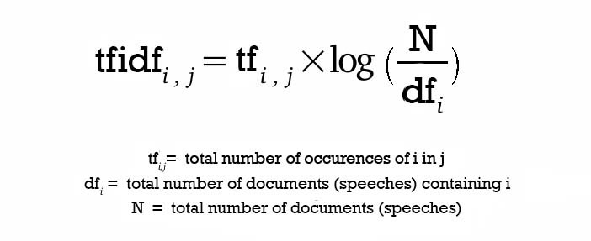
Content-based Filtering Algorithm
relies on the similarity of the items
if you like an item, then you will like a similar item
Term Frequency(TF)/Inverse Document Frequency(IDF)
TfidfVectorizer used to determine the relative importance between movies(TF-frequency of a word in a dataframe, IDF-word frequency in dataframe)

Slide 10
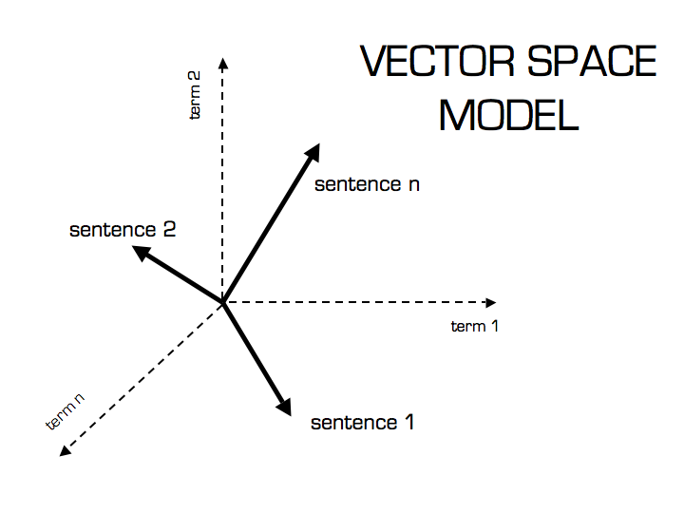
Recommended with Content-based Filtering
we recommended movies based on their genres
Vector Space Model(computes the proximity based on the angle between the vectors)
Cosine Similarities found by linear kernel(determine the similarity between the movies-through genre)

Slide 11
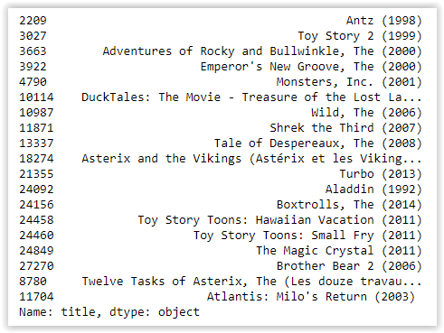
Example of Content-based Filtering
We recommended similar movies to Toy Story based on its genre
We can see that
they are mostly
animation

Slide 12
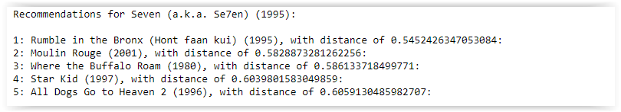
kNN Algorithm
find clusters of similar users based on common movie ratings.
predictions using the average rating of top-k nearest neighbors.
measures distance to determine the “closeness” of instances.
picks the most popular class among the neighbors.

Slide 13
Thank you for your time Questions?

