Slide 1
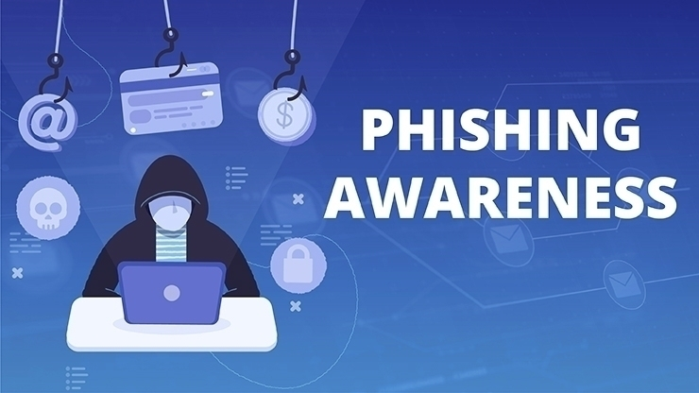
Phishing Awareness Training
Recognizing, Preventing, and Mitigating Phishing Attacks

Slide 2
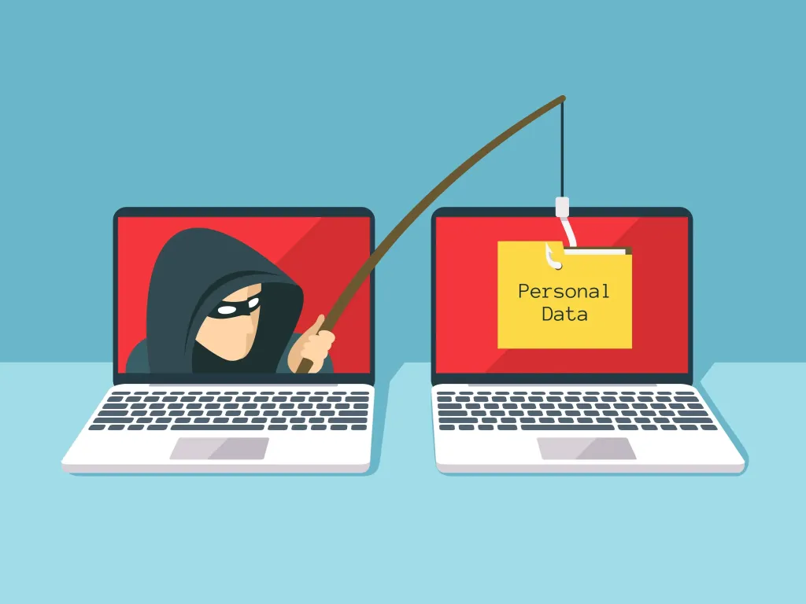
What is Phishing?
Phishing is a cyber attack
where attackers trick individuals
into providing sensitive
information like passwords and
financial details. They often
use emails, fake websites,
and social engineering
techniques to deceive victims.

Slide 3
Types of Phishing Attacks
1. Email Phishing - Mass emails with fake links
2. Spear Phishing - Targeted attacks on specific n
individuals
3. Whaling - High-profile phishing targeting executives
4. Smishing - SMS phishing attempts
5. Vishing - Voice phishing using phone calls
6. Clone Phishing - Copying legitimate emails with malicious links
7. Angler Phishing - Fake social media alerts to steal data
8. Business Email Compromise (BEC) - Impersonating executives to steal money

Slide 4
Example : A Phishing Email
Subject: Urgent Action Required: Account Security Update
Dear Valued Customer,
Email Phishing: We detected unusual login attempts on your account.
Spear Phishing: Dear [Your Name], a suspicious transaction of $1,254.30 was flagged.
Whaling: Dear [CEO's Name], we require immediate confirmation of your credentials.

Slide 5
Smishing: SMS alert: 'Your bank account has been locked. Click to verify.'
Vishing: Fake bank call requesting password verification.
Fake Link: www.banksecure-verification.com
Fake Contact: +1-800-555-FAKE
How to spot phishing: Urgency, fear tactics, spoofed links, grammar errors.

Slide 6
How to Recognize Phishing Emails
- Suspicious sender email address
- Urgent or threatening messages
- Unexpected attachments or links
- Poor grammar and formatting
- Requests for personal information

Slide 7
Phishing Websites: How They Work
- Fake login pages designed to steal credentials
- URLs with slight misspellings (e.g., g00gle.com)
- Lack of HTTPS encryption
- Website asks for excessive personal details

Slide 8
Social Engineering in Phishing
- Pretexting: Fake scenarios to extract information
- Baiting: Offering free software or gifts
- Tailgating: Gaining unauthorized physical access
- Impersonation: Pretending to be a trusted figure

Slide 9
Case Study 1: 2016 Google & Facebook Scam
A hacker tricked Google and Facebook employees into wiring over $100M using fake invoices. He posed as a supplier and used email spoofing techniques to make the fraud believable.

Slide 10
Case Study 2: Twitter 2020 Hack
Hackers compromised high-profile Twitter accounts, including Elon Musk and Barack Obama, by using social engineering techniques against Twitter employees.

Slide 11
Impact of Phishing on Businesses
- Data breaches leading to financial loss
- Reputation damage
- Legal consequences and compliance issues
- Loss of customer trust

Slide 12
Creating Awareness to Prevent Phishing
- Conduct regular cybersecurity training sessions.
- Simulated phishing attack exercises for employees.
- Promote a culture of security awareness.
- Encourage reporting of suspicious emails and
messages.

Slide 13
Tools to Prevent Phishing
- Email filtering software (Proofpoint, Mimecast)
- Multi-Factor Authentication (MFA)
- Web filtering tools to block malicious sites
- Anti-phishing browser extensions
- Security awareness training platforms (KnowBe4)

Slide 14
Laws & Policies Against Phishing
1. GDPR: Protects EU citizens' data, imposes heavy fines on companies failing to prevent phishing breaches.
2. CCPA: Gives California residents control over personal data, companies can be sued for failing security.
3. CFAA: U.S. law that criminalizes phishing-based hacking and unauthorized access.
4. APWG: Global organization researching phishing trends and assisting law enforcement.

Slide 15
Laws & Policies (Detailed Explanation)
1. GDPR (General Data Protection Regulation): EU law protecting personal data. Companies must secure data and report breaches or face heavy fines.
2. CCPA (California Consumer Privacy Act): U.S. law giving California residents control over their personal data. Companies can be sued for failing security measures.
3. CFAA (Computer Fraud and Abuse Act): U.S. law that criminalizes unauthorized access. Used to prosecute phishing-based hacking incidents.
4. APWG (Anti-Phishing Working Group): Global organization researching phishing trends, assisting law enforcement, and providing real-time threat intelligence.

Slide 16
Realistic Phishing Email Example
Subject: ⚠️ Security Alert: Unauthorized Login Attempt
Detected!
From: support@paypal-security.com (Spoofed Email)
Dear Customer,
We have detected an unauthorized login attempt on
your PayPal account from an unknown device. For your
security, we have temporarily locked your account.
To regain access, please verify your account
immediately by clicking the secure link below:
🔗 **Verify Your Account Now** → [www.paypal-
secure-login.com]

Slide 17
If you do not verify your account within 24 hours, it will be permanently suspended.
Thank you for choosing PayPal,
PayPal Security Team
⚠️ **Red Flags:**
- Fake sender email address (spoofed)
- Urgent language (account locked, verify now)
- Fake link (looks real but is a phishing site)
- Threat of suspension to create panic

Slide 18
Conclusion
Phishing is one of the most common cyber threats today. By staying informed, recognizing red flags, using security tools, and reporting suspicious activity, individuals and businesses can reduce risks.

