Slide 1


Coding Golf Xmas Challenge
Do we all know what Coding Golf is?

Slide 2

In Golf minimum number of strokes = Winner!
Coding golf:
PROGRAM
With the minimum number of key strokes =
Winner!

Slide 3

Your challenge should you wish to accept it…
Create a “short” C++ program to do the following
Robotron!

Slide 4
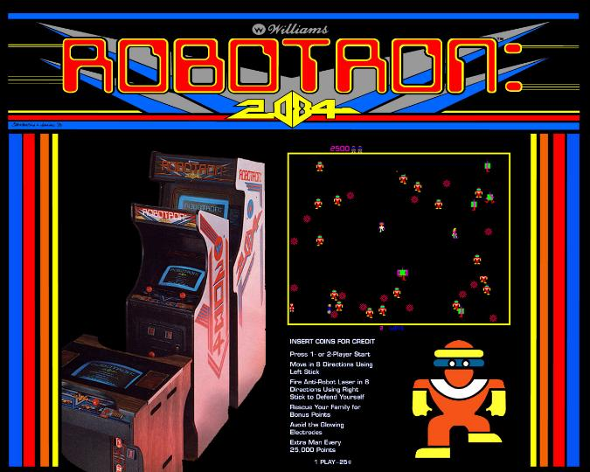

Slide 5
Game Specifications Required
X: Size of Play Area X
Y: Size of Play Area Y
R: Starting population of robots
J: Starting population of junk
L: Starting Lives

Slide 6
Game Specifications Controls
WASD: Movement
H: Hyperspace (jump to random SAFE location)
You move, all robots move towards you, if robots collide both die and replaced by junk.
Redraw level after each step, also showing number of lives left.
@ PLAYER # ROBOT ^ JUNK PILE

Slide 7
Game Golf Deadline
End of First week of teaching after CRIMBO!

