Slide 1

NXP S32K118 FIRMWARE更新架構
00000000H
CAN programmer
e.g, EZCAN
CAN
interface
bootloader
(40K Bytes)
UpdateMcuApp.exe
0000A000H
application program
(216K Bytes)
以CAN bus當作更新firmware的介面
bootloader與application為各自獨立的兩個專案
在application端亦須預留CAN bus,使其能接收來自PC端觸發更新的command
(跳回bootloader更新)
MCU
NXP S32K PFlash

Slide 2
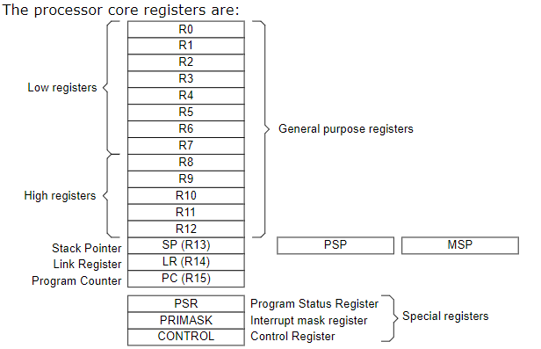
NXP S32K118 的 MEMORY MAP
0H
ARM Cortex-M0
Vector Table
+
PFlash
10H
NXP S32K Interrupt
Vector Table
00000000H
offset +0h +4h
其中:
address 0H :儲存一個位址¸此位址之後會提供給core register 的 SP 指標暫存器
address 4H:儲存一個位址,此位址會提供給 core register 的 PC 指標暫存器
ROM
FlashNVM
C0H
Reserved
1C000000H
3C0H
IFR
RAM
400H
bootloader
/User program
40000000H
SFR
(pheripheral)

Slide 3
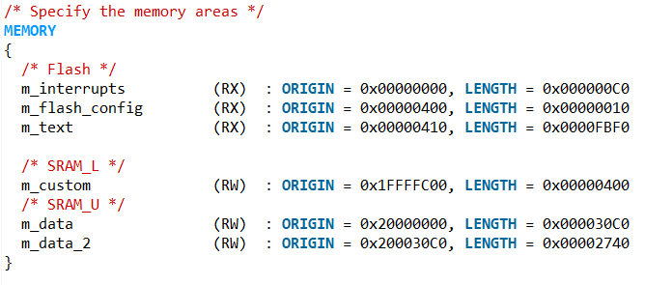
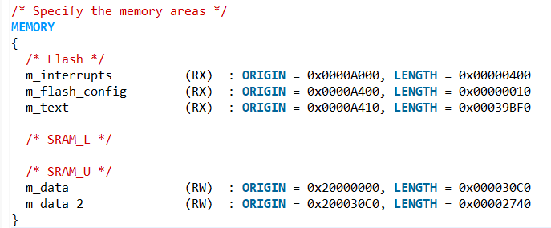
LINKER SCRIPT FILE
bootloader linker file settings:
application linker file settings:

Slide 4
RELOCATE THE ADDRESS BEFORE JUMPING TO APP(1)
bootloader 程式以及app程式為各自獨立的專案,所以在編譯之後會產生各自所屬的中段向量表,假設bootloader在完成app更新之後且確認app為有效的,當欲從bootloader jump到app執行時,我們須對MCU的兩個 core registers 外加一個vector offset register做設定
1. VTOR (Vector Table Register):
Application code 所屬vector table的起始位址, 在編譯app的時候,我們透過
linker scrupt file 將向量表設置在app image的最前端的位址, 而vector table裡
面包含兩個訊息, 其一為ARM Cortex -M0基本的中斷向量表 (offset 0H~FH),
其二為NXP S32K 的中斷向量表 (10H~)
// Update the vector table to the reset vector of the application.
S32_SCB->VTOR = (uint32_t)MEM_APP_START;
2. PC (Program Counter) :
Application code 程式進入點的位址 (也就是程式中Starup code裡面的Reset Handler
所在的位址), 而這個資訊會儲存在application image 的offset 4h
// Point to the start reset vector for the application.
p_jump_to_app = ((uint32_t)MEM_APP_START+4);
3. SP(Stack Pointer):
application code 使用stack的起始位址, 這個位址資訊可以從Vector table的offset
0H 裡面找到
//Set stack for the application
MSR_MSP(*(volatile uint32_t*)MEM_APP_START);

Slide 5
RELOCATE THE ADDRESS BEFORE JUMPING TO APP(2)
APP IMAGE EXAMPLE:
0000H
bootloader vector table
bootloader
0xE000ED08
VTOR
A000H
application vector table
結果:
VTOR = 0xA000
SP = 0x20005800 (stack 在RAM的位址)
PC = 0xA4C5 (Thumb 指令集), 實際上會從
0xA4C4執行
A4C4H
Reset Handler of
application

Slide 6
FIRMWARE UPDATE FLOW
START
A
board init
application = valid?
N
enable CAN
receive
Y
Jump to app
software reset
g_can_rx_complete = false
N
firmware update loop and waiting command from PC
Y
N
timeout?
Y
A

Slide 7
Win App + NXP : Flow
Command | Send | Step | Action
Update | Win App | 1 | 1. Tell Application or Bootloader to start the process 2. Win App delay some time
 | NXP | 2 | Response
Erase | Win App | 3 | Tell Bootloader to erase flash
 | NXP | 4 | Response
Addr | Win App | 5 | Tell Bootloader address
 | NXP | 6 | Response
Data | Win App | 7 | 1. Send data 2. Will repeat step 5,6,7,8 until finish all data
 | NXP | 8 | Response
End | Win App | 9 | Finish
 | NXP | 10 | 1. Response 2. Restart MCU

Slide 8
Win App + NXP : Command context
Command | Send | ID | D0 | D1 | D2 | D3 | D4 | D5 | D6 | D7
Update | Win App | 0x100 | 00 | 00 | 00 | 00 | 00 | 00 | 00 | 00
 | NXP | 0x101 | Pass : 00 Fail : Other | 00 00 | 00 00 | 00 00 | 00 00 | 00 00 | 00 00 | 00 00
Erase | Win App | 0x200 | 00 | 00 | 00 | 00 | 00 | 00 | 00 | 00
 | NXP | 0x201 | Pass : 00 Fail : Other | 00 00 | 00 00 | 00 00 | 00 00 | 00 00 | 00 00 | 00 00
Addr | Win App | 0x300 | 00 | 00 | 00 | 00 | A3 | A2 | A1 | A0
 | NXP | 0x301 | Pass : 00 Fail : Other | 00 00 | 00 00 | 00 00 | 00 00 | 00 00 | 00 00 | 00 00
Data | Win App | 0x400 | D0 | D1 | D2 | D3 | D4 | D5 | D6 | D7
 | NXP | 0x401 | Pass : D0 Fail : Error code | D1 00 | D2 00 | D3 00 | D4 00 | D5 00 | D6 00 | D7 00
End | Win App | 0x500 | 00 | 00 | 00 | 00 | 00 | 00 | 00 | 00
 | NXP | 0x501 | Pass : 00 Fail : Other | 00 00 | 00 00 | 00 00 | 00 00 | 00 00 | 00 00 | 00 00

