Slide 1
PhantomSea – Abyss gt
Digital Revenue Strategy
Team 3 — BSAN 760
Digital Product Team

Slide 2
Executive Summary
January 2026 — PhantomSea Digital Revenue Snapshot
$51,195 Monthly App Revenue — 6 apps across 30,112 vehicles
$35,192 Net Monthly Profit — 68.7% margin
8.4% Avg Penetration Rate — 15,197 active users out of 30,112 vehicles
+65.6% Car fleet growth since Jul 2025 — app adoption is lagging behind
Car sales slowing from economic downturn — app revenue is small today but has massive growth potential.

Slide 3
The Problem
1. Economic Downturn — Car Sales Are Slowing
Traditional car sales revenue under pressure from macroeconomic conditions
App revenue ($51K/mo) is small today — but scalable and recurring
2. Massive Untapped Market — Only 8.4% Penetration
30,112 vehicles on the road (+65.6% growth since Jul 2025)
91.6% of vehicle owners have zero app subscriptions — huge opportunity
Fleet growing fast, but app adoption is not keeping pace
3. Revenue Concentration Risk
Map Directions + Toones = 93% of all app revenue
Only 2 of 6 apps are meaningful revenue drivers
NewNews -50.7% YTD, Unicorn Xplode -32.1% YTD — active deterioration

Slide 4
Digital Product Team Guiding Strategy
How to establish SCA?
Sustainable competitive advantage

Slide 5
Time spent in the car Per day
2.44 trips
60.4 minutes
31.1 miles
EVs recorded the longest average trip times (16.0 minutes) and distances (32.9 miles)
AAA Foundation American Driving Survey: 2024, https://aaafoundation.org/american-driving-survey-2024/

Slide 6
EV Buyers
EV Buyer Preferences
69% of EV buyers plan to increase their use of connectivity solutions
Compared to 47% of traditional car purchasers
Only 45% of car owners use Apple CarPlay or Android Auto, when it is available
Majority still uses OEM infotainment and applications
Current EV Market Sales in the U.S.
1.5 Million Total U.S. EV sales in 2024
1.2 Million BEV sales
320,000 PHEV sales
3.4 Million Projected Total U.S. EV sales by 2030
McKinsey & Company, https://www.mckinsey.com/industries/automotive-and-assembly/our-insights/how-do-consumers-perceive-in-car-connectivity-and-digital-services?
International Energy Agency, https://www.iea.org/data-and-statistics/data-tools/global-ev-data-explorer
Notes:
BEV – Battery Electric Vehicle
PHEV – Plug In Hybrid Electric Vehicle

Slide 7
Competitor Analysis
IBIS World, https://my-ibisworld-com.www2.lib.ku.edu/us/en/industry-specialized/OD4516/companies
Notes:
Tesla, Inc
24.8% Market Share
4.3% Profit Margin
Toyota Motor Corp
15.9% Market Share
7.7% Profit Margin
Ford Motor Co
14.4% Market Share
1.2% Profit Margin
Honda Motor Co Ltd
8.2% Market Share
-0.5% Profit Margin
General Motors Company
7.6% Market Share
2.2% Profit Margin
Hyundai Motor Group
5.4% Market Share
7.9% Profit Margin
Rivian
3.8% Market Share
-24.2% Profit Margin

Slide 8
Technology Stack — Plausible Tech Criterion (33% of Grade)
Abyss GT Hardware Platform
5G OLED Touchscreen High-res display for apps, navigation, media
AR Windshield Augmented overlay, heads-up navigation display
Biometric Sensors Driver ID, fatigue detection, personalization
AI Smart Assistant Voice control, recommendations, upsell engine
Platform Value Proposition
Premium hardware justifies premium recurring subscriptions
5G enables real-time data across all 6 apps
Biometrics power personalized upsell & retention
How Each App Uses the Platform
Map Directions 5G + AR windshield for real-time nav overlay
Toones OLED + 5G for premium in-cabin audio streaming
Unicorn Xplode Gaming via OLED touchscreen
NewNews 5G real-time news aggregation on OLED display
Cat Scratchers Casual touch gaming on OLED during stops
Speedper Biometric + AI for driver performance tracking
All 6 apps are purpose-built for the Abyss GT hardware ecosystem

Slide 9
App Performance Overview — January 2026
App | Maker | Users | $/Mo | Revenue | Cost | Profit | Margin | Penetr.
Map Directions | DigiMaps | 5,660 | $5.25 | $29,715 | $9,988 | $19,727 | 66.4% | 18.8%
Toones | Tzynergism | 7,070 | $2.50 | $17,675 | $4,393 | $13,282 | 75.1% | 23.5%
Unicorn Xplode | Tzynergism | 1,440 | $1.50 | $2,160 | $508 | $1,652 | 76.5% | 4.8%
NewNews ▼ | Sloozer | 662 | $1.99 | $1,317 | $770 | $548 | 41.6% | 2.2%
Cat Scratchers | CATLY | 331 | $0.99 | $328 | $194 | $134 | 40.9% | 1.1%
Speedper (Beta) | Tzynergism | 34 | FREE | $0 | $150 | -$150 | N/A | 0.1%
TOTAL |  | 15,197 | — | $51,195 | $16,003 | $35,192 | 68.7% | ~8.4%
⚠️ Revenue Concentration Warning
Map Directions + Toones = 93% of all app revenue (Map alone = 58%)
Only 2 of 6 apps are meaningful revenue drivers — extreme concentration risk

Slide 10
Analytics Deep-Dive — Analytics Criterion (33% of Grade)
User Growth Trends (Jul 2025 → Jan 2026)
Toones: 6,748 → 7,070 (+4.8%) — steady growth
Map Directions: 5,569 → 5,660 (+1.6%) — stable captive users
NewNews: 1,342 → 662 (-50.7%) — consistent monthly decline
Unicorn Xplode: 2,122 → 1,440 (-32.1%) — sharp Jan drop
Car Fleet: 18,186 → 30,112 (+65.6%) — far outpacing app adoption
⚠ Data Quality Issues (Flagged)
Unicorn Xplode: Dec 2025 MISSING → drops to 1,440 in Jan (possible outage)
Toones: Sep 2025 MISSING — growth rate for that period cannot be computed
Cat Scratchers: volatile (300→425→203→148→680→412→331) — no clear pattern
Price Elasticity Analysis (+/- $0.50)
Map Directions +$0.50 → only -2.9% users. INELASTIC.
Toones -$0.50 → +14.8% user gain. Highly demand elastic.
Cat Scratchers +$0.50 → -36.1% users lost. Extremely sensitive.
NewNews -$0.50 → only +0.25%. Product problem, not price.
Speedper $0 beta — needs monetization strategy
Key Analytical Insights
Map Directions users are captive — only nav app. They will pay more.
Toones discount → adoption → long-term revenue after promo ends
NewNews decline is product quality — no pricing fix will save it

Slide 11
Pricing Strategy — Data-Backed Recommendations
Map Directions: RAISE to $5.75 (from $5.25) — captive users, inelastic demand. Only -2.9% churn = +$2,831/mo
Toones: PROMO $0.50 off for 3 months — +14.8% users (~1,046 new). High demand elasticity = long-term revenue lift
Bundle: "PhantomSea Essentials" @ $6.99/mo — Map + Toones (saves vs. $7.75 separate). Drives dual adoption + reduces churn
Cat Scratchers: KEEP at $0.99 — extremely price-sensitive (+$0.50 loses 36.1% of users). Focus on volume growth
Speedper: LAUNCH at $0.99/mo post-beta — +127% beta growth, $0 revenue today. Low price = immediate adoption

Slide 12
Marketing Strategy

Slide 13
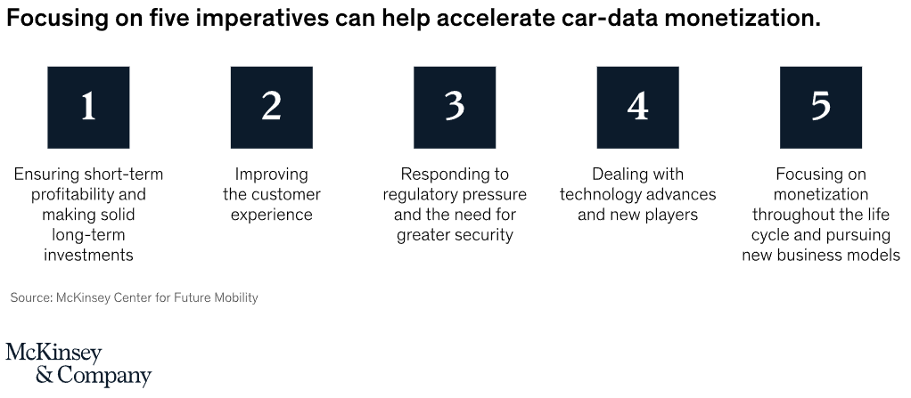
Monetizing Car data
McKinsey & Company, https://www.mckinsey.com/industries/automotive-and-assembly/our-insights/unlocking-the-full-life-cycle-value-from-connected-car-data

Slide 14
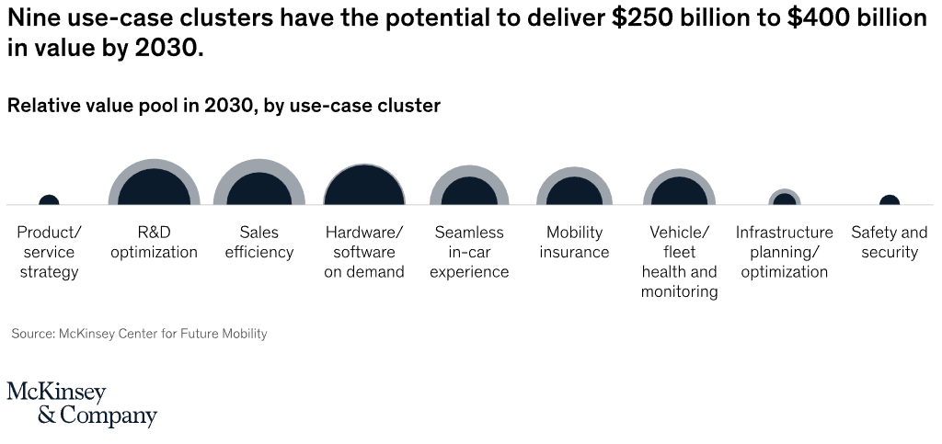
Possibly useful graphic??
McKinsey & Company, https://www.mckinsey.com/industries/automotive-and-assembly/our-insights/unlocking-the-full-life-cycle-value-from-connected-car-data

Slide 15
Other notes on applications
Application support plan
App updates are always OTA
Service level agreement?
How can we design our ecosystem for scaling?

Slide 16
Scenario | Jan 2026 | Feb 2026 | Mar 2026 | Apr 2026 | Growth
Status Quo (No Action) | $51,195 | $50,800 | $50,100 | $49,200 | -3.9%
Conservative | $51,195 | $56,800 | $63,200 | $70,500 | +37.7%
Aggressive (Full Roadmap) | $51,195 | $62,400 | $78,900 | $98,200 | +91.8%
Forecast Assumptions Conservative: 5% monthly user growth, Toones promo (+14.8% users month 1), Map Directions price → $5.75 Aggressive: Adds bundle adoption (15% of users), annual subscriptions, 3rd-party marketplace revenue Status Quo: No changes — declining apps continue trend, no new initiatives; fleet +5%/mo
Key Insight: Conservative scenario adds $19K/mo (+37.7%) by Apr 2026 — achievable with pricing changes alone. Aggressive scenario nearly doubles revenue ($98.2K) if full 30-60-90 day roadmap is executed.

Slide 17
Phase | Key Actions (Select) | Expected Impact
Days 1-30: Quick Wins | Raise Map Directions to $5.75 | Toones promo $0.50 off | Bundle Essentials @ $6.99 | Monetize Speedper @ $0.99 | New owner onboarding pop-up | +$2,831/mo | +1,046 users | New stream | Boost penetration
Days 31-60: Growth | Annual subscriptions (10-15% off) | Tzynergism exclusive content | Rebuild or sunset NewNews | In-app purchases (Unicorn Xplode) | Referral: 1 mo free | Lock-in revenue | Differentiation | Stop -51% bleed | New model | Viral growth
Days 61-90: Scale | 3rd-party marketplace (rev share) | PhantomSea+ premium AR tier | Ads in free apps | Spotify/Netflix bundles | AI recommendations | Evaluate acquisitions | Ecosystem expansion | Premium tier | Passive income | New users | Upsell | Control
Revenue Targets (Apr 2026) | Conservative: $70,500/mo (+37.7%) Aggressive: $98,200/mo (+91.8%) | vs. $51,195 today (Status Quo: $49,200)

Slide 18
Risks & Mitigations
Risk 1: Revenue Concentration
Map Directions + Toones = 93% of total revenue
Any disruption to either app = catastrophic revenue impact
Mitigation: Diversify via 4 underperforming apps + bundle + marketplace
Risk 2: Tzynergism Partner Dependency
Tzynergism controls Toones + Unicorn Xplode + Speedper (3 of 6 apps)
~39% of total revenue flows through a single third-party partner
Mitigation: Negotiate exclusivity; evaluate Tzynergism acquisition
Risk 3: Declining App Portfolio
NewNews: -50.7% YTD — every month declining
Unicorn Xplode: -32.1% with possible Dec service outage
Cat Scratchers: extreme month-to-month volatility
Mitigation: Rebuild or sunset NewNews; investigate Xplode outage; stabilize Cat Scratchers
Risk 4: Persistently Low Penetration (8.4%)
Fleet grew +65.6% but app adoption hasn't kept pace
New owners are not discovering or subscribing to apps
Mitigation: Onboarding pop-ups, referral programs, app discovery features

Slide 19
Questions
PhantomSea — Team 3 | Abyss GT
BSAN 760 — Digital Product Team

