Slide 1
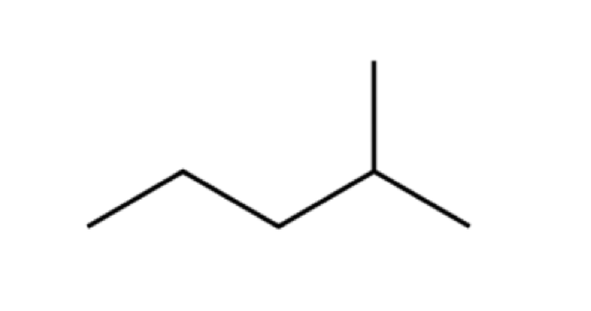
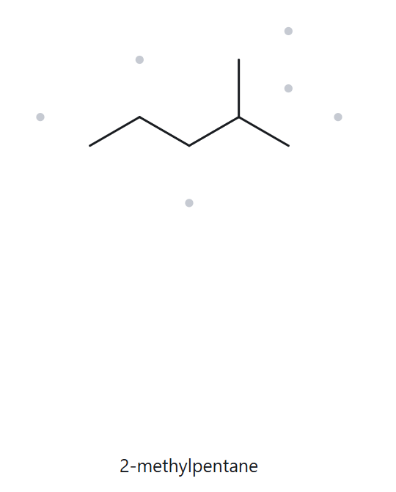

A01
C₆H₁₄
PART A STRUCTURE > NAME
FOUNDATION
1.
NUMBERED PARENT
4.
NAMING TRAIL
PARENT: LONGEST CHAIN = 5 C → PENTANE.
NUMBERING: THE METHYL IS ON C2 FROM THE END NEARER THE BRANCH AND ON C4 FROM THE OTHER END. FIRST POINT OF DIFFERENCE: 2 < 4, SO NUMBER FROM THE END NEARER THE BRANCH.
SUBSTITUENTS: METHYL ON C2 → 2-METHYL.
4
2
5
3
1
3.
MY NAME
5.
THE ALKANE CHECK
2-methylpentane
MATCH
LONGEST CHAIN CONFIRMED LOWEST LOCANTS ALPHABETICAL ORDER PUNCTUATION
FORMULA COUNTED

Slide 2
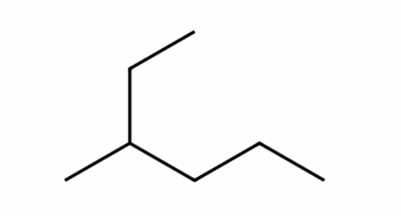
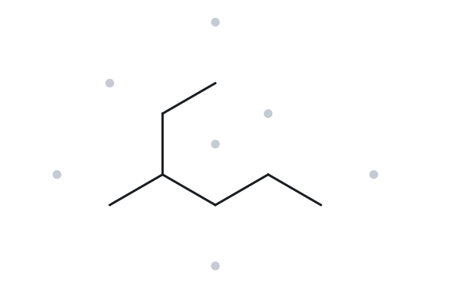
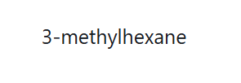
A02
C₇H₁₆
PART A STRUCTURE > NAME
FOUNDATION
1.
NUMBERED PARENT
4.
NAMING TRAIL
1
PARENT: LONGEST CHAIN = 6 C → HEXANE. THE LONGEST PATH RUNS THROUGH THE ETHYL BRANCH, NOT ALONG THE HORIZONTAL LINE.
NUMBERING: THE METHYL IS ON C3 FROM THE ETHYL END AND ON C4 FROM THE OTHER END. FIRST POINT OF DIFFERENCE: 3 < 4, SO NUMBER FROM THE ETHYL END.
SUBSTITUENTS: METHYL ON C3 → 3-METHYL.
2
3
5
4
6
3.
MY NAME
5.
THE ALKANE CHECK
3-methylhexane
MATCH
LONGEST CHAIN CONFIRMED LOWEST LOCANTS ALPHABETICAL ORDER PUNCTUATION
FORMULA COUNTED

Slide 3
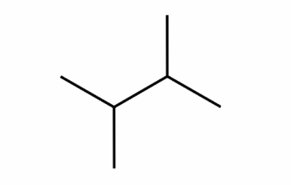
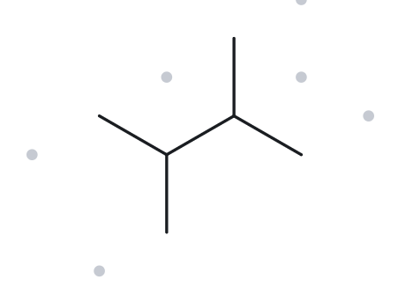

A03
C₆H₁₄
PART A STRUCTURE > NAME
FOUNDATION
1.
NUMBERED PARENT
4.
NAMING TRAIL
PARENT: LONGEST CHAIN = 4 C → BUTANE.
NUMBERING: BOTH DIRECTIONS GIVE 2,3, SO THE NUMBERING IS THE SAME EITHER WAY.
SUBSTITUENTS: METHYL ON C2 AND C3 → 2,3-DIMETHYL.
1
2
3
4
3.
MY NAME
5.
THE ALKANE CHECK
2,3-dimethylbutane
MATCH
LONGEST CHAIN CONFIRMED LOWEST LOCANTS ALPHABETICAL ORDER PUNCTUATION
FORMULA COUNTED

Slide 4
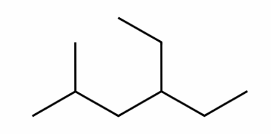
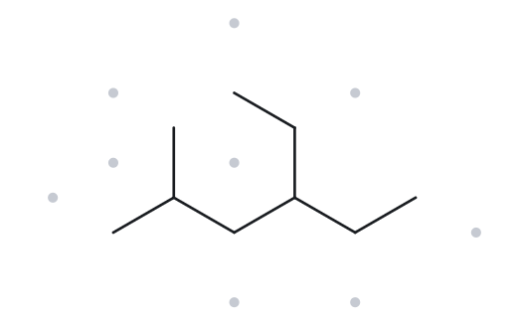

A04
C₉H₂₀
PART A STRUCTURE > NAME
DEVELOPING
1.
NUMBERED PARENT
4.
NAMING TRAIL
PARENT: LONGEST CHAIN = 6 C → HEXANE. SEVERAL 6-C PATHS EXIST, BUT EACH CARRIES ONE ETHYL AND ONE METHYL, SO THEY LEAD TO THE SAME NAME.
NUMBERING: LEFT → RIGHT GIVES 2,4; RIGHT → LEFT GIVES 3,5. FIRST POINT OF DIFFERENCE: 2 < 3, SO NUMBER FROM THE LEFT.
SUBSTITUENTS: ETHYL ON C4, METHYL ON C2. ALPHABETICAL ORDER PUTS ETHYL BEFORE METHYL → 4-ETHYL-2-METHYL.
5
3
1
6
4
2
3.
MY NAME
5.
THE ALKANE CHECK
4-ethyl-2-methylhexane
MATCH
LONGEST CHAIN CONFIRMED LOWEST LOCANTS ALPHABETICAL ORDER PUNCTUATION
FORMULA COUNTED

Slide 5
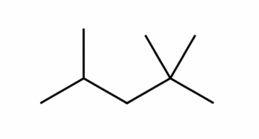
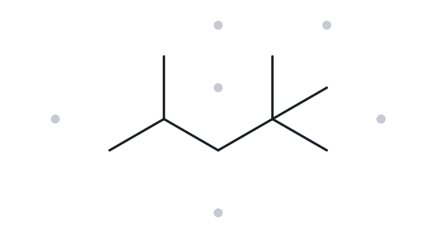

A05
C₈H₁₈
PART A STRUCTURE > NAME
DEVELOPING
1.
NUMBERED PARENT
4.
NAMING TRAIL
PARENT: LONGEST CHAIN = 5 C → PENTANE.
NUMBERING: ONE DIRECTION GIVES 2,2,4; THE OTHER GIVES 2,4,4. FIRST POINT OF DIFFERENCE: 2 < 4, SO NUMBER FROM THE END THAT GIVES 2,2,4.
SUBSTITUENTS: METHYL ON C2, C2 AND C4 → 2,2,4-TRIMETHYL.
5
4
3
2
1
3.
MY NAME
5.
THE ALKANE CHECK
2,2,4-trimethylpentane
MATCH
LONGEST CHAIN CONFIRMED LOWEST LOCANTS ALPHABETICAL ORDER PUNCTUATION
FORMULA COUNTED

Slide 6
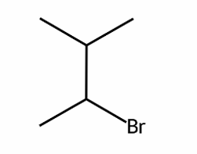
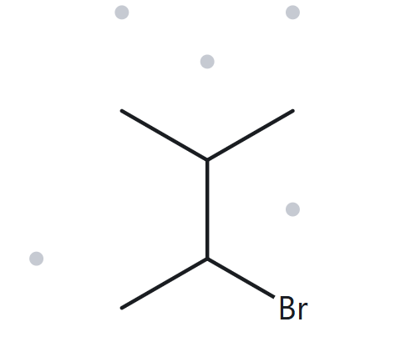

A06
C₅H₁₁BR
PART A STRUCTURE > NAME
DEVELOPING
1.
NUMBERED PARENT
4.
NAMING TRAIL
4
PARENT: LONGEST CHAIN = 4 C → BUTANE.
NUMBERING: BOTH DIRECTIONS GIVE THE SET {2,3}, SO IT IS A TIE. ALPHABETICAL TIEBREAK: BROMO COMES BEFORE METHYL, SO BROMO GETS C2.
SUBSTITUENTS: BROMO ON C2, METHYL ON C3 → 2-BROMO-3-METHYL.
3
2
1
3.
MY NAME
5.
THE ALKANE CHECK
2-bromo-3-methylbutane
MATCH
LONGEST CHAIN CONFIRMED LOWEST LOCANTS ALPHABETICAL ORDER PUNCTUATION
FORMULA COUNTED

Slide 7
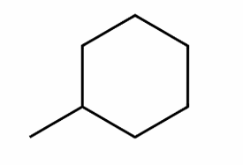
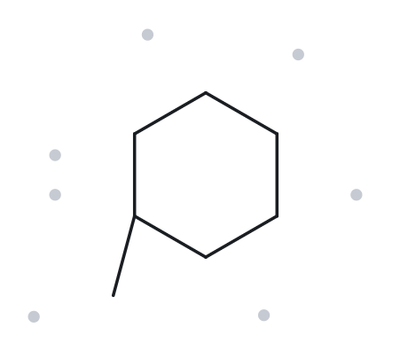

A07
C₇H₁₄
PART A STRUCTURE > NAME
DEVELOPING
1.
NUMBERED PARENT
4.
NAMING TRAIL
3
PARENT: A RING IS PRESENT, SO THE RING IS THE PARENT: 6 C → CYCLOHEXANE.
NUMBERING: THERE IS ONLY ONE SUBSTITUENT, SO NO LOCANT IS NEEDED.
SUBSTITUENTS: METHYL → METHYLCYCLOHEXANE.
2
4
1
5
6
3.
MY NAME
5.
THE ALKANE CHECK
methylcyclohexane
MATCH
LONGEST CHAIN CONFIRMED LOWEST LOCANTS ALPHABETICAL ORDER PUNCTUATION
FORMULA COUNTED

Slide 8
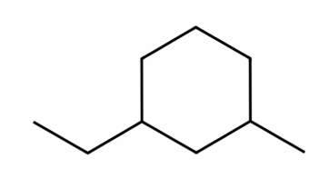
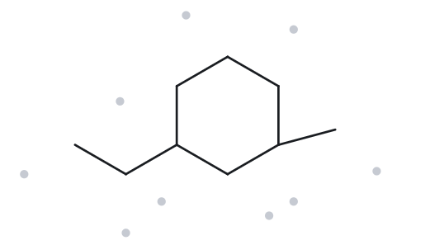

A08
C₉H₁₈
PART A STRUCTURE > NAME
CHALLENGE
1.
NUMBERED PARENT
4.
NAMING TRAIL
3
PARENT: RING OF 6 C → CYCLOHEXANE.
NUMBERING: THE LOCANT SET IS {1,3} IN BOTH DIRECTIONS AROUND THE RING, SO IT IS A TIE. ALPHABETICAL TIEBREAK: ETHYL COMES BEFORE METHYL, SO ETHYL GETS C1.
SUBSTITUENTS: ETHYL ON C1, METHYL ON C3 → 1-ETHYL-3-METHYL.
2
4
1
5
6
3.
MY NAME
5.
THE ALKANE CHECK
1-ethyl-3-methylcyclohexane
MATCH
LONGEST CHAIN CONFIRMED LOWEST LOCANTS ALPHABETICAL ORDER PUNCTUATION
FORMULA COUNTED

Slide 9
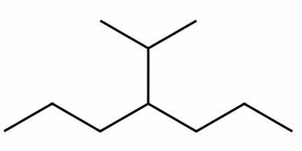
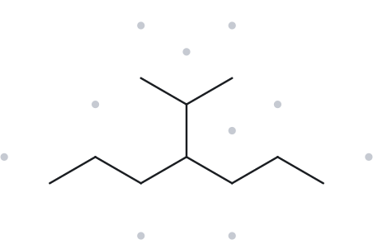

A09
C₁₀H₂₂
PART A STRUCTURE > NAME
CHALLENGE
1.
NUMBERED PARENT
4.
NAMING TRAIL
PARENT: LONGEST CHAIN = 7 C → HEPTANE. THE PATH THROUGH THE BRANCH IS ONLY 6 C, SO IT IS NOT THE PARENT.
NUMBERING: THE BRANCH IS ON C4 FROM EITHER END, SO THE NUMBERING IS THE SAME IN BOTH DIRECTIONS.
SUBSTITUENTS: 1-METHYLETHYL (ISOPROPYL) ON C4 → 4-(1-METHYLETHYL).
2
4
6
1
3
5
7
3.
MY NAME
5.
THE ALKANE CHECK
4-isopropylheptane
MISMATCH
BOTH NAMES DESCRIBE THE SAME COMPOUND (C₁₀H₂₂), BUT THEY CHOOSE DIFFERENT PARENTS. THE LONGEST CONTINUOUS CHAIN IS 7 C (HEPTANE), RUNNING FROM ONE PROPYL ARM THROUGH THE BRANCH CARBON INTO THE OTHER PROPYL ARM. THE ALKANE USED A 6 C PARENT (HEXANE) AND TREATED PART OF THE 7 C CHAIN AS A PROPYL BRANCH.
LONGEST CHAIN CONFIRMED LOWEST LOCANTS ALPHABETICAL ORDER PUNCTUATION
FORMULA COUNTED

Slide 10
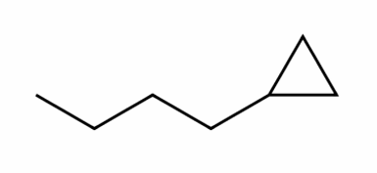
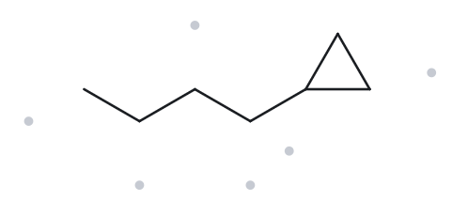

A10
C₇H₁₄
PART A STRUCTURE > NAME
CHALLENGE
1.
NUMBERED PARENT
4.
NAMING TRAIL
2
PARENT: A RING IS PRESENT, SO THE RING IS THE PARENT: 3 C → CYCLOPROPANE. THE 4-C CHAIN IS A SUBSTITUENT.
NUMBERING: THERE IS ONLY ONE SUBSTITUENT, SO NO LOCANT IS NEEDED.
SUBSTITUENTS: BUTYL → BUTYLCYCLOPROPANE.
1
3
3.
MY NAME
5.
THE ALKANE CHECK
butylcyclopropane
MATCH
LONGEST CHAIN CONFIRMED LOWEST LOCANTS ALPHABETICAL ORDER PUNCTUATION
FORMULA COUNTED

Slide 11
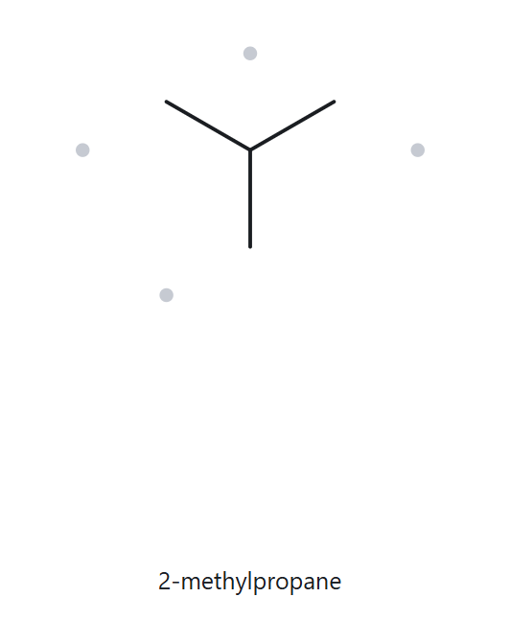
PART B: STRUCTURE > NAME
B01
FOUNDATION
2-methylpropane
1.
NAME DECODED
4.
BOND-LINE STRUCTURE (THE ALKANE)
PARENT: PROPANE, A 3-CARBON CHAIN.
SUBSTITUENT: METHYL ON C2.
EXPECTED FORMULA: 3 + 1 = 4 C; OPEN CHAIN → C₄H₁₀.
3.
FORMULA CHECK
5.
BACK CHECK
COUNTED FROM THE DRAWING: C₄H₁₀
OPEN CHAIN: CₙH₂ₙ₊₂ = C₄H₁₀ ✓
RETURNED BY THE ALKANE:
2-methylpropane
SAME AS THE GIVEN NAME
PARENT LENGTH MATCHES SUBSTITUENT POSITIONS FORMULA AGREES BACK-CHECK RECORDED

Slide 12
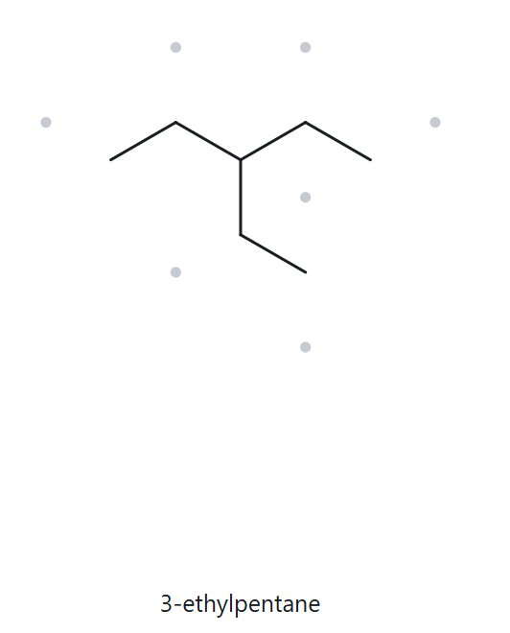
PART B: STRUCTURE > NAME
B02
FOUNDATION
3-ethylpentane
1.
NAME DECODED
4.
BOND-LINE STRUCTURE (THE ALKANE)
PARENT: PENTANE, A 5-CARBON CHAIN.
SUBSTITUENT: ETHYL ON C3.
EXPECTED FORMULA: 5 + 2 = 7 C; OPEN CHAIN → C₇H₁₆.
3.
FORMULA CHECK
5.
BACK CHECK
COUNTED FROM THE DRAWING: C₇H₁₆
OPEN CHAIN: CₙH₂ₙ₊₂ = C₇H₁₆ ✓
RETURNED BY THE ALKANE:
3-ethylpentane
SAME AS THE GIVEN NAME
PARENT LENGTH MATCHES SUBSTITUENT POSITIONS FORMULA AGREES BACK-CHECK RECORDED

Slide 13
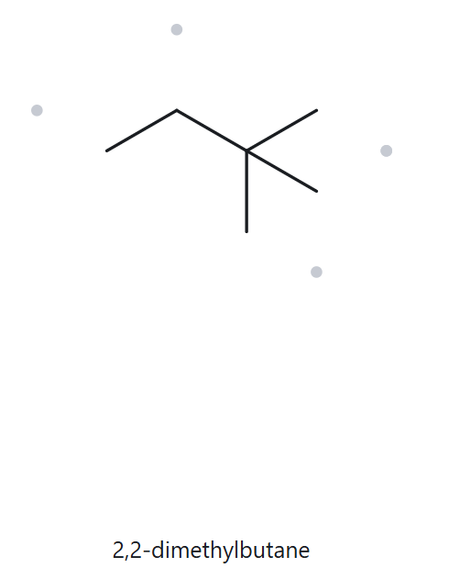
PART B: STRUCTURE > NAME
B03
FOUNDATION
2,2-dimethylbutane
1.
NAME DECODED
4.
BOND-LINE STRUCTURE (THE ALKANE)
PARENT: BUTANE, A 4-CARBON CHAIN.
SUBSTITUENTS: TWO METHYL GROUPS, BOTH ON C2.
EXPECTED FORMULA: 4 + 1 + 1 = 6 C; OPEN CHAIN → C₆H₁₄.
3.
FORMULA CHECK
5.
BACK CHECK
COUNTED FROM THE DRAWING: C₆H₁₄
OPEN CHAIN: CₙH₂ₙ₊₂ = C₆H₁₄ ✓
RETURNED BY THE ALKANE:
2,2-dimethylbutane
SAME AS THE GIVEN NAME
PARENT LENGTH MATCHES SUBSTITUENT POSITIONS FORMULA AGREES BACK-CHECK RECORDED

Slide 14
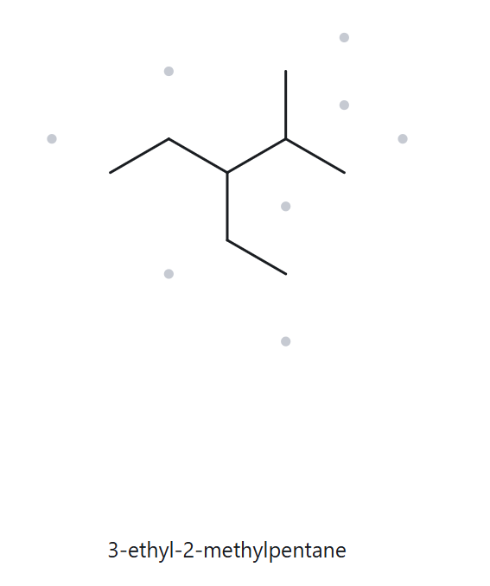
PART B: STRUCTURE > NAME
3-ethyl-2-methylpentane
B04
DEVELOPING
1.
NAME DECODED
4.
BOND-LINE STRUCTURE (THE ALKANE)
PARENT: PENTANE, A 5-CARBON CHAIN.
SUBSTITUENTS: METHYL ON C2; ETHYL ON C3.
EXPECTED FORMULA: 5 + 1 + 2 = 8 C; OPEN CHAIN → C₈H₁₈.
3.
FORMULA CHECK
5.
BACK CHECK
COUNTED FROM THE DRAWING: C₈H₁₈
OPEN CHAIN: CₙH₂ₙ₊₂ = C₈H₁₈ ✓
RETURNED BY THE ALKANE:
3-ETHYL-2-methylpentane
SAME AS THE GIVEN NAME
PARENT LENGTH MATCHES SUBSTITUENT POSITIONS FORMULA AGREES BACK-CHECK RECORDED

Slide 15
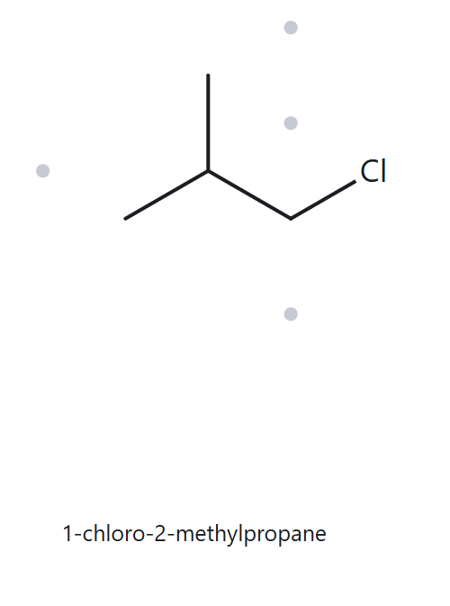
PART B: STRUCTURE > NAME
1-chloro-2-methylpropane
B05
DEVELOPING
1.
NAME DECODED
4.
BOND-LINE STRUCTURE (THE ALKANE)
PARENT: PROPANE, A 3-CARBON CHAIN.
SUBSTITUENTS: CHLORO ON C1; METHYL ON C2.
EXPECTED FORMULA: 3 + 1 = 4 C; OPEN CHAIN → C₄H₁₀; CL REPLACES ONE H → C₄H₉CL.
3.
FORMULA CHECK
5.
BACK CHECK
Counted from the drawing: C₄H₉Cl
Open chain: CₙH₂ₙ₊₂ = C₄H₁₀; minus one H for Cl = C₄H₉Cl ✓
RETURNED BY THE ALKANE:
1-CHLORO-2-methylpropane
SAME AS THE GIVEN NAME
PARENT LENGTH MATCHES SUBSTITUENT POSITIONS FORMULA AGREES BACK-CHECK RECORDED

Slide 16
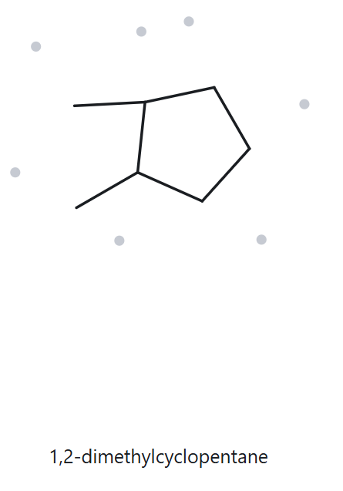
PART B: STRUCTURE > NAME
B06
1,2-dimethylcyclopentane
DEVELOPING
1.
NAME DECODED
4.
BOND-LINE STRUCTURE (THE ALKANE)
PARENT: CYCLOPENTANE, A 5-CARBON RING.
SUBSTITUENTS: METHYL ON C1; METHYL ON C2.
EXPECTED FORMULA: 5 + 1 + 1 = 7 C; ONE RING → C₇H₁₄.
3.
FORMULA CHECK
5.
BACK CHECK
Counted from the drawing: C₇H₁₄
One ring: CₙH₂ₙ = C₇H₁₄ ✓
RETURNED BY THE ALKANE:
1,2-dimethylcyclopentane
SAME AS THE GIVEN NAME
PARENT LENGTH MATCHES SUBSTITUENT POSITIONS FORMULA AGREES BACK-CHECK RECORDED

Slide 17
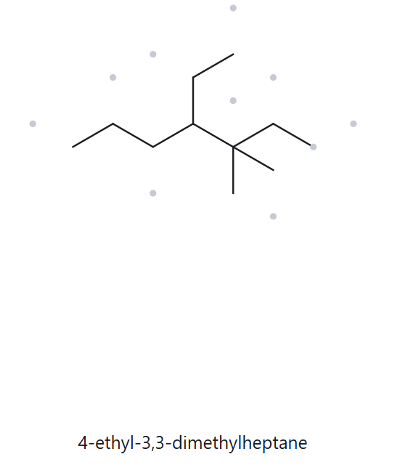
PART B: STRUCTURE > NAME
B07
4-ethyl-3,3-dimethylheptane
DEVELOPING
1.
NAME DECODED
4.
BOND-LINE STRUCTURE (THE ALKANE)
PARENT: HEPTANE, A 7-CARBON CHAIN.
SUBSTITUENTS: TWO METHYL GROUPS ON C3; ETHYL ON C4.
EXPECTED FORMULA: 7 + 1 + 1 + 2 = 11 C; OPEN CHAIN → C₁₁H₂₄.
3.
FORMULA CHECK
5.
BACK CHECK
Counted from the drawing: C₁₁H₂₄
Open chain: CₙH₂ₙ₊₂ = C₁₁H₂₄ ✓
RETURNED BY THE ALKANE:
4-ETHYL-3,3-dimethylheptane
SAME AS THE GIVEN NAME
PARENT LENGTH MATCHES SUBSTITUENT POSITIONS FORMULA AGREES BACK-CHECK RECORDED

Slide 18
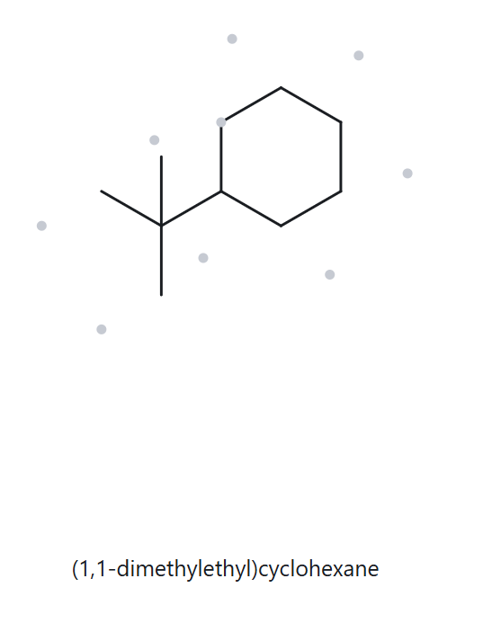
PART B: STRUCTURE > NAME
B08
CHALLENGE
tert-butylcyclohexane
1.
NAME DECODED
4.
BOND-LINE STRUCTURE (THE ALKANE)
PARENT: CYCLOHEXANE, A 6-CARBON RING.
SUBSTITUENT: TERT-BUTYL, –C(CH₃)₃, ON C1 (NO LOCANT NEEDED FOR A SINGLE SUBSTITUENT).
EXPECTED FORMULA: 6 + 4 = 10 C; ONE RING → C₁₀H₂₀.
3.
FORMULA CHECK
5.
BACK CHECK
RETURNED BY THE ALKANE:
(1,1-DIMETHYLETHyl)cyclohexane
Counted from the drawing: C₁₀H₂₀
One ring: CₙH₂ₙ = C₁₀H₂₀ ✓
NOT THE SAME AS THE GIVEN NAME
THE ALKANE USES THE SYSTEMATIC NAME FOR THE SUBSTITUENT, WHILE THE GIVEN NAME USES THE COMMON NAME. TERT-BUTYL, –C(CH₃)₃, IS NAMED SYSTEMATICALLY AS (1,1-DIMETHYLETHYL): AN ETHYL GROUP WITH TWO METHYLS ON C1, THE CARBON ATTACHED TO THE RING.
PARENT LENGTH MATCHES SUBSTITUENT POSITIONS FORMULA AGREES BACK-CHECK RECORDED

Slide 19
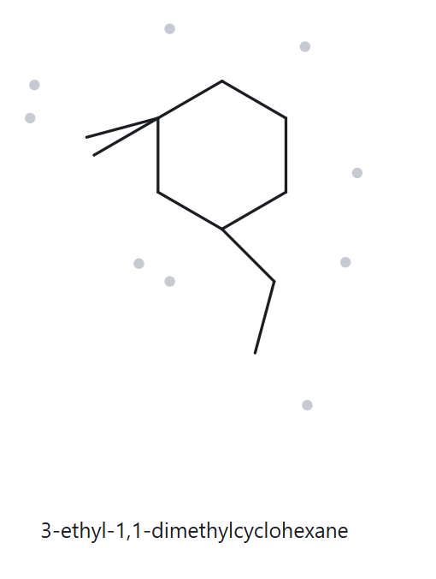
PART B: STRUCTURE > NAME
B09
3-ethyl-1,1-dimethylcyclohexane
CHALLENGE
1.
NAME DECODED
4.
BOND-LINE STRUCTURE (THE ALKANE)
PARENT: CYCLOHEXANE, A 6-CARBON RING.
SUBSTITUENTS: TWO METHYL GROUPS ON C1; ETHYL ON C3.
EXPECTED FORMULA: 6 + 1 + 1 + 2 = 10 C; ONE RING → C₁₀H₂₀.
3.
FORMULA CHECK
5.
BACK CHECK
RETURNED BY THE ALKANE:
3-ETHYL-1,1-dimethylcyclohexane
Counted from the drawing: C₁₀H₂₀
One ring: CₙH₂ₙ = C₁₀H₂₀ ✓
NOT THE SAME AS THE GIVEN NAME
THE GIVEN NAME BREAKS THE LONGEST-CHAIN RULE. IN 2-ETHYLBUTANE, THE “ETHYL” BRANCH ON C2 IS NOT A TRUE BRANCH: IT CONTINUES THE CHAIN. TRACING FROM ONE END THROUGH C2 AND INTO THE ETHYL GROUP GIVES 5 CARBONS (CH₃CH₂–CH–CH₂CH₃), NOT 4. THE PARENT MUST BE PENTANE, NOT BUTANE.
PARENT LENGTH MATCHES SUBSTITUENT POSITIONS FORMULA AGREES BACK-CHECK RECORDED

Slide 20
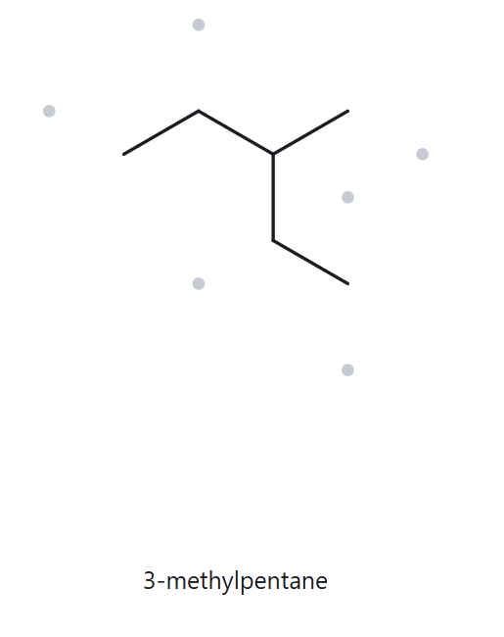
PART B: STRUCTURE > NAME
B10
3-ethyl-1,1-dimethylcyclohexane
CHALLENGE
1.
NAME DECODED
4.
BOND-LINE STRUCTURE (THE ALKANE)
PARENT: BUTANE, A 4-CARBON CHAIN.
SUBSTITUENT: ETHYL ON C2.
EXPECTED FORMULA: 4 + 2 = 6 C; OPEN CHAIN → C₆H₁₄.
3.
FORMULA CHECK
5.
BACK CHECK
Counted from the drawing: C₆H₁₄
Open chain: CₙH₂ₙ₊₂ = C₆H₁₄ ✓
RETURNED BY THE ALKANE:
3-METHYLPentane
SAME AS THE GIVEN NAME
PARENT LENGTH MATCHES SUBSTITUENT POSITIONS FORMULA AGREES BACK-CHECK RECORDED

