Slide 1

PROPANE
CARD 01 - C₃H₈
1.
MOLECULAR FORMULA
4.
LEWIS STRUCTURE
C₃H₈
CONDENSED MOLECULAR FORMULA
3.
5.
BOND-LINE FORMULA
CH₃CH₂CH₃
MOLECULAR FORMULA LEWIS STRUCTURE
CONDENSED MOLECULAR FORMULA BOND-LINE FORMULA

Slide 2


ETHANOL
CARD 02 - C₂H₆O
1.
MOLECULAR FORMULA
4.
LEWIS STRUCTURE
C₂H₆O
CONDENSED MOLECULAR FORMULA
3.
5.
BOND-LINE FORMULA
CH₃CH₂OH
MOLECULAR FORMULA LEWIS STRUCTURE
CONDENSED MOLECULAR FORMULA BOND-LINE FORMULA

Slide 3

ACETONE
CARD 03 - C₃H₆O
1.
MOLECULAR FORMULA
4.
LEWIS STRUCTURE
C₃H₆O
CONDENSED MOLECULAR FORMULA
3.
5.
BOND-LINE FORMULA
CH₃COCH₃
MOLECULAR FORMULA LEWIS STRUCTURE
CONDENSED MOLECULAR FORMULA BOND-LINE FORMULA

Slide 4

ACETIC ACID
CARD 04 - C₂H₄O₂
1.
MOLECULAR FORMULA
4.
LEWIS STRUCTURE
C₂H₄O₂
CONDENSED MOLECULAR FORMULA
3.
5.
BOND-LINE FORMULA
CH₃COOH
MOLECULAR FORMULA LEWIS STRUCTURE
CONDENSED MOLECULAR FORMULA BOND-LINE FORMULA

Slide 5

ETHYL ACETATE
CARD 05 - C₄H₈O₂
1.
MOLECULAR FORMULA
4.
LEWIS STRUCTURE
C₄H₈O₂
CONDENSED MOLECULAR FORMULA
3.
5.
BOND-LINE FORMULA
CH₃COOCH₂CH₃
MOLECULAR FORMULA LEWIS STRUCTURE
CONDENSED MOLECULAR FORMULA BOND-LINE FORMULA

Slide 6

CYCLOHEXANE
CARD 06 - C₆H₁₂
1.
MOLECULAR FORMULA
4.
LEWIS STRUCTURE
C₆H₁₂
CONDENSED MOLECULAR FORMULA
3.
5.
BOND-LINE FORMULA
(CH₂)₆
MOLECULAR FORMULA LEWIS STRUCTURE
CONDENSED MOLECULAR FORMULA BOND-LINE FORMULA
MOLECULAR FORMULA LEWIS STRUCTURE
CONDENSED MOLECULAR FORMULA BOND-LINE FORMULA

Slide 7

CYCLOHEXANONE
CARD 07 - C₆H₁₀O
1.
MOLECULAR FORMULA
4.
LEWIS STRUCTURE
C₆H₁₀O
CONDENSED MOLECULAR FORMULA
3.
5.
BOND-LINE FORMULA
CH₂(CH₂)₄CO
MOLECULAR FORMULA LEWIS STRUCTURE
CONDENSED MOLECULAR FORMULA BOND-LINE FORMULA

Slide 8
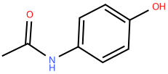
ACETAMINOPHEN
CARD 08 - C₈H₉NO₂
1.
MOLECULAR FORMULA
4.
LEWIS STRUCTURE
C₈H₉NO₂
CONDENSED MOLECULAR FORMULA
3.
5.
BOND-LINE FORMULA
CH₃CONHC₆H₄OH
MOLECULAR FORMULA LEWIS STRUCTURE
CONDENSED MOLECULAR FORMULA BOND-LINE FORMULA

Slide 9
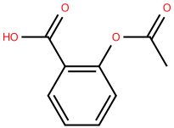
ASPIRIN
CARD 09 - C₉H₈O₄
1.
MOLECULAR FORMULA
4.
LEWIS STRUCTURE
C₉H₈O₄
CONDENSED MOLECULAR FORMULA
3.
5.
BOND-LINE FORMULA
CH₃COOC₆H₄COOH
MOLECULAR FORMULA LEWIS STRUCTURE
CONDENSED MOLECULAR FORMULA BOND-LINE FORMULA

Slide 10
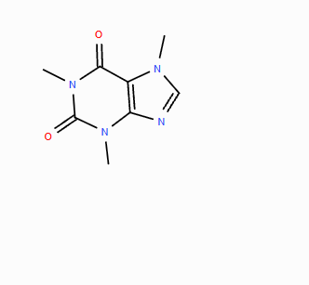
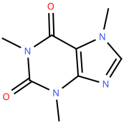
CAFFEINE
CARD 10 - C₈H₁₀N₄O₂
1.
MOLECULAR FORMULA
4.
LEWIS STRUCTURE
C₈H₁₀N₄O₂
CONDENSED MOLECULAR FORMULA
3.
5.
BOND-LINE FORMULA
C₈H₁₀N₄O₂
MOLECULAR FORMULA LEWIS STRUCTURE
CONDENSED MOLECULAR FORMULA BOND-LINE FORMULA

