Slide 1
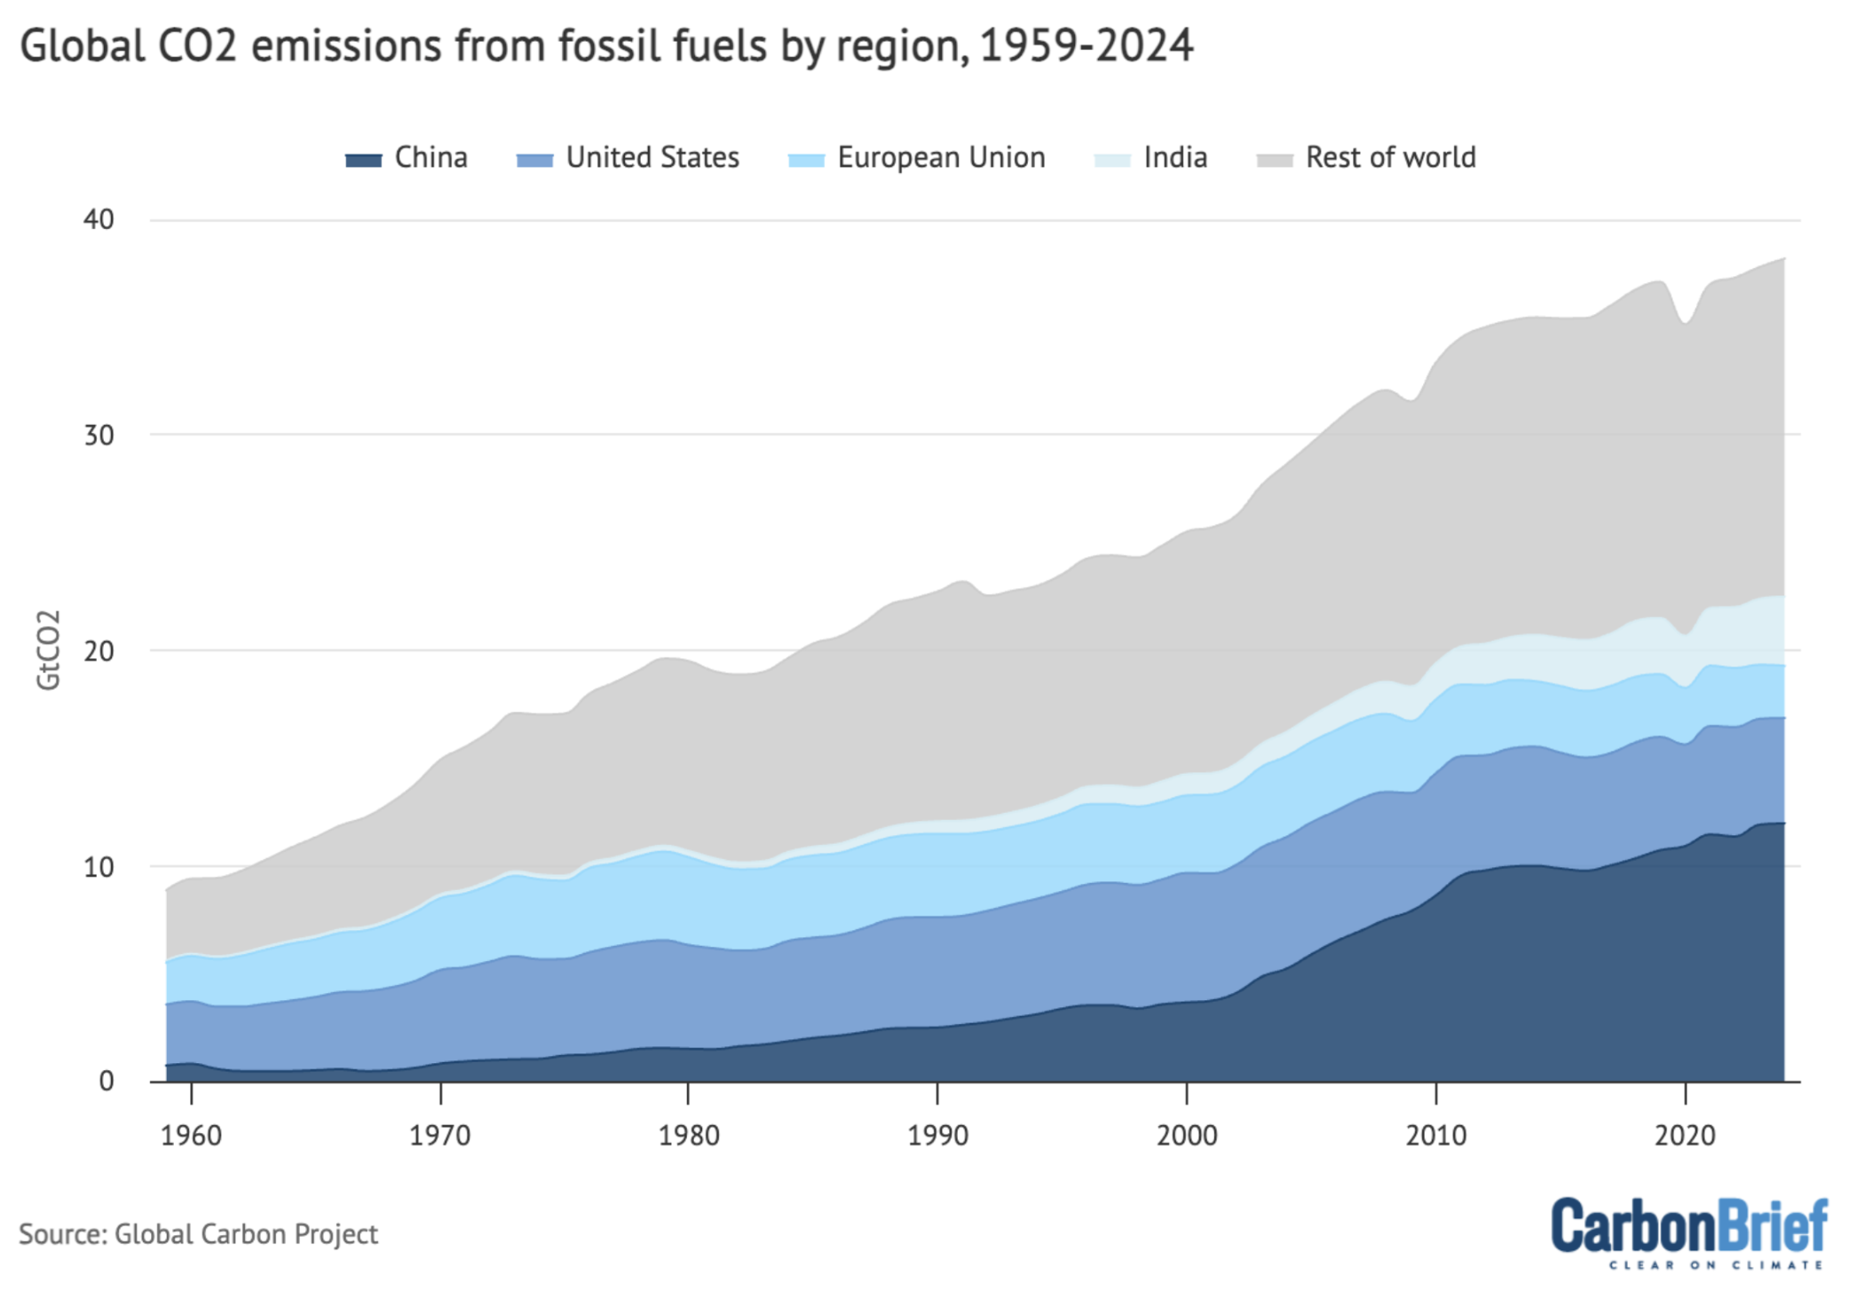
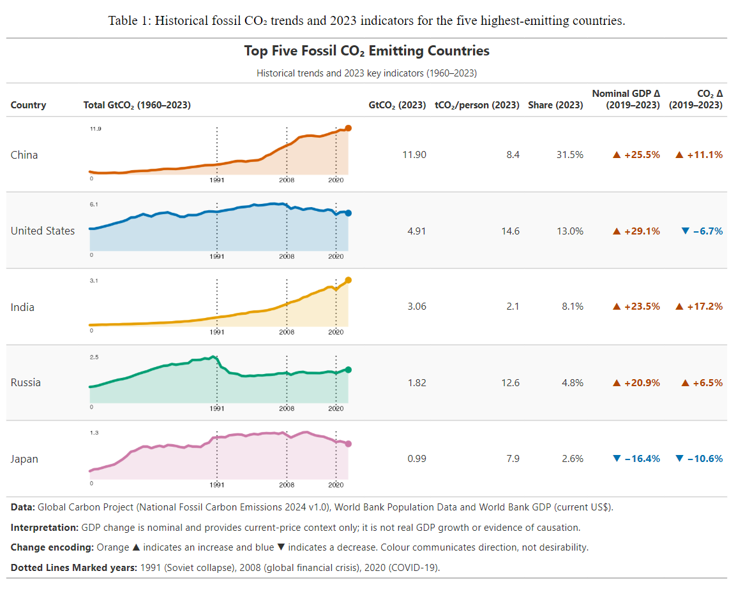
INFORMATION VISUALIZATION REDESIGN
TEAM SLATEBLUE
CSC3107 INFORMATION VISUALIZATION
Global fossil CO₂ emissions, unstacked
A comparison-first redesign for general readers of climate news
1 ORIGINAL VISUALIZATION
3 IMPROVED VISUALIZATION
WHY IT WORKS
• Separate sparklines remove stacked-boundary estimation.
• Direct labels and Okabe–Ito colours speed identification.
• Country-only rows support like-for-like comparison.
• Totals, per-capita values, shares and 2019-2023 changes add context.
Credit: Carbon Brief (2024)
Data: Global Carbon Project
DATA USED
Emissions
Global Carbon Project
National Fossil Carbon Emissions 2024 v1.0
2 WHAT LIMITS COMPARISON?
• Only the bottom layer has a stable baseline; other values require subtracting moving boundaries.
Population
World Bank SP.POP.TOTL
• Similar blue tints and a distant legend increase identification effort.
GDP
World Bank NY.GDP.MKTP.CD
• Countries are mixed with the EU and “Rest of world” aggregates.
Nominal current-price context only; not real growth or causation.
• Total-only values omit population-adjusted context.
DESIGN BRIEF
Main revisions
This redesign is intended for general readers of climate news who want to compare how the largest-emitting countries contribute to global fossil CO₂ emissions. It supports comparisons of national totals and per-capita emissions, showing contributions and population-adjusted differences. The five highest emitters in 2023 are shown because together they produced about 60% of global fossil CO₂ emissions. This keeps the comparison compact without hiding differences inside aggregated regional categories.
• Focus on the five highest-emitting countries for direct comparison
• Use a sparkline summary table to separate historical trends
• Pair trends with totals, per-capita values, global share, and emissions and nominal GDP changes from 2019 to 2023
• Apply distinct Okabe–Ito colours with direct country labels
• Encode increases and decreases with arrows, signs, and blue/orange styling
Carbon Brief · Global Carbon Project · World Bank
TEAM SLATEBLUE
Notes:
[Sources]
Original visualization and article: https://www.carbonbrief.org/analysis-global-co2-emissions-will-reach-new-high-in-2024-despite-slower-growth/
Global Carbon Project, National Fossil Carbon Emissions 2024 v1.0: https://globalcarbonbudget.org/gcb-2024/
World Bank population indicator SP.POP.TOTL: https://data.worldbank.org/indicator/SP.POP.TOTL
World Bank GDP (current US$) indicator NY.GDP.MKTP.CD: https://data.worldbank.org/indicator/NY.GDP.MKTP.CD
Improved visualization: user-provided project output generated from the cited datasets.
[/Sources]

