Slide 1
TRANSACTIONS
Explain the requirements of a database transaction.

Slide 2
Learning objectives
Explain the requirements of a database transaction
Hands-on writing statements to commit a database transaction

Slide 3



A general view on “transaction”
Customer pays $200 to factory via payment portal
Deducts $200 from customer account
B
A
Payment provider checks that factory’s account number is valid for transfer
Bank checks customer account to ensure if there is $200 to deduct.

Slide 4
a general view on “transaction”
Deducts $200 from customer account
Customer pays $200 to factory
B
A
A Unit of transaction shown here is inclusive of (A + B) Both A and B must be successfully executed, otherwise the entire Unit of transaction shall fail

Slide 5
WHY transactions are important
If at any point, the action within the transaction is unable to execute/has failed, then the transaction will be aborted
Check the available quantity of the item to ensure that there are enough to fulfill the purchase request.
Deduct 1 from the available quantity.
Check that the customer has valid credit card information in the database.
Receive authorization from the credit card merchant account to transfer the purchase amount to the retailer.
Generate an order number in the database to keep track of the purchase.

Slide 6
WHY transactions are important
If at any point, the action within the transaction is unable to execute/has failed, then the transaction will be aborted
Initialize Transaction
Commit / Abort operation
To start the transaction
Perform Operations
To perform what is instructed within the transaction
To permanently update (commit) if it succeeds, or rollback (abort) if it fails

Slide 7
WHY transactions are important
Atomicity
Isolation
“All or Nothing”, transactions should succeed in full or not. If failure occurs, data shall remain in original state
Consistency
The data should remain consistent before and after the transaction
Durability
Changes made by the transaction shall be permanent if it is successful
There should not be 2 transactions work on the same data concurrently, transactions should be independent.

Slide 8
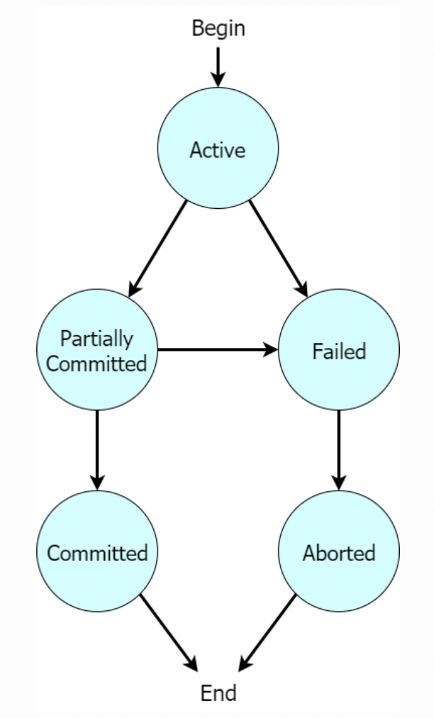
WHY transactions are important
Active: A transaction is active during its execution. This is the initial state of any transaction.
Partially committed: Once a transaction executes its final operation, it is considered partially committed.
Committed: Once a transaction has successfully executed all its operations, the changes are committed, and the operations are permanent.
Failed: A transaction fails when one of its operations cannot complete successfully.
Aborted: If the transaction fails, then the transaction manager rolls over the data to its original state and the operations are aborted.
Usage of Partial Commits – Allows operations to complete concurrently without commiting permanent updates to the database.

Slide 9
WHY transactions are important
Transaction complete
Receive credit card authorization
Retrieve email/contact to send order ID
Generate order ID
Check if item is in stock
Check if customer has valid credit card

Slide 10
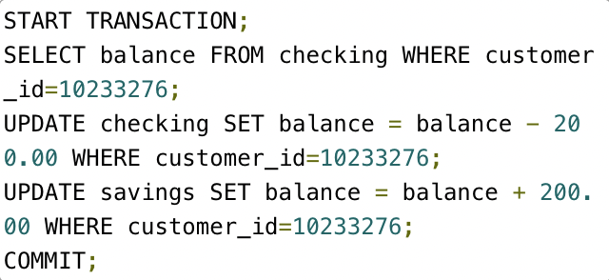
WHY transactions are important
1
2
3

