Slide 1
Introduction to Relational Databases with MySQL
Trip Ottinger

Slide 2
What is MySQL?
MySQL is a relational database management system (RDBMS) that runs on a server and provides mult-user access to databases.
RDBMS - predominant choice for information storage
It's source code is available under the GNU Public license. But ther are paid editions if you require additional functionality.
It's the M in the LAMP stack: Linux, Apache, MySQL, and Perl/PHP/Python.
Many platforms: Linux, Windows, Mac OS X and many, many more

Slide 3
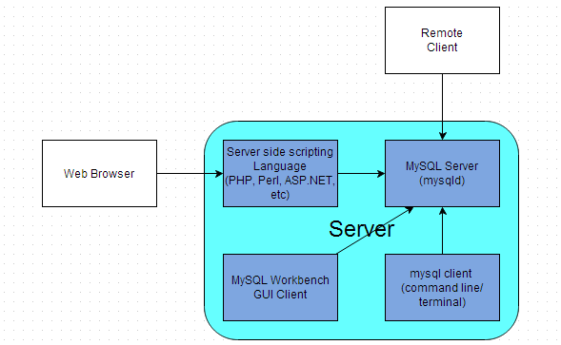
MySQL Architecture and Programs
MySQL is a client/server architecture
mysqld is the MySQL Server.
Databases are stored here
Listens for clients and controls access to the data
Server determines who gets to do what.
Provides clients with information from the db
mysql is an interactive client program
Issue queries and see results
Mysqldump is a backup program to dumb table contents into a file
Mysqladmin allows you to check the status of the server.
Tell the server to shut down
Client programming libraries C, Perl, PHP, Python, Ruby, Java…
Create your own programs that talk to MySQL Server
MySQL Workbench – a GUI

Slide 4
What is a relational database?
A relational database is a collection of data items organized as a set of formally described tables from which data can be accessed easily through SQL, the structured query language.
A relational database is created using the relational model.
In the relational model of a database, all data is represented in terms of rows, grouped into tables. A database organized in terms of the relational model is a relational database.
In SQL, a query language for relational databases, relations are represented by tables, where each row of a table represents a single tuple, and where the values of each attribute form a column.
Column (Attribute)
Table (Relation)
ID | FirstName | LastName | Gender | IsActive
1 | Wally | Moose | M | True
2 | Michael | Mouse | M | True
3 | Thomas | Cat | M | True
4 | Gerald | Mouse | M | True
5 | Millicent | Mouse | F | False
Row (Tuple)

Slide 5
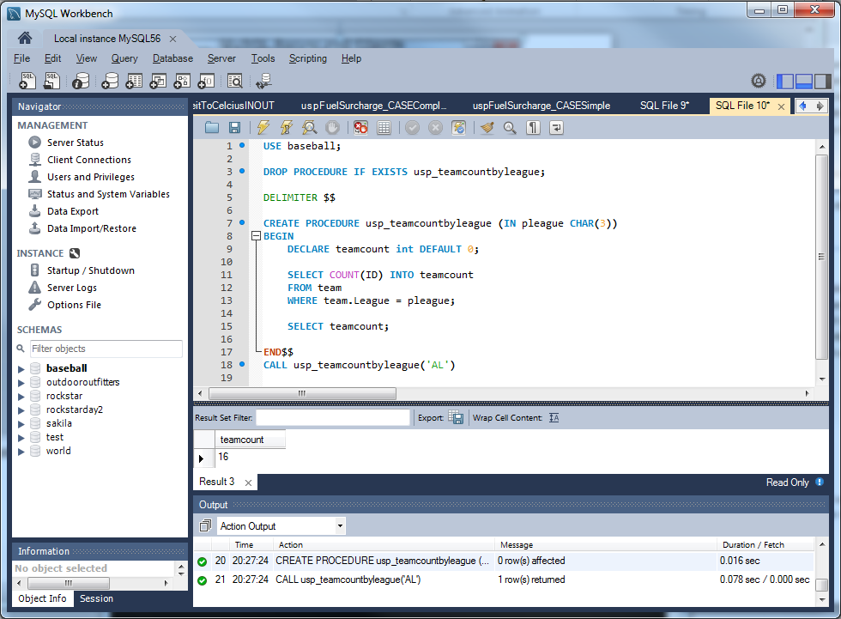
MySQL Workbench
MySQL Workbench is a visual database design tool that integrates SQL development, administration, database design, creation and maintenance into a single integrated development environment.

Slide 6
Connecting to mysql
Command line interface client called “mysql”
Use OSX terminal application
Text based
Applications\Utilities\Terminal
MySQL and client applications installed already
Users and permissions established for creating database and issuing queries

Slide 7
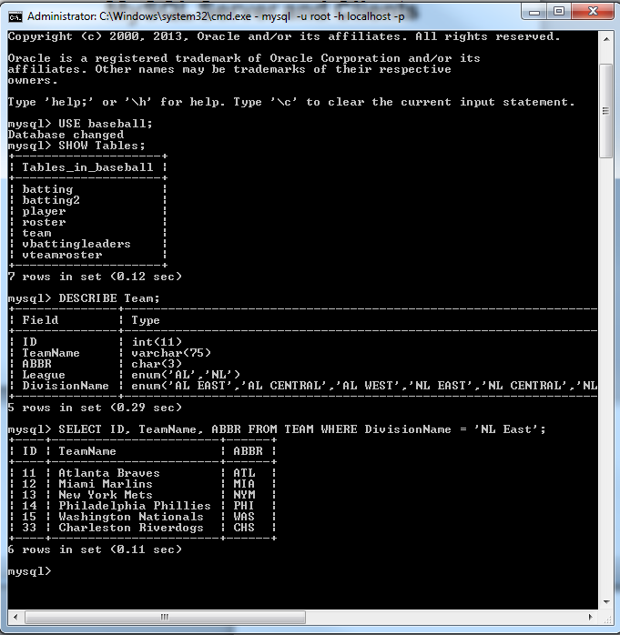
MySQL Server and Clients
A MySQL installation includes a database server and mysql client applications.
The database server stores data and manages data within databases and processes SQL queries on the database.
Use the client to connect and send SQL commands to the database server.
There are different ways to communicate with the database server.
A command line interface client called mysql allows you to issue SQL statements and displays the results. We will use this a lot in this class.
MySQL Workbench is a visual tool for database architects, developers, and DBAs used for database design and modeling, SQL Development, Database administration...
Client libraries that help you write applications that communicate with the database server.
Add, edit, delete, and update data within tables...

Slide 8
Demo: Connecting and Creating a Database
Connect to MySQL Database Server using MySQL Workbench
Create a server instance
A server instance is created to provide a way of connecting to a server to be managed.
Create a new database named OutdoorOutfitters
DROP SCHEMA IF EXISTS OutdoorOutfitters;
CREATE SCHEMA IF NOT EXISTS OutdoorOutfitters;
SHOW WARNINGS;
USE OutdoorOutfitters;

Slide 9
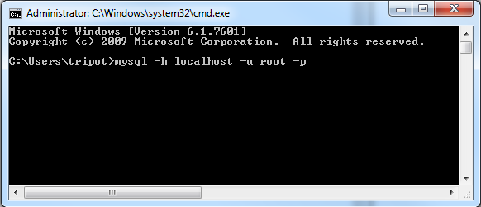
Connecting with mysql: common options
% mysql –h host_name –p –u user_name
–h this is the host where the MySQL Server application is running. In this course, the MySQL Database Server is your host (local) machine. Since the host is the same computer from where you are running the mysql program, you can omit the -h option.
–p you could provide the password directly as part of the command (be careful! no spaces after –p) BUT for security purpose don’t do this. By not providing the value for –p, mysql will prompt you for the password without echoing the password to the screen.
–u the MySQL user name. If using Unix this is the same as the Unix login name. If you want to use the Unix login name as the user name, you can omit the –u option.

Slide 10
GitHub
The GitHub repo location is : https://github.com/chscodecamp/mysql101
Log into GitHub.
Fork the repo using the github.com web site.
Clone the files to your local computer.
The training guide is named IntroRelDBsMySQL.pdf

Slide 11
Exercise 1: Connecting to mysql Exercise 2: Simple SQL Commands Exercise 3: Creating and Deleting Databases
See your training manual named
“IntroRelDBsMySQL.pdf”

Slide 12
Steps to Designing a Data Model
Problem Definition
Eschew Obfuscation…be specific..be clear
Define what the system isnt going to do
Listing of Needs and Wants
List types of users/roles/actors
List the goals the users need to accomplish
Use Case Diagram
Use Cases / User Stories
Logical Data Model
Physical Schema

Slide 13
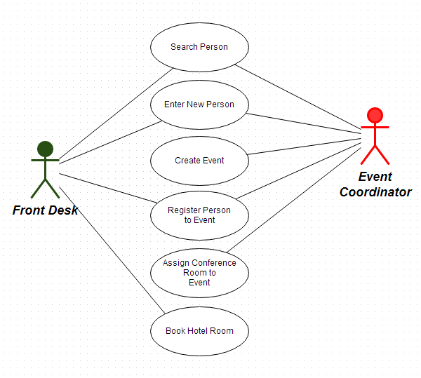
Use Case Diagram
Identify the people and other things that interact with the software
Each ellipsis represents an individual use case and depicts the objective or goal the user (actor) want’s to achieve with the system.

Slide 14
Creating Tables
In the relational model, the model is expressed as tables.
Each table contains rows… like a single spreadsheet page/tab.
Each row represents one thing of interest or entity.
Each row/entity is described by columns.
Each column holds a single value.

Slide 15
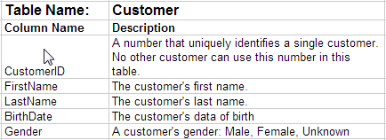
Customer Table
A Customer table may contain columns such as CustomerID, LastName, FirstName, Gender, and BirthDate.

Slide 16
Tables
The relational model specifies that the rows of a table have no specific order.
The rows, in turn, impose no order on the columns.
Each row of a table must be uniquely identifiable by some combination (one or more) of its column values.
This combination is referred to as the primary key.
Primary key
Column (Attribute)
Table (Relation)
ID | FirstName | LastName | Gender | IsActive
1 | Wally | Moose | M | True
2 | Michael | Mouse | M | True
3 | Thomas | Cat | M | True
4 | Gerald | Mouse | M | True
5 | Millicent | Mouse | F | False
Row (Tuple)

Slide 17
Each table should have a primary key
Make column(s) the primary key by adding a PRIMARY KEY constraint
The PRIMARY KEY constraint uniquely identifies each record in a database table.
Primary key must contain unique values.
A primary key column cannot contain NULL values.
Each table should have a primary key
Each table can have only ONE primary key.

Slide 18
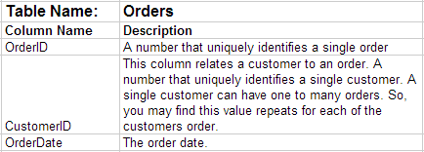
Relating Tables Together
You can have many tables within a relational database
Relate tables to one another
An “Order” table could be related to the “Customer” table

Slide 19
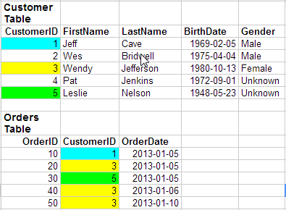
Customers and Orders

Slide 20
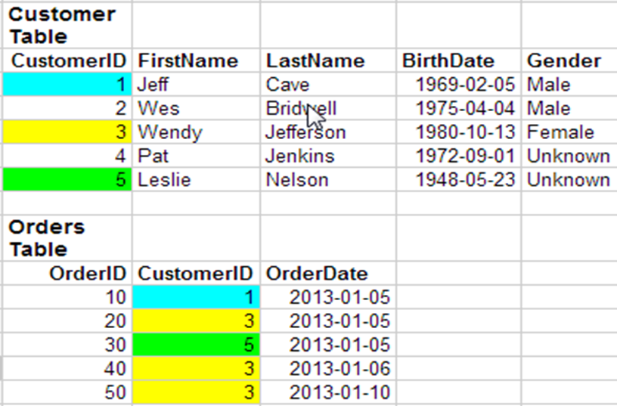
Primary Key (PK) Columns
Each table has an PK column:
CustomerID for the Customer table
OrderID for the Orders table

Slide 21
Demo: Create a Table with PK
Create a new table named Product within the OutdoorOutfitters database
Create two columns named 'ID' and 'NAME'
DROP TABLE IF EXISTS OutdoorOutfitters.Product ;
SHOW WARNINGS;
CREATE TABLE IF NOT EXISTS OutdoorOutfitters.Product
(ID INT NOT NULL AUTO_INCREMENT COMMENT 'The primary key value in the system. Uniquely identifies a row.' ,
Name VARCHAR(50) NOT NULL ,
PRIMARY KEY (ID) ,
UNIQUE INDEX `Name_UNIQUE` (Name ASC) )
ENGINE = InnoDB;

Slide 22
Normalization
Normalization is the process of organizing data in a database.
Minimize redundancy and dependency
Involves dividing large tables into smaller (and less redundant) tables and defining relationships between them.
Redundant data creates maintenance problems.
Don’t want to update a customer’s last name in more than one table
creating tables and establishing relationships between those tables
Rules for database normalization
first three rules..pass them all.. "third normal form”

Slide 23
First Normal Form
Eliminate repeating groups of fields
Create a separate table for each set of related data.
Table: Employee
Name | Phone Number | Home Address | Work Address | Work Phone | Cell Phone
John Ford | 404 555 1212 | 111 Flower Lane Charleston, SC 29490 | 1212 King Street Charleston, SC 29490 | 843 222 1121 | 843 222 1111
Mary Jeffs | 843 910 0102 | 432 Smithson Street Mount Pleasant, SC 29464 | 2000 Daniel Island Drive Charleston, SC 29492 | 843 910 0103 | 843 910 0103

Slide 24
First Normal Form
Atomic: Each data item can’t be broken down any further
Table: Employee
Name | Phone Number | Home Address | Work Address | Work Phone | Cell Phone
John Ford | 404 555 1212 | 111 Flower Lane Charleston, SC 29490 | 1212 King Street Charleston, SC 29490 | 843 222 1121 | 843 222 1111
Mary Jeffs | 843 910 0102 | 432 Smithson Street Mount Pleasant, SC 29464 | 2000 Daniel Island Drive Charleston, SC 29492 | 843 910 0103 | 843 910 0103

Slide 25
First Normal Form
Identify each set of related data with a primary key (PK).
Any columns here that are candidates for a primary key?
Table: Employee
Name | Phone Number | Home Address | Work Address | Work Phone | Cell Phone
John Ford | 404 555 1212 | 111 Flower Lane Charleston, SC 29490 | 1212 King Street Charleston, SC 29490 | 843 222 1121 | 843 222 1111
Mary Jeffs | 843 910 0102 | 432 Smithson Street Mount Pleasant, SC 29464 | 2000 Daniel Island Drive Charleston, SC 29492 | 843 910 0103 | 843 910 0103

Slide 26
First Normal Form
A new ID column as been created as a primary key. Note the underline.
Table: Employee
ID | Name | Phone Number | Home Address | Work Address | Work Phone | Cell Phone
1 | John Ford | 404 555 1212 | 111 Flower Lane Charleston, SC 29490 | 1212 King Street Charleston, SC 29490 | 843 222 1121 | 843 222 1111
2 | Mary Jeffs | 843 910 0102 | 432 Smithson Street Mount Pleasant, SC 29464 | 2000 Daniel Island Drive Charleston, SC 29492 | 843 910 0103 | 843 910 0103

Slide 27
Second Normal Form
Non key attributes must depend on every part of the key.
Compound key primary key
Table: NASCARRaceStat
Driver Last Name | Driver First Name | Track | Season | Laps Completed | Caution Flags | Driver Birth Date
Petty | Richard | Darlington | 1985 | 500 | 5 | 11/2/1949
Elliot | Bill | Darlington | 1985 | 302 | 5 | 10/13/1958
Petty | Richard | Darlington | 1986 | 456 | 5 | 11/2/1949
Earnhart | Dale | Daytona | 1987 | 300 | 6 | 5/1/1957

Slide 28
Third Normal Form
Make sure there aren’t any non key attributes that depend on another non key attribute
Can you spot the error?
Driver Last Name | Driver First Name | Track | Season | Laps Completed | City | State
Petty | Richard | Darlington | 1985 | 500 | Charlotte | NC
Elliot | Bill | Darlington | 1985 | 302 | Charlotte | NC
Petty | Richard | Darlington | 1986 | 456 | Charlotte | NC
Earnhart | Dale | Daytona | 1987 | 300 | Daytona | FL

Slide 29
Data Types
A database contains table(s) and a table contains column(s).
Each column of data is associated with a data type.
Defining table column entails creating a data type

Slide 30
Data Types and Performance
Choosing the correct type to store your data is crucial to getting good performance
Use the smallest data type that can correctly store and represent your data
Choose the smallest one that you don’t think you’ll exceed
Smaller data types are usually faster, because they use less space on the disk, in memory, and in the CPU cache .
Fewer CPU cycles to process

Slide 31
Basic Data Types: String
String Data Type holds text.
The name of your dog…that’s a String
A person’s last name…String
The name of a city…String
Two common data types that hold strings:
CHAR, VARCHAR
CHAR is short for character, VARCHAR is short of variable character
CHAR is fixed length… Ex: CHAR(3) or CHAR(50)
Ex: CHAR(30) will hold up to 30 characters
Data is padded out to 30 characters
Use when data length is relatively fixed
VARCHAR
Not padded
Use with data length is variable.
Ex: VARCHAR(20) would be used to hold characters up to a length of 20.

Slide 32
Exercise 4: Creating Tables

Slide 33
NOT NULL
unknown or missing value
If you mark a column with NOT NULL then you can’t enter a value of NULL.
Empty string within a CHAR/VARCHAR isn’t NULL.
Test for NULLs using IS NULL and IS NOT NULL
I don’t like nulls.

Slide 34
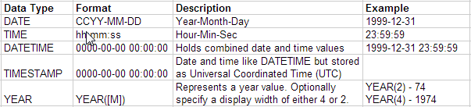
Date and Time Data Types
DATE, TIME, DATETIME, TIMESTAMP, and YEAR
July 4, 1776 is a DATE data type
1776-07-04 or 1776-7-4..ISO standard format

Slide 35
Exercise 5: Creating Tables with date columns
Exercise 6: DESCRIBE lists a Table’s Structure
Exercise 7: ALTER TABLE
Exercise 8: Adding a Column as the Primary Key and using the INT data TyPE

Slide 36
Data Types for Numbers
123.45 is a number .. It’s a fixed point number
DECIMAL data type
123 is a number… it’s an INTEGER (INT)
Integers come in different sizes
TINYINT
SMALLINT
MEDIUMINT
INT
BIGINT

Slide 37
YEAR Data Type
YEAR is a 1-byte type used to represent year values.
Declared s YEAR(4) or YEAR(2).
Default is YEAR with 4 characters if no width is given… so YEAR is the name as YEAR(4)
The value for a year can be specified as a number or a string.
‘1999’ is the same as 1999

Slide 38
ENUM Data Type
ENUM is a string object with a numeric value chosen from a defined, static list of possible values
The strings you specify as input values are translated by the database server as numbers.
Numbers in the column are converted back to the corresponding strings in query results
CREATE TABLE DrinkMenu (
name VARCHAR(40),
size ENUM(’12 oz’, '16 oz', '24 oz', '32 oz')
);

Slide 39
True and False
Not an exact way to represent True and False in MySQL
BOOL, BOOLEAN, TINYINT(1) data types are ways to implement a true/false value within a table column
Each column can store a 0 for false or a 1 for true.
BOOL and BOOLEAN get translated to TINYINT(1)
very small integer value with a signed range is -128 to 127
unsigned range is 0 to 255
You should interpret 0 as False in your client app
Anything other than 0 should be interpreted as True

Slide 40
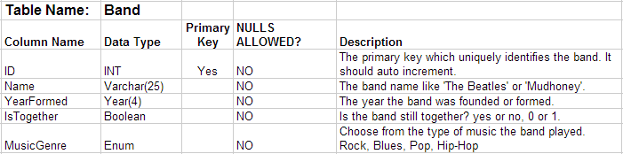
Exercise 9: Using the Year, Enum, and Boolean data types
Create a new table called Band within the RockStar database
INSERT statements to add some bands

Slide 41
Foreign Keys: Relating Tables Together
You can have many tables within a relational database
Relate tables to one another
An “Order” table could be related to the “Customer” table

Slide 42
FOREIGN KEYS
Automobile Table
CREATE TABLE Automobile (
ID INT NOT NULL
, NAME VARCHAR(25) NOT NULL
, PRIMARY KEY (ID)
) ENGINE=INNODB;
Engine Table
CREATE TABLE Engine
(ID INT NOT NULL
, AutomobileID INT NOT NULL
, EngineSize DECIMAL (2,1) NOT NULL
,INDEX AutomobileID_idx (AutomobileID),
FOREIGN KEY (AutomobileID) REFERENCES Automobile(ID)
ON DELETE CASCADE
) ENGINE=INNODB;

Slide 43
Customers and Orders

Slide 44
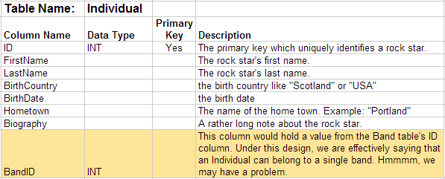
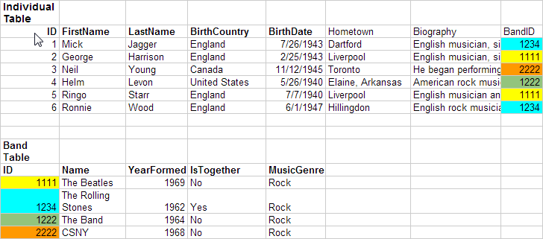
One way to relate bands to individuals…not the best way….

Slide 45
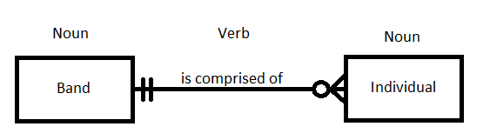
Entity Relationship Diagrams (ERD)
Here is one way to model the relationship between a band and individuals.
“Crow Foot” Notation
One Band is comprised of many Individuals.
An Individual belongs to a single Band.
One-to-Many relationship

Slide 46
Many-to-Many Relationships
So, a band is comprised of many individuals.
Does this statement hold true?
Does the converse hold true?
Is it true to say that one individual belongs to one and only one band?

Slide 47
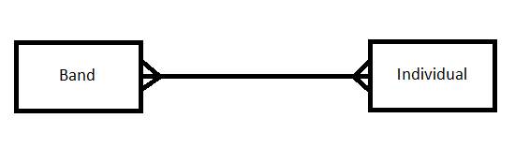
Let it be Band on the Run
Paul McCartney was a member of the Beatles and he was also a member of the band Wings.
So, the individual can belong to many bands and a band is comprised of many individuals.
This is called a Many-to-Many relationship.
Logically, the Many-to-Many relationship looks like this:

Slide 48

Physically implementing Many-to-Many
Logical Model
Physical Model (tables in the database)
A junction or cross-reference table helps implement the Many-to-Many relationship between Band and Individual

Slide 49
Modeling the cross reference table
The IndividualBand table needs the following columns:
An ID for the Primary Key (PK)
A BandID column as a Foreign Key (FK) to the Band table’s ID Column
An IndividualID column as a Foreign Key (FK) to the Individual table’s ID column.

Slide 50
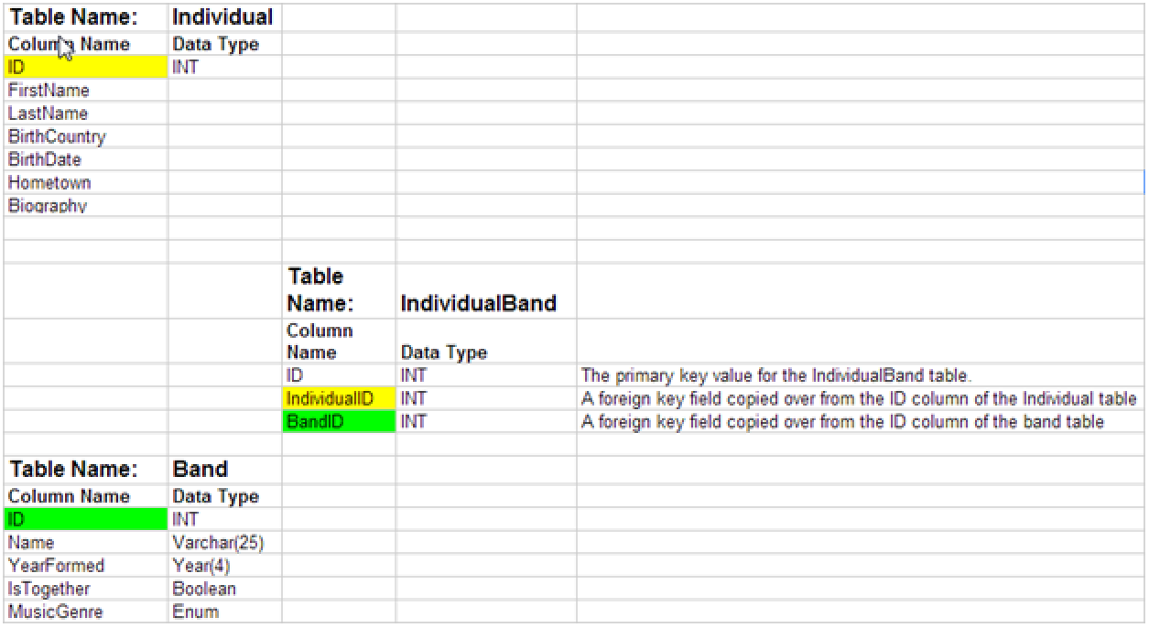
Copy over the Primary Keys into the cross reference table

Slide 51
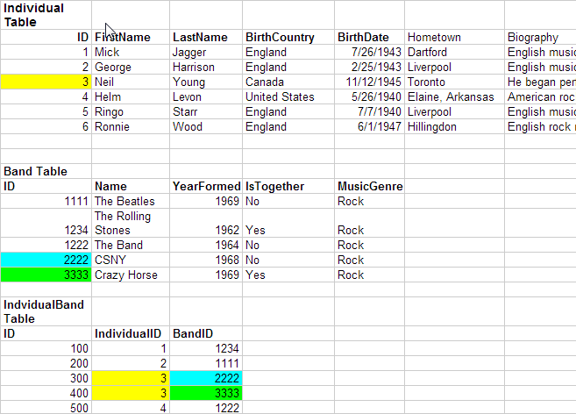
Sample data

Slide 52
Essential Info: Foreign Keys
Foreign keys allow you to relate data together between two tables
create a foreign key by creating a foreign key constraint which helps prevent orphaning records
The foreign key references a parent table and a child table.
Creating a foreign key requires relating a column within a child table to a column within a parent table.
The FOREIGN KEY clause must be placed on the child table.
Both tables referenced by the foreign key must be stored within the INNODB database engine.
The two referenced columns must be of the same data type.
InnoDB requires indexes on the columns within both tables referenced by the foreign key.
Creating a row in the child table will be rejected if there is not a matching value in the parent table.

Slide 53
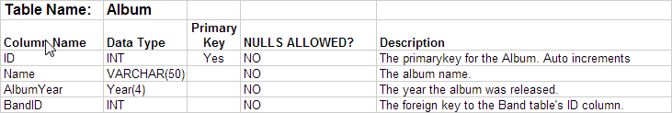
Exercise 10: Create an Album table. Relate the Album table to the Band table using a Foreign Key
Let’s create the Album table

Slide 54
Exercise 11: Building a cross reference table to form the many to many relationship
Read page 22 – 24
Exercise on Page 25

