Slide 1
Introduction to Relational Databases with MySQL
Trip Ottinger

Slide 2
DAY 2
Basic SQL Statements
SELECT
JOINS
GROUP BY
HAVING

Slide 3
Git Hub Exercise: Syncing your Local Fork with the Instructor’s new files. In this exercise we will sync your local fork to the changes made in the instructor’s chscodecamp/mysql101 repository’s master branch.

Slide 4
GitHub Steps
Open your GitHub GUI client
Within the GUI client, open your [GitHub user name]/mysql101 repository.
This is the repo that you forked from the instructor’s chscodecamp/mysql101 repository in the first class.
From the GitHub GUI client, open the Git shell application. This will open a separate shell application in a separate window.
The Setup
Before you can sync, you need to add a remote that points to the upstream repository. You may have done this when you originally forked.
From within the shell application, enter the following command. This will list your current remotes.
$ git remote –v
# List the current remotes
# origin https://github.com/your git hub user name/mysql101.git (fetch)
# origin https://github.com/your git hub user name /mysql101.git (push)

Slide 5
GitHub: remote add upstream
Add a remote that points to the upstream repository
Tip: Syncing your fork only updates your local copy of the repository to the changes that the instructor made to his chscodecamp/mysql101 repository; it does not update your repository on GitHub.com.
$ git remote add upstream https://github.com/chscodecamp/mysql101.git
$ git remote -v
# Verify new remote
# origin https://github.com/your git hub user name/mysql101.git (fetch)
# origin https://github.com/your git hub user name /mysql101.git (push)
# upstream https://github.com/chscodecamp/ mysql101.git (fetch)
# upstream https://github.com/chscodecamp/ mysql101.git (push)

Slide 6
GitHub: Fetch
There are two steps required to sync your repository with the upstream:
Fetch from the remote repository
Merge the desired branch into your local branch.
Fetching from the remote (the instructor’s chscodecamp/mysql101) repository will bring in its branches and their respective commits (new, changed, deleted files). So, this will bring down the latest docs, presentations, sql script files, text files, etc. These will be stored in your local repository under special branches.
Enter the following command to fetch the instructor’s remote repository.
$ git fetch upstream
We now have the upstream (instructor’s master branch) stored in a local branch, upstream/master

Slide 7
GitHub: Merge
Merging
Now that we have fetched the upstream repository, we want to merge its changes into your local branch. This will bring your local branch into sync with the upstream, without losing our local changes.
Enter the following commands:
$ git checkout master
# Check out our local master branch
# Switched to branch 'master'
$ git merge upstream/master
# Merge upstream's master into our own

Slide 8
Create a DB from a script
Create a new database named RockStarDay2
Create tables within the database and populate the tables with data.
.sql script file that contains a series of SQL commands.
We will pipe the instructions stored within a file named rockstar.sql.
$ mysql < C:\Users\tripot\Dropbox\CharlestonCodes\MySQL\SQLScripts\RockStar\rockstar.sql -u root –p

Slide 9
Exercise 1: Creating a Database from a .SQL Script FILE
Page 26

Slide 10
Select Statements
Using SQL you can retrieve data and even change data
Data Manipulation Language statements (DML)
Ex: SELECT * FROM CUSTOMER
define the data structures i.e. create tables
Data Definition Language (DDL)

Slide 11
The SELECT Clause
Use the SELECT clause to retrieve data
Use * to grab all the columns. Not usually a good idea.
Specify columns in SELECT
SELECT ID, FirstName, LastName, BirthDate FROM Individual;
Use only use the least amount of columns in your SELECT statement
SHOW COLUMNS FROM Band

Slide 12
Exercise 2: Building a SELECT Statement
USE RockStarDay2;
SELECT * FROM INDIVIDUAL;

Slide 13
Restricting the Rows Returned
SELECT identified the columns to return
WHERE clause determines the rows to return

Slide 14
Exercise 3: Taking the WHERE clause for a spin
Exercise 4: Translating Requirements to SQL statements
Page 34

Slide 15
SQL Wildcards
Use Wildcards with the LIKE operator within a WHERE clause
Wildcards enable pattern matching
Select * from Individual WHERE FirstName LIKE ‘L%’;
SELECT * FROM Band WHERE Name LIKE ‘%Stones’;
Select * from Individual WHERE FirstName Like ‘_ob’;

Slide 16
Exercise 5: Using Wildcards in a WHERE
Try out some wildcard characters in your WHERE clauses
Try your hand at deciphering the requirements into your own SQL statements

Slide 17
JOIN
An INNER JOIN is the most common type of join.
Only output rows that match between tables
An INNER JOIN clause is used to join two or more tables together based on a common field to produce a result set.
Product
Product options

Slide 18
Base and Derived Relations (Tables)
Tables are called "base relations" because they store data.
You can create a derived relation by relating one or more relations together.
Derived relations do not store data.
Derived relations are implemented in the database as a View. A view can be created with a SQL SELECT query.
Derived relations are convenient in that they act as a single relation, even though they may grab information from several relations (tables).

Slide 19
Demo: JOIN two tables together
Using the CreateOutdoorOutfitters.sql
Open the script and executue piece of the script
Let’s create a new table named ProductOption that displays product options for a product like a bicycle.
Create a Foreign Key back to Product
Let’s use the JOIN statement within a SELECT to JOIN two tables together
Let’s take the SELECT statement as the basis for a VIEW

Slide 20
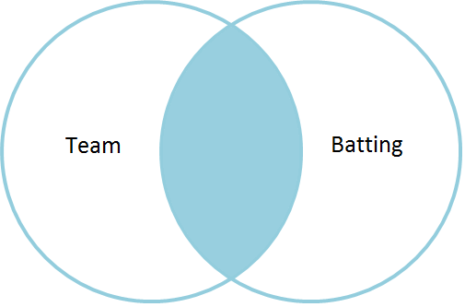
INNER JOIN
Demo: Joining the Team table to the Batting table via the Team ID.
SELECT <Column List>
FROM <Table_A> INNER JOIN <TABLE_B> ON <Table_A>.<Column_Name> = <TableB>.<Column_Name>

Slide 21
Exercise 6: Using an INNER JOIN
Let’s create and populate a new database named ‘baseball’ via a sql script file named ‘baseball.sql’.
Explore some tables in the database
Try some joins.
Learn about Views

Slide 22
LEFT JOIN
Produces a complete set of records from the table on the LEFT side of the JOIN
LEFT JOIN is the same as LEFT OUTER JOIN
In the following statement which table will have all rows returned? Which one is on the LEFT side of the JOIN?
Answer on the next slide.

Slide 23
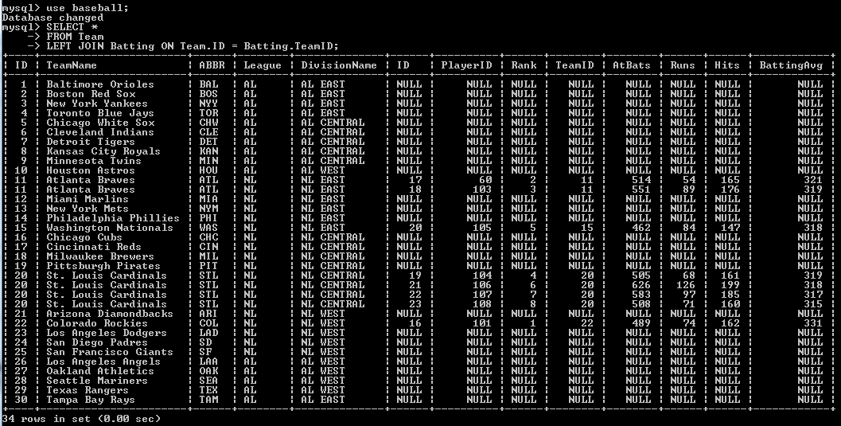
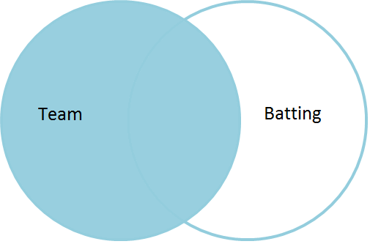
Which table will have all rows returned?
SELECT *
FROM team
left join batting on team.ID = batting.TeamID;

Slide 24
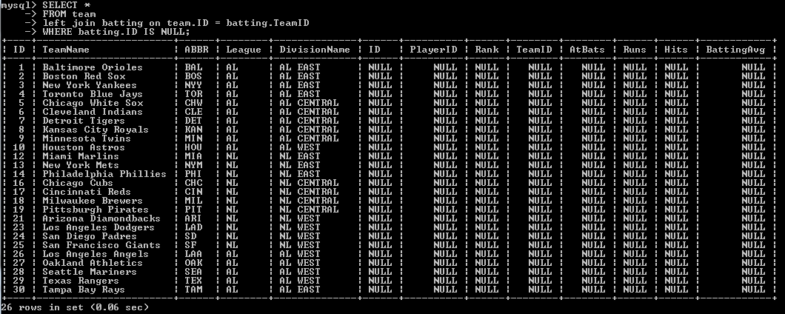
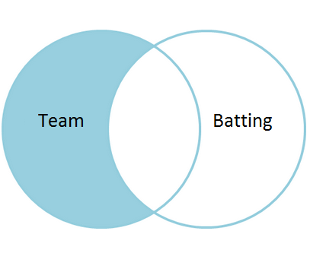
Consider this query…
What if we wanted to produce a listing of teams that did NOT have any batting leaders?
We could use a where clause to only show NULL rows from the batting table:
SELECT *
FROM team
left join batting on
team.ID = batting.TeamID
WHERE batting.ID IS NULL;

Slide 25
Exercise 7: LEFT JOIN
Create a SELECT statement that joins the player table and the batting table.
The query should show all the players and any matching players that exist within the batting table.
You should see NULL when there are no matches in the batting table.

Slide 26
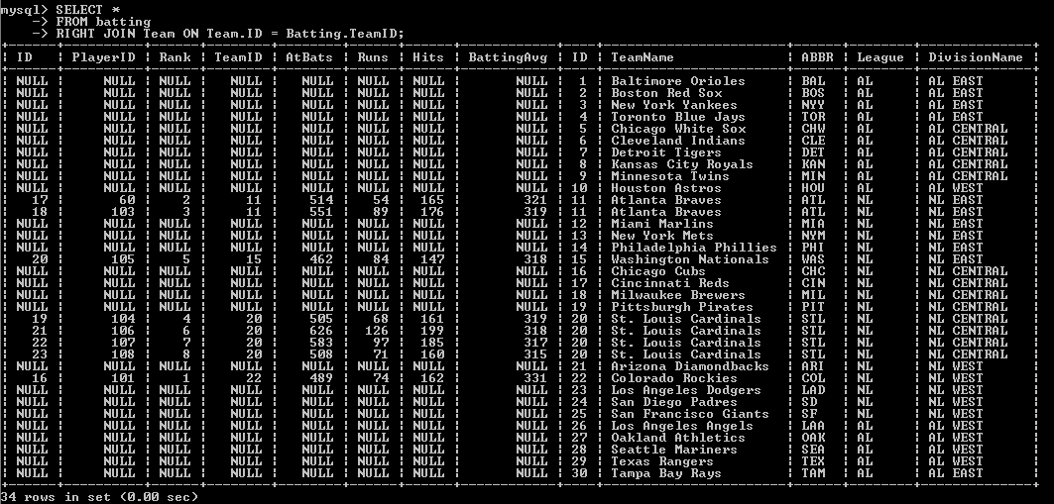
Right Join
With a Right Join, the Right hand side table is dominant and all its rows will be returned.
These two queries are basically the same:
SELECT *
FROM Team
left join Batting on Team.ID = Batting.TeamID;
SELECT *
FROM batting
RIGHT JOIN Team ON Team.ID = Batting.TeamID;

Slide 27
Order By Clause
order the results of a query using a listing of columns
Ascending order is the default
To sort in descending order use DESC
Demo:
Let’s order some baseball info
Ascending
Descending
Both!
vTeamRoster
League, DivisionName, and TeamName are ordered in ASCENDING order AND the HeightInches column is ordered in DESCENDING order

Slide 28
Exercise 8: Trying out the ORDER BY clause

Slide 29
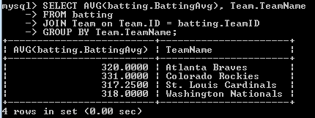
GROUP BY
Used to aggregate (Max, Min, Avg, Count…) rows together by one or more columns.
Use after WHERE
Average the batting averages to calculate a team batting average. GROUP the data BY TeamName.

Slide 30
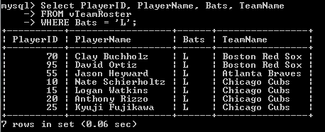
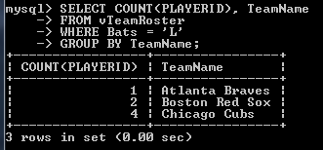
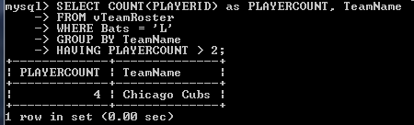
HAVING
Use WHERE to filter the rows before they are grouped.
Use HAVING to FILTER the results after having been grouped.
list all the players from the vTeamRoster view who bat left handed
Determine which team has the most lefties.
limiting the grouped rows to those HAVING a PLAYERCOUNT greater than 2

Slide 31
HOMEWORK
Any remaining exercises or homework for Day 2.
You will need to clone your fork to your home machine.
Create a new folder.
Put folder and files within “SQL Scripts” folder within your local repo.
Commit your local changes to your fork up to GitHub.com
Submit a pull request

Slide 32
DAY 3
INSERT
DELETE
UPDATE
VIEWS
DISTINCT ROWS
COLUMN ALIASES
OPERATORS AND FUNCTIONS

Slide 33
INSERT INTO
INSERT INTO tablename (Col1, Col2, Col3, ...) VALUES (Value1, Value2, Value3, …)
The order of the values should correspond to the column names.

Slide 34
INSERT Statements Add Rows to a Table
Use SQL to add rows to a table
INSERT statement
With this syntax, values must contain a value for each column.
Values should be in the order in which you created the table:
INSERT INTO table_name VALUES (value1, value2,…);
An example would be:
INSERT INTO Individual Values (’Hendrix’,’Jimi’,’1942-11-27’);

Slide 35
Another INSERT Syntax
INSERT INTO table_name (Column1, Column2, Column3,…) Values (value1, value2, value3,…);
An example would be:
INSERT INTO Individual (LastName, FirstName, BirthDate) VALUES (‘Jagger’, ‘Mick’, ‘1943-07-26’);

Slide 36
Third way to INSERT
INSERT INTO table_name VALUES (,,,),(,,,),(,,,),…;
And an example would be:
INSERT INTO Individual VALUES
(‘Jagger’, ‘Mick’, ‘1943-07-26’)
, (‘Zimmerman’, ‘Robert’, ‘1942-05-25’)
, (‘Cobain’, ‘Kurt’, ‘1967-02-20’);

Slide 37
Exercise: Add an Individual to a Band

Slide 38
Add multiple records at once
Each data set is wrapped in parenthesis and separated by a comma
INSERT INTO Band
(Name,YearFormed,IsTogether,Genre)
VALUES
('Rolling Stones', '1962', 1, 'Rock')
, ('Beatles', '1960', 0, 'Rock')
, ('Traveling Wilburys', '1988', 0, 'Rock')
, ('Nirvana', '1987', 0, 'Grunge');
, ('REM', '1980', 0, 'Alternative');

Slide 39
Exercise: More than one way to INSERT INTO
Exercise: INSERT INTO SELECT
Exercise: inserting a row and discovering the value for the last inserted ID

Slide 40
DELETE Statement
DELETE removes row from a table.
DANGER, YOU REALLY NEED A WHERE CLAUSE!
Try SELECT before DELETE to verify rows affected
Dangerous:
DELETE FROM <table_name>;
Much, much better
DELETE FROM <table_name> WHERE ID = 234;

Slide 41
I get nervous
Whenever I use delete without a WHERE clause that identifies rows by the primary key

Slide 42
Using the IN Operator
The IN operation is used to test whether or not a value is ‘in’ the list.
SELECT ID, FirstName, LastName
FROM Individual
WHERE LastName IN (‘Ramone’, ‘Jennings’,’Presley’);
same as:
SELECT ID, FirstName, LastName FROM Individual
WHERE LastName = 'Ramone' OR LastName = 'Presley' OR LastName = 'Jennings';

Slide 43
NOT IN
Use NOT IN to exclude the rows in your list
SELECT ID, LASTNAME FROM Individual WHERE ID NOT IN ('50','51','52','53');

Slide 44
Exercise: Using the DELETE statement
Exercise: Using the IN operator to delete multiple records

Slide 45
UPDATE
UPDATE statement used to update existing records in a table
The SET clause indicates which columns to modify and the values they should be given
The WHERE clause specifies which record or records are updates
UPDATE <table_name>
SET <column_name> = {expression}
WHERE <where_condition>

Slide 46
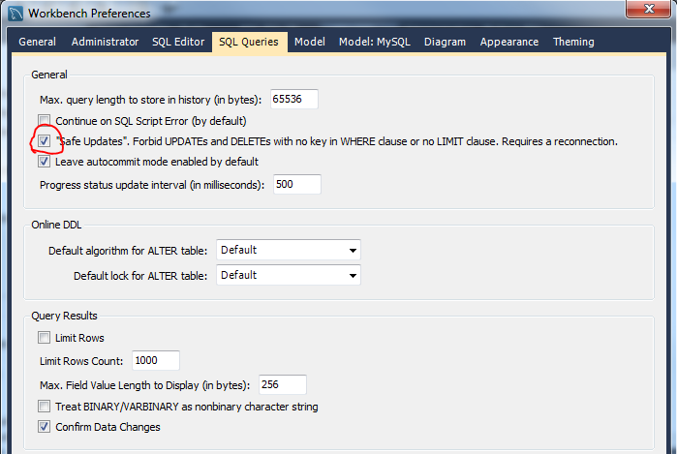
SQL Safe Updates
You may get the following error when attempting to update a column without using the a KEY (primary key) column within the WHERE clause:
“Safe Updates” forbids updates and delete with no key in the WHERE clause or no LIMIT clause.
SET SQL_SAFE_UPDATES = 0;
Edit -> Preferences -> SQL Editor -> SQL Queries

