Slide 1


Dashboard Project
By - Geraldine Smith
David Currie
Mark Donaldson
Calum Sey

Slide 2
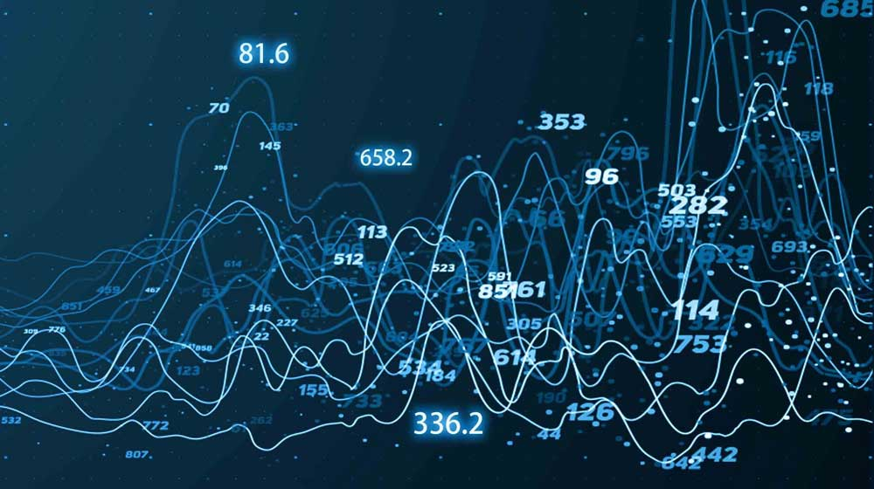
Today’s presentation:
Overview of the project brief and metrics chosen
Demonstration of our Health in Scotland dashboard
Project management and team-working
Data insights and conclusions

Slide 3

Project Brief & Chosen Metrics
Build a dashboard that offers a breakdown of Scottish health and related insights
General overview
Specific health topic
Temporal, geographic , demographic perspectives
Deprivation and it’s effect on any indicators
Teamwork and project management just as important!
Chosen metrics
Life expectancy and life satisfaction
Smoking, drinking and drug use

Slide 4
Dashboard Demo

Slide 5
Project Management
Key elements :
Identify the Business or Stakeholders needs
Project Objectives and Scope
Project Schedule
Defining Roles and Responsibility
Communication
Our Approach :
Detailed review of Project Brief and Scotland’s Public Health Priorities (SPHP)
Step by Step Plan of Action in relation with SPHP and Priority 4
Calendarization of Tasks and Timeline
Splitting up the Data Sets and Dashboard into Tabs
Daily Stand Up – Morning , Afternoon and Evening

Slide 6
Data Insights & Conclusion
Scotland’s Life Expectancy
Scotland’s Life Satisfaction
Alcohol Related Hospital Statistics
Drug Related Hospital Discharges
Scottish Smoking Survey Core Questions

Slide 7

Thank You for Listening
We will now take any Questions

