Slide 1
Chapter 2: Intro to Relational Model

Slide 2
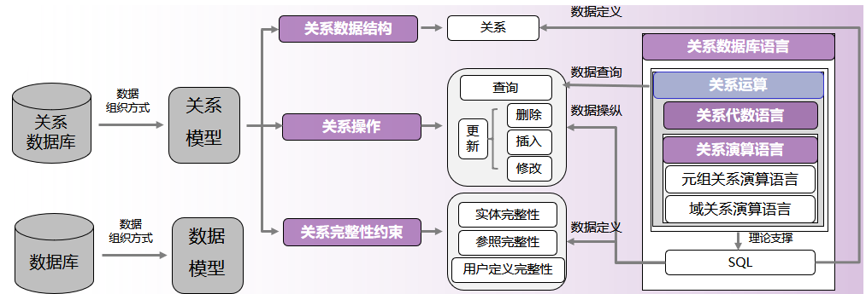
Chapter 2: Intro to Relational Model

Slide 3

关系模型
1970年，IBM公司的埃德加·科德（Edgar F. Codd）
首次,提出了关系模型的概念
随后,提出了关系代数和关系演算的概念
1972年提出了关系的第一、第二、第三范式
1974年提出了关系的巴斯科德范式
1981年，ACM授予埃德加·科德图灵奖，以表彰他在关系数据库研究方面的杰出贡献。
埃德加·科德

Slide 4
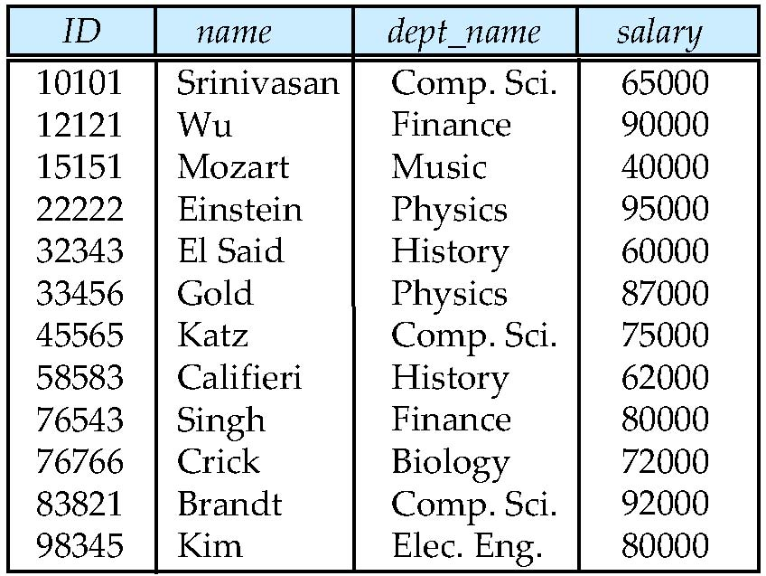
Example of a Relation
attributes
(or columns)
tuples
(or rows)

Slide 5
Attribute Types
The set of allowed values for each attribute is called the domain of the attribute
Attribute values are (normally) required to be atomic;
that is, indivisible
The special value null is a member of every domain.
Indicated that the value is “unknown”
The null value causes complications in the definition of many operations

Slide 6
Relation Schema and Instance
A₁, A₂, …, A_{n} are attributes
R = (A₁, A₂, …, A_{n} ) is a relation schema
Example: instructor = (ID, name, dept_name, salary)
Formally, given sets D₁, D₂, …. D_{n} a relation r is a subset of D₁ x D₂ x … x D_{n} Thus, a relation is a set of n-tuples (a₁, a₂, …, a_{n}) where each a_{i} ∈ D_{i}
The current values (relation instance) of a relation are specified by a table
An element t of r is a tuple, represented by a row in a table

Slide 7
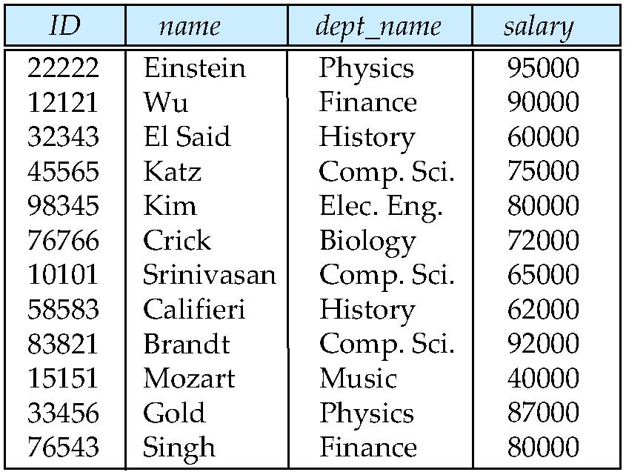
Relations are Unordered
Order of tuples is irrelevant (tuples may be stored in an arbitrary order)
Example: instructor relation with unordered tuples

Slide 8
Keys
Let K ⊆ R
K is a superkey of R if values for K are sufficient to identify a unique tuple of each possible relation r(R)
Example: {ID} and {ID,name} are both superkeys of instructor.
Superkey K is a candidate key if K is minimal Example: {ID} is a candidate key for Instructor
One of the candidate keys is selected to be the primary key.
which one?
Foreign key constraint: Value in one relation must appear in another
Referencing relation
Referenced relation
Example – dept_name in instructor is a foreign key from instructor referencing department

Slide 9
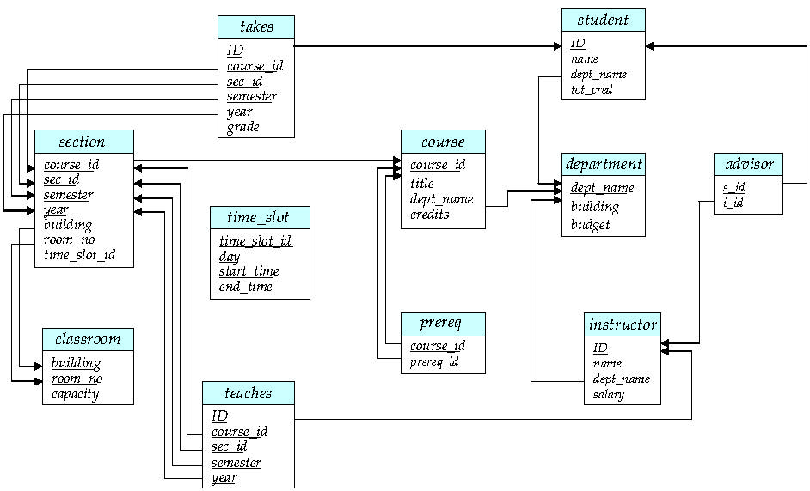
Schema Diagram for University Database

Slide 10
Relational Query Languages
Procedural vs .non-procedural, or declarative
“Pure” languages:
Relational algebra
Tuple relational calculus
Domain relational calculus
The above 3 pure languages are equivalent in computing power
We will concentrate in this chapter on relational algebra
Not turning-machine equivalent
consists of 6 basic operations

Slide 11
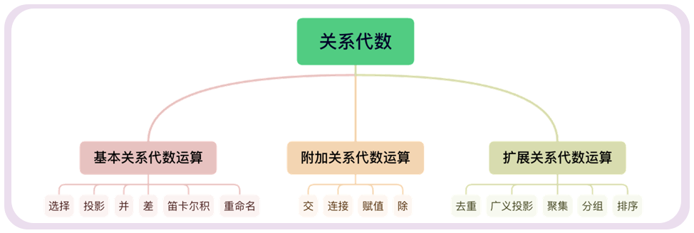
Relational Query Languages
关系代数定义了一个关系数据的运算的集合
关系运算以一个或者两个关系为输入；输出一个新的关系作为运算结果。
关系是一个以元组为元素的多重集合（multiset）- 可能包含重复元素
关系代数运算本质上是对多重集合的运算

Slide 12
Relational Algebra
Procedural language
Six basic operators
select: σ
project: ∏
union: ∪
set difference: –
Cartesian product: x
rename: ρ
The operators take one or two relations as inputs and produce a new relation as a result.

Slide 13
Select Operation
Notation: σ _{p}(r)
p is called the selection predicate
Defined as: σ_{p}(r) = {t | t ∈ r and p(t)}
Where p is a formula in propositional calculus consisting of terms connected by : ∧ (and), ∨ (or), ¬ (not)
Each term is one of:
<attribute> op <attribute> or <constant>
where op is one of: =, ≠, >, ≥. <. ≤
Example of selection: σ _{dept_name=“Physics”}(instructor)
Notes:
propositional calculus:命题演算

Slide 14
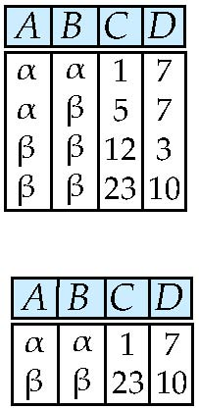
Select Operation – selection of rows (tuples)
Relation r
σ_{A=B ^ D > 5} (r)

Slide 15
Project Operation
Notation:
where A₁, A₂ are attribute names and r is a relation name.
The result is defined as the relation of k columns obtained by erasing the columns that are not listed
Duplicate rows removed from result, since relations are sets
Example: To eliminate the ID,name and salary attribute of intructor ∏_{ID,name,salary} (instructor)

Slide 16
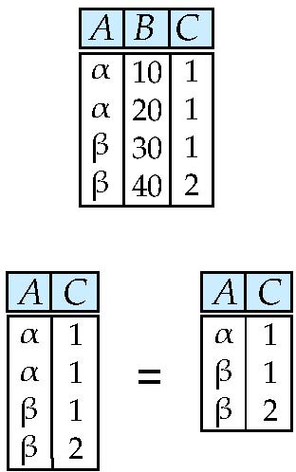
Project Operation – selection of columns (Attributes)
Relation r:
∏_{A,C} (r)

Slide 17
Union Operation
Notation: r ∪ s
Defined as: r ∪ s = {t | t ∈ r or t ∈ s}
For r ∪ s to be valid.
1. r, s must have the same arity (same number of attributes)
2. The attribute domains must be compatible (example: 2nd column of r deals with the same type of values as does the 2nd column of s)
Example: to find all courses taught in the Fall 2009 semester, or in the Spring 2010 semester, or in both ∏_{course_id} (σ _{semester=“Fall” Λ year=2009} (section)) ∪ ∏_{course_id} (σ _{semester=“Spring” Λ year=2010} (section))

Slide 18
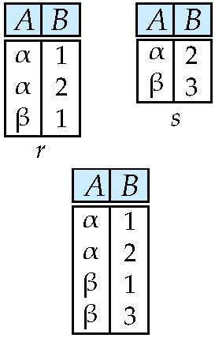
Union of two relations
Relations r, s:
r ∪ s:

Slide 19
Set Difference Operation
Notation r – s
Defined as: r – s = {t | t ∈ r and t ∉ s}
Set differences must be taken between compatible relations.
r and s must have the same arity
attribute domains of r and s must be compatible
Example: to find all courses taught in the Fall 2009 semester, but not in the Spring 2010 semester
∏_{course_id} (σ _{semester=“Fall” Λ year=2009} (section)) − ∏_{course_id} (σ _{semester=“Spring” Λ year=2010} (section))

Slide 20
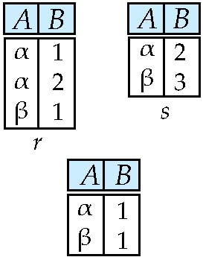
Set difference of two relations
Relations r, s:
r – s:

Slide 21
Cartesian-Product Operation
Notation r x s
Defined as: r x s = {t q | t ∈ r and q ∈ s}
Assume that attributes of r(R) and s(S) are disjoint.
That is, R ∩ S = ∅ .
If attributes of r(R) and s(S) are not disjoint, then renaming must be used.

Slide 22
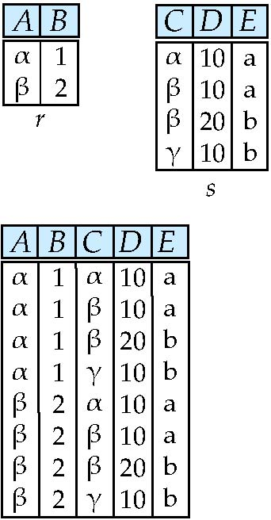
joining two relations -- Cartesian-product
Relations r, s:
r x s:

Slide 23
Cartesian-product – naming issue
B
Relations r, s:
r.B
s.B
r x s:

Slide 24
Renaming a Table
Allows us to refer to a relation, (say E) by more than one name.
ρ _{x} (E)
returns the expression E under the name X
Relations r
r.A r.B s.A s.B
r x ρ _{s} (r)
α
α
β
β
1
1
2
2
α
β
α
β
1
2
1
2

Slide 25
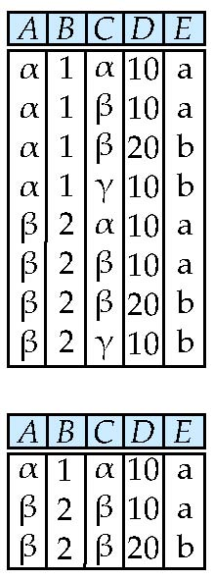
Composition of Operations
Can build expressions using multiple operations
Example: σ_{A=C} (r x s)
r x s
σ_{A=C} (r x s)

Slide 26
Formal Definition
A basic expression in the relational algebra consists of either one of the following:
A relation in the database
A constant relation
Let E₁ and E₂ be relational-algebra expressions; the following are all relational-algebra expressions:
E₁ ∪ E₂
E₁ – E₂
E₁ x E₂
σ_{p} (E₁), P is a predicate on attributes in E₁
∏_{s}(E₁), S is a list consisting of some of the attributes in E₁
ρ _{x} (E₁), x is the new name for the result of E₁

Slide 27
Banking Example
branch (branch_name, branch_city, assets)
customer (customer_name, customer_street, customer_city)
account (account_number, branch_name, balance)
loan (loan_number, branch_name, amount)
depositor (customer_name, account_number)
borrower (customer_name, loan_number)

Slide 28
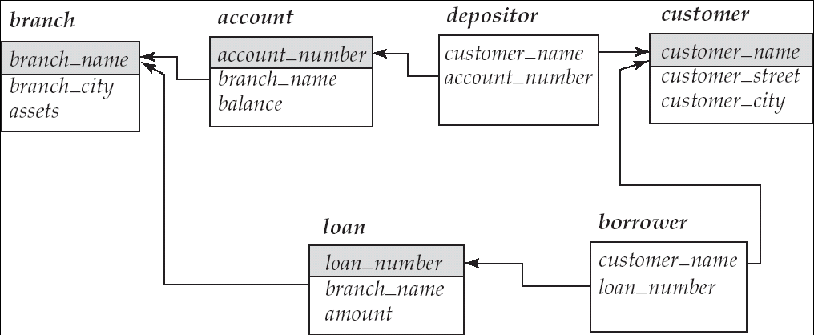
Example Queries
Find all loans of over $1200
σ_{amount > 1200} (loan)
Find the loan number for each loan of an amount greater than $1200
∏_{loan_number} (σ_{amount} _{> 1200} (loan))
Find the names of all customers who have a loan, an account, or both, from the bank
∏_{customer_name} (borrower) ∪ ∏_{customer_name} (depositor)

Slide 29
Example Queries
Find the names of all customers who have a loan at the Perryridge branch.
∏_{customer_name} (σ_{branch_name=“Perryridge”}
(σborrower.loan_number = loan.loan_number(borrower x loan)))
Find the names of all customers who have a loan at the Perryridge branch but do not have an account at any branch of the bank.
∏_{customer_name} (σ_{branch_name = “Perryridge”}(σborrower.loan_number = loan.loan_number(borrower x loan))) – ∏_{customer_name}(depositor)

Slide 30
Example Queries
Find the names of all customers who have a loan at the Perryridge branch.
Query 1 ∏_{customer_name} (σ_{branch_name = “Perryridge”} ( σborrower.loan_number = loan.loan_number (borrower x loan)))
Query 2
∏_{customer_name}(σloan.loan_number = borrower.loan_number ( (σ_{branch_name = “Perryridge”} (loan)) x borrower))

Slide 31
Example Queries
Find the largest account balance
Strategy:
Find those balances that are not the largest
Rename account relation as d so that we can compare each account balance with all others
Use set difference to find those account balances that were not found in the earlier step.
The query is:
∏_{balance}(account) - ∏_{account.balance}
(σ_{account.balance < d.balance} (account x ρ_{d} (account)))

Slide 32
σ_{account.balance < d.balance} (account x ρ_{d}(account))
Account-number | Branch-name | balance | Account-number | Branch-name | balance
A-101 | downtown | 500 | A-101 | downtown | 500
A-101 | downtown | 500 | A-102 | perryridge | 400
A-101 | downtown | 500 | A-201 | Brighton | 900
A-101 | downtown | 500 | A-215 | Mianus | 700
A-101 | downtown | 500 | A-217 | Brighton | 750
A-101 | downtown | 500 | A-222 | Redwod | 700
A-101 | downtown | 500 | A-305 | Round Hill | 350
A-102 | perryridge | 400 | A-101 | downtown | 500
A-102 | perryridge | 400 | A-102 | perryridge | 400
A-102 | perryridge | 400 | A-201 | Brighton | 900
A-102 | perryridge | 400 | A-215 | Mianus | 700
A-102 | perryridge | 400 | A-217 | Brighton | 750
A-102 | perryridge | 400 | A-222 | Redwod | 700
A-102 | perryridge | 400 | A-305 | Round Hill | 350

Slide 33
σ_{account.balance < d.balance} (account x ρ_{d}(account))
Account-number | Branch-name | balance | Account-number | Branch-name | balance
A-201 | Brighton | 900 | A-101 | downtown | 500
A-201 | Brighton | 900 | A-102 | perryridge | 400
A-201 | Brighton | 900 | A-201 | Brighton | 900
A-201 | Brighton | 900 | A-215 | Mianus | 700
A-201 | Brighton | 900 | A-217 | Brighton | 750
A-201 | Brighton | 900 | A-222 | Redwod | 700
A-201 | Brighton | 900 | A-305 | Round Hill | 350
A-215 | Mianus | 700 | A-101 | downtown | 500
A-215 | Mianus | 700 | A-102 | perryridge | 400
A-215 | Mianus | 700 | A-201 | Brighton | 900
A-215 | Mianus | 700 | A-215 | Mianus | 700
A-215 | Mianus | 700 | A-217 | Brighton | 750
A-215 | Mianus | 700 | A-222 | Redwod | 700
A-215 | Mianus | 700 | A-305 | Round Hill | 350

Slide 34
σ_{account.balance < d.balance} (account x ρ_{d}(account))
Account-number | Branch-name | balance | Account-number | Branch-name | balance
A-217 | Brighton | 750 | A-101 | downtown | 500
A-217 | Brighton | 750 | A-102 | perryridge | 400
A-217 | Brighton | 750 | A-201 | Brighton | 900
A-217 | Brighton | 750 | A-215 | Mianus | 700
A-217 | Brighton | 750 | A-217 | Brighton | 750
A-217 | Brighton | 750 | A-222 | Redwod | 700
A-217 | Brighton | 750 | A-305 | Round Hill | 350
A-222 | Redwod | 700 | A-101 | downtown | 500
A-222 | Redwod | 700 | A-102 | perryridge | 400
A-222 | Redwod | 700 | A-201 | Brighton | 900
A-222 | Redwod | 700 | A-215 | Mianus | 700
A-222 | Redwod | 700 | A-217 | Brighton | 750
A-222 | Redwod | 700 | A-222 | Redwod | 700
A-222 | Redwod | 700 | A-305 | Round Hill | 350

Slide 35
σ_{account.balance < d.balance} (account x ρ_{d}(account))
Account-number | Branch-name | balance | Account-number | Branch-name | balance
A-305 | Round Hill | 350 | A-101 | downtown | 500
A-305 | Round Hill | 350 | A-102 | perryridge | 400
A-305 | Round Hill | 350 | A-201 | Brighton | 900
A-305 | Round Hill | 350 | A-215 | Mianus | 700
A-305 | Round Hill | 350 | A-217 | Brighton | 750
A-305 | Round Hill | 350 | A-222 | Redwod | 700
A-305 | Round Hill | 350 | A-305 | Round Hill | 350

Slide 36
Example Queries
∏_{balance}(account) - ∏_{account.balance}
(σ_{account.balance < d.balance} (account x ρ_{d}(account)))
balance
500
400
900
700
750
700
350
balance
500
400
700
750
700
350
-
balance
900
=

Slide 37
Additional Operations
We define additional operations that do not add any power to the relational algebra, but that simplify common queries.
Set intersection
Natural join
Division
Assignment

Slide 38
Set-Intersection Operation
Notation: r ∩ s
Defined as:
r ∩ s = { t | t ∈ r and t ∈ s }
Assume:
r, s have the same arity
attributes of r and s are compatible
Note: r ∩ s = r – (r – s)

Slide 39
Set-Intersection Operation – Example
Relation r, s:
r ∩ s
A B
A B
α
α
β
1
2
1
α
β
2
3
r
s
A B
α 2

Slide 40
Natural-Join Operation
Notation: r s
Let r and s be relations on schemas R and S respectively. Then, r s is a relation on schema R ∪ S obtained as follows:
Consider each pair of tuples t_{r} from r and t_{s} from s.
If t_{r} and t_{s} have the same value on each of the attributes in R ∩ S, add a tuple t to the result, where
t has the same value as t_{r} on r
t has the same value as t_{s} on s
Example:
R = (A, B, C, D)
S = (E, B, D)
Result schema = (A, B, C, D, E)
r s is defined as: ∏_{r.A, r.B, r.C, r.D, s.E} (σ_{r.B = s.B} ∧ _{r.D = s.D} (r x s))

Slide 41
Natural-Join Operation
考虑如下的两个表 r 和 s：
s
B1 | B2 | C
b1 | b1 | c1
b1 | b1 | c2
b1 | b2 | c3
b2 | b2 | c4
r
A | B1 | B2
a1 | b1 | b1
a1 | b2 | b1
a2 | b1 | b2
A | B1 | B2 | C
a1 | b1 | b1 | c1
a1 | b1 | b1 | c2
a2 | b1 | b2 | c3
r s

Slide 42
Natural Join Operation – Example
Relations r, s:
r s
r
s
A
B
C
D
B
D
E
A
B
C
D
E
α
β
γ
α
δ
1
2
4
1
2
α
γ
β
γ
β
a
a
b
a
b
1
3
1
2
3
a
a
a
b
b
α
β
γ
δ
∈
α
α
α
α
δ
1
1
1
1
2
α
α
γ
γ
β
a
a
a
a
b
α
γ
α
γ
δ

Slide 43
选修全部课程的学生
姓名 | 课程
张军 | 物理
王红 | 数学
张军 | 数学
课程
数学
物理
姓名
课程
课程
姓名
张军
物理
×
＝
1.所有学生选修全部课程
数学
张军
王红
数学
物理
王红
张军
数学
王红
物理
姓名
课程
姓名
课程
2. 没有选修全部课程的学生
张军
物理
−
张军
物理
王红
数学
王红
数学
张军
数学
张军
数学
王红
物理
姓名
3. 选修了全部课程的学生
−
姓名
＝
姓名
王红
王红
张军
张军

Slide 44
Division Operation
Notation: r ÷ s
Suited to queries that include the phrase “for all”.
Let r and s be relations on schemas R and S respectively where
R = (A₁, …, A_{m}, B₁, …, B_{n})
S = (B₁, …, B_{n})
The result of r ÷ s is a relation on schema R – S = (A₁, …, A_{m})
r ÷ s = { t | t ∈ ∏ _{R-S}(r) ∧ ∀ u ∈ s ( tu ∈ r ) }
Where tu means the concatenation of tuples t and u to produce a single tuple

Slide 45
Division Operation – Example
Relations r, s:
A
B
B
α
α
α
β
γ
δ
δ
δ
∈
∈
β
1
2
3
1
1
1
3
4
6
1
2
1
2
s
r ÷ s:
A
r
α
β

Slide 46
Another Division Example
Relations r, s:
A
B
C
D
E
D
E
α
α
α
β
β
γ
γ
γ
a
a
a
a
a
a
a
a
α
γ
γ
γ
γ
γ
γ
β
a
a
b
a
b
a
b
b
1
1
1
1
3
1
1
1
a
b
1
1
s
r
r ÷ s:
A
B
C
α
γ
a
a
γ
γ

Slide 47
Division Operation(Cont.)
Property
Let q = r ÷ s
Then q is the largest relation satisfying q x s ⊆ r
Definition in terms of the basic algebra operation Let r(R) and s(S) be relations, and let S ⊆ R
r ÷ s = ∏_{R-S} (r ) – ∏_{R-S} ( ( ∏_{R-S} (r ) x s ) – ∏_{R-S,S}(r ))
To see why
∏_{R-S,S} (r) simply reorders attributes of r
∏_{R-S} (∏_{R-S} (r ) x s ) – ∏_{R-S,S}(r) ) gives those tuples t in ∏_{R-S} (r ) such that for some tuple u ∈ s, tu ∉ r.

Slide 48
r
s
Π_{R-S} (r)
Π _{R-S} (r) × s
Π_{R-S,S} (r)
A | C | B | D
a | c | b | d
a | e | b | f
a | d | b | e
b | e | c | f
e | c | d | d
e | e | d | f
C | D
c | d
e | f
A | B
a | b
b | c
e | d
A | B | C | D
a | b | c | d
a | b | e | f
b | c | c | d
b | c | e | f
e | d | c | d
e | d | e | f
A | B | C | D
a | b | c | d
a | b | e | f
a | b | d | e
b | c | e | f
e | d | c | d
e | d | e | f
Π _{R-S} (r) × s - Π_{R-S,S} (r)
Π _{R-S} (r)- Π _{R-S} ( Π _{R-S} (r) × s - Π_{R-S,S} (r) )
A | B | C | D
b | c | c | d
r ÷ s =
A | B
a | b
b | c
e | d
-
A | B
b | c
=
A | B
a | b
e | d
Π _{R-S} ( Π _{R-S} (r) × s - Π_{R-S,S} (r) )
A | B
b | c

Slide 49
Assignment Operation
The assignment operation (←) provides a convenient way to express complex queries.
Write query as a sequential program consisting of
a series of assignments
followed by an expression whose value is displayed as a result of the query.
Assignment must always be made to a temporary relation variable.
Example: Write r ÷ s as
temp1 ← ∏_{R-S} (r ) temp2 ← ∏_{R-S} ((temp1 x s ) – ∏_{R-S,S} (r )) result = temp1 – temp2
The result to the right of the ← is assigned to the relation variable on the left of the ←.
May use variable in subsequent expressions.

Slide 50
Bank Example Queries
Find the names of all customers who have a loan and an account at bank.
∏_{customer_name} (borrower) ∩ ∏_{customer_name} (depositor)
Find the name of all customers who have a loan at the bank and the loan amount
∏customer_name, loan_number, amount (borrower loan)

Slide 51
Bank Example Queries
Find all customers who have an account from at least the “Downtown” and the Uptown” branches.
Query 1
∏_{customer_name} (σ_{branch_name = “Downtown”} (depositor account )) ∩
∏_{customer_name} (σ_{branch_name = “Uptown”} (depositor account))
Query 2 ∏_{customer_name, branch_name} (depositor account) ÷ ρ_{temp(branch_name)} ({(“Downtown” ), (“Uptown” )})
Note that Query 2 uses a constant relation.

Slide 52
Bank Example Queries
Find all customers who have an account at all branches located in Brooklyn city.
∏_{customer_name, branch_name} (depositor account) ÷ ∏_{branch_name} (σ_{branch_city = “Brooklyn”} (branch))

Slide 53
Extended Relational-Algebra-Operations
Generalized Projection
Aggregate Functions
Outer Join

Slide 54
Generalized Projection
Extends the projection operation by allowing arithmetic functions to be used in the projection list.
E is any relational-algebra expression
Each of F₁, F₂, …, F_{n} are are arithmetic expressions involving constants and attributes in the schema of E.
Given relation credit_info(customer_name, limit, credit_balance), find how much more each person can spend:
∏customer_name, limit – credit_balance (credit_info)
∏customer-name, (limit – credit-balance) as credit-available (credit-info)

Slide 55
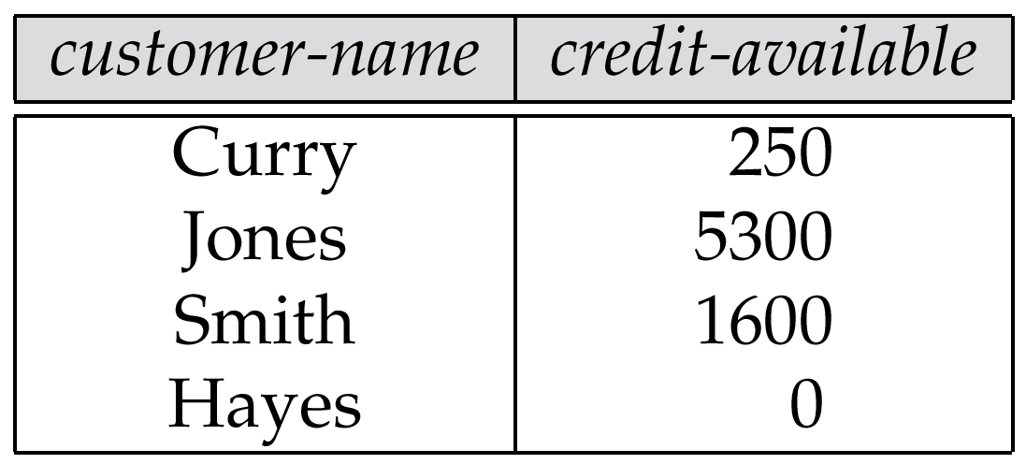
Generalized Projection
credit-info
customer-name
limit
credit-balance
Curry
Hayes
Jones
Smith
2000
1500
6000
2000
1750
1500
700
400

Slide 56
Aggregate Functions and Operations
Aggregation function takes a collection of values and returns a single value as a result.
avg: average value min: minimum value max: maximum value sum: sum of values count: number of values
Aggregate operation in relational algebra
E is any relational-algebra expression
G₁, G₂ …, G_{n} is a list of attributes on which to group (can be empty)
Each F_{i} is an aggregate function
Each A_{i} is an attribute name

Slide 57
Aggregate Operation – Example
Relation r:
A
B
C
α
α
β
β
α
β
β
β
7
7
3
10
g _{sum(c)} (r)
sum(c )
27

Slide 58
Aggregate Operation – Example
Relation account grouped by branch-name:
branch_name
account_number
balance
Perryridge
Perryridge
Brighton
Brighton
Redwood
A-102
A-201
A-217
A-215
A-222
400
900
750
750
700
_{branch_name} g _{sum(balance)} (account)
branch_name
sum(balance)
Perryridge
Brighton
Redwood
1300
1500
700

Slide 59
Aggregate Functions (Cont.)
Result of aggregation does not have a name
Can use rename operation to give it a name
For convenience, we permit renaming as part of aggregate operation
_{branch_name} g _{sum(balance) as sum_balance} (account)

Slide 60
Outer Join
An extension of the join operation that avoids loss of information.
Computes the join and then adds tuples form one relation that does not match tuples in the other relation to the result of the join.
Uses null values:
null signifies that the value is unknown or does not exist
All comparisons involving null are (roughly speaking) false by definition.
We shall study precise meaning of comparisons with nulls later

Slide 61
Outer Join – Example
Relation loan
loan_number
branch_name
amount
L-170
L-230
L-260
Downtown
Redwood
Perryridge
3000
4000
1700
Relation borrower
customer_name
loan_number
Jones
Smith
Hayes
L-170
L-230
L-155

Slide 62
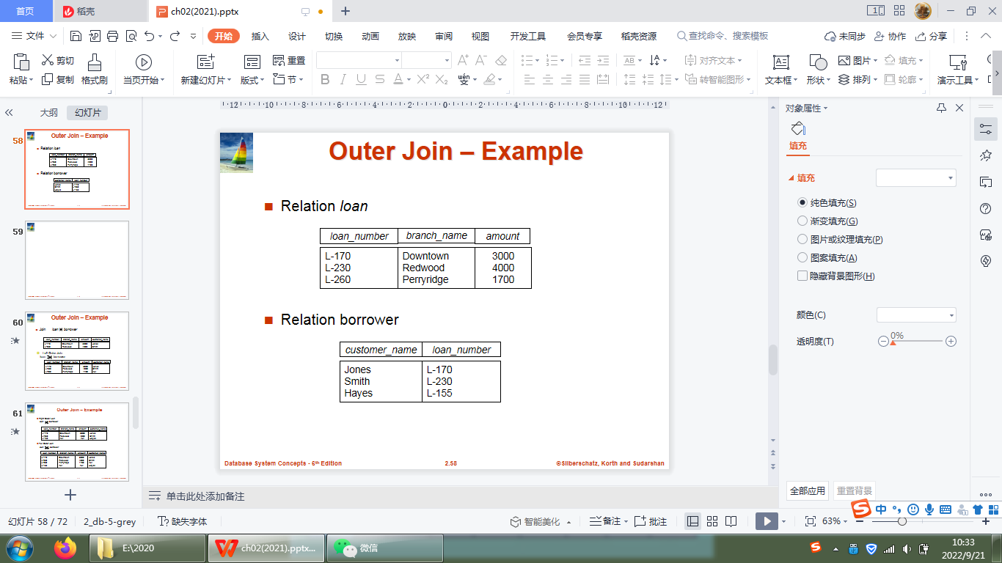

Outer Join – Example
Join loan borrower
loan_number
branch_name
amount
customer_name
L-170
L-230
Downtown
Redwood
3000
4000
Jones
Smith
Left Outer Join loan borrower
loan_number
branch_name
amount
customer_name
L-170
L-230
L-260
Downtown
Redwood
Perryridge
3000
4000
1700
Jones
Smith
null

Slide 63
Outer Join – Example
Right Outer Join
loan borrower
loan_number
branch_name
amount
customer_name
L-170
L-230
L-155
Downtown
Redwood
null
3000
4000
null
Jones
Smith
Hayes
Full Outer Join
loan borrower
loan_number
branch_name
amount
customer_name
L-170
L-230
L-260
L-155
Downtown
Redwood
Perryridge
null
3000
4000
1700
null
Jones
Smith
null
Hayes

Slide 64
Null Values
It is possible for tuples to have a null value, denoted by null, for some of their attributes
null signifies an unknown value or that a value does not exist.
The result of any arithmetic expression involving null is null.
Aggregate functions simply ignore null values (as in SQL)
For duplicate elimination and grouping, null is treated like any other value, and two nulls are assumed to be the same (as in SQL)

Slide 65
Null Values
Comparisons with null values return the special truth value: unknown
If false was used instead of unknown, then not (A < 5) would not be equivalent to A >= 5
Three-valued logic using the truth value unknown:
OR: (unknown or true) = true, (unknown or false) = unknown (unknown or unknown) = unknown
AND: (true and unknown) = unknown, (false and unknown) = false, (unknown and unknown) = unknown
NOT: (not unknown) = unknown
In SQL “P is unknown” evaluates to true if predicate P evaluates to unknown
Result of select predicate is treated as false if it evaluates to unknown

Slide 66
Modification of the Database
The content of the database may be modified using the following operations:
Deletion
Insertion
Updating
All these operations are expressed using the assignment operator.

Slide 67
Deletion
A delete request is expressed similarly to a query, except instead of displaying tuples to the user, the selected tuples are removed from the database.
Can delete only whole tuples; cannot delete values on only particular attributes
A deletion is expressed in relational algebra by:
r ← r – E
where r is a relation and E is a relational algebra query.

Slide 68
Deletion Examples
Delete all account records in the Perryridge branch.
account ← account – σ _{branch_name = “Perryridge”} (account )
Delete all loan records with amount in the range of 0 to 50
loan ← loan – σ _{amount ≥ 0 and amount ≤ 50} (loan)
Delete all accounts at branches located in Needham.
r₁ ← σ _{branch_city = “Needham”} ( account branch )
r₂ ← ∏ _{account_number,} _{branch_name, balance} (r₁)
r₃ ← ∏ _{customer_name, account_number} ( r₂ depositor)
account ← account – r₂
depositor ← depositor – r₃

Slide 69
Insertion
To insert data into a relation, we either:
specify a tuple to be inserted
write a query whose result is a set of tuples to be inserted
in relational algebra, an insertion is expressed by:
r ← r ∪ E
where r is a relation and E is a relational algebra expression.
The insertion of a single tuple is expressed by letting E be a constant relation containing one tuple.

Slide 70
Insertion Examples
Insert information in the database specifying that Smith has $1200 in account A-973 at the Perryridge branch.
account ← account ∪ {(“A-973”, “Perryridge”, 1200)}
depositor ← depositor ∪ {(“Smith”, “A-973”)}
Provide as a gift for all loan customers in the Perryridge branch, a $200 savings account. Let the loan number serve as the account number for the new savings account.
r₁ ← (σ_{branch_name = “Perryridge”} (borrower loan))
account ← account ∪ ∏_{loan_number, branch_name, 200} (r₁)
depositor ← depositor ∪ ∏_{customer_name, loan_number} (r₁)

Slide 71
Updating
A mechanism to change a value in a tuple without charging all values in the tuple
Use the generalized projection operator to do this task
Each F_{i} is either
the I ^{th} attribute of r, if the I ^{th} attribute is not updated, or,
if the attribute is to be updated F_{i} is an expression, involving only constants and the attributes of r, which gives the new value for the attribute

Slide 72
Update Examples
Make interest payments by increasing all balances by 5 percent.
account ← ∏ account_number, branch_name, balance * 1.05 (account)
Pay all accounts with balances over $10,000 6 percent interest and pay all others 5 percent
account ← ∏ account_number, branch_name, balance * 1.06 (σ _{BAL > 10000} (account )) ∪ ∏ account_number, branch_name, balance * 1.05 (σ_{BAL ≤ 10000} (account))

Slide 73
Summary of Relational Algebra Operators
Symbol (Name) Example of Use
σ
(Selection) ^{σ} salary > = 85000 ^{(instructor)}
Return rows of the input relation that satisfy the predicate.
Π
(Projection) ^{Π} ID, salary ^{(instructor)}
Output specified attributes from all rows of the input relation. Remove duplicate tuples from the output.
x
(Cartesian Product) instructor x department
Output pairs of rows from the two input relations that have the same value on all attributes that have the same name.
∪
(Union) ^{Π} name ^{(instructor) ∪ Π} name ^{(student)}
Output the union of tuples from the two input relations.
-
(Set Difference) ^{Π} name ^{(instructor)} ^{-- Π} name ^{(student)}
Output the set difference of tuples from the two input relations.
⋈
(Natural Join) instructor ⋈ department
Output pairs of rows from the two input relations that have the same value on all attributes that have the same name.

Slide 74
End of Chapter 2

