Slide 1
Chapter 3: Introduction to SQL
Notes:
Sql语句的引入和介绍

Slide 2
Outline
Overview of The SQL Query Language
Data Definition
Basic Query Structure
Additional Basic Operations
Set Operations
Null Values
Aggregate Functions
Nested Subqueries
Modification of the Database
Notes:
1

Slide 3
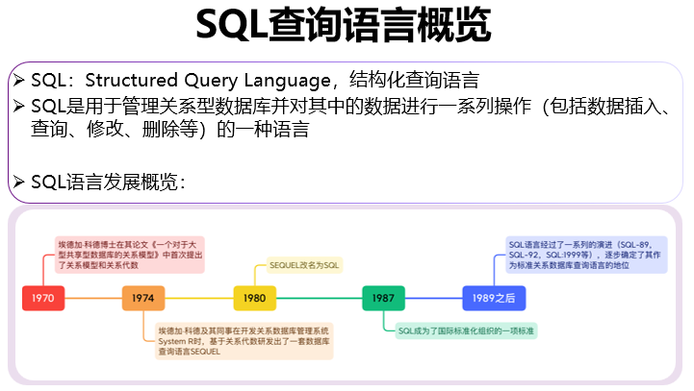

Slide 4
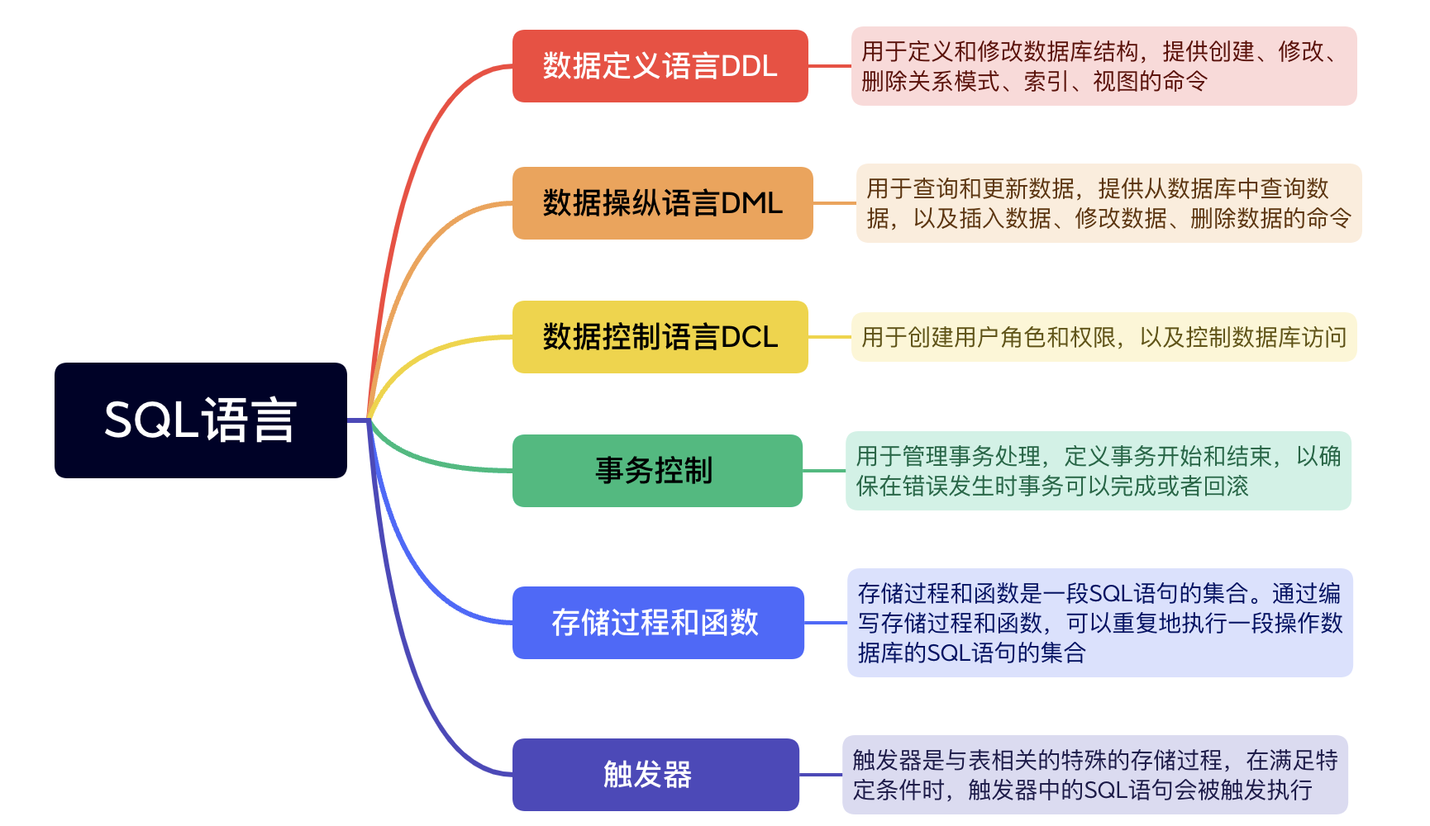
SQL查询语言概览

Slide 5
Data Definition Language
The SQL data-definition language (DDL) allows the specification of information about relations, including:
The schema for each relation.
The domain of values associated with each attribute.
Integrity constraints
And as we will see later, also other information such as
The set of indices to be maintained for each relations.
Security and authorization information for each relation.
The physical storage structure of each relation on disk.

Slide 6
Domain Types in SQL
char(n). Fixed length character string, with user-specified length n.
varchar(n). Variable length character strings, with user-specified maximum length n.
int. Integer (a finite subset of the integers that is machine-dependent).
smallint. Small integer (a machine-dependent subset of the integer domain type).
numeric(p,d). Fixed point number, with user-specified precision of p digits, with d digits to the right of decimal point. (ex., numeric(3,1), allows 44.5 to be stores exactly, but not 444.5 or 0.32)
real, double precision. Floating point and double-precision floating point numbers, with machine-dependent precision.
float(n). Floating point number, with user-specified precision of at least n digits.
More are covered in Chapter 4.

Slide 7
Create Table Construct
An SQL relation is defined using the create table command:
create table r (A₁ D₁, A₂ D₂, ..., A_{n} D_{n}, (integrity-constraint₁), ..., (integrity-constraint_{k}))
r is the name of the relation
each A_{i} is an attribute name in the schema of relation r
D_{i} is the data type of values in the domain of attribute A_{i}
Example: create table instructor ( ID char(5), name varchar(20), dept_name varchar(20), salary numeric(8,2))

Slide 8
Integrity Constraints in Create Table
not null
primary key (A₁, ..., A_{n} )
foreign key (A_{m}, ..., A_{n} ) references r
Example:
create table instructor ( ID char(5), name varchar(20) not null, dept_name varchar(20), salary numeric(8,2), primary key (ID), foreign key (dept_name) references department);
primary key declaration on an attribute automatically ensures not null

Slide 9
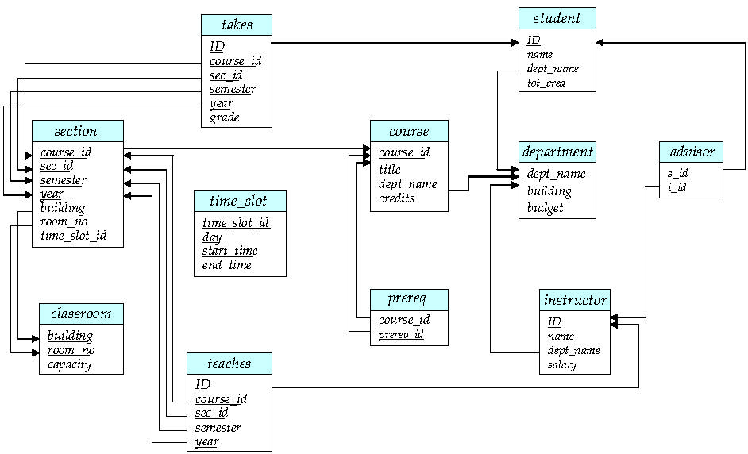
And a Few More Relation Definitions
create table student ( ID varchar(5), name varchar(20) not null, dept_name varchar(20), tot_cred numeric(3,0), primary key (ID),
foreign key (dept_name) references department);
create table takes ( ID varchar(5), course_id varchar(8), sec_id varchar(8), semester varchar(6), year numeric(4,0), grade varchar(2),
primary key (ID, course_id, sec_id, semester, year) ,
foreign key (ID) references student, foreign key (course_id, sec_id, semester, year) references section);
Note: sec_id can be dropped from primary key above, to ensure a student cannot be registered for two sections of the same course in the same semester

Slide 10
And more still
create table course ( course_id varchar(8), title varchar(50), dept_name varchar(20), credits numeric(2,0),
primary key (course_id),
foreign key (dept_name) references department);

Slide 11
Updates to tables
Insert
insert into instructor values (‘10211’, ’Smith’, ’Biology’, 66000);
Delete
Remove all tuples from the student relation
delete from student
Drop Table
drop table r
Alter
alter table r add A D
where A is the name of the attribute to be added to relation r and D is the domain of A.
All exiting tuples in the relation are assigned null as the value for the new attribute.
alter table r drop A
where A is the name of an attribute of relation r
Dropping of attributes not supported by many databases.

Slide 12
Basic Query Structure
A typical SQL query has the form: select A₁, A₂, ..., A_{n} from r₁, r₂, ..., r_{m} where P
A_{i} represents an attribute
R_{i} represents a relation
P is a predicate.
The result of an SQL query is a relation.
Notes:
2

Slide 13
The select Clause
The select clause lists the attributes desired in the result of a query
corresponds to the projection operation of the relational algebra
Example: find the names of all instructors: select name from instructor
NOTE: SQL names are case insensitive (i.e., you may use upper- or lower-case letters.)
E.g., Name ≡ NAME ≡ name
Some people use upper case wherever we use bold font.
Notes:
3

Slide 14
The select Clause (Cont.)
SQL allows duplicates in relations as well as in query results.
To force the elimination of duplicates, insert the keyword distinct after select.
Find the department names of all instructors, and remove duplicates
select distinct dept_name from instructor
The keyword all specifies that duplicates should not be removed.
select all dept_name from instructor
Notes:
4

Slide 15
The select Clause (Cont.)
An asterisk in the select clause denotes “all attributes”
select * from instructor
An attribute can be a literal with no from clause
select ‘437’
Results is a table with one column and a single row with value “437”
Can give the column a name using:
select ‘437’ as FOO
An attribute can be a literal with from clause
select ‘A’ from instructor
Result is a table with one column and N rows (number of tuples in the instructors table), each row with value “A”
Notes:
5

Slide 16
The select Clause (Cont.)
The select clause can contain arithmetic expressions involving the operation, +, –, ∗, and /, and operating on constants or attributes of tuples.
The query:
select ID, name, salary/12 from instructor
would return a relation that is the same as the instructor relation, except that the value of the attribute salary is divided by 12.
Can rename “salary/12” using the as clause:
select ID, name, salary/12 as monthly_salary
Notes:
5

Slide 17
The where Clause
The where clause specifies conditions that the result must satisfy
Corresponds to the selection predicate of the relational algebra.
To find all instructors in Comp. Sci. dept
select name from instructor where dept_name = ‘Comp. Sci.'
Comparison results can be combined using the logical connectives and, or, and not
To find all instructors in Comp. Sci. dept with salary > 80000
select name from instructor where dept_name = ‘Comp. Sci.' and salary > 80000
Comparisons can be applied to results of arithmetic expressions.
Notes:
6

Slide 18
The from Clause
The from clause lists the relations involved in the query
Corresponds to the Cartesian product operation of the relational algebra.
Find the Cartesian product instructor X teaches
select ∗ from instructor, teaches
generates every possible instructor – teaches pair, with all attributes from both relations.
For common attributes (e.g., ID), the attributes in the resulting table are renamed using the relation name (e.g., instructor.ID)
Cartesian product not very useful directly, but useful combined with where-clause condition (selection operation in relational algebra).
Notes:
8

Slide 19
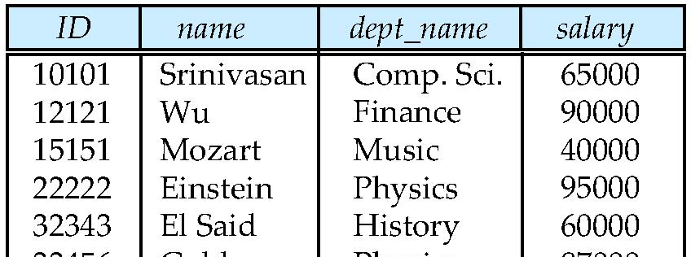
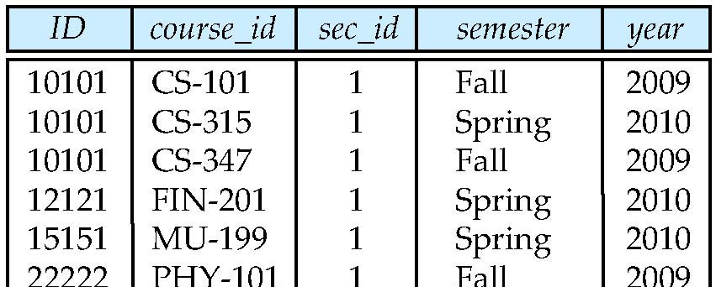
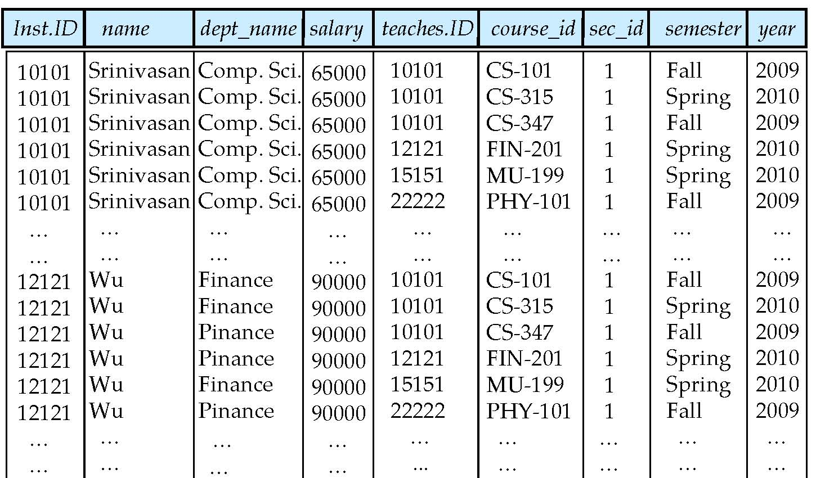
Cartesian Product
instructor
teaches

Slide 20
Examples
Find the names of all instructors who have taught some course and the course_id
select name, course_id from instructor , teaches where instructor.ID = teaches.ID
Find the names of all instructors in the Art department who have taught some course and the course_id
select name, course_id from instructor , teaches where instructor.ID = teaches.ID and instructor. dept_name = ‘Art’
Notes:
9

Slide 21
The Rename Operation
The SQL allows renaming relations and attributes using the as clause:
old-name as new-name
Find the names of all instructors who have a higher salary than some instructor in ‘Comp. Sci’.
select distinct T.name from instructor as T, instructor as S where T.salary > S.salary and S.dept_name = ‘Comp. Sci.’
Keyword as is optional and may be omitted instructor as T ≡ instructor T
Notes:
9

Slide 22
Cartesian Product Example
Relation emp-super
person supervisor
Bob Alice
Mary Susan
Alice David
David Mary
Find the supervisor of “Bob”
Find the supervisor of the supervisor of “Bob”
Find ALL the supervisors (direct and indirect) of “Bob

Slide 23
String Operations
SQL includes a string-matching operator for comparisons on character strings. The operator like uses patterns that are described using two special characters:
percent ( % ). The % character matches any substring.
underscore ( _ ). The _ character matches any character.
Find the names of all instructors whose name includes the substring “dar”.
select name from instructor where name like '%dar%'
Match the string “100%”
like ‘100 \%' escape '\'
in that above we use backslash (\) as the escape character.

Slide 24
String Operations (Cont.)
Patterns are case sensitive.
Pattern matching examples:
‘Intro%’ matches any string beginning with “Intro”.
‘%Comp%’ matches any string containing “Comp” as a substring.
‘_ _ _’ matches any string of exactly three characters.
‘_ _ _ %’ matches any string of at least three characters.
SQL supports a variety of string operations such as
concatenation (using “||”)
converting from upper to lower case (and vice versa)
finding string length, extracting substrings, etc.

Slide 25
Ordering the Display of Tuples
List in alphabetic order the names of all instructors
select distinct name from instructor order by name
We may specify desc for descending order or asc for ascending order, for each attribute; ascending order is the default.
Example: order by name desc
Can sort on multiple attributes
Example: order by dept_name, name

Slide 29
Where Clause Predicates
SQL includes a between comparison operator
Example: Find the names of all instructors with salary between $90,000 and $100,000 (that is, ≥ $90,000 and ≤ $100,000)
select name from instructor where salary between 90000 and 100000
Tuple comparison
select name, course_id from instructor, teaches where (instructor.ID, dept_name) = (teaches.ID, ’Biology’);
Notes:
7

Slide 30
Duplicates
In relations with duplicates, SQL can define how many copies of tuples appear in the result.
Multiset versions of some of the relational algebra operators – given multiset relations r₁ and r₂:
1. σ_{θ} (r₁): If there are c₁ copies of tuple t₁ in r₁, and t₁ satisfies selections σ_{θ,}, then there are c₁ copies of t₁ in σ_{θ} (r₁).
2. Π_{A} (r ): For each copy of tuple t₁ in r₁, there is a copy of tuple Π_{A} (t₁) in Π_{A} (r₁) where Π_{A} (t₁) denotes the projection of the single tuple t₁.
3. r₁ x r₂: If there are c₁ copies of tuple t₁ in r₁ and c₂ copies of tuple t₂ in r₂, there are c₁ x c₂ copies of the tuple t₁. t₂ in r₁ x r₂

Slide 31
Duplicates (Cont.)
Example: Suppose multiset relations r₁ (A, B) and r₂ (C) are as follows:
r₁ = {(1, a) (2,a)} r₂ = {(2), (3), (3)}
Then Π_{B}(r₁) would be {(a), (a)}, while Π_{B}(r₁) x r₂ would be
{(a,2), (a,2), (a,3), (a,3), (a,3), (a,3)}
SQL duplicate semantics:
select A₁,, A₂, ..., A_{n} from r₁, r₂, ..., r_{m} where P
is equivalent to the multiset version of the expression:

Slide 32
Set Operations
Find courses that ran in Fall 2009 or in Spring 2010
(select course_id from section where sem = ‘Fall’ and year = 2009) union (select course_id from section where sem = ‘Spring’ and year = 2010)
Find courses that ran in Fall 2009 and in Spring 2010
(select course_id from section where sem = ‘Fall’ and year = 2009) intersect (select course_id from section where sem = ‘Spring’ and year = 2010)
Find courses that ran in Fall 2009 but not in Spring 2010
(select course_id from section where sem = ‘Fall’ and year = 2009) except (select course_id from section where sem = ‘Spring’ and year = 2010)

Slide 33
Set Operations (Cont.)
Find the salaries of all instructors that are less than the largest salary.
select distinct T.salary from instructor as T, instructor as S where T.salary < S.salary
Find all the salaries of all instructors
select distinct salary from instructor
Find the largest salary of all instructors.
(select “second query” ) except (select “first query”)
Notes:
9

Slide 34
Set Operations (Cont.)
Set operations union, intersect, and except
Each of the above operations automatically eliminates duplicates
To retain all duplicates use the corresponding multiset versions union all, intersect all and except all.
Suppose a tuple occurs m times in r and n times in s, then, it occurs:
m + n times in r union all s
min(m,n) times in r intersect all s
max(0, m – n) times in r except all s

Slide 35
Null Values
It is possible for tuples to have a null value, denoted by null, for some of their attributes
null signifies an unknown value or that a value does not exist.
The result of any arithmetic expression involving null is null
Example: 5 + null returns null
The predicate is null can be used to check for null values.
Example: Find all instructors whose salary is null.
select name from instructor where salary is null

Slide 36
Null Values and Three Valued Logic
Three values – true, false, unknown
Any comparison with null returns unknown
Example: 5 < null or null <> null or null = null
Three-valued logic using the value unknown:
OR: (unknown or true) = true, (unknown or false) = unknown (unknown or unknown) = unknown
AND: (true and unknown) = unknown, (false and unknown) = false, (unknown and unknown) = unknown
NOT: (not unknown) = unknown
“P is unknown” evaluates to true if predicate P evaluates to unknown
Result of where clause predicate is treated as false if it evaluates to unknown

Slide 40
Aggregate Functions
These functions operate on the multiset of values of a column of a relation, and return a value
avg: average value min: minimum value max: maximum value sum: sum of values count: number of values

Slide 41
Aggregate Functions (Cont.)
Find the average salary of instructors in the Computer Science department
select avg (salary) from instructor where dept_name= ’Comp. Sci.’;
Find the total number of instructors who teach a course in the Spring 2010 semester
select count (distinct ID) from teaches where semester = ’Spring’ and year = 2010;
Find the number of tuples in the course relation
select count (*) from course;

Slide 42
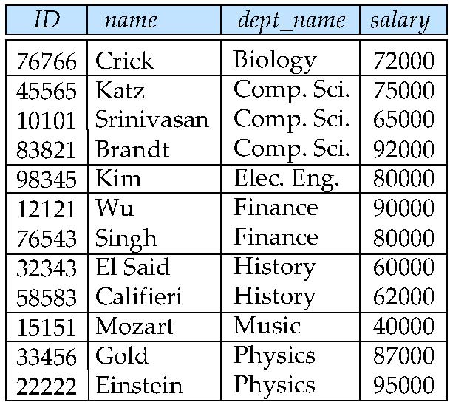
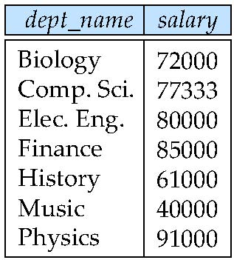
Aggregate Functions – Group By
Find the average salary of instructors in each department
select dept_name, avg (salary) as avg_salary from instructor group by dept_name;
avg_salary

Slide 43
Aggregation (Cont.)
Attributes in select clause outside of aggregate functions must appear in group by list
/* erroneous query */ select dept_name, ID, avg (salary) from instructor group by dept_name;

Slide 47
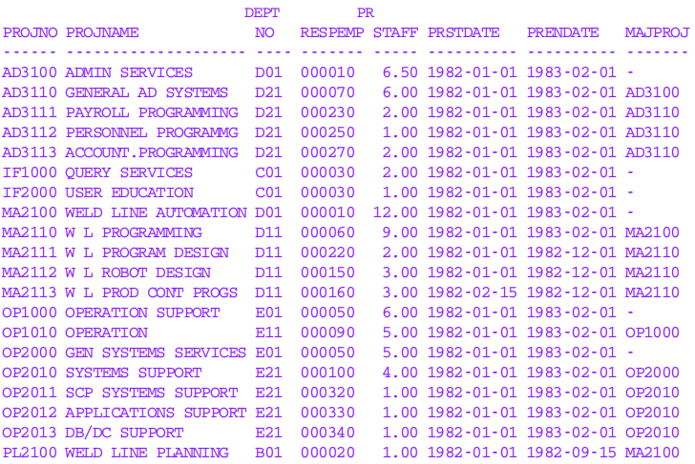

Slide 48
Aggregate Functions – Having Clause
Find the names and average salaries of all departments whose average salary is greater than 42000
select dept_name, avg (salary)
from instructor
group by dept_name
having avg (salary) > 42000;
Note: predicates in the having clause are applied after the formation of groups whereas predicates in the where clause are applied before forming groups

Slide 57
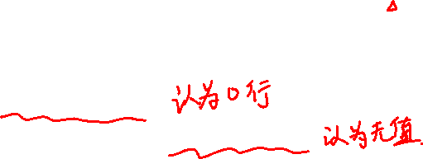
Null Values and Aggregates
Total all salaries
select sum (salary ) from instructor
Above statement ignores null amounts
Result is null if there is no non-null amount
All aggregate operations except count(*) ignore tuples with null values on the aggregated attributes
What if collection has only null values?
count returns 0
all other aggregates return null

Slide 58
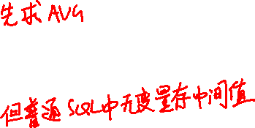

Slide 59

Nested Subqueries
SQL provides a mechanism for the nesting of subqueries. A subquery is a select-from-where expression that is nested within another query.
The nesting can be done in the following SQL query select A₁, A₂, ..., A_{n} from r₁, r₂, ..., r_{m} where P as follows:
A_{i} can be replaced be a subquery that generates a single value.
r_{i} can be replaced by any valid subquery
P can be replaced with an expression of the form:
B <operation> (subquery)
Where B is an attribute and <operation> to be defined later.

Slide 60

Subqueries in the Where Clause

Slide 61
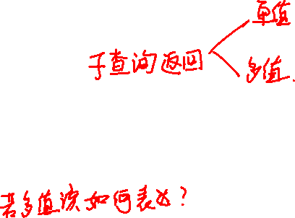

Slide 62
Subqueries in the Where Clause
A common use of subqueries is to perform tests:
For set membership
For set comparisons
For set cardinality.

Slide 64
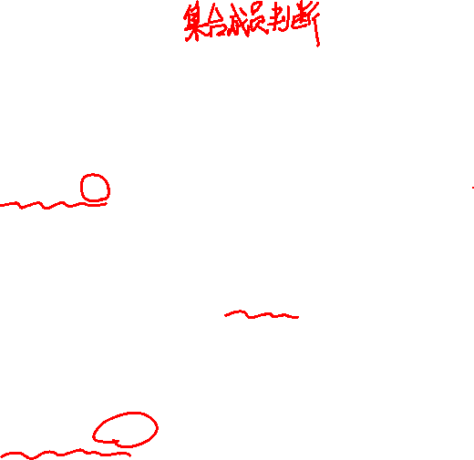
Set Membership
Find courses offered in Fall 2009 and in Spring 2010
select distinct course_id
from section
where semester = ’Fall’ and year= 2009 and course_id in (select course_id
from section
where semester = ’Spring’ and year= 2010);
Find courses offered in Fall 2009 but not in Spring 2010
select distinct course_id
from section
where semester = ’Fall’ and year= 2009 and course_id not in (select course_id
from section
where semester = ’Spring’ and year= 2010);

Slide 65
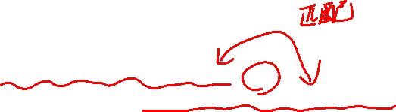
Set Membership (Cont.)
Find the total number of (distinct) students who have taken course sections taught by the instructor with ID 10101
select count (distinct ID)
from takes
where (course_id, sec_id, semester, year) in (select course_id, sec_id, semester, year
from teaches
where teaches.ID= 10101);
Note: Above query can be written in a much simpler manner. The formulation above is simply to illustrate SQL features.

Slide 68


Slide 69
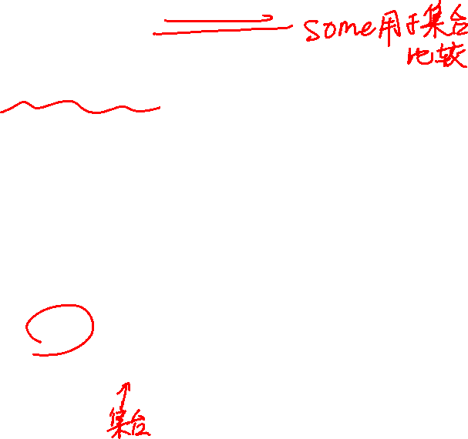
Set Comparison – “some” Clause
Find names of instructors with salary greater than that of some (at least one) instructor in the Biology department.
select distinct T.name
from instructor as T, instructor as S
where T.salary > S.salary and S.dept name = ’Biology’;
Same query using > some clause
select name
from instructor
where salary > some (select salary
from instructor
where dept name = ’Biology’);

Slide 70

Definition of “some” Clause
F <comp> some r ⇔ ∃ t ∈ r such that (F <comp> t ) Where <comp> can be: <, ≤, >, =, ≠
0
(5 < some
5
) = true
(read: 5 < some tuple in the relation)
6
0
(5 < some
5
) = false
0
(5 = some
) = true
5
0
(5 ≠ some
5
) = true (since 0 ≠ 5)
(= some) ≡ in
However, (≠ some) ≡ not in

Slide 71

Set Comparison – “all” Clause
Find the names of all instructors whose salary is greater than the salary of all instructors in the Biology department.
select name
from instructor
where salary > all (select salary
from instructor
where dept name = ’Biology’);

Slide 72

Definition of “all” Clause
F <comp> all r ⇔ ∀ t ∈ r (F <comp> t)
0
(5 < all
5
) = false
6
6
(5 < all
) = true
10
4
(5 = all
) = false
5
4
(5 ≠ all
) = true (since 5 ≠ 4 and 5 ≠ 6)
6
(≠ all) ≡ not in
However, (= all) ≡ in

Slide 73
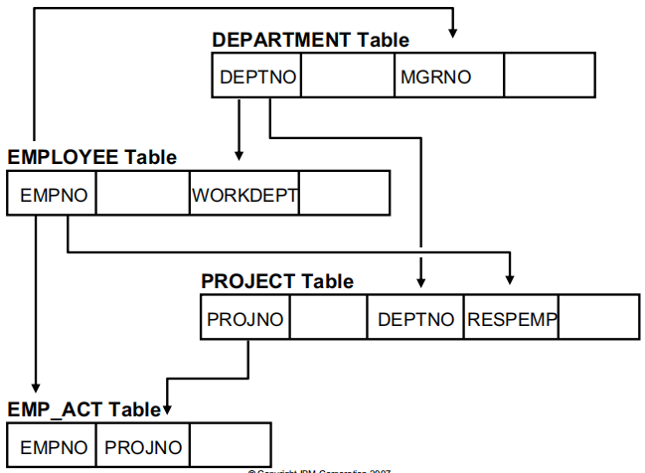

Slide 74
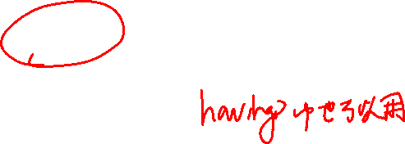

Slide 75


Slide 76

Notes:
1. False. A column function produces a summary row for a set
of rows.
2. False. A GROUP BY is required and all three columns not
in column functions must be listed in the GROUP BY
clause.
3. e
4. False. Column functions may not be used in a WHERE
clause.

Slide 77
Notes:
1. True
2. b
3. IN

Slide 78
Test for Empty Relations
The exists construct returns the value true if the argument subquery is nonempty.
exists r ⇔ r ≠ Ø
not exists r ⇔ r = Ø

Slide 79
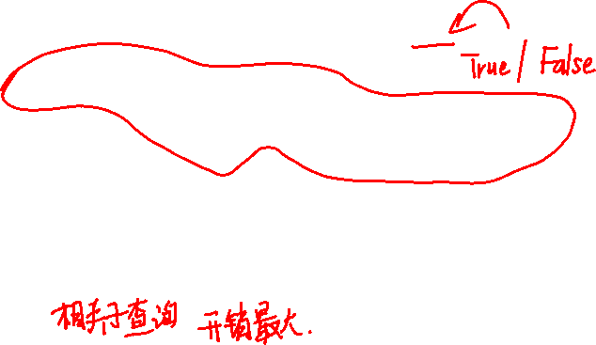
Use of “exists” Clause
Yet another way of specifying the query “Find all courses taught in both the Fall 2009 semester and in the Spring 2010 semester”
select course_id from section as S where semester = ’Fall’ and year = 2009 and exists (select * from section as T where semester = ’Spring’ and year= 2010 and S.course_id = T.course_id);
Correlation name – variable S in the outer query
Correlated subquery – the inner query

Slide 80
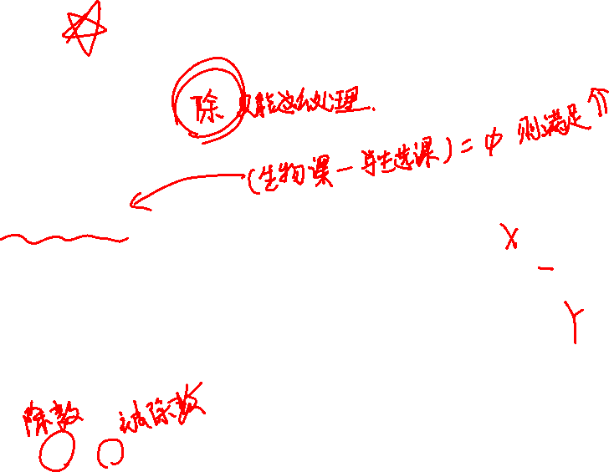
Use of “not exists” Clause
Find all students who have taken all courses offered in the Biology department.
select distinct S.ID, S.name
from student as S
where not exists ( (select course_id from course
where dept_name = ’Biology’)
except
(select T.course_id from takes as T
where S.ID = T.ID));
First nested query lists all courses offered in Biology
Second nested query lists all courses a particular student took
Note that X – Y = Ø ⇔ X ⊆ Y
Note: Cannot write this query using = all and its variants

Slide 81

Test for Absence of Duplicate Tuples
The unique construct tests whether a subquery has any duplicate tuples in its result.
The unique construct evaluates to “true” if a given subquery contains no duplicates .
Find all courses that were offered at most once in 2009
select T.course_id from course as T where unique (select R.course_id from section as R where T.course_id= R.course_id and R.year = 2009);

Slide 82
Subqueries in the From Clause

Slide 83
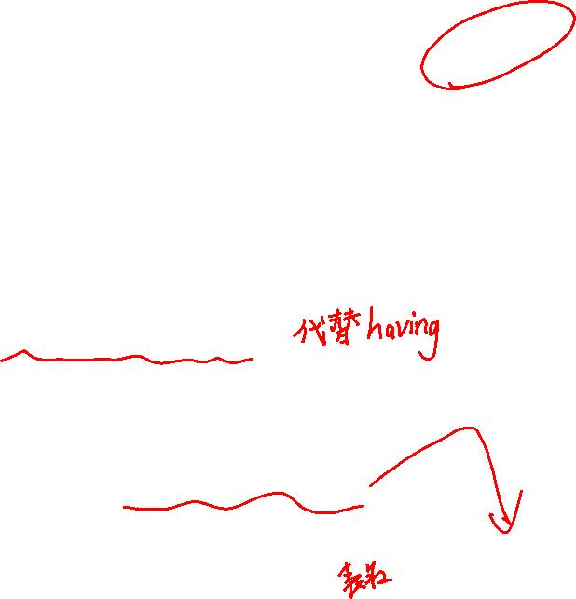
Subqueries in the From Clause
SQL allows a subquery expression to be used in the from clause
Find the average instructors’ salaries of those departments where the average salary is greater than $42,000.”
select dept_name, avg_salary from (select dept_name, avg (salary) as avg_salary from instructor group by dept_name) where avg_salary > 42000;
Note that we do not need to use the having clause
Another way to write above query
select dept_name, avg_salary from (select dept_name, avg (salary) from instructor group by dept_name) as dept_avg (dept_name, avg_salary)
where avg_salary > 42000;

Slide 84

With Clause
The with clause provides a way of defining a temporary relation whose definition is available only to the query in which the with clause occurs.
Find all departments with the maximum budget with max_budget (value) as (select max(budget) from department) select department.name from department, max_budget where department.budget = max_budget.value;

Slide 85
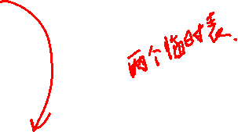
Complex Queries using With Clause
Find all departments where the total salary is greater than the average of the total salary at all departments
with dept _total (dept_name, value) as
(select dept_name, sum(salary)
from instructor
group by dept_name),
dept_total_avg(value) as
( select avg(value)
from dept_total )
select dept_name
from dept_total, dept_total_avg
where dept_total.value > dept_total_avg.value;
total salary at all departments
average of the dept_total

Slide 86
Subqueries in the Select Clause

Slide 87
Scalar Subquery
Scalar subquery is one which is used where a single value is expected
List all departments along with the number of instructors in each department
select dept_name, ( select count(*) from instructor where department.dept_name =
instructor.dept_name) as num_instructors from department;
Runtime error if subquery returns more than one result tuple

Slide 88
Modification of the Database
Deletion of tuples from a given relation.
Insertion of new tuples into a given relation
Updating of values in some tuples in a given relation

Slide 89
Deletion
Delete all instructors
delete from instructor
Delete all instructors from the Finance department delete from instructor where dept_name= ’Finance’;
Delete all tuples in the instructor relation for those instructors associated with a department located in the Watson building.
delete from instructor where dept name in ( select dept name from department where building = ’Watson’);

Slide 90
Deletion (Cont.)
Delete all instructors whose salary is less than the average salary of instructors
delete from instructor
where salary < (select avg (salary)
from instructor);
Problem: as we delete tuples from deposit, the average salary changes
Solution used in SQL:
1. First, compute avg (salary) and find all tuples to delete
2. Next, delete all tuples found above (without
recomputing avg or retesting the tuples)

Slide 91

Insertion
Add a new tuple to course
insert into course values (’CS-437’, ’Database Systems’, ’Comp. Sci.’, 4);
or equivalently insert into course (course_id, title, dept_name, credits) values (’CS-437’, ’Database Systems’, ’Comp. Sci.’, 4);
Add a new tuple to student with tot_creds set to null
insert into student values (’3003’, ’Green’, ’Finance’, null);

Slide 92

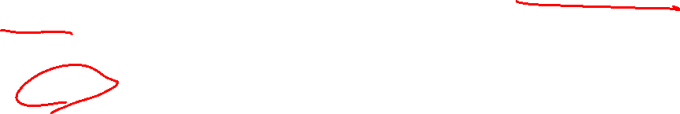
Insertion (Cont.)
Add all instructors to the student relation with tot_creds set to 0
insert into student select ID, name, dept_name, 0 from instructor
The select from where statement is evaluated fully before any of its results are inserted into the relation.
Otherwise queries like
insert into table1 select * from table1
would cause problem

Slide 93
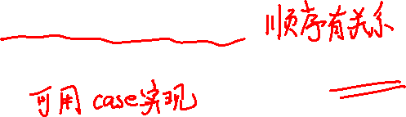
Updates
Increase salaries of instructors whose salary is over $100,000 by 3%, and all others by a 5%
Write two update statements:
update instructor set salary = salary * 1.03 where salary > 100000; update instructor set salary = salary * 1.05 where salary <= 100000;
The order is important
Can be done better using the case statement (next slide)

Slide 94

Case Statement for Conditional Updates
Same query as before but with case statement
update instructor set salary = case when salary <= 100000 then salary * 1.05 else salary * 1.03 end

Slide 95

Updates with Scalar Subqueries
Recompute and update tot_creds value for all students
update student S set tot_cred = ( select sum(credits) from takes, course where takes.course_id = course.course_id and S.ID= takes.ID.and takes.grade <> ’F’ and
takes.grade is not null );
Sets tot_creds to null for students who have not taken any course
Instead of sum(credits), use:
case when sum(credits) is not null then sum(credits) else 0 end

Slide 96
End of Chapter 3

