Slide 1
Chapter 4: Intermediate SQL
Notes:
Intermediate 中间的，中级的

Slide 2
Chapter 4: Intermediate SQL
Join Expressions
Views
Transactions
Integrity Constraints
SQL Data Types and Schemas
Authorization
Notes:
1

Slide 3
Joined Relations
Join operations take two relations and return as a result another relation.
A join operation is a Cartesian product which requires that tuples in the two relations match (under some condition). It also specifies the attributes that are present in the result of the join
The join operations are typically used as subquery expressions in the from clause

Slide 4
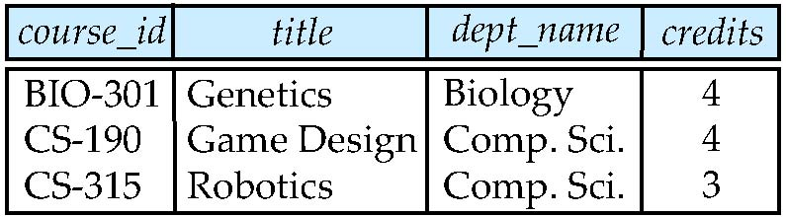
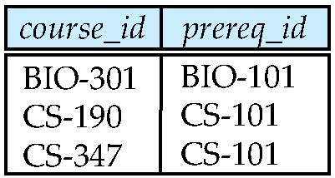
Join operations – Example
Relation course
Relation prereq
Observe that
prereq information is missing for CS-315 and
course information is missing for CS-437

Slide 5
Outer Join
An extension of the join operation that avoids loss of information.
Computes the join and then adds tuples form one relation that does not match tuples in the other relation to the result of the join.
Uses null values.

Slide 6
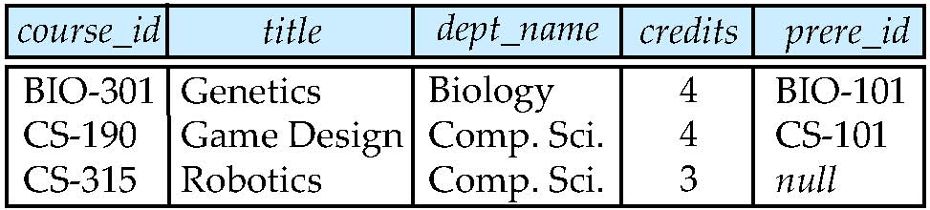
Left Outer Join
course natural left outer join prereq

Slide 7
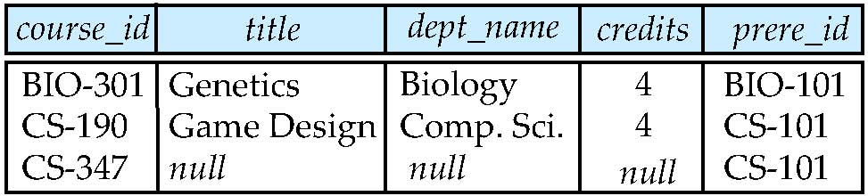
Right Outer Join
course natural right outer join prereq

Slide 8
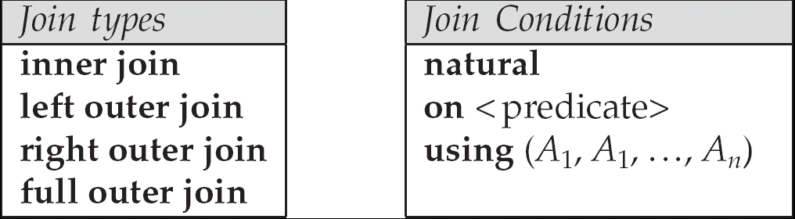
Joined Relations
Join operations take two relations and return as a result another relation.
These additional operations are typically used as subquery expressions in the from clause
Join condition – defines which tuples in the two relations match, and what attributes are present in the result of the join.
Join type – defines how tuples in each relation that do not match any tuple in the other relation (based on the join condition) are treated.

Slide 9
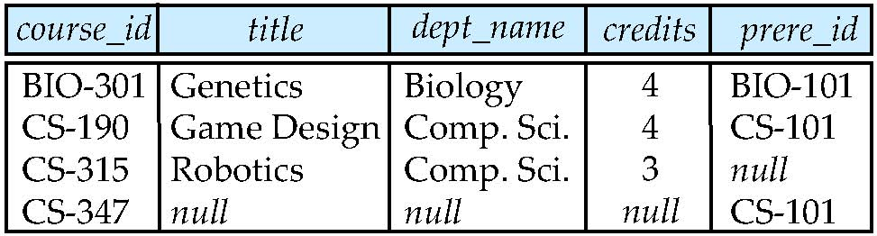
Full Outer Join
course natural full outer join prereq

Slide 10
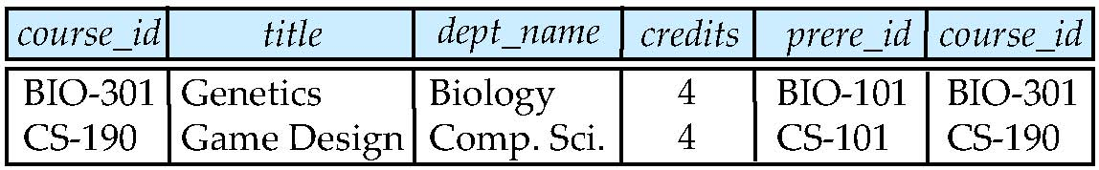
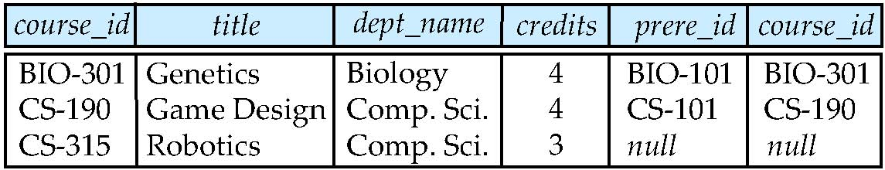
Joined Relations – Examples
course inner join prereq on course.course_id = prereq.course_id
What is the difference between the above, and a natural join?
course left outer join prereq on course.course_id = prereq.course_id

Slide 11
Joined Relations – Examples
course natural right outer join prereq
course full outer join prereq using (course_id)

Slide 12
连接的三种写法
SELECT Student.Sno, Course.Cno, Grade FROM Student, Course, SC WHERE Student.Sno = SC.Sno AND Course. Cno = SC.Cno AND Sname=“李博”
SELECT Student.Sno, Course.Cno, Grade FROM ((Student INNER JOIN SC on Student.Sno = SC.Sno) INNER JOIN Course ON Course. Cno = SC.Cno) WHERE Sname=“李博”
SELECT Student.Sno, Course.Cno, Grade FROM ((Student INNER JOIN SC USING(Sno)) //同名字段 INNER JOIN Course USING(Cno)) WHERE Sname=“李博”

Slide 13
Views
In some cases, it is not desirable for all users to see the entire logical model (that is, all the actual relations stored in the database.)
Consider a person who needs to know an instructors name and department, but not the salary. This person should see a relation described, in SQL, by
select ID, name, dept_name from instructor
A view provides a mechanism to hide certain data from the view of certain users.
Any relation that is not of the conceptual model but is made visible to a user as a “virtual relation” is called a view.

Slide 14
View Definition
A view is defined using the create view statement which has the form
create view v as < query expression >
where <query expression> is any legal SQL expression. The view name is represented by v.
Once a view is defined, the view name can be used to refer to the virtual relation that the view generates.
View definition is not the same as creating a new relation by evaluating the query expression
Rather, a view definition causes the saving of an expression; the expression is substituted into queries using the view.

Slide 15
Example Views
A view of instructors without their salary create view faculty as select ID, name, dept_name from instructor
Find all instructors in the Biology department select name from faculty where dept_name = ‘Biology’
Create a view of department salary totals create view departments_total_salary( dept_name,
total_salary) as select dept_name, sum (salary) from instructor group by dept_name;

Slide 16
Views Defined Using Other Views
create view physics_fall_2009 as select course.course_id, sec_id, building, room_number from course, section where course.course_id = section.course_id and course.dept_name = ’Physics’ and section.semester = ’Fall’ and section.year = ’2009’;
create view physics_fall_2009_watson as select course_id, room_number from physics_fall_2009 where building= ’Watson’;

Slide 17
View Expansion
Expand use of a view in a query/another view
create view physics_fall_2009_watson as
( select course_id, room_number
from ( select course.course_id, building, room_number
from course, section
where course.course_id = section.course_id
and course.dept_name = ’Physics’
and section.semester = ’Fall’
and section.year = ’2009’)
where building= ’Watson’;

Slide 18
Views Defined Using Other Views
One view may be used in the expression defining another view
A view relation v₁ is said to depend directly on a view relation v₂ if v₂ is used in the expression defining v₁
A view relation v₁ is said to depend on view relation v₂ if either v₁ depends directly to v₂ or there is a path of dependencies from v₁ to v₂
A view relation v is said to be recursive if it depends on itself.

Slide 19
View Expansion
A way to define the meaning of views defined in terms of other views.
Let view v₁ be defined by an expression e₁ that may itself contain uses of view relations.
View expansion of an expression repeats the following replacement step:
repeat Find any view relation v_{i} in e₁ Replace the view relation v_{i} by the expression defining v_{i} until no more view relations are present in e₁
As long as the view definitions are not recursive, this loop will terminate

Slide 20
Update of a View
Add a new tuple to faculty view which we defined earlier
insert into faculty values (’30765’, ’Green’, ’Music’);
This insertion must be represented by the insertion of the tuple
(’30765’, ’Green’, ’Music’, null)
into the instructor relation

Slide 21




Some Updates cannot be Translated Uniquely
create view instructor_info as select ID, name, building from instructor, department where instructor.dept_name= department.dept_name;
insert into instructor_info values (’69987’, ’White’, ’Taylor’);
which department, if multiple departments in Taylor?
what if no department is in Taylor?
Most SQL implementations allow updates only on simple views
The from clause has only one database relation.
The select clause contains only attribute names of the relation, and does not have any expressions, aggregates, or distinct specification.
Any attribute not listed in the select clause can be set to null
The query does not have a group by or having clause.

Slide 22
And Some Not at All
create view history_instructors as select * from instructor where dept_name= ’History’;
What happens if we insert (’25566’, ’Brown’, ’Biology’, 100000) into history_instructors?

Slide 23
Materialized Views
Materializing a view: create a physical table containing all the tuples in the result of the query defining the view
If relations used in the query are updated, the materialized view result becomes out of date
Need to maintain the view, by updating the view whenever the underlying relations are updated.
视图是一种“虚关系”，实际查询时需要根据定义查询底层关系，当存在大量这样的查询时会有较高的成本。
某些数据库支持物化视图，像存储表一样将创建的视图关系“物化”存储在数据库中。
物化视图的创建、修改与删除语法同视图类似，区别是多了关键字 MATERIALIZED。

Slide 24
Transactions
Unit of work
Atomic transaction
either fully executed or rolled back as if it never occurred
Isolation from concurrent transactions
Transactions begin implicitly
Ended by commit work or rollback work
But default on most databases: each SQL statement commits automatically
Can turn off auto commit for a session (e.g. using API)
In SQL:1999, can use: begin atomic …. end
Not supported on most databases
Notes:
事务，后面会讲，这里跳过

Slide 25
Integrity Constraints
Integrity constraints guard against accidental damage to the database, by ensuring that authorized changes to the database do not result in a loss of data consistency.
A checking account must have a balance greater than $10,000.00
A salary of a bank employee must be at least $4.00 an hour
A customer must have a (non-null) phone number

Slide 26
Integrity Constraints on a Single Relation
not null
primary key
unique
check (P), where P is a predicate
Notes:
Unique允许空，但是也只能有一个空值

Slide 27
Not Null and Unique Constraints
not null
Declare name and budget to be not null
name varchar(20) not null budget numeric(12,2) not null
unique ( A₁, A₂, …, A_{m})
The unique specification states that the attributes A₁, A₂, … A_{m} form a candidate key.
Candidate keys are permitted to be null (in contrast to primary keys).

Slide 28

The check clause
check (P)， where P is a predicate
Example: ensure that semester is one of fall, winter, spring or summer:
create table section (
course_id varchar (8),
sec_id varchar (8),
semester varchar (6),
year numeric (4,0),
building varchar (15),
room_number varchar (7),
time slot id varchar (4),
primary key (course_id, sec_id, semester, year),
check (semester in (’Fall’, ’Winter’, ’Spring’, ’Summer’)) );
Notes:
Primary key 中若有多个属性，则只需至少其中一个不空即可

Slide 29


Referential Integrity
Ensures that a value that appears in one relation for a given set of attributes also appears for a certain set of attributes in another relation.
Example: If “Biology” is a department name appearing in one of the tuples in the instructor relation, then there exists a tuple in the department relation for “Biology”.
Let A be a set of attributes.
Let R and S be two relations that contain attributes A and where A is the primary key of S.
A is said to be a foreign key of R if for any values of A appearing in R these values also appear in S.

Slide 30
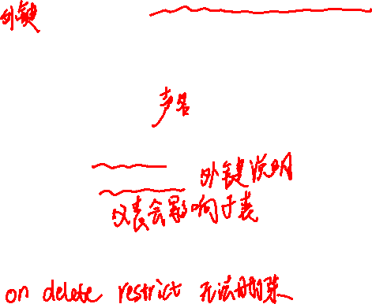
Cascading Actions in Referential Integrity
create table course ( course_id char(5) primary key, title varchar(20), dept_name varchar(20) references department )
create table course ( … dept_name varchar(20), foreign key (dept_name) references department on delete cascade on update cascade, . . . )
alternative actions to cascade: set null, set default

Slide 31

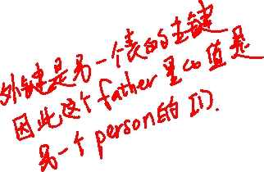
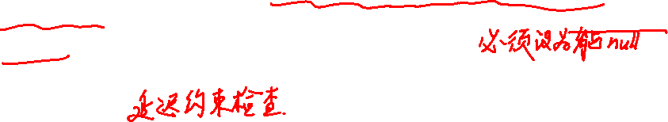
Integrity Constraint Violation During Transactions
E.g.
create table person ( ID char(10), name char(40), mother char(10), father char(10), primary key ID, foreign key father references person, foreign key mother references person)
How to insert a tuple without causing constraint violation ?
insert father and mother of a person before inserting person
OR, set father and mother to null initially, update after inserting all persons (not possible if father and mother attributes declared to be not null)
OR defer constraint checking (next slide)

Slide 32
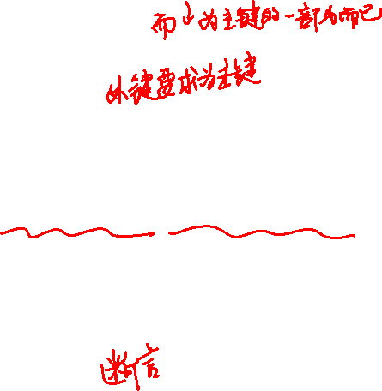
Complex Check Clauses
check (time_slot_id in (select time_slot_id from time_slot))
section关系上定义约束
why not use a foreign key here?
Every section has at least one instructor teaching the section.
how to write this?
Unfortunately: subquery in check clause not supported by pretty much any database
Alternative: triggers (later)
create assertion <assertion-name> check <predicate>;
Also not supported by anyone

Slide 33
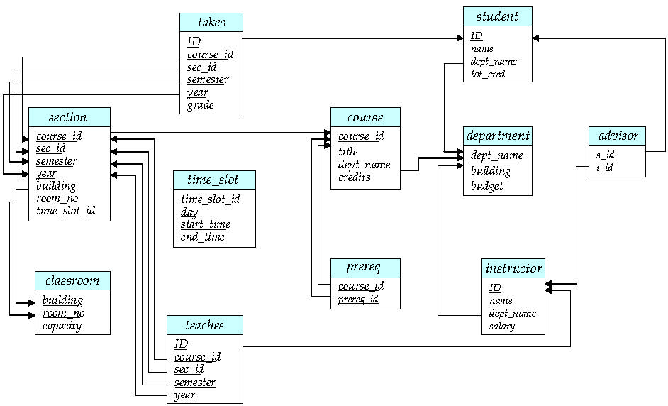
Schema Diagram for University Database

Slide 34
Built-in Data Types in SQL
date: Dates, containing a (4 digit) year, month and date
Example: date ‘2005-7-27’
time: Time of day, in hours, minutes and seconds.
Example: time ‘09:00:30’ time ‘09:00:30.75’
timestamp: date plus time of day
Example: timestamp ‘2005-7-27 09:00:30.75’
interval: period of time
Example: interval ‘1’ day
Subtracting a date/time/timestamp value from another gives an interval value
Interval values can be added to date/time/timestamp values

Slide 35
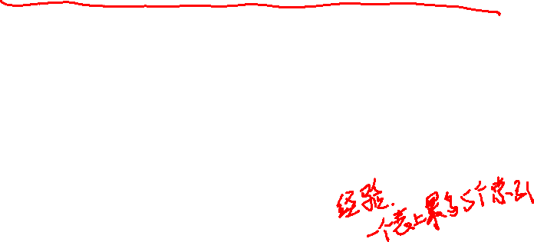
Index Creation
create table student ( ID varchar (5), name varchar (20) not null, dept_name varchar (20), tot_cred numeric (3,0) default 0, primary key (ID) )
create index studentID_index on student(ID)
Indices are data structures used to speed up access to records with specified values for index attributes
e.g. select * from student where ID = ‘12345’
can be executed by using the index to find the required record, without looking at all records of student
More on indices in Chapter 11

Slide 36

User-Defined Types
create type construct in SQL creates user-defined type
create type Dollars as numeric (12,2) final
create table department ( dept_name varchar (20), building varchar (15), budget Dollars );

Slide 37
Domains
create domain construct in SQL-92 creates user-defined domain types
create domain person_name char(20) not null
Types and domains are similar. Domains can have constraints, such as not null, specified on them.
create domain degree_level varchar(10) constraint degree_level_test check (value in (’Bachelors’, ’Masters’, ’Doctorate’));
Notes:
用得少

Slide 38
Large-Object Types
Large objects (photos, videos, CAD files, etc.) are stored as a large object:
blob: binary large object -- object is a large collection of uninterpreted binary data (whose interpretation is left to an application outside of the database system)
clob: character large object -- object is a large collection of character data
When a query returns a large object, a pointer is returned rather than the large object itself.

Slide 39
Authorization
Forms of authorization on parts of the database:
Read - allows reading, but not modification of data.
Insert - allows insertion of new data, but not modification of existing data.
Update - allows modification, but not deletion of data.
Delete - allows deletion of data.
Forms of authorization to modify the database schema
Index - allows creation and deletion of indices.
Resources - allows creation of new relations.
Alteration - allows addition or deletion of attributes in a relation.
Drop - allows deletion of relations.

Slide 40
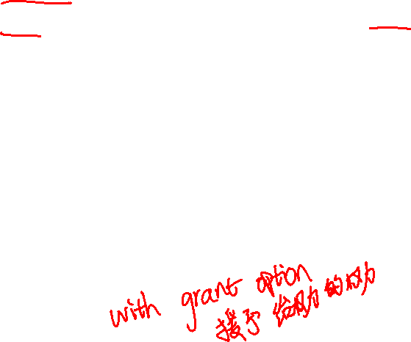
Authorization Specification in SQL
The grant statement is used to confer authorization
grant <privilege list>
on <relation name or view name> to <user list>
<user list> is:
a user-id
public, which allows all valid users the privilege granted
A role (more on this later)
Granting a privilege on a view does not imply granting any privileges on the underlying relations.
The grantor of the privilege must already hold the privilege on the specified item (or be the database administrator).

Slide 41

Privileges in SQL
select: allows read access to relation,or the ability to query using the view
Example: grant users U₁, U₂, and U₃ select authorization on the instructor relation:
grant select on instructor to U₁, U₂, U₃
insert: the ability to insert tuples
update: the ability to update using the SQL update statement
delete: the ability to delete tuples.
all privileges: used as a short form for all the allowable privileges

Slide 42
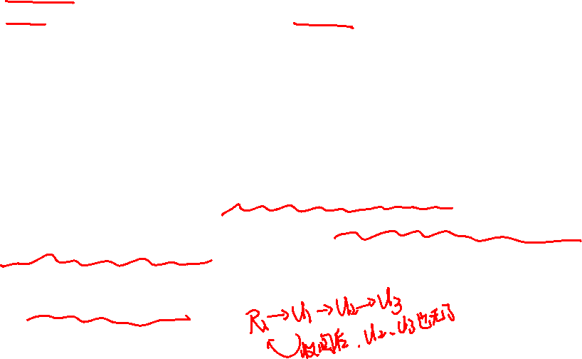
Revoking Authorization in SQL
The revoke statement is used to revoke authorization.
revoke <privilege list>
on <relation name or view name> from <user list>
Example:
revoke select on branch from U₁, U₂, U₃
<privilege-list> may be all to revoke all privileges the revokee may hold.
If <revokee-list> includes public, all users lose the privilege except those granted it explicitly.
If the same privilege was granted twice to the same user by different grantees, the user may retain the privilege after the revocation.
All privileges that depend on the privilege being revoked are also revoked.

Slide 43

Roles
create role instructor;
grant instructor to Amit;
Privileges can be granted to roles:
grant select on takes to instructor;
Roles can be granted to users, as well as to other roles
create role teaching_assistant
grant teaching_assistant to instructor;
Instructor inherits all privileges of teaching_assistant
Chain of roles
create role dean;
grant instructor to dean;
grant dean to Satoshi;

Slide 44
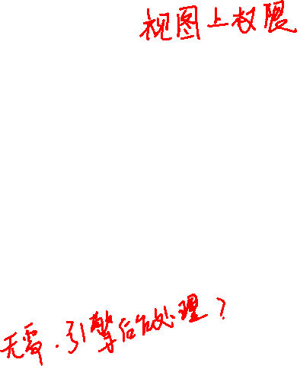

Authorization on Views
create view geo_instructor as ( select * from instructor where dept_name = ’Geology’);
grant select on geo_instructor to geo_staff
Suppose that a geo_staff member issues
select * from geo_instructor;
What if
geo_staff does not have permissions on instructor?
creator of view did not have some permissions on instructor?

Slide 45

Other Authorization Features
references privilege to create foreign key
grant reference (dept_name) on department to Mariano;
why is this required?
transfer of privileges
grant select on department to Amit with grant option;
revoke select on department from Amit, Satoshi cascade;
revoke select on department from Amit, Satoshi restrict;
Etc. read Section 4.6 for more details we have omitted here.

Slide 46
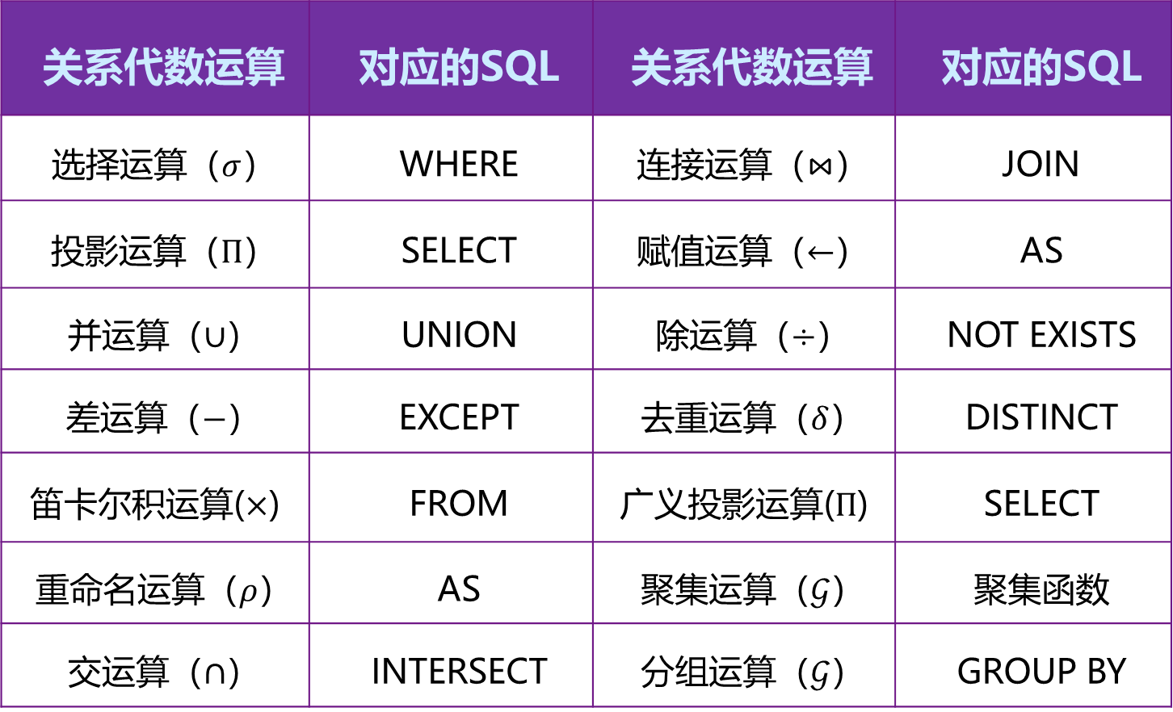
关系代数与SQL的转换
关系代数运算 | 对应的SQL | 关系代数运算 | 对应的SQL
选择运算（$σ$） | WHERE | 连接运算（$⋈$） | JOIN
投影运算（$Π$） | SELECT | 赋值运算（$←$） | AS
并运算（$∪$） | UNION | 除运算（$÷$） | NOT EXISTS
差运算（$−$） | EXCEPT | 去重运算（$δ$） | DISTINCT
笛卡尔积运算($×$) | FROM | 广义投影运算($Π$) | SELECT
重命名运算（$ρ$） | AS | 聚集运算（$𝒢$） | 聚集函数
交运算（$∩$） | INTERSECT | 分组运算（$𝒢$） | GROUP BY

Slide 47
End of Chapter 4

Slide 48
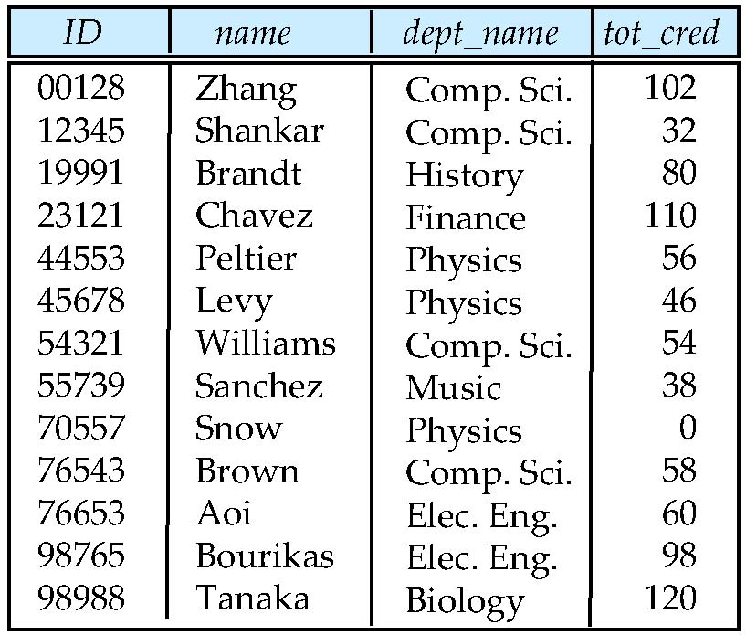
Figure 4.01

Slide 49
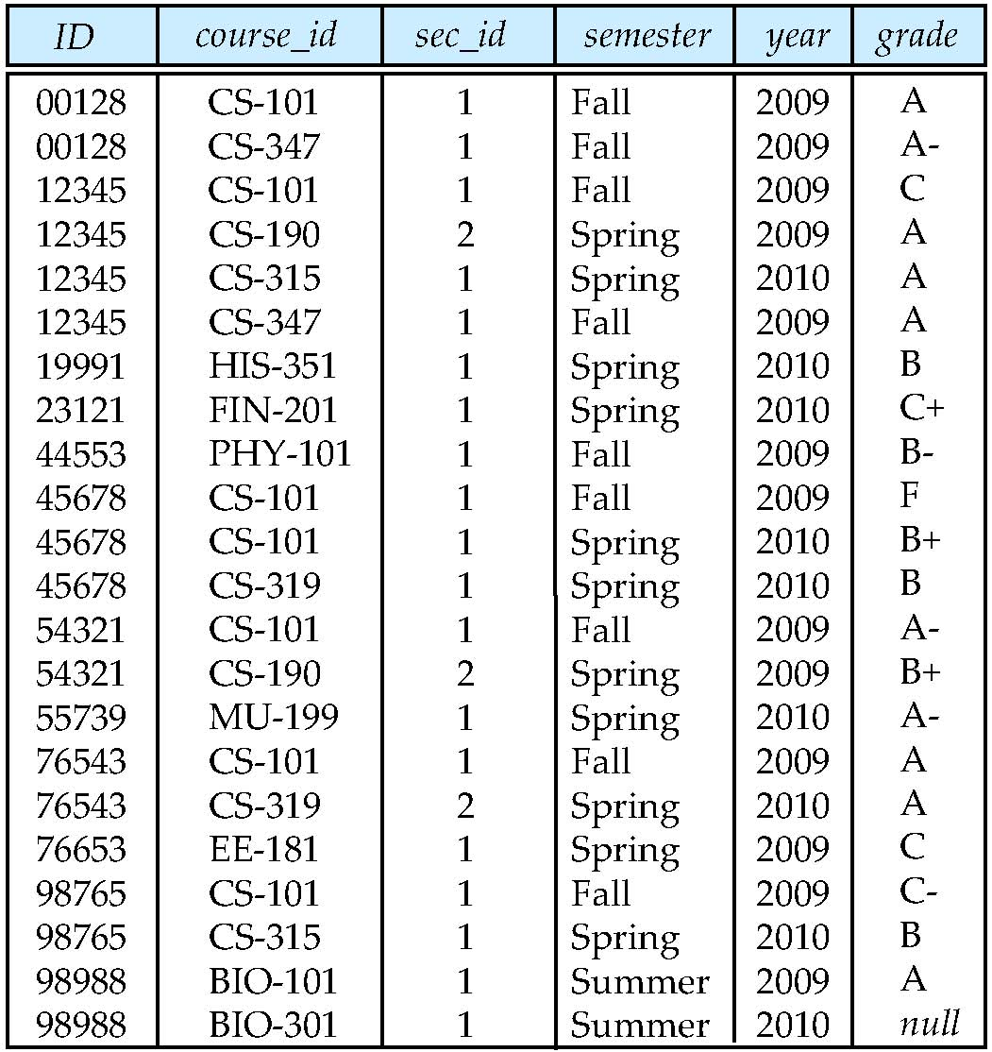
Figure 4.02

Slide 50
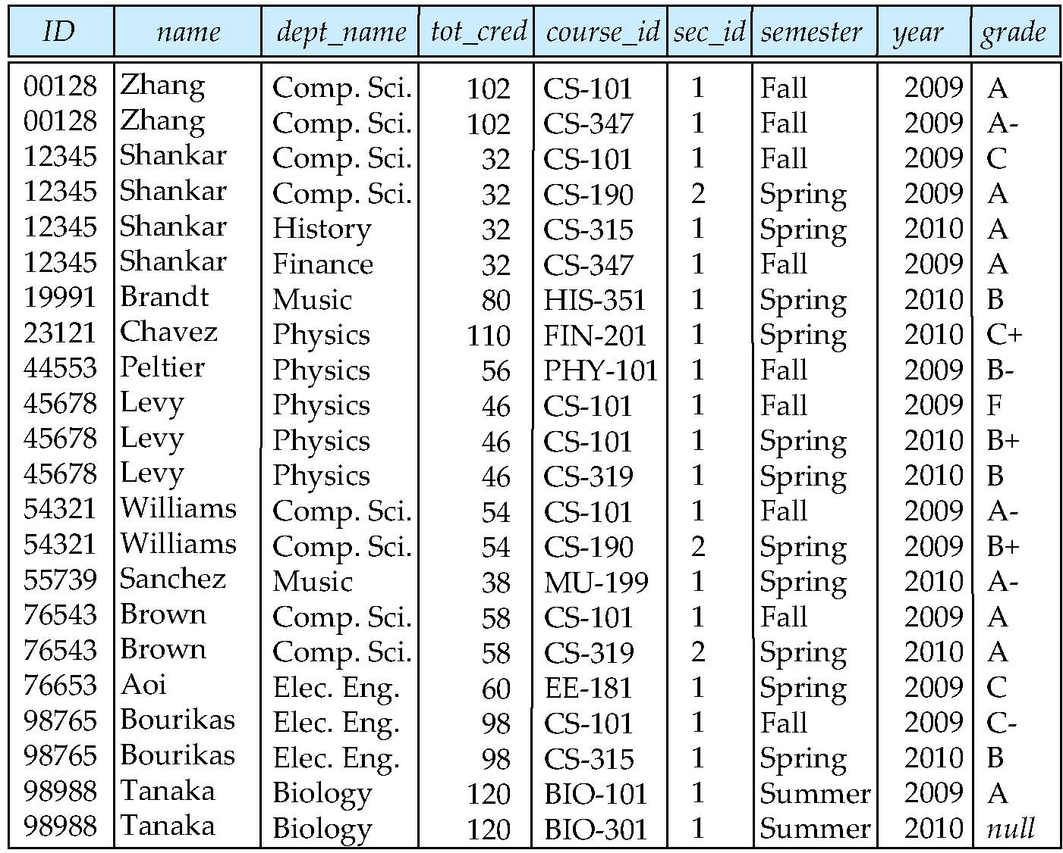
Figure 4.03

Slide 51
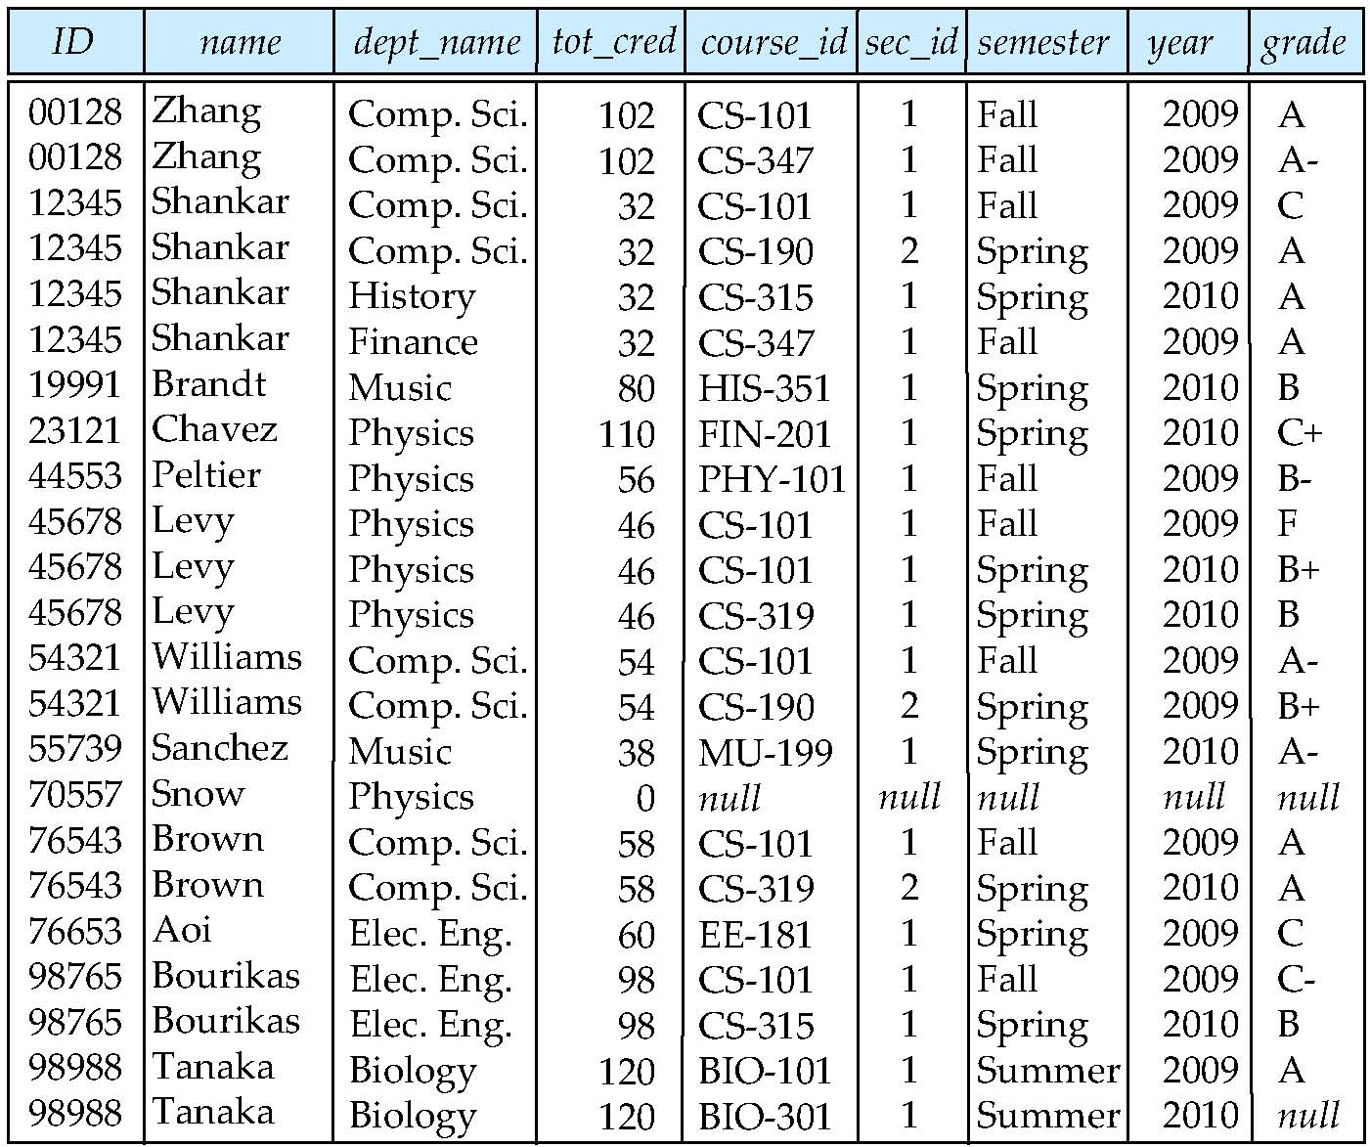
Figure 4.04

Slide 52
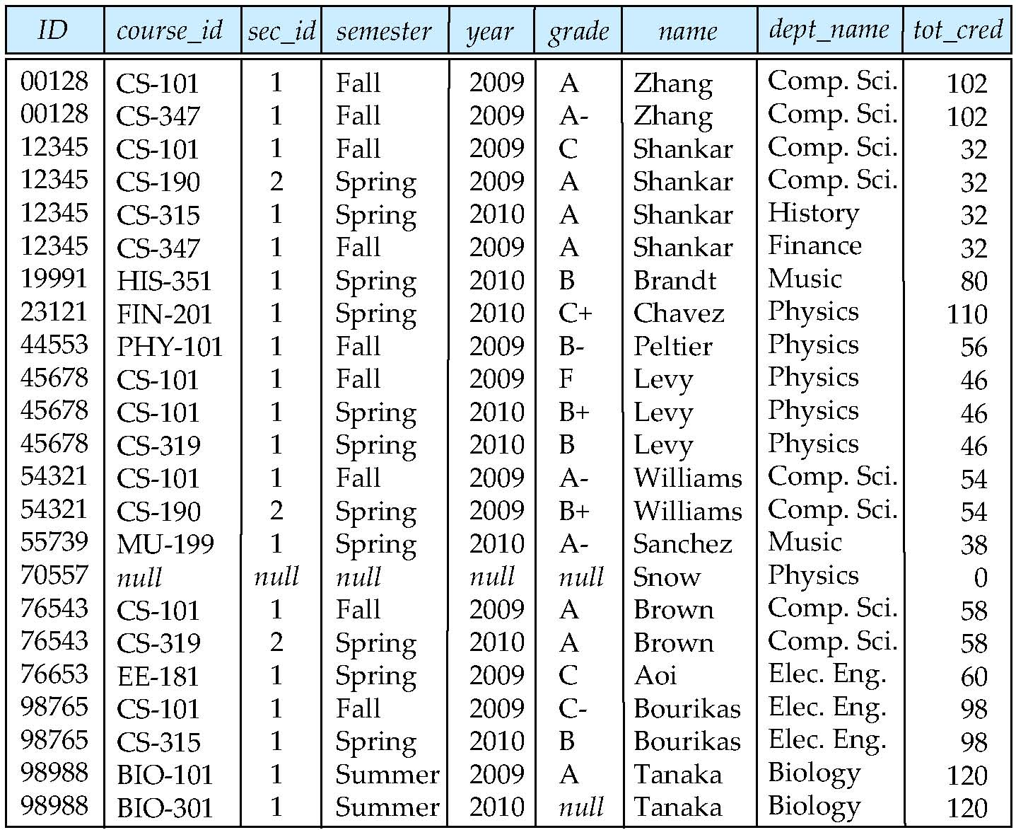
Figure 4.05

Slide 53
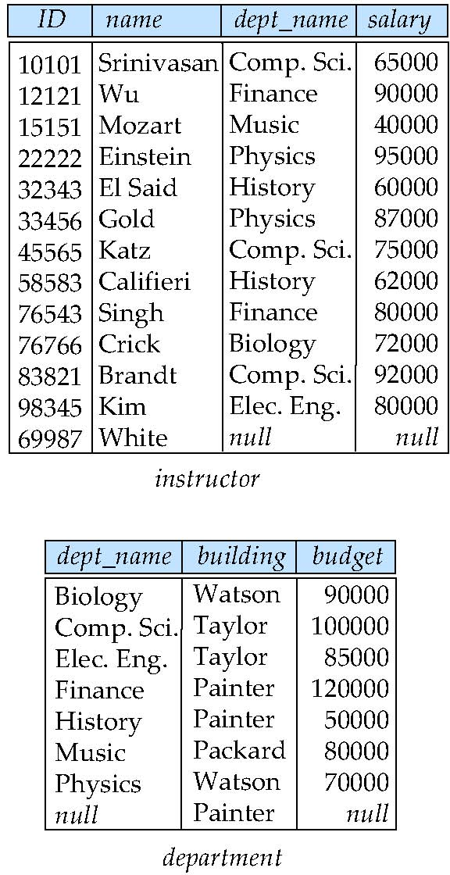
Figure 4.07
Taylor

Slide 54
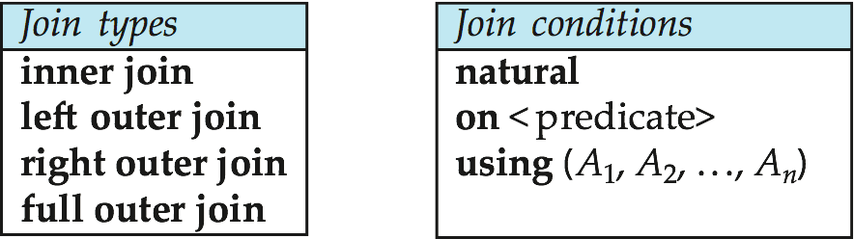
Figure 4.06

Slide 55
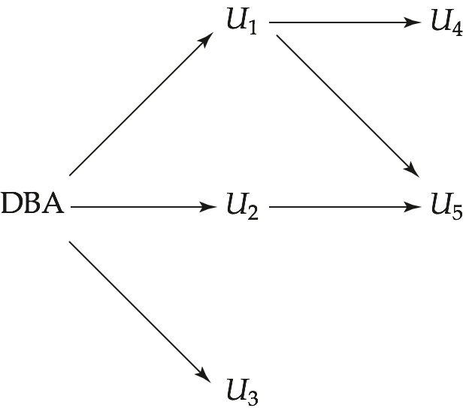
Figure 4.03

