Slide 1
Chapter 5: Advanced SQL
Notes:
高级sql语句

Slide 2
Outline
Accessing SQL From a Programming Language
Functions and Procedural Constructs
Triggers
Recursive Queries
Advanced Aggregation Features
OLAP

Slide 3
Accessing SQL From a Programming Language

Slide 4
Accessing SQL From a Programming Language
API (application-program interface) for a program to interact with a database server
Application makes calls to
Connect with the database server
Send SQL commands to the database server
Fetch tuples of result one-by-one into program variables
Various tools:
JDBC (Java Database Connectivity) works with Java
ODBC (Open Database Connectivity) works with C, C++, C#, and Visual Basic. Other API’s such as ADO.NET sit on top of ODBC
Embedded SQL

Slide 6
JDBC
JDBC is a Java API for communicating with database systems supporting SQL.
JDBC supports a variety of features for querying and updating data, and for retrieving query results.
JDBC also supports metadata retrieval, such as querying about relations present in the database and the names and types of relation attributes.
Model for communicating with the database:
Open a connection
Create a “statement” object
Execute queries using the Statement object to send queries and fetch results
Exception mechanism to handle errors

Slide 7
ODBC
Open DataBase Connectivity (ODBC) standard
standard for application program to communicate with a database server.
application program interface (API) to
open a connection with a database,
send queries and updates,
get back results.
Applications such as GUI, spreadsheets, etc. can use ODBC

Slide 8
Embedded SQL
The SQL standard defines embeddings of SQL in a variety of programming languages such as C, C++, Java, Fortran, and PL/1,
A language to which SQL queries are embedded is referred to as a host language, and the SQL structures permitted in the host language comprise embedded SQL.
The basic form of these languages follows that of the System R embedding of SQL into PL/1.
EXEC SQL statement is used to identify embedded SQL request to the preprocessor
EXEC SQL <embedded SQL statement >;
Note: this varies by language:
In some languages, like COBOL, the semicolon is replaced with END-EXEC
In Java embedding uses # SQL { …. };

Slide 9
Embedded SQL (Cont.)
Before executing any SQL statements, the program must first connect to the database. This is done using:
EXEC-SQL connect to server user user-name using password;
Here, server identifies the server to which a connection is to be established.
Variables of the host language can be used within embedded SQL statements.
They are preceded by a colon (:) to distinguish from SQL variables (e.g., :credit_amount )
Variables used as above must be declared within DECLARE section, as illustrated below. The syntax for declaring the variables, however, follows the usual host language syntax.
EXEC-SQL BEGIN DECLARE SECTION}
int credit-amount ;
EXEC-SQL END DECLARE SECTION;

Slide 10
Embedded SQL (Cont.)
To write an embedded SQL query, we use the
declare c cursor for <SQL query>
statement. The variable c is used to identify the query
Example:
From within a host language, find the ID and name of students who have completed more than the number of credits stored in variable credit_amount in the host langue
Specify the query in SQL as follows:
EXEC SQL
declare c cursor for select ID, name from student where tot_cred > :credit_amount
END_EXEC

Slide 11
Embedded SQL (Cont.)
Example:
From within a host language, find the ID and name of students who have completed more than the number of credits stored in variable credit_amount in the host langue
Specify the query in SQL as follows:
EXEC SQL
declare c cursor for select ID, name from student where tot_cred > :credit_amount
END_EXEC
The variable c (used in the cursor declaration) is used to identify the query

Slide 12
Embedded SQL (Cont.)
The open statement for our example is as follows:
EXEC SQL open c ;
This statement causes the database system to execute the query and to save the results within a temporary relation. The query uses the value of the host-language variable credit-amount at the time the open statement is executed.
The fetch statement causes the values of one tuple in the query result to be placed on host language variables.
EXEC SQL fetch c into :si, :sn END_EXEC
Repeated calls to fetch get successive tuples in the query result

Slide 13
Embedded SQL (Cont.)
A variable called SQLSTATE in the SQL communication area (SQLCA) gets set to ‘02000’ to indicate no more data is available
The close statement causes the database system to delete the temporary relation that holds the result of the query.
EXEC SQL close c ;
Note: above details vary with language. For example, the Java embedding defines Java iterators to step through result tuples.

Slide 14
Updates Through Embedded SQL
Embedded SQL expressions for database modification (update, insert, and delete)
Can update tuples fetched by cursor by declaring that the cursor is for update
EXEC SQL
declare c cursor for select * from instructor where dept_name = ‘Music’ for update
We then iterate through the tuples by performing fetch operations on the cursor (as illustrated earlier), and after fetching each tuple we execute the following code:
update instructor set salary = salary + 1000 where current of c

Slide 15
Extensions to SQL

Slide 16
Functions and Procedures
SQL:1999 supports functions and procedures
Functions/procedures can be written in SQL itself, or in an external programming language (e.g., C, Java).
Functions written in an external languages are particularly useful with specialized data types such as images and geometric objects.
Example: functions to check if polygons overlap, or to compare images for similarity.
Some database systems support table-valued functions, which can return a relation as a result.
SQL:1999 also supports a rich set of imperative constructs, including
Loops, if-then-else, assignment
Many databases have proprietary procedural extensions to SQL that differ from SQL:1999.

Slide 17
SQL Functions
Define a function that, given the name of a department, returns the count of the number of instructors in that department.
create function dept_count (dept_name varchar(20)) returns integer begin declare d_count integer; select count (* ) into d_count from instructor where instructor.dept_name = dept_name return d_count; end
The function dept_count can be used to find the department names and budget of all departments with more that 12 instructors.
select dept_name, budget from department where dept_count (dept_name ) > 12

Slide 18
存储过程和函数
存储过程和函数是事先经过编译并存储在数据库中的一段SQL语句的集合
存储过程和函数可以对一段代码进行封装，以便日后调用
数据库中创建存储过程的语句为CREATE PROCEDURE，并通过CALL语句加存储过程名来调用存储过程
数据库中创建函数的语句为CREATE FUNCTION，并通过函数名来调用函数
存储过程优势：
降低网络开销（存储到DB中，不频繁网络交互）
安全性高
性能高，编译一次多次使用
存储过程劣势：
开发调试难
可移植性差
难以支持分布式数据库

Slide 19
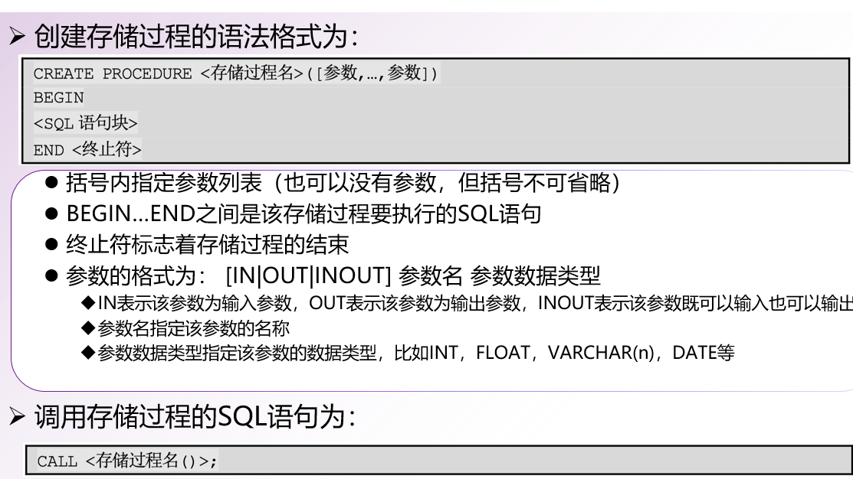
创建和调用存储过程

Slide 20
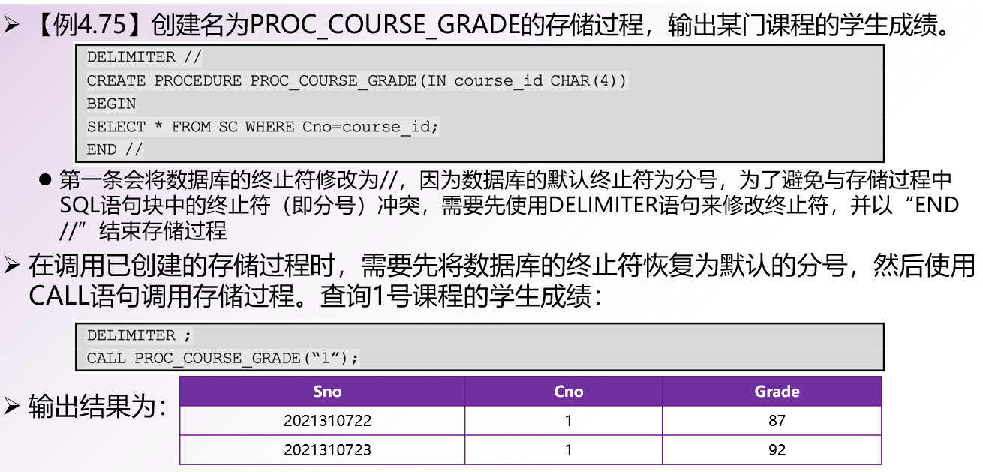
创建和调用存储过程

Slide 21
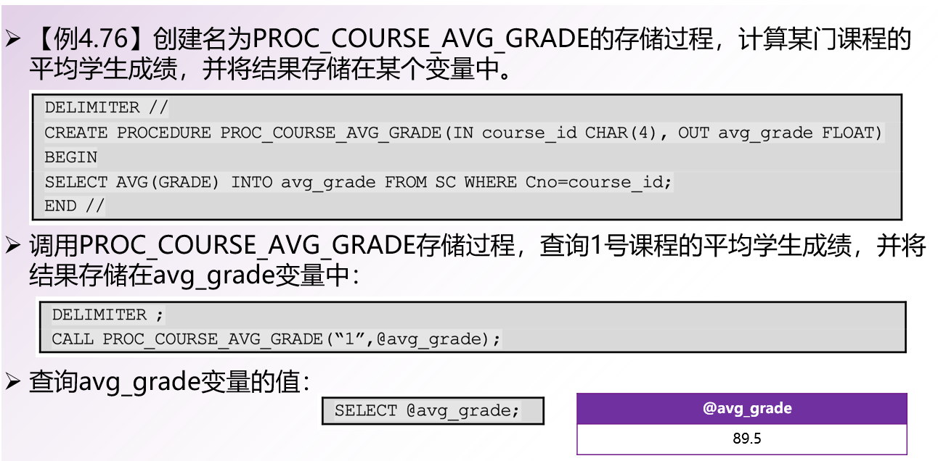
创建和调用存储过程

Slide 22
存储过程与函数
存储过程和函数都用于提高数据库性能，减少频繁访问数据库和减少网络延迟等方式加速执行效率。
函数：简单的计算型任务，例如字符串或日期拼接、返回单个值等。
存储过程：复杂的业务逻辑、更新和删除相关操作。
存储过程需要显式地被调用，并且可以包含各种复杂的控制结构和代码块。

Slide 23
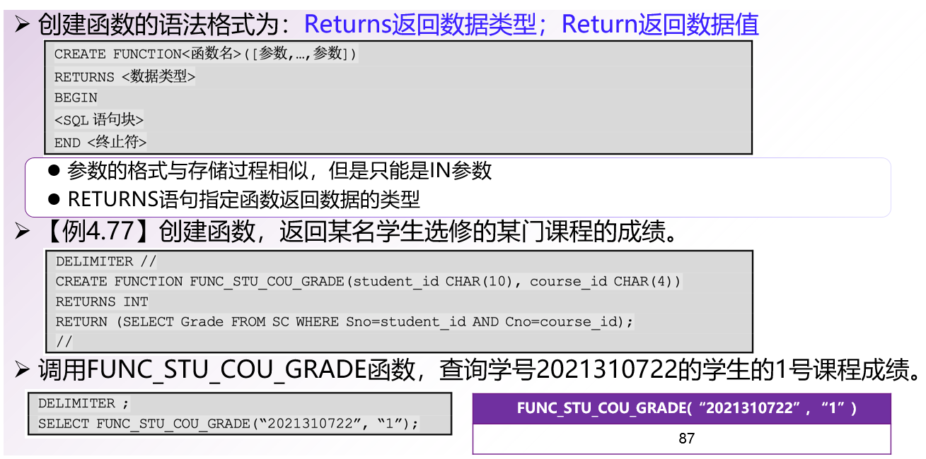
创建和调用函数

Slide 24
存储过程和函数的区别
存储过程可以通过OUT或INOUT参数返回多个值，而函数只能返回RETURNS子句中指定的某一类型的单值或表对象。
存储过程的参数可以为IN、OUT或INOUT，而函数的参数只能是IN类型。
存储过程可以通过CALL语句作为一个独立的部分来调用和执行，而函数可以作为查询语句的一部分来调用。
由于函数可以返回表对象，因此函数的返回结果也可以用在查询语句的FROM子句中。
创建函数时必须指定返回值数据类型，且函数体内必须有一个RETURNS语句。
存储过程中可以执行更新表的数据库操作，而函数则不可以。

Slide 25
Triggers

Slide 26
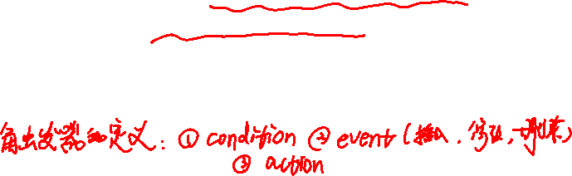
Triggers
A trigger is a statement that is executed automatically by the system as a side effect of a modification to the database.
To design a trigger mechanism, we must:
Specify the conditions under which the trigger is to be executed.
Specify the actions to be taken when the trigger executes.
Triggers introduced to SQL standard in SQL:1999, but supported even earlier using non-standard syntax by most databases.
Syntax illustrated here may not work exactly on your database system; check the system manuals

Slide 27

Triggering Events and Actions in SQL
Triggering event can be insert, delete or update
Triggers on update can be restricted to specific attributes
For example, after update of takes on grade
Values of attributes before and after an update can be referenced
referencing old row as : for deletes and updates
referencing new row as : for inserts and updates
Triggers can be activated before an event, which can serve as extra constraints.
For example, convert blank grades to null.
create trigger setnull_trigger before update of takes referencing new row as nrow for each row when (nrow.grade = ‘ ‘) begin atomic set nrow.grade = null; end;

Slide 28
Trigger to Maintain credits_earned value
create trigger credits_earned after update of takes on (grade) referencing new row as nrow referencing old row as orow for each row when nrow.grade <> ’F’ and nrow.grade is not null and (orow.grade = ’F’ or orow.grade is null) begin atomic update student set tot_cred= tot_cred + (select credits from course where course.course_id= nrow.course_id) where student.id = nrow.id; end;

Slide 29
Statement Level Triggers
Instead of executing a separate action for each affected row, a single action can be executed for all rows affected by a transaction
Use for each statement instead of for each row
Use referencing old table or referencing new table to refer to temporary tables (called transition tables) containing the affected rows
Can be more efficient when dealing with SQL statements that update a large number of rows

Slide 30
触发器可用于以下应用场景中：
（1）数据完整性。触发器可以用来保证数据完整性。
比如在插入数据之前检查数据类型、唯一性、主键约束，或者在数据被更新或删除时，进行级联操作等。
（2）数据审计。触发器可以用来跟踪数据库中数据的变化，以检查数据变化过程是否合法、规范，从而保证业务数据的正确性和合理性。
比如应确保涨薪后的员工工资高于之前的工资。
（3）数据安全性。触发器可以用来进行安全性检查
比如在非工作时间禁止插入新员工。
（4）数据备份和同步。
触发器可以在数据更新时对数据进行备份和同步。

Slide 31
When Not To Use Triggers
Triggers were used earlier for tasks such as
Maintaining summary data (e.g., total salary of each department)
Replicating databases by recording changes to special relations (called change or delta relations) and having a separate process that applies the changes over to a replica
There are better ways of doing these now:
Databases today provide built in materialized view facilities to maintain summary data
Databases provide built-in support for replication
Encapsulation facilities can be used instead of triggers in many cases
Define methods to update fields
Carry out actions as part of the update methods instead of through a trigger

Slide 32
When Not To Use Triggers (Cont.)
Risk of unintended execution of triggers, for example, when
Loading data from a backup copy
Replicating updates at a remote site
Trigger execution can be disabled before such actions.
Other risks with triggers:
Error leading to failure of critical transactions that set off the trigger
Cascading execution

Slide 33
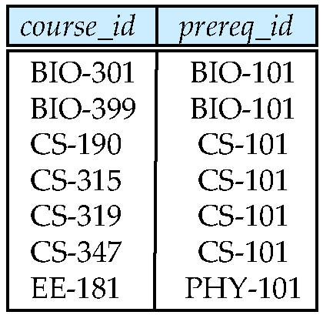

Recursive Queries
层次传递闭包的应用
机构通常用几层组织单元构成
部件又有子部件，传递闭包找出自行车中的所有部件
车轮、踏板
轮胎、轮圈、辐条
flights(to,from)：表示哪个城市可以从其他城市直接飞达
findAllPrereqs函数：找到所有从某个给定城市出发通过一次或一系列的飞行到达的城市
可能存在可达关系的环：去掉已见过的城市
person supervisor
Bob Alice
Mary Susan
Alice David
David Mary

Slide 34
Recursion in SQL
SQL:1999 permits recursive view definition
Example: find which courses are a prerequisite, whether directly or indirectly, for a specific course with recursive rec_prereq(course_id, prereq_id) as ( select course_id, prereq_id from prereq union select rec_prereq.course_id, prereq.prereq_id, from rec_rereq, prereq where rec_prereq.prereq_id = prereq.course_id ) select ∗ from rec_prereq;
This example view, rec_prereq, is called
the transitive closure of the prereq relation
prereq
rec_prere
Notes:
Note: 1st printing of 6th ed erroneously used c_prereq in place of rec_prereq in some places

Slide 35
The Power of Recursion
Recursive views make it possible to write queries, such as transitive closure queries, that cannot be written without recursion or iteration.
Intuition: Without recursion, a non-recursive non-iterative program can perform only a fixed number of joins of prereq with itself
This can give only a fixed number of levels of managers
Given a fixed non-recursive query, we can construct a database with a greater number of levels of prerequisites on which the query will not work
Alternative: write a procedure to iterate as many times as required
See procedure findAllPrereqs in book

Slide 36
The Power of Recursion
Computing transitive closure using iteration, adding successive tuples to rec_prereq
The next slide shows a prereq relation
Each step of the iterative process constructs an extended version of rec_prereq from its recursive definition.
The final result is called the fixed point of the recursive view definition.
Recursive views are required to be monotonic
if we add tuples to prereq the view rec_prereq contains all of the tuples it contained before, plus possibly more
Notes:
36

Slide 37
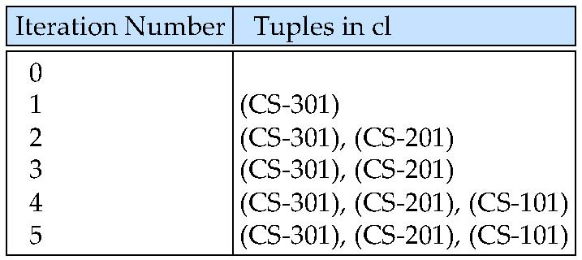
Example of Fixed-Point Computation

Slide 38
End of Chapter 5

