Slide 1
Chapter 8: Relational Database Design

Slide 2
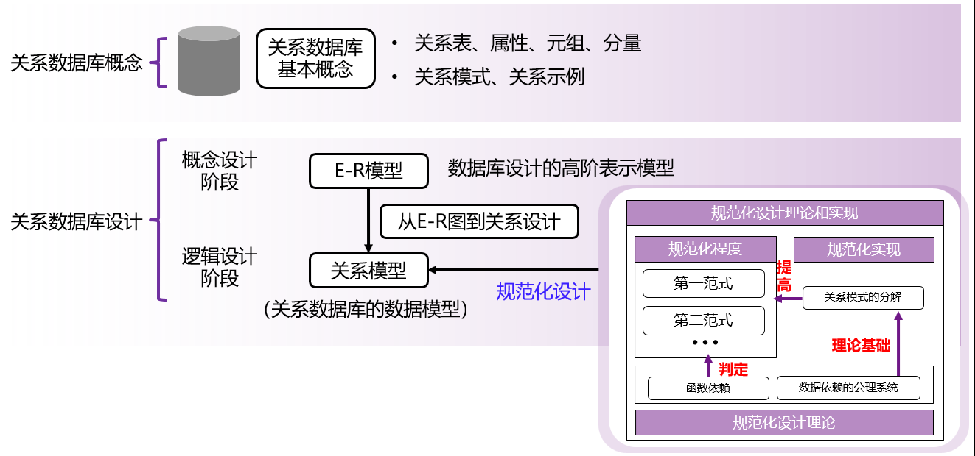
重要概念之间的关系

Slide 3
Chapter 8: Relational Database Design
Features of Good Relational Design
Atomic Domains and First Normal Form
Decomposition Using Functional Dependencies
Functional Dependency Theory
Algorithms for Functional Dependencies
Decomposition Using Multivalued Dependencies
More Normal Form
Database-Design Process
Modeling Temporal Data

Slide 4
为什么要规范化设计？
数据库规范化设计是指在数据库中减少数据冗余和定义一个规范的表间结构，以更好地实现数据完整性和一致性。
数据冗余是指一组数据不必要地重复出现在多个表中。
冗余数据会占用更多存储空间并且提高数据库的维护成本，例如维护数据一致性。
数据库规范化设计具有以下几个优点：
（1）降低数据存储和维护数据一致性的成本。
减少冗余数据，减少存储空间的开销；
当数据发生更新（以及插入和删除）的时候，不必同时更新那些冗余数据，降低了维护数据一致性的成本。
（2）便于设计合理的关系表间的依赖和约束关系
便于实现数据完整性和一致性，避免插入异常、删除异常、更新异常。
（3）便于设计合理的数据库结构，以提高数据库系统的整体性能。

Slide 5
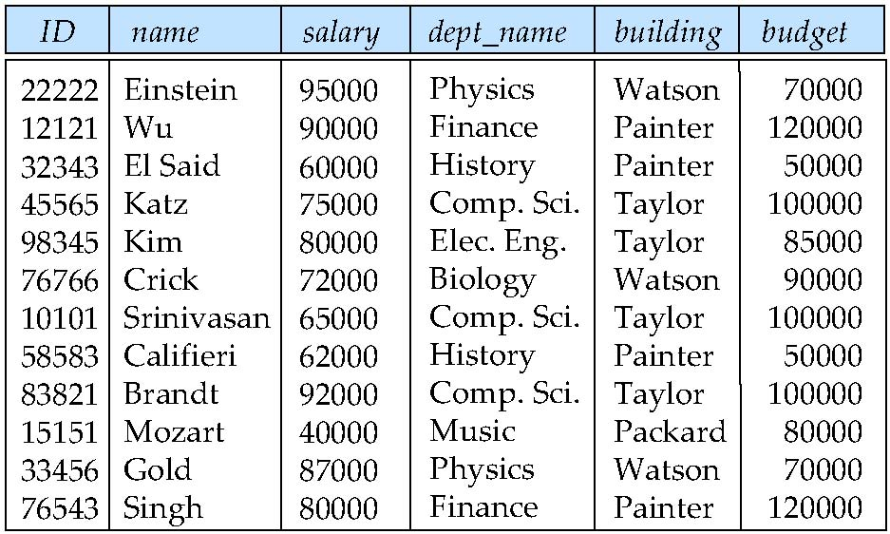
Combine Schemas?
Suppose we combine instructor and department into inst_dept
(No connection to relationship set inst_dept)
Result is possible repetition of information

Slide 6
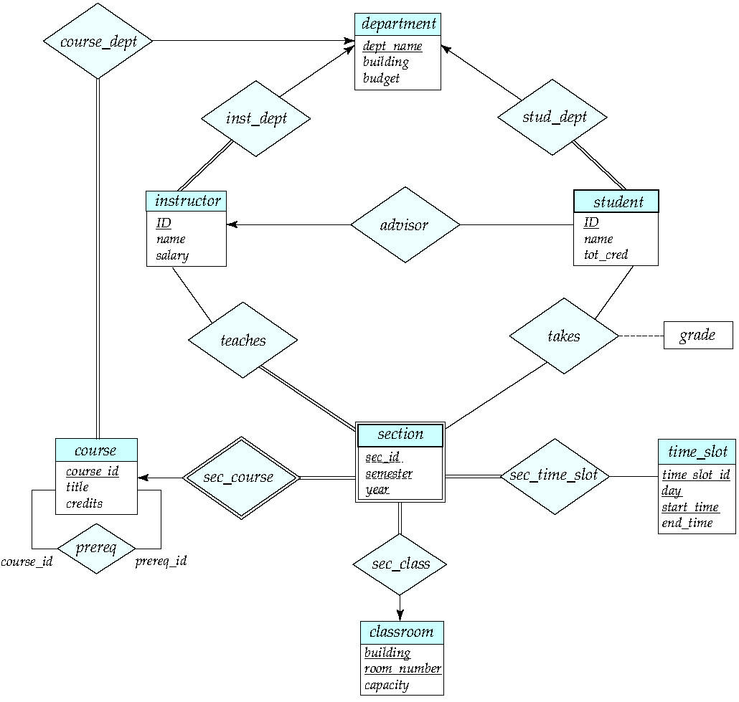

Slide 7
A Combined Schema Without Repetition
Consider combining relations
sec_class(sec_id, building, room_number) and
section(course_id, sec_id, semester, year)
into one relation
section(course_id, sec_id, semester, year, building, room_number)
No repetition in this case

Slide 8
What About Smaller Schemas?
Suppose we had started with inst_dept. How would we know to split up (decompose) it into instructor and department?
Write a rule “if there were a schema (dept_name, building, budget), then dept_name would be a candidate key”
Denote as a functional dependency:
dept_name → building, budget
In inst_dept, because dept_name is not a candidate key, the building and budget of a department may have to be repeated.
This indicates the need to decompose inst_dept
Not all decompositions are good. Suppose we decompose employee(ID, name, street, city, salary) into
employee1 (ID, name)，employee2 (name, street, city, salary)
The next slide shows how we lose information -- we cannot reconstruct the original employee relation -- and so, this is a lossy decomposition.

Slide 9
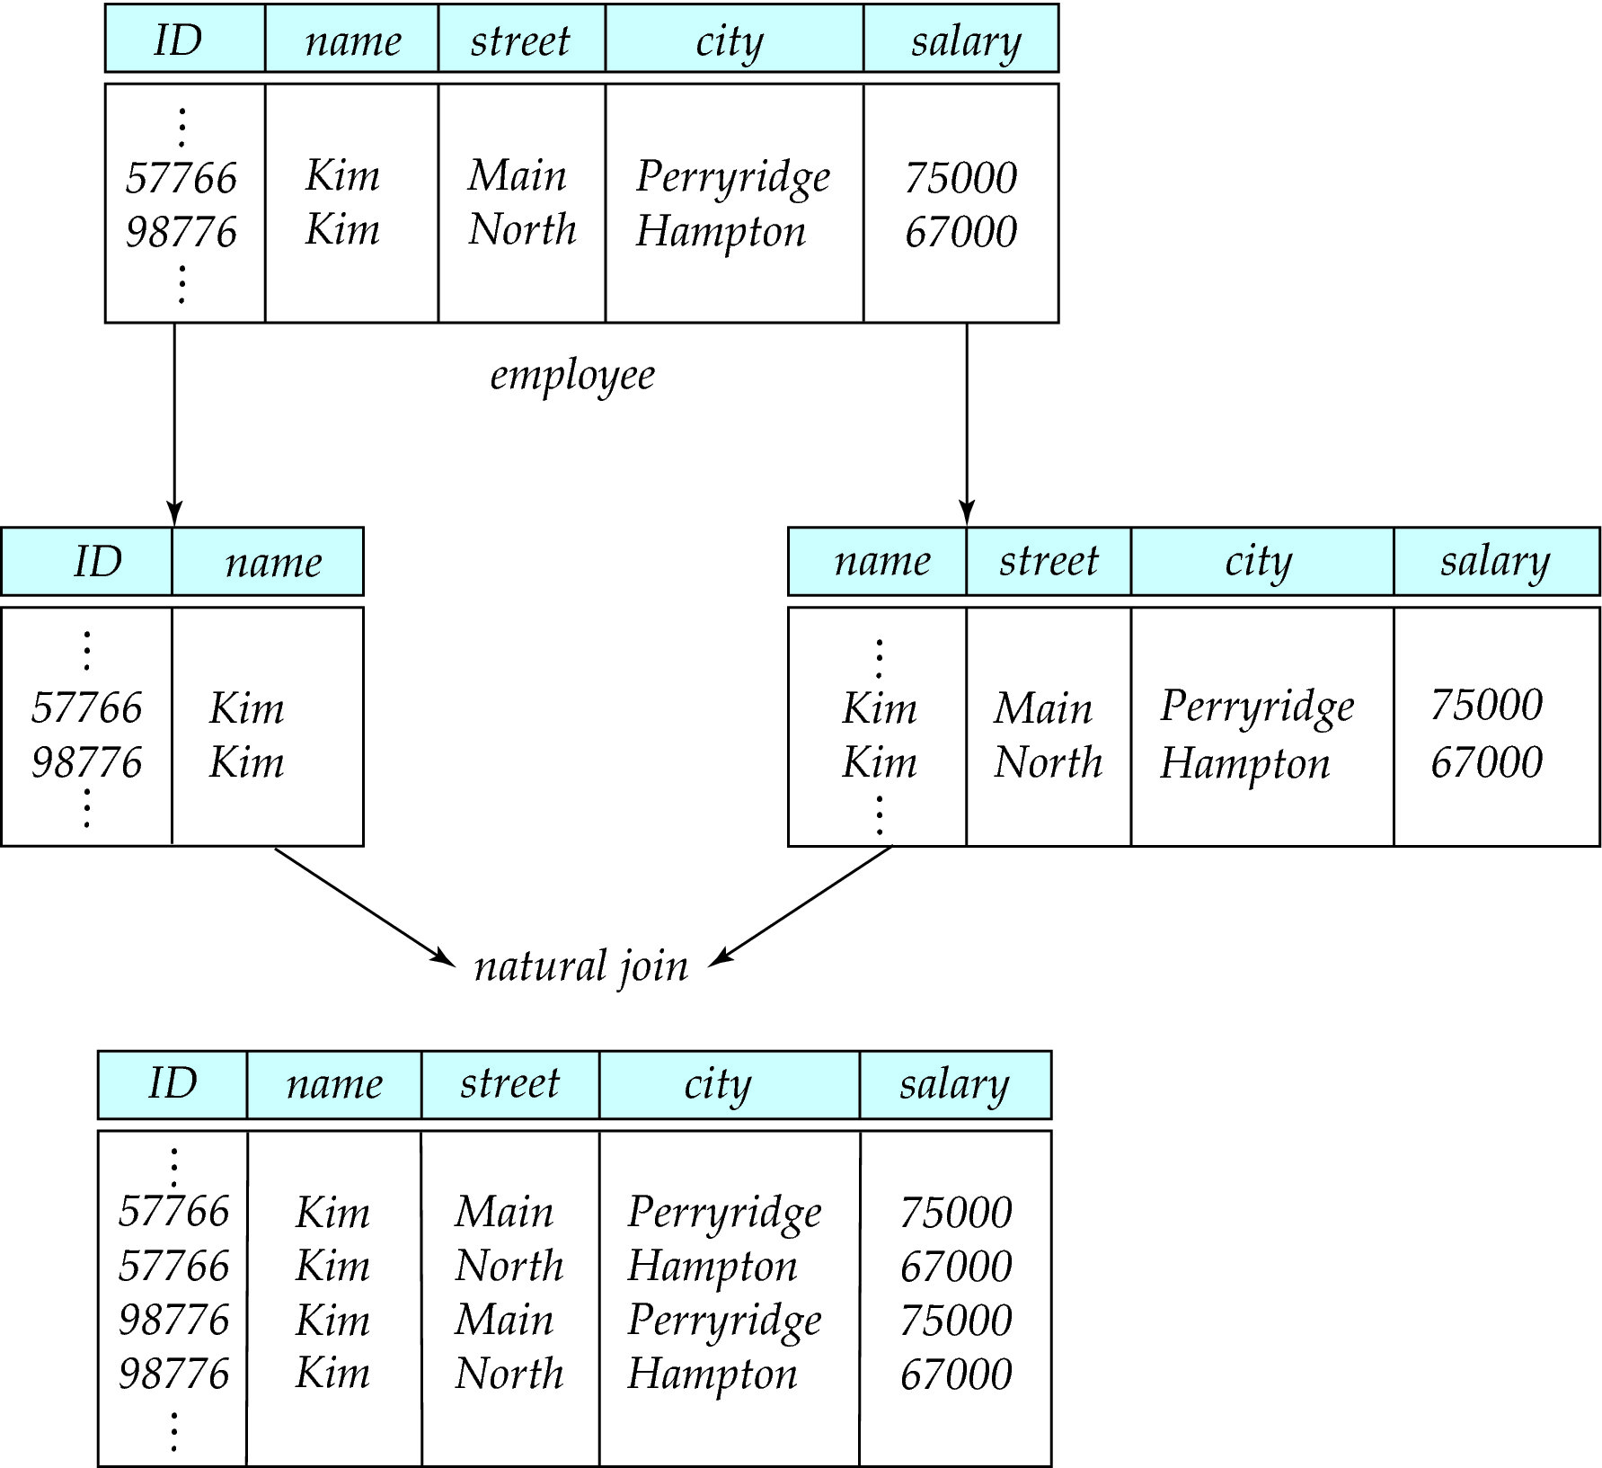
A Lossy Decomposition

Slide 10
Example of Lossless-Join Decomposition
Lossless join decomposition
Decomposition of R = (A, B, C)，R₁ = (A, B) R₂ = (B, C)
A
B
C
A
B
B
C
α
β
1
2
A
B
α
β
1
2
1
2
A
B
r
∏_{A,B}(r)
∏_{B,C}(r)
∏_{A} (r) ∏_{B} (r)
A
B
C
α
β
1
2
A
B

Slide 11
First Normal Form
Domain is atomic if its elements are considered to be indivisible units
Examples of non-atomic domains:
Set of names, composite attributes
Identification numbers like CS101 that can be broken up into parts
A relational schema R is in first normal form if the domains of all attributes of R are atomic
Non-atomic values complicate storage and encourage redundant (repeated) storage of data
Example: Set of accounts stored with each customer, and set of owners stored with each account
We assume all relations are in first normal form (and revisit this in Chapter 22: Object Based Databases)

Slide 12
First Normal Form (Cont’d)
Atomicity is actually a property of how the elements of the domain are used.
Example: Strings would normally be considered indivisible
Suppose that students are given roll numbers which are strings of the form CS0012 or EE1127
If the first two characters are extracted to find the department, the domain of roll numbers is not atomic.
Doing so is a bad idea: leads to encoding of information in application program rather than in the database.

Slide 13
Goal — Devise a Theory for the Following
Decide whether a particular relation R is in “good” form.
In the case that a relation R is not in “good” form, decompose it into a set of relations {R₁, R₂, ..., R_{n}} such that
each relation is in good form
the decomposition is a lossless-join decomposition
Our theory is based on:
functional dependencies
multivalued dependencies

Slide 14
数据冗余、插入异常、删除异常
不良的模式设计
1NF、2NF、3NF、BCNF、4NF
范式
无损连接
减少冗余：范式的判定
保持函数依赖(依赖闭包、正则覆盖)
模式分解的要求
分解为BCNF范式
分解为3NF范式
模式分解
去范式的模式设计

Slide 15
Functional Dependencies
Constraints on the set of legal relations.
Require that the value for a certain set of attributes determines uniquely the value for another set of attributes.
A functional dependency is a generalization of the notion of a key.
函数依赖不是从数据中推导出来，而是客观世界对于数据的约束.
特定数据属性之间的关系，并不能代表该关系模式所有实例数据之间可能的关系.

Slide 16
Functional Dependencies (Cont.)
Let R be a relation schema
α ⊆ R and β ⊆ R
The functional dependency α → β holds on R if and only if for any legal relations r(R), whenever any two tuples t₁ and t₂ of r agree on the attributes α, they also agree on the attributes β. That is,
t₁[α] = t₂ [α] ⇒ t₁[β ] = t₂ [β ]
Example: Consider r(A,B ) with the following instance of r.
On this instance, A → B does NOT hold, but B → A does hold.
4
1 5
3 7

Slide 17
Functional Dependencies (Cont.)
K is a superkey for relation schema R if and only if K → R
K is a candidate key for R if and only if
K → R, and
for no α ⊂ K, α → R
Functional dependencies allow us to express constraints that cannot be expressed using superkeys.
Consider the schema:
inst_dept (ID, name, salary, dept_name, building, budget ).
We expect these functional dependencies to hold:
dept_name→ building and
ID → building
but would not expect the following to hold: dept_name → salary

Slide 18
Use of Functional Dependencies
We use functional dependencies to:
test relations to see if they are legal under a given set of functional dependencies.
If a relation r is legal under a set F of functional dependencies, we say that r satisfies F.
specify constraints on the set of legal relations
We say that F holds on R if all legal relations on R satisfy the set of functional dependencies F.
Note: A specific instance of a relation schema may satisfy a functional dependency even if the functional dependency does not hold on all legal instances.
For example, a specific instance of instructor may, by chance, satisfy name → ID.

Slide 19
Functional Dependencies (Cont.)
A functional dependency is trivial if it is satisfied by all instances of a relation
Example:
ID, name → ID
name → name
In general, α → β is trivial if β ⊆ α

Slide 20
Closure of a Set of Functional Dependencies
Given a set F of functional dependencies, there are certain other functional dependencies that are logically implied by F.
For example: If A → B and B → C, then we can infer that A → C
The set of all functional dependencies logically implied by F is the closure of F.
We denote the closure of F by F⁺.
F⁺ is a superset of F.

Slide 21
Boyce-Codd Normal Form
A relation schema R is in BCNF with respect to a set F of functional dependencies if for all functional dependencies in F⁺ of the form α → β
where α ⊆ R and β ⊆ R, at least one of the following holds:
α → β is trivial (i.e., β ⊆ α)
α is a superkey for R
Example schema not in BCNF:
instr_dept (ID, name, salary, dept_name, building, budget )
because dept_name→ building, budget holds on instr_dept, but dept_name is not a superkey

Slide 22
SQL中的函数依赖
除了候选键和主键外，SQL没有提供函数依赖的支持，可以通过断言来完成
写一个断言以保证在R(A, B, C)上成立B→C
create assertion BtoC check
(not exists
(select B
from R
group by B
having count(distinct c) > 1
) )
SQL不直接提供函数依赖检验
判定函数依赖需要代价
通过表分解避免不合适的函数依赖

Slide 23
Decomposing a Schema into BCNF
Suppose we have a schema R and a non-trivial dependency α →β causes a violation of BCNF.
We decompose R into:
(α U β )
( R - ( β - α ) )
In our example,
α = dept_name
β = building, budget and inst_dept is replaced by
(α U β ) = ( dept_name, building, budget )
( R - ( β - α ) ) = ( ID, name, salary, dept_name )

Slide 24
BCNF and Dependency Preservation
表达数据库一致性约束的方式：
PK、FD、Check、Assertion、Triger
Constraints, including functional dependencies, are costly to check in practice unless they pertain to only one relation
If it is sufficient to test only those dependencies on each individual relation of a decomposition in order to ensure that all functional dependencies hold, then that decomposition is dependency preserving.
若每次分解都恰好是一个函数依赖，则分解保持依赖
Because it is not always possible to achieve both BCNF and dependency preservation, we consider a weaker normal form, known as third normal form.
Notes:
1.如果函数依赖的检验仅需要考虑一个关系就可以完成，那么检查这种约束的开销就很低
2.如果每次分解都恰好是一个函数依赖，则分解就是保持依赖的，但并不都是这种情况，因此，我们考虑一个较弱的范式

Slide 25
Third Normal Form
A relation schema R is in third normal form (3NF) if for all:
α → β in F⁺ at least one of the following holds:
α → β is trivial (i.e., β ∈ α)
α is a superkey for R
Each attribute A in β–α is contained in a candidate key for R
NOTE: each attribute may be in a different candidate key
If a relation is in BCNF it is in 3NF (since in BCNF one of the first two conditions above must hold).
Third condition is a minimal relaxation of BCNF to ensure dependency preservation (will see why later).
Notes:
Trivial 平凡的

Slide 26

Goals of Normalization
Let R be a relation scheme with a set F of functional dependencies.
Decide whether a relation scheme R is in “good” form.
In the case that a relation scheme R is not in “good” form, decompose it into a set of relation scheme {R₁, R₂, ..., R_{n}} such that
each relation scheme is in good form
the decomposition is a lossless-join decomposition
Preferably, the decomposition should be dependency preserving.

Slide 27
How good is BCNF?
There are database schemas in BCNF that do not seem to be sufficiently normalized
Consider a relation
inst_info (ID, child_name, phone)
where an instructor may have more than one phone and can have multiple children
ID
child_name
phone
99999
99999
99999
99999
David
David
William
Willian
512-555-1234
512-555-4321
512-555-1234
512-555-4321
inst_info
Notes:
主键为全键时，一定是BCNF

Slide 28
How good is BCNF? (Cont.)
There are no non-trivial functional dependencies and therefore the relation is in BCNF
Insertion anomalies – i.e., if we add a phone 981-992-3443 to 99999, we need to add two tuples
(99999, David, 981-992-3443) (99999, William, 981-992-3443)

Slide 29
How good is BCNF? (Cont.)
Therefore, it is better to decompose inst_info into:
ID
child_name
inst_child
99999
99999
99999
99999
David
David
William
Willian
ID
phone
inst_phone
99999
99999
99999
99999
512-555-1234
512-555-4321
512-555-1234
512-555-4321
This suggests the need for higher normal forms, such as Fourth Normal Form (4NF), which we shall see later.

Slide 30
How good is BCNF?
Consider a database
classes (course, teacher, book )
such that (c, t, b) ∈ classes means that t is qualified to teach c, and b is a required textbook for c
The database is supposed to list for each course the set of teachers any one of which can be the course’s instructor, and the set of books, all of which are required for the course (no matter who teaches it).

Slide 31
How good is BCNF? (Cont.)
course
teacher
book
database
database
database
database
database
database
operating systems
operating systems
operating systems
operating systems
Avi
Avi
Hank
Hank
Sudarshan
Sudarshan
Avi
Avi
Pete
Pete
DB Concepts
Ullman
DB Concepts
Ullman
DB Concepts
Ullman
OS Concepts
Stallings
OS Concepts
Stallings
classes
There are no non-trivial functional dependencies and therefore the relation is in BCNF
Insertion anomalies – i.e., if Marilyn is a new teacher that can teach database, two tuples need to be inserted
(database, Marilyn, DB Concepts) (database, Marilyn, Ullman)

Slide 32
How good is BCNF? (Cont.)
next
Therefore, it is better to decompose classes into:
course
teacher
course
book
database
database
database
operating systems
operating systems
Avi
Hank
Sudarshan
Avi
Jim
database
database
operating systems
operating systems
DB Concepts
Ullman
OS Concepts
Shaw
text
teaches

Slide 33
Functional-Dependency Theory
We now consider the formal theory that tells us which functional dependencies are implied logically by a given set of functional dependencies.
We then develop algorithms to generate lossless decompositions into BCNF and 3NF
We then develop algorithms to test if a decomposition is dependency-preserving

Slide 34
Closure of a Set of Functional Dependencies
Given a set F set of functional dependencies, there are certain other functional dependencies that are logically implied by F.
For example: If A → B and B → C, then we can infer that A → C
The set of all functional dependencies logically implied by F is the closure of F.
We denote the closure of F by F⁺.
We can find all of F⁺ by applying Armstrong’s Axioms:
if β ⊆ α, then α → β (reflexivity)自反律
if α → β, and β → γ, then α → γ (transitivity)传递律
if α → β, then γ α → γ β (augmentation)增广律
α
α
α
β
β
γ
β
γ

Slide 35
Closure of a Set of Functional Dependencies
Armstrong’s Axioms:
Reflexivity： if β ⊆ α, then α → β
Augmentation：if α → β, then γ α → γ β
Transitivity：if α → β, and β → γ, then α → γ
E.g. R(X, Y), F = {X→Y}
F⁺ = { X→ϕ, X→X, X→Y, X→XY, Y→ϕ, Y→Y, XY→ ϕ, XY→X, XY→Y, XY→XY }

Slide 36
Closure of a Set of Functional Dependencies
These rules are
A = { f | 可用Armstrong公理从F中导出的函数依赖f }
B = { f | 被F所逻辑蕴涵的函数依赖f }
sound (正确性) , generate only functional dependencies that actually hold
用Armstrong公理从F中导出的函数依赖必为F所蕴涵
A ⊆ B
Complete (完备性), generate all functional dependencies that hold.
F所蕴涵的函数依赖都能用Armstrong公理从F中导出
B ⊆ A

Slide 37
Example
R = (A, B, C, G, H, I) F = { A → B， A → C，CG → H，CG → I，B → H }
some members of F⁺
A → H
by transitivity from A → B and B → H
AG → I
by augmenting A → C with G, to get AG → CG and then transitivity with CG → I
CG → HI
by augmenting CG → I to infer CG → CGI,
and augmenting of CG → H to infer CGI → HI, and then transitivity

Slide 38
Procedure for Computing F⁺
To compute the closure of a set of functional dependencies F: F ⁺ = F repeat for each functional dependency f in F⁺ apply reflexivity and augmentation rules on f add the resulting functional dependencies to F ⁺ for each pair of functional dependencies f₁and f₂ in F ⁺ if f₁ and f₂ can be combined using transitivity then add the resulting functional dependency to F ⁺ until F ⁺ does not change any further
NOTE: We shall see an alternative procedure for this task later

Slide 39

Closure of Functional Dependencies (Cont.)
Additional rules:
If α → β holds and α → γ holds, then α → β γ holds (union)
If α → β γ holds, then α → β holds and α → γ holds (decomposition)
If α → β holds and γ β → δ holds, then α γ → δ holds (pseudotransitivity)
The above rules can be inferred from Armstrong's axioms.

Slide 40

Armstrong公理系统
Reflexivity
t[X] = s[X]
Y⊆X
}
t[Y] = s[Y]
X → Y
Transitivity
X → Y
t[X] = s[X]
}
t[Y] = s[Y]
Y → Z
}
t[Z] = s[Z]
X → Z

Slide 41
Armstrong公理系统
Augmentation
t[XZ] = s[XZ]
t[X] = s[X]
t[Y] = s[Y]
}
}
X→Y
t[YZ] = s[YZ]
t[XZ] = s[XZ]
t[Z] = s[Z]
XZ→YZ
union rule
X → Y
增广律
}
X → XY
}
传递律
X → YZ
X → Z
增广律
}
XY → YZ

Slide 42

Armstrong公理系统
next
Decomposition: X->YZ==> X->Y,X->Z
Z ⊆ YZ
自反律
}
YZ → Z
}
传递律
X → Z
X → YZ
pseudotransitivity: If α → β , γ β → δ , then α γ → δ
α → β
增广律
}
γα → γβ
}
传递律
α γ → δ
γ β → δ

Slide 43
Closure of Attribute Sets
Given a set of attributes α, define the closure of α under F (denoted by α⁺) as the set of attributes that are functionally determined by α under F
Algorithm to compute α⁺, the closure of α under F
result := α; while (changes to result) do for each β → γ in F do begin if β ⊆ result then result := result ∪ γ end
Notes:
属性集的闭包

Slide 44
Example of Attribute Set Closure
R = (A, B, C, G, H, I)
F = {A → B A → C CG → H CG → I B → H}
(AG)⁺
1. result = AG
2. result = ABCG (A → C and A → B)
3. result = ABCGH (CG → H and CG ⊆ AGBC)
4. result = ABCGHI (CG → I and CG ⊆ AGBCH)
Is AG a candidate key?
Is AG a super key? Does AG → R? == Is (AG)⁺ ⊇ R
Is any subset of AG a superkey?
Does A → R? == Is (A)⁺ ⊇ R
Does G → R? == Is (G)⁺ ⊇ R
result := a; while (changes to result) do for each β → γ in F do begin if β ⊆ result then result := result ∪ γ end
Notes:
AG是一个candidate key
A的闭包abch
G的闭包g
说明A、G都不能单独作为candidate key

Slide 45
Example of Attribute Set Closure
示例2
R< U, F >, U = (A, B, C, D, E), F = {AB→C, B→D, C→E, CE→B, AC→B},计算(AB)⁺
所用依赖 (AB)⁺
AB→C ABC
B→D ABCD
C→E ABCDE
(AB)⁺ = ABCDE

Slide 46
Example of Attribute Set Closure
next
示例3
R< U, F >, U = (A, B, C, D, E, G), F = {A→E, BE→AG, CE→A, G→D},计算(AB)⁺
所用依赖 (AB)⁺
A→E ABE
BE→AG ABEG
G→D ABEGD
(AB)⁺ = ABEGD

Slide 47
Uses of Attribute Closure
There are several uses of the attribute closure algorithm:
Testing for superkey:
To test if α is a superkey, we compute α^{+,} and check if α⁺ contains all attributes of R.
Testing functional dependencies
To check if a functional dependency α → β holds (or, in other words, is in F⁺), just check if β ⊆ α⁺.
That is, we compute α⁺ by using attribute closure, and then check if it contains β.
Is a simple and cheap test, and very useful
Computing closure of F
For each γ ⊆ R, we find the closure γ⁺, and for each S ⊆ γ⁺, we output a functional dependency γ → S.

Slide 48

候选键的计算
定义
左部（L类）属性，只出现在F左边的属性
右部（R类）属性，只出现在F右边的属性
双部（LR类）属性，出现在F两边的属性
外部（N类）属性，不出现在F中的属性
定理
L类属性一定出现在任何候选码中
R类属性一定不出现在任何候选码中
N类属性一定出现在任何候选码中
LR类属性有可能出现在任何候选码中

Slide 49
候选键的计算
U = (C,T,H,R,S)
F = {C→T,HR→C,HT→R,HS→R}
给出R的所有候选码
出现在左边的属性：{C,T,H,R,S}
出现在右边的属性：{C,T,R}
左部属性：{HS}
右部属性：{}
双部属性：{C,T,R}

Slide 50

候选键的计算
求解关系候选键的核心思路
求解L和N类属性。
若(L,N)⁺ = U，则(L,N)为唯一候选键。
若(L,N)⁺ ≠ U，则找LR类。
若(L,N,LR)⁺ = U，则(L,N,LR)为候选键。
U = {A，B，C，D，E}
F = {AE→C,AC→D,CD→B,D→E}
给出R的所有候选码
出现在左边的属性：{A,C,D,E}
出现在右边的属性：{B,C,D,E}
L类 (左部)属性：{A}
R类 (右部)属性：{B}
LR类 (双部)属性：{C,D,E}

Slide 51
候选键的计算
Key-Finding(求一个候选码)
输入：关系模式<U, F>；
输出：一个候选码K
Key-Finding(U, F)
Begin
(1)K := U;
(2)构造一个FD: K→T,其中T∉U
(3)for 每一个属性A∈K do
if Membership(F∪{K→T},(K-A)→T)
then K:= K-A
return(K)
end.
Membership(F, X→Y): 判断X→Y ∈ F⁺ ?

Slide 52
候选键的计算：替换法
All-Candidate Keys(求全部候选码)
输入：关系模式R<U,F> 输出： R<U,F>的全部候选码
begin (1)K:=Key-Finding(U, F)；
(2)K 入队列Q；
(3)while 队列Q≠Φ do
[ K :=队列Q的头；
W := W ∪{K}；
D := K中全部双部属性；
while D≠Φ do
[ A := D 中一个双部属性；
D := D - {A}；
for 每一个X→Y∈F do
if A∈Y then [ K’ := (K - A) ∪{X} ]
if K’∉Q then K’ 入队列Q；
] ]
end

Slide 53
候选键的计算：替换法
next
U={A, B, C, D, E, G}
F={AB → C, C → A, C → B, AD → B, BE → G, G → A}
所有双部属性={A, B, C, G}
EDC = Key-Finding(U, F)
EDC
AB → C
G → A
EDA
C → A
EDG
EDC
BE → G
EDB
C → B
所有候选码={EDC, EDA, EDG, EDB}
EDC

Slide 54

Canonical Cover
Sets of functional dependencies may have redundant dependencies that can be inferred from the others
For example: A→C is redundant in: {A→B, B → C, A→ C }
Parts of a functional dependency may be redundant
E.g.: on RHS: {A → B, B → C, A → CD} can be simplified to {A → B, B → C, A → D}
E.g.: on LHS: {A → B, B → C, AC → D} can be simplified to {A → B, B → C, A → D}
Intuitively, a canonical cover of F is a “minimal” set of functional dependencies equivalent to F, having no redundant dependencies or redundant parts of dependencies

Slide 55

Extraneous Attributes
Consider a set F of functional dependencies and the functional dependency α → β in F.
Attribute A is extraneous in α if A ∈ α and F logically implies
(F – {α → β}) ∪ {(α – A) → β}.
Attribute A is extraneous in β if A ∈ β and the set of functional dependencies (F – {α → β}) ∪ {α →(β – A)} logically implies F.
Note: implication in the opposite direction is trivial in each of the cases above, since a “stronger” functional dependency always implies a weaker one
Example: Given F = {A → C, AB → C }
B is extraneous in AB → C because {A → C, AB → C} logically implies A → C (I.e. the result of dropping B from AB → C).
Example: Given F = {A → C, AB → CD}
C is extraneous in AB → CD since AB → C can be inferred even after deleting C

Slide 56
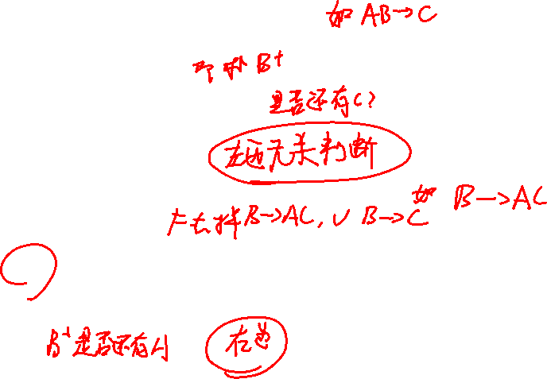
Testing if an Attribute is Extraneous
Consider a set F of functional dependencies and the functional dependency α → β in F.
To test if attribute A ∈ α is extraneous in α
compute ({α} – A)⁺ using the dependencies in F
check that ({α} – A)⁺ contains β; if it does, A is extraneous in α
To test if attribute A ∈ β is extraneous in β
compute α⁺ using only the dependencies in F’ = (F – {α → β}) ∪ {α →(β – A)},
check that α⁺ contains A; if it does, A is extraneous in β

Slide 57

Canonical Cover
A canonical cover for F is a set of dependencies F_{c} such that
F logically implies all dependencies in F_{c,} and
F_{c} logically implies all dependencies in F, and
No functional dependency in F_{c} contains an extraneous attribute, and
Each left side of functional dependency in Fc is unique.
To compute a canonical cover for F: repeat Use the union rule to replace any dependencies in F α₁ → β₁ and α₁ → β₂ with α₁ → β₁ β₂ Find a functional dependency α → β with an extraneous attribute either in α or in β /* Note: test for extraneous attributes done using F_{c,} not F*/ If an extraneous attribute is found, delete it from α → β until F does not change
Note: Union rule may become applicable after some extraneous attributes have been deleted, so it has to be re-applied

Slide 58
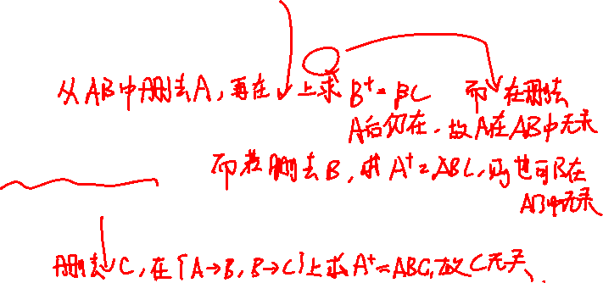
Computing a Canonical Cover
R = (A, B, C)，F = {A → BC，B → C，A → B，AB → C}
Combine A → BC and A → B into A → BC
Set is now { A → BC, B → C, AB → C }
A is extraneous in AB → C
Check if the result of deleting A from AB → C is implied by the other dependencies
Yes: in fact, B → C is already present!
Set is now { A → BC, B → C }
C is extraneous in A → BC
Check if A → C is logically implied by A → B and the other dependencies
Yes: using transitivity on A → B and B → C.
Can use attribute closure of A in more complex cases
The canonical cover is: ｛A → B，B → C ｝
B is extraneous in A → BC ？

Slide 59

Lossless-join Decomposition
For the case of R = (R₁, R₂), we require that for all possible relations r on schema R
r = ∏_{R1} (r ) ∏_{R2} (r )
A decomposition of R into R₁ and R₂ is lossless join if at least one of the following dependencies is in F⁺:
R₁ ∩ R₂ → R₁
R₁ ∩ R₂ → R₂
The above functional dependencies are a sufficient condition for lossless join decomposition;
the dependencies are a necessary condition only if all constraints are functional dependencies

Slide 60
Example
R = (A, B, C)，F = {A → B, B → C)
Can be decomposed in two different ways
R₁ = (A, B), R₂ = (B, C)
Lossless-join decomposition:
R₁ ∩ R₂ = {B} and B → BC
Dependency preserving
R₁ = (A, B), R₂ = (A, C)
Lossless-join decomposition:
R₁ ∩ R₂ = {A} and A → AB
Not dependency preserving (cannot check B → C without computing R₁ R₂)

Slide 61


Dependency Preservation
Let F_{i} be the set of dependencies F ⁺ that include only attributes in R_{i}.
A decomposition is dependency preserving, if
(F₁ ∪ F₂ ∪ … ∪ F_{n} )⁺ = F ⁺
If it is not, then checking updates for violation of functional dependencies may require computing joins, which is expensive.

Slide 62
Testing for Dependency Preservation
To check if a dependency α → β is preserved in a decomposition of R into R₁, R₂, …, R_{n} we apply the following test (with attribute closure done with respect to F)
result = α while (changes to result) do for each R_{i} in the decomposition t = (result ∩ R_{i})⁺ ∩ R_{i} result = result ∪ t
If result contains all attributes in β, then the functional dependencyα → β is preserved.
We apply the test on all dependencies in F to check if a decomposition is dependency preserving
This procedure takes polynomial time, instead of the exponential time required to compute F⁺ and (F₁ ∪ F₂ ∪ … ∪ F_{n})⁺

Slide 63
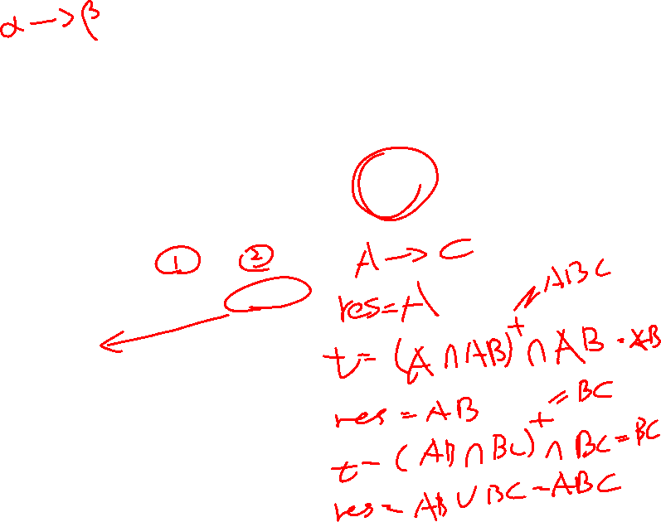
Example
result = α while (changes to result) do for each R_{i} in the decomposition t = (result ∩ R_{i})⁺ ∩ R_{i} result = result ∪ t
If result contains all attributes in β, then the functional dependency α → β is preserved.
R = ( A, B, C )， F = { A → B， B → C } Key = { A }
R is not in BCNF
Decomposition R₁ = (A, B), R₂ = (B, C)
R₁ and R₂ in BCNF
Lossless-join decomposition
Dependency preserving

Slide 64
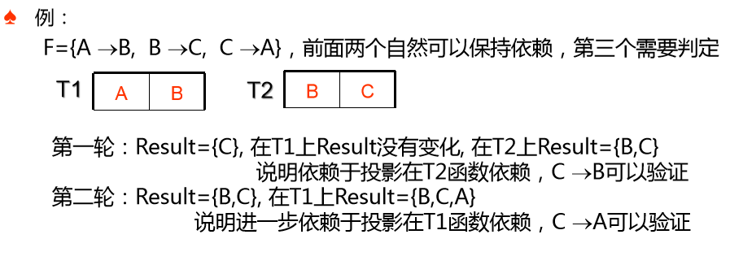

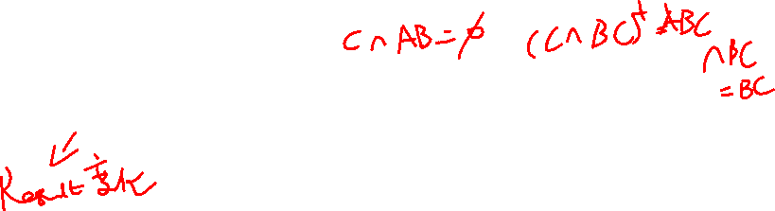
result = α while (changes to result) do for each R_{i} in the decomposition t = (result ∩ R_{i})⁺ ∩ R_{i} result = result ∪ t
If result contains all attributes in β, then the functional dependency α → β is preserved.

Slide 65
Testing for BCNF
To check if a non-trivial dependency α→β causes a violation of BCNF
1. compute α⁺ (the attribute closure of α), and
2. verify that it includes all attributes of R, that is, it is a superkey of R.
Simplified test: To check if a relation schema R is in BCNF, it suffices to check only the dependencies in the given set F for violation of BCNF, rather than checking all dependencies in F⁺.
If none of the dependencies in F causes a violation of BCNF, then none of the dependencies in F⁺ will cause a violation of BCNF either.
However, simplified test using only F is incorrect when testing a relation in a decomposition of R
Consider R = (A, B, C, D, E), with F = { A → B, BC → D}
Decompose R into R₁ = (A,B) and R₂ = (A,C,D, E)
Neither of the dependencies in F contain only attributes from (A,C,D,E) so we might be mislead into thinking R₂ satisfies BCNF.
In fact, dependency AC → D in F⁺ shows R₂ is not in BCNF.
Notes:
判断BCNF：1.全键一定是。2.如果左部为xx，一定不是 11.3.14：30
BCNF分解
得到主键
先把违反函数依赖的去除

Slide 66
Testing Decomposition for BCNF
To check if a relation R_{i} in a decomposition of R is in BCNF,
Either test R_{i} for BCNF with respect to the restriction of F to R_{i} (that is, all FDs in F⁺ that contain only attributes from R_{i})
or use the original set of dependencies F that hold on R, but with the following test: 按照BCNF的定义判断R_{i} 是否违反BCNF的定义
for every set of attributes α ⊆ R_{i}, check that α⁺ (the attribute closure of α in F) either includes no attribute of R_{i}- α, or includes all attributes of R_{i}.
If the condition is violated by some α→ β in F, the dependency α→ (α⁺ - α) ∩ R_{i} can be shown to hold on R_{i}, and R_{i} violates BCNF.
We use above dependency to decompose R_{i}
R = (A, B, C, D, E), F = { A → B, BC → D}
Decompose R into R₁ = (A,B) and R₂ = (A,C,D, E)

Slide 67
BCNF Decomposition Algorithm
result := {R }; done := false; while (not done) do if (there is a schema R_{i} in result that is not in BCNF) then begin let α→ β be a nontrivial functional dependency that holds on R_{i} such that α → R_{i} is not in F ⁺, and α ∩ β = ∅; result := (result – R_{i} ) ∪ (R_{i} – β) ∪ (α, β ); end else done := true;
Note: each R_{i} is in BCNF, and decomposition is lossless-join.

Slide 68
result := {R }; done := false; while (not done) do if (there is a schema R_{i} in result that is not in BCNF) then begin let α→ β be a nontrivial functional dependency that holds on R_{i} such that α → R_{i} is not in F ⁺, and α ∩ β = ∅; result := (result – R_{i} ) ∪ (R_{i} – β) ∪ (α, β ); end else done := true;
给定关系 R (A,B,C,D,E)，函数依赖的集合F={A → B, BC → D}
判定表不是BCNF范式，因为A → B, A不是码
分解R1=(A,B)，R2=(A,C,D,E)
R2满足BCNF吗？
(AC)_{F}⁺=ACBD，在R2中，存在AC → D，但是AC无法决定R2的所有属性
继续分解，R3=(ACD), R4=(ACE)

Slide 69
Example of BCNF Decomposition
R = (A, B, C ) F = {A → B，B → C} Key = {A}
R is not in BCNF (B → C but B is not superkey)
Decomposition
R₁ = (B, C)
R₂ = (A,B)

Slide 70
Example of BCNF Decomposition
class (course_id, title, dept_name, credits, sec_id, semester, year, building, room_number, capacity, time_slot_id)
Functional dependencies:
course_id→ title, dept_name, credits
building, room_number→capacity
course_id, sec_id, semester, year→building, room_number, time_slot_id
A candidate key {course_id, sec_id, semester, year}.
BCNF Decomposition:
course_id→ title, dept_name, credits holds
but course_id is not a superkey.
We replace class by:
course(course_id, title, dept_name, credits)
class-1 (course_id, sec_id, semester, year, building, room_number, capacity, time_slot_id)

Slide 71
BCNF Decomposition (Cont.)
course is in BCNF
How do we know this?
building, room_number→capacity holds on class-1
but {building, room_number} is not a superkey for class-1.
We replace class-1 by:
classroom (building, room_number, capacity)
section (course_id, sec_id, semester, year, building, room_number, time_slot_id)
classroom and section are in BCNF.

Slide 72
BCNF and Dependency Preservation
It is not always possible to get a BCNF decomposition that is dependency preserving
R = (J, K, L ) F = {JK → L， L → K } Two candidate keys = JK and JL
R is not in BCNF
Any decomposition of R will fail to preserve
JK → L
This implies that testing for JK → L requires a join

Slide 73
Third Normal Form: Motivation
There are some situations where
BCNF is not dependency preserving, and
efficient checking for FD violation on updates is important
Solution: define a weaker normal form, called Third Normal Form (3NF)
Allows some redundancy (with resultant problems; we will see examples later)
But functional dependencies can be checked on individual relations without computing a join.
There is always a lossless-join, dependency-preserving decomposition into 3NF.
Notes:
3NF：若不满足BCNF的条件，考虑每一个非平凡依赖函数的右端，判断右端属性是否被KEY所包含

Slide 74
3NF Example
Relation dept_advisor:
dept_advisor (s_ID, i_ID, dept_name) F = { s_ID, dept_name → i_ID, i_ID → dept_name }
Two candidate keys: s_ID, dept_name, and i_ID, s_ID
R is in 3NF
s_ID, dept_name → i_ID
i_ID is contained in a candidate key { i_ID, s_ID }
i_ID → dept_name
dept_name is contained in a candidate key { s_ID, dept_name }
Notes:
和前面JKL的例子一样

Slide 75
Redundancy in 3NF
There is some redundancy in this schema
Example of problems due to redundancy in 3NF
R = (J, K, L) F = {JK → L, L → K }
J
L
K
j₁
j₂
j₃
null
l₁
l₁
l₁
l₂
k₁
k₁
k₁
k₂
repetition of information (e.g., the relationship l₁, k₁)
(i_ID, dept_name)
need to use null values (e.g., to represent the relationship l₂, k₂ where there is no corresponding value for J).
(i_ID, dept_nameI) if there is no separate relation mapping instructors to departments

Slide 76
Testing for 3NF
Optimization: Need to check only FDs in F, need not check all FDs in F⁺.
Use attribute closure to check for each dependency α → β, if α is a superkey.
If α is not a superkey, we have to verify if each attribute in β is contained in a candidate key of R
this test is rather more expensive, since it involve finding candidate keys
testing for 3NF has been shown to be NP-hard
Interestingly, decomposition into third normal form (described shortly) can be done in polynomial time
Notes:
判断BCNF、分解3NF在考试中可行

Slide 77
3NF Decomposition Algorithm
Let F_{c} be a canonical cover for F; i := 0; for each functional dependency α → β in F_{c} do if none of the schemas R_{j}, 1 ≤ j ≤ i contains α β then begin i := i + 1; R_{i} := α β end if none of the schemas R_{j}, 1 ≤ j ≤ i contains a candidate key for R then begin i := i + 1; R_{i} := any candidate key for R; end /* Optionally, remove redundant relations */
repeat if any schema R_{j} is contained in another schema R_{k} then /* delete R_{j} */ R_{j} = R;; i=i-1; return (R₁, R₂, ..., R_{i})

Slide 78
3NF Decomposition Algorithm (Cont.)
Above algorithm ensures:
each relation schema R_{i} is in 3NF
decomposition is dependency preserving and lossless-join
Proof of correctness is at end of this presentation (click here)

Slide 79
3NF Decomposition: An Example
Relation schema:
cust_banker_branch = (customer_id, employee_id, branch_name, type )
The functional dependencies for this relation schema are:
customer_id, employee_id → branch_name, type
employee_id → branch_name
customer_id, branch_name → employee_id
We first compute a canonical cover
branch_name is extraneous in the r.h.s. of the 1st dependency
No other attribute is extraneous, so we get
F_{C} ={ customer_id, employee_id → type employee_id → branch_name customer_id, branch_name → employee_id }

Slide 80
3NF Decompsition Example (Cont.)
The for loop generates following 3NF schema:
(customer_id, employee_id, type )
(employee_id, branch_name)
(customer_id, branch_name, employee_id)
Observe that (customer_id, employee_id, type ) contains a candidate key of the original schema, so no further relation schema needs be added
At end of for loop, detect and delete schemas, such as (employee_id, branch_name), which are subsets of other schemas
result will not depend on the order in which FDs are considered
The resultant simplified 3NF schema is:
(customer_id, employee_id, type)
(customer_id, branch_name, employee_id)

Slide 81
Comparison of BCNF and 3NF
It is always possible to decompose a relation into a set of relations that are in 3NF such that:
the decomposition is lossless
the dependencies are preserved
It is always possible to decompose a relation into a set of relations that are in BCNF such that:
the decomposition is lossless
it may not be possible to preserve dependencies.

Slide 82
BCNF分解总结
BCNF分解是采取关系模式的逐步分解的策略，最终的结果和考虑函数依赖的次序相关；
BCNF分解过程中需要检查当前模式是否满足BCNF的要求，需要测试属性任意子集的闭包或者是仅仅包含自身，或者包含当前模式的所有属性，这个测试是指数时间，所以，BCNF的时间代价为指数的；
BCNF分解过程是无损的
BCNF分解也许不能保持函数依赖

Slide 83
3NF分解总结
基于函数依赖集合的正则覆盖，而不是从属性分解的角度来完成。3NF的分解模式，自然能够保持依赖。
最终的分解结果和正则覆盖集合相关，而一个函数依赖的正则覆盖可能有多个。
能够满足无损连接和保持依赖
不考虑候选码计算代价，分解模式满足3NF是多项式时间的。
考虑保持函数依赖，最终产生的关系模式可能较多

Slide 84
Design Goals
Goal for a relational database design is:
BCNF.
Lossless join.
Dependency preservation.
If we cannot achieve this, we accept one of
Lack of dependency preservation
Redundancy due to use of 3NF
Interestingly, SQL does not provide a direct way of specifying functional dependencies other than superkeys.
Can specify FDs using assertions, but they are expensive to test, (and currently not supported by any of the widely used databases!)
Even if we had a dependency preserving decomposition, using SQL we would not be able to efficiently test a functional dependency whose left hand side is not a key.

Slide 85
去规范化Denomalization设计
设计过程中需要回答的问题
数据是否是只读的
数据是否是更新频繁的
多个数据表是否经常被同时存取
例如
模式
S(SID,SNAME,DID,AGE,LOCATION)
D(DID,DNAME,DEAN)
查询
每天至少发出查询20000次
Select SNAME, DNAME From S, D Where S.DID=D.DID

Slide 86
去规范化Denomalization设计
考虑性能问题，违反范式
例如
在S中增加DNAME
查询
Select SNAME， DNAME from S
代价
增加了DNAME的存储代价
如果DNAME发生变更时，更新代价
收益
提高了每天的检索速度
取舍原则：根据应用系统中数据特性而定

Slide 87
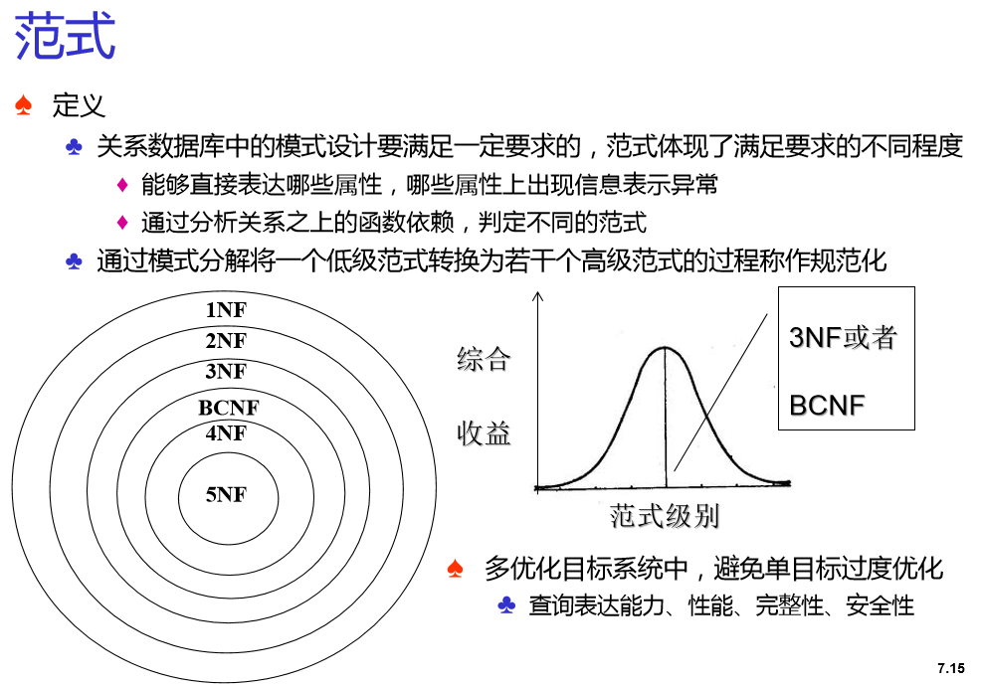

Slide 88
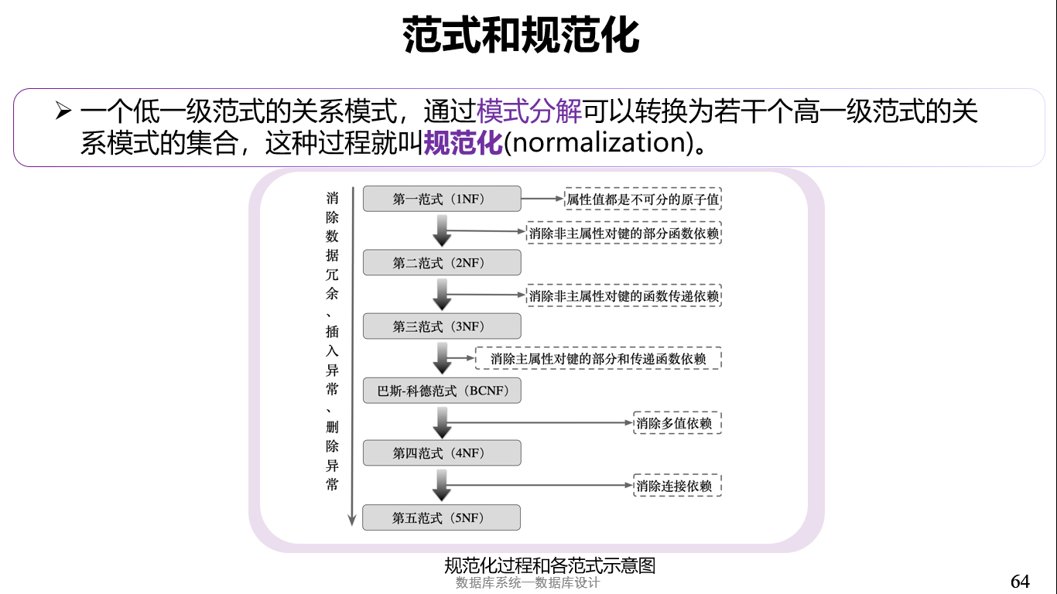
范式和规范化

Slide 89
Multivalued Dependencies
Suppose we record names of children, and phone numbers for instructors:
inst_child(ID, child_name)
inst_phone(ID, phone_number)
If we were to combine these schemas to get
inst_info(ID, child_name, phone_number)
Example data: (99999, David, 512-555-1234) (99999, David, 512-555-4321) (99999, William, 512-555-1234) (99999, William, 512-555-4321)
This relation is in BCNF
Why?

Slide 90
Multivalued Dependencies (MVDs)
Let R be a relation schema and let α ⊆ R and β ⊆ R. The multivalued dependency
α →→ β
holds on R if in any legal relation r(R), for all pairs for tuples t₁ and t₂ in r such that t₁[α] = t₂ [α], there exist tuples t₃ and t₄ in r such that:
t₁[α] = t₂ [α] = t₃ [α] = t₄ [α] t₃[β] = t₁ [β] t₃[R – β] = t₂[R – β] t₄ [β] = t₂[β] t₄[R – β] = t₁[R – β]

Slide 91
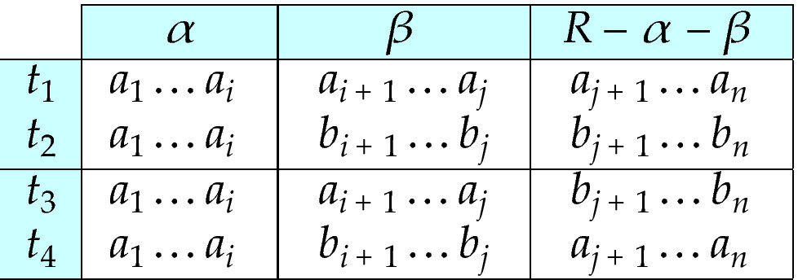
MVD (Cont.)
Tabular representation of α →→ β

Slide 92
Example
Let R be a relation schema with a set of attributes that are partitioned into 3 nonempty subsets.
Y, Z, W
We say that Y →→ Z (Y multidetermines Z ) if and only if for all possible relations r (R )
< y₁, z₁, w₁ > ∈ r and < y₁, z₂, w₂ > ∈ r
then
< y₁, z₁, w₂ > ∈ r and < y₁, z₂, w₁ > ∈ r
Note that since the behavior of Z and W are identical it follows that
Y →→ Z if Y →→ W

Slide 93
Example (Cont.)
In our example:
ID →→ child_name ID →→ phone_number
The above formal definition is supposed to formalize the notion that given a particular value of Y (ID) it has associated with it a set of values of Z (child_name) and a set of values of W (phone_number), and these two sets are in some sense independent of each other.
Note:
If Y → Z then Y →→ Z
Indeed we have (in above notation) Z₁ = Z₂ The claim follows.

Slide 94
Use of Multivalued Dependencies
We use multivalued dependencies in two ways:
1. To test relations to determine whether they are legal under a given set of functional and multivalued dependencies
2. To specify constraints on the set of legal relations. We shall thus concern ourselves only with relations that satisfy a given set of functional and multivalued dependencies.
If a relation r fails to satisfy a given multivalued dependency, we can construct a relations r′ that does satisfy the multivalued dependency by adding tuples to r.

Slide 95
Theory of MVDs
From the definition of multivalued dependency, we can derive the following rule:
If α → β, then α →→ β
That is, every functional dependency is also a multivalued dependency
The closure D⁺ of D is the set of all functional and multivalued dependencies logically implied by D.
We can compute D⁺ from D, using the formal definitions of functional dependencies and multivalued dependencies.
We can manage with such reasoning for very simple multivalued dependencies, which seem to be most common in practice
For complex dependencies, it is better to reason about sets of dependencies using a system of inference rules (see Appendix C).

Slide 96
Fourth Normal Form
A relation schema R is in 4NF with respect to a set D of functional and multivalued dependencies if for all multivalued dependencies in D⁺ of the form α →→ β, where α ⊆ R and β ⊆ R, at least one of the following hold:
α →→ β is trivial (i.e., β ⊆ α or α ∪ β = R)
α is a superkey for schema R
If a relation is in 4NF it is in BCNF

Slide 97
Restriction of Multivalued Dependencies
The restriction of D to R_{i} is the set D_{i} consisting of
All functional dependencies in D⁺ that include only attributes of R_{i}
All multivalued dependencies of the form
α →→ (β ∩ R_{i})
where α ⊆ R_{i} and α →→ β is in D⁺

Slide 98
4NF Decomposition Algorithm
result: = {R}; done := false; compute D⁺; Let D_{i} denote the restriction of D⁺ to R_{i}
while (not done) if (there is a schema R_{i} in result that is not in 4NF) then begin
let α →→ β be a nontrivial multivalued dependency that holds on R_{i} such that α → R_{i} is not in D_{i}, and α∩β=φ; result := (result - R_{i}) ∪ (R_{i} - β) ∪ (α, β); end else done:= true;
Note: each R_{i} is in 4NF, and decomposition is lossless-join

Slide 99
Example
R =(A, B, C, G, H, I)
F ={ A →→ B
B →→ HI
CG →→ H }
R is not in 4NF since A →→ B and A is not a superkey for R
Decomposition
a) R₁ = (A, B) (R₁ is in 4NF)
b) R₂ = (A, C, G, H, I) (R₂ is not in 4NF, decompose into R₃ and R₄)
c) R₃ = (C, G, H) (R₃ is in 4NF)
d) R₄ = (A, C, G, I) (R₄ is not in 4NF, decompose into R₅ and R₆)
A →→ B and B →→ HI ➔ A →→ HI, (MVD transitivity), and
and hence A →→ I (MVD restriction to R₄)
e) R₅ = (A, I) (R₅ is in 4NF)
f)R₆ = (A, C, G) (R₆ is in 4NF)

Slide 100
Further Normal Forms
Join dependencies generalize multivalued dependencies
lead to project-join normal form (PJNF) (also called fifth normal form)
A class of even more general constraints, leads to a normal form called domain-key normal form.
Problem with these generalized constraints: are hard to reason with, and no set of sound and complete set of inference rules exists.
Hence rarely used

Slide 101
Overall Database Design Process
We have assumed schema R is given
R could have been generated when converting E-R diagram to a set of tables.
R could have been a single relation containing all attributes that are of interest (called universal relation).
Normalization breaks R into smaller relations.
R could have been the result of some ad hoc design of relations, which we then test/convert to normal form.

Slide 102
ER Model and Normalization
When an E-R diagram is carefully designed, identifying all entities correctly, the tables generated from the E-R diagram should not need further normalization.
However, in a real (imperfect) design, there can be functional dependencies from non-key attributes of an entity to other attributes of the entity
Example: an employee entity with attributes department_name and building, and a functional dependency department_name→ building
Good design would have made department an entity
Functional dependencies from non-key attributes of a relationship set possible, but rare --- most relationships are binary

Slide 103
Denormalization for Performance
May want to use non-normalized schema for performance
For example, displaying prereqs along with course_id, and title requires join of course with prereq
Alternative 1: Use denormalized relation containing attributes of course as well as prereq with all above attributes
faster lookup
extra space and extra execution time for updates
extra coding work for programmer and possibility of error in extra code
Alternative 2: use a materialized view defined as course prereq
Benefits and drawbacks same as above, except no extra coding work for programmer and avoids possible errors

Slide 104
Other Design Issues
Some aspects of database design are not caught by normalization
Examples of bad database design, to be avoided:
Instead of earnings (company_id, year, amount ), use
earnings_2004, earnings_2005, earnings_2006, etc., all on the schema (company_id, earnings).
Above are in BCNF, but make querying across years difficult and needs new table each year
company_year (company_id, earnings_2004, earnings_2005, earnings_2006)
Also in BCNF, but also makes querying across years difficult and requires new attribute each year.
Is an example of a crosstab, where values for one attribute become column names
Used in spreadsheets, and in data analysis tools

Slide 105
Modeling Temporal Data
Temporal data have an association time interval during which the data are valid.
A snapshot is the value of the data at a particular point in time
Several proposals to extend ER model by adding valid time to
attributes, e.g., address of an instructor at different points in time
entities, e.g., time duration when a student entity exists
relationships, e.g., time during which an instructor was associated with a student as an advisor.
But no accepted standard
Adding a temporal component results in functional dependencies like
ID → street, city
not to hold, because the address varies over time
A temporal functional dependency X → Y holds on schema R if the functional dependency X → Y holds on all snapshots for all legal instances r (R).
t

Slide 106
Modeling Temporal Data (Cont.)
In practice, database designers may add start and end time attributes to relations
E.g., course(course_id, course_title) is replaced by
course(course_id, course_title, start, end)
Constraint: no two tuples can have overlapping valid times
Hard to enforce efficiently
Foreign key references may be to current version of data, or to data at a point in time
E.g., student transcript should refer to course information at the time the course was taken

Slide 107
End of Chapter

Slide 108
Proof of Correctness of 3NF Decomposition Algorithm

Slide 109
Correctness of 3NF Decomposition Algorithm
3NF decomposition algorithm is dependency preserving (since there is a relation for every FD in F_{c})
Decomposition is lossless
A candidate key (C ) is in one of the relations R_{i} in decomposition
Closure of candidate key under F_{c} must contain all attributes in R.
Follow the steps of attribute closure algorithm to show there is only one tuple in the join result for each tuple in R_{i}

Slide 110
Correctness of 3NF Decomposition Algorithm (Cont’d.)
Claim: if a relation R_{i} is in the decomposition generated by the
above algorithm, then R_{i} satisfies 3NF.
Let R_{i} be generated from the dependency α → β
Let γ → B be any non-trivial functional dependency on R_{i}. (We need only consider FDs whose right-hand side is a single attribute.)
Now, B can be in either β or α but not in both. Consider each case separately.

Slide 111
Correctness of 3NF Decomposition (Cont’d.)
Case 1: If B in β:
If γ is a superkey, the 2nd condition of 3NF is satisfied
Otherwise α must contain some attribute not in γ
Since γ → B is in F⁺ it must be derivable from F_{c}, by using attribute closure on γ.
Attribute closure not have used α →β. If it had been used, α must be contained in the attribute closure of γ, which is not possible, since we assumed γ is not a superkey.
Now, using α→ (β- {B}) and γ → B, we can derive α →B
(since γ ⊆ α β, and B ∉ γ since γ → B is non-trivial)
Then, B is extraneous in the right-hand side of α →β; which is not possible since α →β is in F_{c}.
Thus, if B is in β then γ must be a superkey, and the second condition of 3NF must be satisfied.

Slide 112
Correctness of 3NF Decomposition (Cont’d.)
Case 2: B is in α.
Since α is a candidate key, the third alternative in the definition of 3NF is trivially satisfied.
In fact, we cannot show that γ is a superkey.
This shows exactly why the third alternative is present in the definition of 3NF.
Q.E.D.

Slide 113
Figure 8.02

Slide 114
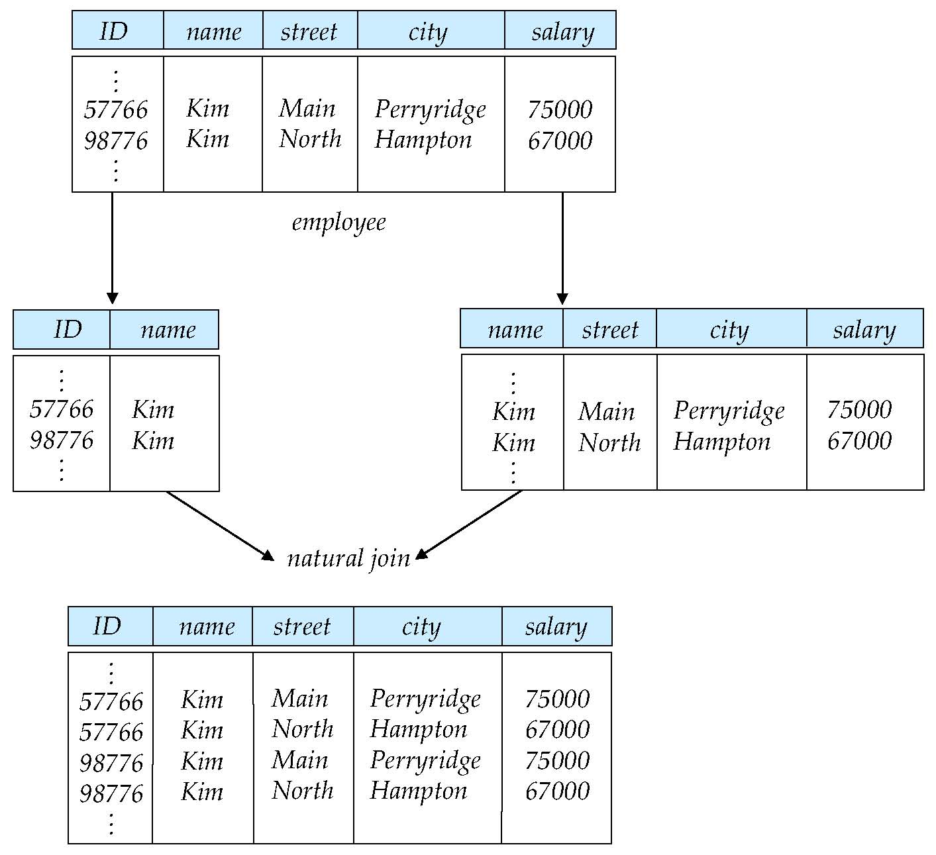
Figure 8.03

Slide 115
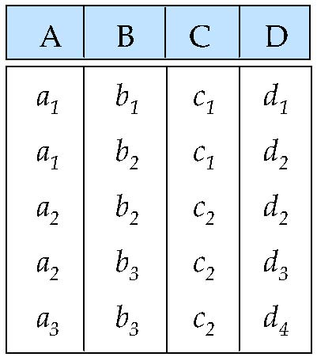
Figure 8.04

Slide 116
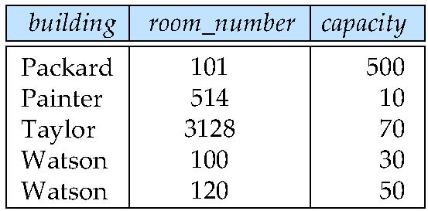
Figure 8.05

Slide 117
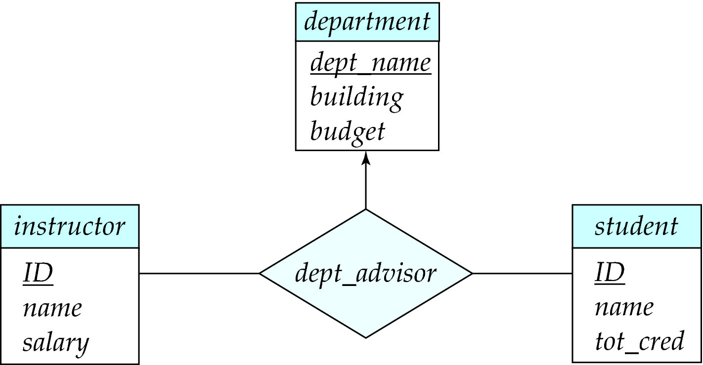
Figure 8.06

Slide 118
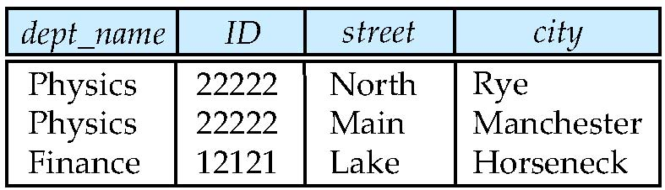
Figure 8.14

Slide 119
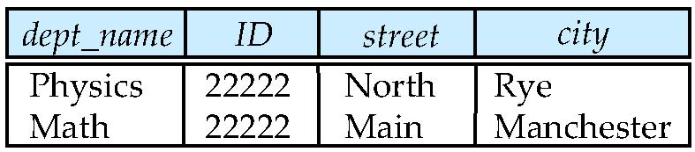
Figure 8.15

Slide 120
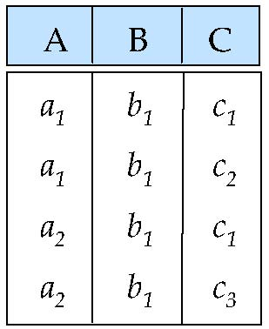
Figure 8.17

